Slide 1
Public Procurement Institute and the procurement system in Russia
WWW.ROSZAKUPKI.COM

Slide 2
About Public Procurement Institute
Public Procurement Institute is the oldest Russian educational center in the field of public procurement.
It was founded in 1998 and since this time carries out scientific, educative and expert work in the field of government and municipal procurement
Every week our experts participate in short-term seminars – tutorials, discussions on different subjects concerning the system of public procurement
Our lawyers consult the biggest public procurement in scientific and educational sphere
We help both our customers - procurement arrangers and commercial companies - procurement participants
We’ve got more than 40 000 representatives of federal, regional and municipal bodies, executives of private and public organizations as auditors of our educational programs
Public Procurement Institute is ready to cooperate both with Russian and foreign public organizations and commercial companies
WWW.ROSZAKUPKI.COM

Slide 3
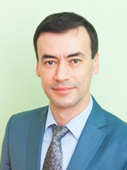
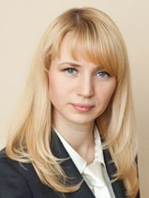
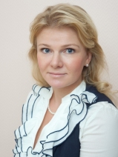
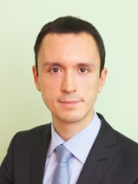
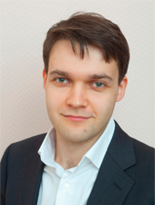
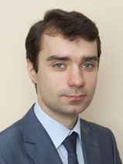
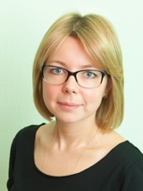
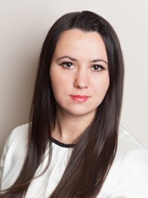
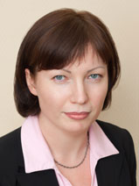
Out team
we work as a team since1998 year
practical experience and expert work in the field of regulated procurements from 10
to 18 years
over 300 successfully completed projects in the field of legal support of companies
and organizations
more than 40 000 trained professionals
WWW.ROSZAKUPKI.COM

Slide 4
The emblem of Public Procurement Institute
The emblem of Public Procurement Institute is executed in stamp style.
In the centre there is a shield entwined from both sides with laurel branches symbolizing that merits of the Institute are recognized both by public authorities and civil society.
The field has clear division into four equal quarterings with a square field in the centre.
Symbolic figures in quarterings are graphic interpretation of bidding held in the epoch of Peter I (“Admiralty and Shipyard Management Regulations” Chapter 1, clause 15 of 1721 “How to find workers and settle a bargain with them”).

Slide 5
The emblem of Public Procurement Institute
The procedure included:
Public declaration (to horn blast and beat of a drum) of state needs in goods and works for the Russian Navy. They mentioned time and place of proposal acceptance from interested merchants. (The symbol is a HORN).
At time specified they lighted a candle (so-called “daily candle”) in the Directing Senate office. The candle burned all day long and bidding participants who wanted to supply goods or carry out works had to be on time setting a bid. (The symbol is a CANDLE).
To prevent fraud the Directing Senate office was protected by officers with broadswords. To avoid opportunity of guard bribery there were not less than two officers. (The symbol is TWO SWORDS).
In a day, when the candle slaked, the contract was concluded with the particip ant having proposed the most suitable conditions. (The symbol is SCROLL WITH A STAMP).
Moreover, every figure symbolizes key elements of efficient state procurement: HORN stand for publicity, CANDLE – for transparency, SWORD with a spike down signifies government control, SWORD with a spike up - social control and SCROLL WITH A STAMP symbolizes legality.

Slide 6
WWW.ROSZAKUPKI.COM
PERIOD OF TRAINING
PHASE OF
EXPERIENCE
STAGE OF DOUBT
PHASE OF PROFESSIONALISM
Our legation is
TO GROW THE EXPERTS AND HELP THEM TO BE SUCCESSFUL IN THE PROFESSION

Slide 7
OUR WEBSITE
EVERYTHING, YOU EVER WANTED TO KNOW ABOUT THE PURCHASES,
BUT DIDN'T KNOW WHERE TO FIND:
all the current regulations for the federal law no. 44-FZ and the federal law no. 223-FZ
clarification of the Federal Antimonopoly Service and the Ministry of Economic Development
the charts from the experts of the Institute of public procurement
video clips
the forum for professionals (more than 12 000 users)
all of the above is on our website :
WWW.ROSZAKUPKI.RU
Over thousands of unique visits a day

Slide 8
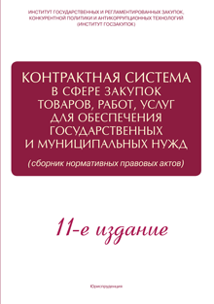
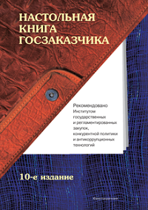
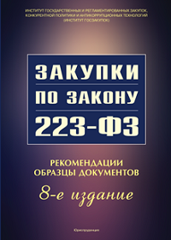
OUR BOOKS
+ annual reports of the Conferences
on the federal law no. 44-FZ
and the federal law no. 223-FZ

Slide 9
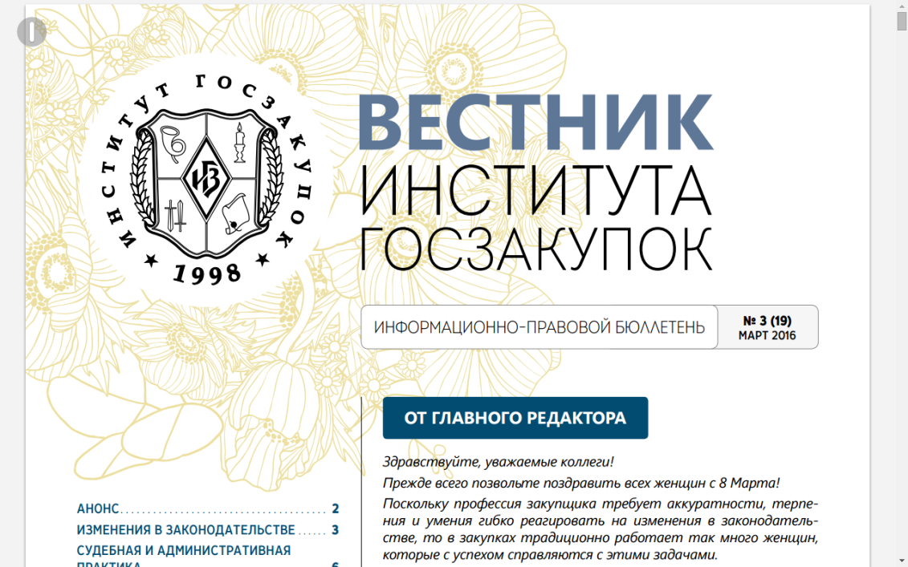
The bulletin of the Institute of public procurement
electronic edition
Recent changes in regulatory acts
Judicial practice
Practice of FAS Russia
Answers to hot issues
Short and clear procurement
EVERY MONTH IN YOUR MAILBOX
Free-payed
SUBSCRIPTION ON THE WEBSITE : WWW.ROSZAKUPKI.RU

Slide 10
CERTIFYING
WWW.ROSZAKUPKI.RU
We certificate:
Specialists and experts in the field of procurement
Assign the level of qualifications according to the professional standards Ministry of Labour
Documentation and Regulations on procurement Information Systems
Training centers and education programs
Check Rosstandart since 2014
The Institute for public procurement is the Central certification body of public procurement
There is a network of accredited certification bodies in the country
Our-issued certificates have a degree of protection of level "B"

Slide 11
There are 2 procurement regime :
Federal Law of 05.04.2013 No. 44-FZ “On the Contract System in State and Municipal Procurement of Goods, Works and Services”:
Federal authorities County government Local authorities State and municipal institutions State and municipal enterprises
Federal Law of 18.07.2011 No. 223-FZ “On Goods, Works, Services Procurement by Certain Types of Legal Entities”:
Public corporations
Organizations with state or municipal participation
The subjects of natural monopolies

Slide 12
The procurement methods
Competitive methods
SINGLE-SOURCING
the sole supplier (contractor, performer)
Tenders
Request for price
Auction
Electronic auction
Request for quotation
open tender
Closed tender
Reverse sealed-bid auction
preliminary selection of procurement participants for the purposes of providing humanitarian aid or liquidating the consequences of natural or technogenic emergencies
two-stage tender
+
selective tender

Slide 13
The methods of procurement
 | The methods of procurement | The winner selection criteria |  |  | Time constraints
1 | Tender |  | Min $ | Quality+qualification | 45-60 days (20 days)
 |  | Goods | 70 % | 30 %
 |  | Works, services | 60 % | 40 %
 |  | Special works, services | 0-40 % | 40-100 %

Slide 14
The methods of procurement
in Russia
 | The methods of procurement | The winner selection criteria | Time constraints
2 | Auction in the electronic form (electronic auction) | Min $ | 35-45 days (7 days)
3 | Auction in the electronic form (electronic auction) | Min $ | 45-55 days (15 days)
4 | Request for quotation | Min $ | 31-44 days (7 working days)
5 | Request for proposal | Min $ Quality Qualification + others | 27-37 days (5 days)
6 | Procurement from the sole supplier (contractor, performer) in exceptional cases | - | 10-15 days
7 | Procurement from the sole supplier (contractor, performer) for «small» purchases | - | 1 day

Slide 15
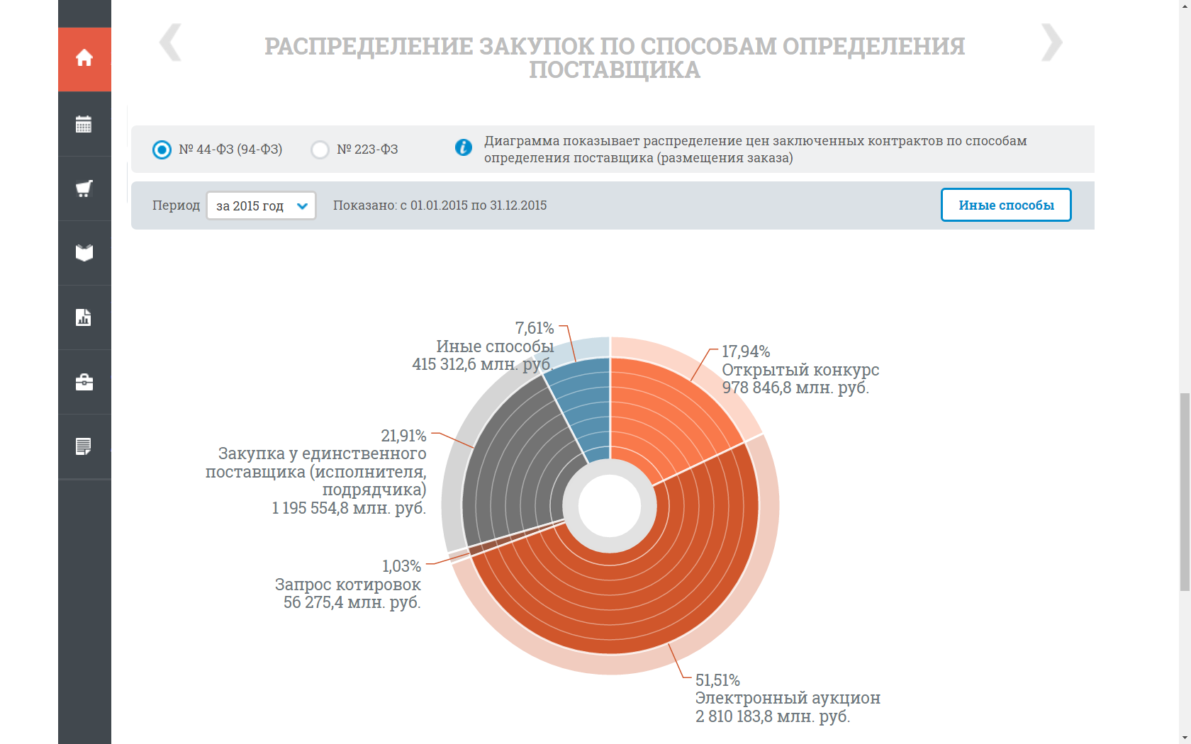
DISTRIBUTION PROCUREMENT METHOD MORE THAN HALF OF PROCUREMENT - ELECTRONIC

Slide 16
The principles of openness and transparency of procurement
e-Procurement (zakupki.gov.ru)
e-Sales (torgi.gov.ru)
More than 3 million notifications procurement year
More than 6.5 trillion rubles procurement volume
More than 250 thousand customers
You can find any purchase more than $ 1,800 on the web-site www.zakupki.gov.ru
At the same web-site all the purchases online:
-federal level
- level of subjects of federation
-municipal level

Slide 17
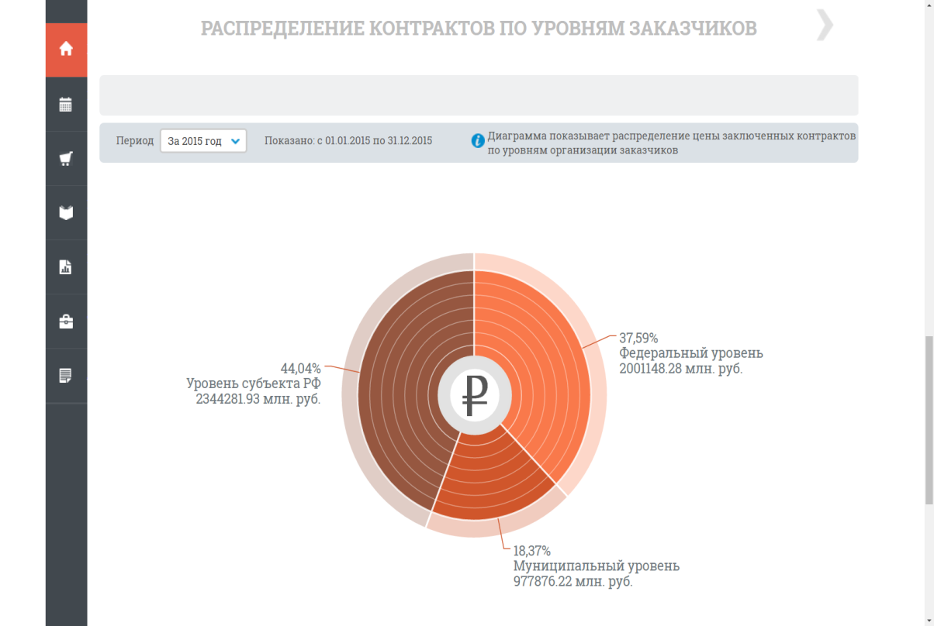
DISTRIBUTION OF CONTRACTS BY LEVEL CUSTOMER

Slide 18
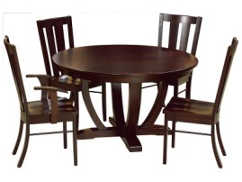
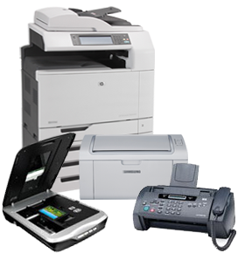
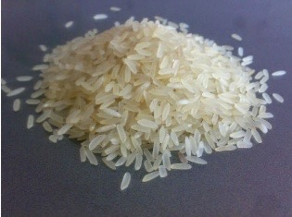
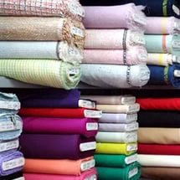
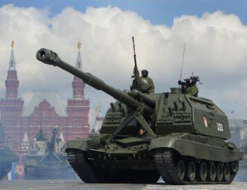
National treatment and import substitution
SPECIAL CONDITIONS OF PERMIT
It is possible to buy imported, but minus 15% of the offer price
food, office equipment, medicines, furniture
LIMITATIONS
Rejections of imported goods if there are two bids with the goods of the Eurasian Economic Union
medicines, medical equipment, meat, rice
PROHIBITION OF ADMISSION
It is prohibited to buy imported goods
transportation, software, consumer goods, products for the defence and security of Russia

Slide 19
Thank you for your attention!

