Slide 1
Contests, Hearings,
SDO Decisions & Appeals
___________________________________________
Duc H. Nguyen
EPA Suspension & Debarment Official
GWU Law 6513 -- Short Course on Suspension & Debarment

Slide 2
Ask me questions anytime!

Slide 3
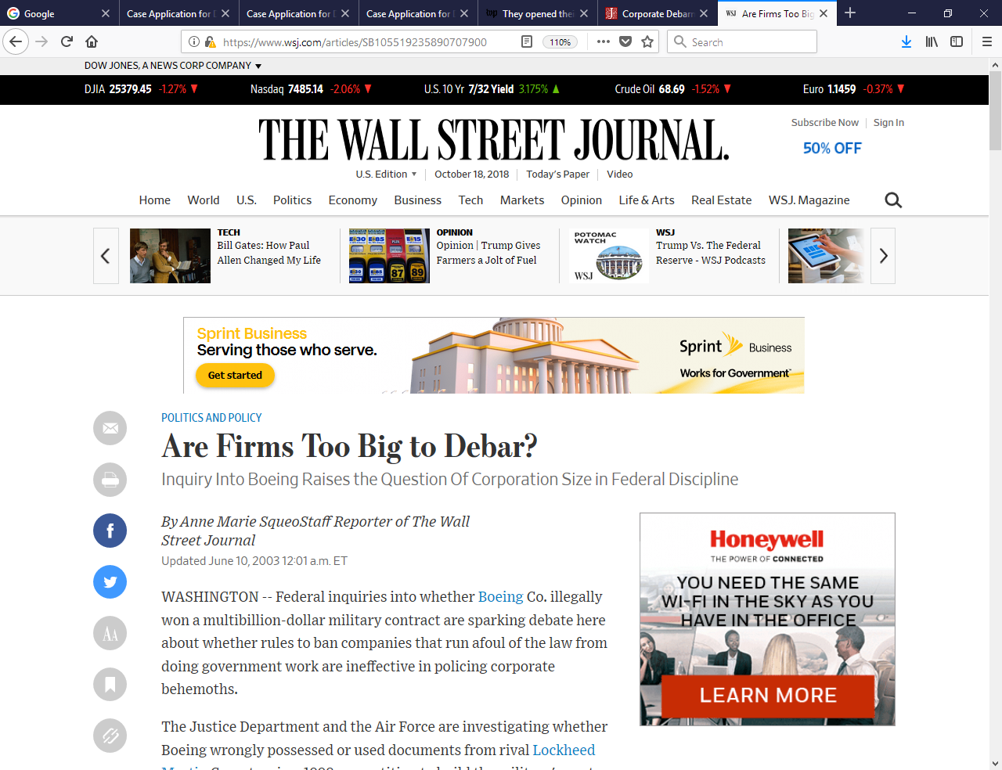
Competing Narratives

Slide 4
Stakeholders

Slide 5
More Stakeholders

Slide 6
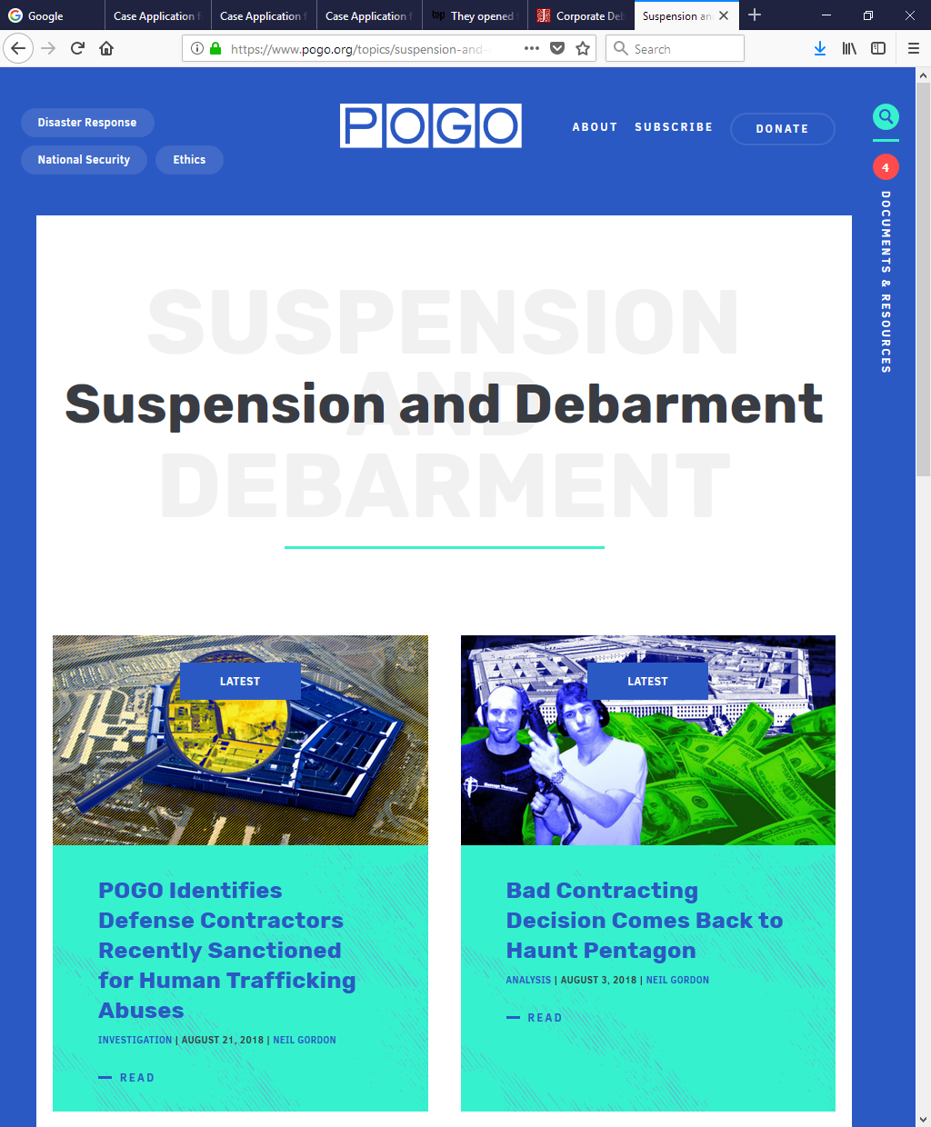
Even More Stakeholders

Slide 7
Debarment:
The Capital Punishment of Government Contracts
John S. Pachter
© 2015 Smith Pachter McWhorter PLC

Slide 8
Suspension and Debarment
Process
Pre-initiation of S&D Proceedings
Notice
Production of the Administrative Record
Contests

Slide 9
Suspension and Debarment
Process Cont’d
SDO Decisions
Reconsideration
Administrative Appeals
Judicial Review

Slide 10
Pre-initiation & Referral
Pre-initiation of S&D Proceedings
→ Investigation/Referral
→ Indictment/conviction-based cases
→ Fact-based cases

Slide 11
Notice
Notice of Suspension
  -- Immediate exclusion
Notice of Proposed Debarment
  -- FAR → Immediate exclusion
  -- NCR → No immediate exclusion*
Show-Cause Notice
* Unless NSPD

Slide 12
Administrative Record
Production of the Administrative Record
→ Contents of the AR
→ Indictment/conviction-based cases
→ Fact-based cases
Development of the AR in the course of legal proceedings
→ Evidence as to cause
→ Aggravating or mitigating evidence
→ Remedial Measures/Corrective Actions

Slide 13
Contests
Written Submissions
Presentations of Matters in Opposition (PMIOs)
Evidentiary Burdens
Fact-Finding

Slide 14
Presentations of Matters in Opposition (PMIOs)
Informal business meetings
  …but sometimes transcribed by a court reporter or taped
  18 U.S.C. § 1001 applies
Government participants
  SDO and debarment counsel
  Program personnel & OIG investigator
Respondent participants --
  Upper management, ethics & compliance officers, in-house & outside counsel (including S&D & criminal defense counsel), individuals involved if still employed by Respondent, consultants

Slide 15
PMIOs Cont’d
Best practices
  What happened? Uncomfortable truths
  Take responsibility for past conduct
  Share findings of internal investigation & Root-cause analysis
  What systems were in place at the time?
  What corrective actions/remedial measures have been instituted since misconduct?
  What corrective actions/remedial measures remain to be implemented?
  All aggravating & mitigating factors

Slide 16
PMIOs v. Fact-Finding Hearings
PMIOs
  Informal business meetings
  Mandatory if requested
  Non-adversarial
  Address cause & present responsibility
  FAR Factors All aggravating & mitigating factors

Slide 17
PMIOs v. Fact-Finding Hearings
Fact-Finding Hearings
  Limited in scope strictly to ascertain material facts genuinely in dispute
  More formal & adversarial in nature
    → Parties present and confront witnesses
  → Transcribed
  Fact-finder must present written findings for the record
  May be denied upon DOJ advisory
  SDO Accepts or Reject Findings of Fact

Slide 18
SDO Decisions
Following case closure
Suspensions
→ Continuation of Suspension
→ Termination of Suspension
Proposed Debarments
→ Decision to Debar
→ Termination of Debarment

Slide 19
Contents of a Decision
Procedural Background
Information in the Administrative Record
→ Establishes a common baseline for appeals & judicial review
Factual findings
General discussion of the S&D remedy
Contractor status (Nexus)
Cause
Present Responsibility
Period of debarment – upward or downward departure

Slide 20
Requests for Reconsideration
Request to the SDO (made at any point during the exclusion)
To reduce period or extent of debarment
Criteria
→ Newly discovered material evidence
→ Reversal or conviction/civil judgment
→ Elimination of other causes
→ Other reasons the debarring official deems appropriate

Slide 21
Administrative Appeals
Available if provided for within the debarring agency’s regulations
Relevant to show exhaustion of all available administrative remedies
Standard of review
→ Arbitrary, capricious, or abuse of discretion
→ clear error of material fact or law
Appeals of the Hearing Officer’s Findings of Fact

Slide 22
Judicial Review
Fora
→ APA Actions in Federal District Court
→ Pre-award bid protests in the Court of Federal Claims (COFC)
→ No BCA or GAO jurisdiction
Exhaustion of remedies
Standard of Review for APA
  Arbitrary & Capricious, lacking in rational basis
  Otherwise not in accordance with the law
Injunctive relief

Slide 23
Final thoughts/questions?
Duc H. Nguyen
O: 202-564-3259
Nguyen.DucH@epa.gov

