Slide 1
The World Bank’s Sanctions System:
The Use of Suspension and Debarment to Combat Fraud and Corruption in International Development
The George Washington University Law School
October 21, 2018
Presented by:
Collin Swan
Counsel (Sanctions), Office of Suspension and Debarment (OSD)
The World Bank

Slide 2
Bretton Woods Conference (July 1-22, 1944)
Creation of the International Monetary Fund (IMF) and
the International Bank for Reconstruction and Development (IBRD)
Mount Washington Hotel in Bretton Woods, New Hampshire
Notes:
Originally called the United Nations Monetary and Financial Conference. Representatives from 44 nations attended.
Drafted the Articles of Agreement for IBRD and the IMF “with the aim of placing the international economy on a sound footing after World War II.”
Two institutions were created – IBRD and the IMF.
World War II would not end for another year.

Slide 3
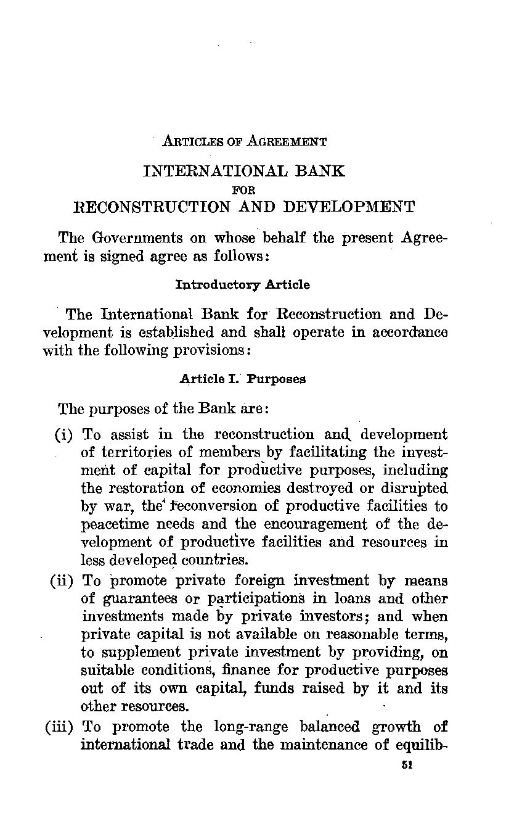

Notes:
First Loan - France had originally applied for a loan of $500 million. The Bank agreed to half that amount, with the possibility of a second tranche. The relative amounts for each category in the overall requirements remained the same. The loan, the Bank's first, was signed on May 9, 1947. With this loan the Bank committed more than one/third of its loanable funds held on June 1,1947. In real terms it is still the Bank's largest single loan, with an FY97 value of $2.6 billion. The Bank's Second Annual Report 1946/1947 assessed the circumstances surrounding the loan to France:
Electric Gantry cranes were installed in several ports.
The importance of France in the economic position of Europe made it particularly fitting that France should be the first country in whose reconstruction the Bank should play an active part. France is vital to Western Europe because of her size and her productive capacity and the problem of her recovery cannot be divorced from the recovery of Western Europe as a whole.

Slide 4

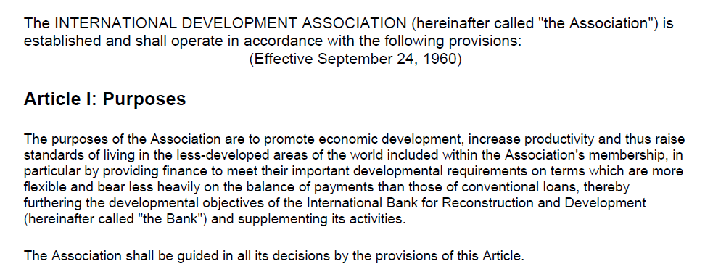
Notes:
Launch of IDA
With an initial funding of $912.7 million, IDA was launched on September 24, 1960 with 15 signatory countries - Australia, Canada, China, Germany, India, Italy, Malaysia, Norway, Pakistan, Sudan, Sweden, Thailand, United Kingdom, United States, and Vietnam. Within its first eight months of launch, IDA had 51 members and allocated credits worth $101 million to four countries. Honduras received the first IDA credit for highway maintenance. Chile, Sudan, and India were the other three recipients.
IDA has grown to include 173 member countries, and has become the leading source of concessional lending to 75 of the world’s poorest countries, with 39 countries in Africa. Overall, 44 countries have graduated from IDA and some have ‘reverse-graduated’ or re-entered IDA. Since its inception, IDA credits and grants have totaled $345 billion, averaging $18 billion over the last three years.

Slide 5
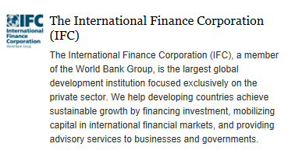
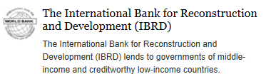
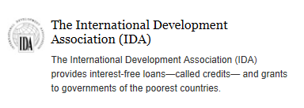
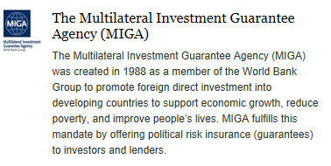
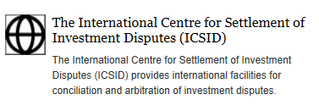
The World Bank Group Today – Five Institutions
Notes:
IBRD – 1944
IDA – 1960
IFC – 1956 (Ambitious goal – “Encouraging the growth of productive private enterprise” by investing, advising, and mobilizing capital from others)
MIGA – 1988
ICSID – 1965

Slide 6


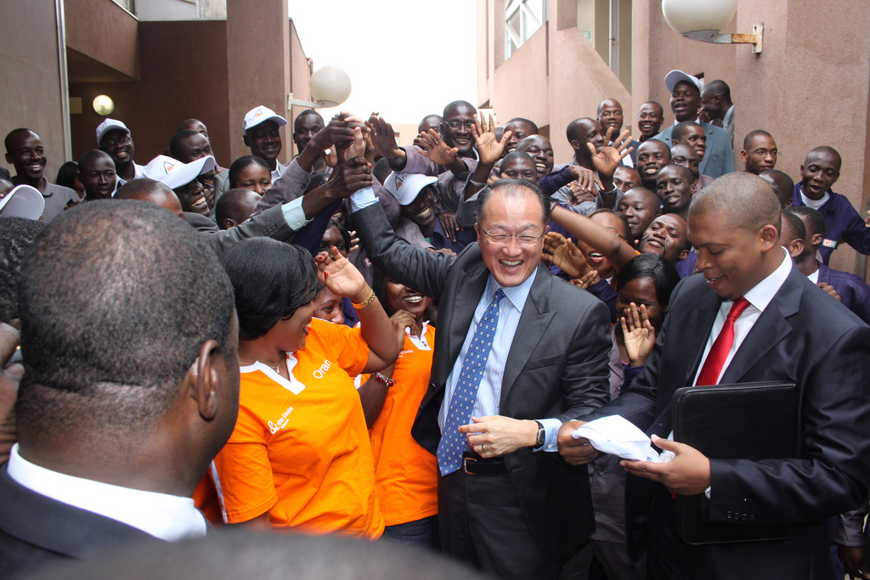
What is the World Bank?
  International Financial Institution (IFI)
  Largest Multilateral Development Bank (MDB)
  Owned by 189 member countries
  Mission: “A World Free of Poverty”
  Poverty Reduction Goals:
    Ending extreme poverty by 2030 by lowering the share of people living on less than $1.25/day from 21 percent in 2010 to 3 percent by 2030.
    Boosting shared prosperity by maximizing income growth for the poorest 40 percent in every country in the developing world.
      (World Bank President Jim Yong Kim, 2013)
Notes:
Membership Numbers:
IBRD – 189 countries
IDA – 173 countries
IFC – 184 countries
MIGA – 181 countries
ICSID – 153 countries
MUST be a member of IMF to become a member of the World Bank.
The organizations that make up the World Bank Group are owned by the governments of member nations, which have the ultimate decision-making power within the organizations on all matters, including policy, financial or membership issues.
Member countries govern the World Bank Group through the Boards of Governors and the Boards of Executive Directors. These bodies make all major decisions for the organizations.
To become a member of the Bank, under the IBRD Articles of Agreement, a country must first join the International Monetary Fund (IMF). Membership in IDA, IFC and MIGA are conditional on membership in IBRD.

Slide 7
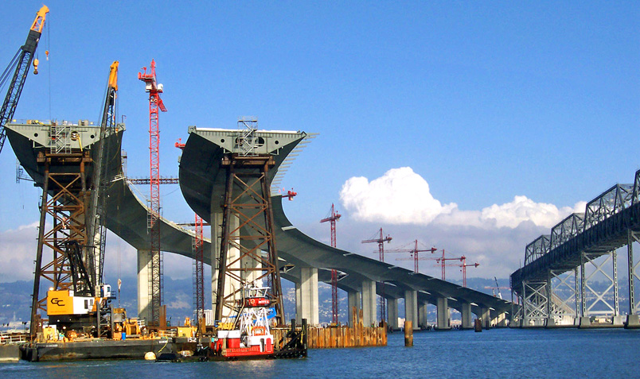
What does the World Bank do?
  Provides financial and technical assistance to developing countries
    IBRD: Middle-Income Countries
      low-interest loans
      guarantees
      advisory services
    IDA: Lower-Income Countries
      interest-free loans
      grants
  Approx. $67 billion committed by the World Bank Group (IBRD/IDA, IFC, MIGA) in FY 2018: distributed in credits, loans, grants, and guarantees. (IBRD/IDA share: $47 billion)

Slide 8
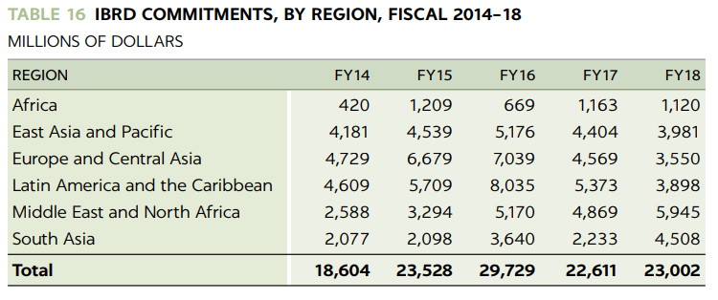
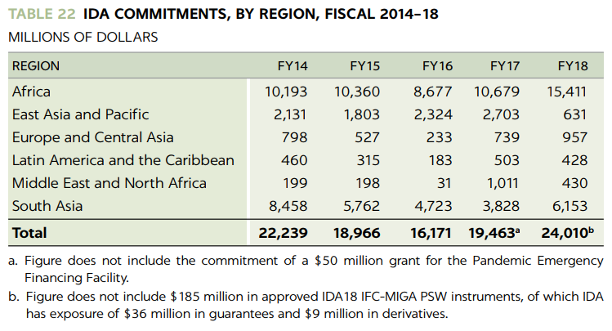
World Bank: Global Commitments FY18

Slide 9
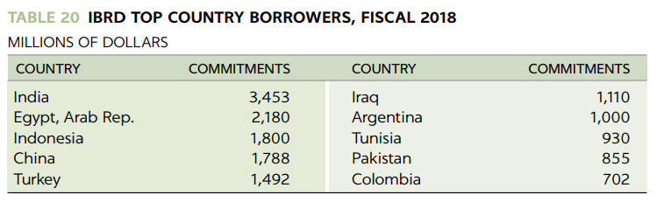
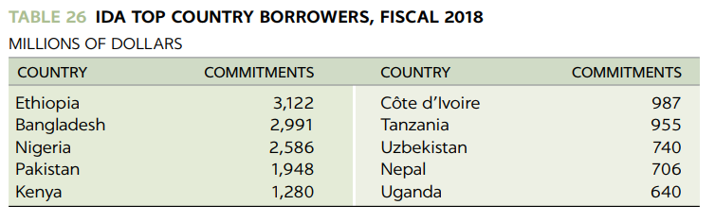
Top Borrowers in FY 18

Slide 10
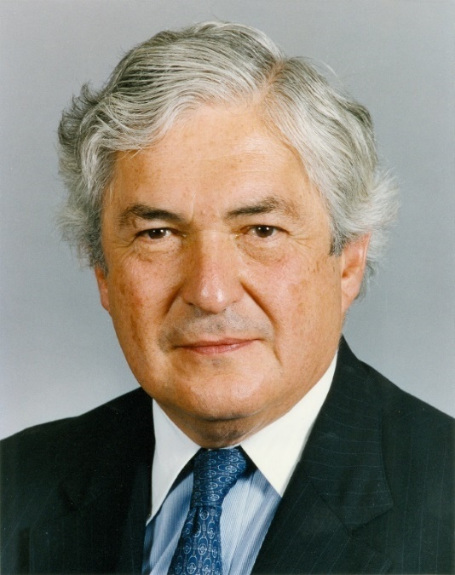
Why Does the World Bank
Care About Fraud & Corruption?
Annual Meetings Address:
James D. Wolfensohn
President
The World Bank
October 1, 1996
[W]e must tackle the issue of economic and financial efficiency. But we also need to address transparency, accountability, and institutional capacity. And let's not mince words: we need to deal with the cancer of corruption. . . .
Let me emphasize that the Bank Group will not tolerate corruption in the programs that we support; and we are taking steps to ensure that our own activities continue to meet the highest standards of probity.

Slide 11
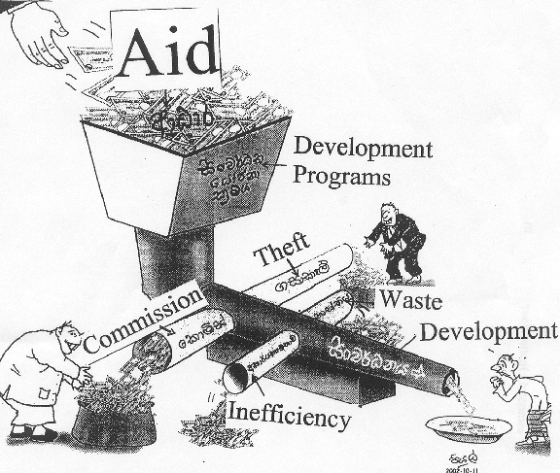
The Big Picture:
Aid, Governance and Development Effectiveness

Slide 12
Why Does the World Bank
Care About Fraud & Corruption?
Economic Reasons
  Corruption is a cancer on effective development – first articulated in James Wolfensohn’s “Cancer of Corruption” Speech (1996)
  Christine Lagarde, IMF (Sept. 2016): “The annual costs of bribery alone – a subset of corruption – is estimated at a massive US $1.5–2 trillion dollars– roughly 2% of global GDP”
  Corruption has been estimated to represent a 20% tax on foreign investment
Legal Reasons
  WB Articles of Agreement (constitution-level establishment document):
    Fiduciary responsibility to ensure Bank funds are used with “due attention to considerations of economy and efficiency”
    Bank funds to be used for their “intended purpose”

Slide 13
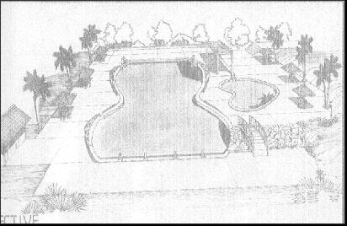
Why Fighting Fraud & Corruption Matters: Eco-Tourism project (Southeast Asia)

Slide 14
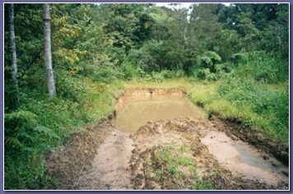
Why Fighting Fraud & Corruption Matters: Eco-Tourism project (Southeast Asia)
30 days to completion – more than 50% of funds disbursed

Slide 15
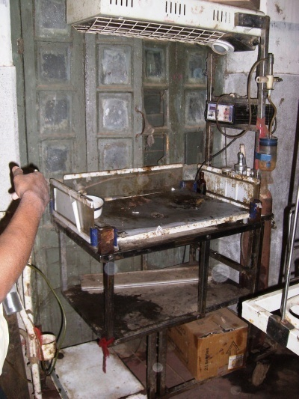
Why Fighting Fraud & Corruption Matters:
Health Project (South Asia)
“New” baby-warmer
Does not fit the specifications
of the procurement
User risks injury
Procurement unit accepted
the delivery
Contract paid in full

Slide 16
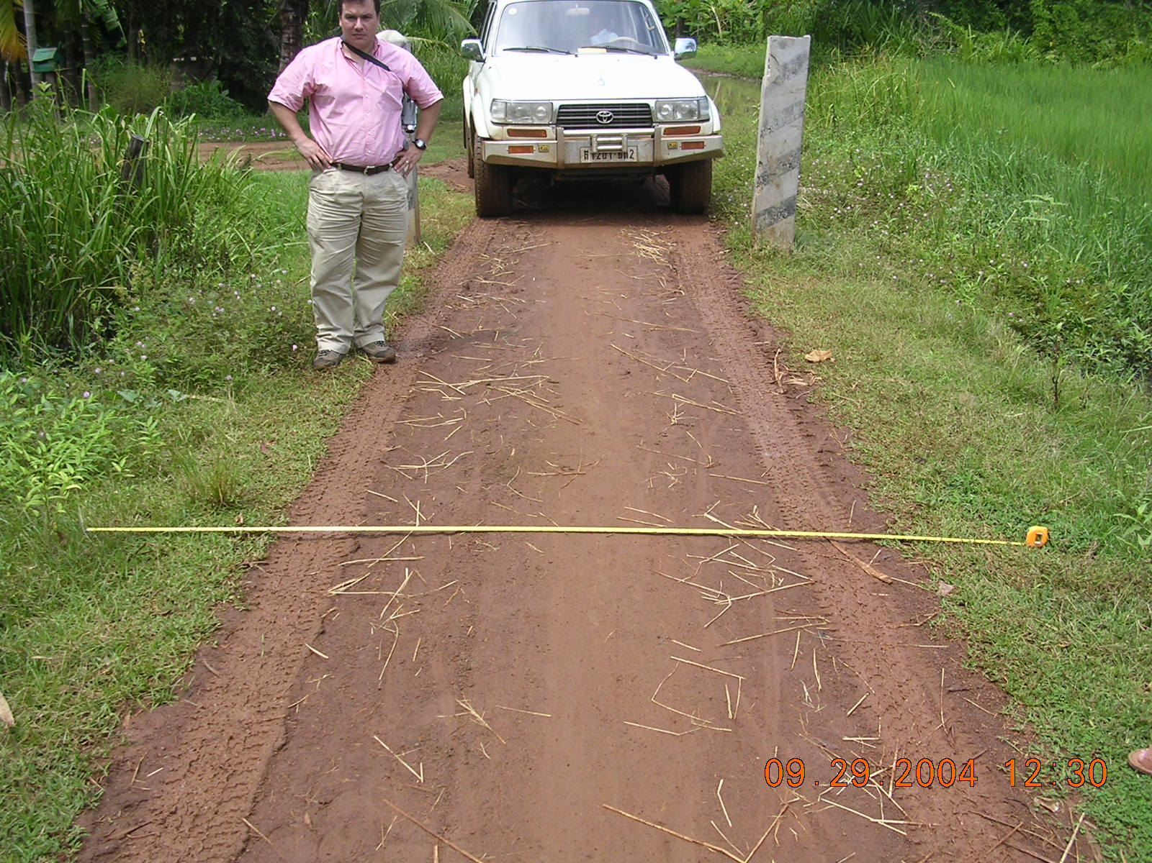
Why Fighting Fraud & Corruption Matters: Infrastructure Project (South America)
Road 30% narrower than specifications
No road surfacing, contrary to specifications
The contract was paid in full

Slide 17
Contractual Relationships
SUPPLIER/ CONTRACTOR/ CONSULTANT
WORLD BANK
INVESTIGATIONS, AUDITS, SANCTIONS
FINANCING/ CREDIT
AGREEMENT
BIDDING
DOCUMENTS, CONTRACTS
IMPLEMENTING AGENCY
(Borrowing Country Government)
17
Notes:
The legal agreement between the Bank and the borrower governs their relationship.
Borrowers (Client countries) are required to use Bank’s pre-established rules for investment operations financed out of loans/credits/grants.
Included in these rules are provisions governing the Bank’s right to investigate, audit, and (if necessary) sanction private firms and individuals engaging in misconduct on Bank-financed projects.

Slide 18
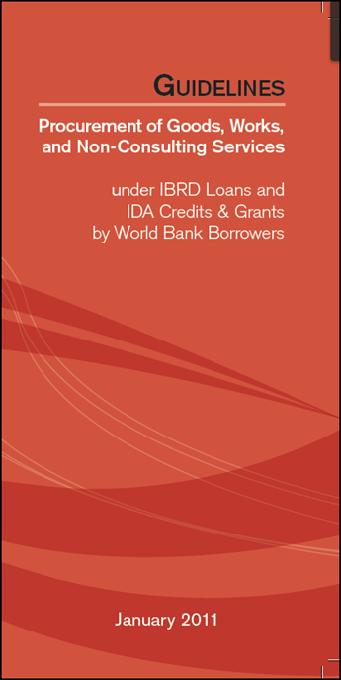
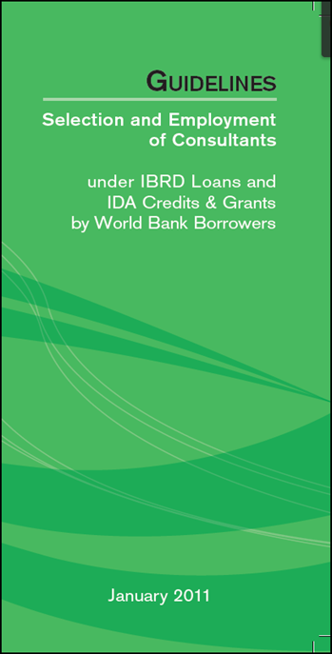
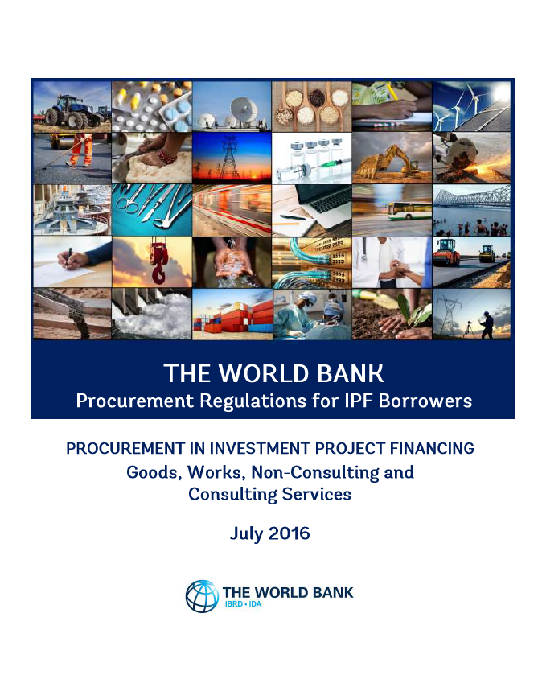
Procurement Regulations for IPF Borrowers July 2016

Slide 19
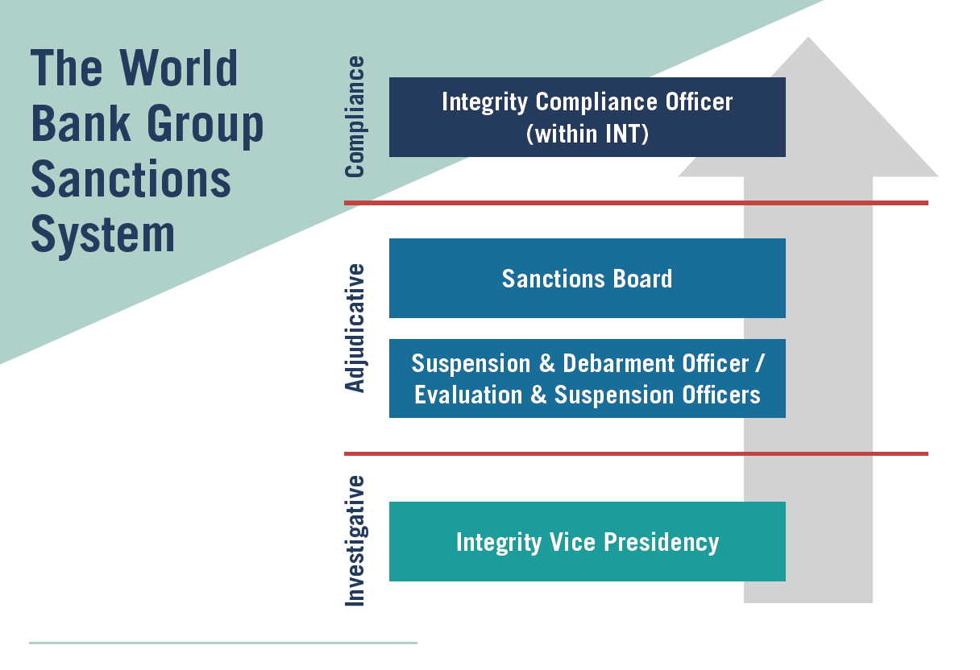
The Sanctions System

Slide 20
What Do We Mean by “Sanctions”?
At the World Bank, “sanctions” means suspension and debarment
Suspension and debarment are administrative remedies, not criminal sanctions – not meant to be punitive
One of a number of tools that the World Bank uses to combat fraud and corruption
Suspended and debarred companies/individuals are ineligible to receive new contracts for World Bank-financed projects

Slide 21
Who Can Be Sanctioned?
Companies / Individuals competing for, or executing, Bank-financed contracts
  Covered by the World Bank Sanctions System
  May be suspended/debarred from receiving new contracts
Actors Covered by Other Systems
Bank staff members and consultants (World Bank Internal Justice System)
  Under the Internal Justice System, misconduct may result in termination, blacklisting against future employment with the World Bank
Government agencies and officials (Referrals to Member governments)
  Evidence of misconduct by government agencies and officials is referred to member governments

Slide 22
Sanctionable Misconduct
The World Bank has defined five sanctionable practices:
Fraudulent Practice
Corrupt Practice
Collusive Practice
Coercive Practice
Obstructive Practice
Definitions found in: Loan, Grant and Contracting Documents (Consultant and Procurement Guidelines (old) and Procurement Regulations (new); Sanctions Procedures; Anti-Corruption Guidelines for Borrowing Countries)
Applies across the World Bank Group (IBRD/IDA, IFC, MIGA, ICSID)
First four definitions are harmonized with other Multilateral Development Banks (IDB, ADB, AfDB, EBRD)

Slide 23
Range of Sanctions:
    Debarment with Conditional Release (‘baseline’ / default)
    Indefinite or Fixed-Term Debarment (without conditions)
    Conditional Non-Debarment
    Letter of Reprimand
    Restitution

Slide 24
Scope of Suspension and Debarment
Suspended/debarred companies and individuals are not eligible to receive new contracts for World Bank projects
    Also cannot be a nominated sub-contractor, consultant, supplier, or service provider of an otherwise eligible firm being awarded a World Bank-financed contract
In most instances, entities controlled by a debarred company or individual (i.e., subsidiaries) will also be ineligible
Suspensions/debarments can also extend to other affiliates (e.g., parents, affiliates under common control) under certain circumstances

Slide 25
Impact of Suspension and Debarment
Sanctions are public: www.worldbank.org/debarr
2010: Cross-Debarment among Multilateral Development Banks (MDBs)
  In March 2010, the World Bank Group and four other MDBs (IDB, ADB, AfDB, EBRD) signed an agreement for the mutual enforcement of debarment decisions
  Covers debarments that are public, over one year
  Cross-debarment is automatic, subject to “opt out” in exceptional cases on legal/policy grounds
2011: Publication of uncontested SDO determinations
2012: Publication of Sanctions Board decisions

Slide 26
The Investigative Phase:
The Integrity Vice Presidency (“INT”)

Slide 27
The Investigative Phase:
The Integrity Vice Presidency (“INT”)
Conducts investigations of sanctionable conduct
Conducts audits of bidders/contract recipients
Negotiates settlements with respondents
Makes referrals to national authorities
Presents arguments to the Suspension and Debarment Officer and the Sanctions Board
Engages with companies participating in Voluntary Disclosure Program
The Integrity Vice Presidency (INT) is an independent World Bank unit that conducts administrative fact-finding inquiries in response to allegations of fraud and corruption involving Bank-financed projects.
Notes:
27
25
INT receives allegations of misconduct from a wide range of sources. In Fiscal Year 2017, approximately 34% of the complaints INT received came from Bank Group staff, while the remainder of complaints came from sources outside the Bank, including “contractors or other bidders, concerned citizens, government officials, employees of NGOs, and other multilateral development banks.” Upon receiving a complaint, INT evaluates the credibility and seriousness of the allegations, among other factors, and decides whether to launch a full investigation.
Anyone can submit a complaint to INT through an online complaint form: http://www.worldbank.org/en/about/unit/integrity-vice-presidency/report-an-allegation.

Slide 28
The Adjudicative Phase:
Office of Suspension and Debarment

Slide 29
The Adjudicative Phase:
Suspension and Debarment Officer (SDO)
Functions like an administrative judge
Evaluates sufficiency of evidence
Issues Notices of Sanctions Proceedings
Temporarily suspends respondents from receiving future Bank-financed contracts
Recommends appropriate sanction (becomes final if not contested)
IFC and MIGA follow parallel procedures for sanctions cases relating to their operations and each have their own Evaluation and Suspension Officer

Slide 30
The Adjudicative Phase:
Suspension and Debarment Officer (SDO)
Reviews written Explanations submitted by respondents.
  Reviews for evidence of the following:
    Manifest error/clear basis meriting a withdraw of notice
    Revise sanction based on additional evidence of mitigating factors
  Possible External Counsel Involvement
Imposes sanction if no appeal to Sanctions Board (65% of cases are not contested)
Reviews settlements for voluntariness and compliance with WBG Sanctioning Guidelines

Slide 31
The Adjudicative Phase:
Temporary Suspension
  “Temporary Debarment” – effect is same as debarment
  Temporary protective measure imposed while sanctions proceedings are underway
  Imposed by the SDO upon issuance of the Notice of Sanctions Proceedings
  Imposed in all cases where the recommended sanction includes a minimum period of debarment in excess of six months
  Unlike final sanction, not announced publicly, but Borrowers and all Bank staff know (Borrowers use Client Connection to access list)

Slide 32
The Adjudicative Phase:
Second and Final Tier: Sanctions Board

Slide 33
Sanctions Board Roles & Functions
Sanctions Board Composition:
  Comprised of 7 external members (appointed by the Bank’s Board of Directors)
  All members serve a nonrenewable 6-year term
  Supported by Secretariat of attorneys
Hearings & Deliberations – The Sanctions Board convenes 2 to 4 times per year
The Sanctions Board reviews appealed cases ‘de novo’ based on pleadings and any hearing
If sufficient evidence, the Sanctions Board imposes an appropriate sanction
The Sanctions Board publishes the full text of its decisions, which are final/not appealable
35% of cases are resolved at this level
33

Slide 34
The Compliance Phase:
Conditional Release

Slide 35
11 Principles of WBG Integrity Compliance Guidelines (for Debarments with Conditional Release)
Prohibition of Misconduct
Responsibility (leadership, individual, compliance function)
Program Initiation, Risk Assessment, and Reviews
Internal Policies (vetting employees, conflict of interest, gifts, hospitality, entertainment, travel, political contributions, charity, facilitation payments, recordkeeping, and fraudulent, collusive and coercive practices)
Business Partners (due diligence, informing partner of integrity commitment, reciprocal commitment, proper documentation, appropriate remuneration, monitoring/oversight)
Internal Controls (financial, contractual obligations, decision-making processes)
Training & Communication
Incentives (positive, disciplinary measures)
Reporting (duty to report, advice, whistle blowing/hotlines, periodic certification)
Remediate Misconduct (investigating procedures, respond)
Collective Action

Slide 36
How Settlement Works
INT and Respondent
negotiate a resolution to a
case
  - Can happen at any time during investigation or sanctions proceedings
  - Can settle the case (i.e., agreed sanction) or defer (‘freeze’) proceedings
SDO reviews
agreement,
imposes
agreed
sanction
LEG clears
the settlement agreement

Slide 37
Case Study
Iraqi-born UK national former World Bank consultant, convicted in UK in July 2017 of receiving corrupt payments from medical companies around the world. Sentenced to 6 years imprisonment.
13 counts of conspiring to accept £1.7 million ($2.2 million) in corrupt payments from various medical companies.
Consultant for the World Bank on 16 bank-financed projects involving 13 countries from August 2007 through September 2011.
UK investigators traced 65 corrupt payments for multiple procurements amounting to £43 million involving projects in Albania, Romania, Uzbekistan, Iraq, Bulgaria and other countries.
Consultant used his inside position to negotiate clandestine agreements with medical suppliers where he would provide drafts of tender documentation, change specifications to suit particular suppliers and assist with making complaints aimed at sinking rival bids.
Bribes were paid to third parties and directly to Swiss bank accounts belonging to Consultant-controlled companies.

Slide 38
Case Study
Dutchmed (Netherlands) was debarred for 14 years
Simed International (Netherlands) was debarred for 5 years.
TOO Distrilab (Kazakhstan) was debarred for 4 years
DRC bv International (Netherlands) was debarred for 4 years and Development and Relief Corporation (Netherlands) was debarred for 3 years.
Nihon Kohden Europe, a unit of a Japanese company, was debarred for 3 years after negotiating a settlement with the World Bank. It paid restitution of $400,000.
Karl Storz (Germany) was debarred for 2 years, after being given credit for cooperating and adopting a compliance program
Ideal Medical Products Engineering (France) was debarred for just 1 year after the World Bank Sanctions Board said “coercion” by Consultant was a mitigating factor.

Slide 39
Lessons and Questions
The Purpose of the System Must Be Clear:
  Is the system punitive? Or is the focus on rehabilitation/self-cleansing?
  Is it focused on the past (adjudicating misconduct), or the future (looking at present responsibility)?
  What is the balance between deterrence and fostering maximum competition?
  Is a suspension/debarment seen as a “good result” or a “bad result”?
Context Matters:
  Is suspension and debarment one among a number of available remedies? Or is it your only available remedy?
  MDBs: Tension between fiduciary obligations and anti-corruption “enforcement” efforts
  MDBs: Tension between competing legal systems/standards of member countries

Slide 40
Lessons and Questions
Practical Questions:
  What is the right balance between certainty and efficiency?
  How many levels of review?
  Who is the decision-maker? Is authority/accountability clear?
  What are the grounds? Fraud and corruption? Poor Performance?
  What is the evidentiary standard? Other key criteria?
  What due process rights are afforded to the accused party?
  What are the right performance measures for the system?
    “gotchas” vs. “success stories”

Slide 41
Additional Resources
World Bank Group Sanctions System Annual Report FY2018
  http://pubdocs.worldbank.org/en/227911538495181415/WBG-SanctionsSystemARFY18-final-for-web.pdf
The Fourth Colloquium on Suspension & Debarment
  Took place at the World Bank on Thursday, September 14, 2017
  Website includes written summaries and recordings of the panel presentations
  http://www.worldbank.org/suspensiondebarment2017
Governing Documents and Other Resources:
  Policy, Directive, Procedures, Sanctioning Guidelines, Public Decisions etc.
  http://www.worldbank.org/sanctions
Website of the Integrity Vice Presidency
  http://www.worldbank.org/integrity
Public Debarment List
  http://www.worldbank.org/debarr

