Slide 1
Sustainability in U.S. Procurement
Professor Christopher Yukins
George Washington University Law School
United states – European union
ENVIRONMENTAL LAW COLLOQUIUM
MAY 30, 2019
Center for american studies - Rome

Slide 2
Sustainability: What needs to be done now

Slide 3
How do we approach sustainability?

Slide 4
European Approach: Sustainability
Economy
Society
Environment
Notes:
The crucial milestone for the development of Sustainable Public Procurement in Europe was the Gothenburg European Council (June 2001)and the adoption of the EU Sustainable Development Strategy. The philosophy of this strategy is that economic, social and environmental objectives could be pursued simultaneously adding an environmental dimension to the Lisbon Process, launched in March 2000. (In the Lisbon Strategy, the EU aims to become ‘the most competitive and dynamic knowledge-based economy in the world, capable of sustainable economic growth with more and better jobs and greater social cohesion’ by 2010.)

Slide 5
United Nations Commission on International Trade Law (UNCITRAL): Model Law on Public Procurement
May address environmental issues in:
Qualifications of supplier
Evaluation criteria for award
Socio-economic (including environmental) requirements must be set forth in statute or regulation

Slide 6
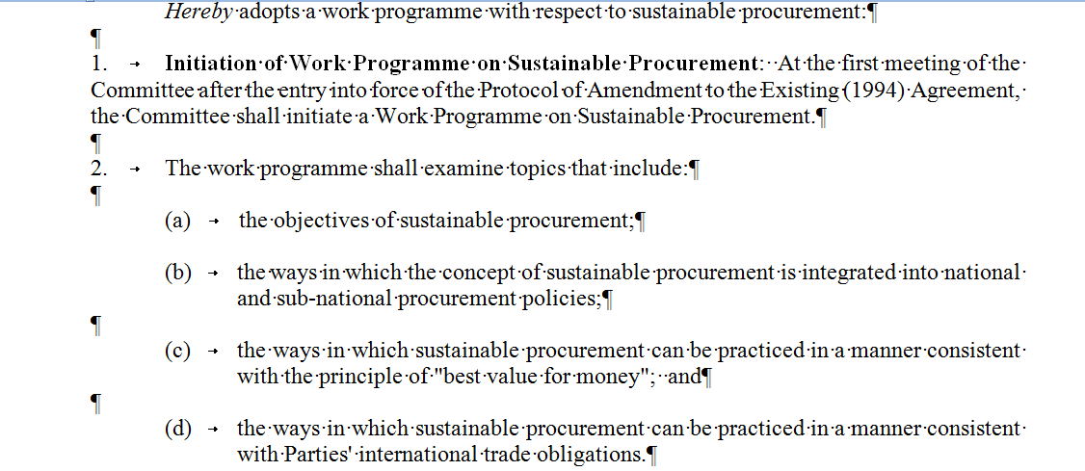
Comprehensive & Progressive Trans-Pacific Partnership
Government Procurement Agreement
Article 15.3: Exceptions
1. Subject to the requirement that the measure is not applied in a manner that would constitute a means of arbitrary or unjustifiable discrimination between Parties where the same conditions prevail, or a disguised restriction on international trade between the Parties, nothing in this Chapter shall be construed to prevent a Party, including its procuring entities, from adopting or maintaining a measure . . . :
(b) necessary to protect human, animal or plant life or health . . .
2. The Parties understand that subparagraph 1(b) includes environmental measures necessary to protect human, animal or plant life or health
Notes:
GPA:
For greater certainty, a Party, including its procuring entities, may, in accordance with this Article, prepare, adopt or apply technical specifications to promote the conservation of natural resources or protect the environment.

Slide 7
How do we achieve environmental sustainability?

Slide 8
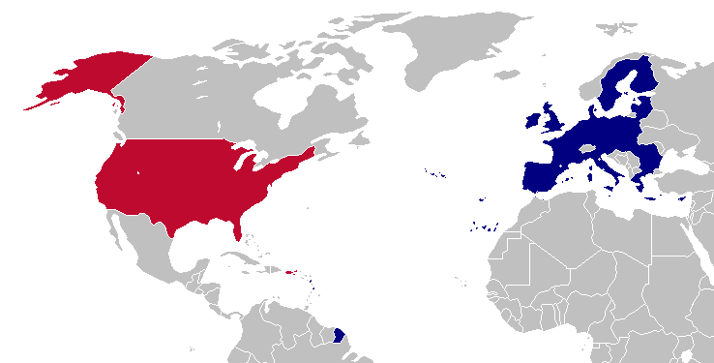
Eco-Labels

Slide 9
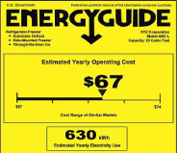
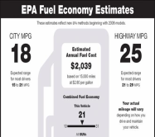
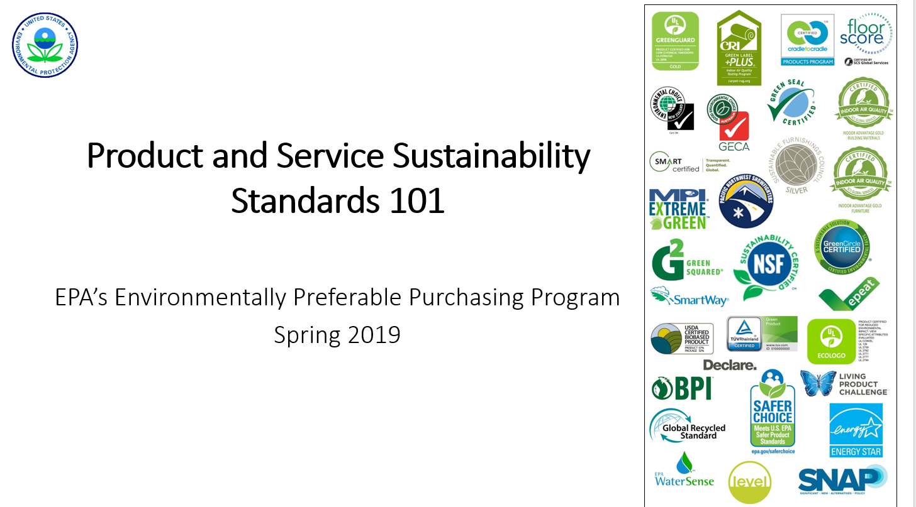
Ecolabels Found In The Marketplace In 1995 (13)
Notes:
9

Slide 10
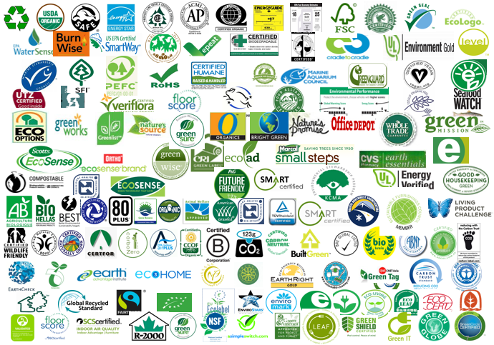
Ecolabels found in the Global Marketplace today (460+)

Slide 11
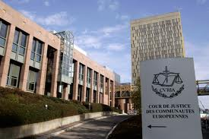
Commission V. Netherlands (CJEU – 2012) (“max Havelaar”)
“[B]y providing . . . that [if] certain products to be supplied bore specific labels would give rise to the grant of a certain number of points in the choice of the most economically advantageous tender, without having listed the criteria underlying those labels and without having allowed proof that a product satisfies those underlying criteria by all appropriate means, the province of North Holland established an award criterion that was incompatible” with the procurement directive
Court Barred Specifying Eco-Label, Without Explanation

Slide 12
Sustainability in Public Procurement: Trajectory
Political
EcoLabel
Carbon Footprint as Evaluation Factor
TRUMP

Slide 13
Japan: Green Contract Act
Contracts related to the procurement, etc. of automobiles . . . . Basic approaches related to the reduction of emissions of greenhouse gases and others for contracts related to the procurement and lease of automobiles . . . :
. . . . the procuring party enters into contract with a party whose proposal is rated the best after a comprehensive evaluation of procurement price and environmental performance
Notes:
http://www.env.go.jp/en/laws/policy/green/contract.html

Slide 14
Conclusion
Christopher R. Yukins
George Washington University
Washington, DC
cyukins@law.gwu.edu
www.publicprocurementinternational.com
Mobile +1 703 304 4773

