Slide 1
Legal issues relating to UN Procurement
Benedetta Audia
Legal Advisor

Slide 2
Overview of Presentation
UN structure
Key UNOPS governing documents regarding procurement
Data on UNOPS procurement
Procurement principles
Vendor registration and ineligibility
Ethics
Solicitation methods and contract types
UN processes for addressing bid challenges
How the UN addresses fraud in contract formation or administration
Any other key legal or practical issues

Slide 3
UN STRUCTURE

Slide 4
UN Structure
The United Nations Charter – an international treaty
The UN Charter is its founding document (29 Chapters, 111 Articles)
--Sets out the rights and obligations of its Member States
The preamble and Article 1 address the main aims of the UN:
Maintain international peace and security
Respect human rights and international law
Solve international economic, social, cultural and humanitarian problems
Amendment requires vote of 2/3 of all UN Members and the ratification by the parliaments of 2/3 of UN Members including all 5 permanent members of the Security Council who hold the power of veto over major changes to the structures and powers of the UN.

Slide 5
Legal Status of UNOPS
As an entity established by the General Assembly pursuant to Article 22 of the UN Charter, UNOPS is a subsidiary organ of the General Assembly and, thus, is an integral part of the United Nations itself.
UNOPS enjoys the legal status and capacity of the United Nations itself…and UNOPS also is entitled to the privileges and immunities provided for in Article 105 of the UN Charter… [as] elaborated in the 1946 Convention on the Privileges and Immunities of the United Nations.

Slide 6
General Assembly and Executive Board
General Assembly decision 48/501 of 19 September 1994: Established UNOPS as a “separate and identifiable entity”
General Assembly resolution 65/176 of 28 March 2011: Reaffirmed UNOPS’ role “as a central resource for the United Nations system in procurement and contracts management as well as in civil works and physical infrastructure development, including capacity development activities”
Executive Board decision 2009/25 of 11 September 2009:
Reconfirmed UNOPS’ mandate “to act as a service provider to the United Nations system agencies, funds and programmes, international and regional financial institutions, intergovernmental
organizations, donor and recipient governments and non-governmental organizations”

Slide 7
KEY UN GOVERNING DOCUMENTS REGARDING PROCUREMENT

Slide 8
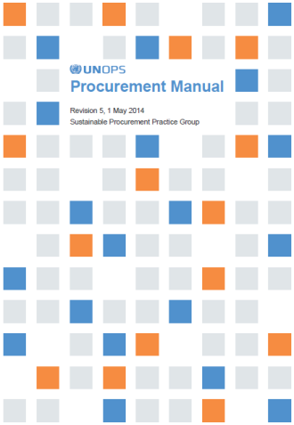
UN-wide external legislation, i.e. UN Charter, 1946 Convention on Privileges and Immunities
UNOPS Organizational Directives (ODs), i.e.:
OD 3: Financial Regulations and Rules
OD 9: Internal Control for UNOPS offices
OD 16: Procurement Framework
OD 34: Framework for Delegations of Authority
OD 41: Framework for Determining Vendor Ineligibility/Sanctions
UNOPS Administrative Instructions (AIs), i.e.:
AI.SPPG.2014.01​: Procurement Manual - Revision 5
AI.EO.2011.01 (rev. 3): Master Table of Authority in Procurement
Guidance materials, templates, etc.

Slide 9
DATA ON UNOPS PROCUREMENT

Slide 10
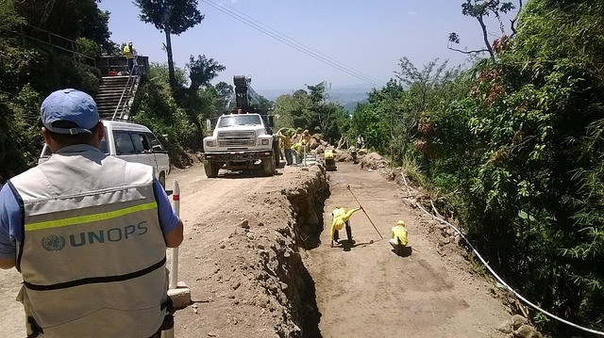
Goods
Services
Vehicles IT equipment Lab and medical equipment Pharmaceuticals | Furniture and office supplies Machinery, generators, tools Fuel
Consultancy Transport and travel services Leasing of equip., and premises | Workshops and trainings Communications Security, cleaning, banking
Photo: UNOPS
Photo: UNOPS
Works
Roads Bridges Schools and universities Police stations | Hospitals, health clinics and laboratories Airports Prisons
Photo: UNOPS/Jose Ubaldo Campos

Slide 11
UNOPS delivery in 2015 = $1.4 Bn
UNOPS procurement volume in 2015 = $717 M
Therefore 50% of UNOPS delivery done through procurement

Slide 12
Vehicles
and parts
UNOPS is a central procurement resource in the United Nations system
$717 million
worth of goods and services
Construction and engineering
Medical equipment and accessories
63%
of UNOPS goods and services were procured from developing countries or countries with economies in transition in 2015.
Pharmaceuticals
and drugs
Politics and civic affairs
Source: UN Annual Statistical Report

Slide 13
Procurement is typically one of the largest components of development projects (other large ones are personnel costs and grants)
Positively and negative influence on a project’s inputs, activities and outputs through impacts on quality, timeline and costs
Example: imagine the negative impacts of a sub-par procurement process, on an education project where one of the key outputs is the construction of a school
Photo: UN Photo/JC McIlwaine

Slide 14
UNOPS PROCUREMENT PRINCIPLES

Slide 15
Concept of stewardship
Professionalism
The term refers to the careful and responsible management of something entrusted to one’s care.
Public sector organizations are the stewards of public funds which have been provided by peoples in trust to fulfil specific public purposes…and a significant amount of these funds is spent through procurement processes.
A number of expectations form the basis of responsible stewardship of public funds and of the public procurement principles…
Value for money
Ethics
Efficiency
Transparency
Sustainability
Accountability
Responsible stewardship

Slide 16
Derived from ultimate objective of procurement to add value to the organization and its clients in fulfilling their goals and objectives
Includes concepts such as maintaining the best image and reputation of the organization and maintaining public good
Optimal combination of quality and cost appropriate to the requirements of the organization
Quality = required performance, reliability, social and environmental considerations
Cost = life cycle cost, not just purchase price
Best interest of the organization & clients
Best value for money
Free from favouritism, impartial, honest and applies visibility and openness in all transactions
All information on policies, procedures, opportunities and processes are clearly defined and made widely known
Ethical behavior
Fostering competition as a driver for best value for money
Achieved through: sufficient number of prospective bidders which are independent and compete under same conditions
Fairness, integrity and transparency
Effective Competition

Slide 17
ETHICS IN
UN PROCUREMENT

Slide 18
Ethical standards
Ethics relates to concepts of right and wrong conduct, moral duty and obligation, moral principles and values, and to moral character
Most procurement principles, i.e. fairness, integrity, transparency and accountability, are based on ethics
When undertaking procurement using public funds entrusted to the organization it is imperative that all activities conform to the highest standards of ethical conduct
All UNOPS personnel involved in procurement shall maintain an unimpeachable standard of integrity in all business relationships, both inside and outside UNOPS.
Ethical conduct shall apply in all dealings with UNOPS partners, donors, Governments and the general public.
Procurement officials must never use their authority or office for personal gain and must seek to uphold and enhance the standing of UNOPS.
Professional standards of ethical conduct of UNOPS staff are stated in the 2013 Standards of Conduct for the International Civil Service, Articles 100 and 101 of the Charter of the United Nations, in the Staff Regulations and Rules of the United Nations, as well as in the FRR.
Although individual contractors do not have the status of UN officials, they must comply with the standards of conduct required of United Nations civil servants (OD 21 (rev. 5) Individual Contractor Agreement Policy).

Slide 19
Standards of conduct
Ethical conduct is an ongoing process of self-regulation and reflection at every stage of the procurement process. It is not possible to specify everything that UNOPS personnel need to know regarding what is allowed and what is prohibited, hence UNOPS personnel must seek to be guided as much by the spirit of the law, as by the letter of the law
UNOPS policy on financial declaration and disclosure of interest applicable to certain categories of UNOPS personnel, including those involved in procurement
The standard of conduct for all personnel involved in procurement actions includes, but is not limited to:
Not giving a particular vendor information on a particular acquisition before being available to the business community at large;
Unnecessarily restrictive or ‘tailored’ specifications, terms of reference or statements of work that can discourage competition;
Shall not solicit or accept, directly or indirectly any promise of future employment from anyone who has sought or is seeking to obtain UNOPS business;
No financial interest in any vendor(s) responding to a UNOPS bidding exercise and are prohibited from any involvement in the procurement action if they do;
Not disclose proprietary and source selection information, directly or indirectly, to any person other than a person authorized to receive such information.
UNOPS has issued AI/OEC/2008/06 outlining post-employment restrictions on UNOPS staff involved in the procurement process after separation.

Slide 20
Conflict of interest
A conflict of interest occurs when personal interests of UNOPS personnel, such as outside activities or relationships or personal financial interests, interfere with the proper performance of his/her official duties or with the integrity or independence required.
UNOPS personnel involved in procurement must be aware of the following situations that may arise a conflict of interest:
In connection with private interests as personal investments and assets; political or other outside activities and affiliations while in the service of UNOPS; employment after retirement from UNOPS service; or the receipt of a gift that may place UNOPS personnel in a position of obligation.
Use of UNOPS assets, including human, financial and material assets, or the use of a UNOPS office or knowledge gained from official functions for private gain or to prejudice the position of someone not favoured by UNOPS personnel.
UNOPS personnel is seen to benefit, directly or indirectly, or allows a third party, including family, friends or someone they favour to benefit from UNOPS personnel decisions.
If any UNOPS personnel believe they have a conflict of interest, it must be promptly and fully disclosed to the UNOPS Ethics Officer. The individual must then refrain from any participation in the matter until the Ethics Officer has resolved the conflict. After full disclosure to those concerned, it may be determined that despite the conflict UNOPS interests remain best served by the participation of the individual.

Slide 21
Best practices for procurement cases
Best practices for meetings with suppliers
All bidders should have:
Information on upcoming procurement at the same time
Identical information during solicitation, including clarifications and amendments
Specifications should not: have conditions limiting competition or unnecessarily restrictive
Evaluation criteria is applied equally
Staff with personal or financial interests in the bidder do not participate in the process
Meetings with supplier representatives to be attended by at least 2 staff
Meetings should take place during standard working hours
Suppliers should be hosted in meeting rooms and not in staff offices
Meetings should have an agenda and minutes for it be created
Meetings should not take place with bidders participating in an ongoing procurement process (except if during a pre-bid meeting)
Gifts and hospitality
UNOPS personnel are prohibited from accepting gifts (“zero tolerance” policy), honours, decorations, favours or any form of remuneration or benefits in the course of their official duties. Such benefits create obligations, which in turn create conflicts of interest, especially in the context of procurement.
Gifts should therefore be returned to vendors or disposed (if low value), with rare exceptions granted for invitations from Governments or other bodies as part of official functions. AI/EO/2012/01

Slide 22
VENDOR REGISTRATION AND INELIGIBILITY

Slide 23
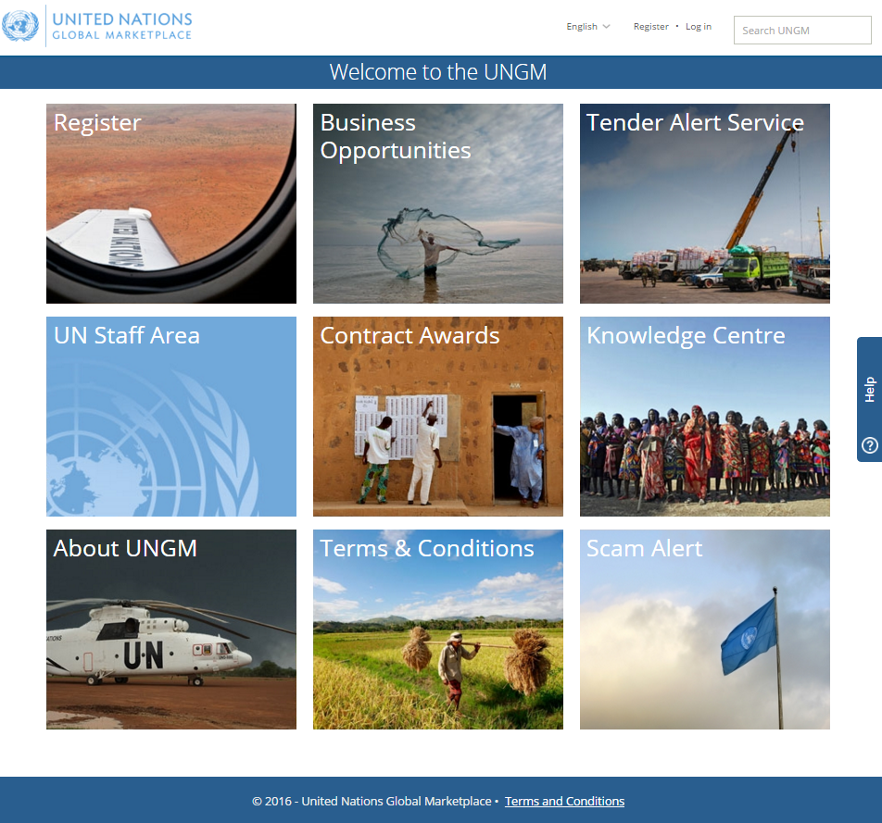
Vendor registration and management
At UNOPS we register suppliers on two data bases, prior to signing a contract/placing an order:
UNGM (United Nations Global Marketplace)
oneUNOPS
UNGM is the procurement portal of the UN, with info of 26+ Agencies
Also relevant for:
Posting tenders
LTA repository
Knowledge management
Ineligibility list

Slide 24
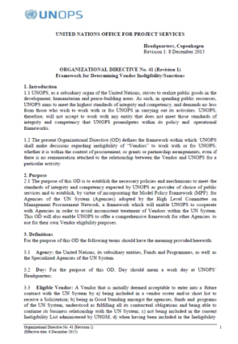
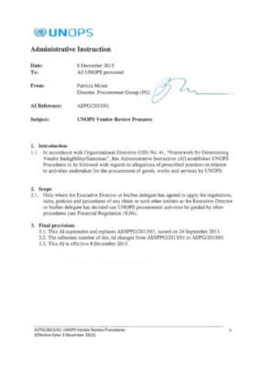
Ineligibility and VRC overview
UNOPS established its Vendor Review Committee (VRC) on September 2013, upon the promulgation of our policies on vendor sanctions: OD No 41 (Framework for Determining Vendor Ineligibility/Sanctions) and AI/SPPG/2013/01 (Vendor Review Procedures)
The policies define the framework within which UNOPS shall make decisions regarding ineligibility of “Vendors” to work with or for UNOPS, whether it is within the context of procurement, grants or partnership arrangements, even if there is no remuneration attached to the relationship between the Vendor and UNOPS for a particular activity
The policy is based on the Model Policy Framework (MPF) for Agencies of the UN System which enhances UNOPS coordination and knowledge-sharing with other Agencies to avoid inconsistent treatment of Vendors within the UN System
UNOPS policy has been updated in December 2015 to further align UNOPS’ vendor sanctions framework to the MPF
Cases reviewed by the VRC are referred by IAIG, following investigations into allegations that vendors had engaged in Proscribed Practices in connection with UNOPS activities

Slide 25
Proscribed practices
Proscribed practices are acts or omissions that may take place at any time during the UNOPS procurement process, including contract execution or beyond.
There are 6 proscribed practices covered in OD 41:
Corrupt practice | Offering, giving, receiving, or soliciting, directly or indirectly, anything of value to influence improperly the actions of another party
Fraudulent practice | Act or omission, including a misrepresentation, that knowingly or recklessly misleads, or attempts to mislead, a party to obtain a financial or other benefit or to avoid an obligation
Coercive practice | Act or omission that impairs or harms, or threatens to impair or harm, directly or indirectly, any party or the property of the party to improperly influence the actions of a party
Collusive practice | Arrangement between two or more parties designed to achieve an improper purpose, including influencing improperly the actions of another party
Unethical practice | Conduct or behaviour that is contrary to the conflict of interest, gifts and hospitality, post-employment provisions or other published requirements of doing business with UNOPS
Obstruction | Acts or omissions by a Vendor that prevent or hinder UNOPS from investigating instances of possible Proscribed Practices

Slide 26
Possible sanctions
A sanction is an administrative determination, including any necessary measures or rehabilitative requirements, determined and applied by UNOPS in its discretion as a result of a Vendor engaging in Proscribed Practices
Sanctions are imposed by the ECPO following recommendation of the VRC:
UNOPS is uses the MPF suggested implementation tool for imposing sanctions to ensure consistency across UNOPS and with other Agencies
Sanctions are normally not permanent with a standard duration of 3 years, which can be increased or decreased depending on aggravating / mitigating circumstances.
The sanctions must be guided by the principles of fairness and business orientation
Censure | A letter of reprimand of the Respondent’s conduct. Censure does not affect the Respondent’s eligibility, but its existence will be an aggravating factor for imposing sanctions in future proceedings;
Ineligibility or Debarment | Formal declaration that a Respondent(s) has become ineligible for a period of time to (a) be awarded and/or to partake in UNOPS contracts; (b) conduct new business with UNOPS as agent or representative of other Vendors; (c) partake in having discussions with UNOPS regarding new contracts. Exceptionally, the VRC may recommend that the Respondent’s debarment be permanent;
Other sanctions | The VRC may recommend other sanctions that it finds appropriate to the circumstances at hand, including reimbursement or subjecting future contracts to special conditions.

Slide 27
Rehabilitation
While sanctions remain in effect, the vendor is ineligible to participate in any future procurement action or enter any future contractual relationships with UNOPS. However, an Ineligible Vendor wishing to restore its business relationship with UNOPS may request to have its eligible status restored by the VRC
Ineligible vendors may request rehabilitation when normally at least half of the sanctions term has expired provided that they can demonstrate that corrective measures have been put in place and have fully met or gone beyond the requirements of the ECPO’s decision.
The sanctioned vendor must provide sufficient information attesting to the medium to long-term effects of corrective measures, the deterrent effects resulting from the sanctions imposed, and must show that re-establishing its eligibility will be a sound business decision for UNOPS

Slide 28
VRC process workflow
IAIG receives a complaint of potential vendor involvement in Proscribed Practices (Corrupt, Fraudulent, Coercive, Collusive, Unethical or Obstruction)
Based on a preliminary assessment of complaint, IAIG decides to launch a formal investigation
If the investigation obtains credible evidence of proscribed practices, IAIG notifies the VRC by sending an investigation report
A Notification of Administrative Action is sent to the vendor with the basis for allegations, providing the vendor an opportunity to respond and stating that the VRC may recommend that ECPO impose Sanctions
VRC meets to review the case , determine if the vendor has engaged in Proscribed Practices and makes a recommendation to the ECPO
ECPO may impose any of the following sanctions or a combination of them:
1. Censure
2. Ineligibility or debarment
3. Other sanctions
VRC informs to the vendors the imposed sanction
UNOPS ineligibility list are updated on intranet, webpage and UNGM. Information is also shared across the UN Procurement Network

Slide 29
Checking ineligibility lists
UNOPS considers the following lists when reviewing vendor ineligibility:
Ineligibility List - list that aggregates information disclosed by UNOPS and other Agencies, Funds or Programs of the UN System, hosted by UNGM
UN/PD's suspended and removed vendors
World Bank Corporate Procurement Listing of Non-Responsible Vendors and World Bank Listing of Ineligible Firms and Individuals
Consolidated United Nations Security Council Sanctions List , which includes UN Security Council Resolution 1267/1989 list
UNGM consolidates all these ineligibility lists, including UNOPS sanctioned vendors. For guidelines on how to search in UNGM if a vendor is sanctioned please refer to the Vendor Sanctions intranet page.
UNOPS personnel are requested to exercise due diligence and systematically check against the ineligibility lists before any procurement contract is awarded to ensure that the selected supplier is not included in the relevant ineligibility lists

Slide 30
VRC case examples
Case 1 – fraud and unethical : A company was sanctioned for fraud and unethical practices for attempting to bribe a UNOPS employee with the intention to influence the actions of the UNOPS employee during the contract management stage of the procurement process.
Case 2 – collusion and fraud : Two companies were sanctioned for collusion and fraud because they misrepresented themselves as separate legal companies and conspired to operate as competitor companies in a tender procedure. The companies were not established business entities and the principals of the companies overlapped.
Case 3 – obstruction and fraud: A company was sanctioned for fraud, obstruction and unethical practices for forging an official UNOPS document, a purchase order, with the aim to take advantage of UNOPS’ reputation and good name, and evoke the false impression of ongoing business activities with UNOPS, in the context of a credit application made to a bank.
Case 4 - fraudulent: A company was sanctioned for fraud for submitting a forged bank guarantee to obtain an advance payment on the contract they were awarded.

Slide 31
SOLICITATION METHODS AND CONTRACT TYPES

Slide 32
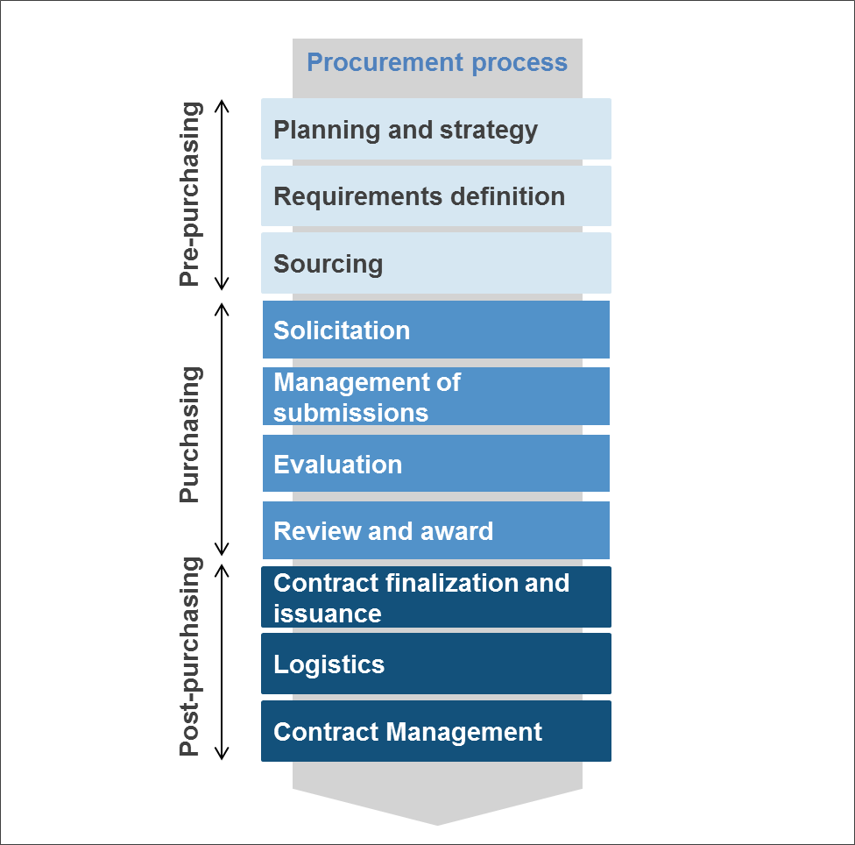
Procurement Process
Ten stages categorized in three groups:

Slide 33
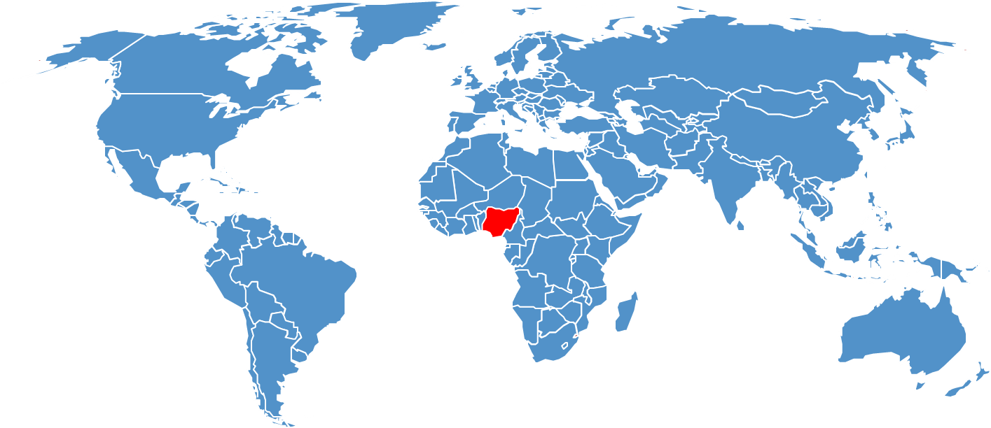
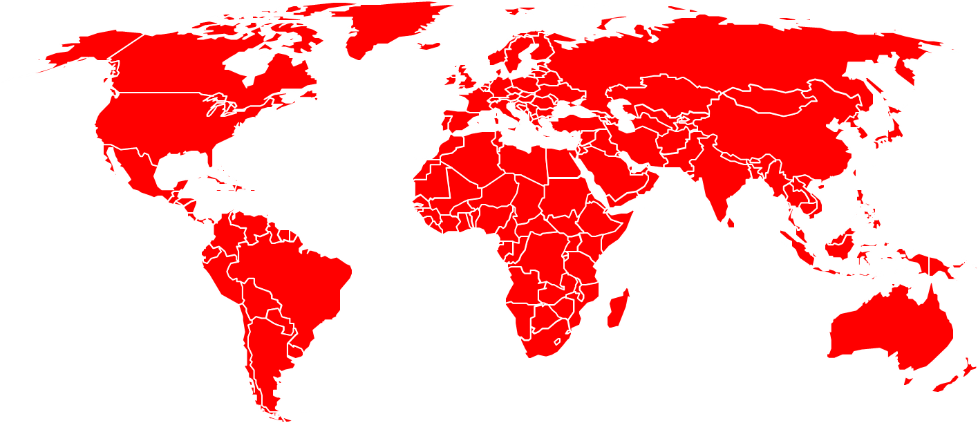
Types of competition
Open competition
Limited competition
Who can participate: everyone
Value: any value, but recommended for higher values as also has higher processing cost (>$50,000)
Advertisement of process: UNOPS website, UNGM, industry magazines, local newspapers, etc.
Geographical scope: national, regional or international. National and regional to be justified: non-interest of intl. suppliers, better national/regional prices, national/regional knowledge required, etc.
Who can participate: a limited number of suppliers (min. 3) identified in a non-discriminate and documented way, or following EOI/pre-qualification
Value:
After EOI/pre-qualification: any value
Other situations: < $50,000
Advertisement of process: sent to short-listed suppliers approved by Procurement Authority (PA) only, no advertisement
Geographical scope: National, regional or international
Geographical Scope
Regional
(E.g. Northern Nigeria)
National
(E.g. Nigeria)
International
The types of competition to be used depends on the value of the procurement, market conditions and other factors. Among other reasons on the below aspects:
Project Agreement with the client/ donor
Tender having negative security implications
Other reasons acceptable to the PA approving the solicitation document

Slide 34
Formal and informal solicitation methods
Shopping
Request for Quotation (RFQ)
Invitation to Bid (ITB)
Request for Proposals (RFP)
Value: <$5,000
Type of requirement: off-the-shelf goods, standard specification commodities or simple goods.
Award criteria: lowest priced most technically acceptable. Tech. compliance: ‘pass-fail’
Solicitation document: not needed: offers may be sought in writing or orally.
Bid receipt/opening: Not applicable
Value: >=$5,000<$50,000
Type of requirement: goods, services or works where requirement is clear and specific
Award criteria: lowest priced most technically acceptable. Tech. compliance: ‘pass-fail’
Solicitation document: RFQ format
Bid receipt/ opening: Procurement officials
may receive the offers directly, either by mail, fax or email.
Value: >=$50,000 (mandatory)
Type of requirement: goods, works, services that can be quantified
Award criteria: lowest priced substantially compliant. Tech. compliance: ‘pass-fail’
Solicitation document: ITB format
Bid receipt/ opening: by Bid Opening Committee. Bids in one sealed envelope (technical + financial)
Value: >=$50,000
Type of requirement: services or complex (not quantifiable) goods/works
Award criteria: cumulative analysis weighting technical + financial (70:30 or 60:40).
Tech. compliance: awarding points and >min. threshold (>60 or 70%)
Solicitation document: RFP format
Bid receipt/ opening: by Bid Opening Committee. Proposals in 2 envelopes: technical + financial
Informal
Formal

Slide 35
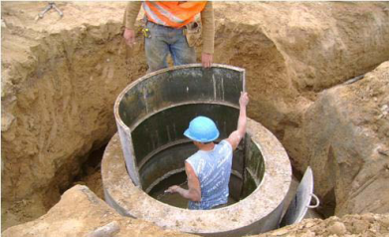
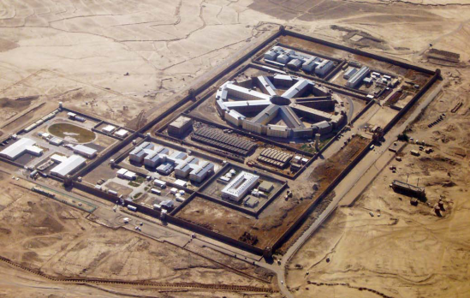
Solicitation methods for works
Minor Works Contract
Short Form Construction Contract
Measured Price Construction Contract
Lump Sum Construction Contract
Most basic of works and contactors with low capacity
Relatively basic and routine construction works
Complex works to be paid on a measured price basis
Complex works to be paid on a lump sum basis
<$250,000
RFQ or ITB
$250,000 - $1M
ITB or RFP
> $1,000,000
ITB or RFP

Slide 36
Exceptions
Possible justifications
For requirements below the threshold of less than $50,000 i.e. Shopping and RFQ.
No competitive marketplace for the requirement (e.g. monopoly) or prices fixed by legislation or government or proprietary products or services
Standardization or previous determination for identical requirement
Result of co-operation with other UN organizations or governments and organizations other than UN agencies.
Offers for identical requirement obtained competitively within reasonable period and conditions remain competitive
Formal solicitation has not produced satisfactory results in reasonable period
Purchase or lease of real property
Genuine exigency of requirement
Services that cannot be objectively evaluated
ECPO determination including but not limited to pre-selection.
Process
Document the justification as per list of possible criteria
Send the supplier a formal invitation letter and appropriate solicitation document (RFQ/ ITB/ RFP) based on the estimated amount
The supplier must submit an offer in writing directly to the procurement official
Evaluate the offer
Justify the reasonableness of the cost
Submit to PA/ CPC (as applicable)
Direct Contracting

Slide 37
What are LTAs & BPAs?
LTA
Long Term Agreement (LTA) is an agreement between UNOPS and a supplier that is established for a defined period of time for specific goods or services at prescribed prices or pricing provisions.
LTAs are not used for works due to their unique nature and complexity of the requirements.
No legal obligation to order any minimum or maximum quantity.
Unlimited value
Typically valid from 01 to 03 years or 05 years as mentioned in the solicitation documents
BPA
Blanket Purchase Agreement (BPA) is a written agreement between UNOPS and a supplier for clearly specified goods/supplies or quantifiable services at fixed prices or fees.
No legal obligation to order any minimum or maximum quantity.
Not to exceed a maximum contract ceiling of $50,000
Valid only for 12 months

Slide 38
Why establish LTAs & BPAs?
LTA
Ensure supply, competitive prices, standardize products and process efficiency
Procurement Group (PG) should be informed about all LTAs. National, regional or global level
BPA
Ensure supply, competitive prices, standardize products and process efficiency.
Issued at the local level to satisfy straightforward and recurring operational requirements of a support nature, such as stationery items, business cards, cleaning supplies, etc.

Slide 39
How to establish LTAs & BPAs?
LTA
Default method of solicitation is Open Competitive process.
Review and award. All new LTAs must be reviewed by HQCPC (Head Quarters Contracts and Property Committee) for ECPO approval
BPA
Defined thresholds for the use of informal methods shall apply: owing to the $50,000 ceiling/12-month period, an RFQ should be used.
BPA review and award shall follow the $50,000 threshold, i.e. approval by the Procurement Authority directly (or CPC review required in case of cumulative amounts)

Slide 40
Using LTAs & BPAs
LTA
No further competitive bidding required. Secondary bidding shall be carried, in case of multiple LTA holders for the same product/ services and as per LTA conditions
Call-off order issued as and when required and should be approved by appropriate Procurement Authority (PA)
For price increases less than 10 percent, the PA must approve the increase documented by the procurement official in a note to the file. All increases more than 10% should be reviewed by HQCPC.
BPA
Issue an order based on conditions in the BPA and track the total amount spent, not to exceed USD50,000.
No amendment of prices or any other conditions allowed

Slide 41
UN PROCESSES FOR ADDRESSING BID CHALLENGES

Slide 42
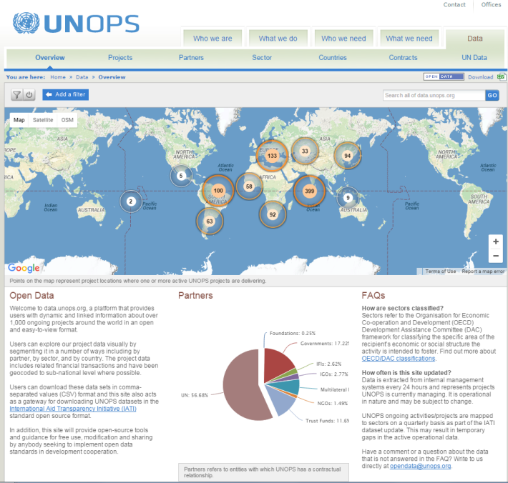
Posting awards
Posting awards
Upon approval of all orders in oneUNOPS, the contract details are posted on the below website for transparency.
Non-disclosure of information shall be granted for scenarios prescribed under OD 30 (rev.1) – Information disclosure policy - section 5
All contracts are posted on http://data.unops.org/index.htm

Slide 43
Bid Challenge Process
Suppliers can file a complaint with the General Counsel, if they feel they were judged unfairly.
All bidders must be informed of UNOPS independent bid protest mechanism in the solicitation documents, as well as in contracts. Under no circumstance, personnel involved in the procurement process under compliant shall be allowed to participate in the review of protest.
Definition of “procurement protest”:
“any allegations made by a supplier with respect to failure of UNOPS (or any of UNOPS personnel) to comply with relevant procurement procedures and uphold the basic principles and standards of integrity, transparency and fairness expected in the public procurement context”

Slide 44
Debrief
UNOPS doesn’t usually debrief unsuccessful bidders, it happens in cases, when there is a complex tender. In such cases the debriefing should be done upon written request.
Important not to disclose trade secrets, proprietary information including methodology, evaluation scoring financial information, ranking and other vendor details.

Slide 45
Bid Challenge Process
Complaint filed prior to contract signature
The contract may not be signed until the complaint is satisfactorily addressed unless:
The goods, works, or services are urgently required;
Delivery or performance would be unduly delayed if a contract is not awarded promptly: or
A prompt award is in the best interest of UNOPS.
Complaint received after contract signature
Immediate suspension of implementation pending resolution of the protest, unless continued performance is justified in situations where:
1. Uninterrupted contract performance is in the best interest of UNOPS; or
2. Urgent, compelling circumstances that significantly affect the best interest of UNOPS do not permit delay in the implementation of contract.

Slide 46
UN PROCESSES FOR ADDRESSING CLAIMS DURING CONTACT ADMINISTRATION

Slide 47
Negotiation/Amicable Settlement
Negotiation = Always the preferred mode of resolution
Parties to use their best effort to settle amicably any dispute, controversy or claim. Contract requirement.
Resolve the outstanding matters of the contract (or lack thereof).
First instance locally, then address to HQ.
Least costly means of settling a dispute.
Do cost-benefit and risk analysis to inform your position and guide you in your negotiations.
If this is successful, contact UNOPS Legal for settlement agreement.
If this fails, next step is normally Arbitration, which is the final option.

Slide 48
Arbitration
Last resort, high cost in terms of staff, time and risk of unfavorable decision = Communication to UNOPS Legal
UNOPS Legal must be consulted prior to escalation to formal dispute settlement. UNOPS Legal will liaise with the Office of Legal Affairs.
UNCITRAL Arbitration Rules = Procedural Law
Request to the Hague when no appointing authority agreed upon the parties.
The Tribunal shall apply the law designated by the parties. For the UN, general principles of international commercial law should apply. No applicable law in our contracts.
Cost of arbitration are borne by the unsuccessful party unless the tribunal apportion between them if it determines reasonable.

Slide 49
HOW UN ADDRESSES
FRAUD IN CONTRACT FORMATION OR ADMINISTRATION

Slide 50
Fraud in contract administration
UNOPS has developed anti-fraud initiatives and has adopted the ‘whistleblower’ policy of the United Nations against retaliation for reporting wrongdoing.
Specifically, UNOPS has implemented a fraud hotline, which allows direct access to the UNOPS Ethics Officer at a secure email address or a secure telephone number.
The Internal Audit Office has also adopted the International Standards for the Professional Practice of Internal Auditing, in accordance with the professional practices framework prescribed by the Institute of Internal Auditors.

Slide 51
Fraud in contract administration
All UNOPS personnel have a duty to report suspected wrongdoing. They may report such suspected wrongdoing to IAIG, or to their immediate supervisor or other appropriate supervisor within the operating unit.
UNOPS Policy to Address Fraud (OD10)
“Intentional act by one or more individuals involving the use of deception to obtain an unjust or illegal advantage”
Attempted fraud is treated as fraud even if there is no direct financial loss to the Organisation.
UNOPS Legal Framework for Addressing Non-Compliance with United Nations Standards of Conduct (OD36)

Slide 52
Misconduct definition and examples
Misconduct means the failure by an individual to comply with their obligations under the Charter of the United Nations, the Staff Regulations and Staff Rules or other relevant administrative issuances, or to observe the standards of conduct expected of an international civil servant.
As examples, misconduct includes acts such as fraud, theft, misuse of UN property, and sexual harassment. Misconduct also includes asking another individual to violate applicable rules and regulations.
UNOPS Executive Director’s report of cases of misconduct that have resulted in the imposition of disciplinary and administrative measures
“…A staff member awarded a contract to a vendor without a competitive procurement exercise. They later falsified documents to state otherwise…”
“…A staff member colluded with a company to recommend the company for a UNOPS contract in exchange for money…”
“… A former individual contractor was found to have been actively associated with the management of a business entity, and to have been holding a financial interest in it, without the approval of UNOPS. The individual’s UNOPS responsibilities included supervising that entity. The individual also took part in the evaluation process…”
“…A staff member forged the signature of one colleague, and the initials of another colleague, on a document that was submitted to the HQCPC. The staff member acted in a misguided attempt to save time. There was no evidence of personal benefit…”

Slide 53
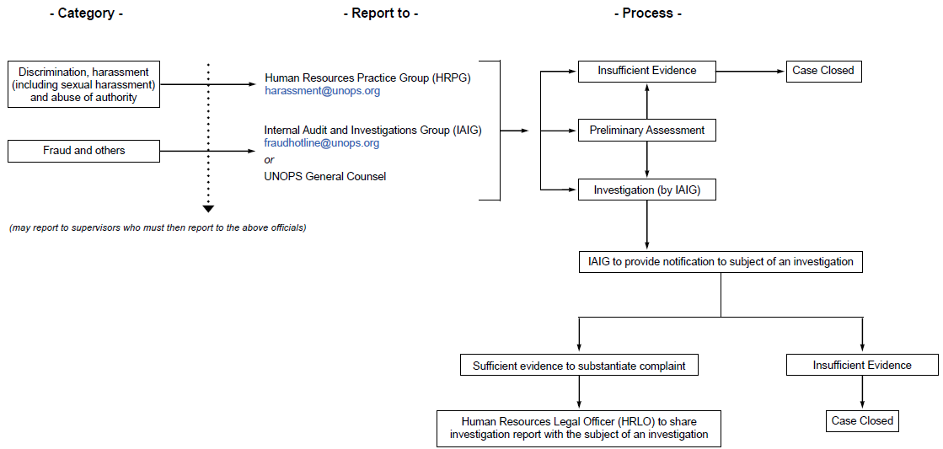
Fraud in contract administration
All UNOPS personnel have a duty to report suspected wrongdoing. They may report such suspected wrongdoing to IAIG, or to their immediate supervisor or other appropriate supervisor within the operating unit.
UNOPS Policy to Address Fraud (OD10)
“Intentional act by one or more individuals involving the use of deception to obtain an unjust or illegal advantage”
Attempted fraud is treated as fraud even if there is no direct financial loss to the Organisation.
UNOPS Legal Framework for Addressing Non-Compliance with

Slide 54
OTHER KEY LEGAL OR PRACTICAL ISSUES

Slide 55
Fundamental Contract Clauses
Basic Terms and conditions - UNOPS Contract for Services:
Contractor’s Status
Damage to Persons and Property (i.e. Indemnity)
Intellectual Property Rights
Especially important if your project’s outputs includes a document that is to be widely distributed
Confidentiality
Advertising (prohibition)
UN is considered to be a prestigious client , who suppliers want to cite on their websites, etc.
But we cannot be referred to by suppliers except with the Secretary General’s approval (SG has delegated this responsibility to UN Office of Legal Affairs)
Virtually never approved

Slide 56
Fundamental Contract Clauses
Basic Terms and conditions - UNOPS Contract for Services:
6. Modifications (who is and is not authorized to agree to)
To minimize the risk of supplier trying to rely on what your receptionist, etc. allegedly said
7. Sub-contracting and Assignment
To avoid ending up with a “partner” or “creditor” that you never planned for
8. Termination
If things do not work out notwithstanding thorough planning
No Applicable Law provision
Privileges and Immunities, and Settlement of Disputes
To avoid the risk of uneven quality of national court systems

Slide 57
Case study
You have spent days negotiating a complex contract. There is only one point left to work out. The last issue is this: the proposed supplier refuses to accept the dispute resolution clause set out in the UNOPS General Conditions of Contract because the supplier believes (wrongly) that it means that a UN body (i.e. UNCITRAL) will decide any disputes and “of course a UN body will decide in UNOPS’ favour”.
i
What would you recommend?
Insert this clause: Any dispute, controversy or claim arising out of or relating to this Contract, or the breach, termination or invalidity thereof, shall be amicably settled by direct negotiation between the parties.”
Insert this clause: “The parties agree that the Royal Courts of Justice of England shall have non-exclusive jurisdiction to hear and determine all disputes arising under this Contract.”
Just agree (in the Special Conditions section of the Contract) to delete the arbitration clause in the UNOPS General Conditions of Contract, without replacing it with another clause.
None of the above as this provision is non-negotiable.
Photo: UNOPS
Photo: UNOPS

Slide 58
Questions:

