Slide 1
Prof. Dr. iur. Dr. rer. pol. h.c. Carl Baudenbacher
Independent Arbitrator and Consultant
Door Tenant at Monckton Chambers, London
Former President of the EFTA Court
Full Professor em. University of St. Gallen
Competition Corruption and Procurement – The Fosen Linjen Saga
King’s College London – GWU Law Annual Symposium, 18 March 2019

Slide 2
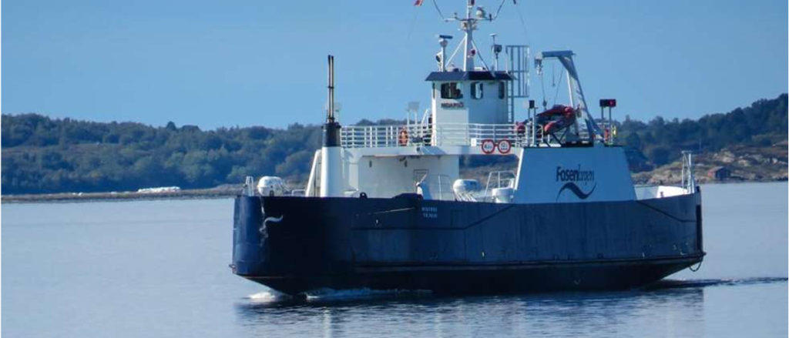
Fosen I

Slide 3
Fosen I
I. Market-oriented approach
E-16/16:
EFTA Court holds on 31 October 2017:
A simple breach of European public procurement rules may suffice to trigger liability of a public authority which has awarded a contract to the wrong bidder.
State liability standard doesn’t apply.
Article 2(1)(c) of the Remedies Directive states:
“1. Member States shall ensure that the measures taken concerning the review procedures specified in Article 1 include provision for powers to: [….] (c) award damages to persons harmed by an infringement.”
Against UK Supreme Court Nuclear Decommissioning Authority (Appellant) v EnergySolutions (no citation).

Slide 4
Fosen I
I. Market-oriented approach
E-16/16.
Main reason:
Contracting authority does not act in an authoritative manner when carrying out a procurement procedure; conclusion of a contract between equal partners.
If public authorities take part in commercial activities, they must be subject to the same rules as private companies.
To privilege the state for the sole reason that it is the state cannot be justified.
The principle that economic operators must be held responsible, i. e. liable, for their mistakes is a pillar of any market economy system (Walter Eucken).
Avoiding moral hazard.

Slide 5
Fosen I
II. Order of reference
Referring court (Frostating Court of Appeal) expressed difficulty in reconciling ECJ Commission v Portugal and Strabag with ECJ Combinatie.
1. Commission v Portugal (C-275/93):
National legislation requiring proof of culpability as a precondition for award of damages set aside.
2. Strabag (C-314/09, 30 September 2010, 3rd Chamber, K. Lenaerts (Rapporteur), President, E. Juhász, G. Arestis, T. von Danwitz and D. Šváby)
Commission v Portugal confirmed.
Austrian legislation required rather strict liability (i.e. presumed fault and reversed burden of proof) – ECJ nevertheless struck it down.
Moreover: Sufficiently seriousness standard not applied in public procurement law; strict liability.

Slide 6
Fosen I
II. Order of reference
3. Combinatie (C-568/08, 9 December 2010, 2nd Chamber, of J.N. Cunha Rodrigues (Rapporteur), President, A. Arabadjiev, A. Rosas, A. Ó Caoimh and P. Lindh)
Member States must make provision for possibility of awarding damages in case of infringement of EU law on award of public contracts. But no detailed statement as to the conditions and as to determination of amount of damages in Article 2(1)(c) of the Remedies Directive.
“That provision gives concrete expression to the principle of State liability for loss and damage caused to individuals as a result of breaches of EU law for which the State can be held responsible [….].” (Paragraph 87.)

Slide 7
Fosen I
II. Order of reference
“In the absence of EU provisions in that area, it is for the legal order of each Member State to determine the criteria on the basis of which damage arising from an infringement of EU law on the award of public contracts must be determined and estimated (see, by analogy, Case C‑315/01 GAT [2003] ECR I‑6351, paragraph 46; and Case C 314/09 Strabag and Others [2010] ECR I-0000, paragraph 33) provided the principles of equivalence and effectiveness are complied with [….].” (Para 90.)
Detailed procedural rules governing actions for safeguarding an individual’s rights under EU law must be no less favourable than those governing similar domestic actions (principle of equivalence) and must not render practically impossible or excessively difficult the exercise of rights conferred by EU law (principle of effectiveness).

Slide 8
Fosen I
III. Composition of the Court
The EFTA Court consists of tree judges; it always sits in the plenum; the judge from the country concerned always sits.
Carl Baudenbacher, President and Judge Rapporteur (LIE), Per Christiansen (NOR), Benedikt Bogason (ICE), ad hoc.

Slide 9
Fosen I
IV. Mercantilists interfere
Two orthodox dualist Norwegian professors call on the referring Court of Appeal of Trondheim not to follow the EFTA Court’s opinion.
Arguments:
This is a case of State liability.
A public authority is only liable if the breach of European public procurement rules is sufficiently serious.
References to ECJ Combinatie and UK Supreme Court Nuclear Decommissioning Authority.
Strict liability is too though on honest, but clumsy civil servants (alehouse argument).

Slide 10
Fosen I
V. Frostating Court of Appeal disregards the EFTA Court’s opinion
Opts for the State liability approach.
No objective liability for compensation for breach of procurement rules.
Maintains understanding of the Norwegian Supreme Court in Nucleus judgment, that there must be a “significant error” to be compensated for the positive interest.
Reference to the article by the two professors.
EFTA Court interprets the two decisions so that they become incompatible, and then sets Strabag aside.
Correct interpretation will allegedly show full consistency of the two ECJ rulings.

Slide 11
Fosen II
I. Fosen challenges the Court of Appeal’s judgment before the Supreme Court
None of the parties requests the Supreme Court to make a second reference to the EFTA Court.
Under the Supreme Court’s rules, the preparing judge may decide on a reference in cooperation with the Chief Justice.
The preparing judge decides to make a second reference.
Question:
“Does Article 2(1)(c) of the Remedies Directive require that any breach of the rules governing public procurement in itself is sufficient for there to be a basis of liability for positive contract interest?”
Background: One of the two professors suggested a second reference in view of the fact that the EFTA Court has a new composition.

Slide 12
Fosen II
I. Fosen challenges the Court of Appeal’s judgment before the Supreme Court
Compare Fosen I:
“1. Do Article 1(1) and Article 2(1)(c) of Directive 89/665/EEC, or other provisions of that Directive, preclude national rules on awarding damages, where the award of damages due to the contracting authority having set aside EEA law provisions concerning public contracts, is conditional on
(a) the existence of culpability and a requirement that the contracting authority’s conduct must deviate markedly from a justifiable course of action?
(b) the existence of a material error where culpability on the part of the contracting authority is part of a more comprehensive overall assessment?
(c) the contracting authority having committed a material, gross and
obvious error?
2. Should [….] provisions of that Directive, be interpreted to mean that a breach of an EEA procurement law provision under which the contracting authority is not free to exercise discretion, constitutes in itself a sufficiently qualified breach that may trigger a right to damages on certain conditions?”

Slide 13
Fosen II
II. Fosen I has answered the positive interest question
Professor Sue Arrowsmith from Nottingham University in no unclear terms supports the EFTA Court’s first Fosen opinion.
In its first opinion, the EFTA Court has not addressed the question whether liability should encompass only the negative contract interest (the costs of bidding which are unimportant) or also the positive contract interest (the loss of profit which are important).
However, it follows from the logic of the first Fosen opinion that the positive contract interest must be included.
Professor Sue Arrowsmith from Nottingham University in no unclear terms supports the EFTA Court’s first Fosen opinion. She is the leading authority in Eropean public procurement law.
The Norwegian Supreme Court has always been extremely reluctant to make a reference to the EFTA Court? Why this change of mind?

Slide 14
Fosen II
III. Leeway argument
EFTA Court Fosen I: Leeway enables arbitrary decisions:
German Supreme Court Brasserie du Pêcheur:
Due to German beer purity law, foreign brewers were prevented from selling their beer in Germany under the name of beer.
Beer contained additives prohibited in Germany.
No sufficiently qualified infringement which would have been the direct cause of the damage claimed.
German prohibition of additives in beer not sufficiently serious.

Slide 15
Fosen II
III. Leeway argument
EFTA Court Dr Jürgen Tschannett (E-6/00):
Austrian physician T unlawfully denied license to practice in Liechtenstein.
T sues Liechtenstein for damages.
Supreme Court in 2006:
Government was not at fault because it had not known in advance that the single practice rule was incompatible with EEA law. Quashed by State Court.
Supreme Court finds again against the plaintiff with the argument that the breach was not sufficiently serious. Quashed by State Court.
Only in 2010, Supreme Court acknowledges liability of the State.

Slide 16
Fosen II
IV. Composition of the Court
The EFTA Court consists of tree judges; it always sits in the plenum; the judge from the country concerned always sits.
Páll Hreinsson, President and Judge Rapporteur (ICE), Per Christiansen (NOR), Bernd Hammermann (LIE).

Slide 17
Fosen II
V. Postponement of the Oral Hearing
Hearing scheduled for 21 March 2019.
Two weeks before, the Norwegian judge Per Christiansen has an accident.
President Hreinsson postpones the Hearing to 13 May 2019.
Article 42 (2)(3) states:
“The President may in special circumstances, after hearing the parties, either on his own initiative or at the request of one of the parties, defer a case to be dealt with at a later date. [….].”
Illness is not special circumstances.
Since it is only a court of three, the EFTA Court has a system of ad hoc judges.
However, no ad hoc judge is called iin.
This happens for the first time in the 25 year history of the Court.

Slide 18
End
Referring until the result fits?
Compatible with the rule of law?
When will the ECJ get a chance?
Several odd circumstances
The subject of today’s conference is Competition, Corruption and Procurement
This is a procurement case
The EFTA Court’s first Fosen judgment was based on competition considerations
Fairness and efficient use of scarce resources

