Slide 1
Joint Public Procurement and Innovation: Lessons Across Borders
Public Procurement: Global Revolution IX
University of Nottingham
June 2019
Gabriella M. Racca
Full Professor of Administrative Law
University of Torino

Slide 2
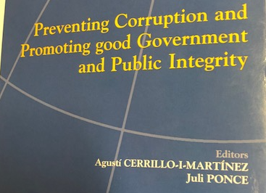
www.ius-publicum.com
www.public-contracts.net/inhalte/home.asp
Building networks…
www.gwu.edu/
NEW Book Forthcoming
Public Contracting and Innovation: Lessons Across Borders
G. M. Racca – C. R. Yukins (eds.) Bruylant, 2019
© Copyright 2019 G. M. Racca

Slide 3
Innovation in Procurement:
PURCHASE OF INNOVATION
INNOVATION IN PROCUREMENT
INNOVATION IN THE PROCUREMENT PROCESS ITSELF
Buying cutting-edge technology in public procurement markets.
Encouraging innovative suppliers in the procurement process.
Developing methods and approaches for the procurement process.

Slide 4
PURCHASE OF INNOVATION
Capacity of a smart city to use artificial intelligence in the performance of its functions.
Purchasing innovative, technologically-advanced products, services or processes of production for the development of smart cities.
Urban public contracting in smart cities:
a. meta-infrastructures
b. smart procurement
c. new public-private partnership arrangements.

Slide 5
How to purchase Innovation?
pre-commercial procurement
public procurement for innovation (PPI)
innovation partnership
→ Greater purchasing power of the EU public procurers in acquiring innovative products and services.
→ Efficiency and quality of public services with a view to promoting the Europe 2020 (and subsequent) plan for smart, sustainable and inclusive growth.

Slide 6
INNOVATION IN PROCUREMENT
can push innovative solutions
strategic public procurement
Capacity of a smart city to use artificial intelligence in the performance of its function.
Purchasing innovative, technologically-advanced products, services or processes of production for the development of smart cities.

Slide 7
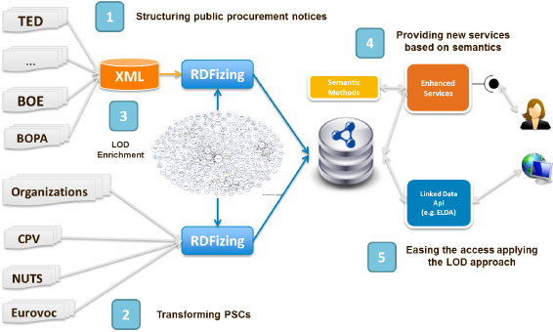
Addressing public requirements efficiently
Through the use of e-portals on a government wide basis, a platform for public procurement can be more expedient and more market-responsive at a presumably reasonable price,

Slide 8
INNOVATION IN THE PROCUREMENT PROCESS ITSELF
Expanded procurement networks among contracting officials across borders in order to share best practices to meet the requirements of the end-users.
Overcoming market fragmentation through new procurement systems and generating efficiencies and savings, which can contribute to economic growth.
The evolution of the MEAT to a value-based approach in specific sectors (e.g. Healthcare).
→EURIPHI project (European wide Innovation Procurement in Health and Care) aims to enable the cross-border transformation of health and social care delivery.

Slide 9
Main Innovations
self-declaration via a standard form (EPSD)
joint cross-border procurement (JCBPP)
cooperative procurement via institutional bodies (e.g. CPBs)
→ combining full digitization of the procurement process from planning to archiving (“e-procurement”).
→ co-operation between large buyers in areas of mutual interests or between buyers not necessarily located in bordering areas (“joint cross-border procurement”).

Slide 10
Key Questions in Joint Cross-Border Procurement
Reasons for joint cross- border
Policy issues
Legal issues
Challenges for the future

Slide 11
Recognized Barriers to Cross-Border Joint Procurement
Joint awarding of contracts by contracting entities from different Member States currently encounters specific legal difficulties, with special reference to conflicts of national laws.
In practice several national legal systems have explicitly or implicitly rendered cross-border joint procurement legally uncertain.
Therefore new rules on cross-border joint procurement designating the applicable law should be established in order to facilitate cooperation between contracting entities across the Single Market, while specific rules should be established for such forms of joint procurement.

Slide 12
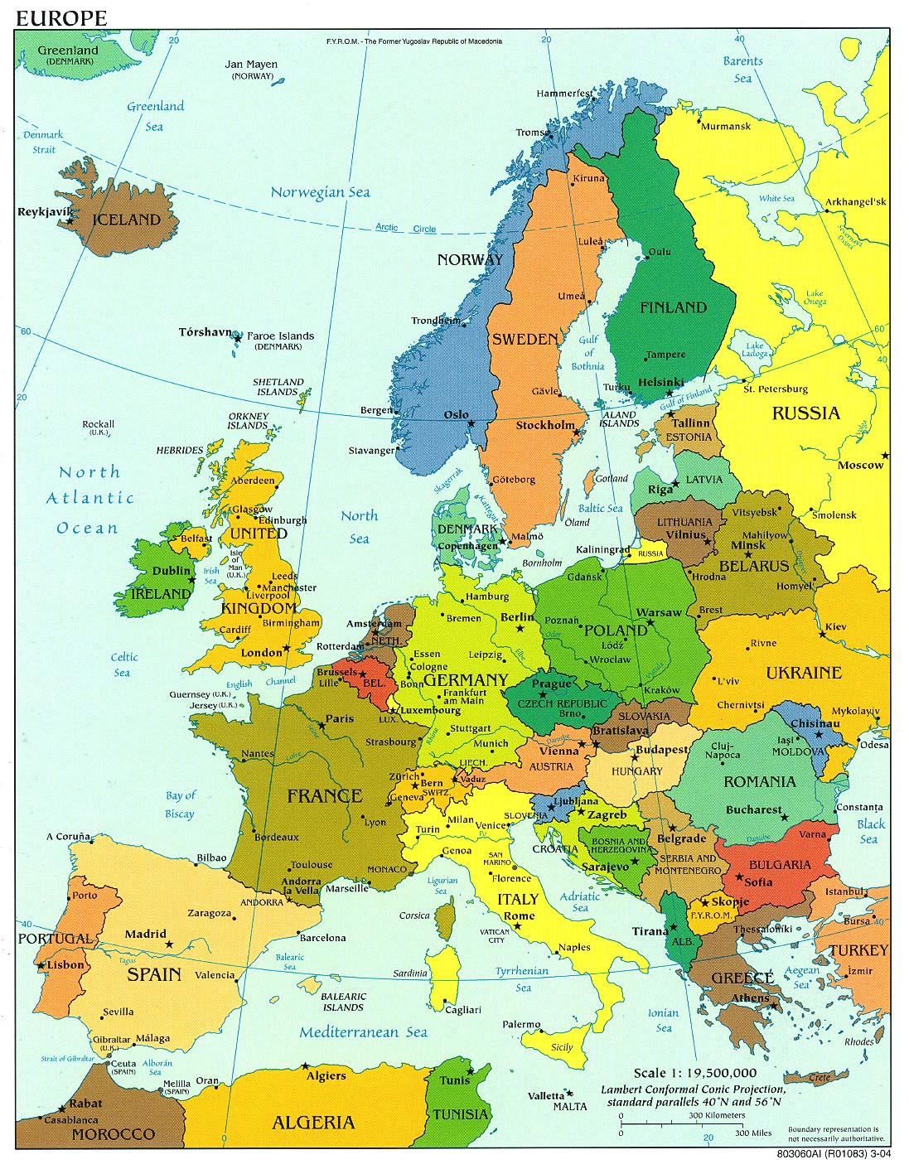
Directive 2014/24/EU, Art. 39
Cleared the Way for Joint Procurement in the European Union
“A Member State shall not prohibit its contracting authorities from using centralised purchasing activities offered by central purchasing bodies located in another Member State.”
C. A.
C. A.
C. A.
CPB
C. A.
© Copyright 2016 G. M. Racca

Slide 13
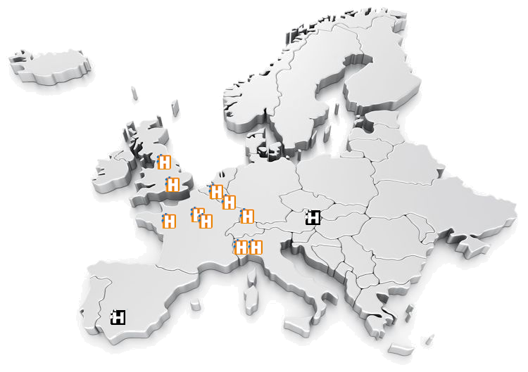
Example: The HAPPI Consortium
13

Slide 14
central purchasing body (F)
EU Hospitals
central purchasing body (UK)
Intermediary
central purchasing body (IT)
central purchasing body (BG)
Partners
central purchasing body (Lux)
Intermediary
GROUPEMENT DE COMMANDE
French Law
(harmonization of terms and conditions)

Slide 15
Master Agreement (Apple)
Participating Addendum
Alabama
Participating Addendum
Wisconsin
Transparency?
Competition?
Socioeconomic?

Slide 16
Legal Issues

Slide 17
(EU Directive 2014/24/EU, Art. 39)
European Purchasing Group
Unless the necessary elements have been regulated by an international agreement concluded between the Member States concerned, the participating contracting authorities shall conclude an agreement that determines:
(a) the responsibilities of the parties and the relevant applicable national provisions;
(b) the internal organisation of the procurement procedure, including the management of the procedure, the distribution of the works, supplies or services to be procured, and the conclusion of contracts.

Slide 18
Transnational administrative procedures New EU Dir. PP - Wh. 73
“Specific rules should be established for such form of joint procurement”
Rome I :
conflict-of-law rules
PROCUREMENT
Award
CONTRACT EXECUTION
Agreement establishing the European purchasing group
Notice
Applicable law on selection and remedies?
Applicable law on contract executions?
18

Slide 19
Performance Responsibility
Which agency oversees performance – centralized purchasing agency or ordering agency?
Which agency has authority to terminate order/contract? Which agency has authority to terminate master contract?
EU Directive 2014/24/EU – Recital 71:
“Each contracting authority should be solely responsible in respect of procedures or parts of procedures it conducts on its own, such as the awarding of a contract, the conclusion of a framework agreement, the operation of a dynamic purchasing system, the reopening of competition under a framework agreement or the determination of which of the economic operators party to a framework agreement shall perform a given task.”
Contractor may not deliver Products under this Master Agreement until a Participating Addendum acceptable to the Participating Entity and Contractor is executed. The NASPO ValuePoint Master Agreement Terms and Conditions are applicable to any Order by a Participating Entity (and other Purchasing Entities covered by their Participating Addendum), except to the extent altered, modified, supplemented or amended by a Participating Addendum.
Notes:
a. Contractor may not deliver Products under this Master Agreement until a Participating Addendum acceptable to the Participating Entity and Contractor is executed. The NASPO ValuePoint Master Agreement Terms and Conditions are applicable to any Order by a Participating Entity (and other Purchasing Entities covered by their Participating Addendum), except to the extent altered, modified, supplemented or amended by a Participating Addendum. By way of illustration and not limitation, this authority may apply to unique delivery and invoicing requirements, confidentiality requirements, defaults on Orders, governing law and venue relating to Orders by a Participating Entity, indemnification, and insurance requirements. Statutory or constitutional requirements relating to availability of funds may require specific language in some Participating Addenda in order to comply with applicable law. The expectation is that these alterations, modifications, supplements, or amendments will be addressed in the Participating Addendum or, with the consent of the Purchasing Entity and Contractor, may be included in the ordering document (e.g. purchase order or contract) used by the Purchasing Entity to place the Order. b. Use of specific NASPO ValuePoint cooperative Master Agreements by state agencies, political subdivisions and other Participating Entities (including cooperatives) authorized by individual state’s statutes to use state contracts are subject to the approval of the respective State Chief Procurement Official. Issues of interpretation and eligibility for participation are solely within the authority of the respective State Chief Procurement Official.

Slide 20
Whose competition rules apply?
Does Each Want Competition?
Central Purchasing Agency?
User Purchasing Agency?
Vendors

Slide 21
Transparency
EU Directive 2014/24/EU,
Recital 73:
“[C]ontracting authorities should not make use of the possibilities for cross-border joint procurement for the purpose of circumventing mandatory public law rules, in conformity with Union law, which are applicable to them in the Member State where they are located. Such rules might include, for example, provisions on transparency and access to documents or specific requirements for the traceability of sensitive supplies.”
Whose transparency rules apply?

Slide 22
Socioeconomic Goals
U.S. GSA Acquisition Manual (GSAM) 552.238-79 , Use of Federal Supply Schedule Contracts by Non-Federal Entities.
Ordering activities may include terms and conditions required by statute, ordinance, regulation, order, or as otherwise allowed by State and local government entities as a part of a statement of work (SOW) or statement of objective (SOO) to the extent that these terms and conditions do not conflict with the terms and conditions of the Schedule contract.
How will socioeconomic goals be met? Whose goals matter?

Slide 23
Choice of Law
EU Procurement Directive, Art. 39, para. 4:
A participating contracting authority fulfils its obligations pursuant to this Directive when it purchases works, supplies or services from a contracting authority which is responsible for the procurement procedure. When determining responsibilities and the applicable national law . . . the participating contracting authorities may allocate specific responsibilities among them and determine the applicable provisions of the national laws of any of their respective Member States. The allocation of responsibilities and the applicable national law shall be referred to in the procurement documents for jointly awarded public contracts.
Whose law applies?

Slide 24
Choice of Forum
U.S. GSA Acquisition Manual (GSAM) 552.238-79 , Use of Federal Supply Schedule Contracts by Non-Federal Entities.
Disputes which cannot be resolved by the parties to the new contract may be litigated in any State or Federal court with jurisdiction over the parties, applying Federal procurement law, including statutes, regulations and case law, and, if pertinent, the Uniform Commercial Code.
Where will disputes be heard?

Slide 25
Resulting Constraints
Legal uncertainties mean:
In U.S., public purchasers “buy up” – larger governments typically do not purchase through subsidiary governments’ vehicles
Joint Procurement/Cooperative Purchasing tends to flourish inside stable communities of states/nations
Unlikely solution for international development
Uncertainties regarding transparency, competition and socioeconomic requirements make vehicles unstable
Legal uncertainties may be magnified by centralized purchasing agencies’ conflicts of interest.

Slide 26
Conclusion
Professor Gabriella Racca
University of Turin
gracca@unito.it

