Slide 1
The World Bank’s Procurement Framework: An Assessment of Aid Effectiveness
Christopher Yukins – George Washington university
Sope Williams-elegbe – Stellenbosch university
Presentation at conference on public procurement – global revolution Ix – university of Nottingham – June 2019

Slide 2
New World Bank Procurement Framework

Slide 3
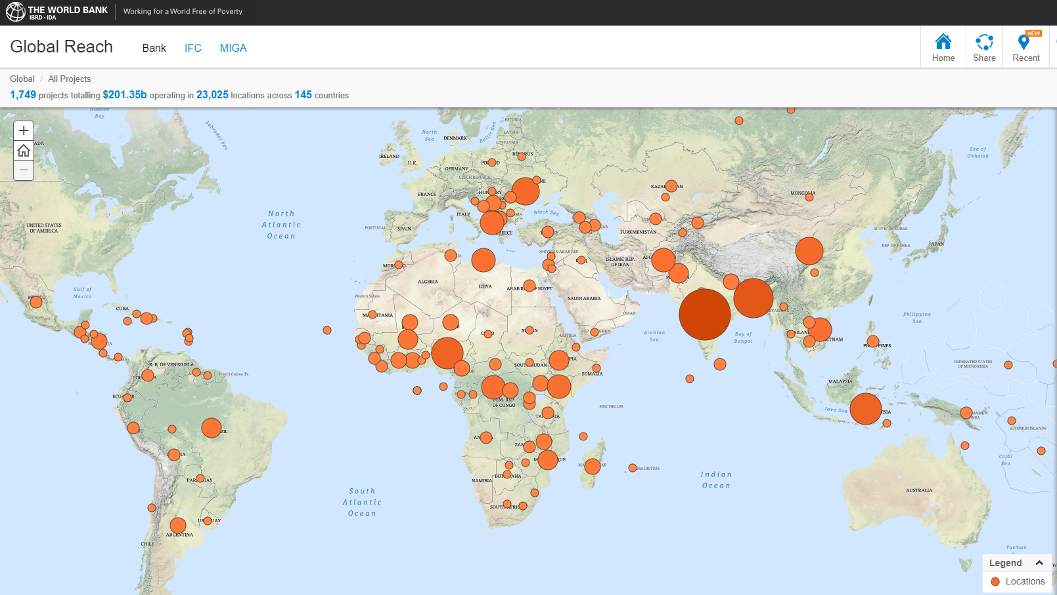

Slide 4
World Bank Procurement Framework
History of Reforms
Fit for Purpose
Value for Money
Alternative Procurement Arrangements
Anti-Corruption
Complaints

Slide 5
Teaching the World Bank’s Procurement Framework

Slide 6
Hub-and-Spoke Shared Teaching
Professor
Recorded Video Online
Reading Online
Professor
Videoconference
Professor

Slide 7
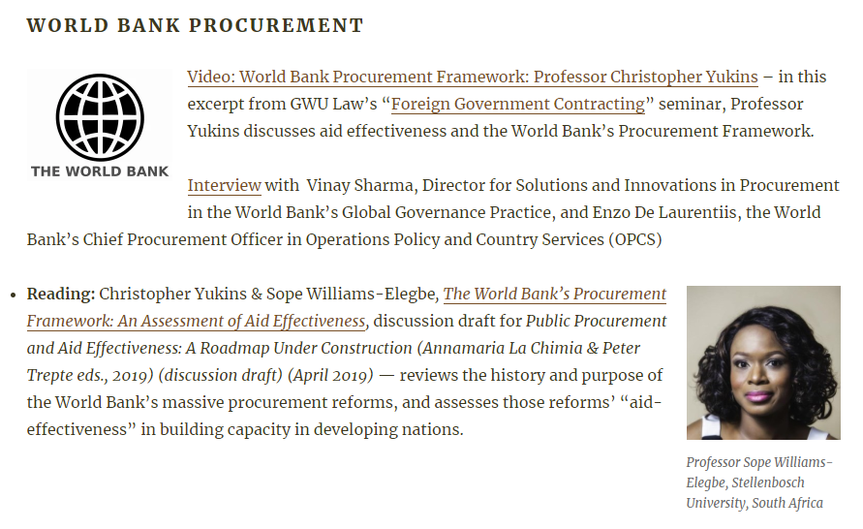
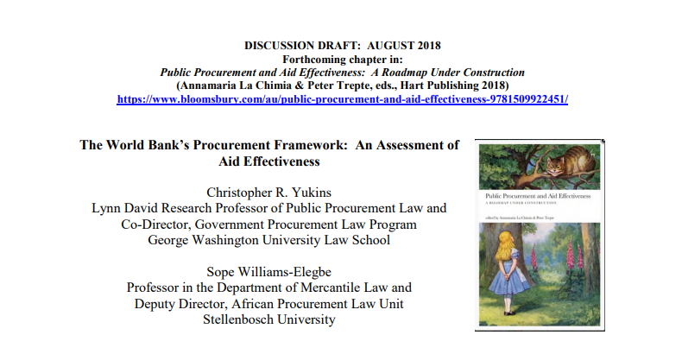

Slide 8
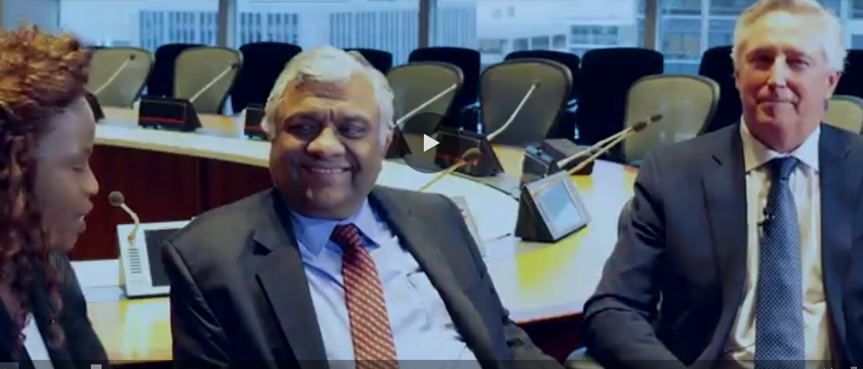
Interview with Vinay Sharma, Director for Solutions and Innovations in Procurement in the World Bank’s Global Governance Practice, and
Enzo De Laurentiis, the World Bank's Chief Procurement Officer in Operations Policy and Country Services (OPCS)

Slide 9
Conclusion
cyukins@law.gwu.edu
sopewe@sun.ac.za

