Slide 1

Introduction – Day 1
Professor Christopher Yukins
George Washington University Law School
The Commercial Law Development Program
Government Procurement Best Practices
August 4-5
Male, Maldives
Hotel Jen

Slide 2
Agenda – Day 1
9:00-9:30 Participant Arrival and Registration
9:30-10:00 Welcoming Remarks and Introductions
Joe Yang, Deputy Chief Counsel, Commercial Law Development Program
Mr. Ibrahim Ameer, Minister of Finance, Maldives Ministry of Finance
10:00-10:15 Tea Break
10:15-10:30 Overview of Maldives Current Procurement Rules
Head of Tender Board ,Maldives Ministry of Finance
10:30-11:15 Overview of UNCITRAL Model Law on Procurement
Speaker: Chris Yukins, The George Washington School of Law
11:15-12:00 International Trends in Government Procurement
Speaker: Chris Yukins, The George Washington School of Law
12:00-12:45 From Planning to Contracting: Government Procurement Life Cycle
Speaker: Elmira Cruz Caisido, Philippines Procurement Policy Board
12:30-13:15 Lunch
13:15-14:00 South Africa’s Procurement Rules
Speaker: Glenn Penfold, Webber Wentzel
14:00-14:45 Tendering Process in U.S. Procurement
Speaker: Chris Yukins, The George Washington School of Law
14:45-15:15 Tea Break
15:15-16:00 The Philippines Procurement Reform Process
Speaker: Elmira Cruz Caisido, Philippines Procurement Policy Board
16:00-16:30 Special Considerations for Island Nations
Speaker: Elmira Cruz Caisido, Philippines Procurement Policy Board
16:45-17:00 Wrap-Up & Review
Facilitator: Joe Yang, CLDP

Slide 3
Agenda – Day 2
9:00-9:15 Day 1 Review
Facilitator: Joe Yang, CLDP
9:15-10:00 Framework Agreements
Speaker: Chris Yukins, The George Washington School of Law
10:00-10:15 Tea Break
10:15-11:30 Ensuring Value in Procurement
Speaker: Chris Yukins, The George Washington School of Law
11:30-12:15 Environmental Sustainability & Procurement
Speaker: Chris Yukins, The George Washington School of Law
12:15-13:15 Lunch
13:15-14:00 E-Procurement & Electronic Reverse Auctions
Speaker: Chris Yukins, The George Washington School of Law
14:00-14:45 Remedies
Speaker: Glenn Penfold, Webber Wentzel
14:45-15:30 Suspension and Debarment
Speaker: Chris Yukins, The George Washington School of Law
15:30-15:45 Tea Break
15:45-16:30 Review of Maldives Act
Panelists:
Head of Tender Board
State Minister, Maldives Ministry of Finance
Chris Yukins, George Washington Law School of Law
Elmira Cruz Caisido, Philippines Procurement Policy Board
Moderator: Glenn Penfold, Webber Wentzel
16:30-17:00 Next Steps & Evaluations
Facilitator: Joe Yang, CLDP

Slide 4
Readings
Christopher R. Yukins, The U.S. Federal Procurement System: An Introduction (UrT 2017), https://papers.ssrn.com/sol3/papers.cfm?abstract_id=3063559.
Steven L. Schooner, Desiderata: Objectives for a System of Government Contract Law (PPLR 2002), https://papers.ssrn.com/sol3/papers.cfm?abstract_id=304620
Christopher R. Yukins, A Versatile Prism: Assessing Procurement Law Through the Principal-Agent Model (PCLJ 2010), https://ssrn.com/abstract=1776295
Johannes Schnitzer & Christopher Yukins, Combatting Corruption in Procurement, in UNOPS: Future-Proofing Procurement 26-29 (2015), https://www.unops.org/SiteCollectionDocuments/ASR/2015-ASR-supplement.pdf

Slide 5

George Washington University
Law School
Traditional and online courses in public procurement, for students in law and management
Government Procurement Law Program, 1960 -

Slide 6
Introduction:
Prof. Christopher Yukins
Nearly 30 years of experience in public procurement
U.S. Justice Department (with Professor Schooner) as trial and appellate attorney
Teaching at George Washington University since 2002
Advisor to U.S. delegation which helped draft the United Nations model procurement law

Slide 7
Procurement Law Centers: 2000
Nottingham.
Washington, D.C.

Slide 8
Procurement Law Centers Today
Stockholm
Vilnius
Copenhagen
Moscow
Northern China
Nottingham.
Munich
Paris
Poland
Beijing
Washington, D.C.
Aix-en-Provence
Galicia
Turin
Rome
Stellenbosch

Slide 9
Overview of the
UNCITRAL Model Law on Procurement
Professor Christopher Yukins
George Washington University Law School

Slide 10
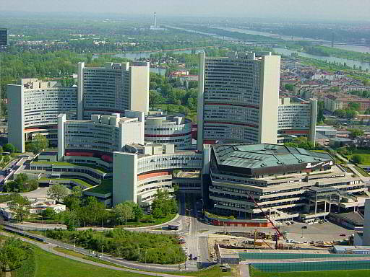


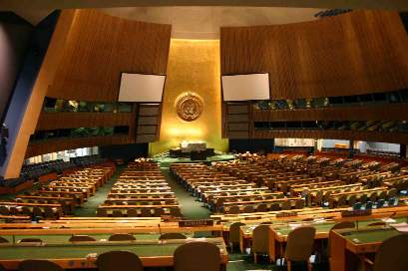
UNCITRAL Working Process
1994
2011

Slide 11


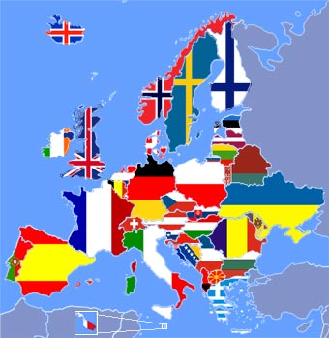

Sources of Revised UNCITRAL Law

Slide 12


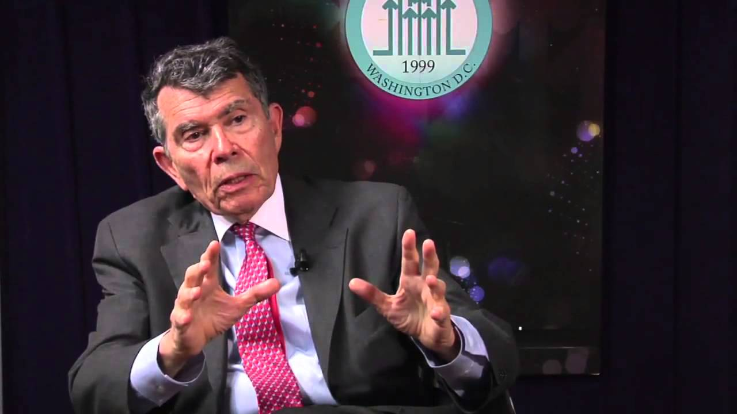
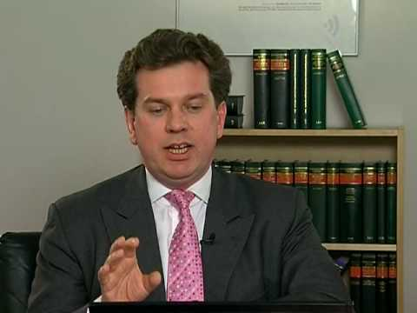

Key Participants

Slide 13

Drafting Issues Which Affected Model Law as a Tool
Should the Model Law be inhibited by stakeholder concerns?
Is the Model Law too complex for use in developing nations?
Should the Model Law be transposed into regulations?
Should contract performance be separately addressed?
13

Slide 14
Overview of UNCITRAL Working Group Issues
Issue | Success
Electronic Publication
Use of Electronic Communications
Reverse Auctions
Suppliers Lists | ??????????
Framework Agreements
Procurement of Services | ???????
Socioeconomic Programs
Remedies and Enforcement
Community Participation
Simplification of Model Law

Slide 15

Implementing the
UNCITRAL Model Law
Maldives – August 2019
Adapted by Professor Christopher Yukins
with the kind permission of:
Caroline Nicholas
UNCITRAL Secretariat

Slide 16


UNCITRAL Model Law
Purpose: a model for modern procurement legislation
Law reform for outdated national systems
Economies in transition
GPA
multilateral framework for government procurement … [to achieve] greater liberalization and expansion of world trade …
Notes:
.

Slide 17
Introduction to UNCITRAL and its work in procurement
What is UNCITRAL?
UN core legal body in commercial law
UNCITRAL members = 60 UN member states (rotating)
40 years old
www.uncitral.org

Slide 18
Introduction to UNCITRAL and its work in procurement
Why did UNCITRAL focus on procurement (1990s)?
Lack of effective procurement
Inadequate/outdated/non-existent legislation
Abuse
Failure to achieve value for money
Notes:
18

Slide 19
Introduction to UNCITRAL and its work in procurement
Why did UNCITRAL focus on procurement?
Amounts involved
10-20 % of GDP, 45% government spending (World Bank, OECD)
Bribery and corruption: < US$ 1 trillion p.a. (Daniel Kaufmann, World Bank Institute)
Systemic corruption = 20-30% of procurement wasted (World Bank)

Slide 20
Introduction to UNCITRAL and its work in procurement
UNCITRAL = model for national procurement law
Minimum standards in procedures
  Cf WTO, like EC Directives
Used by World Bank, MDBs
Most commonly: economies in transition, developing countries
Notes:
If the letter of the Model Law is its text, its spirit is explained in the Guide to Enactment that was published with the Model Law. The Commission published the Guide in the view that the Model Law would be a more effective tool for States modernizing their procurement legislation if background and explanatory information were provided to assist governments in using the Model Law, and particularly for those with limited familiarity with the type of procurement procedures in the Model Law.
The model is flexible and to some extent pragmatic.
Two waves of users – the initial users were ex-Communist countries as economies in transition (ie Eastern European/ex USSR countries – such as Albania, Azerbaijan, Croatia, Estonia, Kazakhstan, Kyrgyzstan, Moldova, Poland, Romania, Uzbekistan); the second wave were developing countries often in MDB financed reform programmes – eg Afghanistan, Bangladesh, Gambia, Ghana, Guyana, Kenya, Madagascar, Malawi (2003), Mauritius, Mongolia, Nepal, Nigeria, Rwanda, Slovakia, Tanzania, Uganda, and Zambia.
Following EC Directives in 2004, some of the initial users went through reforms to use EC Directives. Unlike for treaties, there is no process of informing the UN when a country uses a Model Law, so often we are not aware of who has our Model Laws, nor when Model-Law based legislation is updated (eg Mongolia, Morocco). Also, the text is a template so there is no definition as to whether a law is Model-Law based or not – and language issues exacerbate this problem.

Slide 21
Introduction to UNCITRAL and its work in procurement
Express objectives of the Model Law
    Value for money/economy
    Efficiency
    Participation, competition
    Fair treatment
    Integrity and public confidence
    Transparency
Notes:
Guide to Enactment says (Guide to Enactment, Objectives, para 8):” The objectives of the Model Law, which include maximizing competition, according fair treatment to suppliers and contractors bidding to do Government work, and enhancing transparency and objectivity, are essential for fostering economy and efficiency in procurement and for curbing abuses.” Hence the Model Law puts these latter objectives at the top of the pile and on an equal footing. On the other hand, the EC Directives are expressly not anti-corruption texts.
These are self explanatory, other than “integrity”, which is more a statement that the personnel in procurement will act fairly and ethically. “Economy and efficiency” are now usually called “value for money” and relate to administrative efficiency as well as the ultimate value of the procurement.
These are public sector procurement objectives – the private sector operates quite differently. For example, transparency costs money. Some reformers want to reduce it as a result.

Slide 22
Introduction to UNCITRAL and its work in procurement
Scope of Model Law
A framework text
Subject to other international agreements
Regulates selection of suppliers
  Not procurement planning
  Not contract administration
Now includes “defence” procurement
Notes:
“[The Model Law is] a framework law, to be supplemented by procurement regulations to fill in the procedural details for the procedures authorized by the Model Law … [it addresses] the procedures to be used by procuring entities in selecting the supplier or contractor with whom to enter into a given procurement contract, and consequently it does not address the supporting administrative structure, or other legal questions that might be found in other bodies of law (administrative, contract and judicial-procedure law).” The text “assumes that the enacting State has in place, or will put into place, the proper institutional and bureaucratic structures and human resources necessary to operate the type of procurement procedures provided for in the Model Law,” noting later in the text the importance of adequate training of personnel (Guide to Enactment, A framework law to be supplemented by procurement regulations, paragraph 12).
Importance of other procurement texts – international (UNCAC), plurilateral (WTO GPA), regional (EU, NAFTA, APEC, OECD, FTAA, CAFTA, etc) – they limit the extent that non-procurement objectives can be implemented through procurement. Eg promotion of domestic SMEs/local industry, protection of special industries (eg defence, aerospace), offsets, margins of preference, countertrade, etc.
Most commentators think that procurement planning and contract administration are vital parts of the process, and should be regulated. UNCAC article 9(2), provides that a procurement system must ensure adequate internal control and risk management. Transparency International considers that the other two phases are “increasingly exposed to corruption”: see Transparency International Handbook, “Curbing Corruption in Public Procurement”, 2007, available at http://www.transparency.org/global_priorities/public_contracting/tools_public_contracting/curbing_corruption_in_pp_handbook. Others, including many delegates to UNCITRAL, consider that these are questions of government finances and contracting and should not be part of the procurement law itself. This debate is not closed.

Slide 23
Introduction to UNCITRAL and its work in procurement
Examples of reforms (Chapter I)
Stronger publicity requirements (5,6, 22)
Consolidated communications rules (7)
Stricter rules limiting national participation (8)
Consolidated rules on qualification (9)
  Enhanced objectivity
  Individual expertise for all procurement, not just services
  Removal of reputation as criterion
Notes:
Translating UNCITRAL’s objectives into rules means, for example:
Solicitation documents in open tendering proceedings to contain at a minimum all important information for the procurement (ie information that suppliers would need to participate in the procedure):
Re tenders: instructions for submitting tenders (including language, submission deadline and length of validity); details of the items to be procured (including quality characteristics and technical specifications), the time frame for supply; evaluation and qualification criteria; whether alternatives to the characteristics of the items will be permitted; whether suppliers can submit tenders for part only of the procurement; how to express and formulate the tender price including currency; whether tender securities will be required and whether withdrawal of tenders without forfeiture of tender security is permitted; how further information of clarification can be obtained (with details of the procuring entity’s contact point) and whether meetings of suppliers are envisaged; procedures for tender opening, details of governing law, the fact of the right to challenge procurement decisions, any reservation of a right to reject all tenders and other formalities and requirements
The manner of entry into force of the ultimate procurement contract (Articles 13 and 36)
Any prior reservation of the right to reject all tenders or other bids (Article 12)
Any supplier qualification and pre-qualification requirements (Articles 6 and 7)
Any requirements regarding form and means of communication and submission of tenders or other offers (requiring non-discriminatory methods of communication (Article 9)), the language of documents for the procurement (Article 17)
All information on evaluation and award criteria (Articles 25, 27 and 38, and parts of Chapter V regarding open procedures)
And later on - disclosure to all participants of significant further information provided during the procurement at the request of one participant (article 28).
However, rules are just words on the page.
Promoting best practice means training, peer reviews, but also ensuring adequate resources. Codes of conduct – intended to be a statement of minimum behaviour standards, but normally become the maximum conduct and often conduct falls short.
The fish rots from the head
Integrity pacts – used but many question their validity
If scandals or excess costs are exposed, will the public shrug its shoulders and say that’s life, or will there be pressure to change?

Slide 24
Introduction to UNCITRAL and its work in procurement
Examples of reforms (Chapter I)
More robust rules on descriptions (10)
New evaluation criteria article (11)
New rules on estimating value (12)
Strengthened rules on modifications (15)
New rules on abnormally low tenders (19)
Revised confidentiality provisions (23)
More robust provisions on record (24)
Notes:
Principles based systems – choose suppliers in non-discriminatory and fair manner; be transparent, etc (see UNCITRAL objectives)
Rules-based systems – do this, don’t to that – risk is that blindly following the rules won’t guarantee respect for underlying principles and the rules would need to be incredibly detailed
Outcome-based systems – so long as the results are value for money and there is no corruption, do what you like – too unpredictable
UNCITRAL is a largely principles-based system, but implements the principles through a framework of fairly flexible rules.
Examples: select suppliers in a non-discriminatory manner (principle), or set out rules to say all suppliers must be included in a procurement unless (a) they are unqualified (reference to permissible criteria to decide qualification) or (b) their bids are unresponsive (reference to rules to identify responsive bids).
Evaluation criteria: UNCITRAL requires criteria, their relative weights and their manner of application to be disclosed. This means that suppliers can see how their bids are evaluated – price against a declared basket of non-price criteria (more flexibility is given for non-quantifiable procurement). Compare this with the US system, where only the criteria and which is the most important need to be disclosed. In the US, if a contract is awarded on the basis of price and previous experience, and the suppliers know that price is more important, the loser will have absolutely no idea why he lost. The Europeans are aghast at the US system, but the US considers the EU system too restrictive. They don’t comment publicly on the UNCITRAL system which from some points of view is even more restrictive.

Slide 25
Introduction to UNCITRAL and its work in procurement
Examples of reforms – anti corruption
Stronger rules on inducements (20)
Requirement for code of conduct (25)
Chapter II – consolidation of 1994 provisions
Part I – conditions for use
Part II – consolidated rules on solicitation
Notes:
Translating UNCITRAL’s objectives into rules means, for example:
Solicitation documents in open tendering proceedings to contain at a minimum all important information for the procurement (ie information that suppliers would need to participate in the procedure):
Re tenders: instructions for submitting tenders (including language, submission deadline and length of validity); details of the items to be procured (including quality characteristics and technical specifications), the time frame for supply; evaluation and qualification criteria; whether alternatives to the characteristics of the items will be permitted; whether suppliers can submit tenders for part only of the procurement; how to express and formulate the tender price including currency; whether tender securities will be required and whether withdrawal of tenders without forfeiture of tender security is permitted; how further information of clarification can be obtained (with details of the procuring entity’s contact point) and whether meetings of suppliers are envisaged; procedures for tender opening, details of governing law, the fact of the right to challenge procurement decisions, any reservation of a right to reject all tenders and other formalities and requirements
The manner of entry into force of the ultimate procurement contract (Articles 13 and 36)
Any prior reservation of the right to reject all tenders or other bids (Article 12)
Any supplier qualification and pre-qualification requirements (Articles 6 and 7)
Any requirements regarding form and means of communication and submission of tenders or other offers (requiring non-discriminatory methods of communication (Article 9)), the language of documents for the procurement (Article 17)
All information on evaluation and award criteria (Articles 25, 27 and 38, and parts of Chapter V regarding open procedures)
And later on - disclosure to all participants of significant further information provided during the procurement at the request of one participant (article 28).
However, rules are just words on the page.
Promoting best practice means training, peer reviews, but also ensuring adequate resources. Codes of conduct – intended to be a statement of minimum behaviour standards, but normally become the maximum conduct and often conduct falls short.
The fish rots from the head
Integrity pacts – used but many question their validity
If scandals or excess costs are exposed, will the public shrug its shoulders and say that’s life, or will there be pressure to change?

Slide 26
Introduction to UNCITRAL and its work in procurement
No change in the text as regards
  Local community participation
  Suppliers’ lists
  Stages of procurement covered
  PPPs/concessions
  Thresholds and low-value procurement

Slide 27
Introduction to UNCITRAL and its work in procurement
Procurement methods (updated)
Primacy of tendering
Optional methods
Justify other methods
  By reference to conditions for use and
  Guidance to assist in what is appropriate
  eg for complex/urgent/low value procurement
Benefits of e-procurement in managing discretion
Notes:
Some systems are moving away from tendering as a primary procurement method. Others consider that even if it is not necessarily administratively efficient and the result is that the prices paid by Governments are higher than could be achieved, those costs are outweighed by the benefits of a tendering-based system (avoiding cronyism, corruption – both in terms of diverted money and unnecessary projects). In addition, the systems moving away from tendering are systems with higher levels of capacity to operate negotiated procurement. The Model Law here is not at the forefront of procurement practice in the views of some – we will look into this in more detail when we consider procurement reforms.
Another point to recall here is the role of UNCITRAL – harmonization and promotion of best practice. While there may be some difficulties in establishing universal rules, UNCITRAL is emphatically not intended to lead the way in innovative techniques. These techniques need to be observed in practice before they can be assessed with sufficient objectivity to decide whether they are good innovations or not. Some UNCITRAL delegations do not accept this view and are pushing for much more in-depth reforms.
A significant criticism of the Model Law was that it did not give very helpful guidance on when to enact or use which procurement methods other than tendering – there was no hierarchy to indicate which were more or less competitive or transparent methods. The Guide (commentary to article 19 of the 1994 text) provided regarding two-stage tendering, request for proposals, and competitive negotiation: “an enacting State need not necessarily enact each of the three methods for the common circumstances referred to in article 19 or even enact more than one of them. An enacting State might decide not to enact more than one of the methods in view of the uncertainty likely to be encountered by procuring entities in trying to discern the most appropriate method from among two or three similar methods. In deciding which of the three methods to enact, a decisive criterion for the enacting State might be that, from the standpoint of transparency, competition and objectivity in the selection process, two-stage tendering and request for proposals are likely to offer more than competitive negotiation, with its high degree of flexibility and possibly higher risk of corruption. At least one of the three methods should be enacted, since the cases in question might otherwise only be dealt with through the least competitive of the procurement methods, single-source procurement.
The enacting State also might decide not to extend to procurement of services the methods of procurement set forth in article 19. The rationale behind such a decision could be a determination that the principal method for procurement of services (chapter IV) already contains procedures that are in many respects similar to the procedures for the methods of procurement set forth in article 19.” Some observers thought that there should be more articulate discussions but others that doing so might accuse some States of corruption and these were decisions that should be left to the States themselves.
Another criticism of the 1994 text was that the conditions for use of and guidance on some particular methods was simply unrealistic. For example, the guidance on the use of restricted tendering (Article 20) said: “Article 20 has been included in order to enable the procuring entity, in exceptional cases, to solicit participation only from a limited number of suppliers or contractors. Inclusion of this method in the Model Law is not intended to encourage its use. On the contrary, strict and narrow conditions for use have been included for restricted tendering since the unjustified resort to that method of procurement would impair fundamentally the objectives of the Model Law.” But the conditions were not precisely crafted and use of the method could apply to almost any procurement - a limited number of suppliers or contractors being available (though all had to be invited), and low value of the procurement contract meaning that open tendering was disproportionately costly. The criticisms of the first condition were essentially how did the procuring entity know in many cases (no advertisement to elicit interest was required) and the second was not subject to any threshold, and was subjective.

Slide 28
Introduction to UNCITRAL and its work in procurement
New/revised procurement methods
Request for proposals – complex procurement
  Without negotiation (two-envelope system)
  With dialogue
  With consecutive negotiations
Replace separate services provisions (1994)
NB changes to qualification provisions
Applying evaluation criteria
Options – states need not enact them all

Slide 29
Introduction to UNCITRAL and its work in procurement
Request for proposals with dialogue
Akin to EU Competitive Dialogue
  More transparency requirements & structure
  Considered as alternative to two-stage tendering
  Conditions for use
Possibility for pre-selection (new)
Evaluation criteria in priority order
No changes to evaluation criteria
No ability to reject responsive solutions, qualified (pre-selected) suppliers
Notes:
Recall introductory comments – some systems are moving away from tendering as a primary procurement method. Others consider that even if it is not necessarily administratively efficient and the result is that the prices paid by Governments are higher than could be achieved, those costs are outweighed by the benefits of a tendering-based system (avoiding cronyism, corruption – both in terms of diverted money and unnecessary projects). In addition, the systems moving away from tendering are systems with higher levels of capacity to operate negotiated procurement. The Model Law here is not at the forefront of procurement practice in the views of some – we will look into this in more detail when we consider procurement reforms.
Another point to recall here is the role of UNCITRAL – harmonization and promotion of best practice. While there may be some difficulties in establishing universal rules, UNCITRAL is emphatically not intended to lead the way in innovative techniques. These techniques need to be observed in practice before they can be assessed with sufficient objectivity to decide whether they are good innovations or not. Some UNCITRAL delegations do not accept this view and are pushing for much more in-depth reforms.
A significant criticism of the Model Law was that it did not give very helpful guidance on when to enact or use which procurement methods other than tendering – there was no hierarchy to indicate which were more or less competitive or transparent methods. The Guide (commentary to article 19 of the 1994 text) provided regarding two-stage tendering, request for proposals, and competitive negotiation: “an enacting State need not necessarily enact each of the three methods for the common circumstances referred to in article 19 or even enact more than one of them. An enacting State might decide not to enact more than one of the methods in view of the uncertainty likely to be encountered by procuring entities in trying to discern the most appropriate method from among two or three similar methods. In deciding which of the three methods to enact, a decisive criterion for the enacting State might be that, from the standpoint of transparency, competition and objectivity in the selection process, two-stage tendering and request for proposals are likely to offer more than competitive negotiation, with its high degree of flexibility and possibly higher risk of corruption. At least one of the three methods should be enacted, since the cases in question might otherwise only be dealt with through the least competitive of the procurement methods, single-source procurement.
The enacting State also might decide not to extend to procurement of services the methods of procurement set forth in article 19. The rationale behind such a decision could be a determination that the principal method for procurement of services (chapter IV) already contains procedures that are in many respects similar to the procedures for the methods of procurement set forth in article 19.” Some observers thought that there should be more articulate discussions but others that doing so might accuse some States of corruption and these were decisions that should be left to the States themselves.
Another criticism of the 1994 text was that the conditions for use of and guidance on some particular methods was simply unrealistic. For example, the guidance on the use of restricted tendering (Article 20) said: “Article 20 has been included in order to enable the procuring entity, in exceptional cases, to solicit participation only from a limited number of suppliers or contractors. Inclusion of this method in the Model Law is not intended to encourage its use. On the contrary, strict and narrow conditions for use have been included for restricted tendering since the unjustified resort to that method of procurement would impair fundamentally the objectives of the Model Law.” But the conditions were not precisely crafted and use of the method could apply to almost any procurement - a limited number of suppliers or contractors being available (though all had to be invited), and low value of the procurement contract meaning that open tendering was disproportionately costly. The criticisms of the first condition were essentially how did the procuring entity know in many cases (no advertisement to elicit interest was required) and the second was not subject to any threshold, and was subjective.

Slide 30
Introduction to UNCITRAL and its work in procurement
Request for proposals with dialogue
Issues:
Commercial sector defining requirements?
Can procuring entity judge proposals?
Other capacity issues
No changes to evaluation criteria rule is more restrictive than two-stage tendering
Is it realistic to keep all suppliers participating?
No post-BAFO negotiations (?)
Notes:
Recall introductory comments – some systems are moving away from tendering as a primary procurement method. Others consider that even if it is not necessarily administratively efficient and the result is that the prices paid by Governments are higher than could be achieved, those costs are outweighed by the benefits of a tendering-based system (avoiding cronyism, corruption – both in terms of diverted money and unnecessary projects). In addition, the systems moving away from tendering are systems with higher levels of capacity to operate negotiated procurement. The Model Law here is not at the forefront of procurement practice in the views of some – we will look into this in more detail when we consider procurement reforms.
Another point to recall here is the role of UNCITRAL – harmonization and promotion of best practice. While there may be some difficulties in establishing universal rules, UNCITRAL is emphatically not intended to lead the way in innovative techniques. These techniques need to be observed in practice before they can be assessed with sufficient objectivity to decide whether they are good innovations or not. Some UNCITRAL delegations do not accept this view and are pushing for much more in-depth reforms.
A significant criticism of the Model Law was that it did not give very helpful guidance on when to enact or use which procurement methods other than tendering – there was no hierarchy to indicate which were more or less competitive or transparent methods. The Guide (commentary to article 19 of the 1994 text) provided regarding two-stage tendering, request for proposals, and competitive negotiation: “an enacting State need not necessarily enact each of the three methods for the common circumstances referred to in article 19 or even enact more than one of them. An enacting State might decide not to enact more than one of the methods in view of the uncertainty likely to be encountered by procuring entities in trying to discern the most appropriate method from among two or three similar methods. In deciding which of the three methods to enact, a decisive criterion for the enacting State might be that, from the standpoint of transparency, competition and objectivity in the selection process, two-stage tendering and request for proposals are likely to offer more than competitive negotiation, with its high degree of flexibility and possibly higher risk of corruption. At least one of the three methods should be enacted, since the cases in question might otherwise only be dealt with through the least competitive of the procurement methods, single-source procurement.
The enacting State also might decide not to extend to procurement of services the methods of procurement set forth in article 19. The rationale behind such a decision could be a determination that the principal method for procurement of services (chapter IV) already contains procedures that are in many respects similar to the procedures for the methods of procurement set forth in article 19.” Some observers thought that there should be more articulate discussions but others that doing so might accuse some States of corruption and these were decisions that should be left to the States themselves.
Another criticism of the 1994 text was that the conditions for use of and guidance on some particular methods was simply unrealistic. For example, the guidance on the use of restricted tendering (Article 20) said: “Article 20 has been included in order to enable the procuring entity, in exceptional cases, to solicit participation only from a limited number of suppliers or contractors. Inclusion of this method in the Model Law is not intended to encourage its use. On the contrary, strict and narrow conditions for use have been included for restricted tendering since the unjustified resort to that method of procurement would impair fundamentally the objectives of the Model Law.” But the conditions were not precisely crafted and use of the method could apply to almost any procurement - a limited number of suppliers or contractors being available (though all had to be invited), and low value of the procurement contract meaning that open tendering was disproportionately costly. The criticisms of the first condition were essentially how did the procuring entity know in many cases (no advertisement to elicit interest was required) and the second was not subject to any threshold, and was subjective.

Slide 31
Introduction to UNCITRAL and its work in procurement
Other main reforms
  e-procurement
  Framework agreements
  Evaluation of tenders – horizontal considerations
  Remedies and enforcement
Notes:
Recall introductory comments – some systems are moving away from tendering as a primary procurement method. Others consider that even if it is not necessarily administratively efficient and the result is that the prices paid by Governments are higher than could be achieved, those costs are outweighed by the benefits of a tendering-based system (avoiding cronyism, corruption – both in terms of diverted money and unnecessary projects). In addition, the systems moving away from tendering are systems with higher levels of capacity to operate negotiated procurement. The Model Law here is not at the forefront of procurement practice in the views of some – we will look into this in more detail when we consider procurement reforms.
Another point to recall here is the role of UNCITRAL – harmonization and promotion of best practice. While there may be some difficulties in establishing universal rules, UNCITRAL is emphatically not intended to lead the way in innovative techniques. These techniques need to be observed in practice before they can be assessed with sufficient objectivity to decide whether they are good innovations or not. Some UNCITRAL delegations do not accept this view and are pushing for much more in-depth reforms.
A significant criticism of the Model Law was that it did not give very helpful guidance on when to enact or use which procurement methods other than tendering – there was no hierarchy to indicate which were more or less competitive or transparent methods. The Guide (commentary to article 19 of the 1994 text) provided regarding two-stage tendering, request for proposals, and competitive negotiation: “an enacting State need not necessarily enact each of the three methods for the common circumstances referred to in article 19 or even enact more than one of them. An enacting State might decide not to enact more than one of the methods in view of the uncertainty likely to be encountered by procuring entities in trying to discern the most appropriate method from among two or three similar methods. In deciding which of the three methods to enact, a decisive criterion for the enacting State might be that, from the standpoint of transparency, competition and objectivity in the selection process, two-stage tendering and request for proposals are likely to offer more than competitive negotiation, with its high degree of flexibility and possibly higher risk of corruption. At least one of the three methods should be enacted, since the cases in question might otherwise only be dealt with through the least competitive of the procurement methods, single-source procurement.
The enacting State also might decide not to extend to procurement of services the methods of procurement set forth in article 19. The rationale behind such a decision could be a determination that the principal method for procurement of services (chapter IV) already contains procedures that are in many respects similar to the procedures for the methods of procurement set forth in article 19.” Some observers thought that there should be more articulate discussions but others that doing so might accuse some States of corruption and these were decisions that should be left to the States themselves.
Another criticism of the 1994 text was that the conditions for use of and guidance on some particular methods was simply unrealistic. For example, the guidance on the use of restricted tendering (Article 20) said: “Article 20 has been included in order to enable the procuring entity, in exceptional cases, to solicit participation only from a limited number of suppliers or contractors. Inclusion of this method in the Model Law is not intended to encourage its use. On the contrary, strict and narrow conditions for use have been included for restricted tendering since the unjustified resort to that method of procurement would impair fundamentally the objectives of the Model Law.” But the conditions were not precisely crafted and use of the method could apply to almost any procurement - a limited number of suppliers or contractors being available (though all had to be invited), and low value of the procurement contract meaning that open tendering was disproportionately costly. The criticisms of the first condition were essentially how did the procuring entity know in many cases (no advertisement to elicit interest was required) and the second was not subject to any threshold, and was subjective.

Slide 32
Introduction to UNCITRAL and its work in procurement
Details of UNCITRAL’s work on procurement
http://www.uncitral.org/uncitral/en/commission/working_groups/1Procurement.html
caroline.nicholas@uncitral.org

Slide 33
International Trends in Government Procurement
Professor Christopher Yukins
George Washington University Law School

Slide 34
Context for emerging trends

Slide 35
Desiderata, Goals, Constraints?
Transparency
Integrity
Competition
Uniformity
Risk Avoidance
Wealth Distribution(*)
Best value
Efficiency (administrative)
Customer Satisfaction

Slide 36
Risks of Corruption
Reputation
Performance
Fiduciary

Slide 37
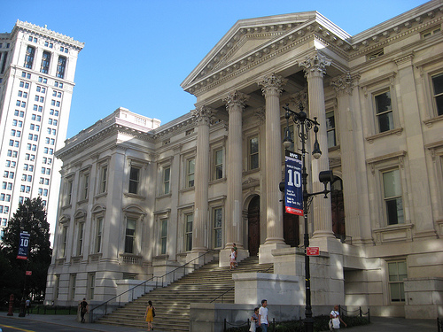
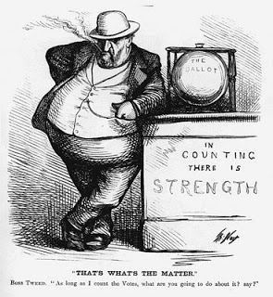
Notes:
FAR 2.101

Slide 38
Principal-Agent Model
MONITORING
Agent 1
CO
Agent 2
Contractor
Purchase
Principal
BONDING (PUNISHING)
Notes:
Bribery?
Gratuity?
Personal conflict of interest?
Organizational conflict of interest?
“Kickback” to vendor?
Fraud?
Collusion?
Other forms of market barriers?

Slide 39
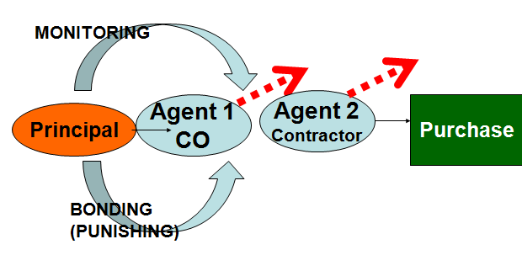
Processes
Rules
Qualification
Responsiveness
Planning
Competition - Methods
Contract
Provisions

Slide 40




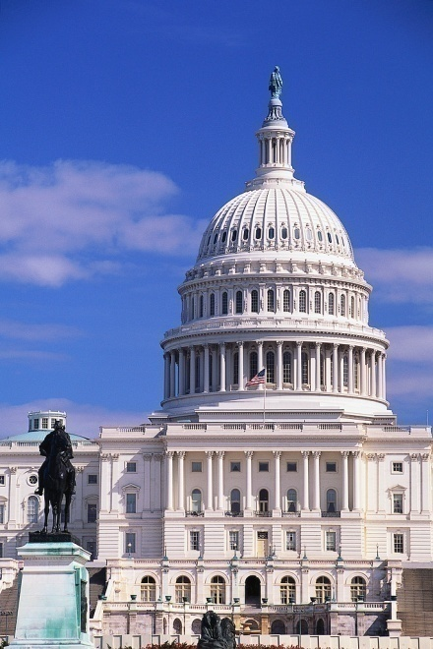



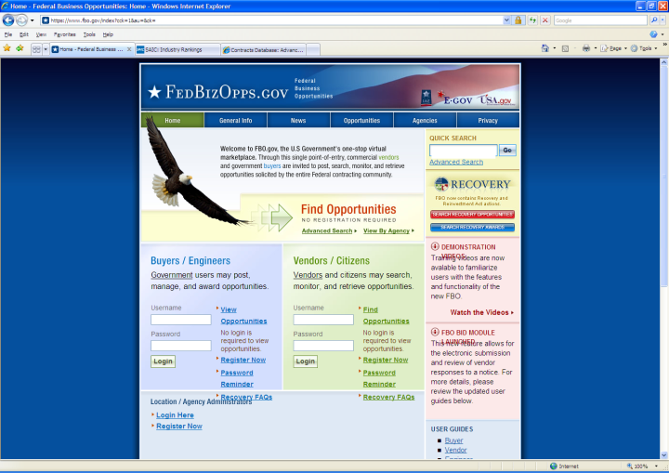

Tools for Fighting Corruption
Corporate Compliance
Tender Boards
Audits
Suspension / Debarment
Ethics
Oversight
Prosecution
Bid Challenges
Transparency

Slide 41
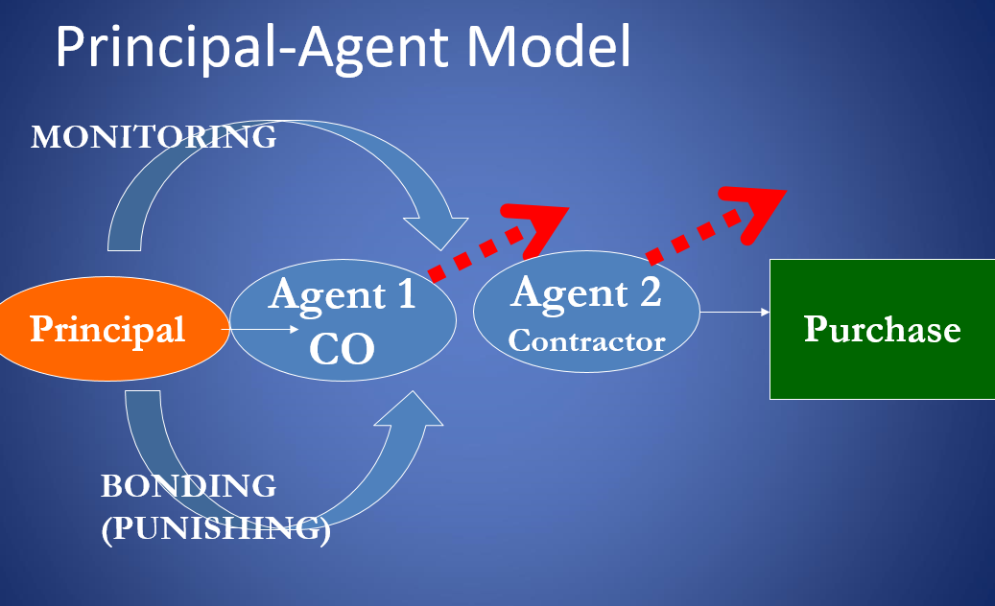
Tools for Fighting Corruption
Corporate Compliance
Tender Boards
Audits
Suspension / Debarment
Ethics
Oversight
Prosecution
Bid Challenges
Transparency

Slide 42

UN Convention Against Corruption (Art. 9)
Public Information
Advance award criteria and publication
Objective and predetermined criteria for award
Bid protest and appeal
Measures to control procurement personnel – e.g., rules and codes
Transparency, including in budgeting and accounting

Slide 43
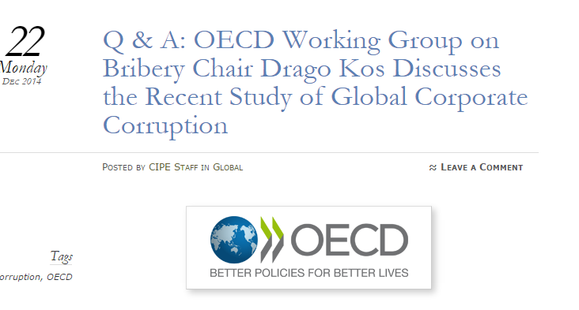
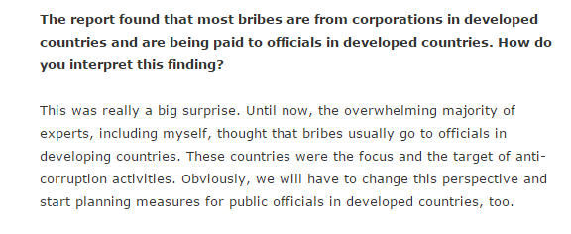

Slide 44
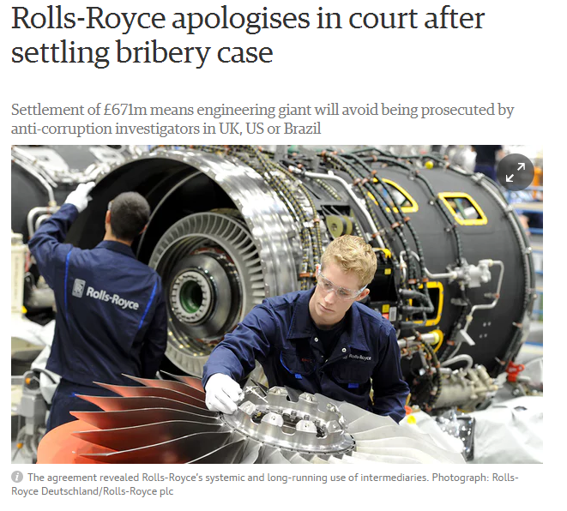
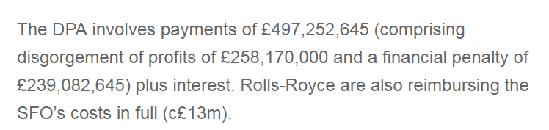

Notes:
https://www.sfo.gov.uk/cases/rolls-royce-plc/

Slide 45

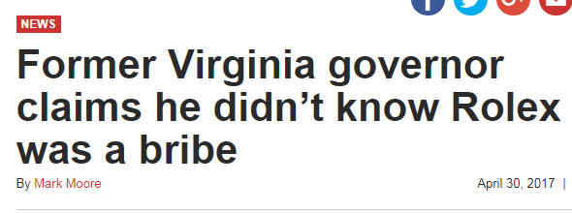
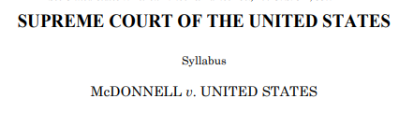
McDonnell and his wife Maureen were convicted of taking golf clubs, luxury vacations, the use of a Ferrari, designer clothes and the $6,000 Rolex watch from Jonnie Williams, a Richmond businessman who was trying to get approval for a dietary supplement from the state.
He said he wouldn’t accept such gifts if he was governor now, but took them at the time because he felt he deserved it.
“Having a family vacation after working 15 hours a day at a nice lake resort with my family, you know, I appreciated that,” McDonnell said.
He chalked up his efforts to set up meetings so Williams could meet state officials as just a part of his duties as governor.
“My job was just to connect people with government. And I considered it a routine part of what I did – for job creation and just regular constituent service,” the Republican told “60 Minutes.”
The question remains whether merely setting up a meeting, hosting an event, or calling another official qualifies as a decision or action on any of those three questions or matters. . . .. Something more is required: §201(a)(3) specifies that the public official must make a decision or take an action on the question or matter, or agree to do so.

Slide 46


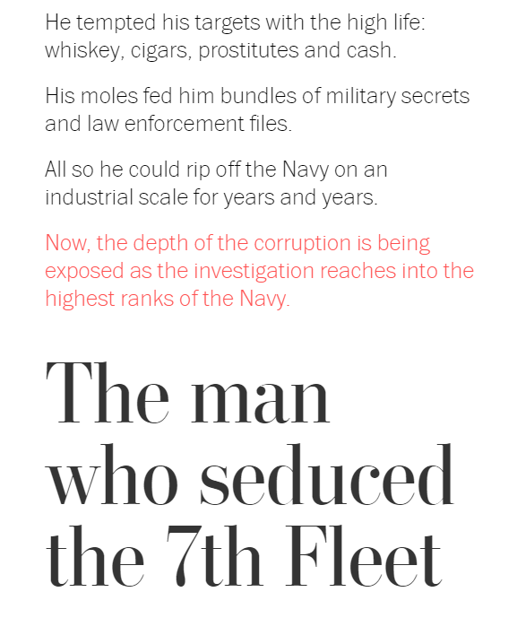

Slide 47
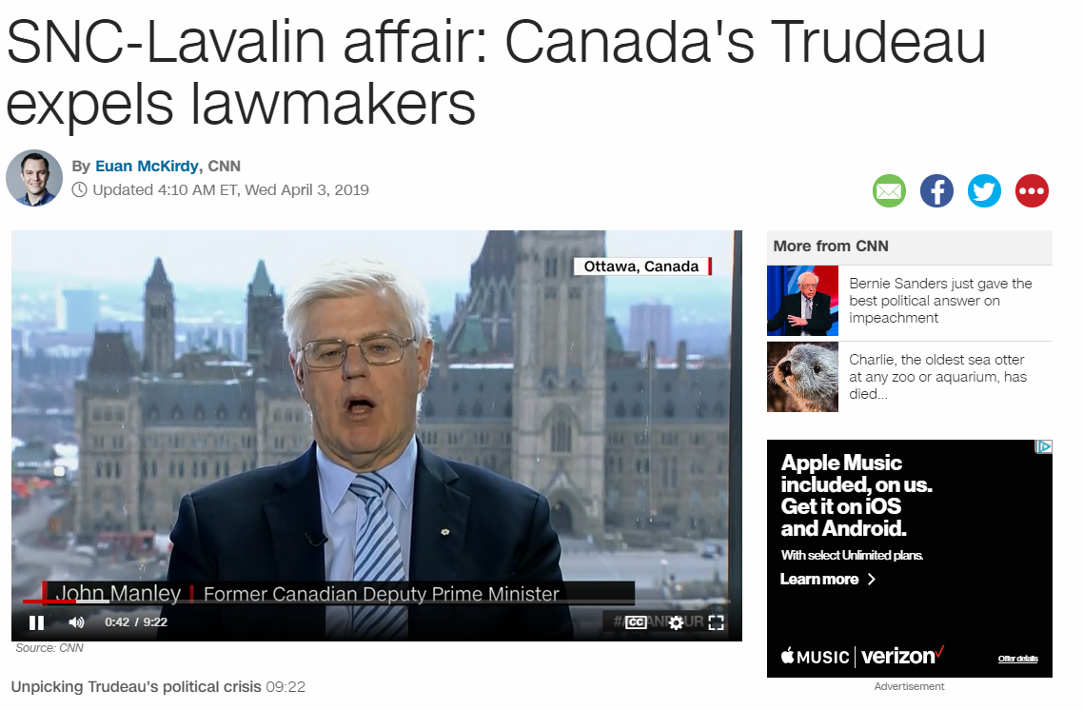
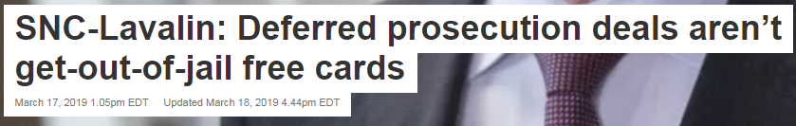

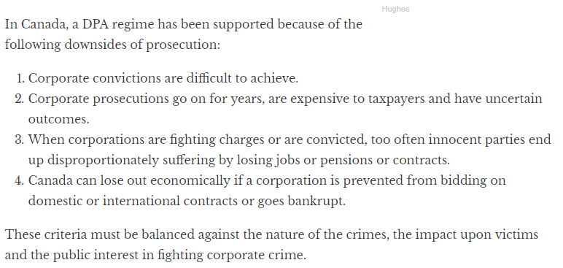

Slide 48
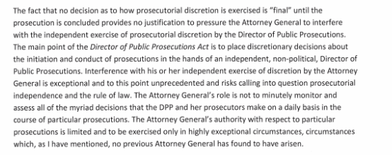
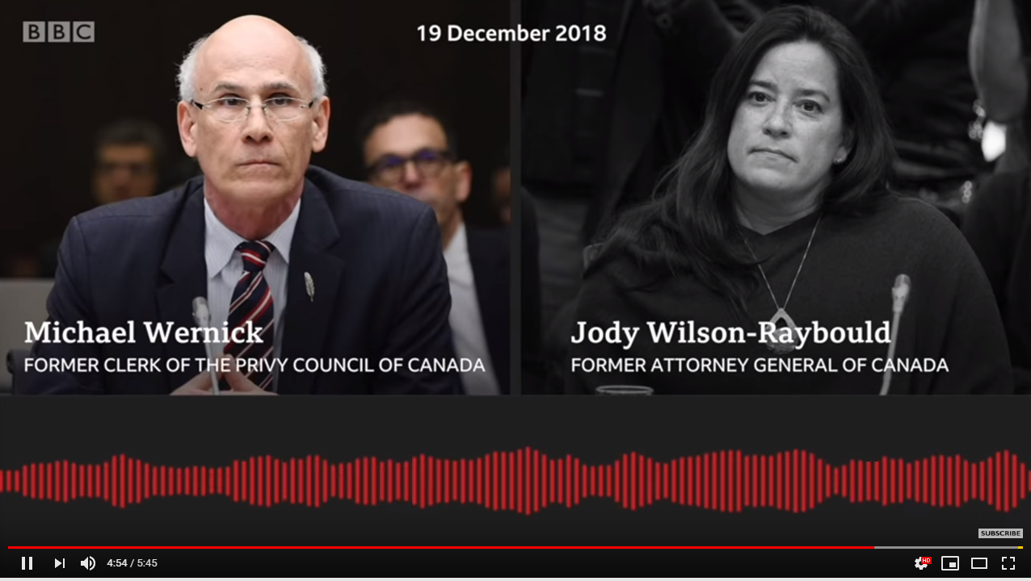

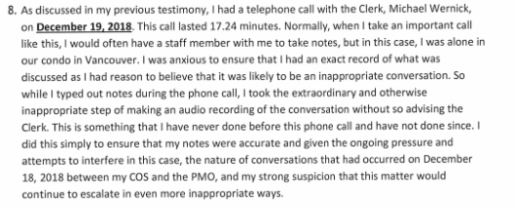
SNC-Lavalin
Deferred prosecution agreement must be:
  In public interest
  Proportionate
https://www.youtube.com/watch?v=OOR4WWcYQPI

Slide 49
Corporate Compliance

Slide 50



1. Standards and procedures | √ | √ | √ | √
2. Knowledgeable leadership |  | √ | √ | √
3. Exclude risky personnel | √ | √ | √ | √
4. Training | √ | √ | √ | √
5. Monitor, evaluate, reporting hotline | √ | √ | √ | √
6. Incentives and discipline | √ | √ | √ | √
7. Adjust program to risk | √ | √ | √ | √
Victim Compensation?
Notes:
Sources:
Serious Fraud Office, Approach of the Serious Fraud Office to Dealing with Overseas Corruption, at 1 (2009), available at http://www.sfo.gov.uk/media/28313/approach%20of%20the%20sfo%20to%20dealing%20with%20overseas%20corruption.pdf.
Lord Bach, Letter to Lord Henley re: Bribery Bill -- “Adequate Procedures’ Guidance (Dec. 2009), http://www.justice.gov.uk/publications/docs/bach-letter-adequate-procedures-guidance.pdf.
Ministry of Justice, Consultation on Guidance About Commercial Organisations Preventing Bribery (Section 9 of the Bribery Act 2010)

Slide 51
Anti-Fraud

Slide 52
FALSE CLAIMS ACT: CIVIL
(& CRIMINAL)
Whistleblower
Recovers 10-30%
Plus Atty. Fees
DAMAGES:
1. Triple the amount of damages suffered by the United States PLUS
2. A civil forfeiture of between $10,781.40 and $21,562.80 per false claim; damages can be reduced in some cases from triple to double
Basis for Liability
  1. Submission of “claim for payment” to the federal government;
  2. The claim is “false” or “fraudulent;” and
  3. The defendant acted “knowingly.”
Does Not Mean Specific Intent . . .
1. Actual knowledge;
2. Acts in deliberate ignorance of the truth or falsity of the information; or
3. Acts in reckless disregard of the truth or falsity.
Notes:
Civil False Claims Act, 31 U.S.C. § 3729
Any person who knowingly presents a false or fraudulent claim for payment or approval to an officer or employee of the United States government, or conspires to defraud the government by getting a false claim paid, is subject to a civil penalty of at least $5,000, but not more than $10,000, plus three times the amount of damages which the government sustained as a result of the false claim.
CRIMINAL:
Section 287. False, fictitious or fraudulent claims Whoever makes or presents to any person or officer in the civil, military, or naval service of the United States, or to any department or agency thereof, any claim upon or against the United States, or any department or agency thereof, knowing such claim to be false, fictitious, or fraudulent, shall be imprisoned not more than five years and shall be subject to a fine in the amount provided in this title.

Slide 53
Trade Agreements

Slide 54
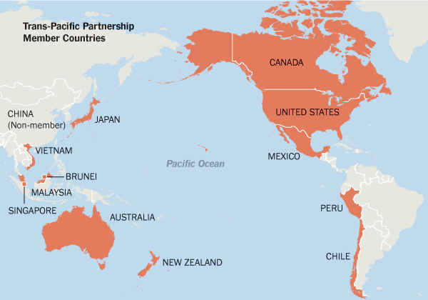
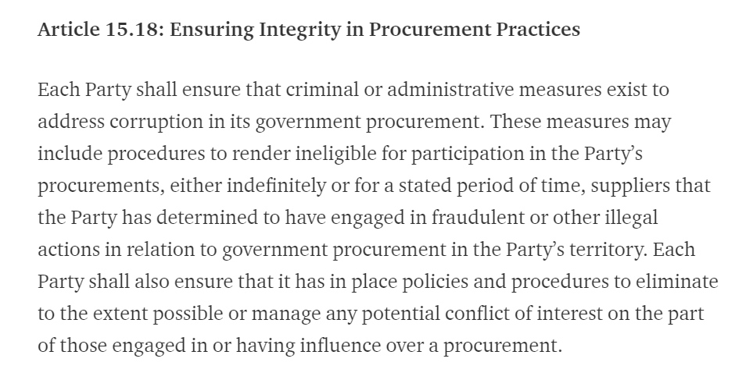
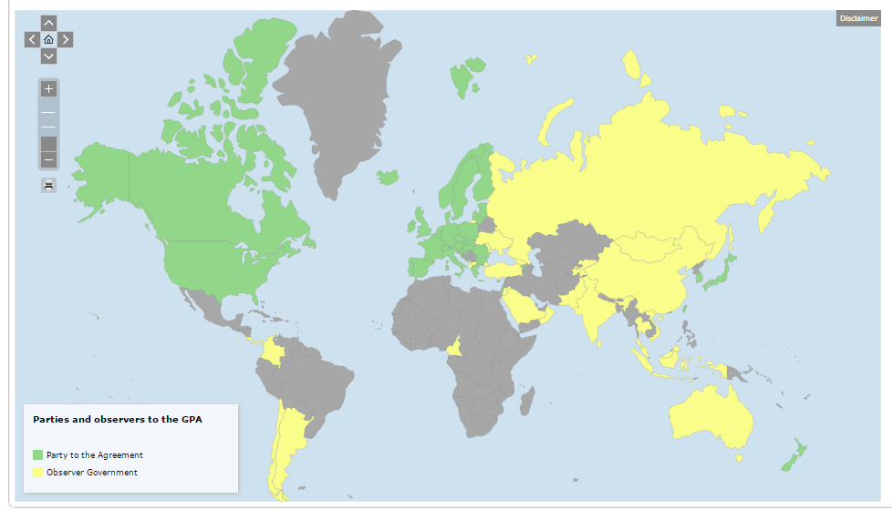
Trade Agreements
WTO Government Procurement Agreement

Slide 55
World Bank Reforms

Slide 56
Competing Forces on Country Systems
Multinationals &
Funders
Developing Nations (and History)

Slide 57
Potential Solutions
Country System
GPA
Domestic Challenges
Investor-State Disputes
Capacity Development
World Bank Challenges
Debarment

Slide 58
International Debates Over Anti-Corruption Measures

Slide 59
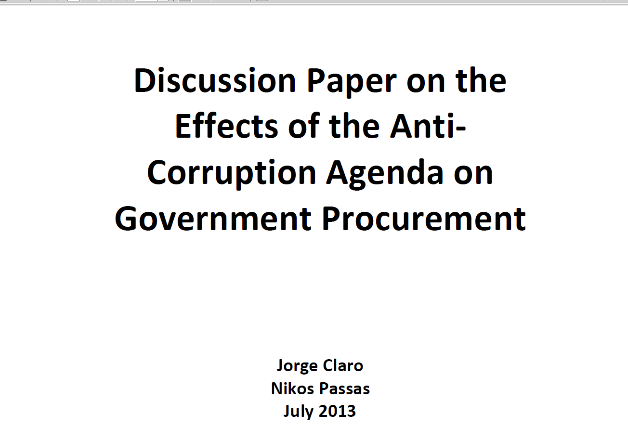




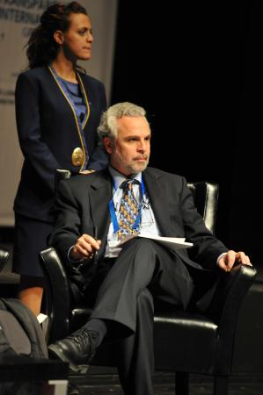


Slide 60
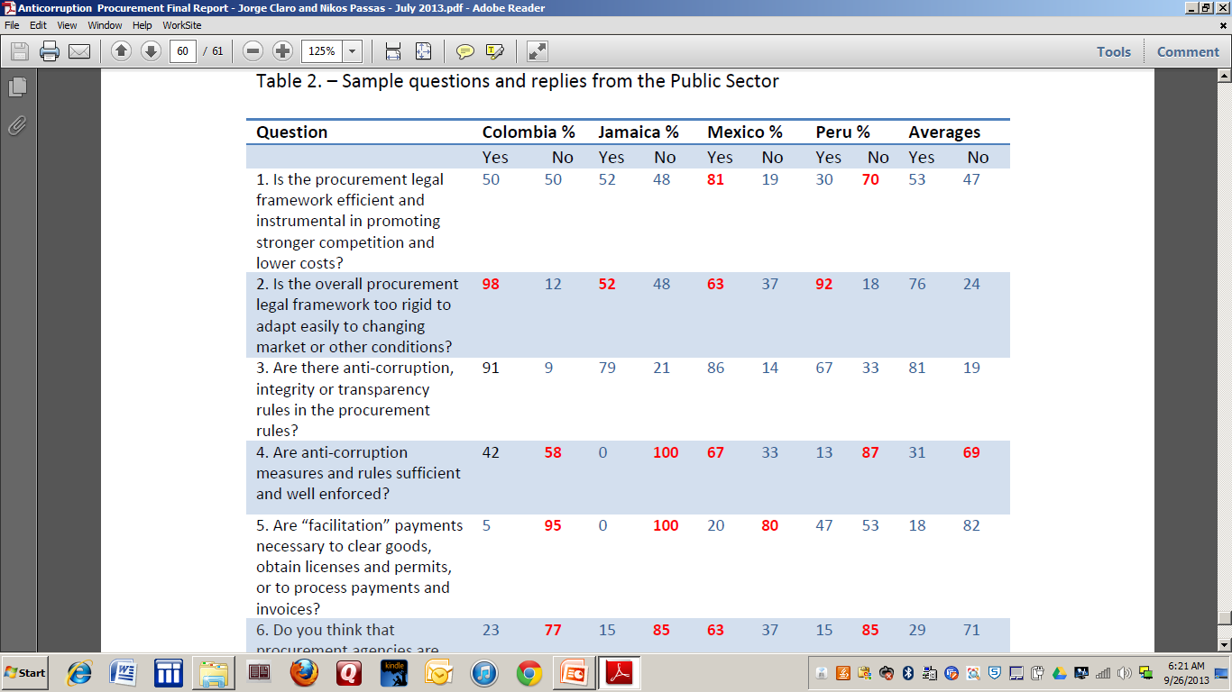
Jorge Claro & Nikos Passas

Slide 61

Sope Williams Elegbe:
Adequacy of Principal-Agent Model

Slide 62
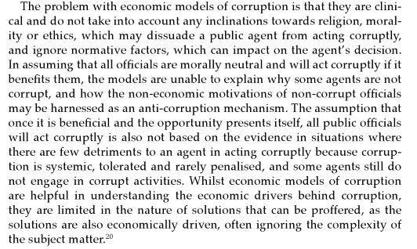

Sope Williams-Elegbe:
Adequacy of Principal-Agent Model
Sope Williams-Elegbe, Fighting Corruption in Public Procurement (2012)

Slide 63
Tendering Process in U.S. Procurement
Professor Christopher Yukins
George Washington University Law School
Washington DC

Slide 64
The United States . . .

Slide 65
. . . Has Separate Procurement Systems
Federal Procurement
State
Local

Slide 66
.. . . Has about $500 billion in annual federal procurement

Slide 67
. . . Accessible
FY07 Contracts - Defense
Notes:
Source: www.fedspending.gov

Slide 68
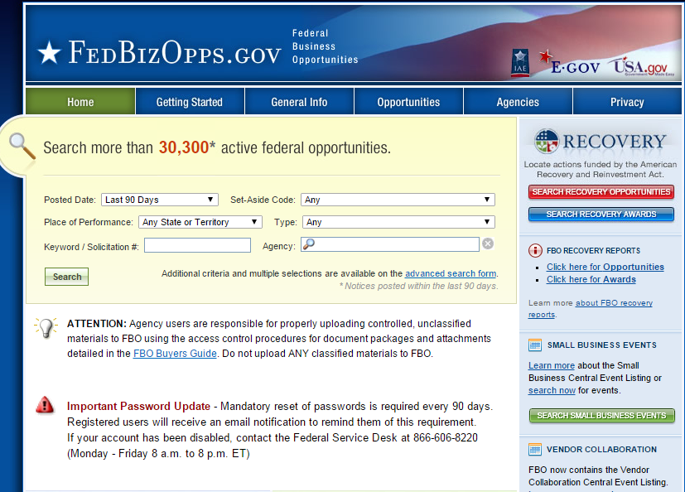
. . . Is Transparent at Opportunity and Award

Slide 69
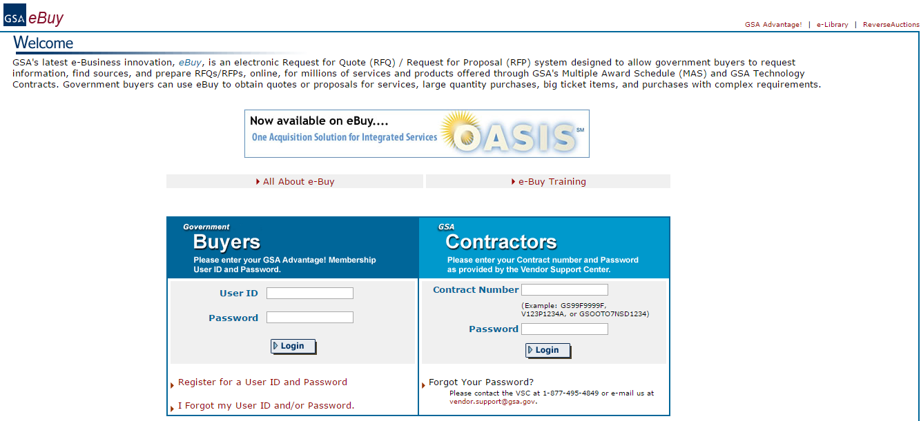
. . . With exceptions to transparency

Slide 70

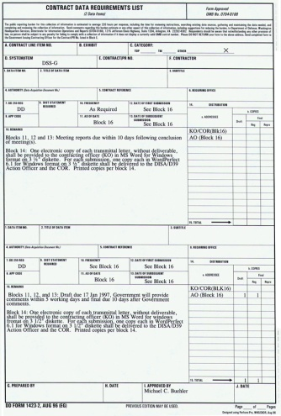


Historical Progression
Sole Source
Sealed Bids
Negotiated Procurements
Frameworks

Slide 71
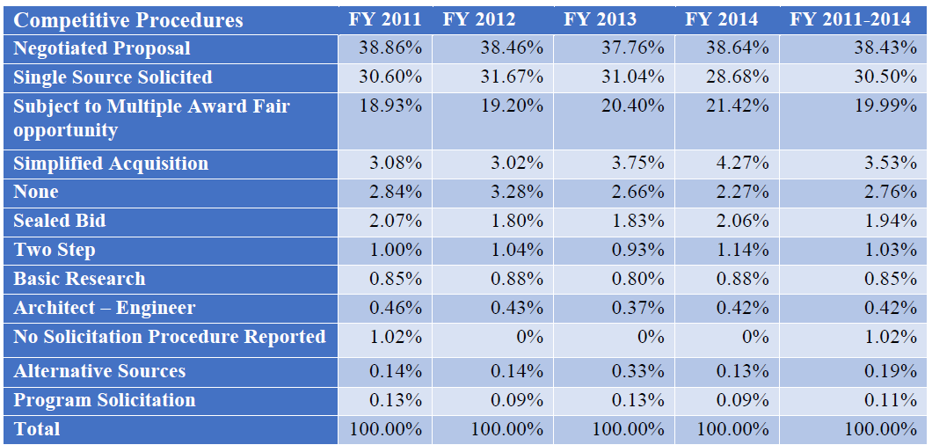

Umer Chaudhry
GWU Law Student

Slide 72
Convergence

Slide 73
Convergence: Procurement Regulation
Best Practices
U.S.
Europe
Others

Slide 74
 | Federal Acquisition Regulation (FAR) | European Procurement Directive 2014/24/EU | World Bank Procurement Framework | WTO Government Procurement Agreement (2012) | ABA Model Procurement Code
Acquisition Planning
Publication of Opportunities
Electronic Reverse Auctions
Sealed Bidding
Competitive Negotiations
IDIQs (Frameworks)
Publication of Awards
Bid Protests
Suspension-Debarment
Contract Administration

Slide 75
Conclusion
Christopher R. Yukins
cyukins@law.gwu.edu
Tel. +1 703 304 4773 (mobile)

