Slide 1

Day 2
Professor Christopher Yukins
George Washington University Law School
The Commercial Law Development Program
Government Procurement Best Practices
August 4-5
Male, Maldives
Hotel Jen

Slide 2
Agenda – Day 2
9:00-9:15 Day 1 Review
Facilitator: Joe Yang, CLDP
9:15-10:00 Framework Agreements
Speaker: Chris Yukins, The George Washington School of Law
10:00-10:15 Tea Break
10:15-11:30 Ensuring Value in Procurement
Speaker: Chris Yukins, The George Washington School of Law
11:30-12:15 Environmental Sustainability & Procurement
Speaker: Chris Yukins, The George Washington School of Law
12:15-13:15 Lunch
13:15-14:00 E-Procurement & Electronic Reverse Auctions
Speaker: Chris Yukins, The George Washington School of Law
14:00-14:45 Remedies
Speaker: Glenn Penfold, Webber Wentzel
14:45-15:30 Suspension and Debarment
Speaker: Chris Yukins, The George Washington School of Law
15:30-15:45 Tea Break
15:45-16:30 Review of Maldives Act
Panelists:
Head of Tender Board
State Minister, Maldives Ministry of Finance
Chris Yukins, George Washington Law School of Law
Elmira Cruz Caisido, Philippines Procurement Policy Board
Moderator: Glenn Penfold, Webber Wentzel
16:30-17:00 Next Steps & Evaluations
Facilitator: Joe Yang, CLDP

Slide 3
Framework agreements

Slide 4

Methods of Procurement
Conditions for Use
Open tendering
Restricted tendering
Request for Quotations
Requests for Proposals Without Negotiations
Two-Stage Tendering
Request for Proposals with Dialogue
Request for Proposals with Consec. Negotiations
Competitive Negotiations
Electronic Reverse Auction
Single-Source Procurement
Framework Agreements
Presumed
Limited number or time
Commodity market, below-threshold
Consider fin. & tech. separately
Need to refine requirements
Can’t define; R&D; security
Consec. needed
Urgent need; catastrophe
Can specify and quantify; market
Urgent, only one source, etc.
Need repetitive or may be urgent

Slide 5
A (1000)
1000
900
B (800)
500
800
C (500)
400
No Notice
Master Agreement
Order
Framework agreements
Efficient
Risks to competition?
  “Closed” and “open” agreements
  Open frameworks rather than
  Suppliers’ lists
Notes:
Suppliers’ lists
Consistent with the aims and objectives of the Model Law?
Recognise and allow optional lists?
Do “open” framework agreements have many of the benefits of lists
Not to be included in revised text

Slide 6
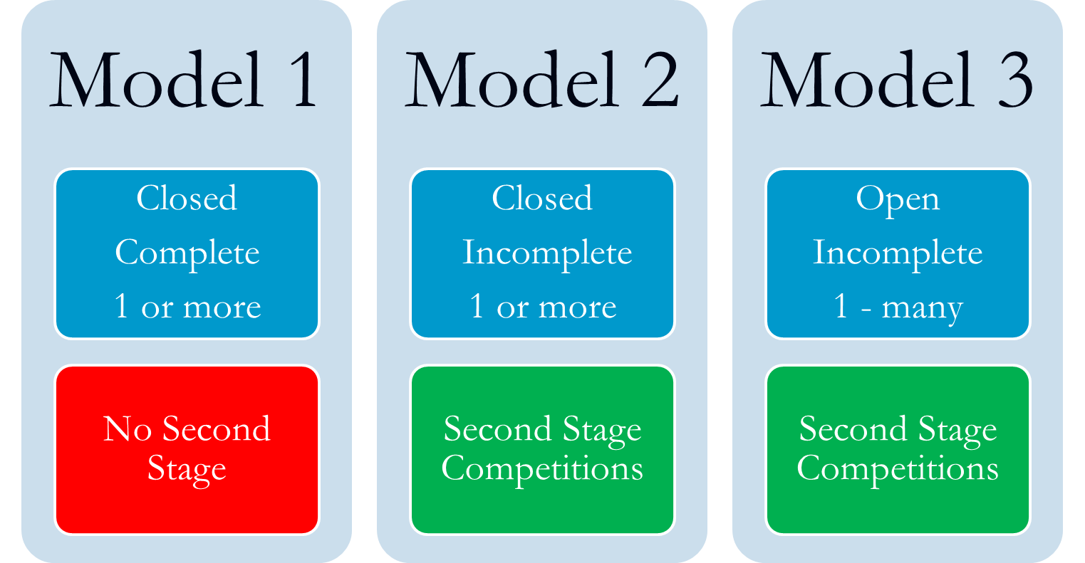
Three Approaches
(Caroline Nicholas & Gian Luigi Albano, The Law and Economics of Framework Agreements)

Slide 7
Problems in U.S. Frameworks: 1990s
Contractors
Centralized Purchasing Agencies
Customer Agencies
Reduced Transparency – Reduced Accountability -- Misuse of Frameworks

Slide 8
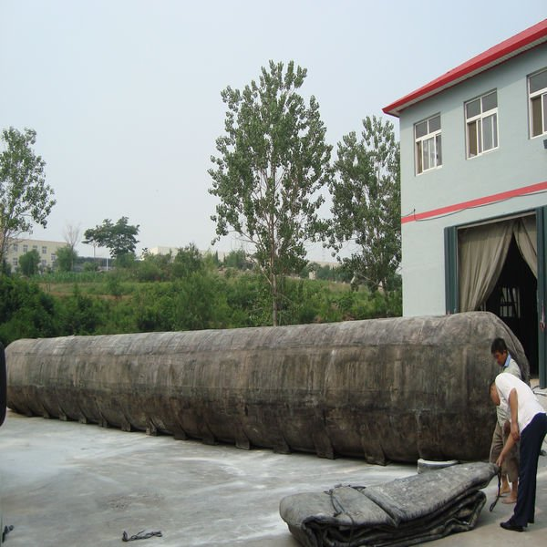
Scandals
Notes:
-- Scandals and reform driven by internal government forces, including Congress, GAO and inspectors general
-- Punctuated by Abu Ghraib disaster

Slide 9
Joint Cross-Border Procurement
(U.S.: “Cooperative Purchasing”)
User Agency
Centralized Purchasing Agency
Contractor
9

Slide 10
Commercial Online Marketplaces

Slide 11

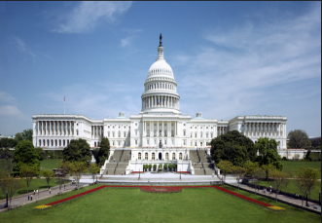



The Players
Online Solution
Centralized Purchasing Agency
Market
Users
Congress
MAJ Abraham Young, USA

Slide 12
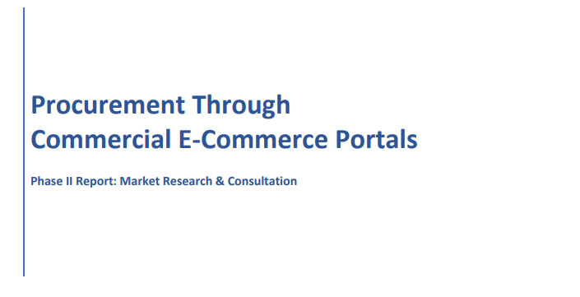
The Proposal
Proposal
Proof of concept with e-marketplace model
Limit to micro-purchases (no regulation – user needs training and authority)
Future
GSA Proposal: Micro-purchase rise from $10,000 to $25,000 for purchases through GSA approved e-portals
Issues
Transparency
Bid challenges
International Trade
Section 809 Panel Proposal: Simplified limit rise to $15 million
Socioeconomic goals
Data
Competition
“Referral sharing” cost reimbursement to GSA

Slide 13
Ensuring Value in Procurement

Slide 14

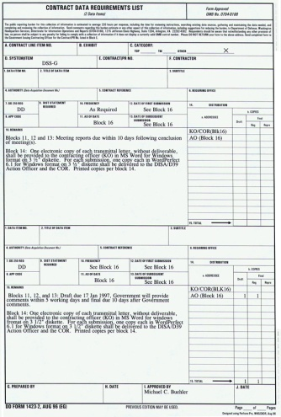

Historical Progression
Sealed Bids
Negotiated Procurements
Frameworks

Slide 15
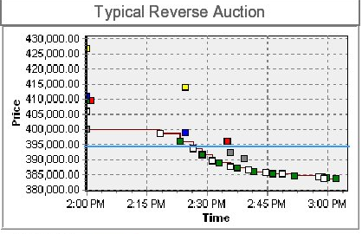
Sealed Bids

Slide 16
Competitive Negotiations:
Multiple Vendors, for Best Value
Negotiated Procurements
Contractor
Contractor
Contractor

Slide 17
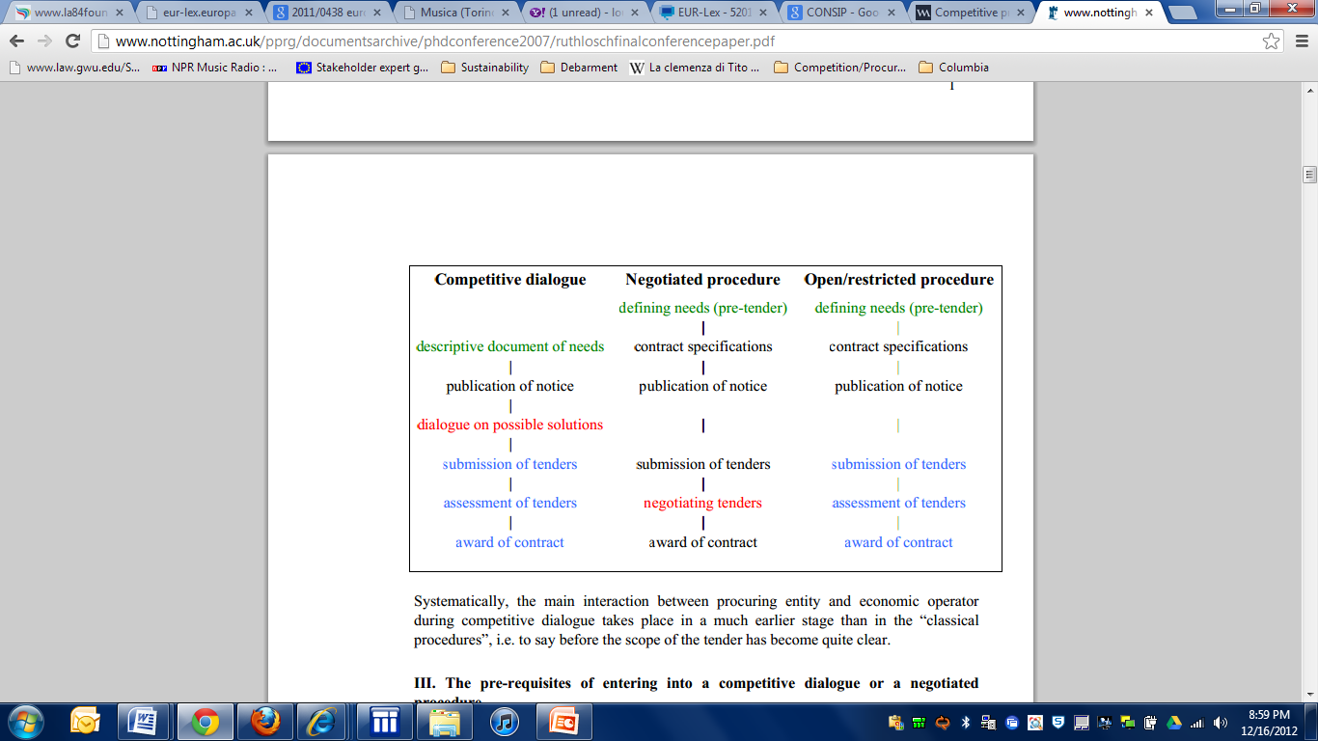
Europe: Also Allows Competitive Negotiations
Competitive Procedure with Negotiation | Procedures Allowed Under 2004 Directive
Defining Needs
Document min. needs & award criteria
Publication (may limit number of participants)
Negotiation on tenders, to improve.
Rounds of negotiations, to narrow field
Final tenders
Award, based upon original criteria, as amended

Slide 18
Competitive Negotiations
Request for Proposals
Competitive
Offeror 1
Offeror 2
Non-Competitive
Announcement
Exchanges
Submissions
Award
Awardee

Slide 19
Examples:
Competitive Negotiation EvaluationS

Slide 20
Evaluation criteria |  | Wt. Factor (%) | Proposal A |  | Proposal B |  | Proposal C
 |  |  | Points | Score | Points | Score | Points | Score
TECHNICAL REQUIREMENTS (25%) | Performance characteristics | 6 | 4 | 24 | 5 | 30 | 5 | 30
 | Effectiveness factors | 4 | 3 | 12 | 4 | 16 | 3 | 12
 | Design approach | 3 | 2 | 6 | 3 | 9 | 1 | 3
 | Design documentation | 4 | 3 | 12 | 4 | 16 | 2 | 8
 | Test & evaluation approach | 3 | 2 | 4 | 1 | 2 | 2 | 4
 | Product support requirements | 5 | 2 | 8 | 3 | 12 | 2 | 8
PRODUCTION CAPABILITY (20%) | Production layout | 8 | 5 | 40 | 6 | 48 | 6 | 48
 | Manufacturing process | 5 | 2 | 10 | 3 | 15 | 4 | 20
 | Quality control/assurance | 7 | 5 | 35 | 6 | 42 | 4 | 28
MANAGEMENT (20%) | Planning (plans/schedules) | 6 | 4 | 24 | 5 | 30 | 4 | 24
 | Organization structure | 4 | 4 | 16 | 4 | 12 | 4 | 16
 | Available personnel resources | 5 | 3 | 15 | 3 | 20 | 3 | 15
 | Management controls | 5 | 3 | 15 | 3 | 20 | 4 | 20
TOTAL COST (25%) | Acquisition price | 10 | 7 | 70 | 5 | 50 | 6 | 60
 | Life cycle cost | 15 | 9 | 135 | 10 | 150 | 8 | 120
ADDITIONAL FACTORS (10%) | Prior experience | 4 | 4 | 16 | 3 | 12 | 3 | 12
 | Past performance | 6 | 5 | 30 | 5 | 30 | 3 | 18
GRAND TOTAL |  | 100 |  | 476 |  | *516 |  | 450

Slide 21
Evaluation criteria |  | Wt. Factor (%) | Proposal A |  | Proposal B |  | Proposal C
 |  |  | Points | Score | Points | Score | Points | Score
TECHNICAL REQUIREMENTS (25%) | Performance characteristics | 6
 | Effectiveness factors | 4
 | Design approach | 3
 | Design documentation | 4
 | Test & evaluation approach | 3
 | Product support requirements | 5
PRODUCTION CAPABILITY (20%) | Production layout | 8
 | Manufacturing process | 5
 | Quality control/assurance | 7
MANAGEMENT (20%) | Planning (plans/schedules) | 6
 | Organization structure | 4
 | Available personnel resources | 5
 | Management controls | 5
TOTAL COST (25%) | Acquisition price | 10
 | Life cycle cost | 15
ADDITIONAL FACTORS (10%) | Prior experience | 4
 | Past performance | 6
GRAND TOTAL |  | 100

Slide 22
Environmental sustainability and procurement

Slide 23

European Approach: Sustainability
Economy
Society
Environment
Notes:
The crucial milestone for the development of Sustainable Public Procurement in Europe was the Gothenburg European Council (June 2001)and the adoption of the EU Sustainable Development Strategy. The philosophy of this strategy is that economic, social and environmental objectives could be pursued simultaneously adding an environmental dimension to the Lisbon Process, launched in March 2000. (In the Lisbon Strategy, the EU aims to become ‘the most competitive and dynamic knowledge-based economy in the world, capable of sustainable economic growth with more and better jobs and greater social cohesion’ by 2010.)

Slide 24

United Nations Commission on International Trade Law (UNCITRAL): Model Law on Public Procurement
May address environmental issues in:
  Qualifications of supplier
  Evaluation criteria for award
Socio-economic (including environmental) requirements must be set forth in statute or regulation

Slide 25
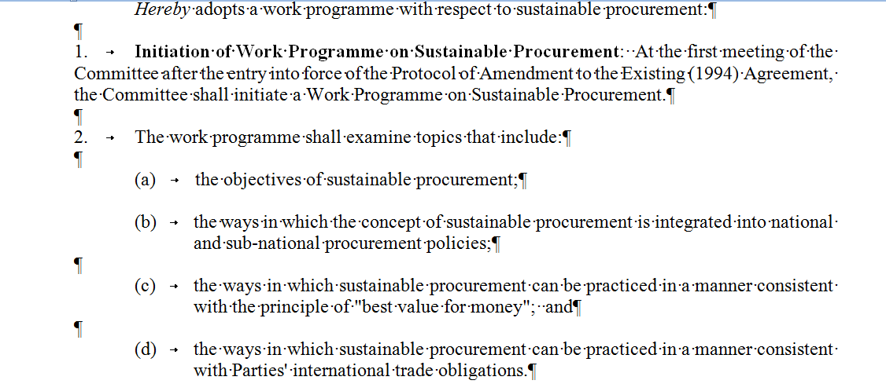

Comprehensive & Progressive Trans-Pacific Partnership
Government Procurement Agreement
Article 15.3: Exceptions
1. Subject to the requirement that the measure is not applied in a manner that would constitute a means of arbitrary or unjustifiable discrimination between Parties where the same conditions prevail, or a disguised restriction on international trade between the Parties, nothing in this Chapter shall be construed to prevent a Party, including its procuring entities, from adopting or maintaining a measure . . . :
(b) necessary to protect human, animal or plant life or health . . .
2. The Parties understand that subparagraph 1(b) includes environmental measures necessary to protect human, animal or plant life or health
Notes:
GPA:
For greater certainty, a Party, including its procuring entities, may, in accordance with this Article, prepare, adopt or apply technical specifications to promote the conservation of natural resources or protect the environment.

Slide 26
How do we achieve environmental sustainability?

Slide 27
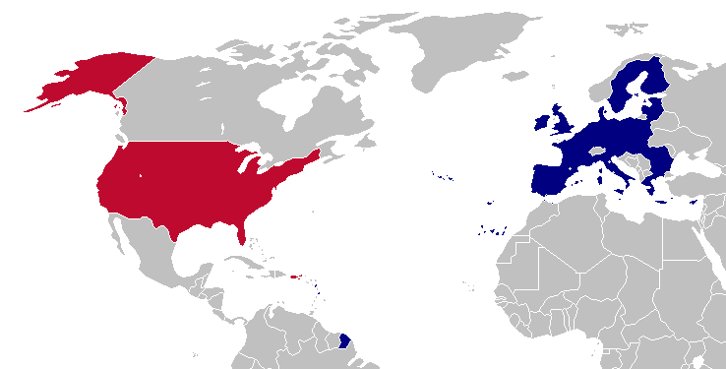

Eco-Labels

Slide 28








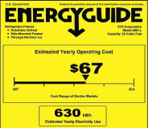
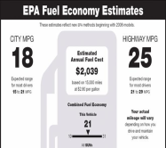




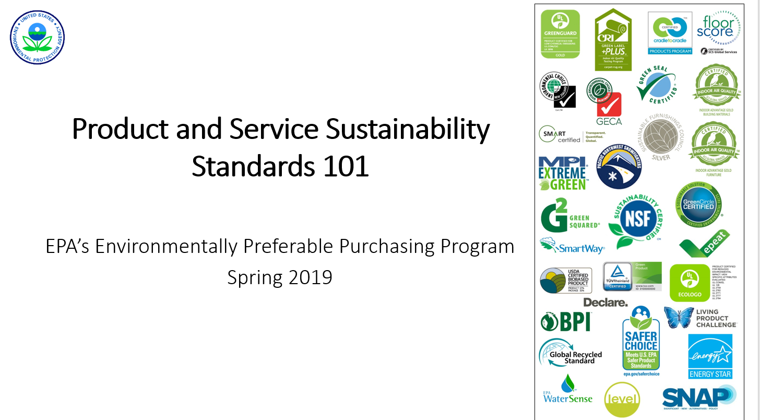
Ecolabels Found In The Marketplace In 1995 (13)
Notes:
28

Slide 29

Ecolabels found in the Global Marketplace today (460+)

Slide 30

Commission V. Netherlands
(CJEU – 2012) (“max Havelaar”)
“[B]y providing . . . that [if] certain products to be supplied bore specific labels would give rise to the grant of a certain number of points in the choice of the most economically advantageous tender, without having listed the criteria underlying those labels and without having allowed proof that a product satisfies those underlying criteria by all appropriate means, the province of North Holland established an award criterion that was incompatible” with the procurement directive
Court Barred Specifying Eco-Label, Without Explanation

Slide 31
Sustainability in Public Procurement: Trajectory
Political
EcoLabel
Carbon Footprint as Evaluation Factor
NOW

Slide 32


Japan: Green Contract Act
Contracts related to the procurement, etc. of automobiles . . . . Basic approaches related to the reduction of emissions of greenhouse gases and others for contracts related to the procurement and lease of automobiles . . . :
    . . . . the procuring party enters into contract with a party whose proposal is rated the best after a comprehensive evaluation of procurement price and environmental performance
Notes:
http://www.env.go.jp/en/laws/policy/green/contract.html

Slide 33
Assessing Electronic Procurement
More efficient?
More transparent?
Discriminatory?
Ready source of comparative lessons?

Slide 34
Major methods of competition
Major Methods of Competition
Open Procedure
Restricted Procedure
Sole-Source Negotiation
Competitive Negotiation
Reverse Auctions?

Slide 35
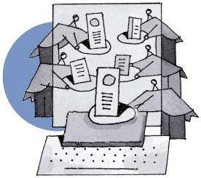
What Is a Reverse Auction?

Slide 36
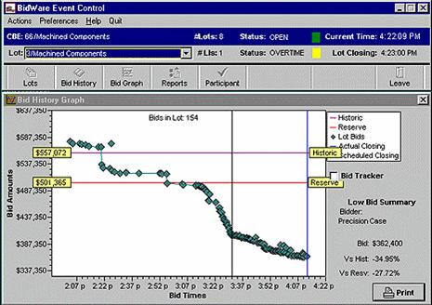

Slide 37
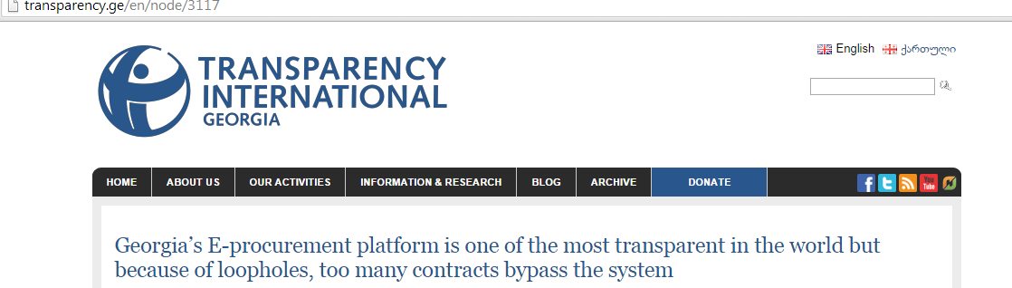

Case study: Georgia –
Using E-Procurement To Combat Corruption
Link to presentation on Georgian e-procurement system:
  https://prezi.com/1yugudjld6rw/e-procurement-reform-in-georgia-everyone-sees-everything/
Transparency International – Georgia report on e-procurement system:
  http://www.transparency.ge/en/node/3117

Slide 38
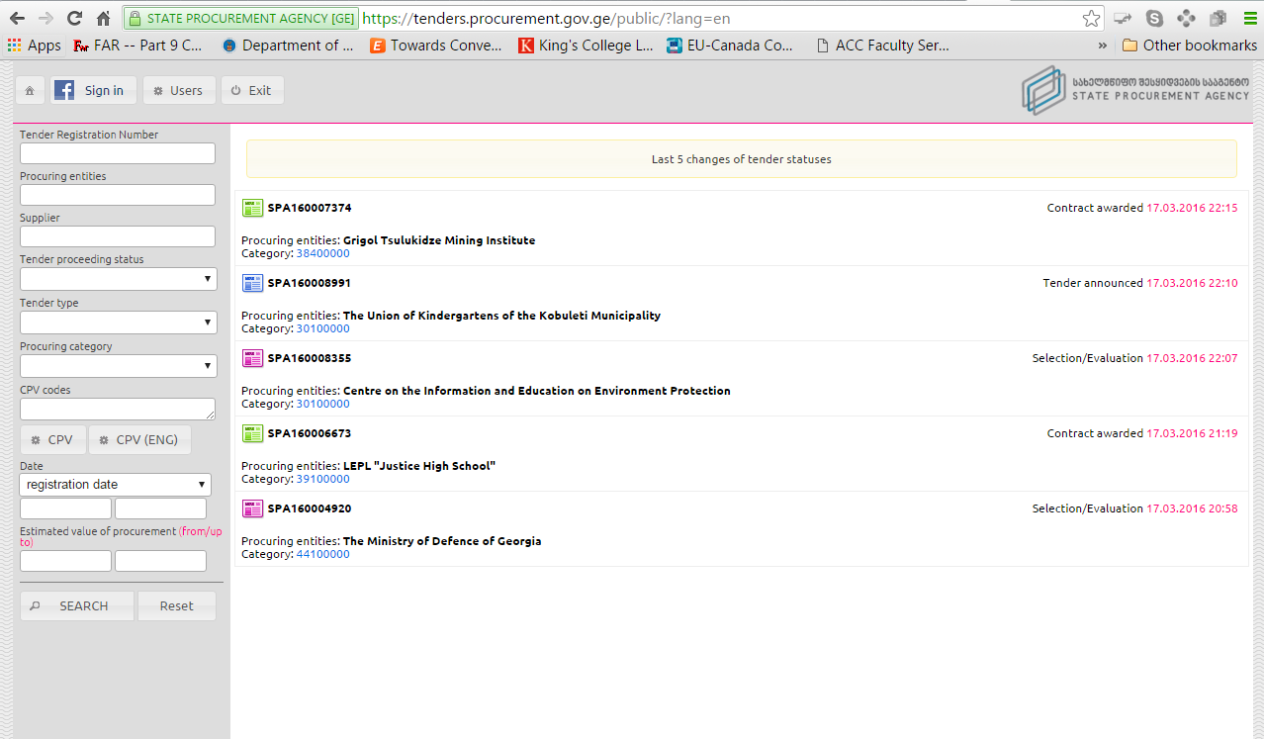
Georgia E-Procurement

Slide 39
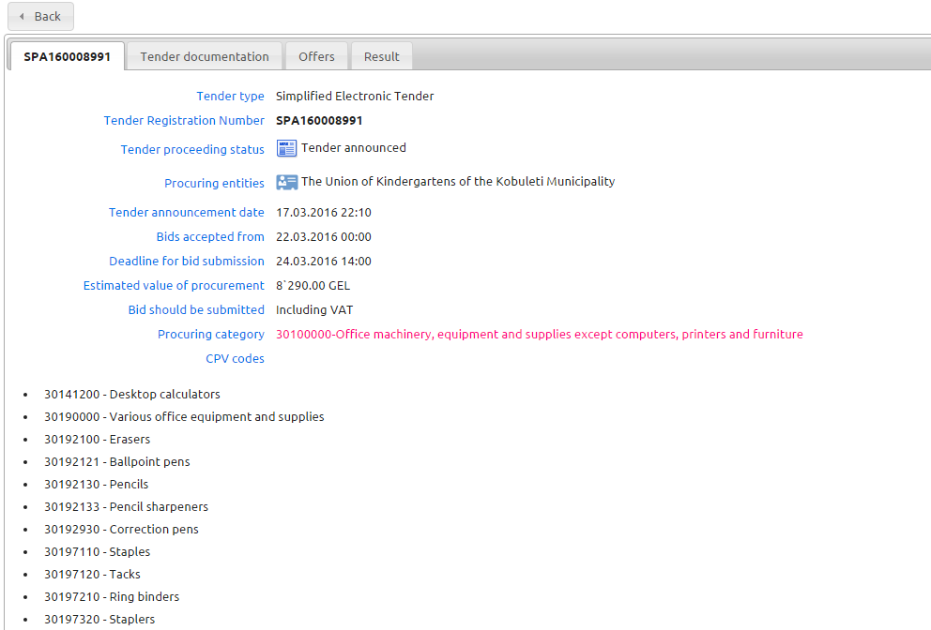
Sample Georgian Auction

Slide 40
The U.S. Rule on Reverse Auctions

Slide 41
Which types of auction can be used?
Type 1 – allowed; is the most common in UK
  winning tender is chosen based solely on the auction phase (usually price only)
  winner (usually lowest price) is apparent to participants during the auction process
European Perspective
- Sue Arrowsmith

Slide 42
Which types of auction can be used?
Type 2 – allowed
  award is based on aspects of tenders assessed before the auction (e.g.quality) and on the auction (where usually only price only is subject to change)
  winner is apparent during the auction process
European Perspective
- Sue Arrowsmith

Slide 43
Which types of auction can be used?
Type 3 – not allowed under directives at all; was rare before new directives except for utilities
  As in type 2, award is based on aspects of tenders not changed in the auction (e.g. quality) and on the auction
  winner is not apparent during the auction process (e.g. quality is judged after the auction and then an overall judgment made on price/quality)
European Perspective
- Sue Arrowsmith

Slide 44
European Union Directive – Cont’d
The electronic auction shall be based:
- either solely on prices when the contract is awarded to the lowest price,
- or on prices and/or on the new values of the features of the tenders indicated in the specification when the contract is awarded to the most economically advantageous tender.

Slide 45
Any Recourse in GPA?

Slide 46
Revised GPA Defines Electronic Reverse Auction
Article I:
(e) electronic auction means an iterative process that involves the use of electronic means for the presentation by suppliers of either new prices, or new values for quantifiable non-price elements of the tender related to the evaluation criteria, or both, resulting in a ranking or re‑ranking of tenders;

Slide 47
And GPA Regulates . . .
Article XIV Electronic Auctions
Where a procuring entity intends to conduct a covered procurement using an electronic auction, the entity shall provide each participant, before commencing the electronic auction, with:
(a) the automatic evaluation method, including the mathematical formula, that is based on the evaluation criteria set out in the tender documentation and that will be used in the automatic ranking or re-ranking during the auction;
(b) the results of any initial evaluation of the elements of its tender where the contract is to be awarded on the basis of the most advantageous tender; and
(c) any other relevant information relating to the conduct of the auction.

Slide 48
Mock Auction Rules
Group descriptions drive bidding strategy
Auction per mock solicitation
U.S. rules regarding reverse auctions apply
U.S. bid protest rules apply
Bids to bidprof@hotmail.com; low bid posted
Professor is both auctioneer and arbiter

Slide 49
Mock Auction
General Facts: Solicitation
Team-Specific Facts (to be distributed)

Slide 50
Suspension and debarment

Slide 51
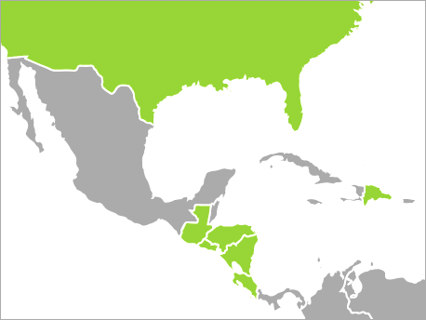
CAFTA-DR Free Trade Agreement
Article 9.13: Ensuring Integrity in Procurement Practices Further to Article 18.8 (Anti-Corruption Measures), each Party shall adopt or maintain procedures to declare ineligible for participation in the Party’s procurements, either indefinitely or for a specified time, suppliers that the Party has determined to have engaged in fraudulent or other illegal actions in relation to procurement. On request of another Party, a Party shall identify the suppliers determined to be ineligible under these procedures, and, where appropriate, exchange information regarding those suppliers or the fraudulent or illegal action.
Notes:
https://creativecommons.org/licenses/by-sa/3.0/
http://commons.wikimedia.org/wiki/file:cafta_countries.png

Slide 52
U.S. Federal Discretionary Debarment
Suspension and Debarment Official
Investigators/ Prosecutors
Competitors
Contracting Officers
Criminal or Civil Fraud
Adverse Past Performance Reports
Suspension or Debarment
Administrative Agreement / Compliance

Slide 53

World Bank Sanctions System
Sanctions Board
Suspension and Debarment Officer (SDO)
Integrity Compliance
Officers (within INT)
Monitors integrity compliance by sanctioned companies (or codes of conduct for individuals)
Decides whether the compliance condition established by the SDO or Sanctions Board as part of a debarment has been satisfied.
Compliance
Comprised of 4 external members and 3 Bank staff
Reviews case ‘de novo’
May hold a hearing with parties and witnesses
Imposes sanctions (not bound by SDO’s recommendation)
Decisions are final and not appealable
39% of cases resolved at this level
Adjudicative
Evaluates evidence presented by INT
Issues Notice of Sanctions Proceedings to respondent
Temporarily suspends respondent
Recommends a sanction (becomes effective if respondent does not contest)
61% of cases resolved at this level
Investigates allegations of fraud, corruption, collusion, coercion and obstruction
Prepares and submits a Statement of Accusations and Evidence (SAE) to the Office of Suspension and Debarment
Integrity Vice Presidency
Investigative
Notes:
Where do Sanctions decisions come from?
As you can see from this chart:
39% of the decisions come from the Sanctions Board;
61% of decisions are made at the OSD level – so, most cases get resolved at the OSD level.
*As of October 2013
All cases are based on investigations by INT. My role as SDO is essentially that of an administrative judge.

Slide 54
Debarment: Paradigms
Responsibility (Qualification)
Only
On a case-by-case basis
Adjudicative Debarment for “Bad Acts”
E.g., World Bank
Discretionary Debarment – U.S. Federal
In U.S. – done by contracting officer
Debarment is a cross-government “meta-qualification” determination
Based on “present responsibility”: focus on present status
Court-Ordered Debarment, After Judicial Proceedings
Allowed by new EU Directives
Performance Risk
Reputation Risk

Slide 55
Cross-Debarment
Country 1:
Debarment
Country 2:
Automatic Effect

Slide 56
Cross-Debarment
Options:
Automatic cross-debarment
Debarments to be considered in other systems
Adverse performance information to be considered
Do nothing

Slide 57
Panel review:
Maldives procurement

Slide 58
Conclusion
Christopher R. Yukins
cyukins@law.gwu.edu
Tel. +1 703 304 4773 (mobile)

