Slide 1
U.S. Procurement: An Update from a Battered America Stockholm Procurement Conference Upphandlingskonferensen
Professor Christopher Yukins
George Washington University Law School
October 24, 2019

Slide 2
For today
Trump Protectionism
All Predictable -- Really?
Electronic Marketplaces
A Huge Step -- Too Far?
Upcoming symposium– March 16, 2020 – King’s College London -- post-award disputes

Slide 3
REadingS

Slide 4
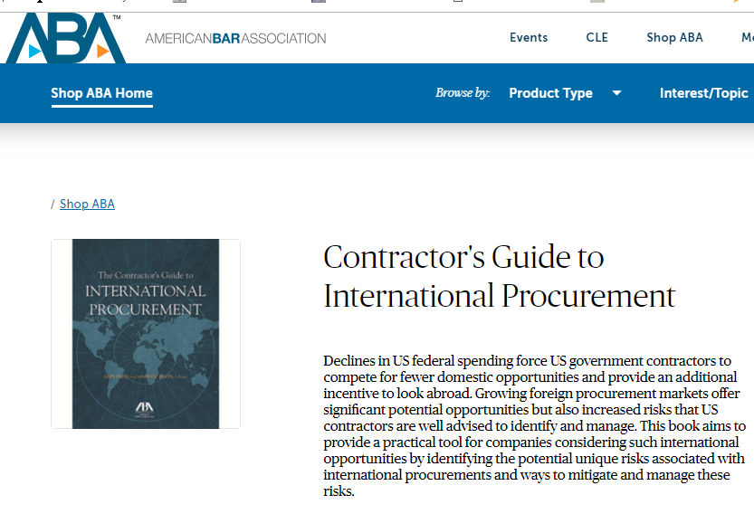
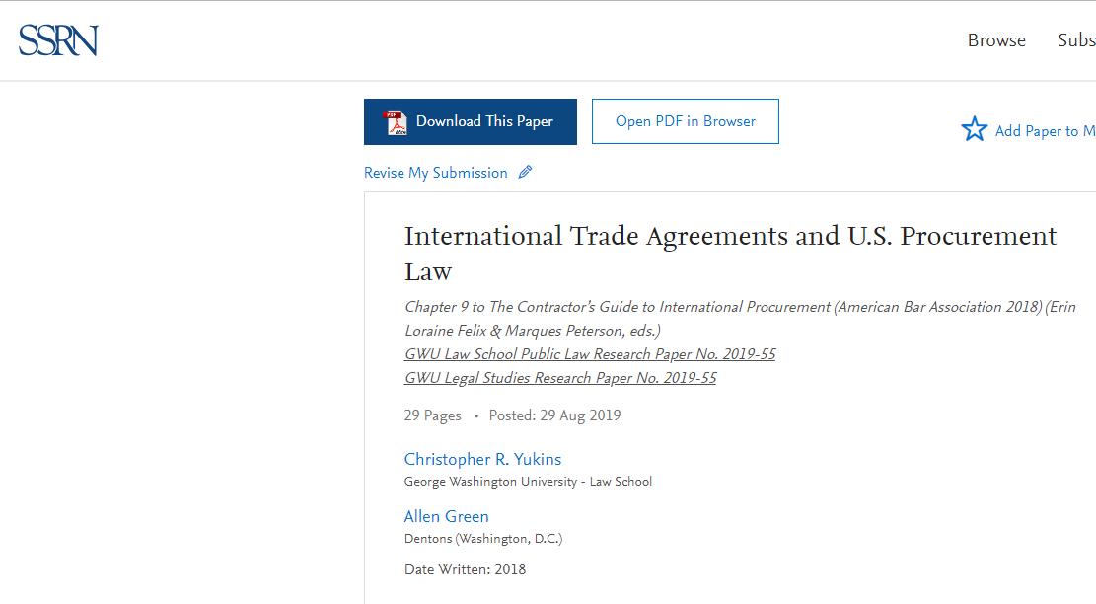
https://papers.ssrn.com/sol3/papers.cfm?abstract_id=3443244

Slide 5
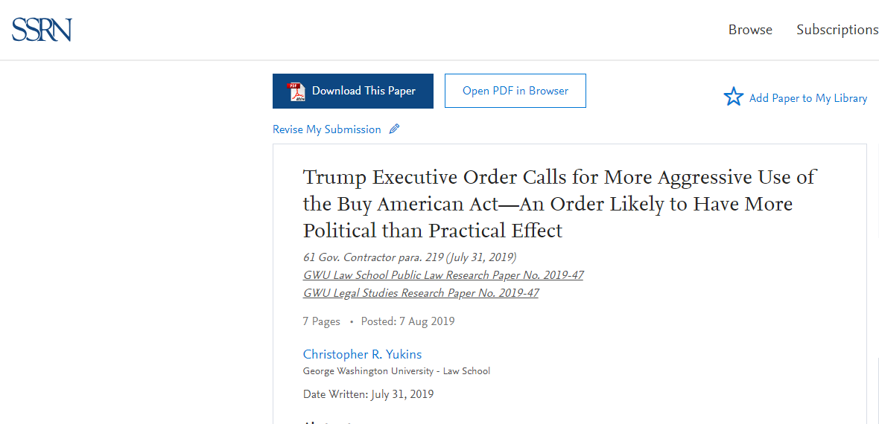
https://papers.ssrn.com/sol3/papers.cfm?abstract_id=3432377

Slide 6
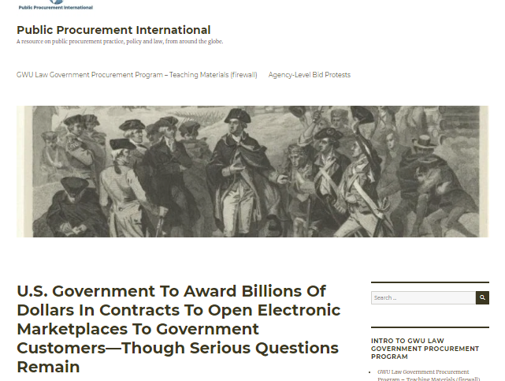
https://publicprocurementinternational.com/2019/10/21/us-government-to-award-billions-of-dollars-in-contracts-to-open-electronic-marketplaces/

Slide 7
Key concepts

Slide 8
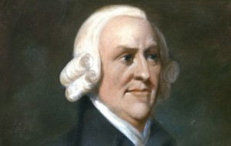
“It is the maxim of every prudent master of a family, never to attempt to make at home what it will cost him more to make than to buy. . . . If a foreign country can supply us with a commodity cheaper than we ourselves can make it, better buy it of them with some part of the produce of our own industry, employed in a way in which we have some advantage.
Adam Smith, An Inquiry into the Nature and Causes of the Wealth of Nations (1776)

Slide 9
What Is Goal of Protectionism?
Protect Jobs
Industrial policy
Ensure security of supply

Slide 10
Prewar Protectionism

Slide 11
United States’ suggested charter for predecessor to World Trade Organization (1946)
Notes:
http://www.worldtradelaw.net/misc/Suggested%20Charter.pdf

Slide 12
Notes:
http://www.worldtradelaw.net/misc/Suggested%20Charter.pdf
WTO on non-discrimination (Most Favored Nation) versus national treatment - http://www.wto.org/english/thewto_e/whatis_e/tif_e/fact2_e.htm
Textbook, Sec. 2:27:
One core provision of the GATT is Article I which makes a general commitment to the long standing practice of “most favored nation treatment” (“MFN”).¹ Article I requires each Contracting Party to accord unconditional MFN status to all other Contracting Parties. Thus, any privilege granted by any Contracting Party to any product imported from any other country must also be “immediately and unconditionally” granted to any “like product” imported from any Contracting Parties.²
Another core provision of GATT is Article III. Article III incorporates the practice of according “national treatment” to imported goods by providing, with specifically enumerated exceptions, that the products of one Contracting State shall be treated in the same manner regarding taxation and regulation as domestic goods. As such, under Article III, products of the exporting GATT Contracting State must be treated no less favorably than domestic products of the importing Contracting State under its laws and regulations concerning sale, internal resale, purchase, transportation and use.³ In addition to the Articles above, the GATT also prohibits the use of certain kinds of quantitative restrictions. For example, Article XI generally, but not completely, prohibits the use of other “prohibitions or restrictions” on imports from Contracting Parties.⁴

Slide 13
U.S. Trade Agreements Act: A “Walled Garden”
GPA &
Free Trade Agreements
Europe
USA
Some Asian Nations
Some Latin American Nations

Slide 14
U.S. Domestic Preference Law: Supplies
Trade Agreements Act: Above $180,000 (approx.)
Buy American Act
Micro-
Purchase

Slide 15
Reciprocal Defense Procurement Agreements

Slide 16
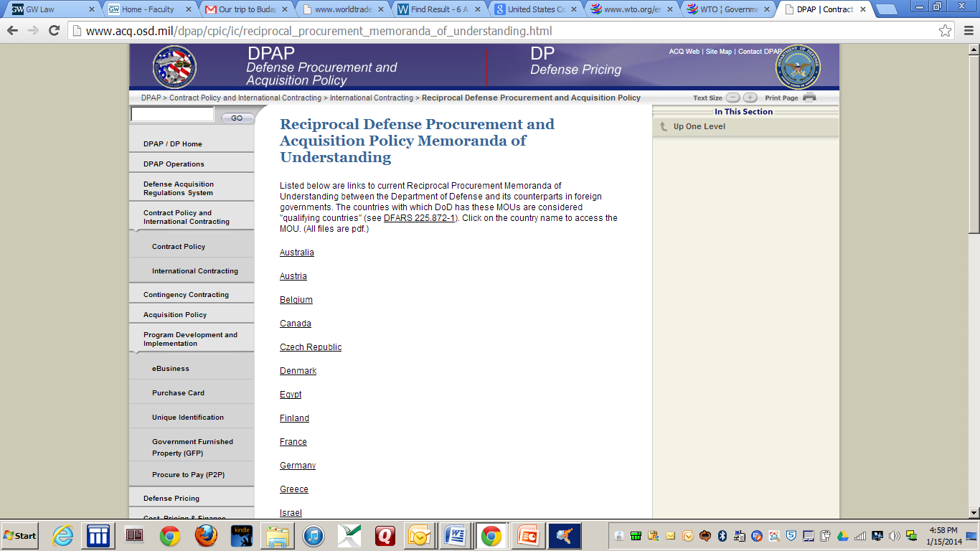
Defense – Memoranda of Understanding
Authority for the defense MOUs rests in the “public interest” exception to the BAA. The agreements serve as a national security benefit, enhance alliance-wide security objectives, and serve as an underpinning for armaments cooperation. – Text § 2:21

Slide 17
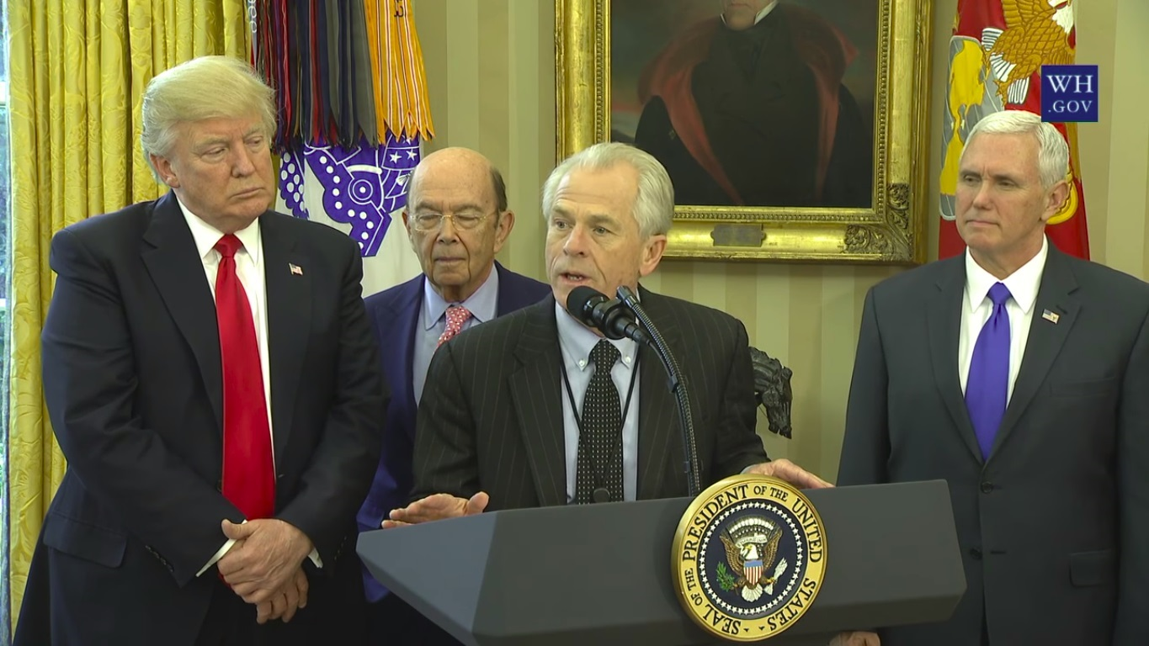
Trump Administration

Slide 18
February 2017

Slide 19
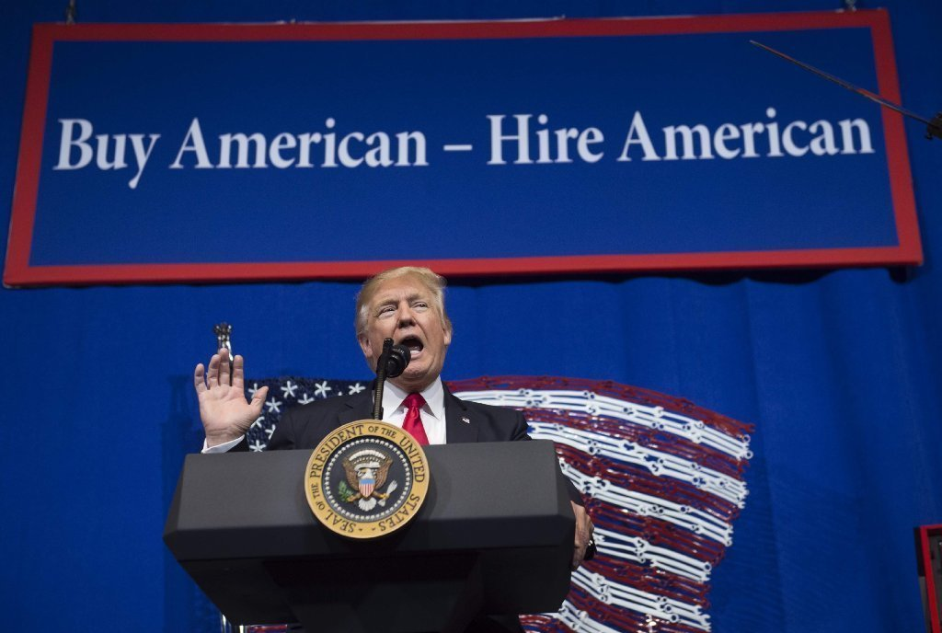

Slide 20
The RECIPROCity CONCEPT

Slide 21
U.S. – Mexico – Canada Agreement (USMCA):
Procurement Chapter

Slide 22
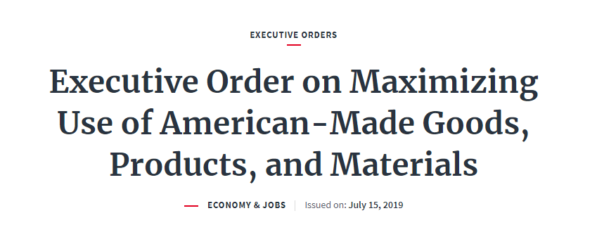
Price Preferences Applied Against Foreign Items Under Buy American Act
 | Small Businesses | Other Businesses
Existing Law | 12% price preference | 6% price preference
Trump Proposal | 30% price preference | 20% price preference

Slide 23
“Squeezing” the Buy American Act | Acquisitions Above Trade Agreements Thresholds (typically $180,000): Buy American Act Does Not Apply
 | Buy American Act Applies: Acquisitions from $10,000 to the Trade Agreements Thresholds
 | Micro-Purchases (Currently up to $10,000): Buy American Act Does Not Apply

Slide 24
Today

Slide 25
Electronic Marketplaces

Slide 26
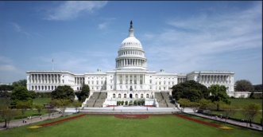
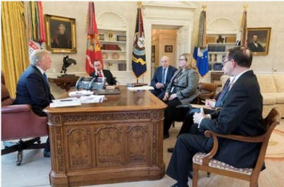
Online Solution
Centralized Purchasing Agency
Market
Users
Congress
MAJ Abraham Young, USA
The Players

Slide 27
Online Solution
Centralized Purchasing Agency
Market
Users
Congress
MAJ Abraham Young, USA
The Problems
Vendor data – bid challenges – transparency –
competition -- socioeconomic goals (including Buy American) – no- standards security review -- fee to GSA – Most Favored Customer pricing

Slide 28
King’s college London conference – 16 March 2020

Slide 30
Professor Christopher Yukins
The George Washington University Law School
Washington DC
cyukins@law.gwu.edu
Tel. +1 202 994 9992
Mobile +1 703 304 4773

