Slide 1
The Devastating Consequences of Corruption in Public Procurement – Presentation of International Cases
Professor Christopher R. Yukins
George Washington University Law School
Tbilisi, Georgia
28 October 2019

Slide 2
Readings & Videos
Christopher R. Yukins, A Versatile Prism: Assessing Procurement Law Through the Principal-Agent Model (PCLJ 2010), https://ssrn.com/abstract=1776295
Johannes Schnitzer & Christopher Yukins, Combatting Corruption in Procurement, in UNOPS: Future-Proofing Procurement 26-29 (2015), https://www.unops.org/SiteCollectionDocuments/ASR/2015-ASR-supplement.pdf
  Video: Fighting Corruption in Procurement (40:12) – in this video excerpted from GWU Law School’s “Foreign Government Contracting” course, Professor Christopher Yukins discusses common patterns and strategies in fighting corruption in public procurement around the world.
  Video: Corporate Compliance (7:50) – in this video excerpted from GWU Law School’s “Foreign Government Contracting” course, Professor Christopher Yukins discusses corporate compliance requirements and strategies, from around the world.

Slide 3
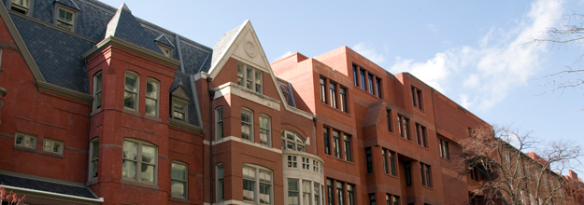
George Washington University Law School
Providing traditional and online procurement law classes to students from around the world
Government Procurement Law Program, established 1960

Slide 4
Procurement Law Centers: 2000
Nottingham.
Washington, D.C.

Slide 5
Procurement Law Centers Today
Stockholm
Vilnius
Copenhagen
Moscow
Northern China
Nottingham.
Munich
Paris
Poland
Beijing
Washington, D.C.
Aix-en-Provence
Galicia
Turin
Rome
Stellenbosch

Slide 6
Definition of Corruption

Slide 7
Law of Georgia on Conflict of Interest
“’Corruption in public service' is the abuse of the position or the opportunities related to the position by a public servant in order to obtain property or other assets prohibited by law . . . “
Does this definition “fit” corruption in public procurement?

Slide 8
Risks of Corruption in procurement

Slide 9
Risks
Reputation
Performance
Fiduciary

Slide 10
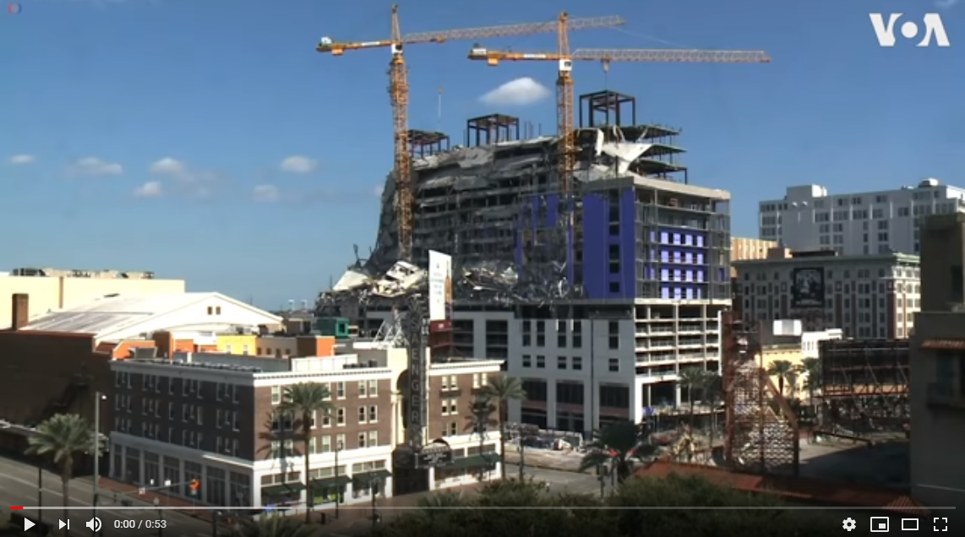
Performance Risk: New Orleans
New Orleans – Defective Construction – Building Collapse – Controlled Explosion

Slide 11
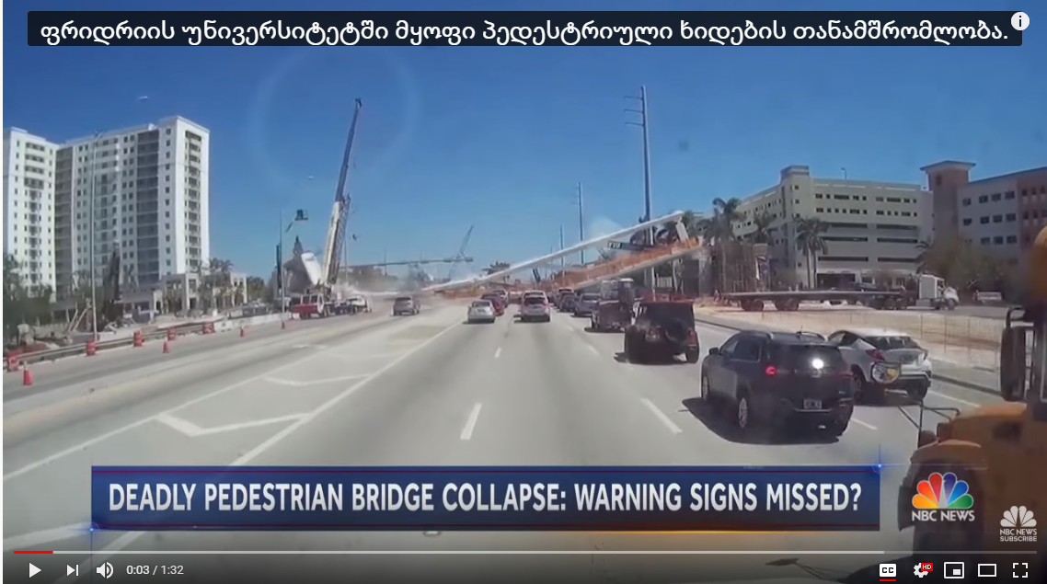
Performance Risk:
Florida International University
https://www.youtube.com/watch?v=jLoqhWjXc5E

Slide 12
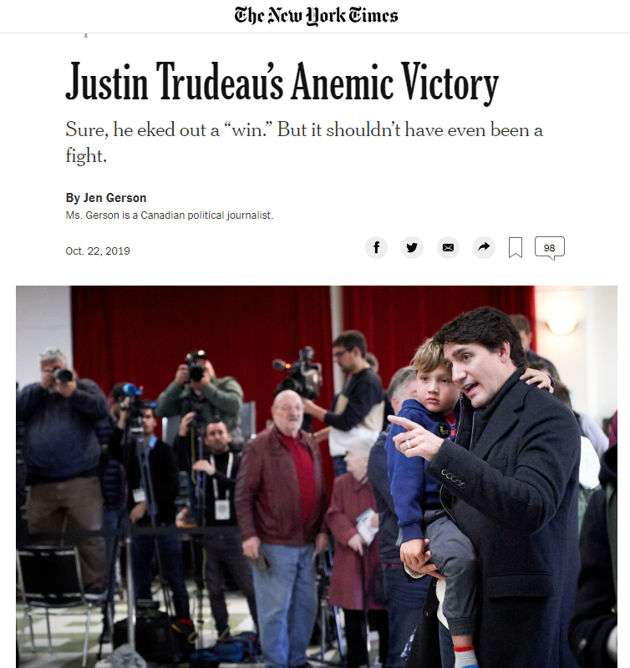
Reputation Risk
“[Trudeau] demonstrated the hollowness of his progressive virtues during what became known as the SNC-Lavalin scandal, in which he allegedly sidelined Canada’s first Indigenous attorney general because she refused to subvert the independence of her office by granting a politically well-connected engineering firm a pass on corruption charges. The episode betrayed a government that is just as centralized, controlling and cynical as the one it replaced.”

Slide 13
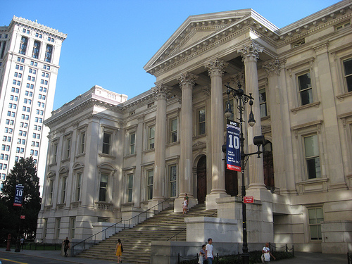
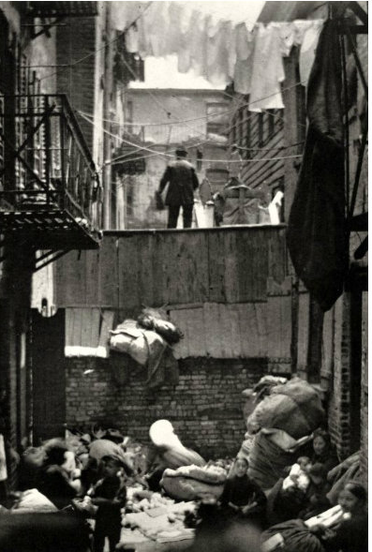
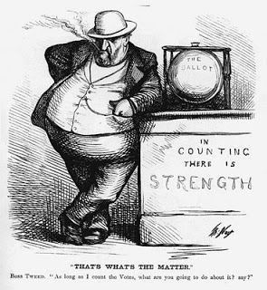
“Boss” Tweed:
Fiduciary Risks of Misdirected Funds
Notes:
FAR 2.101

Slide 14

Impact of Corruption in Public Procurement in Georgia
“Public procurement is one of the most corruption-prone systems. Ineffective public procurement system [diverts the] market from competition [and thus increases the costs of] goods, service and construction works and results in unjustified public expenses and thus, affects taxpayers’ financial resources. Furthermore, . . . public procurement [as a portion of] GDP is relatively high and . . . fluctuates around 12%.”
National Anti-Corruption strategy of georgia
2017-2018

