Slide 1
Aspects of a Thorough Anti-Corruption Strategy for Public Procurement
11:30-13:00

Slide 2
Georgia: Anti-Corruption in Procurement
Georgia‘s Law on Public Procurement
National Anti-Corruption Strategy
2017-2018
Anti-Corruption
Strategy and Action Plan
2019
Draft Procurement Law
Detailed below
2005-2015
Builds on:
  EU - Georgia Association Agreement, per Decree #536 of 31 March 2016.
  UN Convention Against Corruption (UNCAC)
Transparency and reduction of corruption-related risks in procurement
Enhance procurement system
Prevent corruption in defense and infrastructure projects
Detailed below

Slide 3
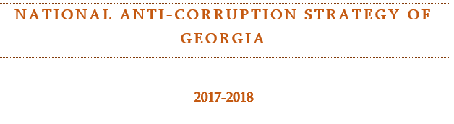
“. . . Georgia has moved to a new stage of the fight against corruption and similarly to the democratic European states, the main target for Georgia now is to achieve a high level of transparency and accountability, to increase access to information and enhance the involvement of citizens, to further improve corruption prevention mechanisms and apply technologies and innovations in the public governance.”

Slide 4

United Nations Convention Against Corruption (Art. 9)
Public Information
Advance award criteria and publication
Objective and predetermined criteria for award
Bid protest and appeal
Measures to control procurement personnel – e.g., rules and codes
Transparency, including in budgeting and accounting

Slide 5




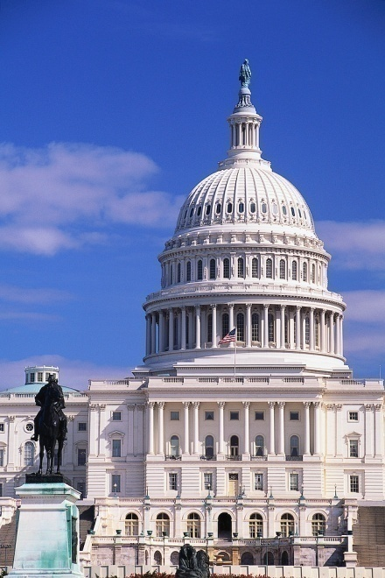





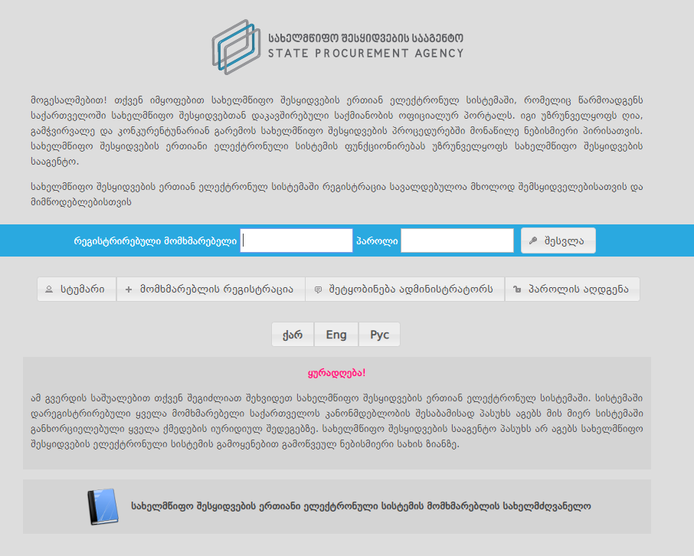
Tools for Fighting Corruption in Procurement
Corporate Compliance
Tender Boards
Audits
Exclusion / Debarment
Whistleblower
Ethics/Conflicts of Interest
Oversight
Anti-Fraud
Bid Challenges
Transparency
Prosecution

Slide 6
Tender boards

Slide 7
Current Georgia Law
3-person tender committee on electronic tenders (Art. 11)
Draft Georgia Law
Addresses personal conflicts of interest of board members
Practices To Consider
Separating technical and price evaluations boards from senior official making ultimate purchase decision
Tender Boards

Slide 8
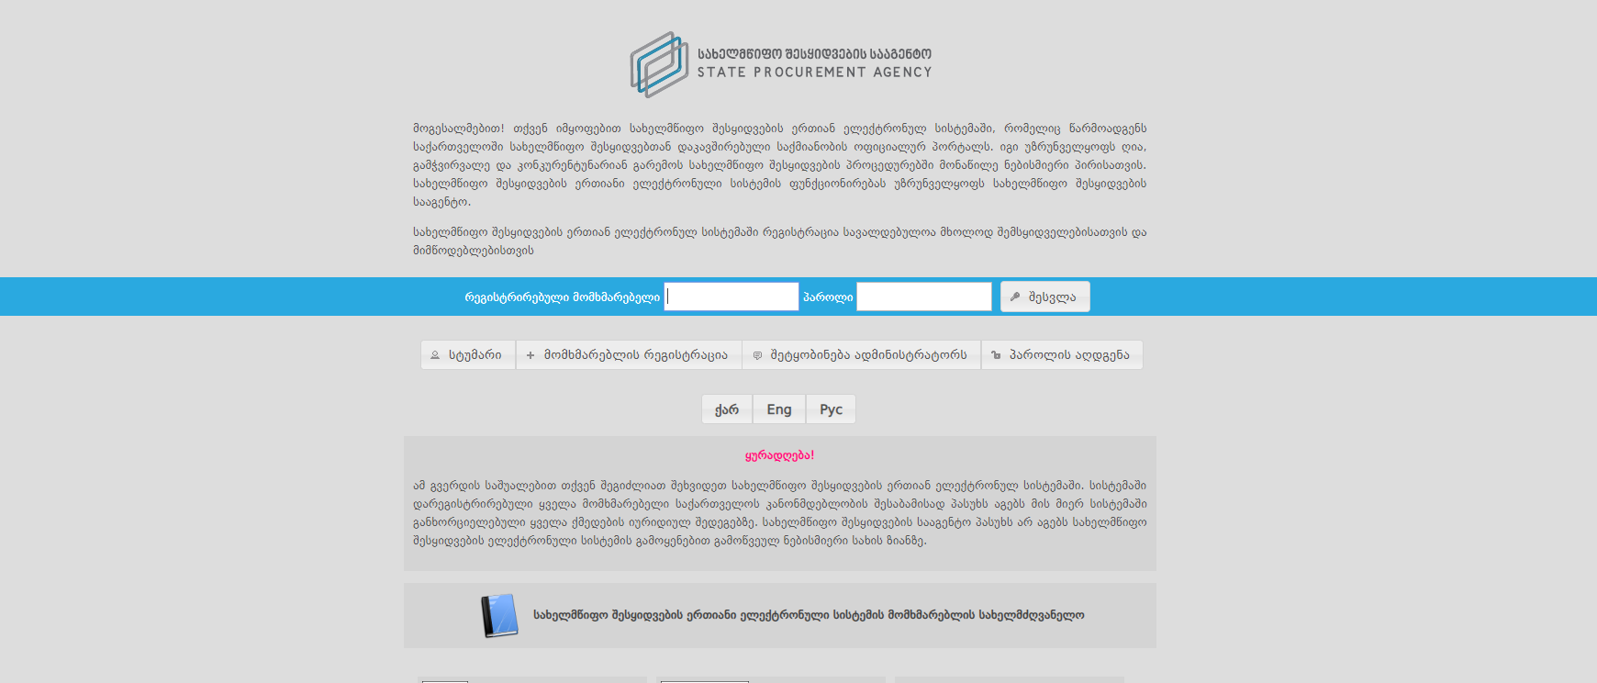
Transparency
“According to the . . . Report of Georgia issued by the Anticorruption Network of the Organisation of the Economic Cooperation and Development (OECD-ACN), ‘the State Procurement Agency (SPA) maintains one of the highest levels of transparency and openness of . . . public procurement in the world through the use of e-procurement platform.’”
National Anti-Corruption strategy of georgia
2017-2018

Slide 9
Open Government Partnership Action Plan of Georgia 2018-2019:
The Public Procurement Agency (PPA), with the support of the World Bank (WB) and the Department of International Development (DFID), also in cooperation with the Open Contracting Partnership (OCP) actively works on the introduction of the Open Contracting Data Standard (OCDS). It should be noted that the OCDS implies introduction of an open data standard for publication of structured information on all stages of a contracting process: from planning to implementation.
Accessible
Usable
Notes:
https://www.opengovpartnership.org/documents/georgia-action-plan-2018-2019/

Slide 10
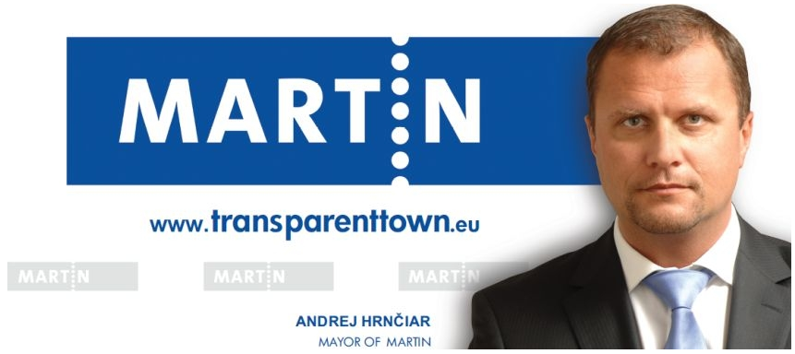

Slide 11

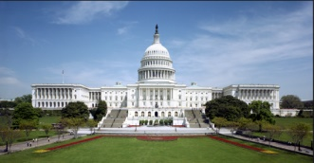

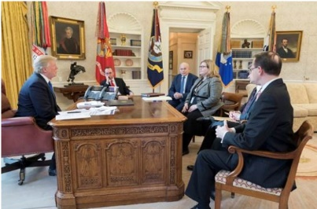
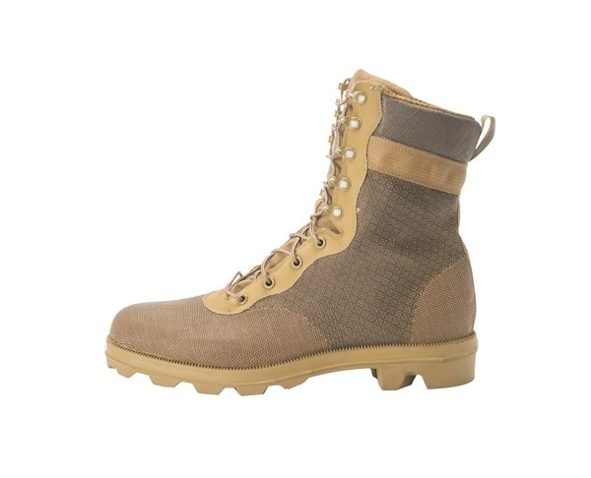
Online Solution
Centralized Purchasing Agency
Market
Users
Congress
MAJ Abraham Young, USA

Slide 12
Whistleblower Protection

Slide 13
Georgia Conflict of Interest Law
Protection for disclosing violation of conflicts of interest law or other law, which may hurt government reputation
Draft Georgia Procurement Law
Practices To Consider
Encourage procurement fraud whistleblower:
Allow to drive process
Lower proof standard regarding fraudulent intent
Bounty or special protection
Whistleblower

Slide 14
Corporate Compliance

Slide 15
EU Directive Calls for “Self-Cleaning” of Corrupt Contractors
Georgia’s Anti-Corruption Strategy 2017-2018 Calls for Corporate Integrity Measures, Especially in State-Owned Enterprises
Corporate Integrity Standards Are Parallel Across the Globe

Slide 16
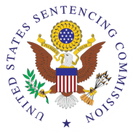


1. Standards and procedures | √ | √ | √ | √
2. Knowledgeable leadership |  | √ | √ | √
3. Exclude risky personnel | √ | √ | √ | √
4. Training | √ | √ | √ | √
5. Monitor, evaluate, reporting hotline | √ | √ | √ | √
6. Incentives and discipline | √ | √ | √ | √
7. Adjust program to risk | √ | √ | √ | √
Victim Compensation?
Notes:
Sources:
Serious Fraud Office, Approach of the Serious Fraud Office to Dealing with Overseas Corruption, at 1 (2009), available at http://www.sfo.gov.uk/media/28313/approach%20of%20the%20sfo%20to%20dealing%20with%20overseas%20corruption.pdf.
Lord Bach, Letter to Lord Henley re: Bribery Bill -- “Adequate Procedures’ Guidance (Dec. 2009), http://www.justice.gov.uk/publications/docs/bach-letter-adequate-procedures-guidance.pdf.
Ministry of Justice, Consultation on Guidance About Commercial Organisations Preventing Bribery (Section 9 of the Bribery Act 2010)

Slide 17
Mandatory Disclosure
U.S. contracting – contractor must disclose to contracting official and inspector general: Fraud Criminal conflict of interest Bribe or gratuity Significant Overpayment

Slide 18
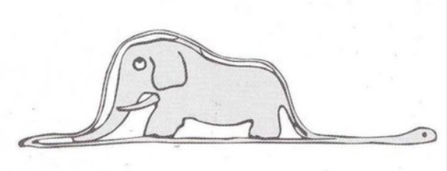
World Bank – Voluntary Disclosure Program
Antoine de Saint-Exupéry, The Little Prince

Slide 19
Ethics: Conflicts of Interest

Slide 20
Current Georgia Procurement Law
Personal conflict of interest if procuring or oversight official is relative or under common control (Art. 8)
Draft Georgia Procurement Law
Addresses personal conflicts of interest
Publishing committee minutes (notable best practice)
Practices To Consider
For procurement officials, stricter:
Official must declare any conflict
Vendor may not influence procurement or oversight
Gift limit
“Revolving door” limits
No disclosure of bidder or procurement-sensitive information
Publish common Code of Ethics for Contracting Entities, for vendors to mirror
Organizational conflict of interest (OCI) barred if unfair advantage (Art. 19) – for “equal treatment”?
Bar OCI’s for biased advice
Conflict of Interest
Georgia Conflict of Interest Law: Gifts not to exceed 15% of annual compensation.
Georgia Conflict of Interest Law: Officials not to disclose confidential information.
Georgia Conflict of Interest Law: 3-year “revolving door” bar against work at supervised entity.

Slide 21
Exclusion and debarment

Slide 22
Current Georgia Law
“White” list
“Black” list of mala fide (done with bad faith)
Draft Georgia Law
“Black” list, for:
Practices To Consider
Integrating vendor information into (1) qualification, (2) exclusion, and (3) past performance evaluations
Approach: assessing performance and reputational risks
Consider sharing information internationally
Crime
Poor performance
“Black” list applies to vendor’s “branches”
Limiting exclusion to affiliates with shared compliance
Clarifying compliance “self-cleaning” measures
“White” list looks more like simple registration
Exclusion/Debarment

Slide 23


USA vs. United Nations Model Law
United States: Qualification | UNCITRAL: Qualification
Adequate financial resources | Adequate financial resources; not insolvent
Technical qualifications | Technical qualifications
Integrity and business ethics | Integrity and business ethics
Capable of performing | Capable of performing
Necessary facilities | Necessary facilities
Satisfactory performance record | “Capability, reliability and experience”
Paid federal taxes | Paid taxes
Contractor and principals not convicted or debarred | Contractor and principals not convicted or debarred
Notes:
United States
FAR 9.401-1
UNCITRAL
Art. 9

Slide 24

U.S. Debarment - Discretionary
Suspension and Debarment Official
Investigators/ Prosecutors
Competitors
Contracting Officers
Criminal or Civil Fraud
Adverse Past Performance Reports
Other problems:
No uniform procedures
Huge disparity in actions
Suspension or Debarment
Administrative Agreement / Compliance

Slide 25

World Bank Sanctions System
Sanctions Board
Suspension and Debarment Officer (SDO)
Integrity Compliance
Officers (within INT)
Monitors integrity compliance by sanctioned companies (or codes of conduct for individuals)
Decides whether the compliance condition established by the SDO or Sanctions Board as part of a debarment has been satisfied.
Compliance
Comprised of 4 external members and 3 Bank staff
Reviews case ‘de novo’
May hold a hearing with parties and witnesses
Imposes sanctions (not bound by SDO’s recommendation)
Decisions are final and not appealable
39% of cases resolved at this level
Adjudicative
Evaluates evidence presented by INT
Issues Notice of Sanctions Proceedings to respondent
Temporarily suspends respondent
Recommends a sanction (becomes effective if respondent does not contest)
61% of cases resolved at this level
Investigates allegations of fraud, corruption, collusion, coercion and obstruction
Prepares and submits a Statement of Accusations and Evidence (SAE) to the Office of Suspension and Debarment
Integrity Vice Presidency
Investigative
Notes:
Quick little overview to get us started.
Where do Sanctions decisions come from?
As you can see from this chart:
39% of the decisions come from the Sanctions Board;
61% of decisions are made at the OSD level – so, most cases get resolved at the OSD level.
*As of October 2013
All cases are based on investigations by INT. My role as SDO is essentially that of an administrative judge.

Slide 26
Comparing Debarment Approaches
Responsibility (Qualification)
Discretionary Debarment – U.S. Federal
Based on “present responsibility”: focus on present status
Adjudicative Debarment for “Bad Acts””
E.g., World Bank
On a case-by-case basis
Court-Ordered Debarment, After Judicial Proceedings
In U.S. – done by contracting officer
Allowed by new EU Directives, 2014/24/EU Art. 57
Debarment is a cross-government determination
Reputation Risk
Performance Risk
Notes:
This slide tries to array different approaches to debarment against the various risks at issue. Thus, for example, a rigid system of automatic exclusion of convicted contractors (the right-hand shape) does quite well at addressing reputational risk, but is not as good an instrument for addressing, say, performance risk.

Slide 27


Trinidad & Tobago –
Example of Combined Approach
(3) The Office may add a supplier or contractor to
the ineligibility list where the supplier or contractor—
(a) consistently fails to provide satisfactory
performance;
(b) is found to be indulging in corrupt or
fraudulent practices; or
(c) is convicted of an offence under this Act.

Slide 28
Cross-Debarment
Country 1:
Debarment
Country 2:
Automatic Effect

Slide 29
Automatic cross-debarment
Exchange list and causes
Publicly list excluded vendors
Do nothing
Options for Cross-Debarment

Slide 30
Conclusion
Christopher Yukins
cyukins@law.gwu.edu

