Slide 1
POLISH PUBLIC PROCUREMENT LAW ASSOCIATION CONFERENCE
GROUNDS FOR EXCLUSION – APPLICATION PRACTICE IN EU/EFTA COUNTRIES AND the UNITED STATES
Suspension and Debarment in the U.S. Government -- Comparative Lessons for the EU’s Next Steps in Procurement
Christopher R. Yukins
Lynn David Research Professor in
Government Procurement Law
The George Washington University Law School
30 Sept. 2019

Slide 2
Introduction

Slide 3

George Washington University
Law School
Providing traditional and online procurement law training to students from around the world
Government Procurement Law Program, established 1960

Slide 4
Procurement Law Centers: 2000
Nottingham.
Washington, D.C.

Slide 5
Procurement Law Centers Today
Stockholm
Vilnius
Copenhagen
Moscow
Northern China
Nottingham.
Munich
Paris
Poland
Beijing
Washington, D.C.
Aix-en-Provence
Galicia
Turin
Rome
Stellenbosch

Slide 6
Research Resources

Slide 7
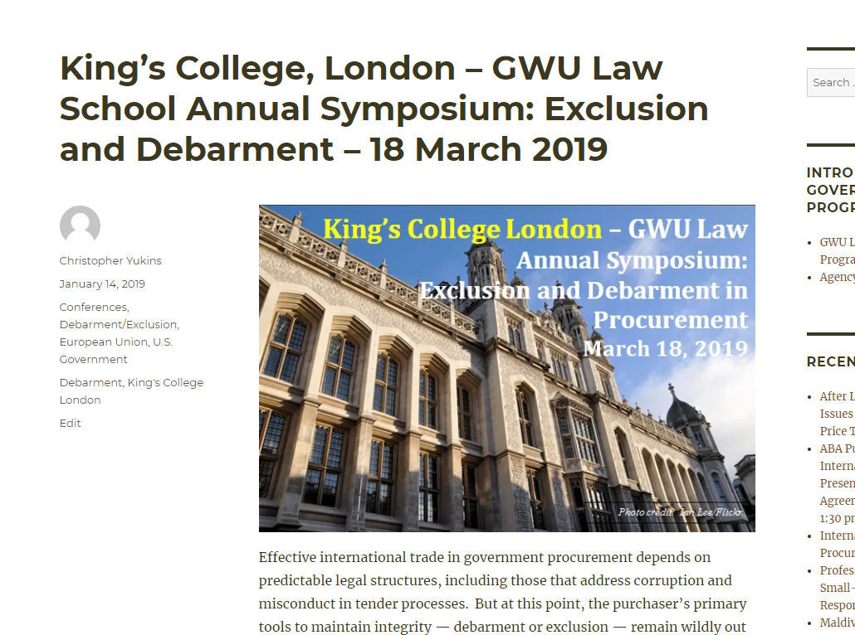
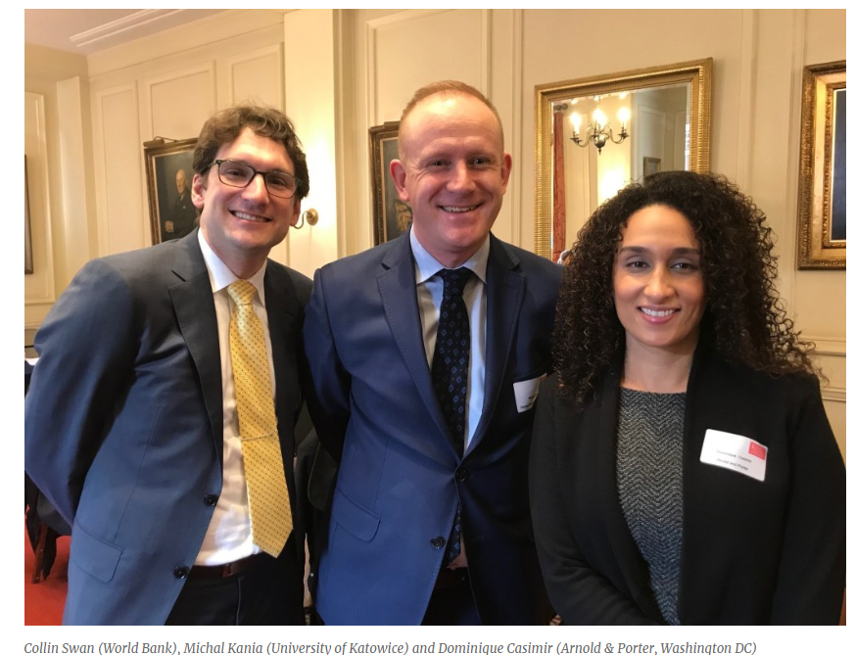
https://publicprocurementinternational.com/2019/01/14/kings-college-london-gwu-law-school-annual-symposium-exclusion-and-debarment-18-march-2019/

Slide 8
Readings
Steven L. Schooner, Desiderata: Objectives for a System of Government Contract Law (PPLR 2002), https://papers.ssrn.com/sol3/papers.cfm?abstract_id=304620
Christopher R. Yukins, A Versatile Prism: Assessing Procurement Law Through the Principal-Agent Model (PCLJ 2010), https://ssrn.com/abstract=1776295
Johannes Schnitzer & Christopher Yukins, Combatting Corruption in Procurement, in UNOPS: Future-Proofing Procurement 26-29 (2015), https://content.unops.org/publications/ASR/ASR-supplement-2015_EN.pdf?mtime=20171214185135
Christopher Yukins & Michal Kania, Suspension and Debarment in the U.S. Government: Comparative Lessons for the EU’s Next Steps in Procurement, 19-2 UrT 47 (2019), https://ssrn.com/abstract=3422499

Slide 9

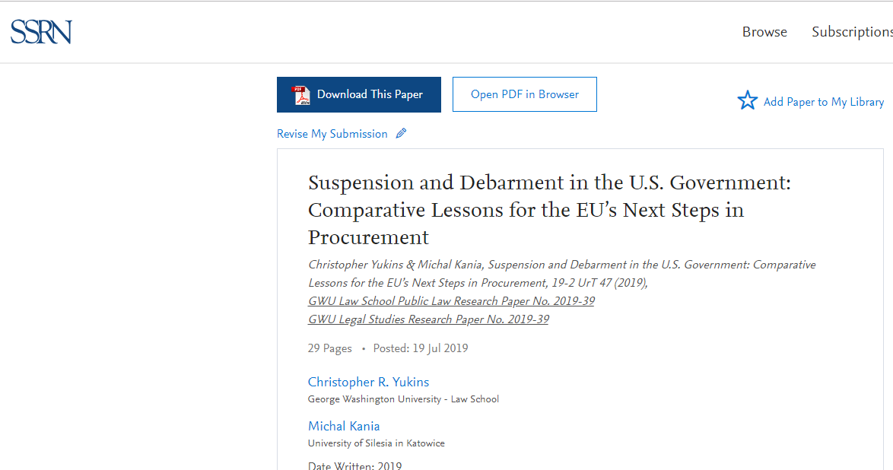

Slide 10
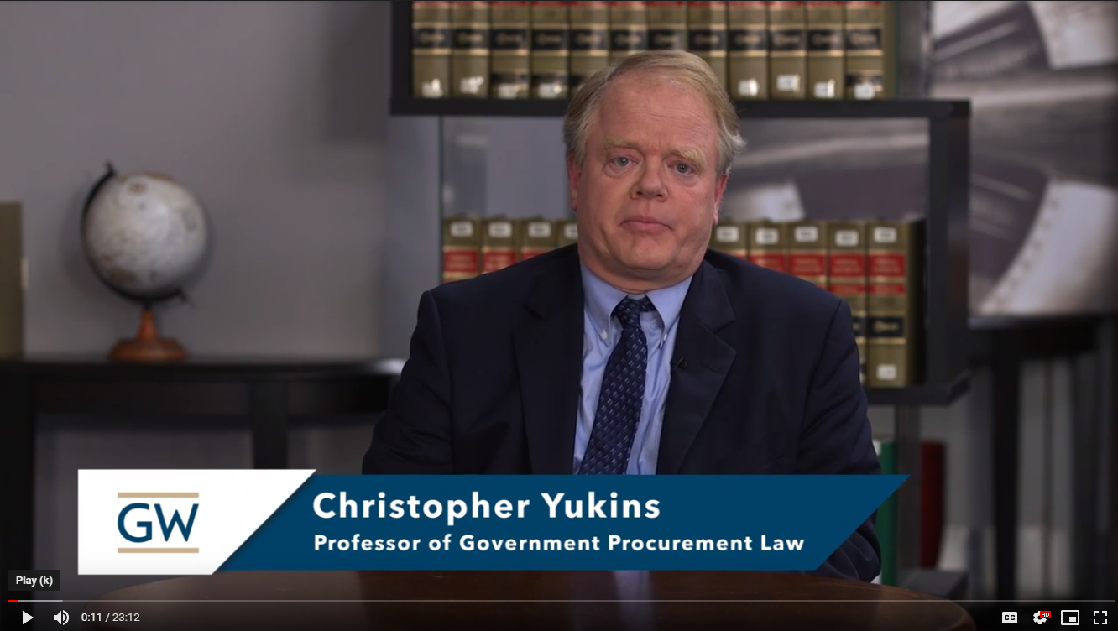
“Introduction to U.S. Federal Procurement”
Video
Text

Slide 11
Professional Exchanges
Open Online Courses
(free or certificate)
Traditional Classroom –
Online Classroom
Teaching Strategies

Slide 12
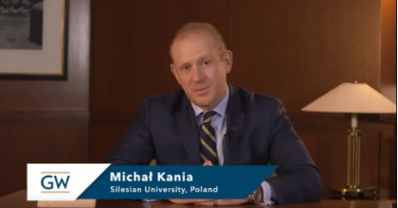
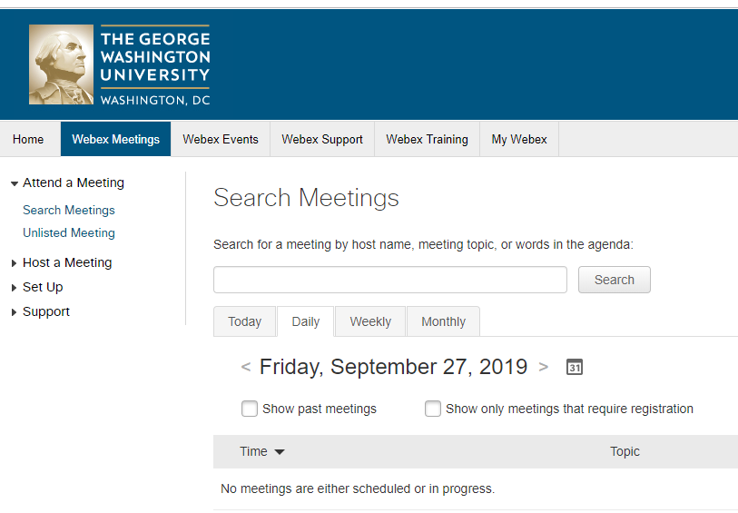
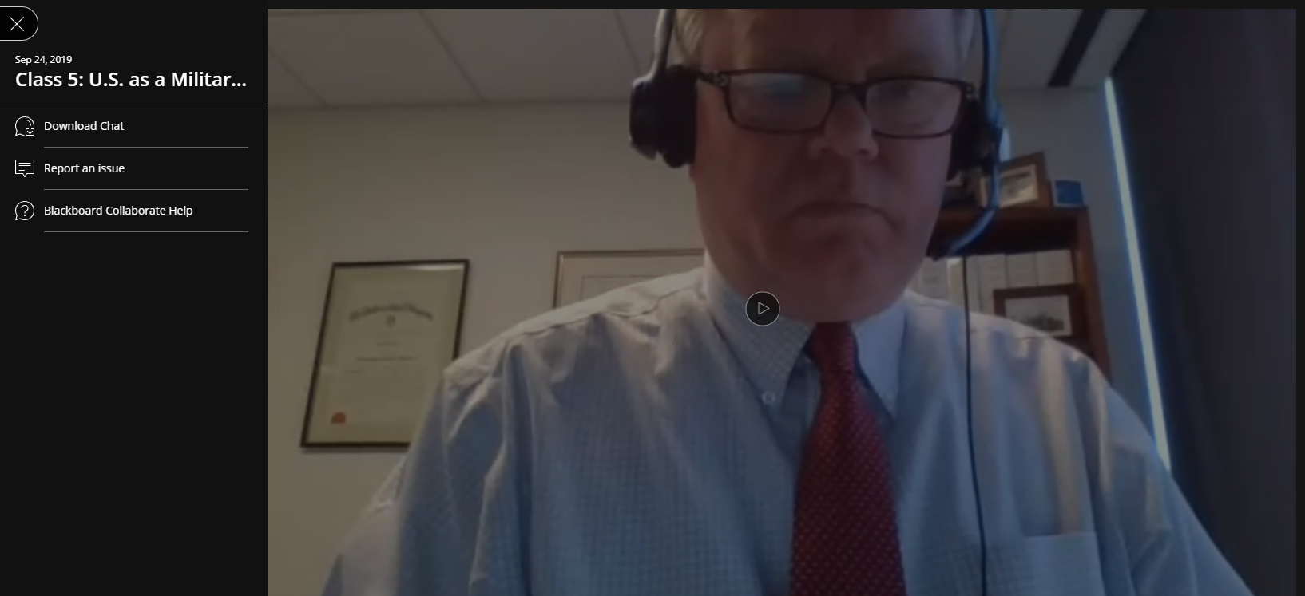
Basic Elements of Online Teaching
Reading
Video Conference
Video Lecture

Slide 13
Theoretical Models

Slide 14
Protecting Procurement
Remedies
Prosecution
Compliance
Ethics
Exclusion
Qualification
Price
Technical
Past Performance
AWARD

Slide 15
Principal-Agent Model
MONITORING
Agent 1
Official
Agent 2
Contractor
Purchase
Principal
Qualification
Exclusion
BONDING (SANCTIONS)
Notes:
Bribery?
Gratuity?
Personal conflict of interest?
Organizational conflict of interest?
“Kickback” to vendor?
Fraud?
Collusion?
Other forms of market barriers?

Slide 16
What Risks Do Qualification and Exclusion Address?
Reputation
Performance
Fiduciary

Slide 17
Is Qualification the Same All Over the World?

Slide 18


U.S. vs. UNCITRAL
United States | UNCITRAL
Adequate financial resources | Adequate financial resources; not insolvent
Technical qualifications | Technical qualifications
Integrity and business ethics | Integrity and business ethics
Capable of performing | Capable of performing
Necessary facilities | Necessary facilities
Satisfactory performance record | “Capability, reliability and experience”
Paid federal taxes | Paid taxes
Contractor and principals not convicted or debarred | Contractor and principals not convicted or debarred
QUALIFICATION STANDARDS: UNIFORM
Notes:
United States
FAR 9.401-1
UNCITRAL
Art. 9

Slide 19
How To Exclude?

Slide 20

Exclusion by Non-Qualification
1

Slide 21

U.S. Federal Discretionary Debarment
2
Suspension and Debarment Official
Investigators/ Prosecutors
Competitors
Contracting Officers
Criminal or Civil Fraud
Adverse Past Performance Reports
Suspension or Debarment
Administrative Agreement / Compliance

Slide 22

World Bank Sanctions System
3
Sanctions Board
Suspension and Debarment Officer (SDO)
Integrity Compliance
Officers (within INT)
Monitors integrity compliance by sanctioned companies (or codes of conduct for individuals)
Decides whether the compliance condition established by the SDO or Sanctions Board as part of a debarment has been satisfied.
Compliance
Comprised of 4 external members and 3 Bank staff
Reviews case ‘de novo’
May hold a hearing with parties and witnesses
Imposes sanctions (not bound by SDO’s recommendation)
Decisions are final and not appealable
39% of cases resolved at this level
Adjudicative
Evaluates evidence presented by INT
Issues Notice of Sanctions Proceedings to respondent
Temporarily suspends respondent
Recommends a sanction (becomes effective if respondent does not contest)
61% of cases resolved at this level
Investigates allegations of fraud, corruption, collusion, coercion and obstruction
Prepares and submits a Statement of Accusations and Evidence (SAE) to the Office of Suspension and Debarment
Integrity Vice Presidency
Investigative
Notes:
Where do Sanctions decisions come from?
As you can see from this chart:
39% of the decisions come from the Sanctions Board;
61% of decisions are made at the OSD level – so, most cases get resolved at the OSD level.
*As of October 2013
All cases are based on investigations by INT. My role as SDO is essentially that of an administrative judge.

Slide 23
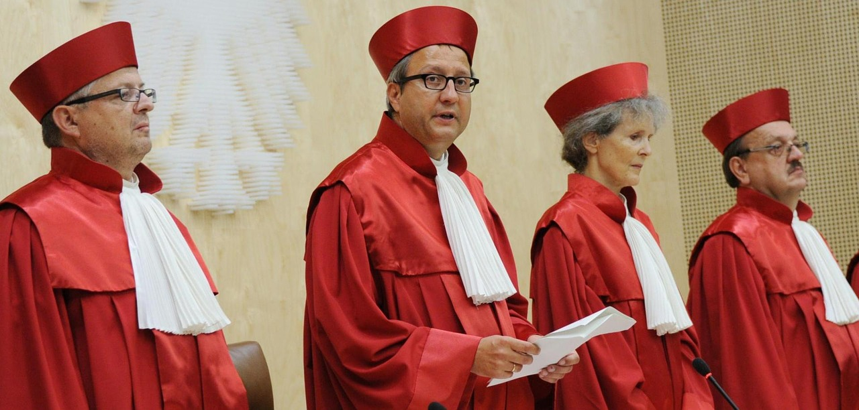
Exclusion by Court Order
4

Slide 24
Four Paradigms for Exclusion
Qualification
Only
On a case-by-case basis
Adjudicative Debarment for “Bad Acts”
E.g., World Bank
Discretionary Debarment – U.S. Federal
In U.S. – done by contracting official
Debarment is a cross-government “meta-qualification” determination
Based on “present responsibility”: focus on present status
Court-Ordered Debarment, After Judicial Proceedings
Allowed by EU Directives
Performance Risk
Reputation Risk

Slide 25
How To Resolve Exclusion:
Self-Cleaning (“corporate Compliance”)

Slide 26
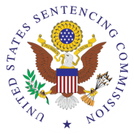



1. Standards and procedures | EU Directive Art. 57: “Concrete technical, organisa-tional and personnel measures” | √ | √ | √
2. Knowledgeable leadership |  | √ | √ | √
3. Exclude risky personnel |  | √ | √ | √
4. Training |  | √ | √ | √
5. Monitor, evaluate, reporting hotline |  | √ | √ | √
6. Incentives and discipline |  | √ | √ | √
7. Adjust program to risk |  | √ | √ | √
Victim Compensation?
Notes:
Sources:
Recital 102 interprets Art. 57:
(102) Allowance should, however, be made for the possibility that economic operators can adopt compliance measures aimed at remedying the consequences of any criminal offences or misconduct and at effectively preventing further occurrences of the misbehaviour. Those measures might consist in particular of personnel and organisational measures such as the severance of all links with persons or organisations involved in the misbehaviour, appropriate staff reorganisation measures, the implementation of reporting and control systems, the creation of an internal audit structure to monitor compliance and the adoption of internal liability and compensation rules. Where such measures offer sufficient guarantees, the economic operator in question should no longer be excluded on those grounds alone. Economic operators should have the possibility to request that compliance measures taken with a view to possible admission to the procurement procedure be examined. However, it should be left to Member States to determine the exact procedural and substantive conditions applicable in such cases. They should, in particular, be free to decide whether to allow the individual contracting authorities to carry out the relevant assessments or to entrust other authorities on a central or decentralised level with that task
Serious Fraud Office, Approach of the Serious Fraud Office to Dealing with Overseas Corruption, at 1 (2009), available at http://www.sfo.gov.uk/media/28313/approach%20of%20the%20sfo%20to%20dealing%20with%20overseas%20corruption.pdf.
Lord Bach, Letter to Lord Henley re: Bribery Bill -- “Adequate Procedures’ Guidance (Dec. 2009), http://www.justice.gov.uk/publications/docs/bach-letter-adequate-procedures-guidance.pdf.
Ministry of Justice, Consultation on Guidance About Commercial Organisations Preventing Bribery (Section 9 of the Bribery Act 2010)

Slide 27
EMERGING ISSUES

Slide 28
Cross-
Debarment
Options:
1. Automatic cross-debarment
2. Lists of debarred firms considered
3. Lists + underlying information
4. Do nothing

Slide 29
Why Exclusion Grows More Important
Major Systems
Robust qualification information
Middle-Tier Acquisitions
Qualification Information
Reliance on Low-Price (25% in Defense Department) = No Past Performance, No Technical
Micro-Purchases to $10,000 (“amazon.gov”)
User purchases through electronic marketplaces
Exclusions recognized
Performance-related qualification information
Technical and Past Performance considered

Slide 30
 | Federal Acquisition Regulation (FAR) | European Procurement Directive 2014/24/EU | World Bank Procurement Framework | WTO Government Procurement Agreement (2012) | ABA Model Procurement Code
Acquisition Planning
Publication of Opportunities
Electronic Reverse Auctions
Sealed Bidding
Competitive Negotiations
IDIQs (Frameworks)
Publication of Awards
Bid Protests
Suspension-Debarment
Contract Administration

Slide 31

Conclusion
Christopher R. Yukins
cyukins@law.gwu.edu
+1 703 304 4773 (mobile)

