Slide 1
The Devastating Consequences of Corruption in Public Procurement – Presentation of Croatian Cases Maja Kuhar president State Commission for Supervision of Public Procurement Procedures

Slide 2
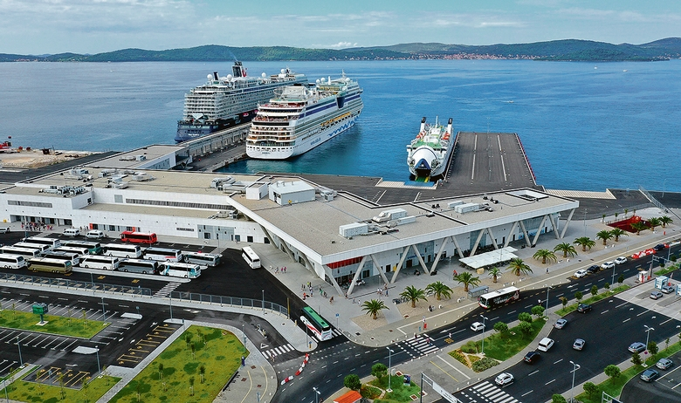
1. Port Gaženica Case (Zadar Cruise Port) - 2008

Slide 3
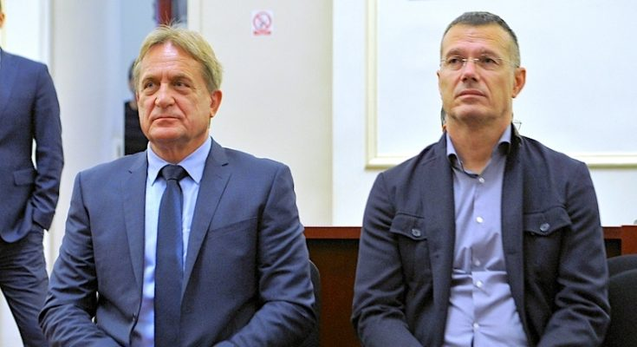
1. „Port Gaženica” case (Zadar Cruise Port) - 2008 minister of transport and infrastrucure and his State Secretary

Slide 4
1. Port Gaženica (Zadar Cruise Port) - 2008
Remorker company
(Million euro)
I.P.
Strabag
Minister of transport
Public company for road constructions
(3 directors)
J.S.
J.S.
I.P.
20%
State secretary
Minister of transport
Public procurement procedure for construction of Port Gaženica
only two bids
State secretary

Slide 5
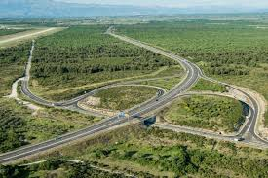
2. The „Kalmetina” case – access roads to port Gaženica- 2008 minister of transport and infrastrucure and his State Secretary

Slide 6
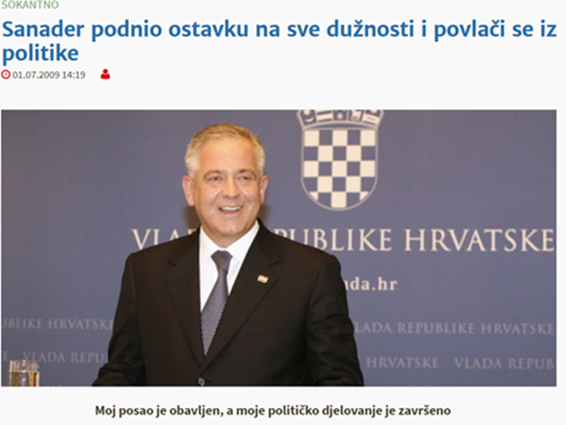
3. The „FIMI Media” case – 2007 Croatian Prime Minister resignes in 2009

Slide 7
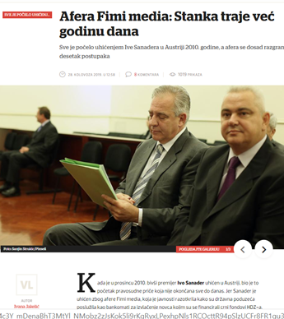
3. The „FIMI Media” case - 2007

Slide 8
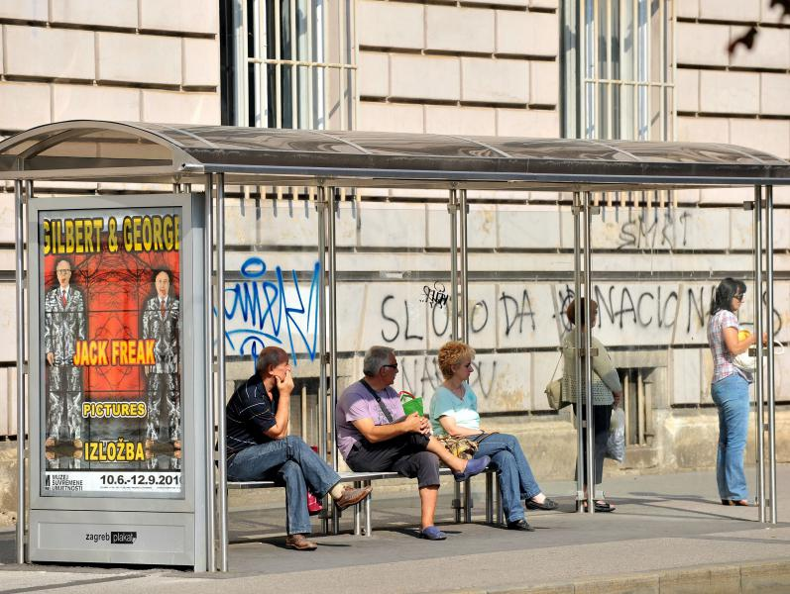
4. „Tram stops” case

Slide 9
Thank you for your attention

