Slide 1
Procurement Anti-Corruption Event
28th October, 2019
Tbilisi, Republic of Georgia

Slide 2
Agenda
Corruption in public procurement
Case-study
Public Procurement Corruptions Patterns
Famous Romanian Corruption Cases

Slide 3
Corruption in public procurement
Case-study
Organization: Children's Clinical Hospital of X City - state hospital, public network
Principal Agents/Public servants involved: 1) General Manager, 2) Economic manager
Beneficiary: Two companies from the same city, the W City, having the same administrator

Slide 4
2017 - Two Works Contracts are concluded in order to arrange the space for the endoscopy cabinet within the hospital (surface of 108.40 m²), finally paying unjustified large amounts, over the right price.
The Children's Clinical Hospital published in the SEAP – Electronic System of Public Procurement (the electronic platform that ensures the transparency of the procurement process and procedures) a notice - Participation notice no.1750451/4th of May 2017 regarding the organization of the tender procedure for the award of the contract with the object "Arrangement of space for the endoscopy office/cabinet"

Slide 5
Several appeals were filed in this procedure, and by the Court Decision no.3485/3th June 2017 of the Court of Appeal, the Hospital was forced to adopt several remedial measures in the procedure.
The hospital chose to cancel the entire award procedure, reasoning that, in executing the court's provisions, it cannot intervene on the technical specifications after opening the tenders.
The measure of annulment of the procedure was challenged by another company (commercial company), and the claim was admitted by the Court Decision no.2100/10thJuly 2017 of the Court of Appeal X.
The annulment decision was canceled and the award procedure was resumed from checking of the admissibility stage tenders.

Slide 6
The clinical hospital has not yet completed this procedure, on 12th August 2017 informing the participants that the technical proposals have been analyzed and will proceed to the next phase of the evaluation process, the analysis of the financial proposals.
Meanwhile, the Hospital has also initiated a negotiation procedure without prior publication of a contract notice for the award of the execution contract.
In this regard, SC A LTD ( Company A in text) was invited through participate notice no.282/9th.October 2017, and SC B LTD (Company B in text) through participating notice no.289/9th October 2017.

Slide 7
  The clinical hospital claimed that organizing the negotiation procedure without prior publication of a participation notice (for the award of the execution contract) respects the conditions of the law - art.104 paragraph 1 letter c of the Law no.98/2016.
The hospital justified being a necessary measure in a extremely urgent situation, taking into account the medical emergencies and the time period required to complete the open tender procedure still in progress.

Slide 8
  The endoscopy cabinet development works consist of:
- Works to get rid of old medical equipment,
- Cleaning of walls, old painters, tiles, removing old electrical installations,
- Casting of screed, tiles, walls and ceilings of gypsum board, washable and acrylic paints, applying tiles,
- New electrical installations, new installation routes to be executed
- New electrical equipment, introducing electrical routes and safety installations
- Old air conditioning and heating systems changed

Slide 9
The hospital divided the works into two groups:Lot (Group of works) no.1Lot value 1: 251,056.5 RON = 52,854 Euro (1 EURO = 4.75 RON)The works consist of:- Disposal of old medical equipment,- Removing plumbing- Cleaning of walls, old painters, faience, tiles, removing old electrical installations,- Molding of screed, tiles, walls and ceilings of plasterboard, Washable and acrylic paints, application of tiles, - Supply and installation of sanitary installationsThe hospital assigned Lot no.1 to Company A

Slide 10
The contract of works no.64/PL/15th November 2017 was concluded between the Children's Clinical Hospital of City X as beneficiary
Lot (Group of works) no.2
The value of the lot was established: 344,527 RON = 72,532 Euros (1 EURO = 4.75 RON)
The works consist of:
Removing old electrical installations and equipment,
Execution of new electrical installations, new installation routes

Slide 11
The hospital assigned Lot no.2 to Company B
The works contract no.65/PL/15 November.2017 is concluded between Children's Clinical Hospital of City X as beneficiary and Company B as executor.
Both contracts are signed by the representatives of the contracting authority - General Manager Mrs. S and Mr. T. Economic Director.
In both contracts was mentioned that the duration of the contract and the value of the contract can be increased, on the basis of necessity notes (NN) and with the approval of the construction/site manager

Slide 12
The value of the lots was established on the basis of the necessity report no. 873 / 20.04.2017.
The report did not indicate the average market value of the works to be executed, and did not contain a comparative analysis of the types of works on the market.
The works began to be executed after 25.11.2017 when the order of the Hospital X is issued.
The works are set to last until 22.03.2018.

Slide 13
In this respect, was signed the Additional Act No.1 to the Works Contract no.65 / PL/15th November 2017 between the City X Children's Clinical Hospital as beneficiary and Company B as executor.
By this additional act, the execution term passes from the estimated date 22nd March,2018, to 22nd April.2018, and the price increased by 40,579.25 RON = 8,543 Euro Lot no. 1 was finished on 22nd March 2018.
Lot no.2 was finished on 22nd April 2018.

Slide 14
For both contracts, the reception commissions was headed by the Economic Director of the Clinical Hospital, Mr. T, and the minutes of the reception are concluded.
The works - considered appropriate.
In total, the Hospital pays: 251,056.5 RON (52,854 E) Lot 1 + 344,527 RON (72532 E) Lot 2 + 40,579.25 RON (8543 E) additional works Lot.2 = 636,162.5 RON =133,929 EUR
On 10th September 2018, the Romanian Court of Accounts - Public Audit Directorate County X began an audit for 2017 public procurement contracts in X City hospitals.

Slide 15
Public Audit Directorate developed the Audit Report no. 671/04.11.2018 for public procurement contracts at the Children's Clinical Hospital of City X.
For the two works contracts no.64 and 65 PL/15th November 2017 an evaluating expertise was performed.
The evaluation report no.674/2nd February 2019 established that the correct market value of the entire work - Planning of the space for the endoscopy cabinet with a surface of 88.40 within the hospital must be391.770.5, ie 82,478 Euro.

Slide 16
The Hospital Board of Directors, meeting on 11th March 2019, decided to recover the damage from those responsible for its production - Manager Ms.S (at this moment retired) and Economic Director - Mr.T, who no longer works at the Hospital, in equal percentage – 50% each.
They challenge in court the imputation act.
The hospital cannot add some of the invoices to the court

Slide 17
The court requested the two companies – Company A, Company B to communicate the invoices.
One of the companies was, at the time of the trial, dissolved – Company B, and Company A cannot identify all the invoices.
There was a technical expertise to evaluate the works in situ (on the ground) which finds that the works do not exceed in total 85,520 Euros, being a difference of 48,409 Euros

Slide 18
This concrete case described corresponds in
THE RELATIONAL MODEL OF CORRUPTION IN PUBLIC ACQUISITIONS
Figure 1 - highlights the main actors with different roles in the production of corruption facts, as well as the relationships that are established between them

Slide 19
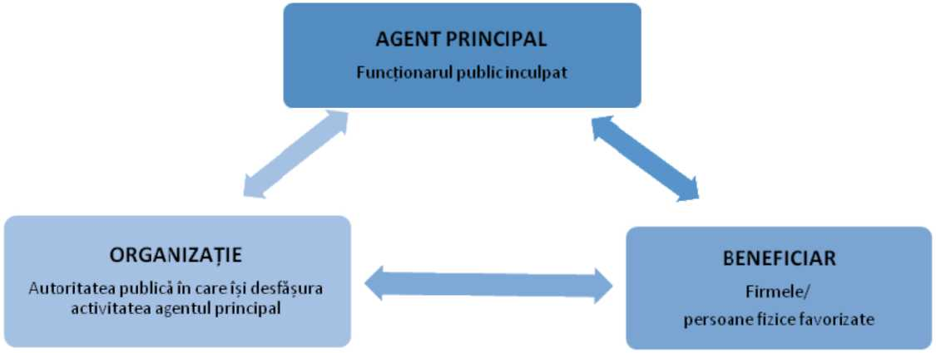
Figure 1
PRINCIPAL AGENT
ORGANIZATION
BENEFICIARY
Principal Agent

Slide 20
Figure 2
Principal Agent | the civil servant – office clerk - who coordinates the corruption activity. It has, most of the times, a decision-making function, whether it is a director, elected or appointed, of the public institution, or head of the structure that manages the budget (economic director).The function it occupies, by law, gives it certain prerogatives, its "power" within the institution being sometimes enhanced by the political position it occupies. failure to perform or by failing to perform the duties.
Organization | the public institution, in the case of the present analysis, belonging to the local public administration (mayors, county councils, institutions subordinated to them, etc.). The institution represents the "land" on which the act of corruption is manifested.
Beneficiary | the economic agent / natural person who unjustifiably receives public money / land (the proceeds of the crime).As regards public procurement, companies can be acquired or set up specifically to carry out contracts with that public institution or companies that, traditionally, carry out contracts with the state.

Slide 21
  Principal Agent - Manager - Ms. S and Economic Director Mr. T
Organization - public institution - Children's Clinical Hospital X City
Beneficiary - The Company A and Company B with the same administrator

Slide 22
The ways in which the public procurement procedure has been fraudulent, through corruption:
Pre-award
1) Abandoning the transparent and competitive procedure
2) An unjustified use of the emergency procedure
3) Dividing the purchase into several lots with lower values ​​in order to avoid competitive procedures;
4) Lack of adequate price analysis;
Post-award
Additional contracts, which increase the prices above the offered limit

Slide 23
Pre-award
The hospital, through its manager, justified the abandonment of the tender procedure, (which required publication of the notice in the SEAP and the comparative analysis of some offers), on exceptional provisions of the national law that transposed Directive 2004/24/EU
The Law no.98/2016 says in article 69:
The contracting authority shall award public procurement contracts/framework agreements, if the estimated value is greater than or equal to the value thresholds provided for in Article 7 paragraph 1 by applying the open or restricted tender procedures.
  By exception from the provisions of the first paragraph, the contracting authority has the right to apply the negotiation procedure without prior publication of a participation notice exclusively in the cases and conditions provided in art.no.104

Slide 24
Art. 104 paragraph 1 letter c of the Law no.98 / 2016
The contracting authority has the right to apply the negotiation procedure without prior publication of a contract notice for the award of public procurement contracts/ framework agreements for works, products or services as a strictly necessary measure, when the periods of application of the procedures open tender, restricted tender, competitive negotiation or simplified procedure cannot be respected for extremely urgent reasons, caused by unforeseeable events/circumstances and which are not due in any form to an action or inaction of the contracting authority.
In situations where immediate intervention is required, the contracting authority has the right to make the public procurement in parallel with the application of the negotiation procedure without prior publication of a participation notice.

Slide 25
The hospital illegally abandoned the negotiation procedure with the prior publication of the contract notice for awarding the execution contract for endoscopy cabinet works.
It did not justify (by a specific note) the real urgency and the application of art. 104 paragraph 1 letter c of the Law no.98/2016.
Only the precarious condition of the hospital's endoscopy cabinet was not sufficient for this emergency procedure.
The legislator has imposed that the use of this procedure be in cases of extreme urgency, determined by unforeseeable events and which are not due in any form to an action or inaction of the contracting authority.

Slide 26
Also, the work could be auctioned individually, there are companies that have as object of activity all the works that have been entrusted separately in two lots.
However, it was observed at the control that there are two companies in the same city and that have the same administrator, being in fact one person behind both companies.
An adequate analysis of market prices for all categories of works was not done by the hospital.

Slide 27
Post-award
The additional works could and had to be identified from the completion of the technical project that was part of the award documentation, because it was clear that the hospital facilities were all old and needed to be replaced.
The additional works were over-evaluated.

Slide 28
Post Scriptum
The two persons who must repay the money do not have funds and assets to recover the damage.
There are appropriations set up on their incomes but as pension income - Ms S and salary - Mr T, the state cannot exceed more than 1/3 a month from incomes.

Slide 29
Famous Romanian Corruption Cases
1 . MICROSOFT CASE
2004 Starting in
The Microsoft licensing corruption scandal - a political scandal and criminal investigation in Romania, involving large bribes paid to Romanian government members in exchange for approving increases in license fees for Microsoft products.
In September 2014, National Anticorruption Directorate, (DNA) announced that it started prosecuting nine former ministers in a case related to overpriced IT licenses public acquisitions for schools in Romania, also known as the Microsoft case. The damage in this case was estimated at almost USD 67 million.

Slide 30
Nine government ministers, including 2 PM have been charged.
They are belonging to the former PM Năstase, Tăriceanu and Boc Cabinets. The bribes were estimated at more than $67 million.
Apart from Microsoft, this scandal involved several major multinational corporations, including Fujitsu-Siemens, IBM, Compaq, Hewlett-Packard, S&T and local software companies like SIVECO and Softwin.^{[3]}
The first contract for the purchase of Microsoft IT licenses for schools in Romania was signed in 2004, during Adrian Nastase’s government. The contract wasn’t signed directly with Microsoft, but with Fujitsu Siemens Computers, and the prices of the licenses was highly inflated.

Slide 31
The ministers who were being prosecuted for this initial contract were former education ministers EA and A A, former finance minister M. T., former communications ministers D. N. and A. T., and former government general secretary S. M.
The DNA dropped the charges against former education minister D. F., as the accusations against him were unsubstantiated.
DNA has managed to get final convictions in this case against former communications minister G. S., former Piatra Neamţ mayor G. S., and local businessmen N.D. and D: C:.
The prosecutors also sent to court local businessmen C.F. and D. P., the men who intermediated the closing of the license purchase contracts and also benefited from these contracts.

Slide 32
According to prosecutors, Mr.C got a bribe of EUR 9 million from businessmen C.F and D.P. so that his wife at that time, U. E., who was minister of Development, would help seal the deal regarding the software licenses between F’s firms and the Ministry of Communication.
Former Communications minister V. V. and former Microsoft Romania CEO were also sent to court in this case.
Former minister S. said that the black money from the Microsoft affair was also used to finance political campaigns in Romania.
Lately, DNA has dropped the charges against seven of the former ministers due to a judicial error.
The prosecutor who initially investigated the case was dismissed in Summer, 2017, and the DNA chief prosecutors asked the Judicial Inspection to investigate if the prosecutor respected the procedures.

Slide 33
This is DNA’s biggest failure to date, given the magnitude of this case.
On February 1, 2018, the DNA announced that it had to drop the charges against seven former ministers who were being prosecuted in this case because they were indicted after the limitation period for their charges expired.
The prosecutor who initially investigated this case indicted the seven former ministers in January 2015 but the limitation period expired at the end of 2014. The ministers were charged with abuse of office, for which the limitation period is 10 years.

Slide 34
The Zeus Affair
2019, September - Constantin Nicolescu, former SDP president of County Council Arges, was definitively sentenced to 7 years and 8 months in prison, but will not go in jail.
The judges also canceled the disposition of the substantive court regarding the confiscation of the 4.5 million lei ( 1 million Euro) from Nicolescu.

Slide 35
Former President of Arges County Council, Constantin Nicolescu, was definitively sentenced on Tuesday by the High Court of Cassation and Justice to 7 years and 8 months in prison for taking bribes, but the court upheld a previous decision on conditional release from prison.
According to DNA, in March 2011, CJ Arges, as a contracting authority, organized a public procurement procedure through an open tender, which aimed to rehabilitate two flood-affected bridges, located on county roads, in the localities of Căteasca and Ciomăgeşti, respectively.

Slide 36
The respective funds came from accessing a project funded by PHARE funds, aimed strictly at the rehabilitation of the road infrastructure and environmental objectives affected by the floods of April - May and July - August 2010.
In order to access the European money, officials from County Council Argeş testified unrealistically in the financing request, that the respective bridges had been affected by the floods, although one of them, the one from Căteasca commune, had been damaged previously, so it was not eligible for the project..

Slide 37
DNA stated that the forged document was used and presented to the Ministry of Public Works and Housing Development and to the South - Muntenia Regional Development Agency and, as a result, the grant agreement was concluded based on which payments from the PHARE Program were made in value of about 985,000 euros, the equivalent of over 4.4 million lei, funds obtained unfairly, representing damage created to the Ministry of Regional Development.

Slide 38
During 2012, following the auction organized by CJ Arges, the contract for the rehabilitation of the Căteasca bridge was illegally awarded to the company Zeus SA, given that, initially, the winner of the auction had been declared another company, subsequently removed, arbitrarily, by the evaluation commission, after the resumption of the procedure ordered by Constantin Nicolescu.
The construction works were performed by SC Zeus and Dracones Construct Grup SRL Pitesti,

Slide 39
, the latter having as associate the son-in-law of the County Council Arges president.
Moreover, the supplier of goods for the construction of the work was SC Setro Metal Group SA Câmpulung, a company also controlled by a close relative of the president CJ Arges.
Based on counterfeit documents, during a completely forged procurement procedure, during June 2012, CJ Arges awarded to the same company, SC Zeus, a contract worth almost 5 million RON (1 million E), for alleged additional works on the same bridge, which in fact they were no longer justified.

Slide 40
During 2012, Constantin Nicolescu received with bribe title from Grigore Dobre, majority shareholder and administrator of SC Zeus, a commercial space located in the city of Pitesti, with an area of ​​over 300 sqm, worth 447,000 lei.
In order to conceal the crime of corruption, on March 23, 2012, at the Public Notary's Office Didea Ionel a fictitious sale-purchase contract was concluded.
In the course of the public tender procedure, as well as during the process of carrying out the contract, several documents were falsified (construction site provisions, reports of necessity, minutes etc.) ”, the investigators stated.

Slide 41
Through the activities described, it was established that a damage amounting to almost 985,000 euros was created at the expense of the Ministry of Regional Development, representing European funds obtained unfairly through the presentation of false documents, and a damage of almost 9.5 million lei to the contracting authority's damage. – County Council Arges, which constitutes an undue patrimonial advantage in favor of SC Zeus SA Piteşti.

Slide 42
Deficiencies of the institutional system
The central functions of the public procurement system are distributed in a fragmented and redundant way between the following institutions with key competences in this area (the situation IN April 2015):
ANAP, former ANRMAP - regulatory functions, consultative and operational support, ex-ante verification of the award documentation, partial ex-post control, monitoring and international cooperation;

Slide 43
CNSC - independent body with administrative-jurisdictional activity, for the resolution of the appeals (the first body for solving the appeals);
AADR - electronic public procurement system (e-auction platform);
The Court of Accounts of Romania and Audit Authority (for purchases from European funds) - audit and control activities;
Competition Council – competition activities control;

Slide 44
The Courts of Appeal - competent courts to resolve the complaint against the decision issued by the CNSC (the second body for solving the complaints).
In parallel, a separate system of ex-post control of public procurement, applicable to EU funds, has been developed: the managing authorities and the certifying authority have the obligation to validate the eligible expenses to the European Commission, while the Audit Authority has to audit the expenses. declared to the Commission.

Slide 45
There is a strong focus on compliance, legislation and controls, without taking into account the essential strategic functions of a public procurement system, such as the concrete provision of operational support, market monitoring, policy making, and system oversight.
There is also a mechanism for controlling and balancing the existing functions, currently facing the system with segregated approaches, which do not communicate and do not coordinate.

Slide 46
There are no indicators on the performance of the functions and no comprehensive evaluation regarding the functioning of the system in terms of the efficiency and effectiveness.
The imbalances in the system generated the lack of responsibility of the contracting authorities, a tendency that discouraged the use of public procurement as an instrument of economic development. The ex-ante verification of the award documentation only concerns the information included in the Datasheets - in particular the qualification and award criteria and, consequently, it cannot identify the concrete cases of fraud.f the specific functions.

Slide 47
Brief Introduction
Georgia and Romania similarities
The Republic of Georgia and Romania have several geographical and historical similarities that can model in a similar way the economic, social, cultural development, the two countries being located at almost the same

Slide 48
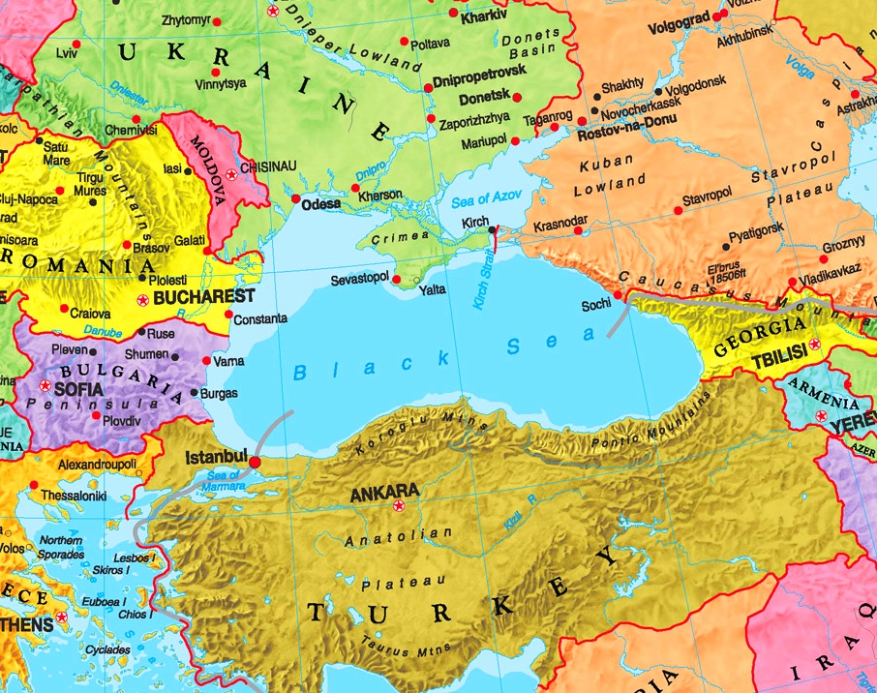

Slide 49
Also, both countries went through the period of the communist, Soviet regime in Rep. Georgia and Romanian communism, also of Soviet influence, in the case of Romania.
Coming out of communism left both countries, beyond the inherent discussions about the old / new social, economic, cultural system with a huge shortage of products and services, with extremely small infrastructure compared to the countries of Western Europe, with problems very large in terms of the education system, the medical system and in general with all that means the development of cities and villages.

Slide 50
The accession of Romania to the European Union in 2007 meant, beyond the accession to an advanced civilization system, of Western Europe, liberal and democratic, and the access to the necessary funds for the development of the country, which meant investments in almost all fields of activity.
Most of these investments were supported by European funds, in the context of the European Union's Sustainable Development Strategy, with the European Council adopting in Gothenburg (2001) the first EU Sustainable Development Strategy.

Slide 51
This has always been revised (2005, 2009, 2013, 2017) but the main objectives have remained the same throughout the European Union:
Environmental protection
2. Equity and social cohesion
3. Economic prosperity
4. Respect for international commitments

Slide 52
To meet these goals, they have been set
DIRECTING POLICY PRINCIPLES OF THE EUROPEAN UNION:
Increased social dialogue, social responsibility
2) Corporate growth and public-private partnerships
3) Political coherence and governance
4) Integration of economic, social and environmental policies for coherence,
5) Use the best available knowledge

Slide 53
Principle no. 2, regarding Corporate Growth and Public-Private Partnerships, was established both to ensure sustainable economic development, but also to promote the cooperation and joint responsibilities needed to achieve sustainable consumption and production.
This principle has the public procurement policy as main engine, at European Union level, the public procurement policy, which has required the establishment of a common European framework, embodied in unifying Community legislation

Slide 54
directives, regulations and subsequent acts and European jurisprudence, at the level of the European Court of Justice. (ECJ) which clarifies the way of interpreting and applying the normative acts in the matter. The key role of public procurement was recognized by the European Commission in the Europe 2020 Strategy, presented in the European Commission communication of 3 March 2010, entitled "Europe 2020. A European strategy for smart, environmentally friendly and inclusive growth".

Slide 55
Romania has implemented in the national legislation, since the accession to the European Union in 2007, the European public procurement directives. Ever since the first European normative acts in the field of public procurement, the principles based on which the procedures in this matter have begun are outlined, and the last directives have synthesized all the principles that must now be applied by the public authorities of any Member State of the European Union. in awarding public procurement contracts:

Slide 56
The award of public contracts by or on behalf of the authorities of the Member States must comply with the principles of the Treaty on the Functioning of the European Union (TFEU), namely the free movement of goods, the freedom of establishment and the freedom to provide services, as well as the principles deriving therefrom, such as equal treatment, non-discrimination, mutual recognition, proportionality and transparency.

Slide 57
The particularly important role is determined by the fact that one fifth (1/5) of the GDP (Gross Domestic Product) at EU level is spent every year by public and governmental authorities for the procurement of goods, works and services.
The field of public procurement presents a high risk of corruption. The European Commission released the first report on corruption in the Member States of the European Union in 2014. Considering the legal instruments that define corruption, respectively, the United Nations Convention against Corruption, and on the other hand, the regulations issued by the Council of Europe, this report defines corruption as:

Slide 58
Corruption definition
"the abuse of power for private gain".
The aforementioned definition does not have the role of providing a restrictive interpretation of the phenomenon of corruption, but starts from the premise of analysis that corruption is a complex phenomenon with economic, social, political and cultural dimensions and from understanding that

Slide 59
an adequate response of states membership cannot be reduced to a simple set of measures to be applied automatically.
The report has a thematic chapter focused on corruption in public procurement, the field considered, as we have shown, crucial for the common market. According to a study conducted in 2013, the level of corruption in public procurement in 2010, registered in eight Member States, in only five sectors of activity is between 1.4 and 2.2 billion euros.

Slide 60
Public Procurement Corruptions Patterns
1) elaboration of technical specifications so as to favor certain bidders,
2) dividing an acquisition into several lots with lower values ​​in order to avoid competitive procedures,
3) conflicts of interest affecting different stages of the procedure,
4) unjustified exclusions from bidding procedures,
5) unjustified use of emergency procedures,

Slide 61
6) lack of an adequate analysis of the very low prices offered,
7) excessive use of the lowest price criterion at the expense of quality to avoid competitive procedures,
At local and regional level, if the procedures are organized by the local administrative authorities, it is found that there is a discretionary power of these authorities outside any control mechanisms, even if the level of public funds allocated is quite high.

Slide 62
Common procurement fraud systems:
Corruption - bribes and illegal commissions. The most common indicator of offering illegal bribes and commissions is the unjustified favorable treatment granted to a contractor by the contracting officer, over a period of time.
2) Non-declaration of conflict of interest. Specific fraud indicators: favoring a certain contractor, continuous acceptance of works at high prices and low quality, failure to submit declarations regarding the conflict of interest, etc.

Slide 63
3) Practices of secret cooperation cooperation materialized in the submission of a courtesy offer, the refusal to participate, the rotation of the offers, the division of the markets.
Example of specific fraud indicators: all bidders keep prices high, but the price of bids decreases when a new bidder joins the auction; bidders rotation according to region, type of activity, type of works; rejected bidders are employed as subcontractors, while qualified contractors refrain from submitting a tender and become subcontractors, etc

Slide 64
4) Discrepant offers - within this system, the favorite bidder has confidential information regarding the fact that certain activities provided in the award documentation will not be performed.
Specific fraud indicators: the offer for certain activities seems to be unjustifiably low; after the award of the contract, modifications or eliminations of the requirements regarding the activities will take place.

Slide 65
5) Manipulation of specifications - the documentation prepared by the contracting authority corresponds to the competences of a certain tenderer (the most common situation is in the IT field, but also in the case of other technical contracts). Specific fraud indicators: a single bidder or very few bidders respond to the call for tenders, the existence of similarities between specifications and the bidder's products / services, the specifications are unusual or unreasonable.

Slide 66
6) Disclosure of auction data - a favorite bidder receives information regarding estimated budgets, preferred solutions, competing offers, etc. Specific fraud indicators: unjustified reduction of legal terms; the winning bid is a little lower than the next bid, the winning bidder communicates privately with the contracting staff, via email or other means, etc.
7) Handling of tenders - is performed by the personnel of the authority after submitting the tenders, with the purpose of selecting a favorite contractor. Specific fraud indicators: complaints from bidders, cancellation of an offer due to an error, a qualified bidder is disqualified for suspicious reasons,

Slide 67
8) Fragmentation of acquisitions - fragmentation of an acquisition into two or more lots with lower values, in order to avoid a competitive procedure. Specific fraud indicators: two or more consecutive and similar purchases from the same contractor, etc.
9) Unwarranted assignments to a single contractor - in case it is repeated and suspected, such as fragmentation of procurement; drafting very restrictive specifications. Specific fraud indicators: the request for tender is transmitted to a single supplier; purchases previously made under competitive conditions have become non-competitive, etc.

Slide 68
10) Combining the contracts, respectively, collecting the same costs for several orders that could actually have different activity volumes, which generates over-invoicing. Specific fraud indicators: similar invoices for the same activities or different contracts;
11) Incorrect establishment of costs, respectively, intentional invoicing of costs that are not allowed or are not reasonable.

Slide 69
The most vulnerable domain is considered to be the one related to labor costs and, therefore, the fraud indicators are properly related to this domain.
A potential fraud indicator refers to the excessive and unusual amounts received for the workforce; lack of time sheets.
12) Price manipulation occurs when the contractors do not provide current, complete data on costs and prices from the financial offer. Specific fraud indicators: the contractor refuses, delays or does not provide supporting documents; high prices compared to similar contracts; price list or average prices at industry level;

Slide 70
13) Failure to comply with the specifications of the contract, although it is falsely stated that they have been fulfilled. Specific fraud indicators: absence of certificates or test or inspection documents; lower quality and large number of complaints.
14) False, double or overpriced invoices - a contractor knowingly presents false, double or overpriced invoices, acting on his own account or in collaboration with employees of the contracting authority, following their corruption.

Slide 71
Specific fraud indicators: the goods or services are not in the inventory or cannot be located; there are no purchase orders or they are suspicious; multiple invoices with identical data; payments to cash and offshore companies.
15) Fictitious service providers - embezzlement of funds, usually to fictional companies with similar names to real companies. Specific fraud indicators: an offshore company is used; The address or phone number of the fictitious provider is incorrect.

Slide 72
16) Substitution of the product - replacement without the knowledge of the buyer of the products established by contract with some of inferior quality. Specific fraud indicators: unusual or generic packaging; certificates of conformity signed by unqualified or unskilled persons in the field

Slide 73
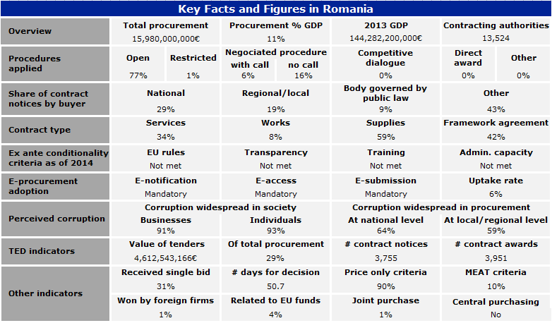

Slide 74
According to official figures, services, goods and public works represent Despite this fact, the bidders in the public procurement procedures do not consider that in Romania the rules regarding transparency, integrity and simplification of bureaucracy work efficiently.
Thus, 91% of companies consider that the level of corruption is high and 64% consider that the environment is characterized by fraud and nepotism. Also, 82% of the respondents considered that bribery and the use of links is the easiest way to gain access to contracts that have as their object goods, services and public works.an important share of GDP

Slide 75
Name: DRĂGUŢESCU MIHAI
Institution TRIBUNAL OF BUCHAREST
Function JUDGE, PRESIDENT OF THE ADMINISTRATIVE AND FISCAL COURT
mailto: dragutescumihai@yahoo.com, dragutescumihai@gmail.com, dragutescumihai@just.ro
phone:+40 737 41 00 21
Picture

