Slide 1
An Introduction to U.S. Procurement
Part I
Professor Christopher Yukins
George Washington University Law School
Washington DC
Tuesday – Thursday
December 9 - 11
University of Paris

Slide 2
Schedule
  10 - 12:30
  Lunch
  1:30 - 5:30
Notes:
9-10.30/ Coffee/ 11-12.30/ Lunch /13h30-14h45 /Coffee/ 15-16

Slide 3
Readings & Videos
Christopher R. Yukins, The U.S. Federal Procurement System: An Introduction (UrT 2017), https://papers.ssrn.com/sol3/papers.cfm?abstract_id=3063559.
  Video: An Introduction to U.S. Procurement, by Prof. Christopher Yukins
Steven L. Schooner, Desiderata: Objectives for a System of Government Contract Law (PPLR 2002), https://papers.ssrn.com/sol3/papers.cfm?abstract_id=304620
Christopher R. Yukins, A Versatile Prism: Assessing Procurement Law Through the Principal-Agent Model (PCLJ 2010), https://ssrn.com/abstract=1776295
Johannes Schnitzer & Christopher Yukins, Combatting Corruption in Procurement, in UNOPS: Future-Proofing Procurement 26-29 (2015), https://www.unops.org/SiteCollectionDocuments/ASR/2015-ASR-supplement.pdf
  Video: Fighting Corruption in Procurement (40:12) – in this video excerpted from GWU Law School’s “Foreign Government Contracting” course, Professor Christopher Yukins discusses common patterns and strategies in fighting corruption in public procurement around the world.
  Video: Corporate Compliance (7:50) – in this video excerpted from GWU Law School’s “Foreign Government Contracting” course, Professor Christopher Yukins discusses corporate compliance requirements and strategies, from around the world.
Christopher Yukins & Allen Green, International Trade Agreements and U.S. Procurement Law (2018). Chapter 9 to The Contractor’s Guide to International Procurement (ABA 2018) (Erin Loraine Felix & Marques Peterson, eds.), https://ssrn.com/abstract=3443244
  Video: Protectionism – Part I (20:14): In this excerpt from GWU Law’s “Foreign Government Contracting” seminar, Professor Yukins discusses the core concepts in protectionism, U.S. barriers to foreign vendors and key international agreements to open procurement markets.
  Video: Protectionism – Part II (13:27): In this excerpt, also from GWU Law’s “Foreign Government Contracting” seminar, Professor Yukins discusses key issues in U.S. protectionism, from the “walled garden” of the Trade Agreements Act to reciprocity and the U.S.-Mexico-Canada-Agreement (USMCA).
  Video: Protectionism – Part III (6:21): In this final excerpt, Professor Yukins discusses special issues in protectionism and national security, such as the Reciprocal Defense Procurement Agreements between the U.S. and its allies, and the deference afforded national security interests under international trade agreements on procurement.

Slide 4

George Washington University
Law School
Classroom and distance learning in public procurement law and policy, for students in law and business
Government Procurement Law Program
Established 1960

Slide 5





Introduction to George Washington University Law School –
Public Procurement Law Program (JD, LLM and MSL/Government Contracts)
Steven Schooner
Joshua Schwartz
Jessica Tillipman
Karen Thornton

Slide 6
Procurement Law Centers: 2000
Nottingham.
Washington, D.C.

Slide 7
Procurement Law Centers Today
Stockholm
Vilnius
Copenhagen
Moscow
Nottingham.
Munich
Northern China
Paris
Poland
Beijing
Washington, D.C.
Aix-en-Provence
Galicia
Turin
Rome
Stellenbosch

Slide 8
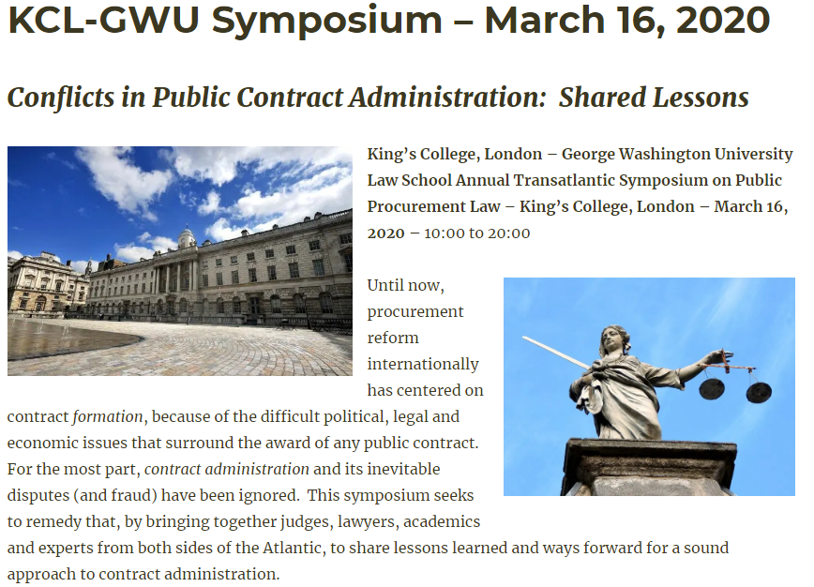
https://publicprocurementinternational.com/kcl-gwu-annual-symposium-contract-administration-march-16-2020/
Program Flyer 2020-KCL-GW-Symposium

Slide 9
Principles: The Desiderata (Steven Schooner, 2002)
Transparency
Integrity
Competition
Uniformity
Risk Avoidance
Wealth Distribution -- Socioeconomic
Best value
Efficiency (administrative)
Customer Satisfaction

Slide 10
What is Procurement:
Pathologies and Processes

Slide 11
Principal-Agent Model
MONITORING
Agent 1
CO
Agent 2
Contractor
Purchase
Principal
BONDING (PUNISHING)
Notes:
Bribery?
Gratuity?
Personal conflict of interest?
Organizational conflict of interest?
“Kickback” to vendor?
Fraud?
Collusion?
Other forms of market barriers?

Slide 12
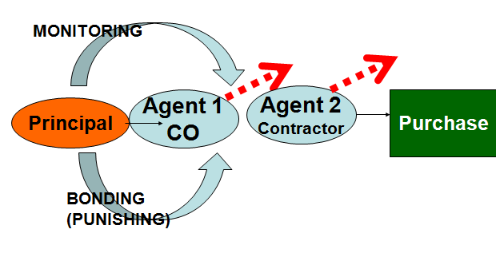
Processes
Rules
Qualification
Responsiveness
Planning
Competition - Methods
Cost Reimb.
Contract
Provisions

Slide 13
The United States . . .

Slide 14
. . . Has Separate Procurement Systems
Federal Procurement
State
Local

Slide 15
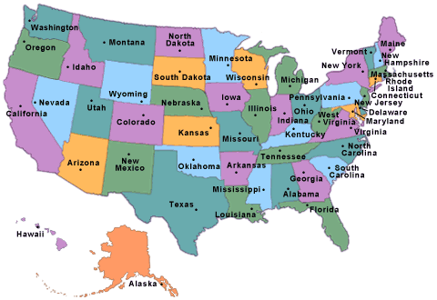
U.S. Domestic Harmonization
Model Law?
Through Federal Grants?
Cooperative Purchasing?

Slide 16
.. . . Has about $500 billion in annual federal procurement

Slide 17
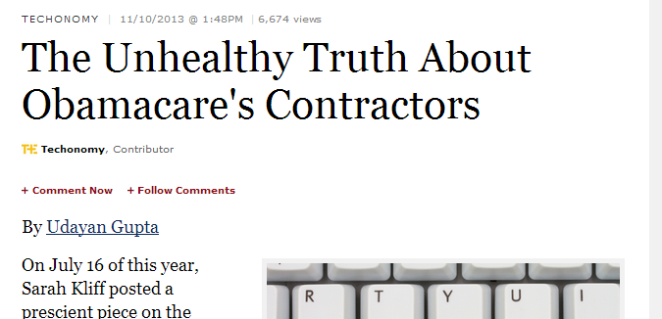
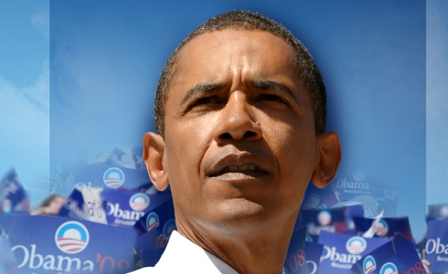
. . . Procurement is a High-Profile Political Issue

Slide 18
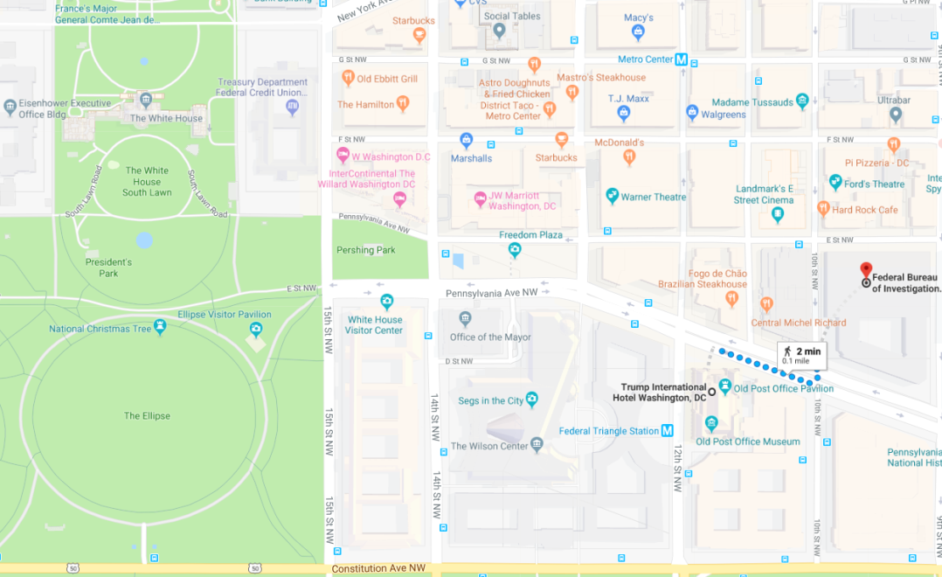
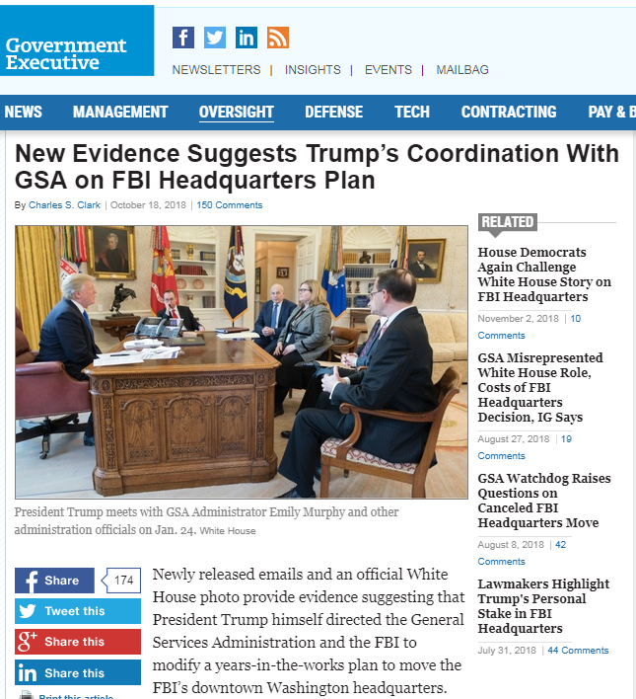
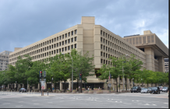
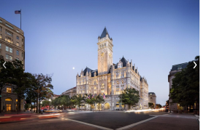
. . . Procurement Remains Political
Question: If President Trump did interfere with this procurement for his personal benefit, would this be:
Petty corruption
Grand corruption
State capture?

Slide 19
. . . But Not Driven by Individual Politicians
Virginia 8 (James P. Moran) | 1
District of Columbia nonvoting (Eleanor Holmes Norton) | 2
Texas 12 (Kay Granger) | 3
Missouri 1 (William (Bill) Clay / Wm. Lacy Clay) | 4
Virginia 10 (Frank R. Wolf) | 5
Alabama 5 (Robert E. (Bud) Cramer Jr.) | 6
California 37 (Juanita Millender-McDonald) | 7
Mississippi 4 (Ronnie Shows / Gene Taylor) | 8
Virginia 3 (Robert C. Scott) | 9
California 14 (Anna G. Eshoo) | 10
Top 10 Congressional Districts for Federal Contracts, FY07

Slide 20
. . . Accessible
FY07 Contracts - Defense
Notes:
Source: www.fedspending.gov

Slide 21
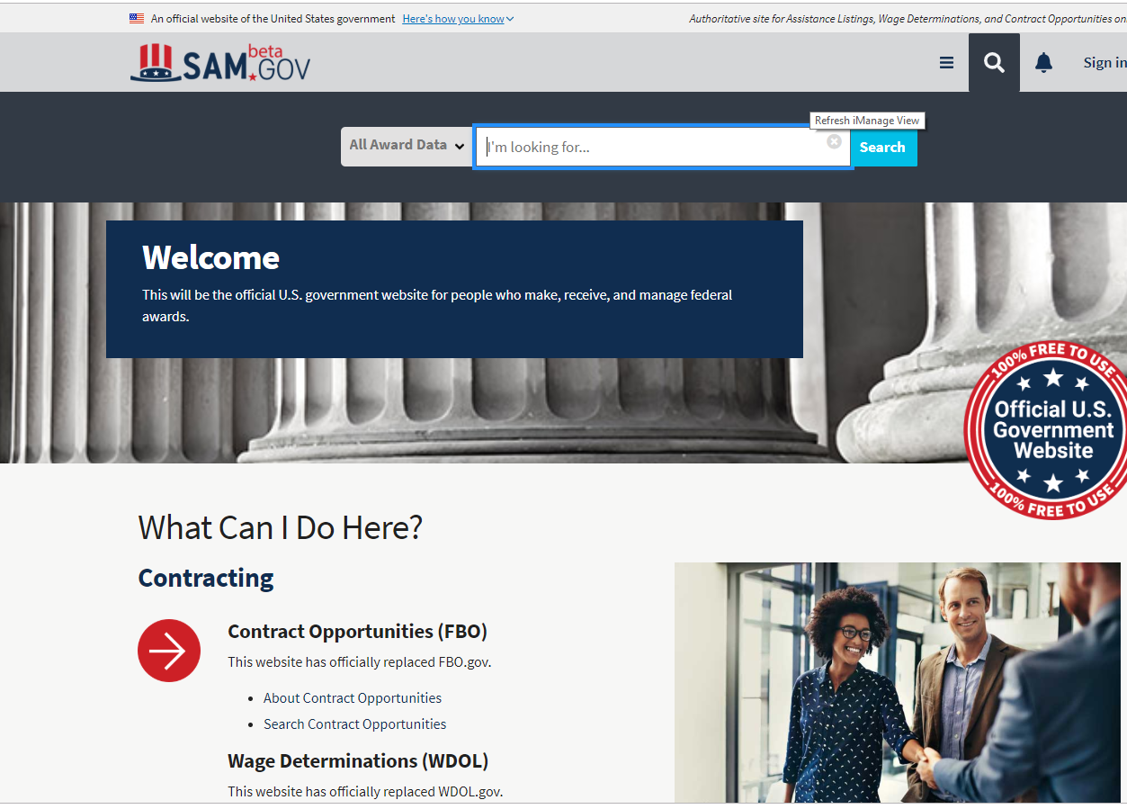
. . . Is Transparent at Opportunity and Award

Slide 22
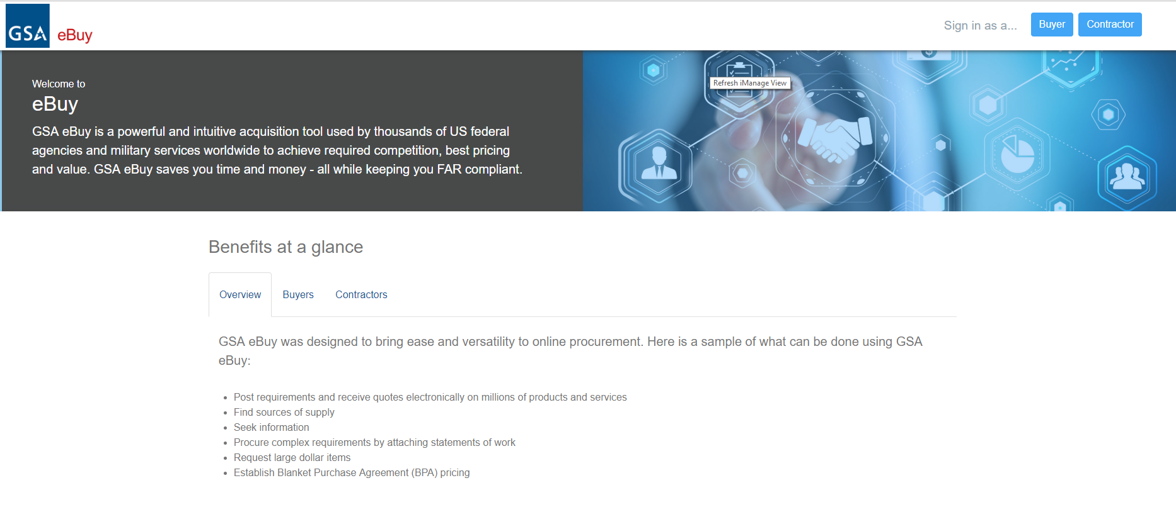
. . . With exceptions to transparency

Slide 23
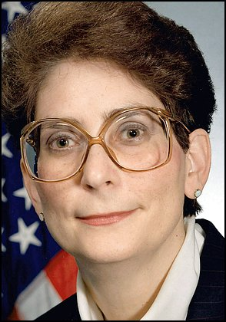
. . . Prone to Scandal
Darleen Druyun
Previously highest-ranking civilian official in Air Force procurement systems
Convicted of improper job negotiations with Boeing during tanker procurement
Admitted favoring Boeing in hundreds of millions of dollars in procurement
Sentenced to prison
$650M Boeing settlement

Slide 24


More
Scandal
Duke Cunningham
David Safavian
Congressman resigns after bribery plea
California Republican admits selling influence for $2.4 million
Monday, November 28, 2005
(CNN) -- Rep. Randy "Duke" Cunningham
Ex-Aide To Bush Found Guilty
Safavian Lied in Abramoff Scandal
Washington Post,
Wednesday, June 21, 2006; Page A01

Slide 25
1984
Federal Acquisition Regulation (FAR)
Defense Federal Acquisition Regulation Supplement
Defense Logistics Agency Supplement
Other Defense Subagency Supplements
Civilian Agency Supplement
Civilian Agency Supplement
. . . a Unified Regulatory System
. . . Has a Uniform Set of Regulations

Slide 26

Defense Authorization Act = Annual vehicle for reform
Federal Acquisition Regulation (FAR)
Defense Federal Acquisition Regulation Supplement
Defense Logistics Agency Supplement
Other Defense Subagency Supplements
Civilian Agency Supplement
Civilian Agency Supplement
. . . A Uniform Set of Regulations

Slide 27
Major methods of competition
. . . Familiar Major Methods of Procurement
Open Procedure (less than 3%)
Restricted Procedure
Negotiated Procedure (primary method)
Sole-Source

Slide 28

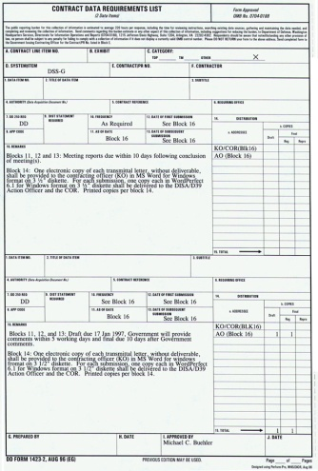


Historical Progression
Sole Source
Sealed Bids
Negotiated Procurements
Frameworks

Slide 29
Competitive Negotiations
(EU: “Competitive Dialogue” or “Competitive Procedures with Negotiations”)

Slide 30
Competitive Negotiations:
Multiple Vendors, for Best Value
Negotiated Procurements
Contractor
Contractor
Contractor

Slide 31
Competitive Negotiations
Request for Proposals
Competitive
Offeror 1
Offeror 2
Non-Competitive
Announcement
Exchanges
Submissions
Award
Awardee

Slide 32
Frameworks
Frameworks emerged in the United States and elsewhere along parallel paths
Supplier Lists

Slide 33
Frameworks: Sample
 | A | B | C
FRAMEWORK AWARD PRICE – PER UNIT | US$1000 | US$600 | US$1500
JANUARY (NASA: 500 UNITS) | US$900 | US$600
APRIL ORDER (ARMY: 1000 UNITS ) | US$800 | US$550
DECEMBER ORDER (NAVY: 2000 UNITS) | US$550 | US$550

Slide 34
Problems in U.S. Frameworks: 1990s
Contractors
Centralized Purchasing Agencies
Customer Agencies
Reduced Transparency – Reduced Accountability -- Misuse of Frameworks

Slide 35

Scandals
Notes:
-- Scandals and reform driven by internal government forces, including Congress, GAO and inspectors general
-- Punctuated by Abu Ghraib disaster

Slide 36
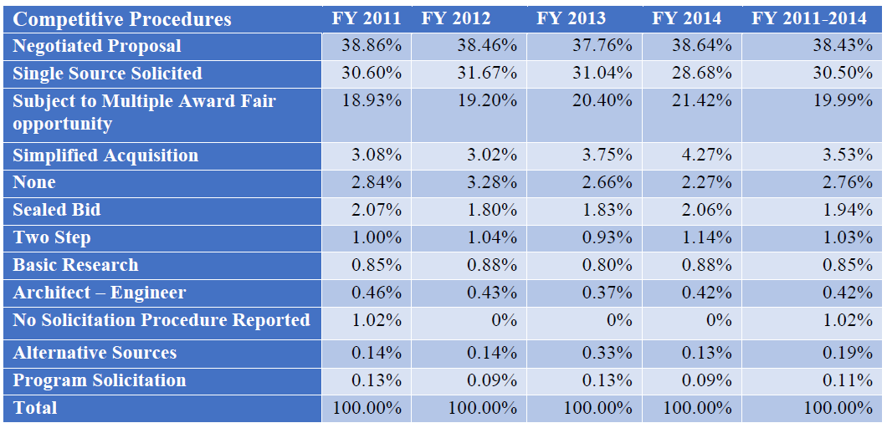

Umer Chaudhry
GWU Law Student

Slide 37
EU uses same methods – but in a different historical progression
Sole Source
√
Sealed Bids
Negotiated Procurements
√
Frameworks
√
√

Slide 38
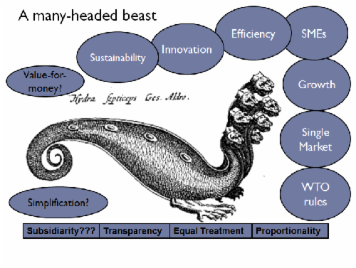

Do the EU Directives Impose Additional Principles?
Source: Abby Semple, www.procurementanalysis.eu/
Author: Abby Semple
Notes:
Source: Abby Semple

Slide 39
Patterns in U.S. Procurement

Slide 40
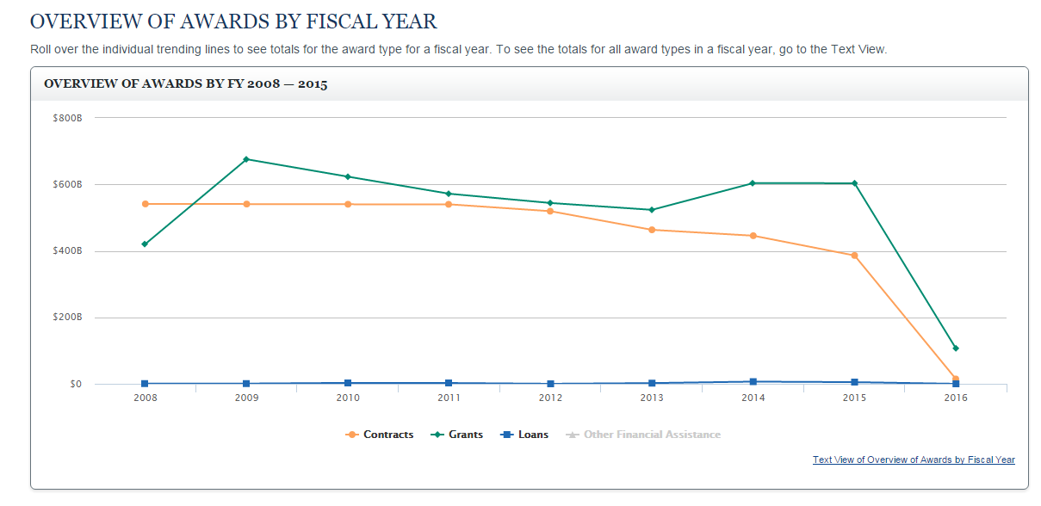
www.usaspending.gov

Slide 41
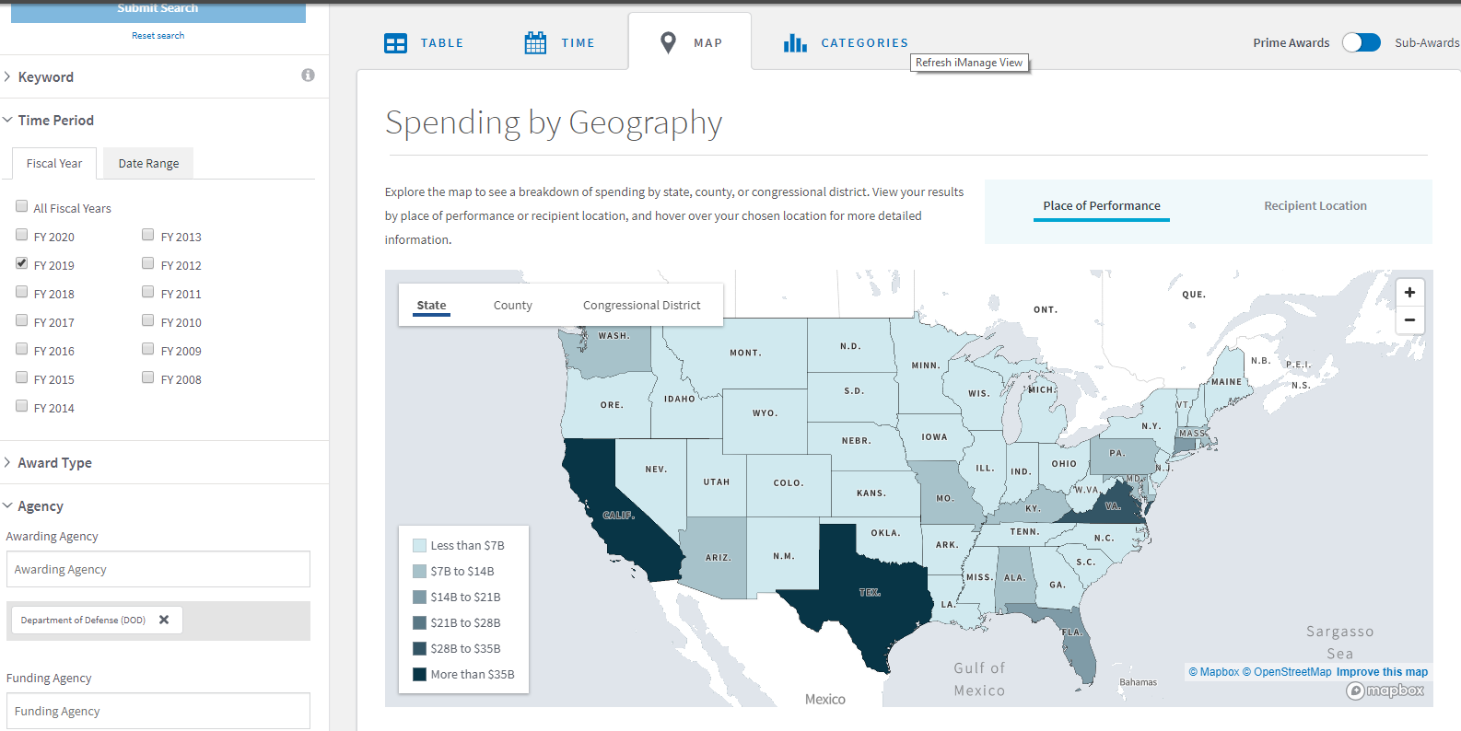
Defense Department Procurement – FY 2019

Slide 42
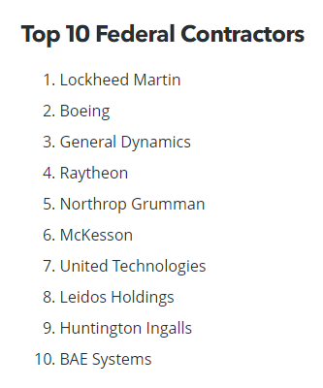
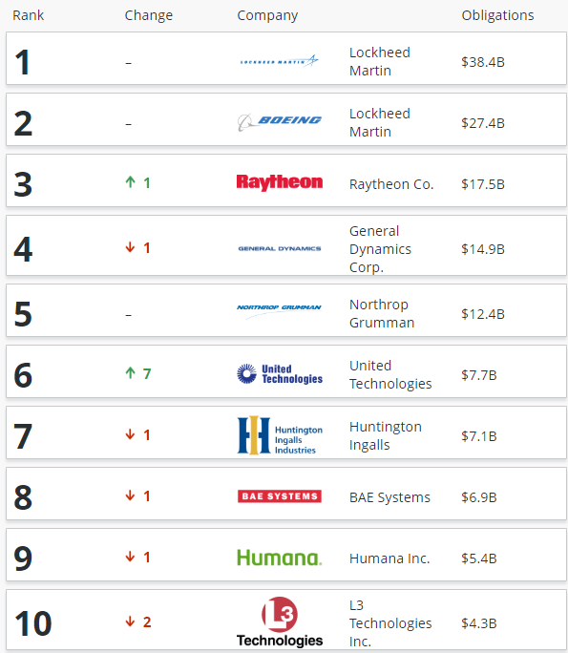

Top Defense
France Defense Budget:
US$42 billion
Notes:
BGOV Data – FY2018

Slide 43
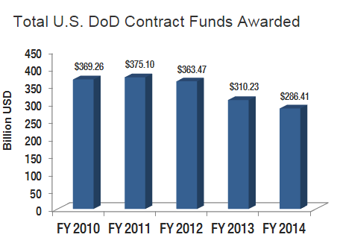
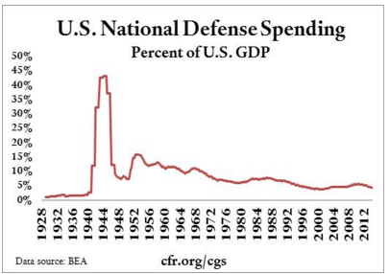
Some Trends in DoD Procurement
Notes:
http://www.bga-aeroweb.com/Top-100-Defense-Contractors-2014.html

Slide 44
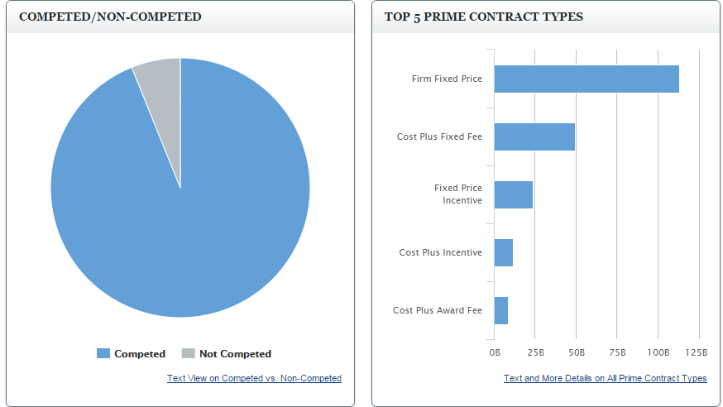

Slide 45
Access for Foreign Firms to Unitary Federal Procurement Market, Civilian and Defense

Slide 46

DoD Acquisition Workforce
The size of DoD’s civilian acquisition workforce has grown by some 20,000 employees over the past five years and now numbers about 135,000 personnel members, according to Stephanie Barna, acting assistant secretary of Defense for Readiness and Force Management.
Civilians make up 90 percent of the department’s total acquisition workforce. The military component of the acquisition workforce also ticked up by about 2,500 employees, reaching more than 16,000 employees, Barna said.
Notes:
http://federalnewsradio.com/congress/2014/07/house-panel-probes-dods-acquisition-workforce/
http://dau.dodlive.mil/2014/04/17/2013-defense-acquisition-workforce-awards/
(Left to Right): Hon. Frank Kendall, Major James Rodriguez, Hon. William LaPlante, Hon. Katrina
McFarland

Slide 47
Typical Progress
Subcontract
Framework (Indefinite Delivery-Indefinite Quantity)
Prime Contract

Slide 48
Protectionism and the
Trump Administration

Slide 49


Slide 50
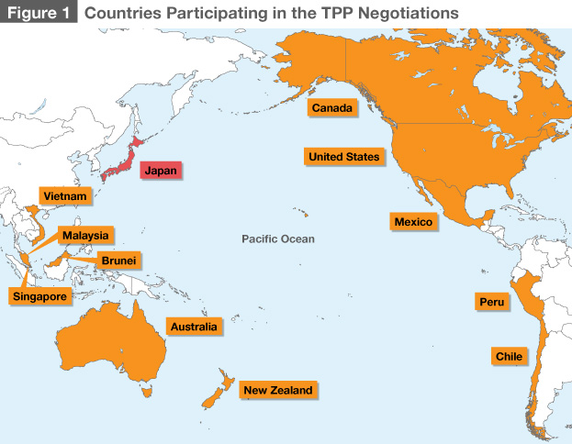

Slide 51
Key concepts

Slide 52
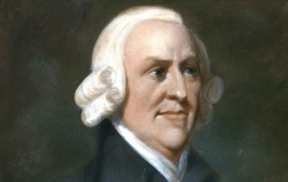
“It is the maxim of every prudent master of a family, never to attempt to make at home what it will cost him more to make than to buy. . . . If a foreign country can supply us with a commodity cheaper than we ourselves can make it, better buy it of them with some part of the produce of our own industry, employed in a way in which we have some advantage.
  Adam Smith, An Inquiry into the Nature and Causes of the Wealth of Nations (1776)

Slide 53

What Is Goal of Protectionism?
Protect Jobs
Industrial policy
Ensure security of supply

Slide 54



Prewar Protectionism

Slide 55
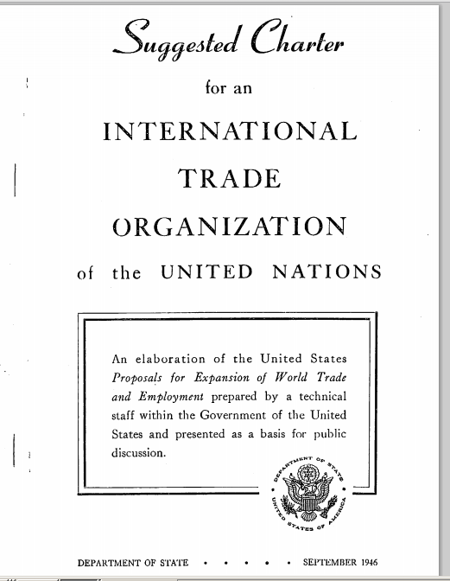
United States’ suggested charter for predecessor to World Trade Organization (1946)
Notes:
http://www.worldtradelaw.net/misc/Suggested%20Charter.pdf

Slide 56
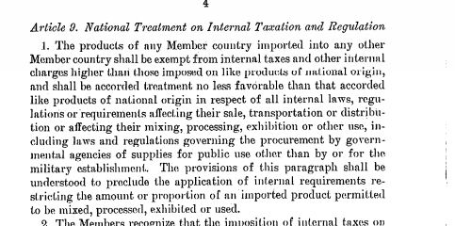
Notes:
http://www.worldtradelaw.net/misc/Suggested%20Charter.pdf
WTO on non-discrimination (Most Favored Nation) versus national treatment - http://www.wto.org/english/thewto_e/whatis_e/tif_e/fact2_e.htm
Textbook, Sec. 2:27:
One core provision of the GATT is Article I which makes a general commitment to the long standing practice of “most favored nation treatment” (“MFN”).¹ Article I requires each Contracting Party to accord unconditional MFN status to all other Contracting Parties. Thus, any privilege granted by any Contracting Party to any product imported from any other country must also be “immediately and unconditionally” granted to any “like product” imported from any Contracting Parties.²
Another core provision of GATT is Article III. Article III incorporates the practice of according “national treatment” to imported goods by providing, with specifically enumerated exceptions, that the products of one Contracting State shall be treated in the same manner regarding taxation and regulation as domestic goods. As such, under Article III, products of the exporting GATT Contracting State must be treated no less favorably than domestic products of the importing Contracting State under its laws and regulations concerning sale, internal resale, purchase, transportation and use.³ In addition to the Articles above, the GATT also prohibits the use of certain kinds of quantitative restrictions. For example, Article XI generally, but not completely, prohibits the use of other “prohibitions or restrictions” on imports from Contracting Parties.⁴

Slide 57




U.S. Trade Agreements Act:
A “Walled Garden”
GPA &
Free Trade Agreements
Europe
USA
Some Asian Nations
Some Latin American Nations

Slide 58
U.S. Domestic Preference Law: Supplies
Trade Agreements Act: Above $180,000 (approx.)
Buy American Act
Micro-
Purchase

Slide 59
Reciprocal Defense Procurement Agreements

Slide 60
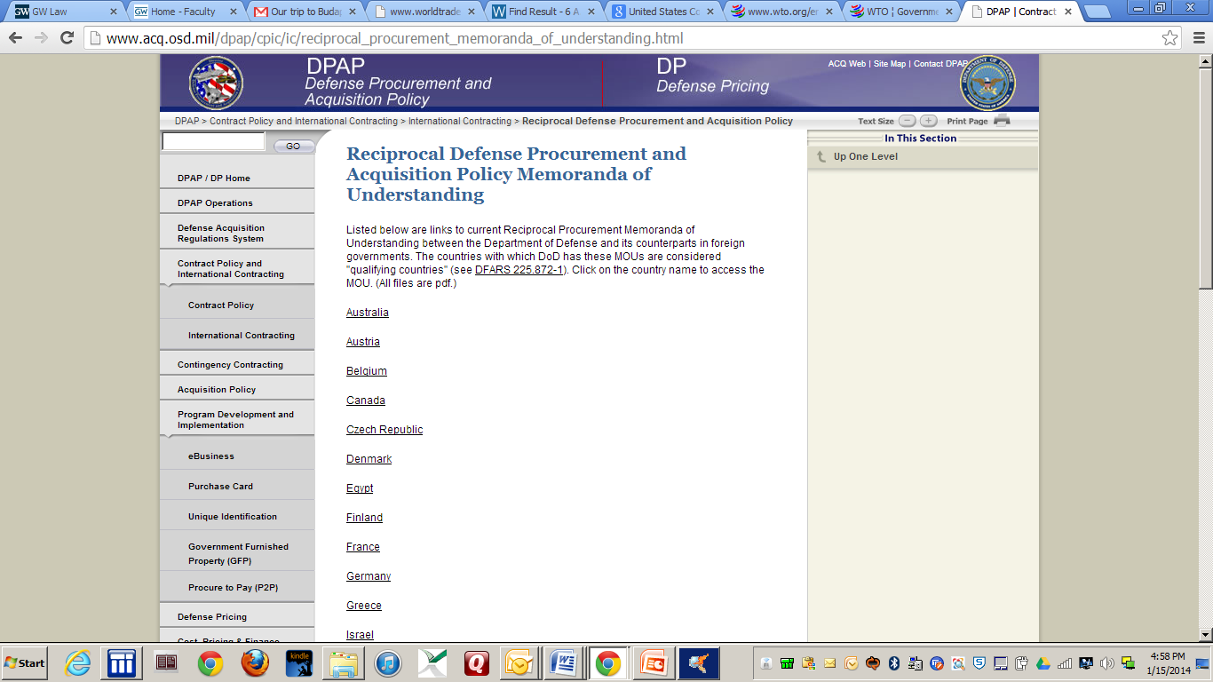
Defense – Memoranda of Understanding
Authority for the defense MOUs rests in the “public interest” exception to the BAA. The agreements serve as a national security benefit, enhance alliance-wide security objectives, and serve as an underpinning for armaments cooperation. – Text § 2:21

Slide 61
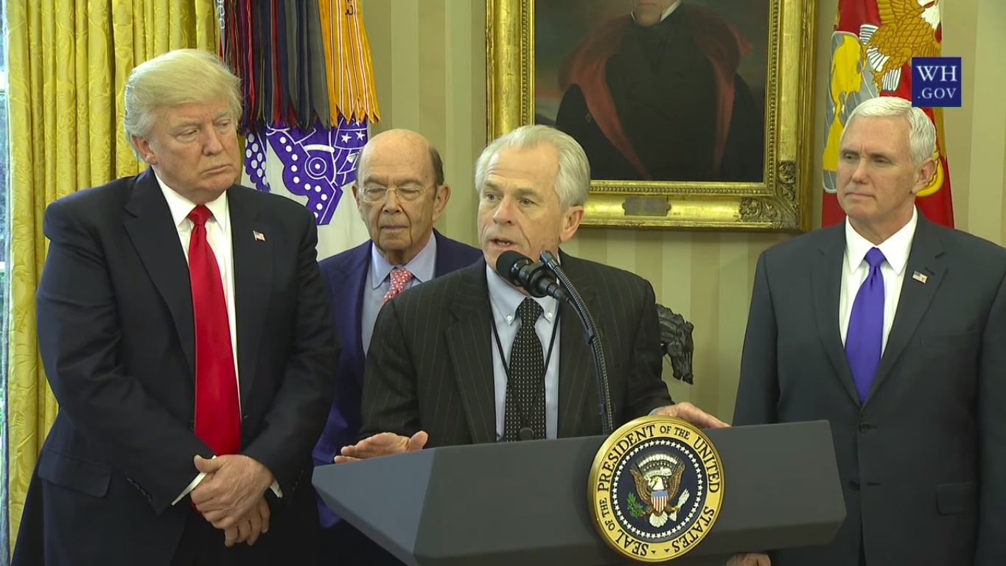
Trump Administration

Slide 62
February 2017

Slide 63
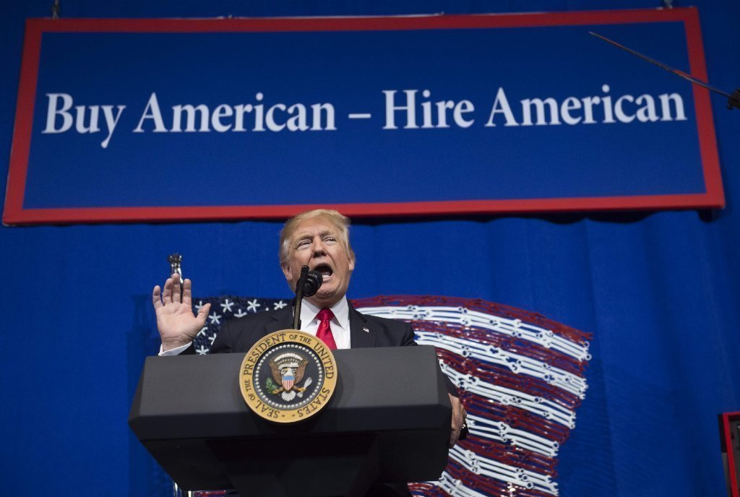

Slide 64

The RECIPROCity CONCEPT

Slide 65

U.S. – Mexico – Canada Agreement (USMCA):
Procurement Chapter

Slide 66
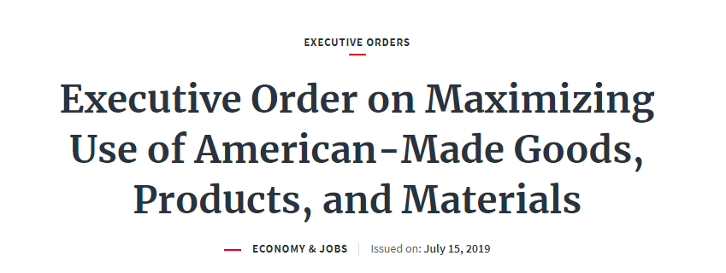
Price Preferences Applied Against Foreign Items Under Buy American Act
 | Small Businesses | Other Businesses
Existing Law | 12% price preference | 6% price preference
Trump Proposal | 30% price preference | 20% price preference

Slide 67
“Squeezing” the Buy American Act | Acquisitions Above Trade Agreements Thresholds (typically $180,000): Buy American Act Does Not Apply
 | Buy American Act Applies: Acquisitions from $10,000 to the Trade Agreements Thresholds
 | Micro-Purchases (Currently up to $10,000): Buy American Act Does Not Apply

Slide 68
Today

Slide 69
Electronic Marketplaces

Slide 70

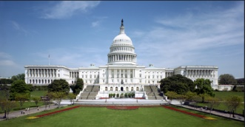

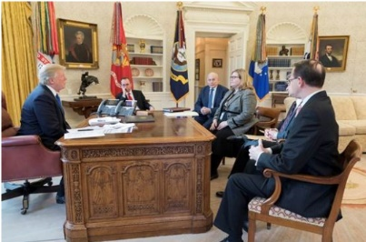

Online Solution
Centralized Purchasing Agency
Market
Users
Congress
MAJ Abraham Young, USA
The Players

Slide 71
Online Solution
Centralized Purchasing Agency
Market
Users
Congress
MAJ Abraham Young, USA
The Problems
Vendor data – bid challenges – transparency –
competition -- socioeconomic goals (including Buy American) – no- standards security review -- fee to GSA – Most Favored Customer pricing

Slide 72
Context: International Procurement

Slide 73
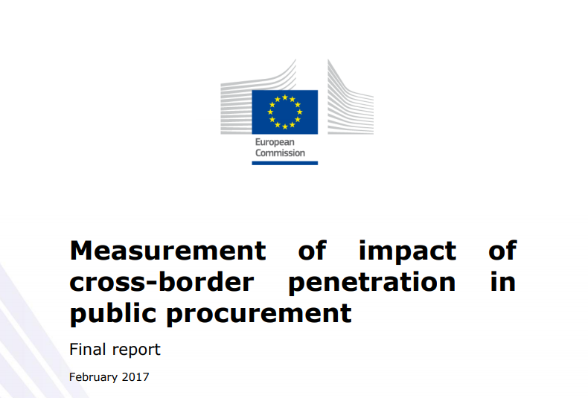
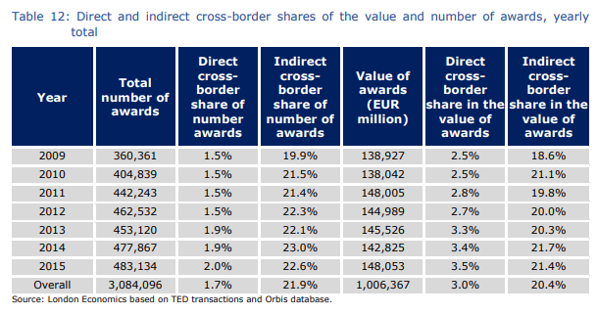
“ . . . the direct cross-border share in the number of awards remained under 5% in the majority of EU28 Member States.”
“At the EU level, it is estimated that import penetration in the private sector is about 10% higher than in the public sector. . . . There is no consistent indication of a domestic bias in public purchasing despite . . . the fact that overall import penetration in private purchasing is significantly higher than for the public sector. Higher import penetration in private sector purchasing appears to a large extent to be explained by the significant differences in the composition of purchases between the two groups.”
Notes:
https://publications.europa.eu/en/publication-detail/-/publication/5c148423-39e2-11e7-a08e-01aa75ed71a1/language-en

Slide 74
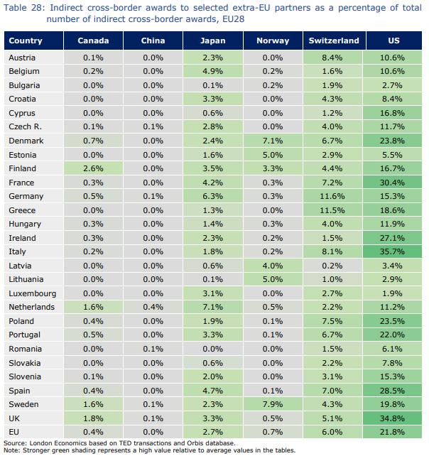
U.S. has largest shares of indirect cross-border awards in the European Union

Slide 75
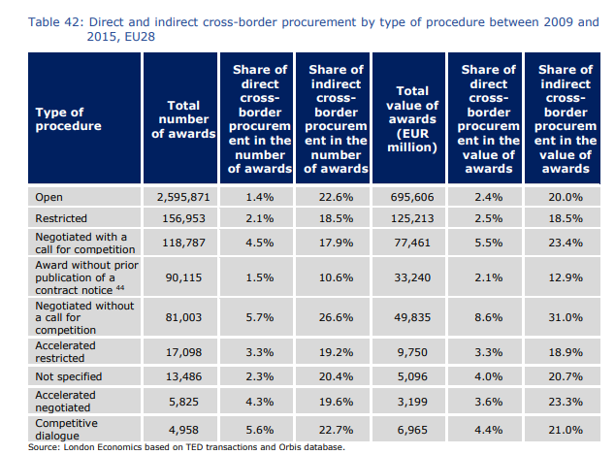

Slide 76
Convergence: Procurement Regulation
Best Practices
U.S.
Europe
Others

Slide 77
 | USA - Federal | EU | World Bank | WTO | USA Model Law for States
Acquisition Planning
Publication of Opportunities
Electronic Auctions
Open Procedure
Competitive Dialogue
Frameworks
Contract Award Notices
Bid Challenges
Exclusion
Contract Administration
CONVERGENCE

