Slide 1
Sustainability

Slide 2

Three “Pillars” to Sustainable Procurement
Economy
Society
Environment
Notes:
The crucial milestone for the development of Sustainable Public Procurement in Europe was the Gothenburg European Council (June 2001)and the adoption of the EU Sustainable Development Strategy. The philosophy of this strategy is that economic, social and environmental objectives could be pursued simultaneously adding an environmental dimension to the Lisbon Process, launched in March 2000. (In the Lisbon Strategy, the EU aims to become ‘the most competitive and dynamic knowledge-based economy in the world, capable of sustainable economic growth with more and better jobs and greater social cohesion’ by 2010.)

Slide 3

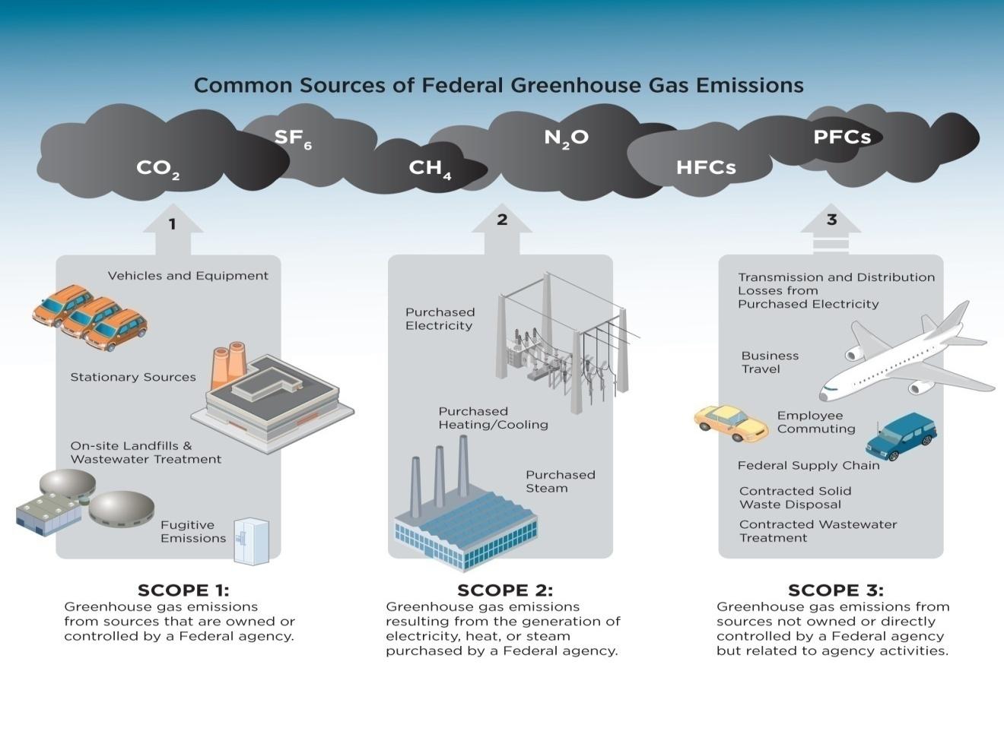
Goal: Reduce Government Scope 3 Emissions

Slide 4
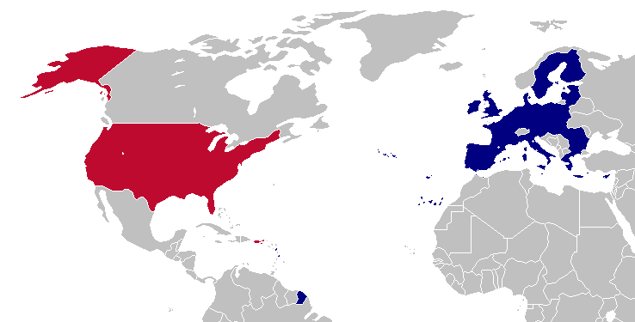

Eco-Labels

Slide 5
Sustainability in Public Procurement: Trajectory
Political
EcoLabel
Carbon Footprint as Evaluation Factor
TRUMP

Slide 6
Administrative Cooperation: U.S. Defense Department
Cybersecurity for Unclassified Information Technology
Cybersecurity Defense
Non-USA?
Chief Information Officer (CIO)
Reviews and approves
Competition and Award

Slide 7
Reciprocal Defense Procurement Agreements

Slide 8
Defense Department Memoranda of Understanding with “Qualifying” Countries
Australia
Austria
Belgium
Canada
Czech Republic
Denmark
Egypt
Estonia
Finland
France
Germany
Greece
Israel
Italy
Japan
Latvia
Luxembourg
Netherlands
Norway
Poland
Portugal
Slovenia
Spain
Sweden
Switzerland
Turkey
United Kingdom of Great Britain and Northern Ireland.
225.872-1 General.
(a) As a result of memoranda of understanding and other international agreements, DoD has determined it inconsistent with the public interest to apply restrictions of the Buy American statute or the Balance of Payments Program to the acquisition of qualifying country end products from the following qualifying countries . . . .

Slide 9
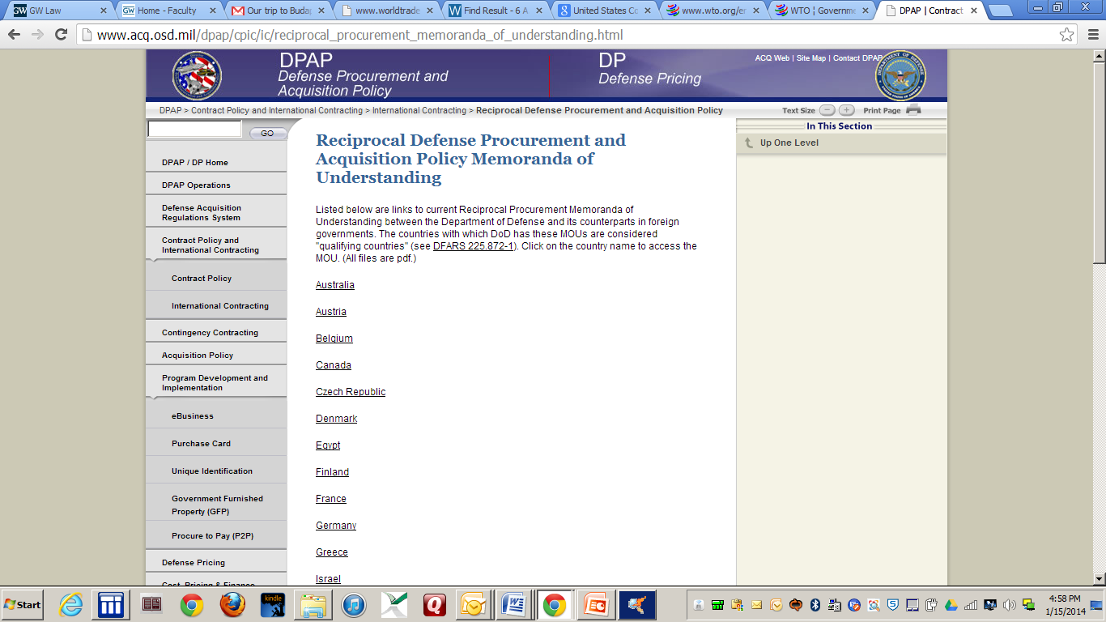
Defense – Memoranda of Understanding
Authority for the defense MOUs rests in the “public interest” exception to the BAA. The agreements serve as a national security benefit, enhance alliance-wide security objectives, and serve as an underpinning for armaments cooperation. – Text § 2:21

Slide 10
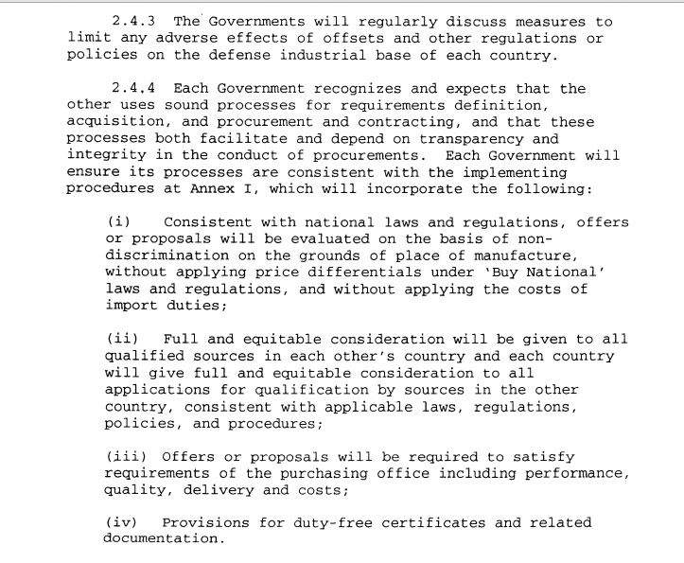

Defense – Memoranda of Understanding – UK Example
Discuss
Don’t discriminate

Slide 11
Security of Supply

Slide 12
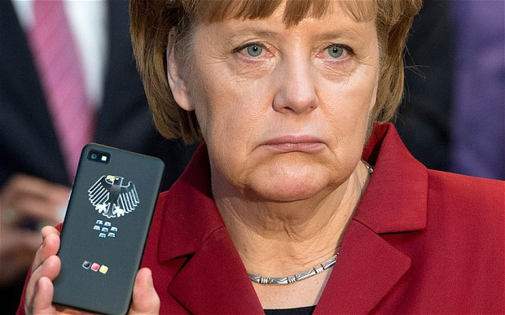
Angela Merkel’s Mobile Phone

Slide 13
Germany Canceled Verizon Contract
Thu Jun 26, 2014
German government cancels Verizon contract in wake of U.S. spying row
BERLIN
REUTERS/RICK WILKING
The German government has cancelled a contract with U.S. telecoms firm Verizon Communications Inc VZ.N as part of an overhaul of its internal communications, prompted by revelations last year of U.S. government spying.
Reports based on disclosures by former U.S. intelligence contractor Edward Snowden alleged Washington had conducted mass surveillance in Germany and had even eavesdropped on Chancellor Angela Merkel's mobile phone.
Berlin subsequently demanded talks with Washington on a "no-spy" deal, but these collapsed after the United States appeared unwilling to give the assurances Germany wanted.
Germany also launched an overhaul of its internal communications and secure government networks. This is one of the first actions involving a U.S. firm to result.
Notes:
"The pressures on networks as well as the risks from highly developed viruses or Trojans are rising," Germany's Interior Ministry said in a statement on Thursday.
"Furthermore, the ties revealed between foreign intelligence agencies and firms in the wake of the U.S. National Security Agency (NSA) affair show that the German government needs a very high level of security for its critical networks."
Verizon has been providing network infrastructure for the German government's Berlin-Bonn network, used for communication between ministries, since 2010, the statement said. The contract is set to expire in 2015.
The government said Deutsche Telekom AG DTEGn.DE would replace services provided by Verizon, and noted Deutsche Telekom was already responsible for the most sensitive communications between ministries or between the government and German intelligence agencies.
Information on the value of the contract was not immediately available.
According to reports and documents published last year, Verizon was obliged to turn over international and domestic calling records of its customers to U.S. intelligence agencies.
Verizon is the second-biggest U.S. telephone company behind AT&T Inc T.N in terms of revenue.
Detlef Eppig, head of Verizon's German unit Verizon Germany said on Thursday: "Verizon Germany is a German company and we comply with German law."
Verizon did not receive any demands from Washington in 2013 for data stored in other countries, the company said.
"The U.S. government cannot compel us to produce our customers' data stored in data centres outside the U.S., and if it attempts to do so, we would challenge that attempt in a court," it added.
The firm declined to comment on whether there had been requests in previous years.
(Reporting by Thorsten Severin; Additional reporting by Marina Lopes in Washington D.C.; Writing by Alexandra Hudson; Editing by David Holmes and Eric Walsh)

Slide 14

GPA, Art. III Leaves Discretion To Discriminate Regarding Classified Work
1. Nothing in this Agreement shall be construed to prevent any Party from taking any action or not disclosing any information that it considers necessary for the protection of its essential security interests relating to the procurement of arms, ammunition or war materials, or to procurement indispensable for national security or for national defence purposes.

Slide 15
GPA, Art. III Leaves Discretion To Discriminate Regarding Classified Work
1. Nothing in this Agreement shall be construed to prevent any Party from taking any action or not disclosing any information that it considers necessary for the protection of its essential security interests relating to the procurement of arms, ammunition or war materials, or to procurement indispensable for national security or for national defence purposes.
DoD May Exclude “Risky” Contractors:
SUBPART 239.73--REQUIREMENTS FOR INFORMATION RELATING TO SUPPLY CHAIN RISK

Slide 16
European Response

Slide 17

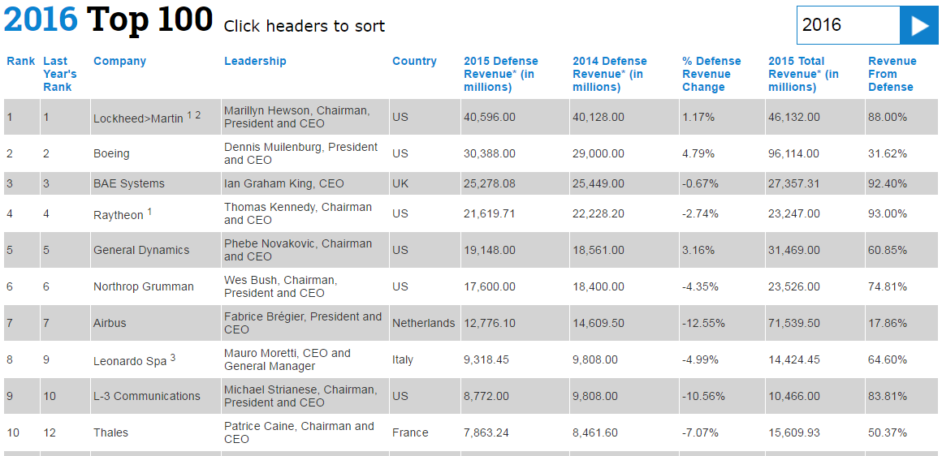
Background:
Top 10 U.S. Defense Contractors

Slide 18
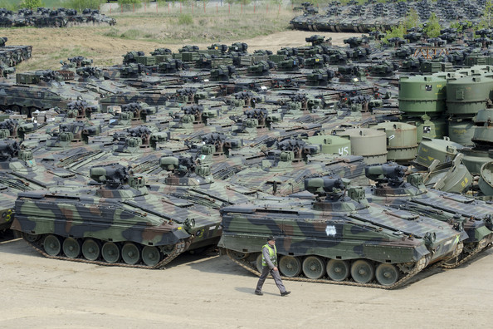
Reciprocal defense procurement agreements

Slide 19
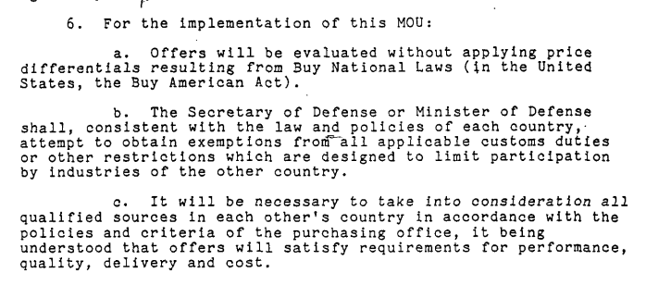

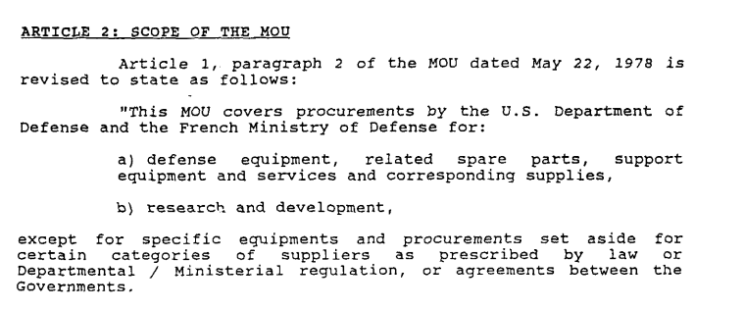

Sample Reciprocal Defense Procurement Agreement:
U.S. - France
Don’t discriminate
Amended to cover both materiel and R&D

Slide 20
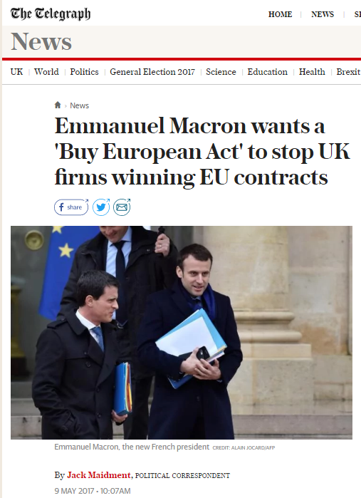
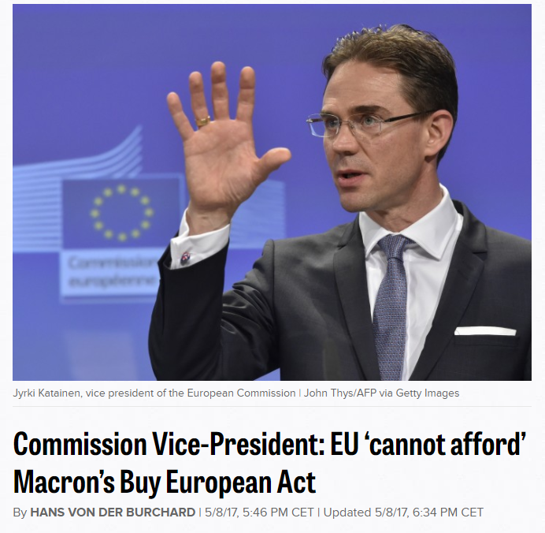
Potential EU Protectionism

Slide 21

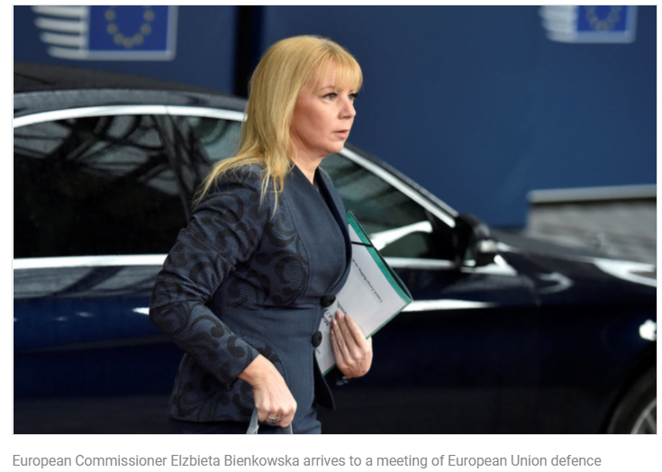

BRUSSELS (Reuters) –[June 7, 2017] The European Union's executive is ready to increase support for the bloc's first ever defense research program, offering more funds to develop new military hardware in its earliest stages after years of government cuts, a top EU official said.
Following a 90-million-euro pilot investment from the EU's common budget in 2017-2019, the European Commission is proposing 500 million euros ($563 million) for the 2019-2020 period that could rise to 1.5 billion euros a year from 2021, Industry Commissioner Elzbieta Bienkowska told Reuters.
European Defense Fund

Slide 22
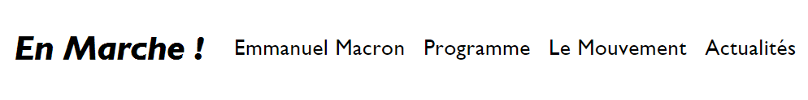
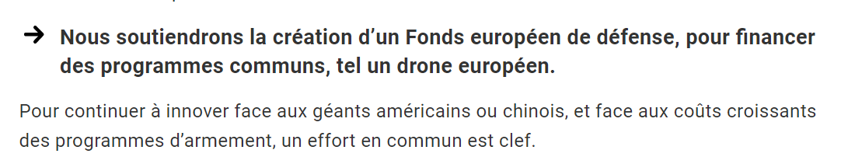

EU Defense Fund: Macron Manifesto
We will support the creation of a European Defense Fund to finance joint programs such as a European drone.
To continue to innovate in the face of American or Chinese giants, and in the face of increasing costs of armaments programs, a joint effort is key.

Slide 23
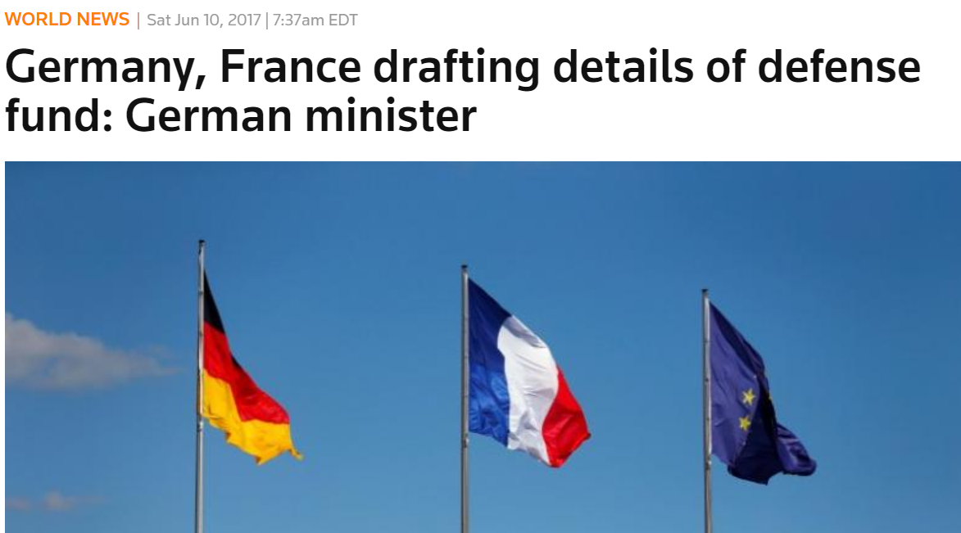
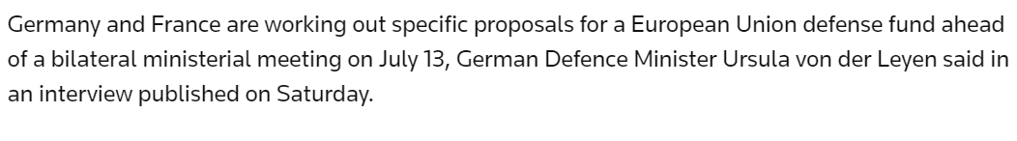
EU Defense Fund: Progressing
(REUTERS)

Slide 24

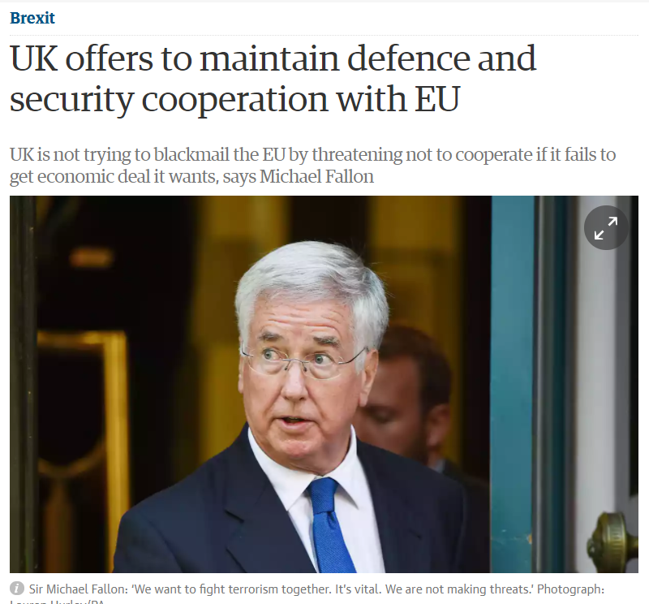
Sept. 12, 2017
The paper says the UK would like to work with the EU on its defence missions, and help with operational planning and developing their mandate. It also sets out plans for continuing to contribute to the commission’s nascent European defence fund, including the European defence research programme and the European defence industrial development programme.

Slide 25
European Commission - Press release A European Defence Fund: €5.5 billion per year to boost Europe's defence capabilities
Research Funding
Priority Areas Agreed by Member States
€500 million per year after 2020
Development and Acquisition
C0-Financing and Commission Support
Members State Collaborative Projects Only
€1 billion per year after 2020
Notes:
http://europa.eu/rapid/press-release_IP-17-1508_en.htm
The European Defence Fund has two strands:
Research: The research aspect of the Fund is already delivering. Starting in 2017, the EU will for the first time offer grants for collaborative research in innovative defence technologies and products, fully and directly funded from the EU budget. Projects eligible for EU funding will focus on priority areas previously agreed by Member States, and could typically include electronics, metamaterials, encrypted software or robotics. This will be financed with:
€90 million until the end of 2019, with €25 million allocated for 2017. A call for proposals is being launched today for projects in the areas of unmanned systems in a naval environment and soldiers systems. The signature of the first grant agreements is expected by the end of this year.
€500 million per year after 2020. In 2018, the Commission will propose a dedicated EU defence research programme with an estimated annual budget of €500 million making the EU one of the biggest defence research investors in Europe.
Development and acquisition: The Fund will create incentives for Member States to cooperate on joint development and the acquisition of defence equipment and technology through co-financing from the EU budget and practical support from the Commission. Member States may for example jointly invest in developing drone technology or satellite communication, or bulk buy helicopters to reduce costs. Only collaborative projects will be eligible, and a proportion of the overall budget will be earmarked for projects involving cross-border participation of SMEs. The EU will offer co-financing with:
€500 million in total for 2019 and 2020, under a dedicated defence and industrial development programme proposed today.
€1 billion per year after 2020. A more substantial programme will be prepared for post-2020, with an estimated annual budget of €1 billion. The programme will leverage national financing with an expected multiplying effect of 5. It could therefore generate a total investment in defence capability development of €5 billion per year after 2020.

Slide 26
European Commission - Press release A European Defence Fund: €5.5 billion per year to boost Europe's defence capabilities
Research Funding
Priority Areas Agreed by Member States
€500 million per year after 2020
Development and Acquisition
C0-Financing and Commission Support
Members State Collaborative Projects Only
€1 billion per year after 2020
Expansion in 2018:
In 2018, the European Commission proposed a budget of €13 billion for 2021–2027 for the European Defence Fund. The new fund will be used to support innovation and development in defense across Europe.
Notes:
http://europa.eu/rapid/press-release_IP-17-1508_en.htm
The European Defence Fund has two strands:
Research: The research aspect of the Fund is already delivering. Starting in 2017, the EU will for the first time offer grants for collaborative research in innovative defence technologies and products, fully and directly funded from the EU budget. Projects eligible for EU funding will focus on priority areas previously agreed by Member States, and could typically include electronics, metamaterials, encrypted software or robotics. This will be financed with:
€90 million until the end of 2019, with €25 million allocated for 2017. A call for proposals is being launched today for projects in the areas of unmanned systems in a naval environment and soldiers systems. The signature of the first grant agreements is expected by the end of this year.
€500 million per year after 2020. In 2018, the Commission will propose a dedicated EU defence research programme with an estimated annual budget of €500 million making the EU one of the biggest defence research investors in Europe.
Development and acquisition: The Fund will create incentives for Member States to cooperate on joint development and the acquisition of defence equipment and technology through co-financing from the EU budget and practical support from the Commission. Member States may for example jointly invest in developing drone technology or satellite communication, or bulk buy helicopters to reduce costs. Only collaborative projects will be eligible, and a proportion of the overall budget will be earmarked for projects involving cross-border participation of SMEs. The EU will offer co-financing with:
€500 million in total for 2019 and 2020, under a dedicated defence and industrial development programme proposed today.
€1 billion per year after 2020. A more substantial programme will be prepared for post-2020, with an estimated annual budget of €1 billion. The programme will leverage national financing with an expected multiplying effect of 5. It could therefore generate a total investment in defence capability development of €5 billion per year after 2020.

Slide 27
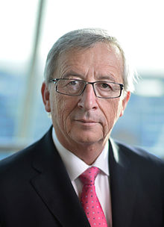
Continued Support:
EU President Jean-Clause Juncker’s State of the Union Address (Sept. 2018)
. . . [D]espite great resistance at the time - I reignited the Europe of Defence as early as 2014. And this is why I will continue to work day and night over the next months to see the European Defence Fund and Permanent Structured Cooperation in Defence become fully operational. Allow me to clarify one important point: we will not militarise the European Union. What we want is to become more autonomous and live up to our global responsibilities.

Slide 28
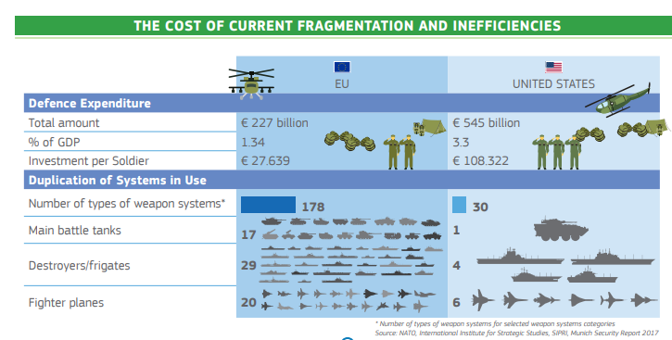
Notes:
https://ec.europa.eu/docsroom/documents/34509/attachments/1/translations/en/renditions/native

Slide 29

Domestic Preference Under EU Defense Fund
“As the Programme aims at enhancing the competitiveness of the Union's defence industry, only entities established in the Union and effectively controlled by Member States or their nationals should be eligible for support. Additionally, in order to ensure the protection of essential security interests of the Union and its Member States, the infrastructure, facilities, assets and resources used by the beneficiaries and subcontractors in actions funded under the Programme, shall not be located on the territory of non-Member States.”

Slide 30

EU Defense Fund:
Limited Caveat
(16) The promotion of innovation and technological development in the Union defence industry should take place in a manner coherent with the security interests of the Union. Accordingly, the action's contribution to those interests and to the defence capability priorities commonly agreed by Member States should serve as an award criterion. Within the Union, common defence capability priorities are identified notably through the Capability Development Plan. Other Union processes such as the Coordinated Annual Review on Defence (CARD) and the Permanent Structured Cooperation will support the implementation of relevant priorities through enhanced cooperation. Where appropriate regional or international cooperative initiatives, such as in the NATO context, and serving the Union security and defence interest, may also be taken into account.

Slide 31
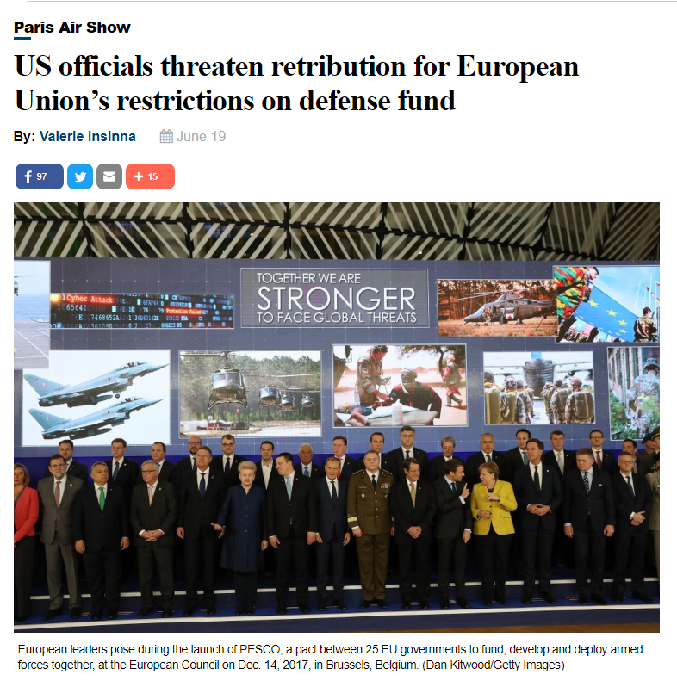
U.S. Response: June 2019

Slide 32
Anti-Corruption

Slide 33
Risks of Corruption
Reputation
Performance
Fiduciary

Slide 34


Notes:
FAR 2.101

Slide 35
Public corruption occurs when an office-holder or other governmental employee acts in an official capacity for personal gain.
MONITORING
Agent 1
CO
Agent 2
Contractor
Purchase
Principal
BONDING (PUNISHING)

Slide 36
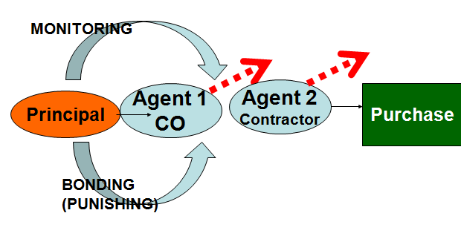
Processes
Rules
Qualification
Responsiveness
Planning
Competition - Methods
Cost Reimb.
Contract
Provisions

Slide 37
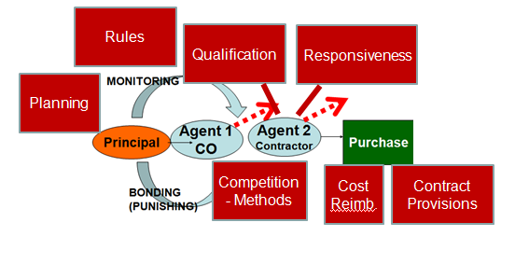
Anti-Corruption
Compliance
Objective Criteria
“Brains”
Exclusion/
Debarment
Fraud
Transparency
Professionalism
Users
UNCAC
Gov. Claims
Ethics
Challenges
Audits
Conditions for Use

Slide 38








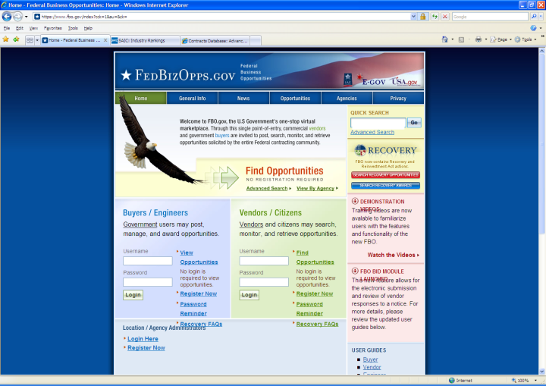
Tools for Fighting Corruption
Corporate Compliance
Tendering Rules
Audits
Suspension / Debarment
Ethics
Oversight
Bid Challenges
Transparency
Prosecution

Slide 39

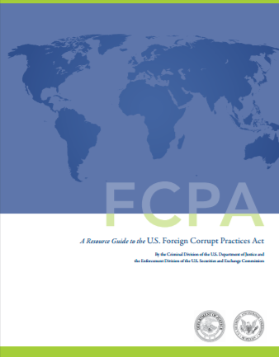
Red Flags – Third Parties
Excessive Commissions
Unreasonably large discounts
Vague Consulting Agreements
Consultant in Different Line of Business
Consultant Related to Official
Third Party Added at Official Insistence
Third Party Is Mere Shell Company
Third Party Requests Payment to Offshore Accounts
Notes:
excessive commissions to third-party agents or consultants; • unreasonably large discounts to third-party distributors; • third-party “consulting agreements” that include only vaguely described services; • the third-party consultant is in a different line of business than that for which it has been engaged; • the third party is related to or closely associated with the foreign official; • the third party became part of the transaction at the express request or insistence of the foreign official; • the third party is merely a shell company incorporated in an offshore jurisdiction; and • the third party requests payment to offshore bank accounts.

Slide 40

UK Bribery Act of 2010
Strict liability – unless compliance plan
  UK Ministry of Justice guidance (2011)
Extraterritorial application
Covers commercial bribery

Slide 41
U.S. Sentencing Commission Sentencing Guidelines - §8B2.1 | U.S. Contractor Compliance System: Final Federal Acquisition Regulation Rule (73 Fed. Reg. 67064 (Nov. 12, 2008) (effective 12/12/08) | UK Ministry of Justice Guidance for Corporate Compliance (March 2011)
1. Standards and procedures | W/in 30 days: written code of business ethics and conduct | “Clear, Practical and Accessible Policies and Procedures” A Code of Ethics; principles applicable regardless of local laws or culture. A policy concerning political contributions and lobbying activities. A policy on gifts and hospitality and facilitation payments. A commitment to making it explicit that the anti-bribery code applies to business partners
2. Knowledgeable leadership | No explicit reference. | “Top Level Commitment” Board expected to take a strong anti-bribery stance; CEO should take leading role. Senior officer should be in charge of compliance function. Decisionmaking structured to address risk.
3. Exclude risky personnel | W/in 90 days: “reasonable efforts not to include an individual as a principal, whom due diligence would have exposed as having engaged in conduct that is in conflict with Contractor’s code | Where appropriate, employees should be vetted. A policy on outside advisers/third parties including vetting and due diligence and appropriate risk assessments.
4. Training | W/in 90 days: business ethics awareness , compliance program | Training to ensure dissemination of the anti-corruption culture to all staff at all levels within the corporate.
5. Monitor, evaluate, reporting hotline | W/in 90 days: internal control system to facilitate timely discovery | “Due diligence” and “Monitoring and Review” Regular checks and auditing in a proportionate manner. A helpline which enables employees to report concerns; safeguards for whistleblowers Financial controls Supply chain partners to have codes of conduct
6. Incentives and discipline | W/in 90 days: internal control system to ensure corrective measures | “Effective Implementation” Individual accountability Appropriate and consistent disciplinary processes.
7. Adjust program to risk | W/in 90 days: review and adjust | “Risk Assessment”: Risk management to address corruption. Whether there have been previous cases of corruption within the corporate and, if so, the effect of any remedial action. Due diligence and risk assessments.
Notes:
Sources:
Serious Fraud Office, Approach of the Serious Fraud Office to Dealing with Overseas Corruption, at 1 (2009), available at http://www.sfo.gov.uk/media/28313/approach%20of%20the%20sfo%20to%20dealing%20with%20overseas%20corruption.pdf.
Lord Bach, Letter to Lord Henley re: Bribery Bill -- “Adequate Procedures’ Guidance (Dec. 2009), http://www.justice.gov.uk/publications/docs/bach-letter-adequate-procedures-guidance.pdf.
Ministry of Justice, Consultation on Guidance About Commercial Organisations Preventing Bribery (Section 9 of the Bribery Act 2010)

Slide 42

Brazil’s Anti-Corruption Law
Art. 5th. For the purposes of this Law, acts harmful to the public administration, national or foreign, are those performed by the legal persons cited in the paragraph of Art. 1st, which violate the national or foreign public patrimony, principles of the public administration, or the international commitments assumed by Brazil, defined thus:
. . .
IV – insofar as requests for bids and contracts:
. . .
f) to obtain an improper advantage or benefit, fraudulently, for modifications or extensions in contracts entered into with the public administration, not authorized by law, the invitation to the public request for bid, or the respective contractual instruments; or
g) to manipulate or defraud the economic and financial balance of contracts entered into with the public administration;
Notes:
Art. 5th. For the purposes of this Law, acts harmful to the public administration, national or foreign, are those performed by the legal persons cited in the paragraph of Art. 1st, which violate the national or foreign public patrimony, principles of the public administration, or the international commitments assumed by Brazil, defined thus:
. . .
IV – insofar as requests for bids and contracts:
. . .
f) to obtain an improper advantage or benefit, fraudulently, for modifications or extensions in contracts entered into with the public administration, not authorized by law, the invitation to the public request for bid, or the respective contractual instruments; or
g) to manipulate or defraud the economic and financial balance of contracts entered into with the public administration;

Slide 43
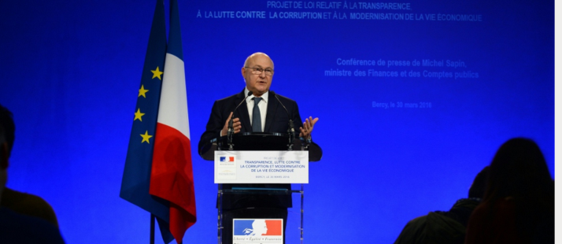
France’s Law “Sapin II” (2016)
The new law “also lays down an obligation to implement a corruption prevention plan in large companies. The National [Anti-Corruption] Agency will ensure that companies with a workforce of over 500 and whose annual turnover exceeds €100 million put in place procedures to guard against the risk of corruption, for example by training their employees. This obligation already exists in a number of countries, including the United Kingdom and Switzerland. The Agency will be able to penalise any failings in the 1,600 companies in France in this bracket. In this way, it will be able to issue a formal warning or impose a fine of up to €1 million for legal entities and €200,000 for natural persons, and make the proposed penalty public.”
Notes:
http://www.gouvernement.fr/en/sapin-ii-law-transparency-the-fight-against-corruption-modernisation-of-the-economy

Slide 44
France’s Law “Sapin II”
Corporate compliance system must include (Art. 17)
  1. Code of Conduct
  2. Internal alert system
  3. Risk-mapping
  4. Customer and supplier assessment
  5. Internal accounting controls
  6. Training for those at risk
  7. Discipline
  8. Evaluation and oversight of system
Notes:
Article 17 En savoir plus sur cet article...
I. - Les présidents, les directeurs généraux et les gérants d'une société employant au moins cinq cents salariés, ou appartenant à un groupe de sociétés dont la société mère a son siège social en France et dont l'effectif comprend au moins cinq cents salariés, et dont le chiffre d'affaires ou le chiffre d'affaires consolidé est supérieur à 100 millions d'euros sont tenus de prendre les mesures destinées à prévenir et à détecter la commission, en France ou à l'étranger, de faits de corruption ou de trafic d'influence selon les modalités prévues au II.
Cette obligation s'impose également :
1° Aux présidents et directeurs généraux d'établissements publics à caractère industriel et commercial employant au moins cinq cents salariés, ou appartenant à un groupe public dont l'effectif comprend au moins cinq cents salariés, et dont le chiffre d'affaires ou le chiffre d'affaires consolidé est supérieur à 100 millions d'euros ;
2° Selon les attributions qu'ils exercent, aux membres du directoire des sociétés anonymes régies par l'article L. 225-57 du code de commerce et employant au moins cinq cents salariés, ou appartenant à un groupe de sociétés dont l'effectif comprend au moins cinq cents salariés, et dont le chiffre d'affaires ou le chiffre d'affaires consolidé est supérieur à 100 millions d'euros.
Lorsque la société établit des comptes consolidés, les obligations définies au présent article portent sur la société elle-même ainsi que sur l'ensemble de ses filiales, au sens de l'article L. 233-1 du code de commerce, ou des sociétés qu'elle contrôle, au sens de l'article L. 233-3 du même code. Les filiales ou sociétés contrôlées qui dépassent les seuils mentionnés au présent I sont réputées satisfaire aux obligations prévues au présent article dès lors que la société qui les contrôle, au sens du même article L. 233-3, met en œuvre les mesures et procédures prévues au II du présent article et que ces mesures et procédures s'appliquent à l'ensemble des filiales ou sociétés qu'elle contrôle.
II. - Les personnes mentionnées au I mettent en œuvre les mesures et procédures suivantes :
1° Un code de conduite définissant et illustrant les différents types de comportements à proscrire comme étant susceptibles de caractériser des faits de corruption ou de trafic d'influence. Ce code de conduite est intégré au règlement intérieur de l'entreprise et fait l'objet, à ce titre, de la procédure de consultation des représentants du personnel prévue à l'article L. 1321-4 du code du travail ;
2° Un dispositif d'alerte interne destiné à permettre le recueil des signalements émanant d'employés et relatifs à l'existence de conduites ou de situations contraires au code de conduite de la société ;
3° Une cartographie des risques prenant la forme d'une documentation régulièrement actualisée et destinée à identifier, analyser et hiérarchiser les risques d'exposition de la société à des sollicitations externes aux fins de corruption, en fonction notamment des secteurs d'activités et des zones géographiques dans lesquels la société exerce son activité ;
4° Des procédures d'évaluation de la situation des clients, fournisseurs de premier rang et intermédiaires au regard de la cartographie des risques ;
5° Des procédures de contrôles comptables, internes ou externes, destinées à s'assurer que les livres, registres et comptes ne sont pas utilisés pour masquer des faits de corruption ou de trafic d'influence. Ces contrôles peuvent être réalisés soit par les services de contrôle comptable et financier propres à la société, soit en ayant recours à un auditeur externe à l'occasion de l'accomplissement des audits de certification de comptes prévus à l'article L. 823-9 du code de commerce ;
6° Un dispositif de formation destiné aux cadres et aux personnels les plus exposés aux risques de corruption et de trafic d'influence ;
7° Un régime disciplinaire permettant de sanctionner les salariés de la société en cas de violation du code de conduite de la société ;
8° Un dispositif de contrôle et d'évaluation interne des mesures mises en œuvre.
Indépendamment de la responsabilité des personnes mentionnées au I du présent article, la société est également responsable en tant que personne morale en cas de manquement aux obligations prévues au présent II.
III. - L'Agence française anticorruption contrôle le respect des mesures et procédures mentionnées au II du présent article.
Le contrôle est réalisé selon les modalités prévues à l'article 4. Il donne lieu à l'établissement d'un rapport transmis à l'autorité qui a demandé le contrôle et aux représentants de la société contrôlée. Le rapport contient les observations de l'agence sur la qualité du dispositif de prévention et de détection de la corruption mis en place au sein de la société contrôlée ainsi que, le cas échéant, des recommandations en vue de l'amélioration des procédures existantes.
IV. - En cas de manquement constaté, et après avoir mis la personne concernée en mesure de présenter ses observations, le magistrat qui dirige l'agence peut adresser un avertissement aux représentants de la société.
Il peut saisir la commission des sanctions afin que soit enjoint à la société et à ses représentants d'adapter les procédures de conformité internes destinées à la prévention et à la détection des faits de corruption ou de trafic d'influence.
Il peut également saisir la commission des sanctions afin que soit infligée une sanction pécuniaire. Dans ce cas, il notifie les griefs à la personne physique mise en cause et, s'agissant d'une personne morale, à son représentant légal.
V. - La commission des sanctions peut enjoindre à la société et à ses représentants d'adapter les procédures de conformité internes à la société destinées à la prévention et à la détection des faits de corruption ou de trafic d'influence, selon les recommandations qu'elle leur adresse à cette fin, dans un délai qu'elle fixe et qui ne peut excéder trois ans.
La commission des sanctions peut prononcer une sanction pécuniaire dont le montant ne peut excéder 200 000 € pour les personnes physiques et un million d'euros pour les personnes morales.
Le montant de la sanction pécuniaire prononcée est proportionné à la gravité des manquements constatés et à la situation financière de la personne physique ou morale sanctionnée.
La commission des sanctions peut ordonner la publication, la diffusion ou l'affichage de la décision d'injonction ou de sanction pécuniaire ou d'un extrait de celle-ci, selon les modalités qu'elle précise. Les frais sont supportés par la personne physique ou morale sanctionnée.
La commission des sanctions statue par décision motivée. Aucune sanction ni injonction ne peut être prononcée sans que la personne concernée ou son représentant ait été entendu ou, à défaut, dûment convoqué.
Les sanctions pécuniaires sont versées au Trésor public et recouvrées comme créances de l'Etat étrangères à l'impôt et au domaine.
Un décret en Conseil d'Etat précise les conditions de fonctionnement de la commission, notamment les conditions de récusation de ses membres.
VI. - L'action de l'Agence française anticorruption se prescrit par trois années révolues à compter du jour où le manquement a été constaté si, dans ce délai, il n'a été fait aucun acte tendant à la sanction de ce manquement.
VII. - Les recours formés contre les décisions de la commission des sanctions sont des recours de pleine juridiction.
VIII. - Le présent article entre en vigueur le premier jour du sixième mois suivant la promulgation de la présente loi.

Slide 45

Mexico’s General Law of Administrative Accountability (2017)
However, Mexico’s new law also provides that sanctions shall be mitigated by 50-70 percent where a company self-reports past or ongoing misconduct and has implemented and enforced an adequate “Integrity Policy.” An “Integrity Policy” is defined to include, at a minimum: (1) a document setting forth the functions and responsibilities of each of the company’s areas, the leadership throughout the company and a clear chain of command; (2) a code of conduct with enforcement protocol; (3) control and audit systems that regularly supervise standards of compliance within the organization; (4) internal whistleblower and reporting systems that allow for appropriate reporting to enforcement authorities and disciplinary procedures for employees acting contrary to company policy or Mexican law; and (5) human resources policies for preventing the hiring of persons that may pose compliance risks to the organization.
https://www.corporatecomplianceinsights.com/anti-corruption-enforcement-mexico/

Slide 46
U.S. Anti-Fraud Law
Whistleblower - Incentivized
Low Knowledge
Steep Penalties

Slide 47

UN Convention Against Corruption (Art. 9)
Public Information
Advance award criteria and publication
Objective and predetermined criteria for award
Bid protest and appeal
Measures to control procurement personnel – e.g., rules and codes
Transparency, including in budgeting and accounting

Slide 48
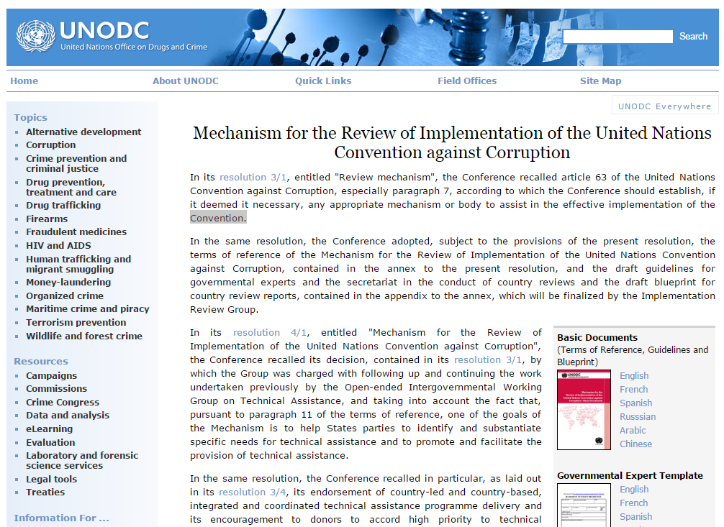
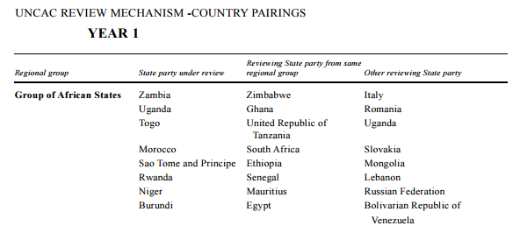
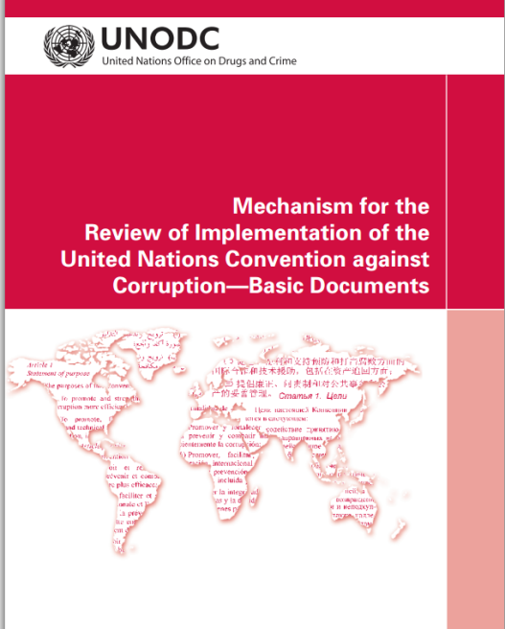
UNCAC Peer Review

Slide 49

Corporate compliance

Slide 50
What Is a Compliance System?
1. Standards and procedures
2. Knowledgeable leadership
3. Exclude risky personnel
4. Training
5. Monitor, evaluate, reporting hotline
6. Incentives and discipline
7. Adjust program to risk

Slide 51



1. Standards and procedures | √ | √ | √ | √
2. Knowledgeable leadership |  | √ | √ | √
3. Exclude risky personnel | √ | √ | √ | √
4. Training | √ | √ | √ | √
5. Monitor, evaluate, reporting hotline | √ | √ | √ | √
6. Incentives and discipline | √ | √ | √ | √
7. Adjust program to risk | √ | √ | √ | √
Notes:
Sources:
Serious Fraud Office, Approach of the Serious Fraud Office to Dealing with Overseas Corruption, at 1 (2009), available at http://www.sfo.gov.uk/media/28313/approach%20of%20the%20sfo%20to%20dealing%20with%20overseas%20corruption.pdf.
Lord Bach, Letter to Lord Henley re: Bribery Bill -- “Adequate Procedures’ Guidance (Dec. 2009), http://www.justice.gov.uk/publications/docs/bach-letter-adequate-procedures-guidance.pdf.
Ministry of Justice, Consultation on Guidance About Commercial Organisations Preventing Bribery (Section 9 of the Bribery Act 2010)

Slide 52
Issues in Compliance
Gifts
Revolving door
Conflicts of interest (personal)
Integrity of the procurement process
  Bid & proposal
  Internal government procurement information
Oversight by compliance officers

Slide 53
Should Organizational Conflicts of Interest Be a Basis for Debarment? Addressed in a Compliance System?
Co. A
Consulting company
Co. B
Parent of “Co. A”
Manufacturer
Unfair competition
Biased specifications
Impaired objectivity

Slide 54
Suspension/Debarment/
Exclusion

Slide 55
US – Mexico – Canada Agreement
(USMCA)
Article 13.17: Ensuring Integrity in Procurement Practices
Each Party shall ensure that criminal, civil, or administrative measures exist that can address corruption, fraud, and other wrongful acts in its government procurement.
These measures may include procedures to debar, suspend, or declare ineligible from participation in the Party’s procurements, for a stated period of time, a supplier that the Party has determined to have engaged in corruption, fraud, or other wrongful acts relevant to a supplier’s eligibility to participate in a Party’s government procurement . . .

Slide 56
United States:
Procurement Suspension or Debarment =
“Meta”- Responsibility Determination
FAR 9.402 Policy.
(a) Agencies shall solicit offers from, award contracts to, and consent to subcontracts with responsible contractors only. Debarment and suspension are discretionary actions that, taken in accordance with this subpart, are appropriate means to effectuate this policy.
Notes:
In individual procurements, individual contracting officers assess the prospective contractor’s “responsibility” – whether that contractor is “qualified” to perform the work on that individual contract, both in terms of systems and in terms of its ethics.
An agency’s Suspension and Debarment Official takes a much broader view – he or she assesses the contractor’s present responsibility for ALL prospective contracts.
When a contractor is debarred for procurement purposes, that is, in effect, a finding that the contractor cannot and should not be found responsible (or qualified) in ANY procurement.

Slide 57
U.S. Federal Discretionary Debarment
Suspension and Debarment Official
Investigators/ Prosecutors
Competitors
Contracting Officers
Criminal or Civil Fraud
Adverse Past Performance Reports
Suspension or Debarment
Administrative Agreement / Compliance
Other problems:
No uniform procedures
Huge disparity in actions

Slide 58



Comparing Causes for Debarment/Exclusion
United States
World Bank
European Union
Conviction of a crime or civil fraud
Poor contract performance
Other serious misconduct showing the contractor is not responsible
Misconduct, as narrowly defined by Anti-Corruption, Guidelines, and Consultant and Procurement Guidelines: fraud, corruption, collusion, coercion and obstruction
Mandatory:
Corruption, fraud, money laundering
Non-Mandatory:
Bankruptcy
Convicted re: professional conduct
Grave professional misconduct
Social security / taxes
Notes:
New European Procurement Directive:
(100)
Public contracts should not be awarded to economic operators that have participated in a criminal organisation or have been found guilty of corruption, fraud to the detriment of the Union’s financial interests, terrorist offences, money laundering or terrorist financing. The non-payment of taxes or social security contributions should also lead to mandatory exclusion at the level of the Union. Member States should, however, be able to provide for a derogation from those mandatory exclusions in exceptional situations where overriding requirements in the general interest make a contract award indispensable. This might, for example, be the case where urgently needed vaccines or emergency equipment can only be purchased from an economic operator to whom one of the mandatory grounds for exclusion otherwise applies.
(101)
Contracting authorities should further be given the possibility to exclude economic operators which have proven unreliable, for instance because of violations of environmental or social obligations, including rules on accessibility for disabled persons or other forms of grave professional misconduct, such as violations of competition rules or of intellectual property rights. It should be clarified that grave professional misconduct can render an economic operator’s integrity questionable and thus render the economic operator unsuitable to receive the award of a public contract irrespective of whether the economic operator would otherwise have the technical and economical capacity to perform the contract.
Bearing in mind that the contracting authority will be responsible for the consequences of its possible erroneous decision, contracting authorities should also remain free to consider that there has been grave professional misconduct, where, before a final and binding decision on the presence of mandatory exclusion grounds has been rendered, they can demonstrate by any appropriate means that the economic operator has violated its obligations, including obligations relating to the payment of taxes or social security contributions, unless otherwise provided by national law. They should also be able to exclude candidates or tenderers whose performance in earlier public contracts has shown major deficiencies with regard to substantive requirements, for instance failure to deliver or perform, significant shortcomings of the product or service delivered, making it unusable for the intended purpose, or misbehaviour that casts serious doubts as to the reliability of the economic operator. National law should provide for a maximum duration for such exclusions.
In applying facultative grounds for exclusion, contracting authorities should pay particular attention to the principle of proportionality. Minor irregularities should only in exceptional circumstances lead to the exclusion of an economic operator. However repeated cases of minor irregularities can give rise to doubts about the reliability of an economic operator which might justify its exclusion.
Subsection 1
Criteria for qualitative selection
Article 57
Exclusion grounds
1. Contracting authorities shall exclude an economic operator from participation in a procurement procedure where they have established, by verifying in accordance with Articles 59, 60 and 61, or are otherwise aware that that economic operator has been the subject of a conviction by final judgment for one of the following reasons:
(a)
participation in a criminal organisation, as defined in Article 2 of Council Framework Decision 2008/841/JHA (32);
(b)
corruption, as defined in Article 3 of the Convention on the fight against corruption involving officials of the European Communities or officials of Member States of the European Union (33) and Article 2(1) of Council Framework Decision 2003/568/JHA (34) as well as corruption as defined in the national law of the contracting authority or the economic operator;
(c)
fraud within the meaning of Article 1 of the Convention on the protection of the European Communities’ financial interests (35);
(d)
terrorist offences or offences linked to terrorist activities, as defined in Articles 1 and 3 of Council Framework Decision 2002/475/JHA (36) respectively, or inciting or aiding or abetting or attempting to commit an offence, as referred to in Article 4 of that Framework Decision;
(e)
money laundering or terrorist financing, as defined in Article 1 of Directive 2005/60/EC of the European Parliament and of the Council (37);
(f)
child labour and other forms of trafficking in human beings as defined in Article 2 of Directive 2011/36/EU of the European Parliament and of the Council (38).
The obligation to exclude an economic operator shall also apply where the person convicted by final judgment is a member of the administrative, management or supervisory body of that economic operator or has powers of representation, decision or control therein.
2. An economic operator shall be excluded from participation in a procurement procedure where the contracting authority is aware that the economic operator is in breach of its obligations relating to the payment of taxes or social security contributions and where this has been established by a judicial or administrative decision having final and binding effect in accordance with the legal provisions of the country in which it is established or with those of the Member State of the contracting authority.
Furthermore, contracting authorities may exclude or may be required by Member States to exclude from participation in a procurement procedure an economic operator where the contracting authority can demonstrate by any appropriate means that the economic operator is in breach of its obligations relating to the payment of taxes or social security contributions.
This paragraph shall no longer apply when the economic operator has fulfilled its obligations by paying or entering into a binding arrangement with a view to paying the taxes or social security contributions due, including, where applicable, any interest accrued or fines.
3. Member States may provide for a derogation from the mandatory exclusion provided for in paragraphs 1 and 2, on an exceptional basis, for overriding reasons relating to the public interest such as public health or protection of the environment.
Member States may also provide for a derogation from the mandatory exclusion provided in paragraph 2, where an exclusion would be clearly disproportionate, in particular where only minor amounts of taxes or social security contributions are unpaid or where the economic operator was informed of the exact amount due following its breach of its obligations relating to the payment of taxes or social security contributions at such time that it did not have the possibility of taking measures as provided for in the third subparagraph of paragraph 2 before expiration of the deadline for requesting participation or, in open procedures, the deadline for submitting its tender.
4. Contracting authorities may exclude or may be required by Member States to exclude from participation in a procurement procedure any economic operator in any of the following situations:
(a)
where the contracting authority can demonstrate by any appropriate means a violation of applicable obligations referred to in Article 18(2);
(b)
where the economic operator is bankrupt or is the subject of insolvency or winding-up proceedings, where its assets are being administered by a liquidator or by the court, where it is in an arrangement with creditors, where its business activities are suspended or it is in any analogous situation arising from a similar procedure under national laws and regulations;
(c)
where the contracting authority can demonstrate by appropriate means that the economic operator is guilty of grave professional misconduct, which renders its integrity questionable;
(d)
where the contracting authority has sufficiently plausible indications to conclude that the economic operator has entered into agreements with other economic operators aimed at distorting competition;
(e)
where a conflict of interest within the meaning of Article 24 cannot be effectively remedied by other less intrusive measures;
(f)
where a distortion of competition from the prior involvement of the economic operators in the preparation of the procurement procedure, as referred to in Article 41, cannot be remedied by other, less intrusive measures;
(g)
where the economic operator has shown significant or persistent deficiencies in the performance of a substantive requirement under a prior public contract, a prior contract with a contracting entity or a prior concession contract which led to early termination of that prior contract, damages or other comparable sanctions;
(h)
where the economic operator has been guilty of serious misrepresentation in supplying the information required for the verification of the absence of grounds for exclusion or the fulfilment of the selection criteria, has withheld such information or is not able to submit the supporting documents required pursuant to Article 59; or
(i)
where the economic operator has undertaken to unduly influence the decision-making process of the contracting authority, to obtain confidential information that may confer upon it undue advantages in the procurement procedure or to negligently provide misleading information that may have a material influence on decisions concerning exclusion, selection or award.
Notwithstanding point (b) of the first subparagraph, Member States may require or may provide for the possibility that the contracting authority does not exclude an economic operator which is in one of the situations referred to in that point, where the contracting authority has established that the economic operator in question will be able to perform the contract, taking into account the applicable national rules and measures on the continuation of business in the case of the situations referred to in point (b).
5. Contracting authorities shall at any time during the procedure exclude an economic operator where it turns out that the economic operator is, in view of acts committed or omitted either before or during the procedure, in one of the situations referred to in paragraphs 1 and 2.
At any time during the procedure, contracting authorities may exclude or may be required by Member States to exclude an economic operator where it turns out that the economic operator is, in view of acts committed or omitted either before or during the procedure, in one of the situations referred to in paragraph 4.
6. Any economic operator that is in one of the situations referred to in paragraphs 1 and 4 may provide evidence to the effect that measures taken by the economic operator are sufficient to demonstrate its reliability despite the existence of a relevant ground for exclusion. If such evidence is considered as sufficient, the economic operator concerned shall not be excluded from the procurement procedure.
For this purpose, the economic operator shall prove that it has paid or undertaken to pay compensation in respect of any damage caused by the criminal offence or misconduct, clarified the facts and circumstances in a comprehensive manner by actively collaborating with the investigating authorities and taken concrete technical, organisational and personnel measures that are appropriate to prevent further criminal offences or misconduct.
The measures taken by the economic operators shall be evaluated taking into account the gravity and particular circumstances of the criminal offence or misconduct. Where the measures are considered to be insufficient, the economic operator shall receive a statement of the reasons for that decision.
An economic operator which has been excluded by final judgment from participating in procurement or concession award procedures shall not be entitled to make use of the possibility provided for under this paragraph during the period of exclusion resulting from that judgment in the Member States where the judgment is effective.
7. By law, regulation or administrative provision and having regard to Union law, Member States shall specify the implementing conditions for this Article. They shall, in particular, determine the maximum period of exclusion if no measures as specified in paragraph 6 are taken by the economic operator to demonstrate its reliability. Where the period of exclusion has not been set by final judgment, that period shall not exceed five years from the date of the conviction by final judgment in the cases referred to in paragraph 1 and three years from the date of the relevant event in the cases referred to in paragraph 4.

Slide 59
World Bank Sanctions System
Sanctions Board
Suspension and Debarment Officer (SDO)
Integrity Compliance
Officers (within INT)
Monitors integrity compliance by sanctioned companies (or codes of conduct for individuals)
Decides whether the compliance condition established by the SDO or Sanctions Board as part of a debarment has been satisfied.
Compliance
Comprised of 4 external members and 3 Bank staff
Reviews case ‘de novo’
May hold a hearing with parties and witnesses
Imposes sanctions (not bound by SDO’s recommendation)
Decisions are final and not appealable
39% of cases resolved at this level
Adjudicative
Evaluates evidence presented by INT
Issues Notice of Sanctions Proceedings to respondent
Temporarily suspends respondent
Recommends a sanction (becomes effective if respondent does not contest)
61% of cases resolved at this level
Investigates allegations of fraud, corruption, collusion, coercion and obstruction
Prepares and submits a Statement of Accusations and Evidence (SAE) to the Office of Suspension and Debarment
Integrity Vice Presidency
Investigative
Notes:
Quick little overview to get us started.
Where do Sanctions decisions come from?
As you can see from this chart:
39% of the decisions come from the Sanctions Board;
61% of decisions are made at the OSD level – so, most cases get resolved at the OSD level.
*As of October 2013
All cases are based on investigations by INT. My role as SDO is essentially that of an administrative judge.

Slide 60
Four Paradigms
Responsibility (Qualification)
Only
On a case-by-case basis
Adjudicative Debarment for “Bad Acts”
E.g., World Bank
Discretionary Debarment – U.S. Federal
In U.S. – done by contracting officer
Debarment is a cross-government “meta-qualification” determination
Based on “present responsibility”: focus on present status
Court-Ordered Debarment, After Judicial Proceedings
Allowed by new EU Directives
Performance Risk
Reputation Risk

Slide 61
Looming Issue:
Cross-Debarment
Options:
Automatic cross-debarment
Debarments to be considered in other systems
Adverse performance information to be considered
Do nothing

Slide 62
Voluntary versus mandatory Disclosure

Slide 63
U.S. Federal Mandatory Disclosure:
FAR 52.203-13
“Credible Evidence”
Civil or Criminal Fraud, Bribe, Gratuity or Criminal Personal Conflict of Interest, or
“Significant Overpayment”
Report to Contracting Officer and Inspector General
Failure to report: grounds for suspension or debarment

Slide 64
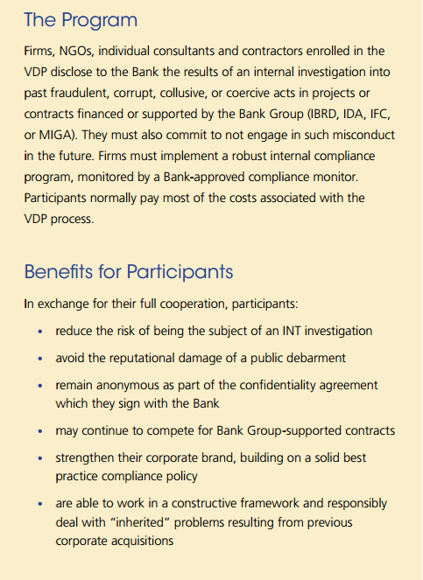
World Bank Voluntary Disclosure Program
Disclose Investigation
Avoid Debarment
Past fraudulent, corrupt, collusive or coersive act
Remain Anonymous

Slide 65
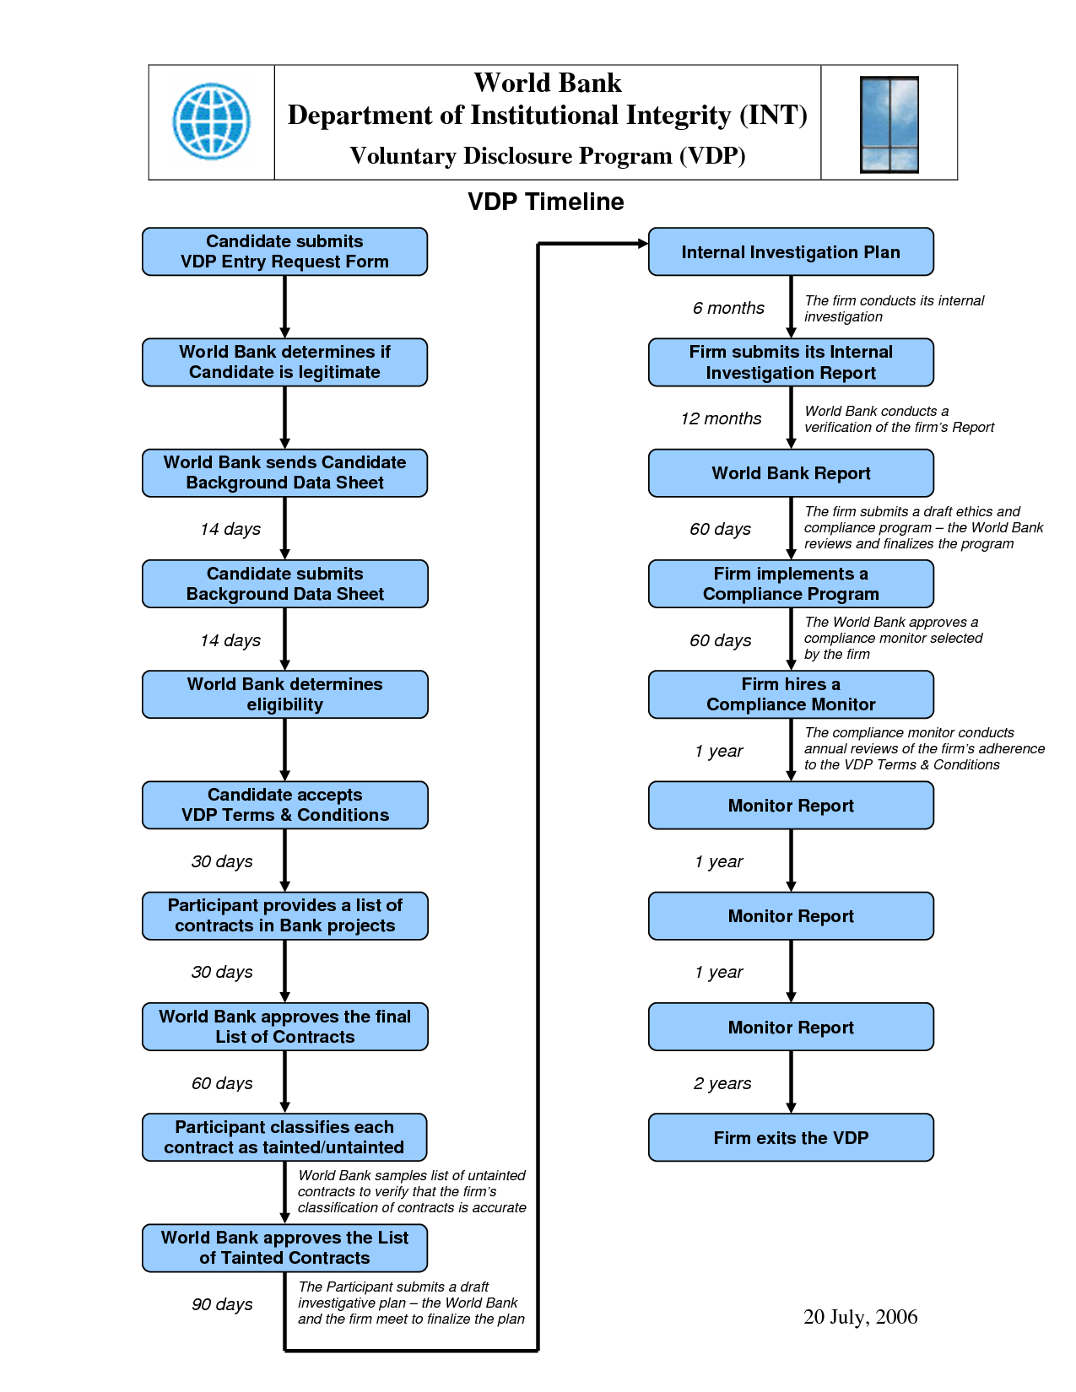
World Bank Voluntary Disclosure Program

Slide 66
Combine?
Mandatory Disclosure
Voluntary Disclosure
Whistleblower

Slide 67
Combine?
Goal:
Reputation Risk?
Performance Risk?
Mandatory Disclosure
Voluntary Disclosure
Whistleblower

Slide 68
Reverse Auctions

Slide 69
Assessing Electronic Procurement
More efficient?
More transparent?
Discriminatory?
Ready source of comparative lessons?

Slide 70

What Is a Reverse Auction?

Slide 71
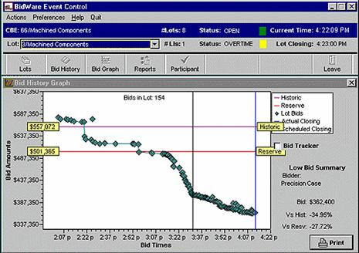

Slide 72
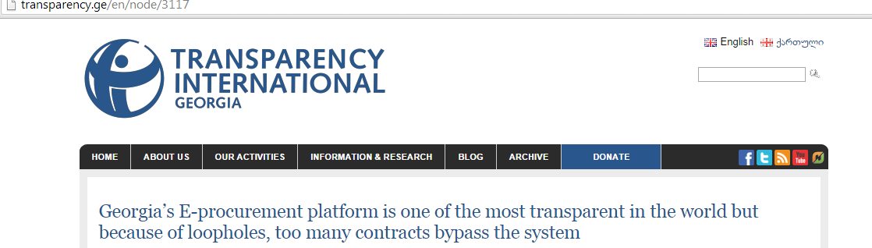

Case study: Georgia –
Using E-Procurement To Combat Corruption
Link to presentation on Georgian e-procurement system:
  https://prezi.com/1yugudjld6rw/e-procurement-reform-in-georgia-everyone-sees-everything/
Transparency International – Georgia report on e-procurement system:
  http://www.transparency.ge/en/node/3117

Slide 73
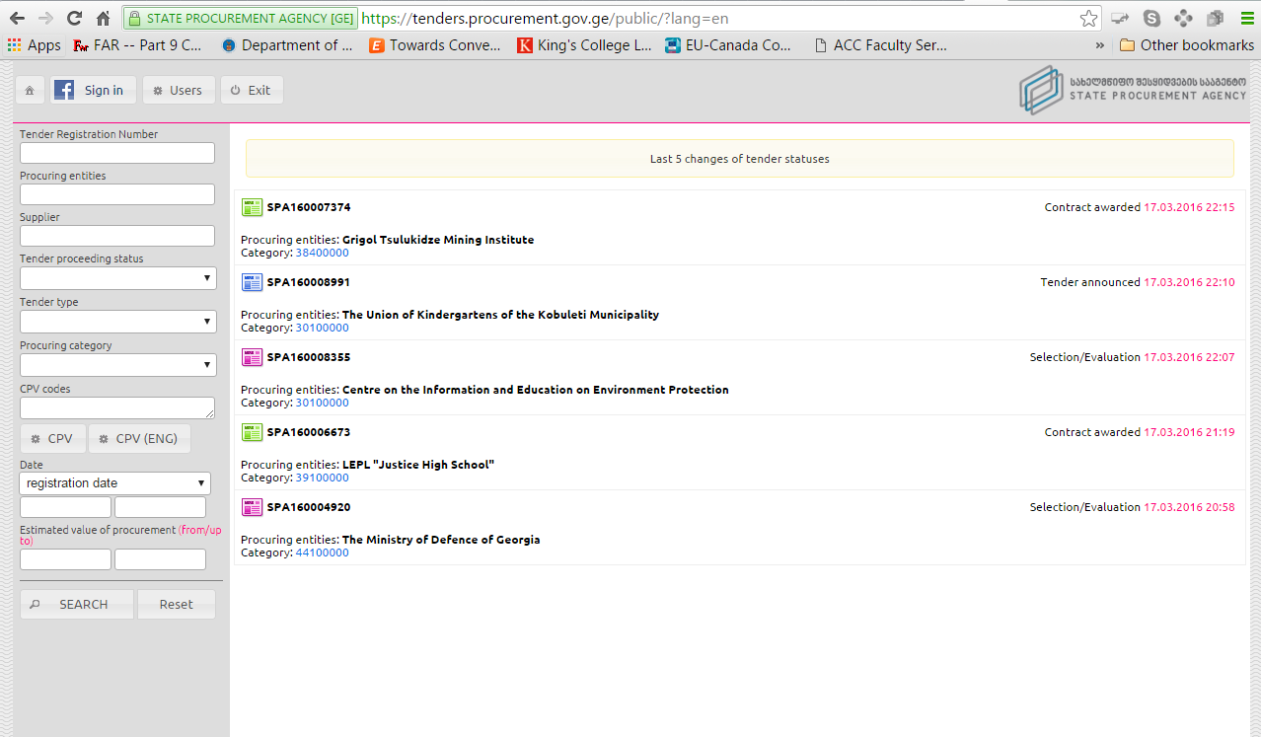
Georgia E-Procurement

Slide 74
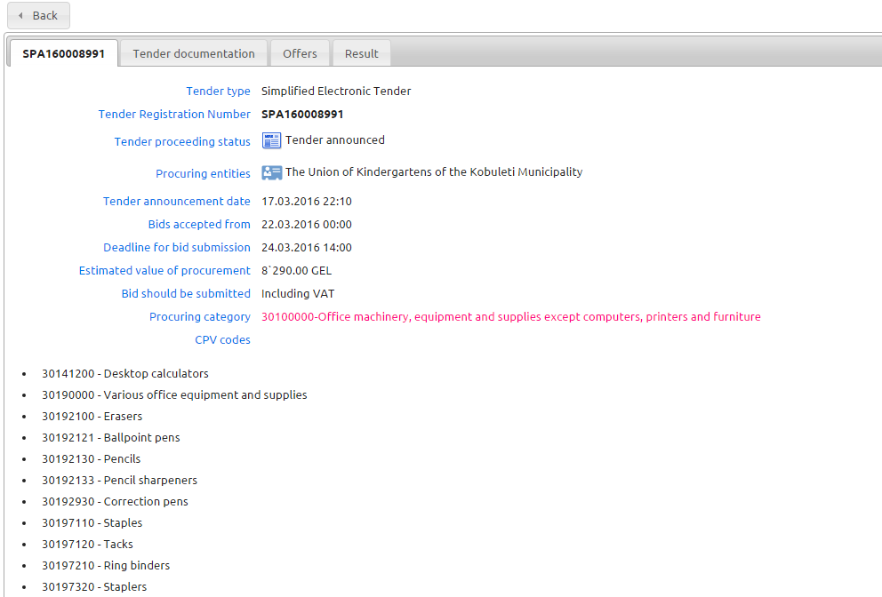
Sample Georgian Auction

Slide 75
The U.S. Rule on Reverse Auctions

Slide 76
Which types of auction can be used?
Type 1 – allowed; is the most common in UK
  winning tender is chosen based solely on the auction phase (usually price only)
  winner (usually lowest price) is apparent to participants during the auction process
European Perspective
- Sue Arrowsmith

Slide 77
Which types of auction can be used?
Type 2 – allowed
  award is based on aspects of tenders assessed before the auction (e.g.quality) and on the auction (where usually only price only is subject to change)
  winner is apparent during the auction process
European Perspective
- Sue Arrowsmith

Slide 78
Which types of auction can be used?
Type 3 – not allowed under directives at all; was rare before new directives except for utilities
  As in type 2, award is based on aspects of tenders not changed in the auction (e.g. quality) and on the auction
  winner is not apparent during the auction process (e.g. quality is judged after the auction and then an overall judgment made on price/quality)
European Perspective
- Sue Arrowsmith

Slide 79
European Union Directive – Cont’d
The electronic auction shall be based:
- either solely on prices when the contract is awarded to the lowest price,
- or on prices and/or on the new values of the features of the tenders indicated in the specification when the contract is awarded to the most economically advantageous tender.

Slide 80
Any Recourse in GPA?

Slide 81
Revised GPA Defines Electronic Reverse Auction
Article I:
(e) electronic auction means an iterative process that involves the use of electronic means for the presentation by suppliers of either new prices, or new values for quantifiable non-price elements of the tender related to the evaluation criteria, or both, resulting in a ranking or re‑ranking of tenders;

Slide 82
And GPA Regulates . . .
Article XIV Electronic Auctions
Where a procuring entity intends to conduct a covered procurement using an electronic auction, the entity shall provide each participant, before commencing the electronic auction, with:
(a) the automatic evaluation method, including the mathematical formula, that is based on the evaluation criteria set out in the tender documentation and that will be used in the automatic ranking or re-ranking during the auction;
(b) the results of any initial evaluation of the elements of its tender where the contract is to be awarded on the basis of the most advantageous tender; and
(c) any other relevant information relating to the conduct of the auction.

Slide 83
Mock Auction Rules
Group descriptions drive bidding strategy
Auction per mock solicitation
U.S. rules regarding reverse auctions apply
U.S. bid protest rules apply
Bids to be submitted; low bid posted
Professor is both auctioneer and arbiter

Slide 84
Mock Auction
General Facts: Solicitation
Team-Specific Facts (to be distributed)

Slide 85
Conclusion

