Slide 1
Is the practice of negociation in public contracts a mere and common principle? / La négociation peut-elle être considérée comme un principe commun des contrats publics?
Daniel Schoeni
The views expressed here are the author’s and do not reflect an official position of the Department of the Air Force, Department of Defense, or any other US government agency.
Notes:
s

Slide 2
Preview
Ph.D. elevator pitch
Transatlantic caricatures
Covered procurements
Composition of purchases
Competitive negotiation

Slide 3
Ph.D. elevator pitch
Here’s my thesis in 60 second or less. Time me.

Slide 4
PhD elevator pitch
TTIP is important. Combined US/EU economy is huge – nearly half of global GDP.
Public procurement is a big area of concern.
Tariffs aren’t the problem. Non-tariff barriers are.
Hypothetical: suppose TTIP passed and all overt barriers removed. What barriers would remain?
Sue Arrowsmith: foreign procurement regimes create ‘structural restrictions’.
Yukins/Schooner: such restrictions ‘raise practical barriers to entry as foreign vendors run headlong into dense and alien procurement regimes’.

Slide 5
Dense and alien regimes
Award and qualification procedures
Competitive procedures
(negotiation contracts as a competitive procedure)
Challenge procedures

Slide 6
Transatlantic caricatures
American versus European spending priorities

Slide 7
Different spending priorities
Rugged individualists
Socialists

Slide 8
Facts about U.S. federal spending

Slide 10
Grants: non-procurement spending

Slide 11
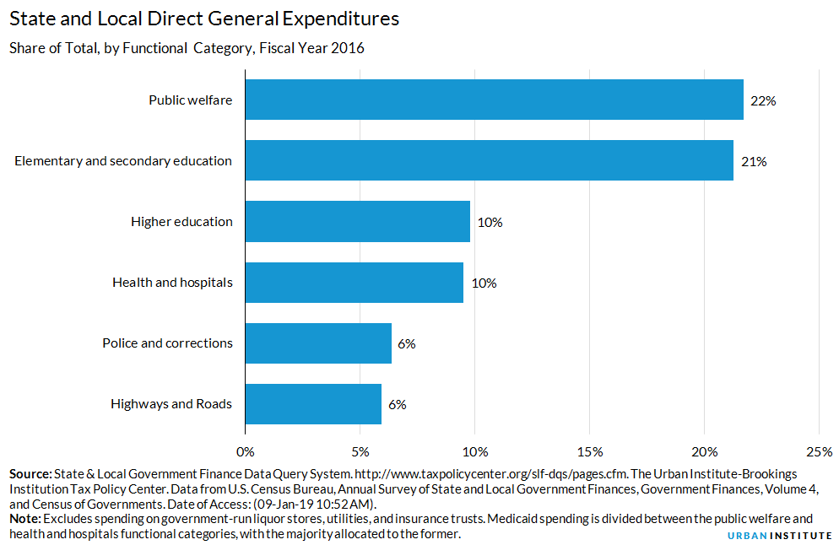

Slide 12
Europe: 2nd largest defense budget

Slide 13
Covered procurements
Why spending priorities seem to be so different

Slide 14
The fox knows many things, but the hedgehog knows one big thing.

Slide 15
Coverage
European Union 3.3%
United States 4%
Covers local, regional, and Member State level
Broad definition of “procurement”
Most Member State spending is covered.
Only 10% defense is covered by a directive
Covered defense spending only .3%
FAR covers only the central government
Narrow definition (excludes healthcare)
Most federal spending isn’t covered.
Almost 100% defense covered by the FAR
What is covered is mostly defense (70-80%)

Slide 16
Defense coverage
United States
FAR doesn’t cover state or local procurement.
Nor federal grants.
When sub-central and grants and are excluded, skews toward defence.
70–80% federal procurement
European Union
EU procurement covers all procurement: 2.4 € trillion.
Member states spend 80 € billion on defence.
3.3% share of procurement
Of that, only less than 10% under one of the directives.

Slide 17
Consider the math .
3.3% x 9.5% = .3%
70–80% ÷ .3% = 210–240
U.S. federal procurement’s share of defense is 210–240x larger than what falls under the EU directives.

Slide 18
Acknowledgements
I did the heavy lifting on the EU defense data.
It would require a “willful blindness” to miss that defense has played a central role in the U.S. federal procurement system.

Slide 19
Composition of purchases
What buy determines how we buy

Slide 20
Defence exceptionalism
Termination for convenience
Christian doctrine
Sovereign acts and unmistakability doctrines
Deferential standards of review for bid protests
Strict compliance doctrine
Government’s right to submit change orders
Cost-reimbursement contracts
Competitive negotiation

Slide 21
Defense is different
Jeffrey Bialos, Christine Fisher & Stuart Koehl, Fortresses & Icebergs

Slide 22
Composition of purchases
European Union
United States
Local and regional spending large share
Healthcare large share procurement spending
Defense small share of procurement spending
More spending on commodities
Therefore, price often the primary criterion
No local or regional spending included
Limited for healthcare spending federal level
Defense majority of procurement spending
More spending on high-tech, bespoke goods
Thus, criteria often can’t be reduced to price

Slide 23
Negotiated procurements
Coverage drives composition, which in turn drives policies about negotiation

Slide 24
Competitive negotiation
American vendor
European vendor
Predominant method: 38% negotiated.
Add in IDIQ, that’s 60%.
Negotiation is the norm (viewed as competitive).
Sealed bids can’t weigh non-price factors.
Apt to submit incomplete bids to EU purchasers.
Open procedures: 87%.
Add in restricted, and the total comes to 91%.
Negotiation impermissible for both open/restricted.
Open bids may consider non-price factors.
Apt to miss opportunities for negotiation in the US.

Slide 25
Shared evolution
United States 60%
European Union 10%
Longstanding history with sealed bidding
Tolerance developed during the Cold War
Negotiation finally recognized in 1984
“Perfect competition” differentiated products impossible…negotiation allows some competition
Preference for open competition
Negotiation disfavored, national preferences
Competitive dialogue in 2004 directive
Existing methods weren’t working for complex/IT
Yukins: striking parallel with America

Slide 26
Conclusion
Ph.D. elevator pitch
Transatlantic caricatures
Covered procurements
Composition of purchases
Competitive negotiation
Questions?

