Slide 1
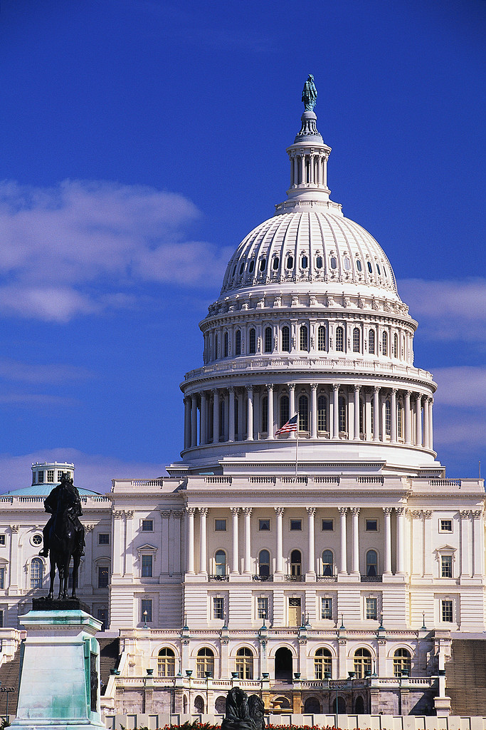
Agency-Level Bid Protests: Study Commissioned by the Administrative Conference of the United States (ACUS)
Christopher Yukins
Program information: https://publicprocurementinternational.com/agency-level-bid-protests/

Slide 2
Briefing
Introduction
Study by the Administrative Conference of the United States: Overview
Federal Agency-Level Bid Protests
Potential Areas of Reform
Next Steps

Slide 3
Disclaimer
This meeting is not sponsored by the Administrative Conference of the United States.

Slide 4
Administrative Conference of the United States - Study

Slide 5
Study Background
The Administrative Conference of the United States (ACUS) is undertaking a study of agency-level bid protests, coordinated by Professor Christopher Yukins (George Washington University Law School), with research assistance by GWU Law student Benjamin Smith.

Slide 6
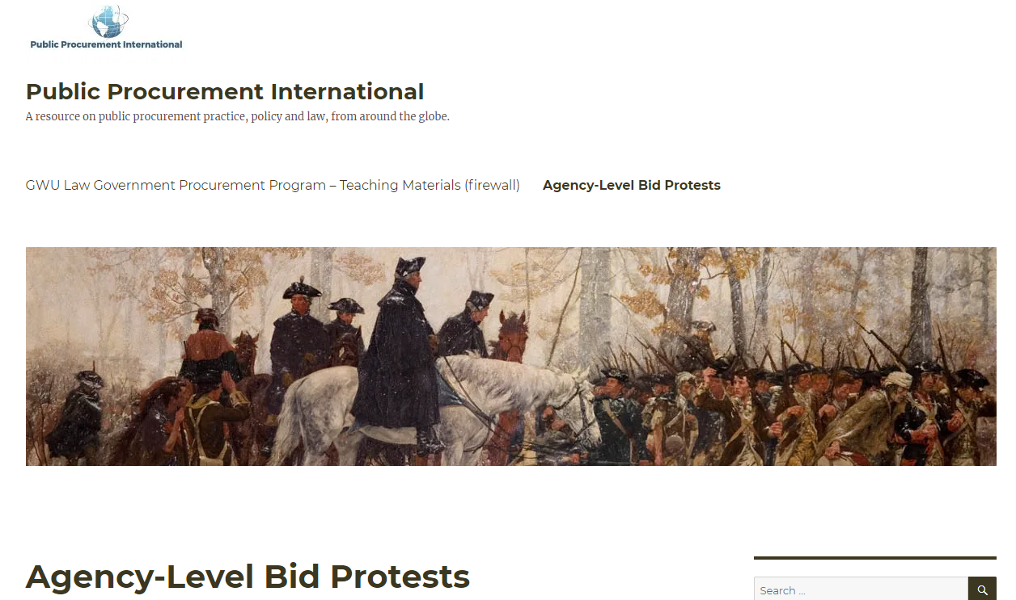
Resources
Materials on this initiative:
https://publicprocurementinternational.com/agency-level-bid-protests/

Slide 7
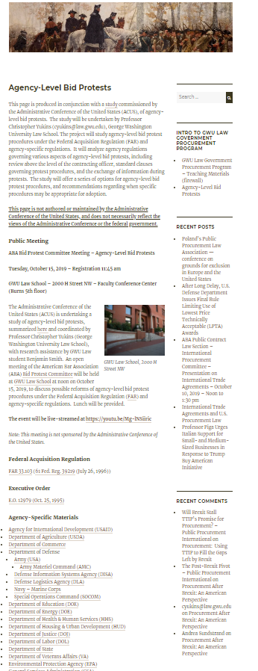
RESOURCES
Background on ACUS Study
ABA Committee Meeting
FAR 33.103
Executive Order
Agency-Specific Regulations and other resources

Slide 8
Background on Agency-Level Bid Protests

Slide 9
What Are Agency-Level Protests?
Agency-Level Protests
Independent Agency
In U.S.: Government Accountability Office (GAO)
Court
In U.S.: Court of Federal Claims
To Agency
Subsequent protests allowed to independent agency or court
Structure generally adopted by U.S. federal procurement system, ABA State & Local Model Procurement Code, UNCITRAL (United Nations) Model Procurement Law, and the European Union Remedies Directive

Slide 10
Evolution of Agency-Level Protests
Army Materiel Command
Model for Agency-Level Protests
Executive Order 12979
President Clinton
Federal Acquisition Regulation 33.103
October 25, 1995
Agency-Specific Procedures

Slide 11
Major Issues in Bid Protest System
Who may protest
Contracts Final?
Time Limits?
Stop Procurement
Abusive?
Time to Decide
Evidence Allowed?
Winning Percentage
Power to Enforce?
Where Protest Heard?
What May Be Protested?
Notes:
Daniel I. Gordon, Constructing a Bid Protest Process: Choices Every Procurement Challenge System Must Make, 35 Pub. Cont. L.J. 427 (2006), available at https://ssrn.com/abstract=892781
Where is the forum located?
How broad is the forum’s jurisdiction?
Who is allowed to protest?
How is the issue of the finality of signed contracts handled?
How strict are time limits for protesting to the forum?
Is the procurement put “on hold” while the protest is pending?
How is abuse of protest process avoided or dealt with?
How long does the forum have to decide the case?
What evidence does the forum have before it in reaching its decisions?
How difficult is it for a protester to win a protest?
What power does the forum have to offer (and enforce) meaningful relief?

Slide 12
Potential Areas of ReVIEW

Slide 13
Where Is the Protest Heard?
GSA/Labor/DOJ
Protest to CO or “Agency Protest Official”
EPA
Initial protest to CO
May appeal to higher EPA officer or GAO (per GAO’s 10-day bar after initial adverse agency decision)
FAR
CO or designated official
Protester may request independent reviewer -- should have no previous personal involvement
Notes:
All protests filed directly with the agency will be addressed to the contracting officer or official designated to receive protest (FAR 33.103(d)(3))
Interested parties may request an independent review of their protest at a level above the contracting officer. (FAR 33.103(d)(4))
When practicable officials designated to conduct independent review should not have had previous personal involvement in the procurement. (FAR 33.103(d)(4))
The officials conducting the independent review should not have had previous personal involvement in the procurement (FAR 33.103(d)(4))
C

Slide 14
Potential Approaches
FAR 33.103(d)
(3) All protests filed directly with the agency will be addressed to the contracting officer or other official designated to receive protests.
(4) In accordance with agency procedures, interested parties may request an independent review of their protest at a level above the contracting officer; solicitations should advise potential bidders and offerors that this review is available. Agency procedures and/or solicitations shall notify potential bidders and offerors whether this independent review is available as an alternative to consideration by the contracting officer of a protest or is available as an appeal of a contracting officer decision on a protest. Agencies shall designate the official(s) who are to conduct this independent review, but the official(s) need not be within the contracting officer's supervisory chain. When practicable, officials designated to conduct the independent review should not have had previous personal involvement in the procurement. If there is an agency appellate review of the contracting officer's decision on the protest, it will not extend GAO's timeliness requirements. Therefore, any subsequent protest to the GAO must be filed within 10 days of knowledge of initial adverse agency action (4 CFR 21.2(a)(3)).
GSA/Labor/DOJ
GSAAR 533.103-1(a) Any protester filing an agency protest has the choice of requesting either that the contracting officer or the Agency Protest Official decide the protest. If the protest is silent on this matter, the contracting officer will decide the protest. If a party requests a review at a level above the contracting officer, the Agency Protest Official will decide the protest. The decision by the Agency Protest Official for GSA is an alternative to a decision by the contracting officer on a protest. The Agency Protest Official for GSA will not consider an appeal of the contracting officer’s decision on an agency protest.
EPA 1552.233-70: Agency protests must be filed with the Contracting Officer in accordance with the requirements of FAR 33.103 (d) and (e). Within 10 calendar days after receipt of an adverse Contracting Officer decision, the protester may submit a written request for an independent review by the Head of the Contracting Activity. This independent review is available only as an appeal of a Contracting Officer decision on a protest. Accordingly, as provided in 4 CFR 21.2(a)(3), any protest to the GAO must be filed within 10 days of knowledge of the initial adverse Agency action.

Slide 15
What May Be Protested to the Agency?
FAR
No Limitation
AID:
Exclusions
No:
Small business issues
No:
Responsibility determinations
Electronic Marketplaces?
GSA will soon award $6 billion in no-cost contracts for “electronic marketplaces” for micro-purchases ($10,000)

Slide 16
Time Limits
FAR:
10 days to file protest (5 days after debriefing)
Labor & Justice:
Scheduling conference within 5 days
GSA:
Scheduling conf. soon as practicable
GSA:
Agency must respond in writing within 10 days
FAR:
Best efforts to resolve in 35 days
Labor & Justice:
Best efforts in 20 days
GSA:
If protest sustained, relief implemented within 30 days
Justice:
If sustained, relief implemented or explanation within 30 days
FAR:
Agency decision well-reasoned and explain bases

Slide 17
Timeliness – Adverse Agency Action Triggers GAO Deadline
Our Bid Protest Regulations contain strict rules for the timely submission of protests. Where a protest first has been filed with a contracting activity, any subsequent protest to our Office, to be considered timely, must be filed within 10 calendar days of “actual or constructive knowledge of initial adverse agency action.” 4 C.F.R. §21.2(a)(3). The term “adverse agency action” means any action or inaction on the part of a contracting agency that is prejudicial to the position taken in a protest filed with the agency, including the “opening of bids or receipt of proposals.” 4 C.F.R. §21.0(e).
Mls-Multinational Logistic Servs., Ltd., B-415782 (Mar. 7, 2018)

Slide 18
Timeliness -- Example
Agency-Level Bid Protest Filed
Proposals Due
10 Days
GAO Protest Filed
Contracting Officer Denies Protest
“. . . once the contracting activity proceeds with receipt of proposals, the protester is on notice that the contracting activity will not undertake the requested corrective action; consequently, timeliness is measured from this point rather than from the receipt of a subsequent formal denial of the agency-level protest. DAI, Inc., supra, at 3; Lifecare Mgmt. Partners, supra, at 10; Ann Riley & Assocs., Ltd., B–237365, Nov. 15, 1989, 89–2 CPD ¶463 at 2; Consolidated Indus. Skills Corp., B–231669.2, July 15, 1988, 88–2 CPD ¶58 at 1–2. Mls-Multinational Logistic Servs., Ltd., B-415782 (Mar. 7, 2018)

Slide 19
Timeliness -- Example
Agency-Level Bid Protest Filed
Proposals Due
10 Days
GAO Protest Filed
Contracting Officer Denies Protest
Possible Approach: Deemed Denial?
“. . . once the contracting activity proceeds with receipt of proposals, the protester is on notice that the contracting activity will not undertake the requested corrective action; consequently, timeliness is measured from this point rather than from the receipt of a subsequent formal denial of the agency-level protest. DAI, Inc., supra, at 3; Lifecare Mgmt. Partners, supra, at 10; Ann Riley & Assocs., Ltd., B–237365, Nov. 15, 1989, 89–2 CPD ¶463 at 2; Consolidated Indus. Skills Corp., B–231669.2, July 15, 1988, 88–2 CPD ¶58 at 1–2. Mls-Multinational Logistic Servs., Ltd., B-415782 (Mar. 7, 2018)

Slide 20
Stop Procurement?
Labor:
If protest denied,
wait 5 days to
lift suspension
FAR:
Stop procurement unless override

Slide 21
Discovery Allowed?
RAND Corp. report recommended, per DoD personnel suggestion, that Congress establish a statutory process for protective orders in agency-level protests:
"Create a statutory protective order scheme for agency-level protests whereby protesters can examine source-selection and proposal information to help resolve the protest."
DoD, Air Force, NASA & GSA:
Extended debriefing (e.g., redacted Source Selection doc.)
GSA:
Agency Protest Official may establish record
FAR:
None
GSA:
Agency Protest Official ask parties to supp. presentations with documents
Section 809 panel report: Recommentation 69: “Provide as part of a debriefing, in all procurements where a debriefing is required, a redacted source selection decision document and the technical evaluation of the vendor receiving the debriefing.”

Slide 22
Winning Percentage – Decisions Published?
No agency requires published decision
AMC:
Written decision
FAR:
Well-reasoned decision
Labor:
Prefer to resolve orally

Slide 23
Next Steps

Slide 24
Advanced Agency Procedures
Potential
Improvement
Current Agency-Level
Bid Protest Rule
Agency counsel to comment on whether agencies can support more robust procedures
Stronger Procedures
Minimum Procedures Under Current FAR Rule
Contractors’ attorneys to explain benefits of more robust procedures
Reassessing Agency-Level Protests

Slide 25
Conclusion
Please feel free to send comments or questions to:
Prof. Christopher Yukins - cyukins@law.gwu.edu

