Slide 1
An Introduction to
U.S. Procurement – Part I
Professor Christopher Yukins
George Washington University Law School
Washington DC
February 4, 2020
Master in Public Procurement for Sustainable Development
ITC- ILO and University of Turin

Slide 2
Schedule
  9:30-10:45
  11:15-12:45
  Lunch
  14:00-16:00
Notes:
9-10.30/ Coffee/ 11-12.30/ Lunch /13h30-14h45 /Coffee/ 15-16

Slide 3
Background Readings & Videos
Christopher R. Yukins, The U.S. Federal Procurement System: An Introduction (UrT 2017), https://papers.ssrn.com/sol3/papers.cfm?abstract_id=3063559.
  Video: An Introduction to U.S. Procurement, by Prof. Christopher Yukins
Steven L. Schooner, Desiderata: Objectives for a System of Government Contract Law (PPLR 2002), https://papers.ssrn.com/sol3/papers.cfm?abstract_id=304620
Christopher R. Yukins, A Versatile Prism: Assessing Procurement Law Through the Principal-Agent Model (PCLJ 2010), https://ssrn.com/abstract=1776295
Johannes Schnitzer & Christopher Yukins, Combatting Corruption in Procurement, in UNOPS: Future-Proofing Procurement 26-29 (2015), https://www.unops.org/SiteCollectionDocuments/ASR/2015-ASR-supplement.pdf
  Video: Fighting Corruption in Procurement (40:12) – in this video excerpted from GWU Law School’s “Foreign Government Contracting” course, Professor Christopher Yukins discusses common patterns and strategies in fighting corruption in public procurement around the world.
  Video: Corporate Compliance (7:50) – in this video excerpted from GWU Law School’s “Foreign Government Contracting” course, Professor Christopher Yukins discusses corporate compliance requirements and strategies, from around the world.
Christopher Yukins & Allen Green, International Trade Agreements and U.S. Procurement Law (2018). Chapter 9 to The Contractor’s Guide to International Procurement (ABA 2018) (Erin Loraine Felix & Marques Peterson, eds.), https://ssrn.com/abstract=3443244
  Video: Protectionism – Part I (20:14): In this excerpt from GWU Law’s “Foreign Government Contracting” seminar, Professor Yukins discusses the core concepts in protectionism, U.S. barriers to foreign vendors and key international agreements to open procurement markets.
  Video: Protectionism – Part II (13:27): In this excerpt, also from GWU Law’s “Foreign Government Contracting” seminar, Professor Yukins discusses key issues in U.S. protectionism, from the “walled garden” of the Trade Agreements Act to reciprocity and the U.S.-Mexico-Canada-Agreement (USMCA).
  Video: Protectionism – Part III (6:21): In this final excerpt, Professor Yukins discusses special issues in protectionism and national security, such as the Reciprocal Defense Procurement Agreements between the U.S. and its allies, and the deference afforded national security interests under international trade agreements on procurement.
Blog: www.publicprocurementinternational.com

Slide 4
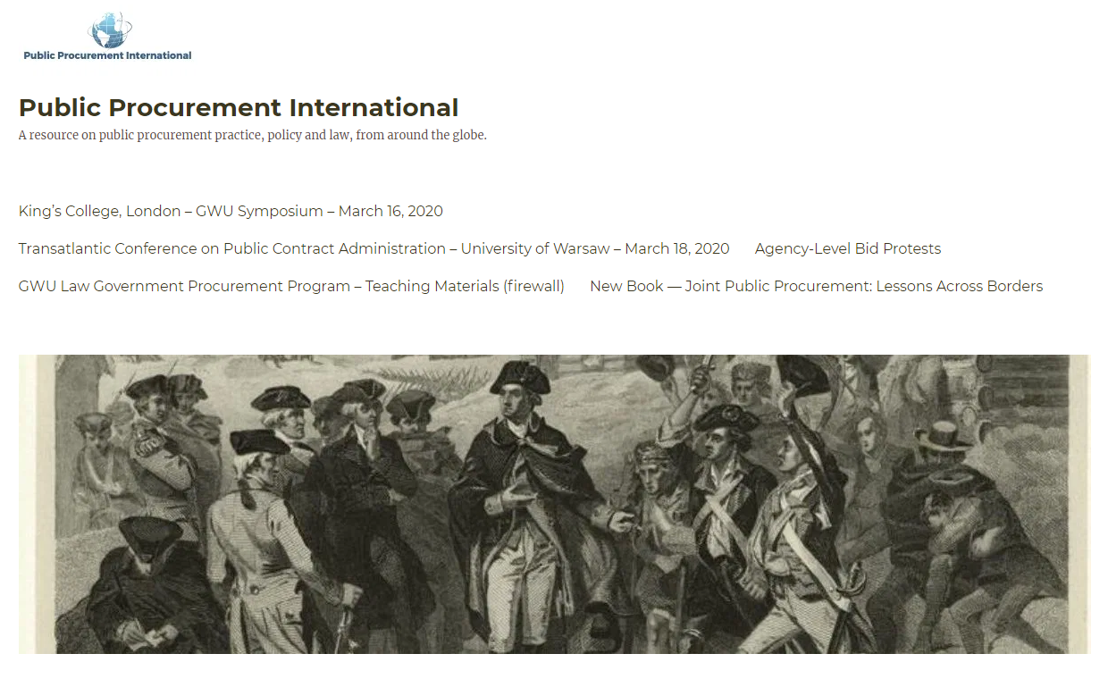

Slide 5
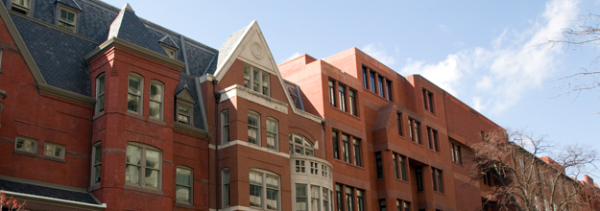
George Washington University
Law School
Classroom and distance learning in public procurement law and policy, for students in law and business
Government Procurement Law Program
Established 1960

Slide 6
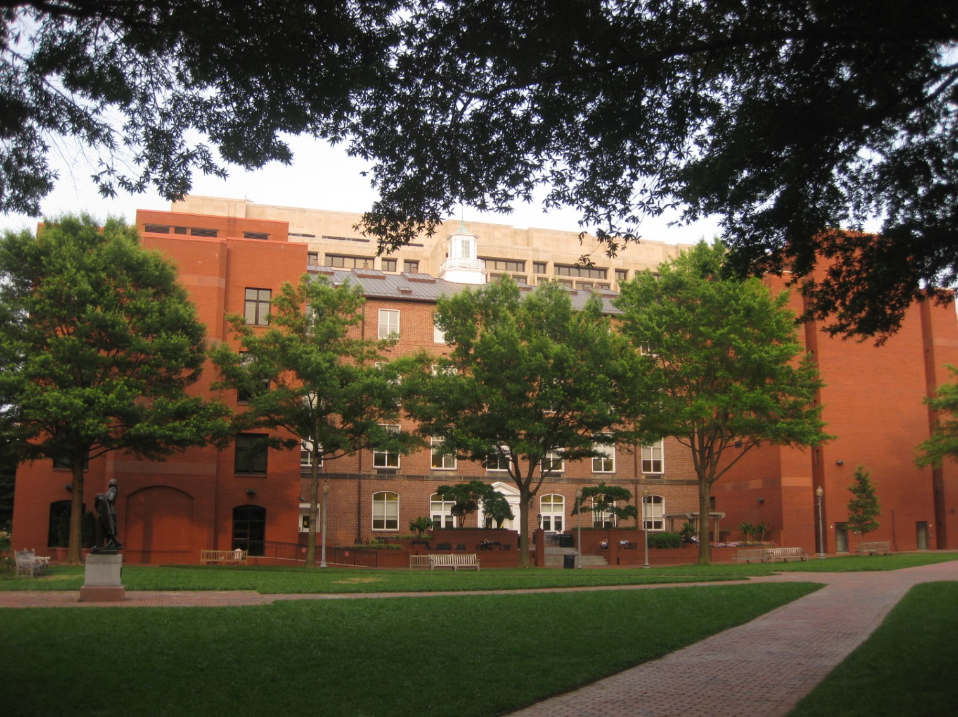

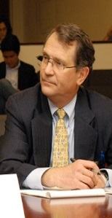
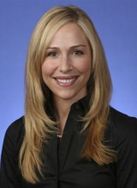
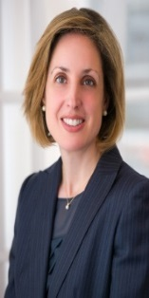
Introduction to George Washington University Law School –
Public Procurement Law Program (JD, LLM and MSL/Government Contracts)
Steven Schooner
Joshua Schwartz
Jessica Tillipman
Karen Thornton

Slide 7
Procurement Law Centers: 2000
Nottingham.
Washington, D.C.

Slide 8
Procurement Law Centers Today
Stockholm
Vilnius
Copenhagen
Moscow
Nottingham.
Munich
Northern China
Paris
Poland
Beijing
Washington, D.C.
Aix-en-Provence
Galicia
Turin
Rome
Stellenbosch

Slide 9
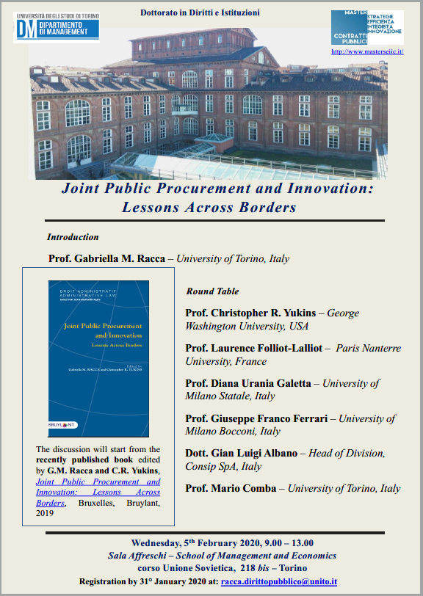
Procurement Symposium
. . . Recording has been requested, as you have class scheduled

Slide 10
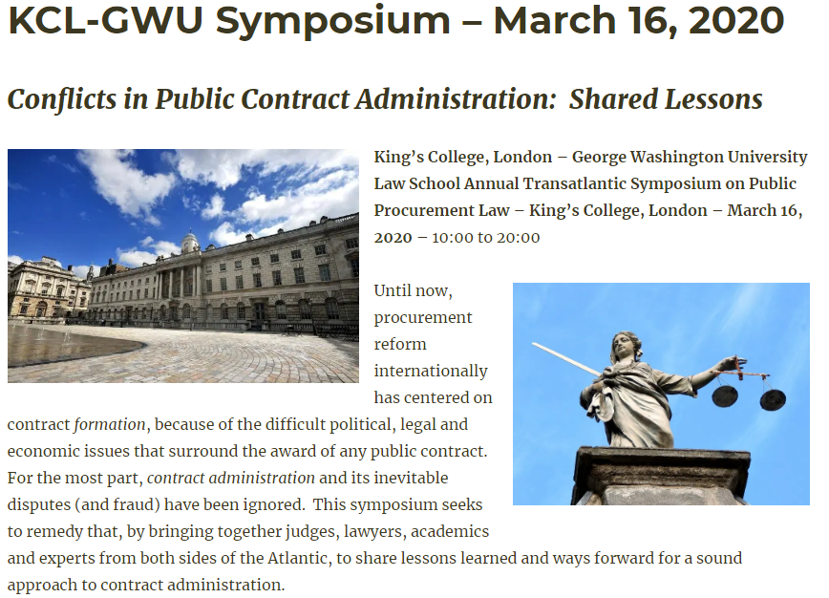
https://publicprocurementinternational.com/kcl-gwu-annual-symposium-contract-administration-march-16-2020/
Program Flyer 2020-KCL-GW-Symposium

Slide 11
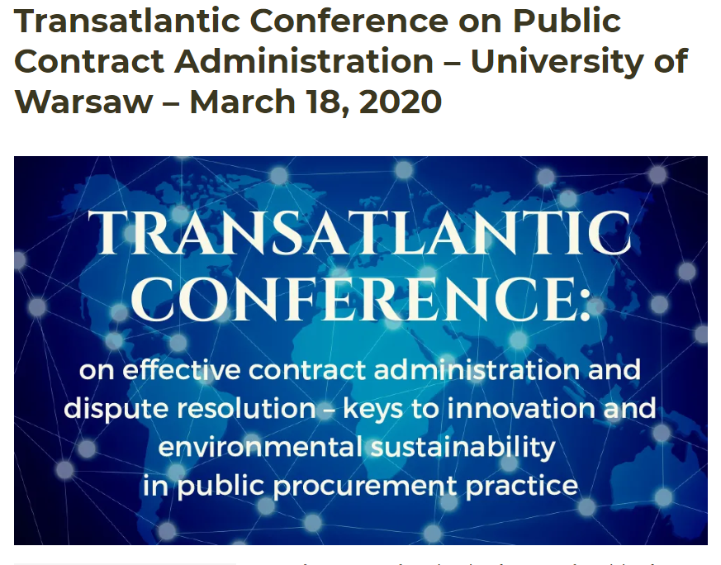

Slide 12
Principles: The Desiderata (Steven Schooner, 2002)
Transparency
Integrity
Competition
Uniformity
Risk Avoidance
Wealth Distribution -- Socioeconomic
Best value
Efficiency (administrative)
Customer Satisfaction

Slide 13
What is Procurement:
Pathologies and Processes

Slide 14
Principal-Agent Model
MONITORING
Agent 1
CO
Agent 2
Contractor
Purchase
Principal
BONDING (PUNISHING)
Notes:
Bribery?
Gratuity?
Personal conflict of interest?
Organizational conflict of interest?
“Kickback” to vendor?
Fraud?
Collusion?
Other forms of market barriers?

Slide 15
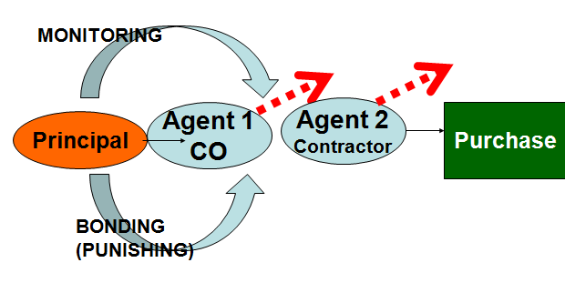
Processes
Rules
Qualification
Responsiveness
Planning
Competition - Methods
Cost Reimb.
Contract
Provisions

Slide 16
The United States . . .

Slide 17
. . . Has Separate Procurement Systems
Federal Procurement
State
Local

Slide 18
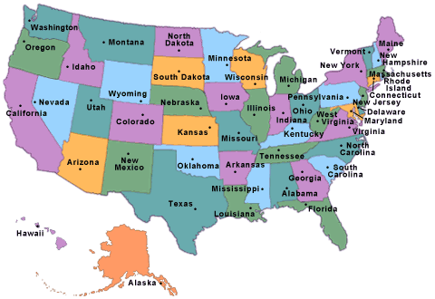
U.S. Domestic Harmonization
Model Law?
Through Federal Grants?
Cooperative Purchasing?

Slide 19
.. . . Has about $500 billion in annual federal procurement

Slide 20
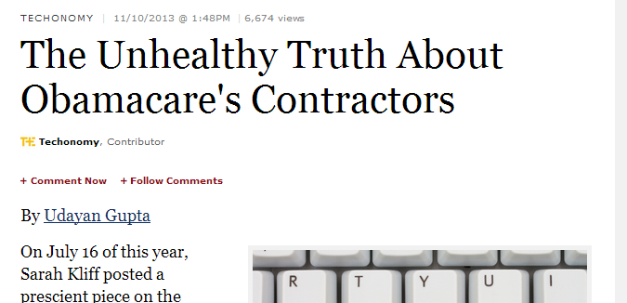
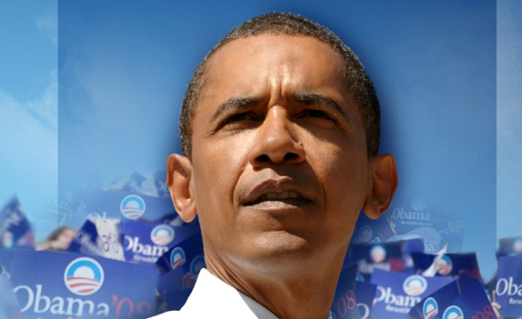
. . . Procurement is a High-Profile Political Issue

Slide 21
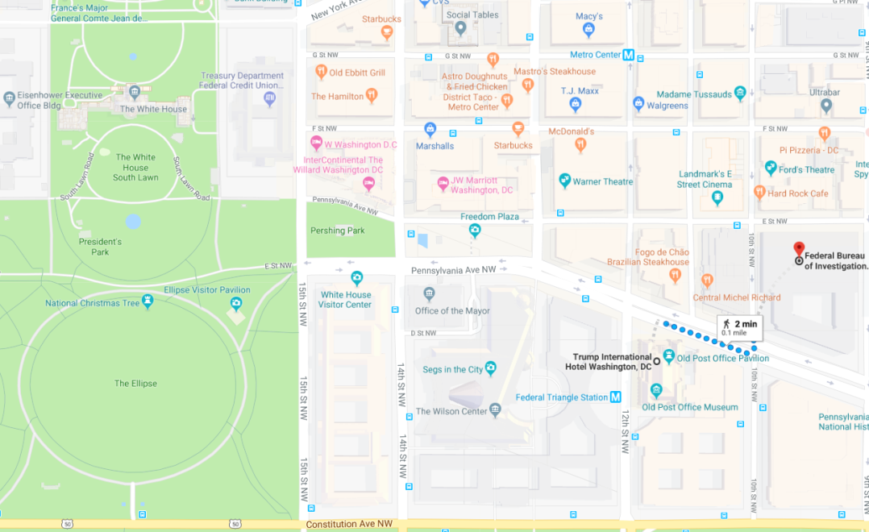
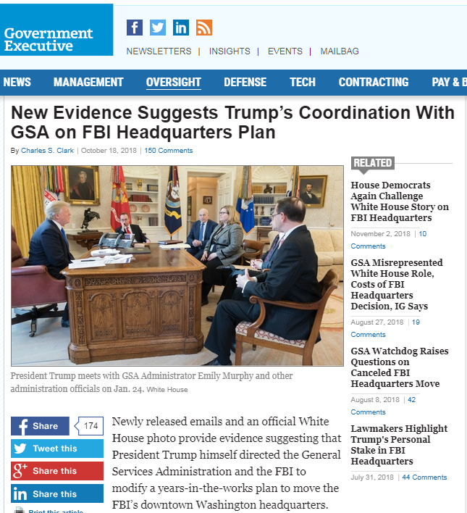
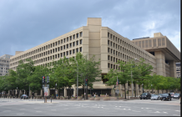
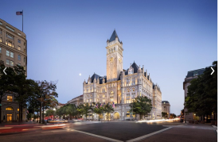
. . . Procurement Remains Political
Question: If President Trump did interfere with this procurement for his personal benefit, would this be:
Petty corruption
Grand corruption
State capture?

Slide 22
. . . But Not Driven by Individual Politicians
Virginia 8 (James P. Moran) | 1
District of Columbia nonvoting (Eleanor Holmes Norton) | 2
Texas 12 (Kay Granger) | 3
Missouri 1 (William (Bill) Clay / Wm. Lacy Clay) | 4
Virginia 10 (Frank R. Wolf) | 5
Alabama 5 (Robert E. (Bud) Cramer Jr.) | 6
California 37 (Juanita Millender-McDonald) | 7
Mississippi 4 (Ronnie Shows / Gene Taylor) | 8
Virginia 3 (Robert C. Scott) | 9
California 14 (Anna G. Eshoo) | 10
Top 10 Congressional Districts for Federal Contracts, FY07

Slide 23
. . . Accessible
FY07 Contracts - Defense
Notes:
Source: www.fedspending.gov

Slide 24
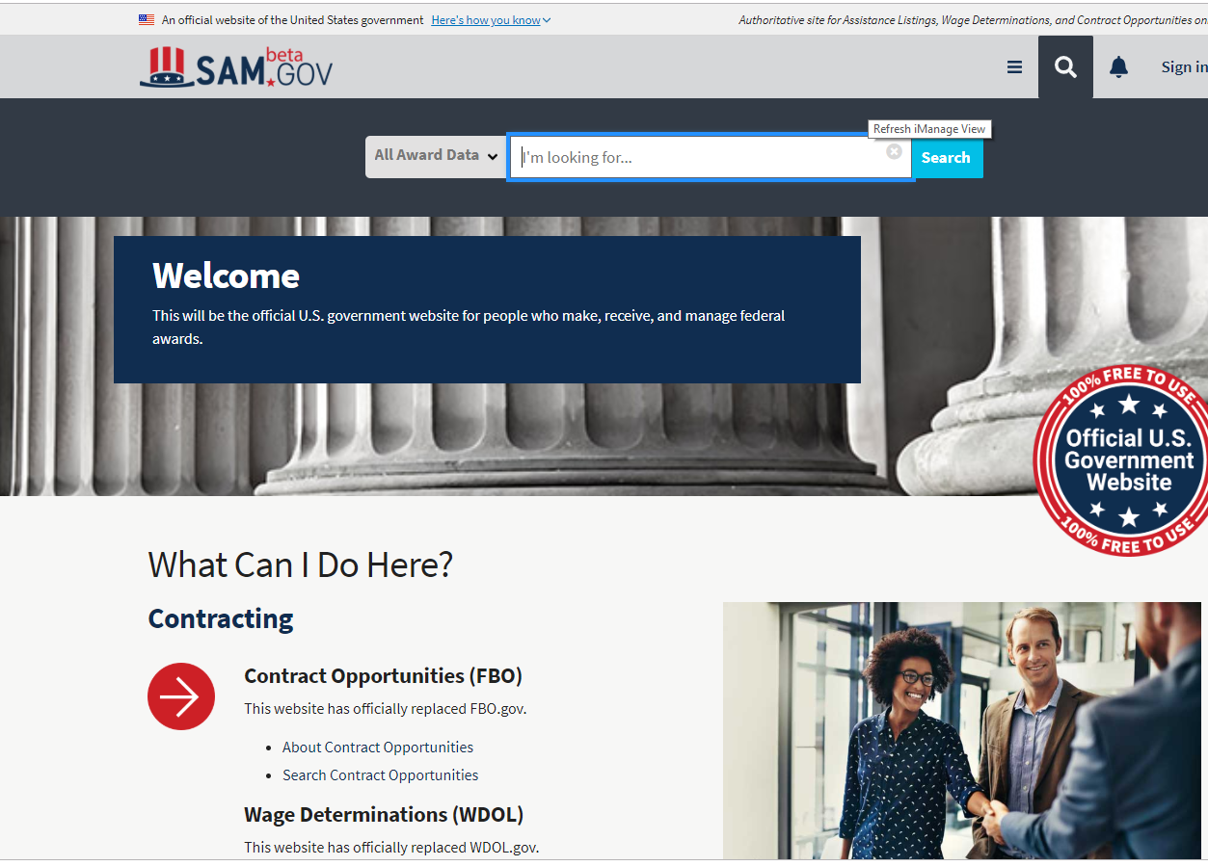
. . . Is Transparent at Opportunity and Award

Slide 25
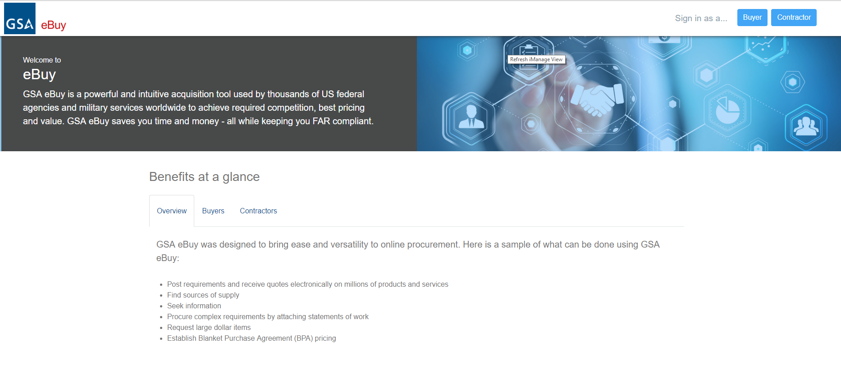
. . . With exceptions to transparency

Slide 26
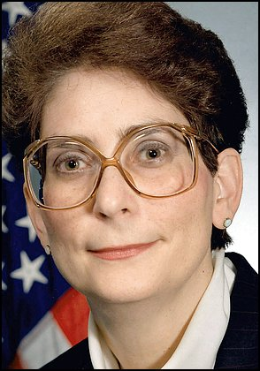
. . . Prone to Scandal
Darleen Druyun
Previously highest-ranking civilian official in Air Force procurement systems
Convicted of improper job negotiations with Boeing during tanker procurement
Admitted favoring Boeing in hundreds of millions of dollars in procurement
Sentenced to prison
$650M Boeing settlement

Slide 27
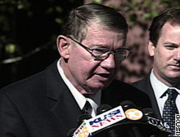
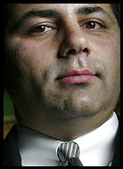
More
Scandal
Duke Cunningham
David Safavian
Congressman resigns after bribery plea
California Republican admits selling influence for $2.4 million
Monday, November 28, 2005
(CNN) -- Rep. Randy "Duke" Cunningham
Ex-Aide To Bush Found Guilty
Safavian Lied in Abramoff Scandal
Washington Post,
Wednesday, June 21, 2006; Page A01

Slide 28
. . . U.S. has interesting anti-corruption strategies

Slide 29
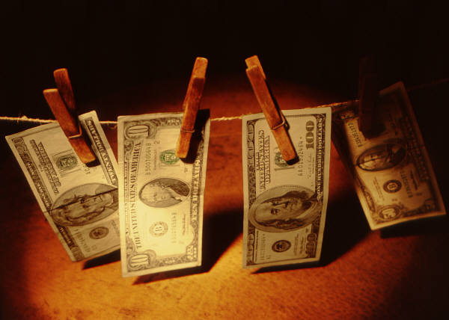



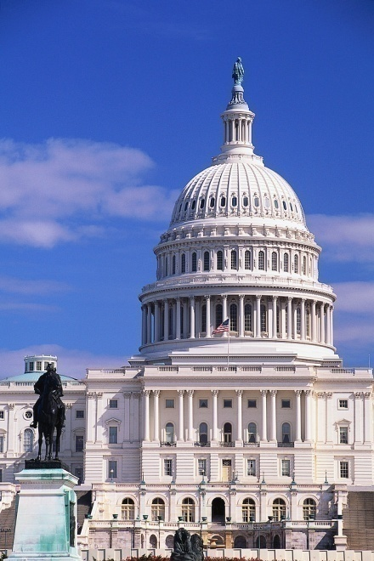



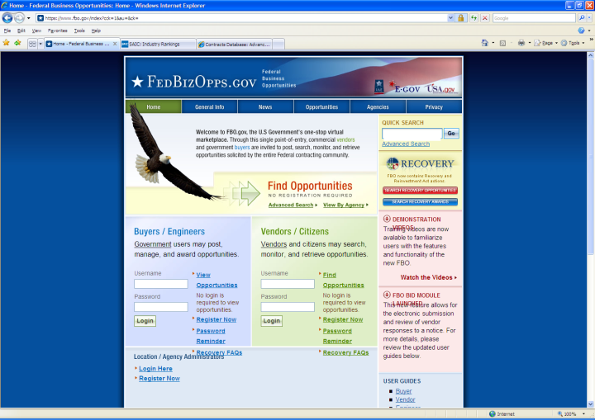
U.S. Tools for Fighting Corruption
Corporate Compliance
Tender Boards
Audits
Suspension / Debarment
Ethics
Oversight
Bid Challenges
Transparency
Prosecution

Slide 30

Corporate compliance

Slide 31
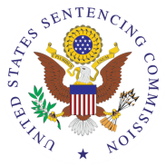


1. Standards and procedures | √ | √ | √ | √
2. Knowledgeable leadership |  | √ | √ | √
3. Exclude risky personnel | √ | √ | √ | √
4. Training | √ | √ | √ | √
5. Monitor, evaluate, reporting hotline | √ | √ | √ | √
6. Incentives and discipline | √ | √ | √ | √
7. Adjust program to risk | √ | √ | √ | √
Notes:
Sources:
Serious Fraud Office, Approach of the Serious Fraud Office to Dealing with Overseas Corruption, at 1 (2009), available at http://www.sfo.gov.uk/media/28313/approach%20of%20the%20sfo%20to%20dealing%20with%20overseas%20corruption.pdf.
Lord Bach, Letter to Lord Henley re: Bribery Bill -- “Adequate Procedures’ Guidance (Dec. 2009), http://www.justice.gov.uk/publications/docs/bach-letter-adequate-procedures-guidance.pdf.
Ministry of Justice, Consultation on Guidance About Commercial Organisations Preventing Bribery (Section 9 of the Bribery Act 2010)

Slide 32
FALSE CLAIMS ACT: CIVIL (& CRIMINAL)
Qui Tam Relator:
Recovers 10-30%
Plus Atty. Fees
DAMAGES:
1. Triple the amount of damages suffered by the United States PLUS
2. A civil forfeiture of between $10,781.40 and $21,562.80 per false claim; damages can be reduced in some cases from triple to double
Basis for Liability
  1. Submission of “claim for payment” to the federal government;
  2. The claim is “false” or “fraudulent;” and
  3. The defendant acted “knowingly.”
Does Not Mean Specific Intent . . .
1. Actual knowledge;
2. Acts in deliberate ignorance of the truth or falsity of the information; or
3. Acts in reckless disregard of the truth or falsity.
Notes:
Civil False Claims Act, 31 U.S.C. § 3729
Any person who knowingly presents a false or fraudulent claim for payment or approval to an officer or employee of the United States government, or conspires to defraud the government by getting a false claim paid, is subject to a civil penalty of at least $5,000, but not more than $10,000, plus three times the amount of damages which the government sustained as a result of the false claim.
CRIMINAL:
Section 287. False, fictitious or fraudulent claims Whoever makes or presents to any person or officer in the civil, military, or naval service of the United States, or to any department or agency thereof, any claim upon or against the United States, or any department or agency thereof, knowing such claim to be false, fictitious, or fraudulent, shall be imprisoned not more than five years and shall be subject to a fine in the amount provided in this title.

