Slide 1
Emerging International Models for Debarment
Christopher Yukins
George Washington University Law School

Slide 2
Debarment/Exclusion: How -- Four Paradigms
Responsibility (Qualification)
Only
On a case-by-case basis
Adjudicative Debarment for “Bad Acts”
E.g., World Bank
Discretionary Debarment – U.S. Federal
In U.S. – done by contracting officer
Debarment is a cross-government “meta-qualification” determination
Based on “present responsibility”: focus on present status
Court-Ordered Debarment, After Judicial Proceedings
Allowed by new EU Directives
Performance Risk
Reputation Risk

Slide 3
Trinidad & Tobago – Sample Exclusion Provision Why: Corruption and Performance
(3) The Office may add a supplier or contractor to the ineligibility list where the supplier or contractor—
(a) consistently fails to provide satisfactory
performance;
(b) is found to be indulging in corrupt or
fraudulent practices; or
(c) is convicted of an offence under this Act.

Slide 4
Cross-Debarment
Options:
Automatic cross-debarment
Debarment to be considered in other systems
Debarment + adverse info to be considered
Do nothing

Slide 5
Strategies
Exclusion, Sanctions or “Business Risk” System?
Immaterial. Prepare for reputational and performance risks.
How to Prepare?
Compliance system from start
Outreach – centralized or not
Addressing Customers’ Perceived Risk
Reputational: Anti-corruption
Performance: Monitor and address published information

Slide 6
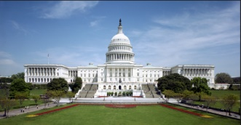
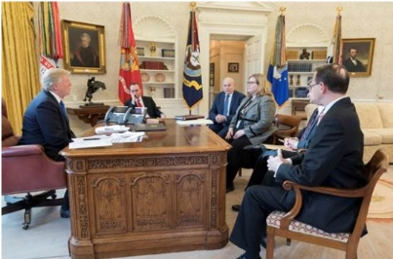
Online Solution
GSA
Market
Users
Congress
MAJ Abraham Young, USA
Electronic Marketplaces

Slide 7
Conclusion

