Slide 1


Joint Public Procurement and Innovation:
Lessons Across Borders
Public Contracts in Globalisation
Prof. Gabriella M. Racca
Full Professor of Administrative Law
University of Turin - Italy
gabriella.racca@unito.it
Prof. Christopher R. Yukins
Professor of Government Procurement Law
George Washington University
cyukins@law.gwu.edu

Slide 2

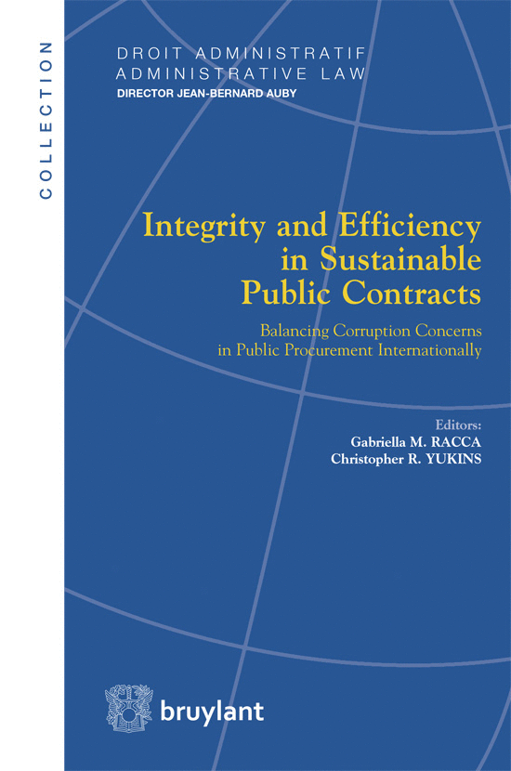
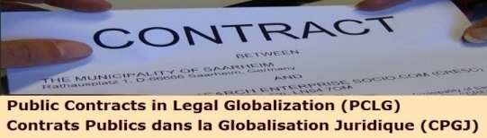

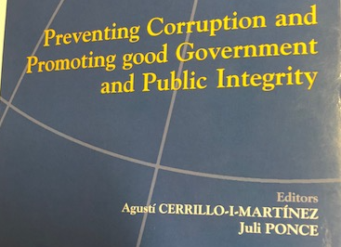
www.ius-publicum.com
www.public-contracts.net/inhalte/home.asp
www.gwu.edu/
Building networks…18
Administrative law Collection Director J.B. AUBY
27-Public Contracting and Innovation: Lessons Across Borders
G. M. Racca – C. R. Yukins (eds. by) Bruylant, 2019
© Copyright 2019 G. M. Racca
International Symposium UPEC…

Slide 3
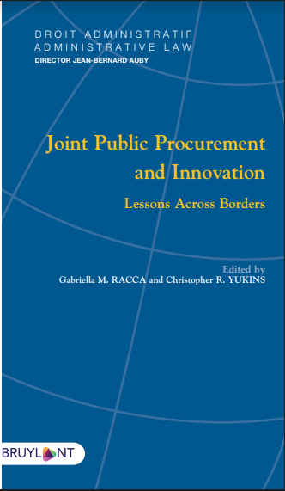
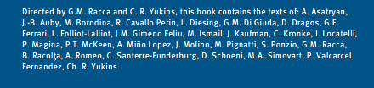
https://www.larcier.com/fr/joint-public-procurement-and-innovation-2019-9782802763802.html

Slide 4
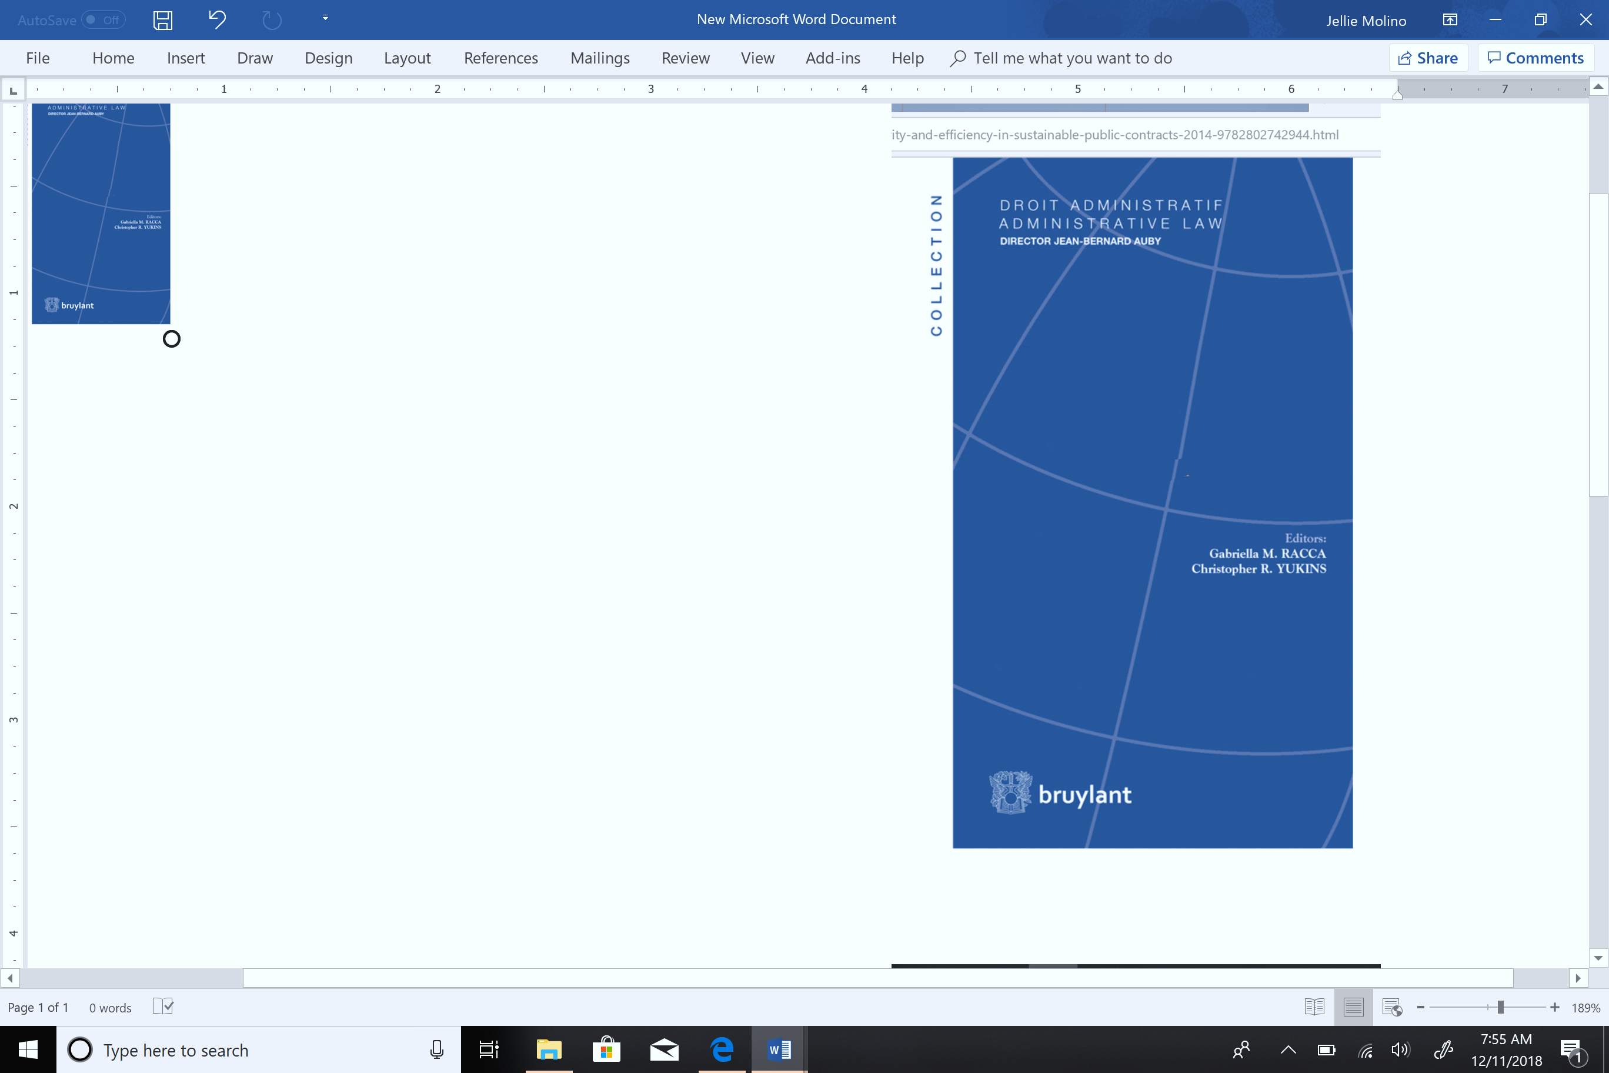

Joint Public Procurement and Innovation: Lessons Across Borders
(Eds. By G.M. Racca – C.R. Yukins)
Table of contents:
PART I. Crossborder Procurement and Innovation
PART II. Smart Cities and Procurement
PART III. Encouraging Innovation
PART IV. Innovation in the Procurement Process
Joint Public Procurement
and Innovation:
Lessons Across Borders

Slide 5
Innovation in Procurement:
Buying cutting-edge technology in public procurement markets.
Encouraging innovative suppliers in the procurement process.
Developing methods and approaches for the procurement process.
JOINT - CROSSBORDER
PURCHASE OF INNOVATION
INNOVATION IN PROCUREMENT
INNOVATION IN THE PROCUREMENT PROCESS ITSELF

Slide 6
Transnational Administrative Law EU Dir. PP - Wh. 73
Article 39
PRINCIPLES?
Procurement involving contracting authorities from different Member States
Without prejudice to Article 12,
contracting authorities from different Member States
may act jointly in the award of public contracts
by using one of the means provided for in this Article.
Contracting authorities
shall NOT use the means provided in this Article
for the purpose of avoiding the application
of mandatory public law provisions
in conformity with Union law
to which they are subject in their Member State.

Slide 7

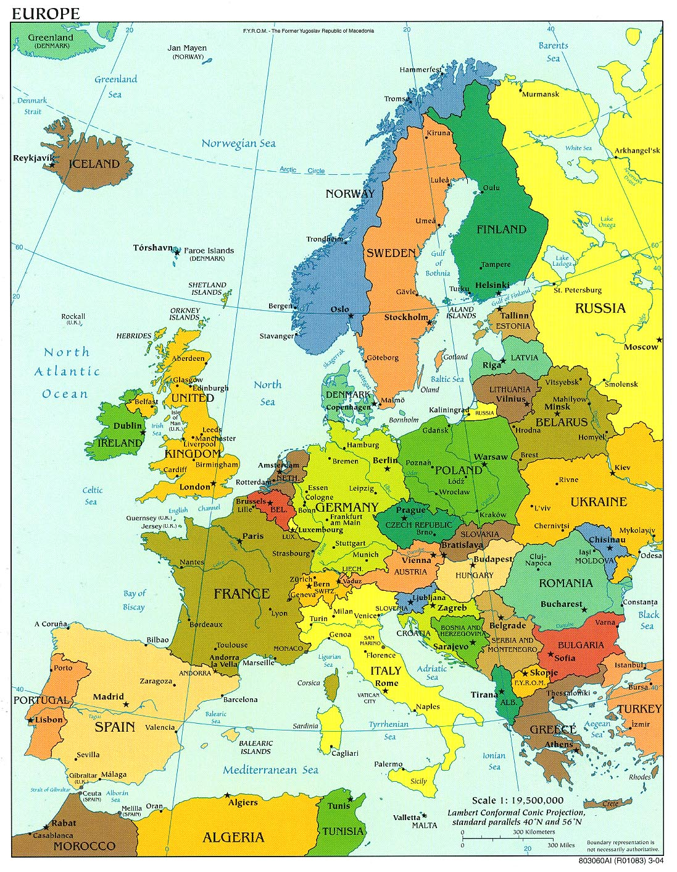
Directive 2014/24/EU, Art. 39
Cleared the Way for Joint Procurement in the European Union
“A Member State shall not prohibit its contracting authorities from using centralised purchasing activities offered by central purchasing bodies located in another Member State.”
C. A.
C. A.
C. A.
CPB
C. A.
© Copyright 2016 G. M. Racca

Slide 8

DIRECTIVE 2014/24/EU of 26 February 2014
DIFFERENT MODELS
Art. 39, Procurement involving contracting authorities
from different Member States (par. 1)
Contracting authorities (C.A.) from different MEMBER STATES
Execution of the contract
C. A.
C. A.
Award procedure
Execution of the contract
C. A.
Joint procurement
Execution of the contract
Occasional
Structured
© Copyright 2016 G. M. Racca

Slide 9

DIRECTIVE 2014/24/EU of 26 February 2014
DIFFERENT MODELS
Art. 39, Procurement involving contracting authorities from different Member States (par. 5)
3° model
Joint Legal Entity
EGTC
European Grouping of Territorial Cooperation
CPB
Applicable law?
CPB
CPB
Agreement between CPBs
CPB
CPB
M.S. where EGTC has its registered office
M.S. where EGTC is carrying out its activities
Undetermined period, limited to a certain period of time,
Certain types of contracts, one or more individual contract awards
© Copyright 2016 G. M. Racca

Slide 10

Transnational administrative procedures EU Dir. PP - Wh. 73
“Specific rules should be established for such form of joint procurement”
Rome I :
conflict-of-law rules
PROCUREMENT
Award
CONTRACT EXECUTION
Agreement establishing the European purchasing group
Notice
Applicable law on selection and remdies?
Applicable law on contract executions?
PRINCIPLES?
Case-law…
10

Slide 11

CROSS BORDER JOINT PUBLIC PROCUREMENT
EU
US
PRINCIPLES - DIRECTIVES
FEDERAL PROCUREMENT
Desiderata…..
28 MEMBER STATES Implementations
50 STATES different rules
MEMBER
STATE
MEMBER
STATE
MEMBER
STATE
STATE
STATE
STATE
State procurement
regulation
State procurement
regulation
State procurement
regulation
National Principles - Rules
National Principles - Rules
National Principles - Rules
Integration
Single market
Strategic Industrial policy
No integration
Enhance Performance
Risk Allocation

Slide 12


NATIONAL ASSOCIATION OF
STATE PROCUREMENT OFFICIALS
Master Agreement
Participating Addendum
Alabama
Participating Addendum
Wisconsin
Transparency?
Competition?
Socioeconomic?
HARMONIZATION?
DIFFERENT APPROACHES?
ON POLITICAL/SOCIAL ISSUES

Slide 13






COORDINATE DEMANDE SIDE
DIFFERENT JURISDICTIONS
central purchasing body (F)
EU Hospitals
central purchasing body (UK)
Intermediary
central purchasing body (IT)
central purchasing body (BG)
Partners
central purchasing body (Lux)
Intermediary
GROUPEMENT DE COMMANDE
French Law
(harmonization of terms and conditions)

Slide 14
CROSS BORDER JOINT PUBLIC PROCUREMENT
COORDINATE DEMANDE SIDE
DIFFERENT JURISDICTIONS
Cooperation among
C. A.
C. A.
C. A.
of different Member States
EU Principles - Rules
Directive 2014/24/UE
Art. 39
National law
principles and rules
on award ----------- execution
Private economic operators

Slide 15

Performance Responsibility
Which agency oversees performance – centralized purchasing agency or ordering agency?
Which agency has authority to terminate order/contract? Which agency has authority to terminate master contract?
EU Directive 2014/24/EU – Recital 71:
“Each contracting authority should be solely responsible in respect of procedures or parts of procedures it conducts on its own, such as the awarding of a contract, the conclusion of a framework agreement, the operation of a dynamic purchasing system, the reopening of competition under a framework agreement or the determination of which of the economic operators party to a framework agreement shall perform a given task.”
Contractor may not deliver Products under this Master Agreement until a Participating Addendum acceptable to the Participating Entity and Contractor is executed. The NASPO ValuePoint Master Agreement Terms and Conditions are applicable to any Order by a Participating Entity (and other Purchasing Entities covered by their Participating Addendum), except to the extent altered, modified, supplemented or amended by a Participating Addendum.
Notes:
a. Contractor may not deliver Products under this Master Agreement until a Participating Addendum acceptable to the Participating Entity and Contractor is executed. The NASPO ValuePoint Master Agreement Terms and Conditions are applicable to any Order by a Participating Entity (and other Purchasing Entities covered by their Participating Addendum), except to the extent altered, modified, supplemented or amended by a Participating Addendum. By way of illustration and not limitation, this authority may apply to unique delivery and invoicing requirements, confidentiality requirements, defaults on Orders, governing law and venue relating to Orders by a Participating Entity, indemnification, and insurance requirements. Statutory or constitutional requirements relating to availability of funds may require specific language in some Participating Addenda in order to comply with applicable law. The expectation is that these alterations, modifications, supplements, or amendments will be addressed in the Participating Addendum or, with the consent of the Purchasing Entity and Contractor, may be included in the ordering document (e.g. purchase order or contract) used by the Purchasing Entity to place the Order. b. Use of specific NASPO ValuePoint cooperative Master Agreements by state agencies, political subdivisions and other Participating Entities (including cooperatives) authorized by individual state’s statutes to use state contracts are subject to the approval of the respective State Chief Procurement Official. Issues of interpretation and eligibility for participation are solely within the authority of the respective State Chief Procurement Official.

Slide 16
Whose competition rules apply
Want competition?
Central Purchasing Agency?
User Purchasing Agency?
Vendors

Slide 17

Transparency
EU Directive 2014/24/EU,
Recital 73:
“[C]ontracting authorities should not make use of the possibilities for cross-border joint procurement for the purpose of circumventing mandatory public law rules, in conformity with Union law, which are applicable to them in the Member State where they are located. Such rules might include, for example, provisions on transparency and access to documents or specific requirements for the traceability of sensitive supplies.”
Whose transparency rules apply?

Slide 18

Socioeconomic Goals
U.S. GSA Acquisition Manual (GSAM) 552.238-79 , Use of Federal Supply Schedule Contracts by Non-Federal Entities.
Ordering activities may include terms and conditions required by statute, ordinance, regulation, order, or as otherwise allowed by State and local government entities as a part of a statement of work (SOW) or statement of objective (SOO) to the extent that these terms and conditions do not conflict with the terms and conditions of the Schedule contract.
How will socioeconomic goals be met? Whose goals matter?

Slide 19

Choice of Law
EU Procurement Directive, Art. 39, para. 4:
A participating contracting authority fulfils its obligations pursuant to this Directive when it purchases works, supplies or services from a contracting authority which is responsible for the procurement procedure. When determining responsibilities and the applicable national law . . . the participating contracting authorities may allocate specific responsibilities among them and determine the applicable provisions of the national laws of any of their respective Member States. The allocation of responsibilities and the applicable national law shall be referred to in the procurement documents for jointly awarded public contracts.
Whose law applies?

Slide 20
Choice of Forum
U.S. GSA Acquisition Manual (GSAM) 552.238-79 , Use of Federal Supply Schedule Contracts by Non-Federal Entities.
Disputes which cannot be resolved by the parties to the new contract may be litigated in any State or Federal court with jurisdiction over the parties, applying Federal procurement law, including statutes, regulations and case law, and, if pertinent, the Uniform Commercial Code.
Where will disputes be heard?

Slide 21
Resulting Constraints
Legal uncertainties mean:
  In U.S., public purchasers “buy up” – larger governments typically do not purchase through smaller governments’ vehicles
  Joint Procurement/Cooperative Purchasing tends to flourish inside stable communities of states/nations
    Unlikely solution for international development
Uncertainties regarding transparency, competition and socioeconomic requirements make vehicles unstable
  Legal uncertainties may be magnified by centralized purchasing agencies’ conflicts of interest.
NEW PRINCIPLES WILL COME OUT
FROM EXPERIENCE AND CASE-LAW

Slide 22
Potential Research
Contract Administration
Role of European Union
Smart Cities
BIM
“Amazon.gov” vs. Dynamic Purchasing Systems
Defense Procurement
Nations joining Association agreements with EU

Slide 23

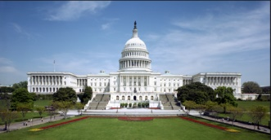

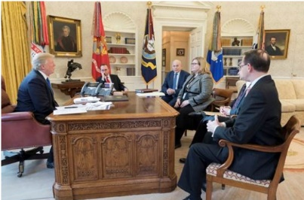

Online Solution
Centralized Purchasing Agency
Market
Users
Congress
MAJ Abraham Young, USA
The Players

Slide 24
Online Solution
Centralized Purchasing Agency
Market
Users
Congress
MAJ Abraham Young, USA
The Problems
Vendor data – bid challenges – transparency –
competition -- socioeconomic goals (including Buy American) – no- standards security review -- fee to GSA – Most Favored Customer pricing

Slide 25
Teaching Strategies

Slide 26
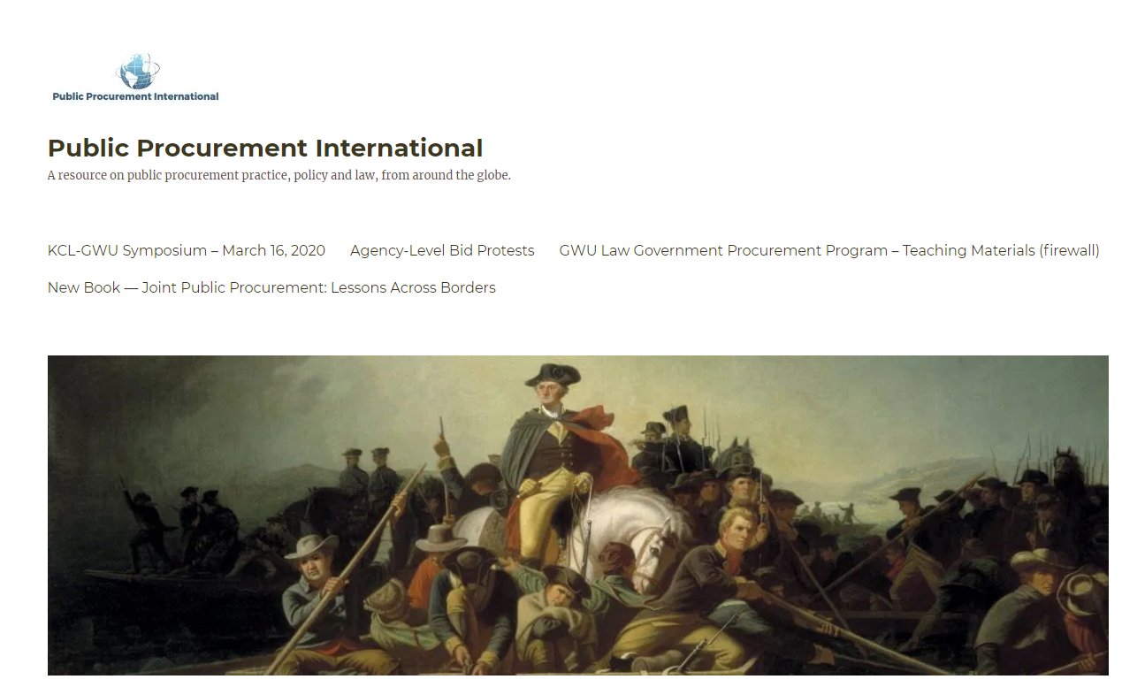

Slide 27
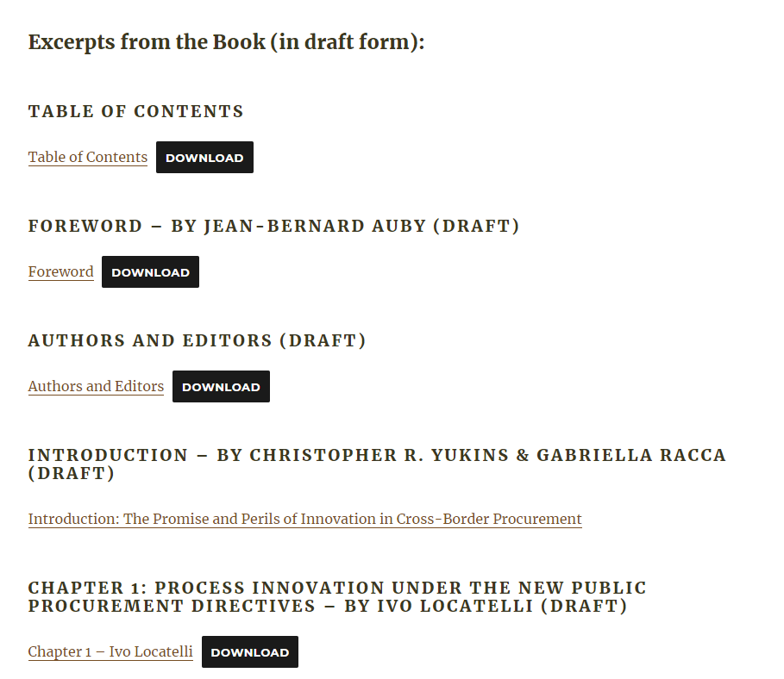

Slide 28
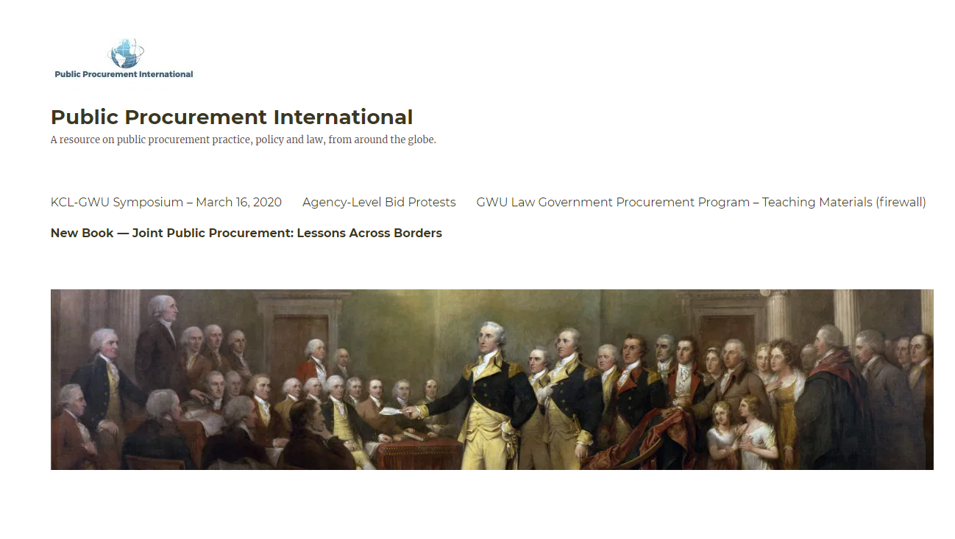
gwu

Slide 29


Slide 31
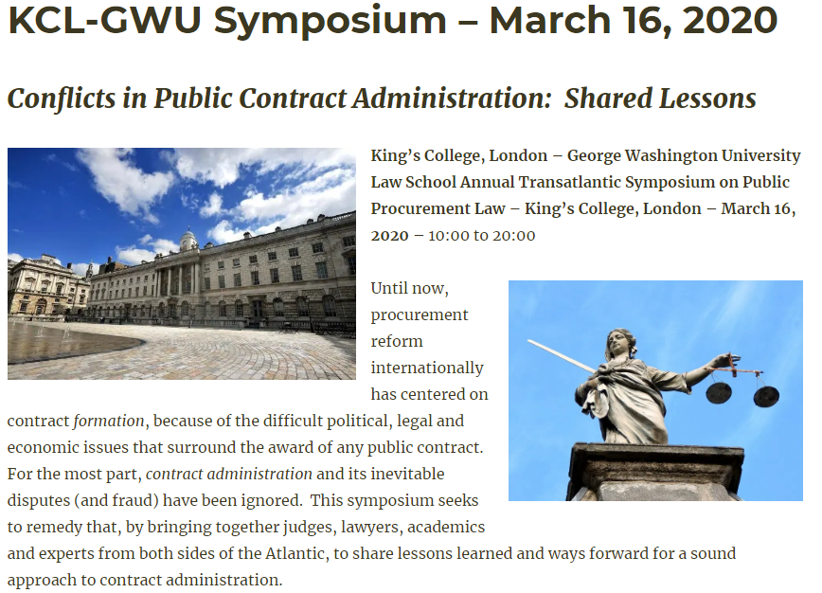
https://publicprocurementinternational.com/kcl-gwu-annual-symposium-contract-administration-march-16-2020/
Program Flyer 2020-KCL-GW-Symposium
. . . And University of Warsaw, March 18, 2020

Slide 32
REFERENCES

Slide 33

PPI2Innovate
Capacity building to boost usage of PPI in Central Europe
https://www.interreg-central.eu/Content.Node/PPI2Innovate.html
© Copyright 2019 G. M. Racca

Slide 34

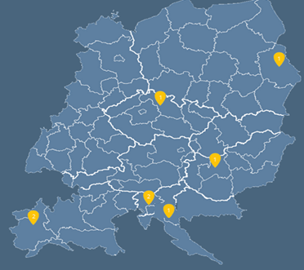
NEXT CHALLENGES…
Development of nationally customized PPI2Innovative tools for SMART Health, Energy and ICT
NEXT CHALLENGES…
Development of competence centers on Circular Procurement…
Objective: develop PPI2Innovate Tools - realize pilot project on innovation - support public procurers
© Copyright 2019 G. M. Racca

Slide 35

Project "Smart Circular Procurement$"$ (CircPro)
Public procurement has a major role to play in the transition towards a Circular Economy.
It is important and efficient to make the right choices early on in the product creation process, so that materials and components are suitable, at end-of-life, for repair or refurbishment and re-use, thus helping to close the materials loop.
Project CircPro aims to promote the transition to a more Circular Economy related national and regional decision making by increasing the implementation of the Circular Procurement. There is no official definition yet, but "Circular Public Procurement in the Nordic Countries" (CIPRON) study suggests that Circular Procurement (CP) is a procurement of competitively priced products, services or systems that satisfy the customer needs and lead to extended lifespan, value retention and/or remarkably improved and non-risky cycling of biological or technical materials, compared to other solutions for a similar purpose in the market.
© Copyright 2019 G. M. Racca

Slide 36

CircPro 2018 - Partners
Partners | Country
Kouvola Innovation Oy (coordinator) | Finland
2. Consejería de Medio Ambiente y Ordenación del Territorio, Junta de Andalucía | Spain
3. Regione Piemonte | Italy
4. Università degli Studi di Torino | Italy
5. Region of East Macedonia and Thrace | Greece
6. Comissão De Coordenação E Desenvolvimento Regional Do Alentejo | Portugal
7. Bulgarian Association of Recycling | Bulgaria
8. Development Agency IGRA | Croatia
9. Lithuanian Innovation Center | Lithuania
10. Stockholm Environment Institute Tallinn Center | Estonia
11. Municipality of Elverum | Norway
12. Government of Åland | Finland
© Copyright 2019 G. M. Racca

Slide 37
Project “Financing impact on regional development of cultural heritage valorisation” (FINCH)
Cultural heritage is a shared resource and a common good. The EU's cohesion policies can be instrumental in promoting the valorisation of cultural heritage, that’s why seven European regions have decided to join their efforts to face the challenge of conservation, restoration, valorisation and management of cultural heritage with the involvement of private actors.
This will allow to enhance cultural heritage exploitation while also assuring its conservation in a dynamic and productive perspective, attracting and incubating new activities, revitalising already existing ones, improving people general wellness and assuring environmental sustainability.
FINCH project will support the implementation of light financial instruments targeted to private actors and Public-Private Partnerships to enable local and regional policies move towards more sustainable models of cultural heritage valorization.
© Copyright 2019 G. M. Racca

Slide 38

Public Procurement Regulation in the EU and in its Global Context MA/Pg Dip
“Our distance learning Procurement Regulation Postgraduate Diploma, MA has been specifically designed for professionals wishing to expand their knowledge and understanding of EU procurement law and regulation, while also placing that system within its wider international context. The course is particularly suitable for lawyers in private practice or in the public sector, in house legal advisers and officials dealing with practice or policy in the procurement field as procurement specialists who wish to add further legal experience to their practical experience”.
Further informations…
https://www.kcl.ac.uk/law/research/centres/european/programmes/procurementsyllabus.aspx
© Copyright 2019 G. M. Racca

Slide 39


Slide 40
Réseau Smart cities & Digital administration - Law and Governance, (MADP)
LINKS: Chaire MADP - Sciences Po Paris Departement of Law - University of Udine Departement of Economics - Ca' Foscari University of Venice Center for Governance & Social Innovation - Fondazione Ca' Foscari of Venice

Slide 41
MASTER IN PUBLIC PROCUREMENT FOR SUSTAINABLE DEVELOPMENT
Further informations…
https://www.itcilo.org/masters-programmes/master-in-public-procurement-management-for-sustainable-development/MasterinPublicProcurementManagementSD20172018.pdf/view

Slide 42
MASTER EN GOUVERNANCE ET MANAGEMENT DES MARCHÉS PUBLICS EN APPUI AU DÉVELOPPEMENT DURABLE
Further informations…
https://www.itcilo.org/masters-programmes/master-en-gouvernance-et-management-des-marches-publics-en-appui-au-developpement-durable

Slide 43




Master di II livello in
Strategie per l’efficienza, l’integrità e l’innovazione nei contratti pubblici – SEIIC
Strategies for the efficiency, integrity and innovation in Public contracts
http://www.masterseiic.it/

Slide 44
Scientific committee
Prof. Gianmaria Ajani – Rettore dell’Università degli Studi di Torino
Dott. Gian Luigi Albano – Consip S.p.A.
Prof. Valter Cantino – Ordinario di Economia Aziendale
Prof. Roberto Cavallo Perin – Ordinario di Diritto Amministrativo
Dott. Michele Corradino – Componente Autorità Nazionale Anticorruzione
Prof. Carlo Emanuele Gallo – Ordinario di Diritto Amministrativo
Prof. Bernardo G. Mattarella – Ordinario di Diritto Amministrativo
Prof. Francesco Merloni – Componente Autorità Nazionale Anticorruzione
Prof. Ida Angela Nicotra – Componente Autorità Nazionale Anticorruzione
Prof. Nicoletta Parisi – Componente Autorità Nazionale Anticorruzione
Prof. Gabriella M. Racca – Ordinario di Diritto Amministrativo
Prof. Piercarlo Rossi – Associato di Diritto Privato Comparato
Prof. Laura M. Scomparin – Ordinario di Diritto Processuale Penale
Prof. Alberto Zito – Ordinario di Diritto Amministrativo
http://www.masterseiic.it/

Slide 45
http://www.masterseiic.it/
e-mail: segreteriamasterseiic@gmail.com
Master di II livello in Strategie per l’efficienza, l’integrità e l’innovazione nei contratti pubblici – SEIIC
Strategies for the efficiency, integrity and innovation in Public contracts
V edition
Pre-registrations – October 2019
Start– March 2020
In distance learning

Slide 46
References materials
G. M. RACCA, Collaborative procurement and contract performance in the Italian healthcare sector: illustration of a common problem in European procurement, in Public Procurement Law Review, 2010, 119-133, available at http://papers.ssrn.com/sol3/papers.cfm?abstract_id=1714278;
G. M. RACCA, Aggregate models of public procurements and secondary considerations, in R. CARANTA - M. TRYBUS (eds), The Law of Green and Social Procurement in Europe, Djøf Publishing, Copenhagen, 2010, 165-178;
G. M. RACCA - S. PONZIO, La mutualisation des achats dans le secteur de la santé publique: les centrales d’achat et les accords-cadres dans une perspective comparative, in Droit Administratif, n. 7/2011, 7-12;
G. M. RACCA – R. CAVALLO PERIN – G. L. ALBANO, Competition in the Execution Phase of Public Procurement, in Public Contract Law Journal, Vol. 41, No. 1, p. 89, 2011, available at http://papers.ssrn.com/sol3/papers.cfm?abstract_id=2011114.;
© Copyright 2019 G. M. Racca

Slide 47
References materials
G. M. RACCA – R. CAVALLO PERIN – G. L. ALBANO, The Safeguard of Competition in the Execution Phase of Public Procurement: Framework Agreements as Flexible Competitive Tools, Seminar on 'The New Public Law in a Global (Dis)order. A Perspective from Italy', Istituto di Ricerche Sulla Pubblica Amministrazione (IRPA) and Jean Monnet Center of NYU School of Law, available at http://papers.ssrn.com/sol3/papers.cfm?abstract_id=2180856;
G. M. RACCA, D. CASALINI, Competitive dialogue in Italy, in S. ARROWSMITH - S. TRUMER, Competitive dialogue, Cambridge University Press, Cambridge, 2012, 458-490;
G. M. RACCA, The Electronic Award and Execution of Public Procurement, Ius Publicum Network Review, 2012, available at http://papers.ssrn.com/sol3/papers.cfm?abstract_id=2229253;
G. M. RACCA – R. CAVALLO PERIN, Material Amendments of Public Contracts during their Terms: From Violations of Competitions to Symptoms of Corruption, in European Procurement & Public Private Partnership Law Review, 4/2013, 279-293;
G. M. RACCA, G. L. ALBANO, Collaborative Public Procurement and Supply Chain in the EU experience, in C. HARLAND – G. NASSIMBENI - E. SCHNELLER, Strategic Supply Management Sage Publications, Londra, 2013, 179-213;
G. M. RACCA, The Risks of Emergencies in Public Procurement, in Journal of Public Finance and Public Choice, 2013, 105 s.;
G. M. RACCA, Joint Procurement Challenges in the Future Implementation of the New Directives, in F. LICHÈRE – R. CARANTA – S. TREUMER (a cura di) Modernising Public Procurement: the New Directive, DJØF Publishing, Copenhagen, 2104, 225-254 ;
© Copyright 2019 G. M. Racca

Slide 48
References materials
G. M. RACCA – R. CAVALLO PERIN, Material Amendments of Public Contracts during their Terms: From Violations of Competitions to Symptoms of Corruption, in European Procurement & Public Private Partnership Law Review, 4/2013, 279-293;
G. M. RACCA – C. R. YUKINS (eds), Integrity and Efficiency in Sustainable Public Contracts. Balancing Corruption Concerns in Public Procurement Internationally, Bruylant, Bruxelles, 2014; Prof. Racca’s contributions in this book available at https://papers.ssrn.com/sol3/cf_dev/AbsByAuth.cfm?per_id=1571949
G. M. RACCA, Joint Procurement Challenges in the Future Implementation of the New Directives, in F. LICHÈRE – R. CARANTA – S. TREUMER (a cura di) Modernising Public Procurement: the New Directive, DJØF Publishing, Copenhagen, 2104, 225-254
G. M. RACCA - R. CAVALLO PERIN – G. L. ALBANO, Public Contracts and International Public Policy Against Corruption, in M. Audit- S. W. Schill (eds. by) Transnational Law of Public Contracts Bruylant, 2016, 845 e ss.;
R. CAVALLO PERIN – G.M. RACCA, Administrative Cooperation in the Public Contracts and Service Sectors for the Progress of European Integration, in F. MERLONI, A. PIOGGIA (eds.), European Democratic Institutions and Administrations Cohesion and Innovation in Times of Economic Crisis, Springer, Giappichelli, 2018
G.M. RACCA – S. PONZIO, La scelta del contraente come funzione pubblica: i modelli organizzativi per l’aggregazione dei contratti pubblici, in Dir. Amm., 1, 2019
© Copyright 2019 G. M. Racca

Slide 49
References materials
G. M. RACCA – C. R. YUKINS (eds), Joint Public Procurement and Innovation: Lessons Across Borders, Bruylant, 2019
G. M. RACCA, Joint Cross-border Procurement Of Innovative Solutions In The Healthcare Sector: The HAPPI project experience, (forthcoming)
Other references at: https://papers.ssrn.com/sol3/cf_dev/AbsByAuth.cfm?per_id=1571949

Slide 50
Directive 2014/24/EU
Whereas no. 73
Joint awarding of public contracts by contracting authorities from different Member States currently encounters specific legal difficulties concerning conflicts of national laws. Despite the fact that Directive 2004/18/EC implicitly allowed for cross-border joint public procurement, contracting authorities are still facing considerable legal and practical difficulties in purchasing from central purchasing bodies in other Member States or jointly awarding public contracts. In order to allow contracting authorities to derive maximum benefit from the potential of the internal market in terms of economies of scale and risk-benefit sharing, not least for innovative projects involving a greater amount of risk than reasonably bearable by a single contracting authority, those difficulties should be remedied. Therefore new rules on cross-border joint procurement should be established in order to facilitate cooperation between contracting authorities and enhancing the benefits of the internal market by creating cross-border business opportunities for suppliers and service providers.

Slide 51
Directive 2014/24/EU
Whereas no. 73
…Those rules should determine the conditions for cross-border utilisation of central purchasing bodies and designate the applicable public procurement legislation, including the applicable legislation on remedies, in cases of cross-border joint procedures, complementing the conflict of law rules of Regulation (EC) No 593/2008 of the European Parliament and the Council (13). In addition, contracting authorities from different Member States should be able to set up joint entities established under national or Union law. Specific rules should be established for such forms of joint procurement.
However, contracting authorities should not make use of the possibilities for cross-border joint procurement for the purpose of circumventing mandatory public law rules, in conformity with Union law, which are applicable to them in the Member State where they are located. Such rules might include, for example, provisions on transparency and access to documents or specific requirements for the traceability of sensitive supplies.

Slide 52
Directive 2014/24/EU
Article 39
Procurement involving contracting authorities from different Member States
1. Without prejudice to Article 12, contracting authorities from different Member States may act jointly in the award of public contracts by using one of the means provided for in this Article.
Contracting authorities shall not use the means provided in this Article for the purpose of avoiding the application of mandatory public law provisions in conformity with Union law to which they are subject in their Member State.
2. A Member State shall not prohibit its contracting authorities from using centralised purchasing activities offered by central purchasing bodies located in another Member State.
In respect of centralised purchasing activities offered by a central purchasing body located in another Member State than the contracting authority, Member States may, however, choose to specify that their contracting authorities may only use the centralised purchasing activities as defined in either point (a) or in point (b) of point (14) of Article 2(1).

Slide 53
Directive 2014/24/EU
Article 39
3. The provision of centralised purchasing activities by a central purchasing body located in another Member State shall be conducted in accordance with the national provisions of the Member State where the central purchasing body is located.
The national provisions of the Member State where the central purchasing body is located shall also apply to the following:
(a) the award of a contract under a dynamic purchasing system;
(b) the conduct of a reopening of competition under a framework agreement;
(c) the determination pursuant to points (a) or (b) of Article 33(4) of which of the economic operators, party to the framework agreement, shall perform a given task.

Slide 54
Directive 2014/24/EU
Article 39
4. Several contracting authorities from different Member States may jointly award a public contract, conclude a framework agreement or operate a dynamic purchasing system. They may also, to the extent set out in the second subparagraph of Article 33(2), award contracts based on the framework agreement or on the dynamic purchasing system. Unless the necessary elements have been regulated by an international agreement concluded between the Member States concerned, the participating contracting authorities shall conclude an agreement that determines:
(a) the responsibilities of the parties and the relevant applicable national provisions;
(b) the internal organisation of the procurement procedure, including the management of the procedure, the distribution of the works, supplies or services to be procured, and the conclusion of contracts.

Slide 55
Directive 2014/24/EU
Article 39
4. …
A participating contracting authority fulfils its obligations pursuant to this Directive when it purchases works, supplies or services from a contracting authority which is responsible for the procurement procedure. When determining responsibilities and the applicable national law as referred to in point (a), the participating contracting authorities may allocate specific responsibilities among them and determine the applicable provisions of the national laws of any of their respective Member States. The allocation of responsibilities and the applicable national law shall be referred to in the procurement documents for jointly awarded public contracts.

Slide 56
Directive 2014/24/EU
Article 39
5. Where several contracting authorities from different Member States have set up a joint entity, including European Groupings of territorial cooperation under Regulation (EC) No 1082/2006 of the European Parliament and of the Council (30) or other entities established under Union law, the participating contracting authorities shall, by a decision of the competent body of the joint entity, agree on the applicable national procurement rules of one of the following Member States:
(a) the national provisions of the Member State where the joint entity has its registered office;
(b) the national provisions of the Member State where the joint entity is carrying out its activities.
The agreement referred to in the first subparagraph may either apply for an undetermined period, when fixed in the constitutive act of the joint entity, or may be limited to a certain period of time, certain types of contracts or to one or more individual contract awards.

Slide 57
Background Readings & Videos
Christopher R. Yukins, The U.S. Federal Procurement System: An Introduction (UrT 2017), https://papers.ssrn.com/sol3/papers.cfm?abstract_id=3063559.
  Video: An Introduction to U.S. Procurement, by Prof. Christopher Yukins
Steven L. Schooner, Desiderata: Objectives for a System of Government Contract Law (PPLR 2002), https://papers.ssrn.com/sol3/papers.cfm?abstract_id=304620
Christopher R. Yukins, A Versatile Prism: Assessing Procurement Law Through the Principal-Agent Model (PCLJ 2010), https://ssrn.com/abstract=1776295
Johannes Schnitzer & Christopher Yukins, Combatting Corruption in Procurement, in UNOPS: Future-Proofing Procurement 26-29 (2015), https://www.unops.org/SiteCollectionDocuments/ASR/2015-ASR-supplement.pdf
  Video: Fighting Corruption in Procurement (40:12) – in this video excerpted from GWU Law School’s “Foreign Government Contracting” course, Professor Christopher Yukins discusses common patterns and strategies in fighting corruption in public procurement around the world.
  Video: Corporate Compliance (7:50) – in this video excerpted from GWU Law School’s “Foreign Government Contracting” course, Professor Christopher Yukins discusses corporate compliance requirements and strategies, from around the world.
Christopher Yukins & Allen Green, International Trade Agreements and U.S. Procurement Law (2018). Chapter 9 to The Contractor’s Guide to International Procurement (ABA 2018) (Erin Loraine Felix & Marques Peterson, eds.), https://ssrn.com/abstract=3443244
  Video: Protectionism – Part I (20:14): In this excerpt from GWU Law’s “Foreign Government Contracting” seminar, Professor Yukins discusses the core concepts in protectionism, U.S. barriers to foreign vendors and key international agreements to open procurement markets.
  Video: Protectionism – Part II (13:27): In this excerpt, also from GWU Law’s “Foreign Government Contracting” seminar, Professor Yukins discusses key issues in U.S. protectionism, from the “walled garden” of the Trade Agreements Act to reciprocity and the U.S.-Mexico-Canada-Agreement (USMCA).
  Video: Protectionism – Part III (6:21): In this final excerpt, Professor Yukins discusses special issues in protectionism and national security, such as the Reciprocal Defense Procurement Agreements between the U.S. and its allies, and the deference afforded national security interests under international trade agreements on procurement.
Blog: www.publicprocurementinternational.com

Slide 58
Conclusion
Thank you for your attention!
Prof. Gabriella M. Racca
Full Professor of Administrative Law
University of Turin
gabriella.racca@unito.it
SSRN page:
https://papers.ssrn.com/sol3/cf_dev/AbsByAuth.cfm?per_id=1571949

