Slide 1
An Introduction to U.S. Procurement – Part II
Professor Christopher Yukins
George Washington University Law School
Washington DC
February 4, 2020
Master in Public Procurement for Sustainable Development ITC- ILO and University of Turin

Slide 2
. . . And a U.S. approach to renewing its legal regime

Slide 3
1984
Federal Acquisition Regulation (FAR)
Defense Federal Acquisition Regulation Supplement
Defense Logistics Agency Supplement
Other Defense Subagency Supplements
Civilian Agency Supplement
Civilian Agency Supplement
. . . a Unified Regulatory System
. . . Has a Uniform Set of Regulations

Slide 4
Defense Authorization Act = Annual vehicle for reform
Federal Acquisition Regulation (FAR)
Defense Federal Acquisition Regulation Supplement
Defense Logistics Agency Supplement
Other Defense Subagency Supplements
Civilian Agency Supplement
Civilian Agency Supplement
. . . A Uniform Set of Regulations

Slide 5
Major methods of competition
. . . Familiar Major Methods of Procurement
Open Procedure (less than 3%)
Restricted Procedure
Negotiated Procedure (primary method)
Sole-Source

Slide 6
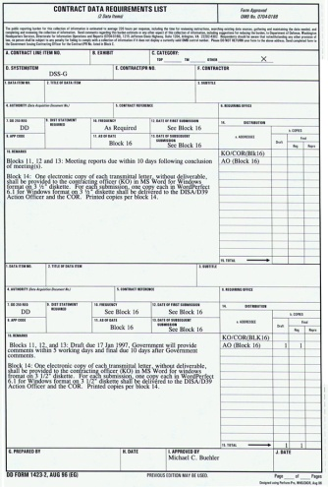
Historical Progression
Sole Source
Sealed Bids
Negotiated Procurements
Frameworks

Slide 7
Competitive Negotiations (EU: “Competitive Dialogue” or “Competitive Procedures with Negotiations”)

Slide 8
Competitive Negotiations: Multiple Vendors, for Best Value
Negotiated Procurements
Contractor
Contractor
Contractor

Slide 9
Competitive Negotiations
Request for Proposals
Competitive
Offeror 1
Offeror 2
Non-Competitive
Announcement
Exchanges
Submissions
Award
Awardee

Slide 10
Frameworks
Frameworks emerged in the United States and elsewhere along parallel paths
Supplier Lists

Slide 11
Frameworks: Sample
 | A | B | C
FRAMEWORK AWARD PRICE – PER UNIT | US$1000 | US$600 | US$1500
JANUARY (NASA: 500 UNITS) | US$900 | US$600
APRIL ORDER (ARMY: 1000 UNITS ) | US$800 | US$550
DECEMBER ORDER (NAVY: 2000 UNITS) | US$550 | US$550

Slide 12
Problems in U.S. Frameworks: 1990s
Contractors
Centralized Purchasing Agencies
Customer Agencies
Reduced Transparency – Reduced Accountability -- Misuse of Frameworks

Slide 13
Scandals
Notes:
-- Scandals and reform driven by internal government forces, including Congress, GAO and inspectors general
-- Punctuated by Abu Ghraib disaster

Slide 14
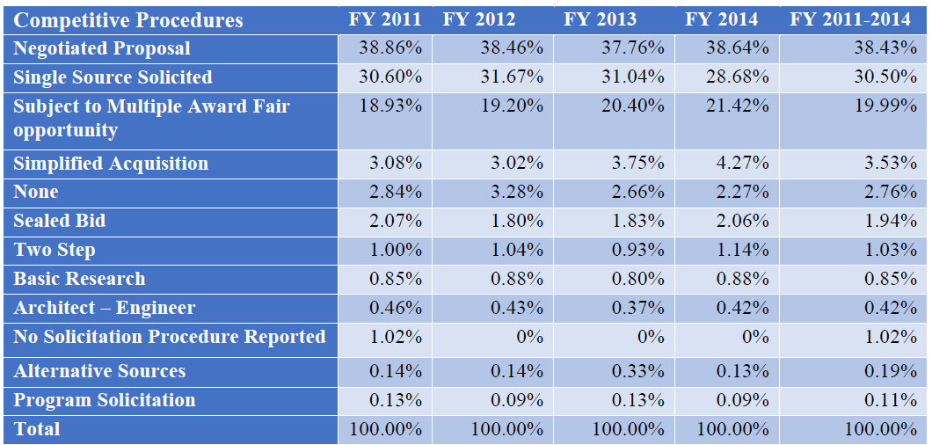
Umer Chaudhry
GWU Law Student

Slide 15
EU uses same methods – but in a different historical progression
Sole Source
√
Sealed Bids
Negotiated Procurements
√
Frameworks
√
√

Slide 16
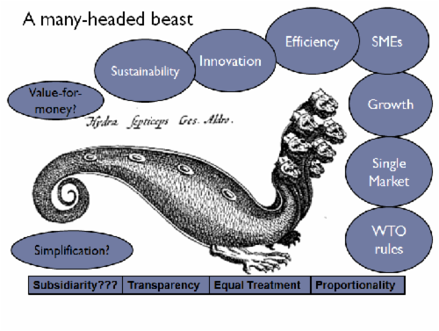
Do the EU Directives Impose Additional Principles?
Source: Abby Semple, www.procurementanalysis.eu/
Author: Abby Semple
Notes:
Source: Abby Semple

Slide 17
Patterns in U.S. Procurement

Slide 18
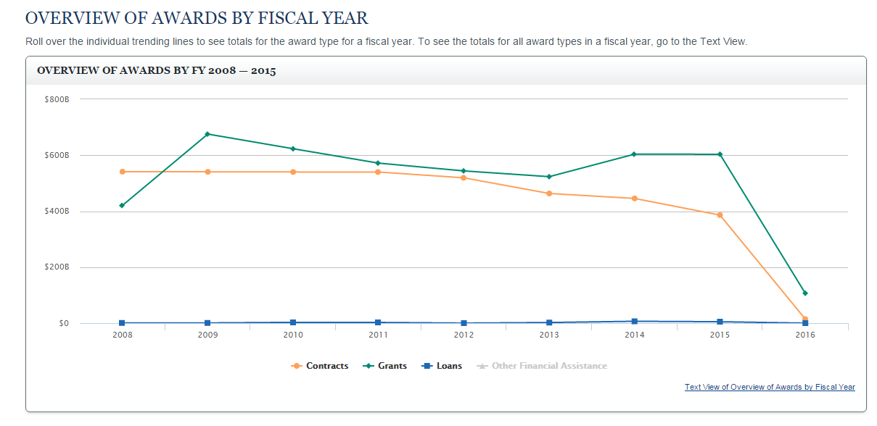
www.usaspending.gov

Slide 19
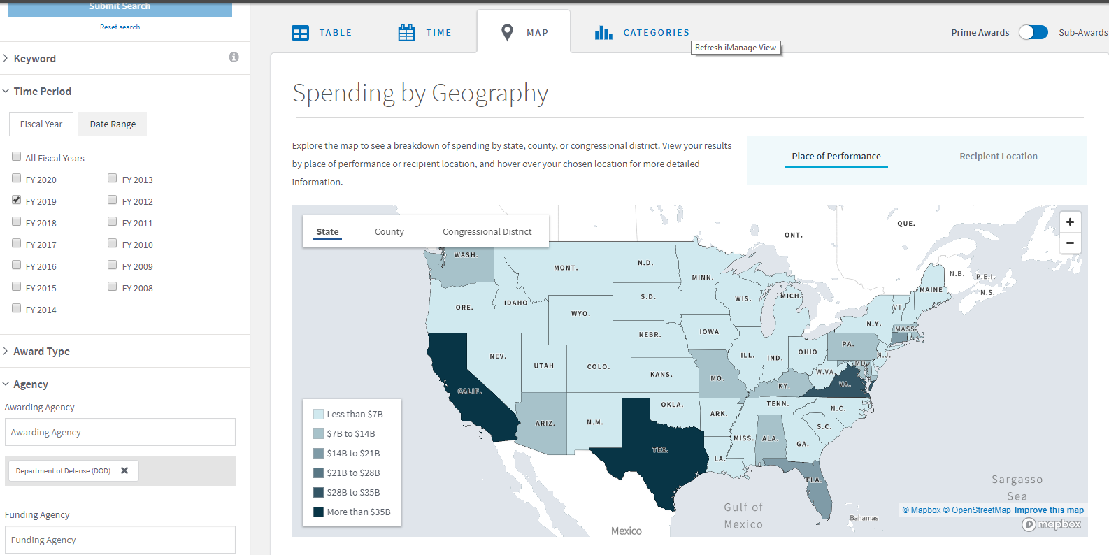
Defense Department Procurement – FY 2019

Slide 20
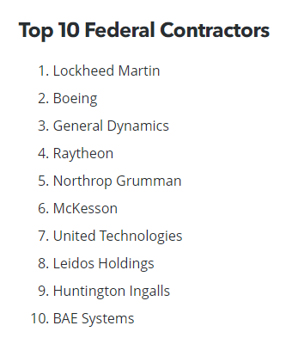
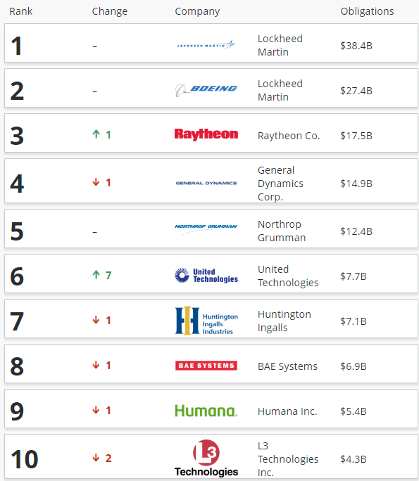
Top Defense
France Defense Budget:
US$42 billion
Notes:
BGOV Data – FY2018

Slide 21
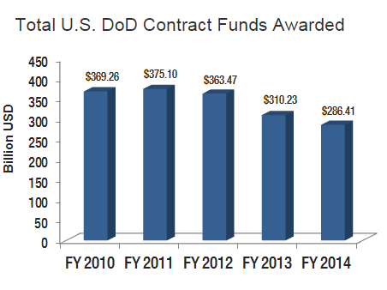
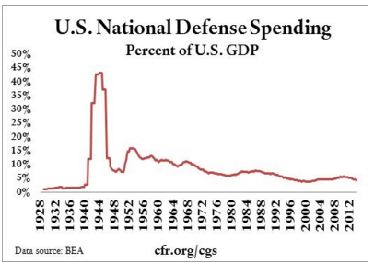
Some Trends in DoD Procurement
Notes:
http://www.bga-aeroweb.com/Top-100-Defense-Contractors-2014.html

Slide 22
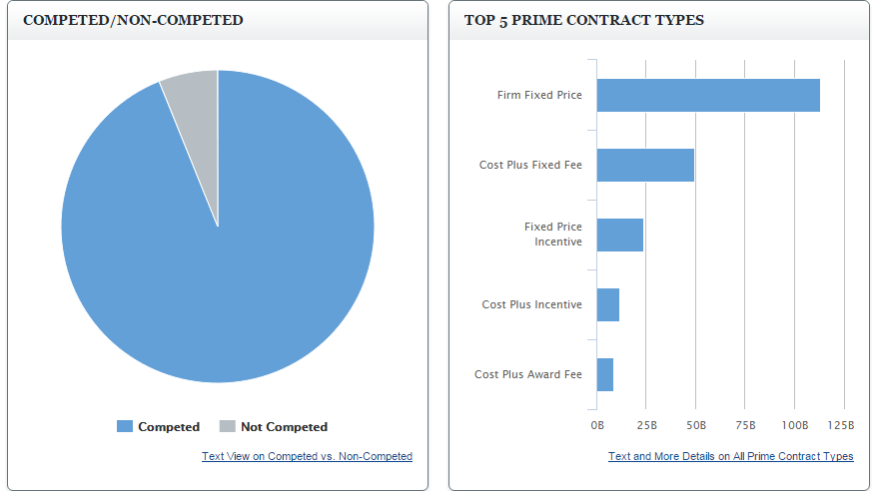

Slide 23
Access for Foreign Firms to Unitary Federal Procurement Market, Civilian and Defense

Slide 24
DoD Acquisition Workforce
The size of DoD’s civilian acquisition workforce has grown by some 20,000 employees over the past five years and now numbers about 135,000 personnel members, according to Stephanie Barna, acting assistant secretary of Defense for Readiness and Force Management.
Civilians make up 90 percent of the department’s total acquisition workforce. The military component of the acquisition workforce also ticked up by about 2,500 employees, reaching more than 16,000 employees, Barna said.
Notes:
http://federalnewsradio.com/congress/2014/07/house-panel-probes-dods-acquisition-workforce/
http://dau.dodlive.mil/2014/04/17/2013-defense-acquisition-workforce-awards/
(Left to Right): Hon. Frank Kendall, Major James Rodriguez, Hon. William LaPlante, Hon. Katrina McFarland

Slide 25
Typical Progress
Subcontract
Framework (Indefinite Delivery-Indefinite Quantity)
Prime Contract

Slide 26
Protectionism and the Trump Administration

Slide 28
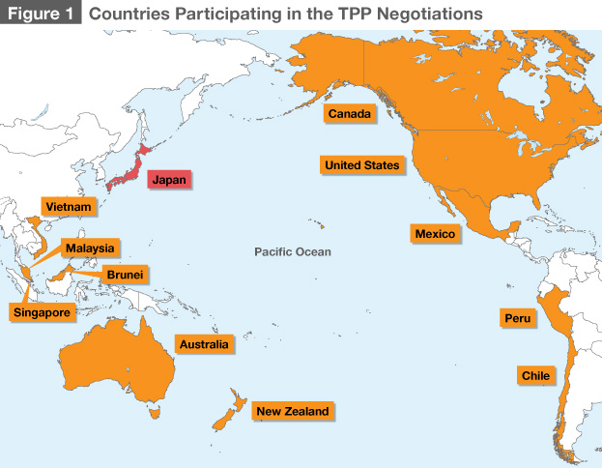

Slide 29
Key concepts

Slide 30
“It is the maxim of every prudent master of a family, never to attempt to make at home what it will cost him more to make than to buy. . . . If a foreign country can supply us with a commodity cheaper than we ourselves can make it, better buy it of them with some part of the produce of our own industry, employed in a way in which we have some advantage.
Adam Smith, An Inquiry into the Nature and Causes of the Wealth of Nations (1776)

Slide 31
What Is Goal of Protectionism?
Protect Jobs
Industrial policy
Ensure security of supply

Slide 32
Prewar Protectionism

Slide 33
United States’ suggested charter for predecessor to World Trade Organization (1946)
Notes:
http://www.worldtradelaw.net/misc/Suggested%20Charter.pdf

Slide 34
Notes:
http://www.worldtradelaw.net/misc/Suggested%20Charter.pdf
WTO on non-discrimination (Most Favored Nation) versus national treatment - http://www.wto.org/english/thewto_e/whatis_e/tif_e/fact2_e.htm
Textbook, Sec. 2:27:
One core provision of the GATT is Article I which makes a general commitment to the long standing practice of “most favored nation treatment” (“MFN”).¹ Article I requires each Contracting Party to accord unconditional MFN status to all other Contracting Parties. Thus, any privilege granted by any Contracting Party to any product imported from any other country must also be “immediately and unconditionally” granted to any “like product” imported from any Contracting Parties.²
Another core provision of GATT is Article III. Article III incorporates the practice of according “national treatment” to imported goods by providing, with specifically enumerated exceptions, that the products of one Contracting State shall be treated in the same manner regarding taxation and regulation as domestic goods. As such, under Article III, products of the exporting GATT Contracting State must be treated no less favorably than domestic products of the importing Contracting State under its laws and regulations concerning sale, internal resale, purchase, transportation and use.³ In addition to the Articles above, the GATT also prohibits the use of certain kinds of quantitative restrictions. For example, Article XI generally, but not completely, prohibits the use of other “prohibitions or restrictions” on imports from Contracting Parties.⁴

Slide 35
U.S. Trade Agreements Act: A “Walled Garden”
GPA &
Free Trade Agreements
Europe
USA
Some Asian Nations
Some Latin American Nations

Slide 36
U.S. Domestic Preference Law: Supplies
Trade Agreements Act: Above $180,000 (approx.)
Buy American Act
Micro-
Purchase

Slide 37
Reciprocal Defense Procurement Agreements

Slide 38
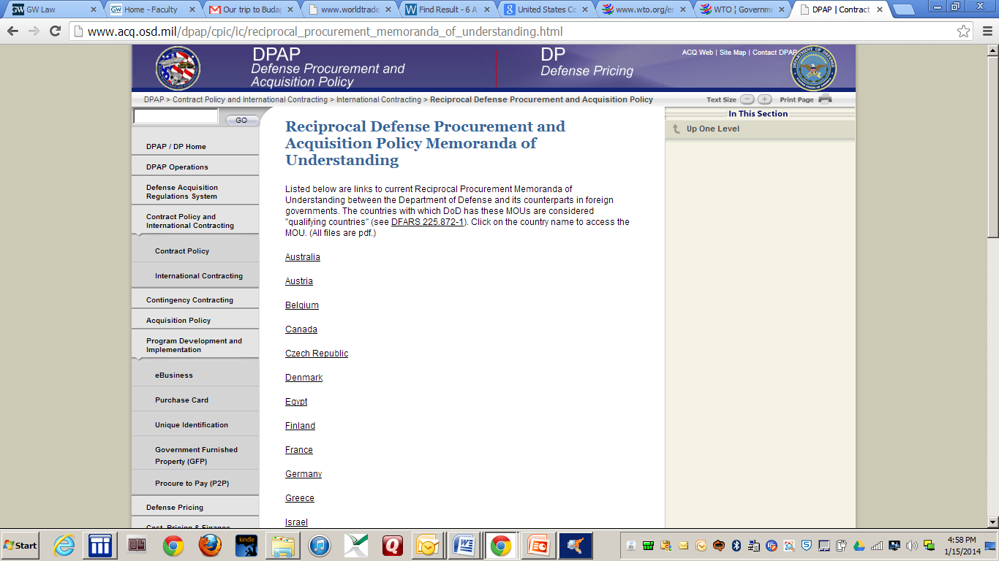
Defense – Memoranda of Understanding
Authority for the defense MOUs rests in the “public interest” exception to the BAA. The agreements serve as a national security benefit, enhance alliance-wide security objectives, and serve as an underpinning for armaments cooperation. – Text § 2:21

Slide 39
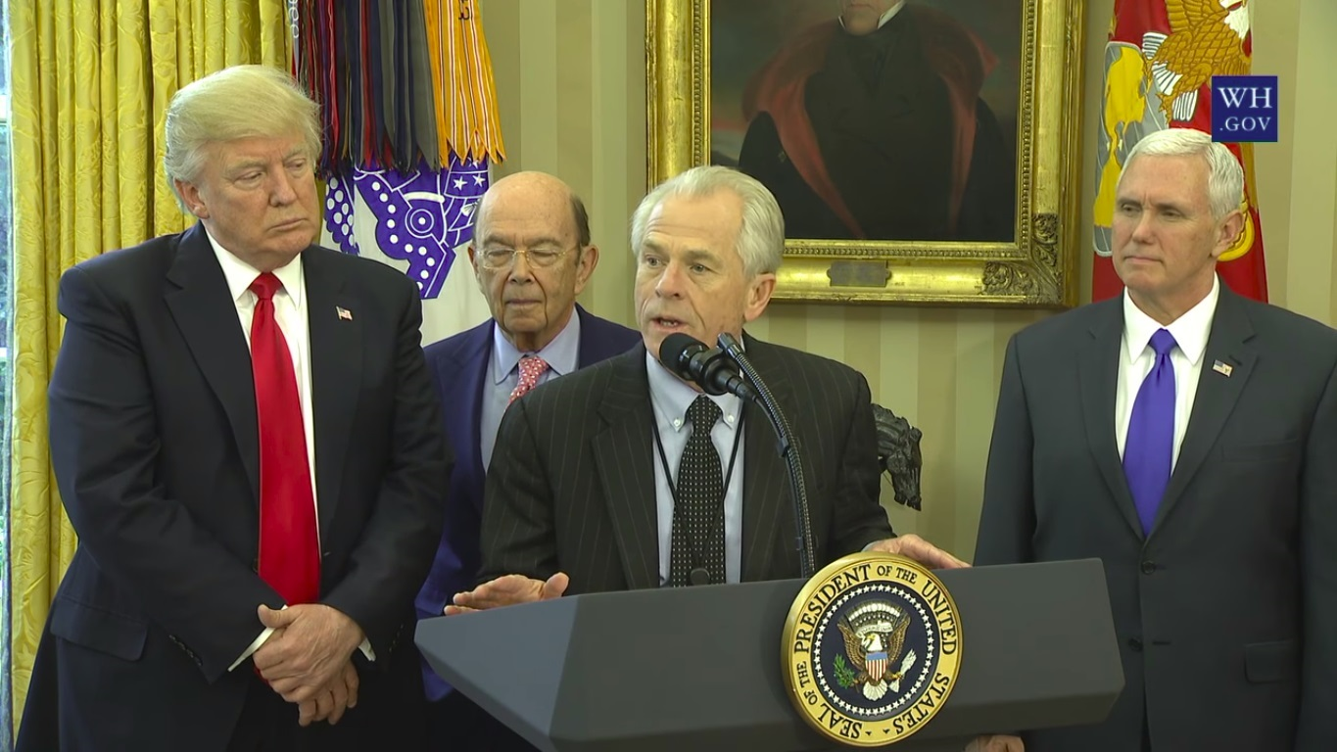
Trump Administration

Slide 40
February 2017

Slide 41
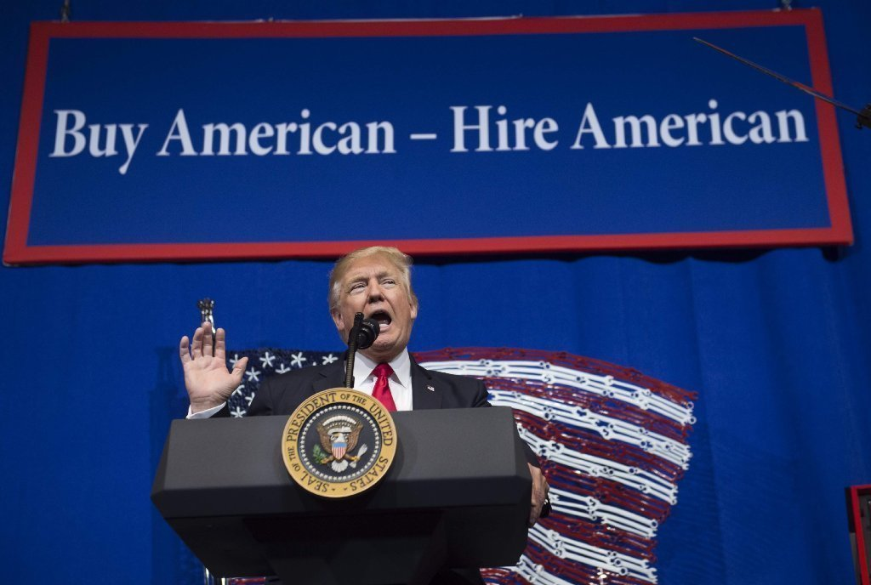

Slide 42
The RECIPROCity CONCEPT

Slide 43
U.S. – Mexico – Canada Agreement (USMCA):
Procurement Chapter

Slide 44
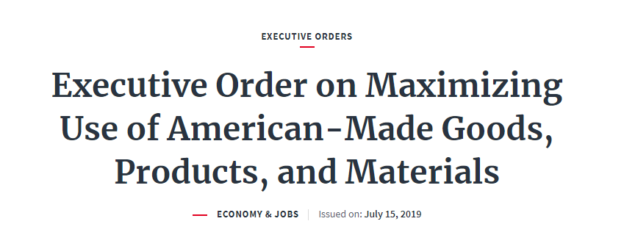
Price Preferences Applied Against Foreign Items Under Buy American Act
 | Small Businesses | Other Businesses
Existing Law | 12% price preference | 6% price preference
Trump Proposal | 30% price preference | 20% price preference

Slide 45
“Squeezing” the Buy American Act | Acquisitions Above Trade Agreements Thresholds (typically $180,000): Buy American Act Does Not Apply
 | Buy American Act Applies: Acquisitions from $10,000 to the Trade Agreements Thresholds
 | Micro-Purchases (Currently up to $10,000): Buy American Act Does Not Apply

Slide 46
Today

