Slide 1
An Introduction to U.S. Procurement – Part III
Professor Christopher Yukins
George Washington University Law School
Washington DC
February 4, 2020
Master in Public Procurement for Sustainable Development ITC- ILO and University of Turin

Slide 2
Electronic Marketplaces

Slide 3
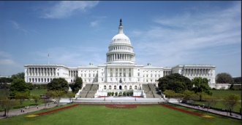
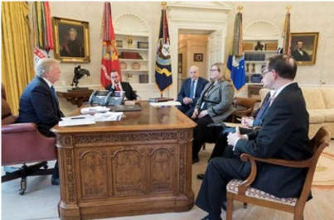
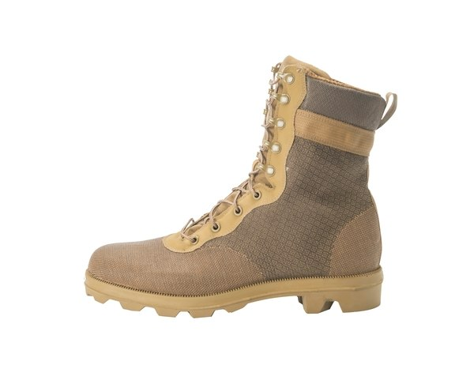
Online Solution
Centralized Purchasing Agency
Market
Users
Congress
MAJ Abraham Young, USA
The Players

Slide 4
Online Solution
Centralized Purchasing Agency
Market
Users
Congress
MAJ Abraham Young, USA
The Problems
Vendor data – bid challenges – transparency –
competition -- socioeconomic goals (including Buy American) – no- standards security review -- fee to GSA – Most Favored Customer pricing

Slide 5
Context: International Procurement

Slide 6
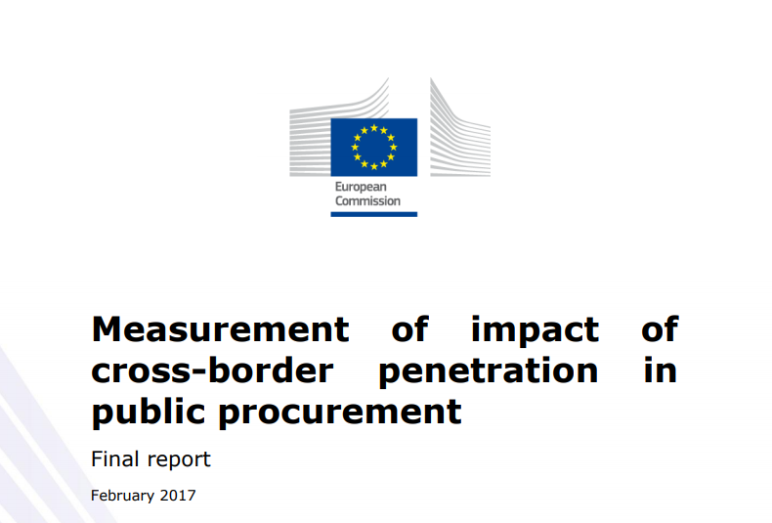
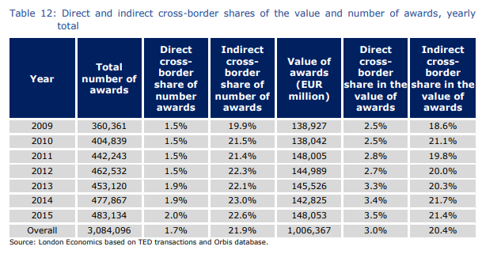
“ . . . the direct cross-border share in the number of awards remained under 5% in the majority of EU28 Member States.”
“At the EU level, it is estimated that import penetration in the private sector is about 10% higher than in the public sector. . . . There is no consistent indication of a domestic bias in public purchasing despite . . . the fact that overall import penetration in private purchasing is significantly higher than for the public sector. Higher import penetration in private sector purchasing appears to a large extent to be explained by the significant differences in the composition of purchases between the two groups.”
Notes:
https://publications.europa.eu/en/publication-detail/-/publication/5c148423-39e2-11e7-a08e-01aa75ed71a1/language-en

Slide 7
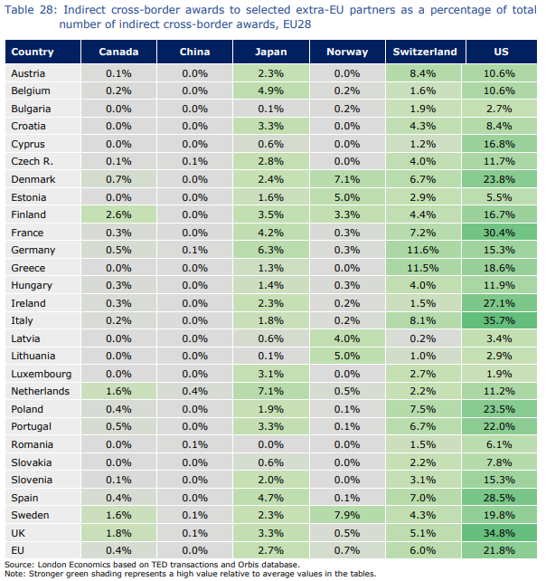
U.S. has largest shares of indirect cross-border awards in the European Union

Slide 8
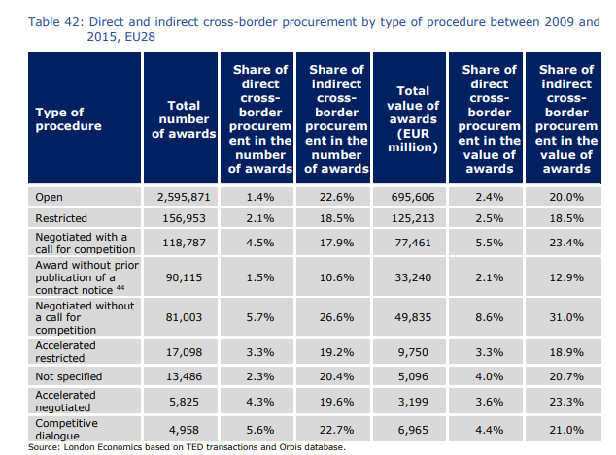

Slide 9
Convergence: Procurement Regulation
Best Practices
U.S.
Europe
Others

Slide 10
 | USA - Federal | EU | World Bank | WTO | USA Model Law for States
Acquisition Planning
Publication of Opportunities
Electronic Auctions
Open Procedure
Competitive Dialogue
Frameworks
Contract Award Notices
Bid Challenges
Exclusion
Contract Administration
CONVERGENCE

Slide 11
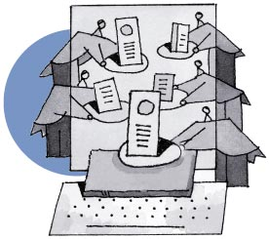
What Is a Reverse Auction?

Slide 12
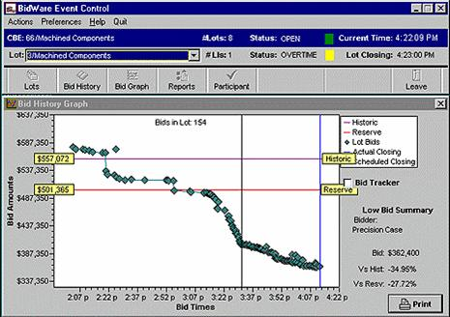

Slide 13
Case study: Georgia – Using E-Procurement To Combat Corruption
Link to presentation on Georgian e-procurement system:
https://prezi.com/1yugudjld6rw/e-procurement-reform-in-georgia-everyone-sees-everything/
Transparency International – Georgia report on e-procurement system:
http://www.transparency.ge/en/node/3117

Slide 14
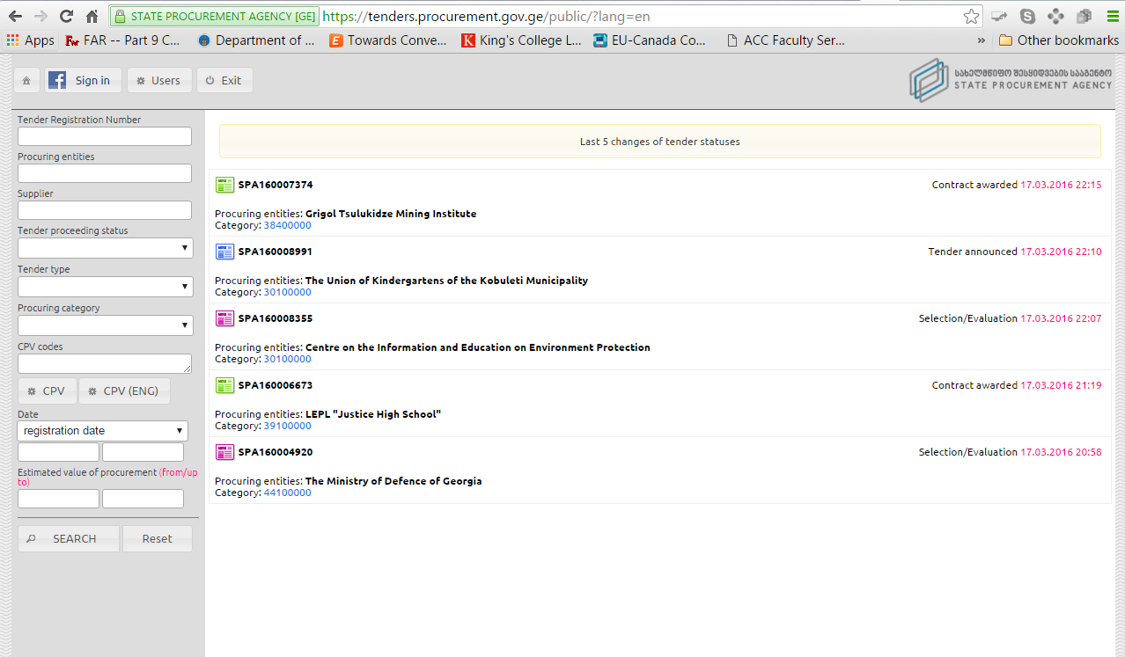
Georgia E-Procurement

Slide 15
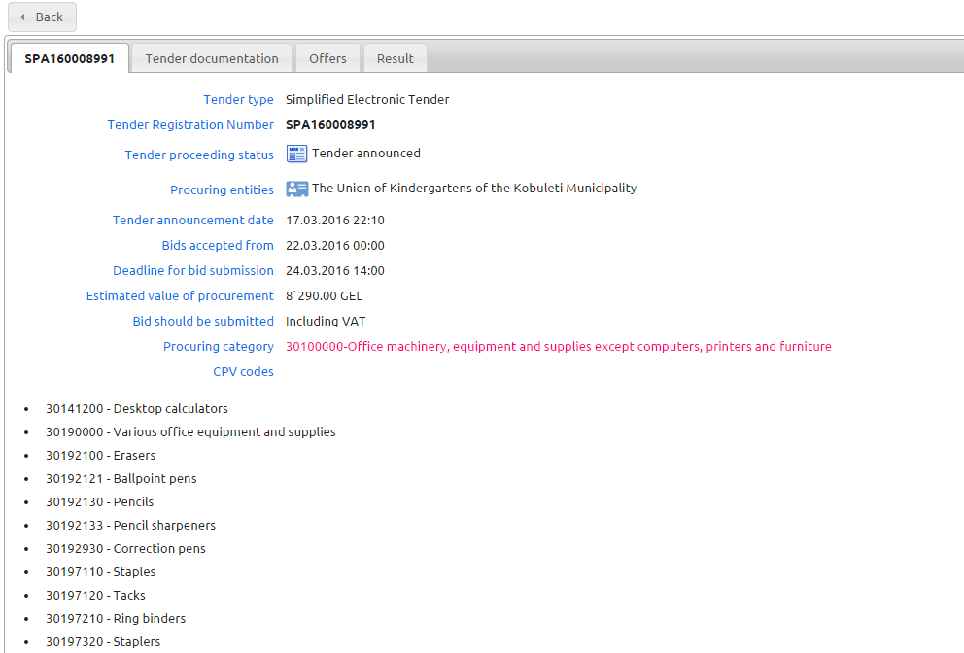
Sample Georgian Auction

Slide 16
The U.S. Rule on Reverse Auctions

Slide 17
Which types of auction can be used?
Type 1 – allowed; is the most common in UK
winning tender is chosen based solely on the auction phase (usually price only)
winner (usually lowest price) is apparent to participants during the auction process
European Perspective
- Sue Arrowsmith

Slide 18
Which types of auction can be used?
Type 2 – allowed
award is based on aspects of tenders assessed before the auction (e.g.quality) and on the auction (where usually only price only is subject to change)
winner is apparent during the auction process
European Perspective
- Sue Arrowsmith

Slide 19
Which types of auction can be used?
Type 3 – not allowed under directives at all; was rare before new directives except for utilities
As in type 2, award is based on aspects of tenders not changed in the auction (e.g. quality) and on the auction
winner is not apparent during the auction process (e.g. quality is judged after the auction and then an overall judgment made on price/quality)
European Perspective
- Sue Arrowsmith

Slide 20
European Union Directive – Cont’d
The electronic auction shall be based:
- either solely on prices when the contract is awarded to the lowest price,
- or on prices and/or on the new values of the features of the tenders indicated in the specification when the contract is awarded to the most economically advantageous tender.

Slide 21
Mock Auction Rules
Group descriptions drive bidding strategy
Auction per mock solicitation
U.S. rules regarding reverse auctions apply
U.S. bid protest rules apply
Bids to auctioneer; low bid posted
Professor is both auctioneer and arbiter

Slide 22
Mock Auction
General Facts: Solicitation
Team-Specific Facts (to be distributed)

Slide 23
Conclusion
Christopher R. Yukins
cyukins@law.gwu.edu
Tel. +1 703 304 4773

