Slide 1

Procurement Law in the Wider World
King’s College London
March 2020
Caroline Nicholas
UNCITRAL Secretariat, Vienna
Christopher Yukins
George Washington University Law School

Slide 2

King’s College London – GWU Law
Annual Symposium: March 16, 2020
On Contract Administration
Info: publicprocurementinternational.com

Slide 3
Introductions

Slide 4

UN Commission on International Trade Law (UNCITRAL)
N

Slide 5

George Washington University
Law School
Government Procurement Law Program, Est. 1960

Slide 6
Topics for Today
Governing Principles and Harmonization
The United Nations Convention against Corruption (UNCAC)
The World Trade Organisation (WTO) Agreement on Government Procurement (GPA)
The United Nations Commission on International Trade Law (UNCITRAL) Model Law on Public Procurement
World Bank Procurement Reforms
N

Slide 7
Desiderata – Steven Schooner (PPLR 2002)
Transparency
Integrity
Competition
Uniformity
Risk Avoidance
Wealth Distribution
Best value
Efficiency
Customer Satisfaction

Slide 8
 | U.S. Federal Acquisition Regulation (FAR) | European Procurement Directive (2014/24/EU) | WTO Government Procurement Agreement (2012) | American Bar Association Model Procurement Code
Acquisition Planning
Publication of Opportunities
Electronic Reverse Auctions
Sealed Bidding (Open Tendering)
Competitive Negotiations (Dialogue)
IDIQs (Frameworks)
Publication of Awards
Bid Protests (Remedies)
Suspension-Debarment (Exclusion)
Contract Administration
CONVERGENCE?

Slide 9
Discussion Question:
Why should international institutions focus on procurement?
N

Slide 10
International legal framework for PP
  UN Convention Against Corruption (UNCAC)
  WTO Government Procurement Agreement (GPA)/Regional Free Trade Agreements (FTAs)
  European Union Directives
  UNCITRAL Model Law on Procurement
  Multilateral Development Banks (e.g., World Bank, European Bank for Reconstruction and Development (EBRD) procurement policies
  National systems are often based on one or more of these texts
MDBs
UNCITRAL
UNCAC
EU Directives
WTO/GPA/FTAs
N
Notes:
10

Slide 11
EXAMPLE OF MODEL LAW:
THE UNCITRAL MODEL
LAW ON PUBLIC PROCUREMENT (2011)
N

Slide 12
Essential principles and procedures of the Model Law:
Legislation or regulations implementing the Model Law should include the following essential principles and procedures
N

Slide 13
Adhering to Essential principles and Procedures
While it is intended that States should adapt the Model Law to local circumstances, including their legislative tradition, they should not compromise the Model Law’s essential principles and procedures in so doing.
N

Slide 14
Transparency of Law
the applicable law, procurement regulations and other relevant information are to be made publicly available
N

Slide 15
Transparency of procurement Opportunities and awards
  The model law requires:
    prior publication of announcements for each procurement procedure (with relevant details) (arts. 33-35)
    ex post facto notice of the award of procurement contracts (article 23)
N

Slide 16
Sound Specifications
Items to be procured are to be described in accordance with article 10 (that is, objectively, and without reference to specific brand names as a general rule, so as to allow submissions to be prepared and compared on a common and objective basis)
N

Slide 17
Qualifications (contractor responsibility)
qualification procedures and permissible criteria to determine which suppliers or contractors will be able to participate are set out in the law, and the particular criteria that will determine whether or not suppliers or contractors are qualified in a particular procurement procedure are to be advised to all potential suppliers or contractors (articles 9 and 18)
N

Slide 18
Open Tendering = preferred method
open tendering (also known as “sealed bidding” in some systems) is the recommended procurement method
the rules require an objective justification for the use of any other procurement method (article 28)
N

Slide 19
Conditions for Use –
Other Procurement Methods
other procurement methods are available to cover the main circumstances likely to arise (simple or low-value procurement, urgent and emergency procurement, repeated procurement and the procurement of complex or specialised items or services).
The law sets out conditions for use of these procurement methods (articles 29-31)
Standard procedures for the conduct of each procurement procedure are prescribed in the law (Chapters III-VII )
N

Slide 20
Open Communications with Suppliers
communications with suppliers are to be in a form and manner that does not impede access to the procurement (article 7)
N

Slide 21
Mandatory Standstill –
Effective Remedies
(Bid Challenges)
The Model Law calls for:
  A mandatory standstill period between the identification of the winning supplier or contractor and the award of the contract or framework agreement, in order to allow any non-compliance with the provisions of the Model Law to be addressed prior to any such contract entering into force (article 22(2))
  mandatory challenge and appeal procedures if rules or procedures are breached (Chapter VIII)
N

Slide 22
Ongoing UNCITRAL Work:
Public-Private Partnerships
N

Slide 23
Example of International Agreement Addressing Procurement:
UN Convention Against Corruption
N

Slide 24

UN Convention Against Corruption (Art. 9)
Public Information
Advance award criteria and publication
Objective and predetermined criteria for award
Bid challenge and appeal
Measures to control procurement personnel – e.g., rules and codes
Transparency, including in budgeting and accounting
Notes:
24

Slide 25
 | UN Convention Against Corruption, per Article 9, calls for a procurement system that affords: | UNCITRAL Model Procurement Law
Rules Public | Public distribution of information relating to procurement procedures and contracts. (Paragraph 1(a)) | Yes
Advance Conditions | Advance establishment of the conditions for participation in a procurement, including award criteria and tendering rules, and their publication. (Paragraph 1(b)) | Yes
Objective Criteria | Objective and predetermined criteria for procurement decisions, to facilitate subsequent verification. (Paragraph 1(c)) | Yes

Slide 26
 | UN Convention Against Corruption, per Article 9, calls for a procurement system that affords: | UNCITRAL Model Procurement Law
Challenge Systems (next slide) | An effective system of domestic review, including an effective system of appeal, to ensure legal recourse and remedies in the event that established rules are not followed. (Paragraph 1(d)) | Yes
Ethics | Measures to regulate procurement personnel, such as declarations of personal interest in procurements, screening procedures, and training. (Paragraph 1(e)) | Yes

Slide 27
UNCITRAL Review (Challenge) Mechanisms
Procuring Agency
Independent Administrative
Court
Court
Independent Administrative
Court
N
27
Notes:
Tore’s Comments:
My own comments to Chapter VIII are as follows.
My understanding of the present text is that it establishes a review system where (i) a supplier may bring a complaint to the PE or an AA until the procurement contract has entered into force (“within the standstill period”) or within the period for presenting submissions if the complaint is about the terms of the solicitation (I leave that out in the following); (ii) that an appeal can be made but only in respect of a decision of the PE or the AA resulting from a complaint or a failure by the PE or the AA to take such decision (art. 61 (i)); (iii) that a complaint can also be brought to an IAB directly up and until and after the PC has entered into force (art. 63 (2); (v) that an appeal to the IAB can be brought up until and after the entry into force of the PC; (iv) that the timely submission of a complaint or an appeal requires the review body (the PE, the AA or the IAB) to suspend the procurement proceedings (and the framework agreement?) or the PC, as the case may be, for a period decided by the review body; and (vi) that there is a discretionary choice for the supplier between bringing a complaint to the PE or the AA, as the case may be, or to the IAB, in which latter case there is no appeal unless the law of the state allows such appeal to the courts. This seems rather straight forward except that the text is not easy to read. So , if I am right in my understanding, we need first to agree if this is what the WG wishes to have.
Then there are number of subsidiary provisions some of which may be considered to be doubtful. For example,
Art. 62 (3) “Unless the complaint is resolved by mutual agreement of the parties..”(which” parties” and is this without limits as to what the “parties” can agree upon?)
Art. 62 (4) the PE can institute proceedings under art. (63 or 66) – Doubtful.
Art. 62(5) and art. 64 (2). “suppliers and contractors participating in the review proceedings..” and “has the right to participate in the review proceedings..” – Raises the question of when at the latest other suppliers/contractors can join in the proceedings.
The WG may wish to state that periods of time for submitting complaints (other than those regarding the terms of the solicitation) should start at the earliest when the decision to award a PC has been published. The powers set forth in art. 63 (5) (f) seemingly applies without any limitations and then to any error. The WG may wish to consider that the cancellation of a PC can only be made in certain more serious cases of errors, and, in case of a cancellation, if the ML would require to set forth the consequences as to performances med under the PC.
As to footnote 11, in view of art. 65 (2) is it necessary to include a provision of the kind mentioned in footnote 11?
Then there are some drafting issues to be dealt with.
I would be pleased to have some reaction to the above, and any other comments you may have.
Best regards
Tore Wiwen-Nilsson

Slide 28
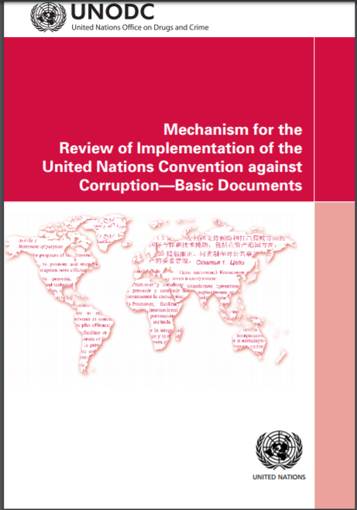
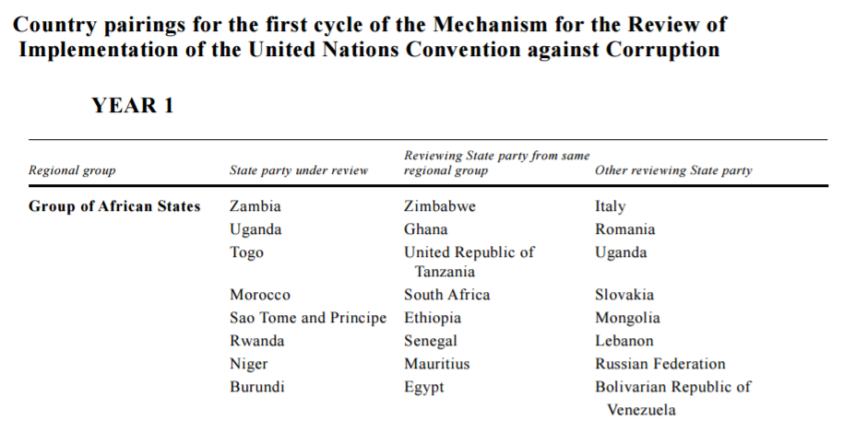
Example of Peer Review Mechanism Under International Agreement
Mechanism for the Review of Implementation of the United Nations Convention against Corruption (UNCAC)
Notes:
Conference of the States Parties to the United Nations Convention against Corruption
Pursuant to article 63 of the Convention, the Conference of the States Parties to the United Nations Convention against Corruption was established to improve the capacity of and cooperation between States parties to achieve the objectives set forth in the Convention and to promote and review its implementation.

Slide 29
Paths to Harmonization – If Sought
Directives – International Conventions
Trade Agreements
Model Laws

Slide 30
Example of Trade Agreement: WTO Government Procurement Agreement
N

Slide 31
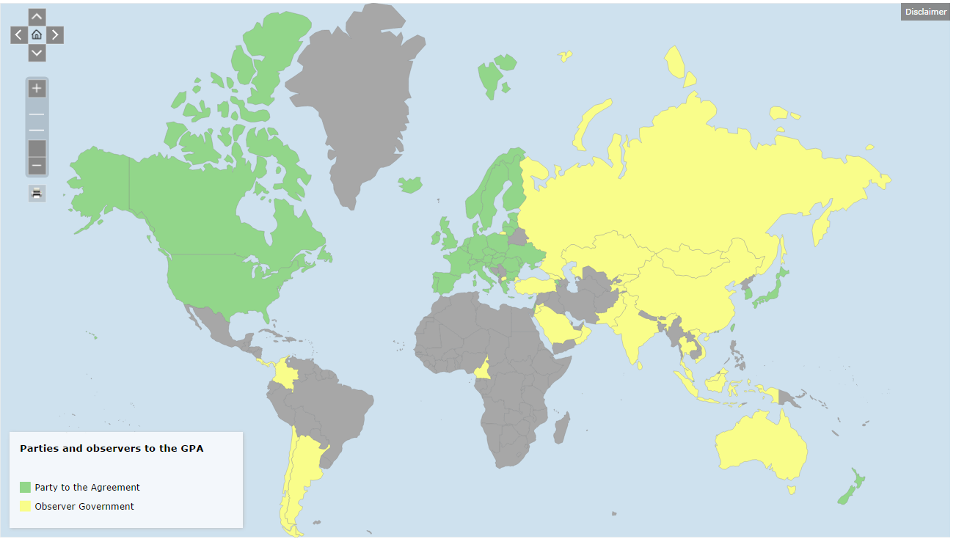
WTO Government Procurement Agreement
No Discrimination
Eliminate Non-Tariff Barriers in Procurement
Harmonize – Best Practices or Uniform? Anti-Corruption?
GPA Progress
Notes:
Map: https://www.wto.org/english/tratop_e/gproc_e/memobs_e.htm

Slide 32

GPA Core Obligations
Non-Discrimination
National Treatment
N

Slide 33
Structure of GPA
Text
Minimum requirements for Procurement System
Coverage
Agencies
Goods
Services
Party Exclusions
2014
2007
N

Slide 34
GPA Exclusions
Defense
Grants
Party Exceptions

Slide 35
Party Exclusions: Examples
U.S.
Small Business Preferences
Reserved Preferences
EU
Broadcast Materials
Agricultural Products
Israel
Water
Energy

Slide 36
Developing Nations – Special and Differential Treatment under GPA
Preferential Market Access
Transitional Price Preferences/Offsets
N

Slide 37
Work Programs – (2012) GPA
Also:
“a review of the use, transparency and the legal frameworks of public-private partnerships, and their relationship to covered procurement”
SMEs
Statistical Data
Sustainable Procurement
Exclusions
Safety Standards
N
Notes:
DECISION ON THE OUTCOMES OF THE NEGOTIATIONS UNDER ARTICLE XXIV:7 OF THE AGREEMENT ON GOVERNMENT PROCUREMENT 3
APPENDIX 1 4
Decision of the Committee on Government Procurement on Adoption of the Text of "The Protocol Amending the Agreement on Government Procurement" 5
Protocol Amending the Agreement on Government Procurement 6
Annex to the Protocol Amending the Agreement on Government Procurement 7
Appendix I Final Appendix I Offers of the GPA Parties in the GPA Coverage Negotiations 37
Final Appendix I Offer of the Republic of Armenia 38
Final Appendix I Offer of Canada 48
Future Appendix I Commitments of the European Union (Final) 79
Final Appendix I Offer of Hong Kong, China 255
Final Appendix I Offer of Iceland 265
Final Appendix I Offer of Israel 282
Final Appendix I Offer of Japan 293
Final Appendix I Offer of the Republic of Korea 308
Final Appendix I Offer of the Principality of Liechtenstein 321
Final Appendix I Offer of the Kingdom of the Netherlands with Respect to Aruba 333
Final Appendix I Offer of Norway 340
Final Appendix I Offer of Singapore 361
Final Appendix I Offer of Switzerland 370
Final Appendix I Offer of the Separate Customs Territory of Taiwan, Penghu, Kinmen and Matsu 393
Final Appendix I Offer of the United States 411
Appendix II 434
Appendix III 434
Appendix IV 434
APPENDIX 2 435
Annex A Decision of the Committee on Government Procurement on Notification Requirements under Articles XIX and XXII of the Agreement 436
Annex B Decision of the Committee on Government Procurement on Adoption of Work Programmes 438
Annex C Decision of the Committee on Government Procurement on a Work Programme on SMEs 439
Annex D Decision of the Committee on Government Procurement on a Work Programme on the Collection and Reporting of Statistical Data 442
Annex E Decision of the Committee on Government Procurement on a Work Programme on Sustainable Procurement 444
Annex F Decision of the Committee on Government Procurement on a Work Programme on Exclusions and Restrictions in Parties' Annexes 445
Annex G Decision of the Committee on Government Procurement on a Work Programme on Safety Standards in International Procurement 447

Slide 38
How Enforceable Is GPA Under U.S. Law?

Slide 39
19 U.S.C. 3512(a)(2)(A) – The Barrier to Enforcement of Sub-Central Access Under the
WTO Government Procurement Agreement
No State law, or the application of such a State law, may be declared invalid as to any person or circumstance on the ground that the provision or application is inconsistent with any of the Uruguay Round Agreements, except in an action brought by the United States for the purpose of declaring such law or application invalid.

Slide 40
Example of Harmonization:
Corporate Anti-Corruption Compliance/Controls

Slide 41



1. Standards and procedures | √ | √ | √ | √
2. Knowledgeable leadership |  | √ | √ | √
3. Exclude risky personnel | √ | √ | √ | √
4. Training | √ | √ | √ | √
5. Monitor, evaluate, reporting hotline | √ | √ | √ | √
6. Incentives and discipline | √ | √ | √ | √
7. Adjust program to risk | √ | √ | √ | √
Notes:
Sources:
Serious Fraud Office, Approach of the Serious Fraud Office to Dealing with Overseas Corruption, at 1 (2009), available at http://www.sfo.gov.uk/media/28313/approach%20of%20the%20sfo%20to%20dealing%20with%20overseas%20corruption.pdf.
Lord Bach, Letter to Lord Henley re: Bribery Bill -- “Adequate Procedures’ Guidance (Dec. 2009), http://www.justice.gov.uk/publications/docs/bach-letter-adequate-procedures-guidance.pdf.
Ministry of Justice, Consultation on Guidance About Commercial Organisations Preventing Bribery (Section 9 of the Bribery Act 2010)

Slide 42
Example in Anti-Corruption: International Institutions

Slide 43
Risks of Corruption in Procurement
Reputation
Best Value
Fiduciary

Slide 44
World Bank/International Institutions’ Definition of Sanctionable Conduct
(a) “Corrupt practice”, i.e. offering, giving, receiving, or soliciting, directly or indirectly, anything of value to influence the action of a public official in the selection process or in contract execution
(b) “Fraudulent practice”, i.e. a misrepresentation or omission of facts in order to influence a selection process or the execution of a contract
(c) “Collusive practices”, i.e. a scheme or arrangement between two or more respondents with or without the knowledge of the procuring entity, designed to establish prices at artificial, non-competitive levels and
(d) “Coercive practices” means harming or threatening to harm, directly or indirectly, persons or their property to influence their participation in a procurement process, or affect the execution of a contract.
Notes:
Also: Obstructive Practice

Slide 45
Lessons from Cybersecurity Regulations

Slide 46

GPA, Art. III Leaves Discretion To Discriminate Regarding Classified Work
1. Nothing in this Agreement shall be construed to prevent any Party from taking any action or not disclosing any information that it considers necessary for the protection of its essential security interests relating to the procurement of arms, ammunition or war materials, or to procurement indispensable for national security or for national defence purposes.

Slide 47

U.S. Defense Department Retains Discretion to Exclude
Increasingly important as Russia and China move to join the WTO Government Procurement Agreement
U.S. excludes limited defense procurement, on a “negative list” basis
Notes:
SUBPART 239.73--REQUIREMENTS FOR INFORMATION RELATING TO SUPPLY CHAIN RISK
(Revised October 30, 2015)
239.7300 Scope of subpart.
239.7301 Definitions.
239.7302 Applicability.
239.7303 Authorized individuals.
239.7304 Determination and notification.
239.7305 Exclusion and limitation on disclosure.
239.7306 Solicitation provision and contract clause.
239.7300 Scope of subpart.
(a) This subpart implements section 806 of the National Defense Authorization Act for Fiscal Year 2011 (Pub. L. 111-383) and elements of DoD Instruction 5200.44, Protection of Mission Critical Functions to Achieve Trusted Systems and Networks (TSN), at (http://www.dtic.mil/whs/directives/corres/pdf/520044p.pdf).
(b) The authority provided in this subpart expires on September 30, 2018 (see section 806(a) of Pub. L. 112-239).
239.7301 Definitions.
As used in this subpart—
“Covered item of supply” means an item of information technology that is purchased for inclusion in a covered system, and the loss of integrity of which could result in a supply chain risk for a covered system (see section 806(e)(6) of Pub. L. 111-383).
“Covered system” means a national security system, as that term is defined at 44 U.S.C. 3542(b) (see section 806(e)(5) of Pub. L. 111-383). It is any information system, including any telecommunications system, used or operated by an agency or by a contractor of an agency, or other organization on behalf of an agency—
(1) The function, operation, or use of which—
(i) Involves intelligence activities;
(ii) Involves cryptologic activities related to national security;
(iii) Involves command and control of military forces;
(iv) Involves equipment that is an integral part of a weapon or weapons system; or
(v) Is critical to the direct fulfillment of military or intelligence missions, but this does not include a system that is to be used for routine administrative and business applications, including payroll, finance, logistics, and personnel management applications; or
(2) Is protected at all times by procedures established for information that have been specifically authorized under criteria established by an Executive order or an Act of Congress to be kept classified in the interest of national defense or foreign policy.
“Supply chain risk” means the risk that an adversary may sabotage, maliciously introduce unwanted function, or otherwise subvert the design, integrity, manufacturing, production, distribution, installation, operation, or maintenance of a national security system (as that term is defined at 44 U.S.C. 3542(b)) so as to surveil, deny, disrupt, or otherwise degrade the function, use, or operation of such system.
239.7302 Applicability.
Notwithstanding FAR 39.001, this subpart shall be applied to acquisition of information technology for national security systems, as that term is defined at 44 U.S.C. 3542(b), for procurements involving—
(a) A source selection for a covered system or a covered item of supply involving either a performance specification (see 10 U.S.C. 2305(a)(1)(C)(ii)), or an evaluation factor (see 10 U.S.C. 2305(a)(2)(A)), relating to supply chain risk;
(b) The consideration of proposals for and issuance of a task or delivery order for a covered system or a covered item of supply where the task or delivery order contract concerned includes a requirement relating to supply chain risk (see 10 U.S.C. 2304c(d)(3) and FAR 16.505(b)(1)(iv)(D)); or
(c) Any contract action involving a contract for a covered system or a covered item of supply where such contract includes a requirement relating to supply chain risk.
239.7303 Authorized individuals.
(a) Subject to 239.7304, the following individuals are authorized to take the actions authorized by 239.7305:
(1) The Secretary of Defense.
(2) The Secretary of the Army.
(3) The Secretary of the Navy.
(4) The Secretary of the Air Force.
(b) The individuals authorized at paragraph (a) may not delegate the authority to take the actions at 239.7305 or the responsibility for making the determination required by 239.7304 to an official below the level of—
(1) For the Department of Defense, the Under Secretary of Defense for Acquisition, Technology, and Logistics; and,
(2) For the military departments, the senior acquisition executive for the department concerned.
239.7304 Determination and notification.
The individuals authorized in 239.7303 may exercise the authority provided in 239.7305 only after—
(a) Obtaining a joint recommendation by the Under Secretary of Defense for Acquisition, Technology, and Logistics and the Chief Information Officer of the Department of Defense, on the basis of a risk assessment by the Under Secretary of Defense for Intelligence, that there is a significant supply chain risk to a covered system;
(b) Making a determination in writing, in unclassified or classified form, with the concurrence of the Under Secretary of Defense for Acquisition, Technology, and Logistics, that—
(1) Use of the authority in 239.7305(a), (b), or (c) is necessary to protect national security by reducing supply chain risk;
(2) Less intrusive measures are not reasonably available to reduce such supply chain risk; and
(3) In a case where the individual authorized in 239.7303 plans to limit disclosure of information under 239.7305(d), the risk to national security due to the disclosure of such information outweighs the risk due to not disclosing such information; and
(c)(1) Providing a classified or unclassified notice of the determination made under paragraph (b) of this section—
(i) In the case of a covered system included in the National Intelligence Program or the Military Intelligence Program, to the Select Committee on Intelligence of the Senate, the Permanent Select Committee on Intelligence of the House of Representatives, and the congressional defense committees; and
(ii) In the case of a covered system not otherwise included in paragraph (a) of this section, to the congressional defense committees; and
(2) The notice shall include—
(i) The following information (see 10 U.S.C. 2304(f)(3)):
(A) A description of the agency's needs.
(B) An identification of the statutory exception from the requirement to use competitive procedures and a demonstration, based on the proposed contractor's qualifications or the nature of the procurement, of the reasons for using that exception.
(C) A determination that the anticipated cost will be fair and reasonable.
(D) A description of the market survey conducted or a statement of the reasons a market survey was not conducted.
(E) A listing of the sources, if any, that expressed in writing an interest in the procurement.
(F) A statement of the actions, if any, the agency may take to remove or overcome any barrier to competition before a subsequent procurement for such needs;
(ii) The joint recommendation by the Under Secretary of Defense for Acquisition, Technology, and Logistics and the Chief Information Officer of the Department of Defense as specified in paragraph (a) of this section;
(iii) A summary of the risk assessment by the Under Secretary of Defense for Intelligence that serves as the basis for the joint recommendation specified in paragraph (a) of this section; and
(iv) A summary of the basis for the determination, including a discussion of less intrusive measures that were considered and why they were not reasonably available to reduce supply chain risk.
239.7305 Exclusion and limitation on disclosure.
Subject to 239.7304, the individuals authorized in 239.7303 may, in the course of procuring information technology, whether as a service or as a supply, that is a covered system, is a part of a covered system, or is in support of a covered system—
(a) Exclude a source that fails to meet qualification standards established in accordance with the requirements of 10 U.S.C. 2319, for the purpose of reducing supply chain risk in the acquisition of covered systems;
(b) Exclude a source that fails to achieve an acceptable rating with regard to an evaluation factor providing for the consideration of supply chain risk in the evaluation of proposals for the award of a contract or the issuance of a task or delivery order;
(c) Withhold consent for a contractor to subcontract with a particular source or direct a contractor for a covered system to exclude a particular source from consideration for a subcontract under the contract; and
(d) Limit, notwithstanding any other provision of law, in whole or in part, the disclosure of information relating to the basis for carrying out any of the actions authorized by paragraphs (a) through (c) of this section, and if such disclosures are so limited—
(1) No action undertaken by the individual authorized under such authority shall be subject to review in a bid protest before the Government Accountability Office or in any Federal court; and
(2) The authorized individual shall—
(i) Notify appropriate parties of action taken under paragraphs (a) through (d) of this section and the basis for such action only to the extent necessary to effectuate action;
(ii) Notify other Department of Defense components or other Federal agencies responsible for procurements that may be subject to the same or similar supply chain risk, in a manner and to the extent consistent with the requirements of national security; and
(iii) Ensure the confidentiality of any such notifications.
239.7306 Solicitation provision and contract clause.
(a) Insert the provision at 252.239-7017, Notice of Supply Chain Risk, in all solicitations, including solicitations using FAR part 12 procedures for the acquisition of commercial items, for information technology, whether acquired as a service or as a supply, that is a covered system, is a part of a covered system, or is in support of a covered system, as defined at 239.7301.
(b) Insert the clause at 252.239-7018, Supply Chain Risk, in all solicitations and contracts, including solicitations and contracts using FAR part 12 procedures for the acquisition of commercial items, for information technology, whether acquired as a service or as a supply, that is a covered system, is a part of a covered system, or is in support of a covered system, as defined at 239.7301.

Slide 48
Court of Justice for the European Union, in Max Havelaar Case, Barred Technical Specification Without Explanation and Adjudication
“[B]y providing, in the specifications, that the fact that certain products to be supplied bore specific labels would give rise to the grant of a certain number of points in the choice of the most economically advantageous tender, without having listed the criteria underlying those labels and without having allowed proof that a product satisfies those underlying criteria by all appropriate means, the province of North Holland established an award criterion that was incompatible with Article 53(1)(a) of Directive 2004/18.”

Slide 49
Defense Department: “Or Equal” Technical Requirements
Example: DFARS 252.204-7012 [Unclassified USDOD Info] (excerpt)
(ii)(A) The Contractor shall implement NIST SP 800-171, as soon as practical, but not later than December 31, 2017. For all contracts awarded prior to October 1, 2017, the Contractor shall notify the DoD Chief Information Officer (CIO), via email at osd.dibcsia@mail.mil, within 30 days of contract award, of any security requirements specified by NIST SP 800-171 not implemented at the time of contract award.
(B) The Contractor shall submit requests to vary from NIST SP 800-171 in writing to the Contracting Officer, for consideration by the DoD CIO. The Contractor need not implement any security requirement adjudicated by an authorized representative of the DoD CIO to be nonapplicable or to have an alternative, but equally effective, security measure that may be implemented in its place.
Notes:
(ii)(A) The Contractor shall implement NIST SP 800-171, as soon as practical, but not later than December 31, 2017. For all contracts awarded prior to October 1, 2017, the Contractor shall notify the DoD Chief Information Officer (CIO), via email at osd.dibcsia@mail.mil, within 30 days of contract award, of any security requirements specified by NIST SP 800-171 not implemented at the time of contract award.
(B) The Contractor shall submit requests to vary from NIST SP 800-171 in writing to the Contracting Officer, for consideration by the DoD CIO. The Contractor need not implement any security requirement adjudicated by an authorized representative of the DoD CIO to be nonapplicable or to have an alternative, but equally effective, security measure that may be implemented in its place.

Slide 50
Next Steps
Comprehensive & Progressive Trans-Pacific Partnership (CPTPP) –alive, U.S. out
Transatlantic Trade & Investment Partnership (TTIP) – dead
  EU initially called for broader sub-central access
  Likely alternative: broader regulatory cooperation
Nondiscrimination
Legal Protections
Regulatory Cooperation

Slide 51
Procurement on World Bank-Financed Projects

Slide 52
Old System:
World Bank Procurement Guidelines Governing Certain Bank-Financed Projects
OTHER
FUNDER
REQUIREMENTS
COUNTRY
SYSTEM
FOR
PROCUREMENT
GUIDELINES PROCUREMENT OF GOODS, WORKS, AND NON-CONSULTING SERVICES UNDER IBRD LOANS AND IDA CREDITS & GRANTS BY WORLD BANK BORROWERS

Slide 53
Goal: “Improving Aid Effectiveness by Increasing Use of Country Procurement Systems”
Easier Co-Financing
Reduced
Transaction
Costs
Sustainability
Stronger Country Systems
Notes:
From:
Background Paper Review of World Bank’s Procurement Policies and Procedures USE OF PROCUREMENT COUNTRY SYSTEMS Prepared by: Asha Ayoung, Lead Procurement Specialist. with support from Nancy Bikondo, Procurement Specialist and Alaleh Motamedi, Sr. Procurement Specialist (Feb. 2013)
https://consultations.worldbank.org/Data/hub/files/meetings/Procurement_Policies/Background_Paper_on_Use_of_Country_Systems.pdf
“The idea of strengthening and using country systems came from many years of experience in development that shows that when donors bypass country systems and policies in favor of the donors’ own policies and procedures, the sustainability of their efforts are undermined along with the country’s ability to manage their own development. The use of national systems promises to alleviate the load on recipient countries of having to deal with multiple policies, in particular procurement rules; make it easier for donors to co-finance operations; and in the long run reduce the transaction costs for the countries. Most importantly, it also provides a strong incentive for countries to bring their systems to an acceptable standard and thus scale up development by improving the return on all government expenditures not just those funded by donors.”

Slide 54
Competing Forces -- Country Systems
Multinationals &
Funders
Developing Nations (and History)

Slide 55
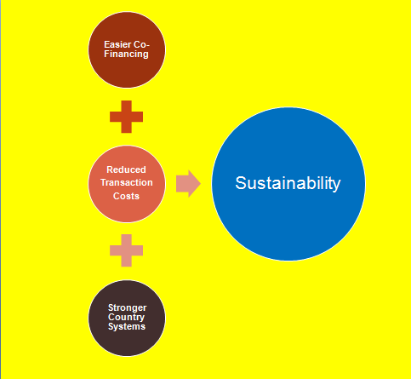
Competition
Integrity
Uniformity
Transparency
Professionalism
POTENTIAL FAILURES

Slide 56

A Closer Look:
The Principal-Agent Problem
Traditional World Bank Monitoring – Per Guidelines
Goal
Principal (Funder, Government, People, Etc.)
Agent
(contracting authority)

Slide 57
A Closer Look:
The Principal-Agent Problem
Challenges:
Operational pressures
Lost discipline of Guidelines
Unfamiliar rules
Focus on reputational not performance risk
Traditional World Bank Monitoring – Per Guidelines
Country Procurement Rules
Goal
Principal (Funder, Government, People, Etc.)
Agent
(contracting authority)

Slide 58
Potential Solutions
Country System
GPA
Domestic Challenges
Investor-State Disputes
Capacity Development
World Bank Challenges
Debarment

Slide 59
Back-Up Slides

Slide 60
For today
Trump
  Regulatory cooperation
Trade
  New perspectives
Anti-Corruption
  Exclusion and coordination

Slide 61
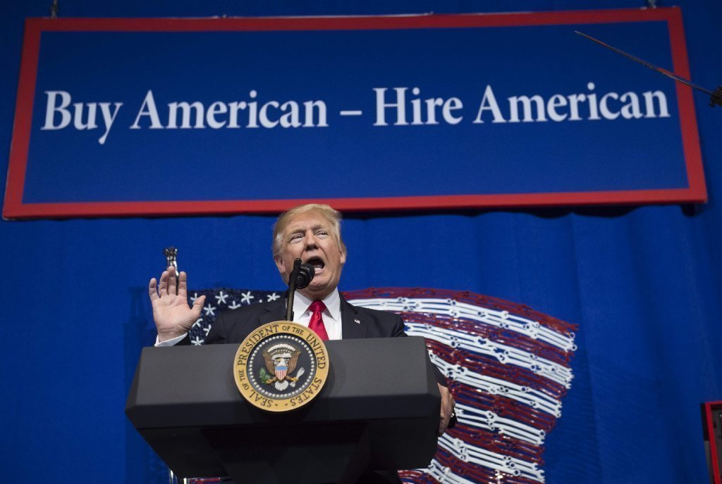

Slide 62
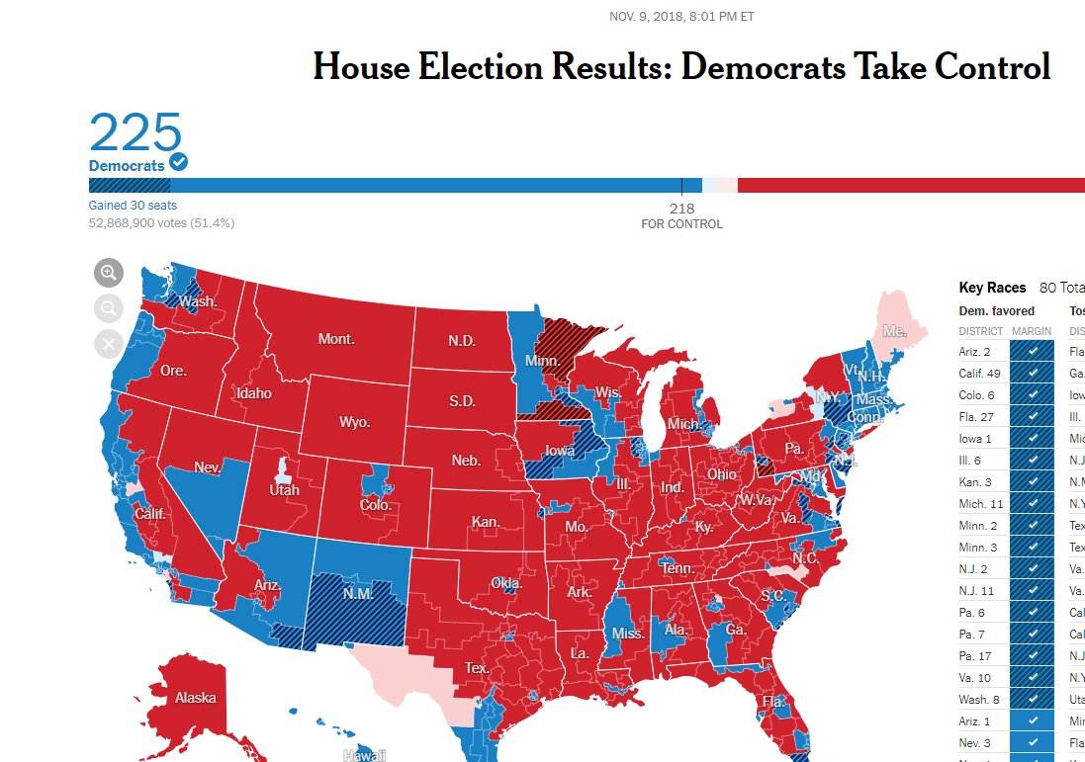

Slide 63
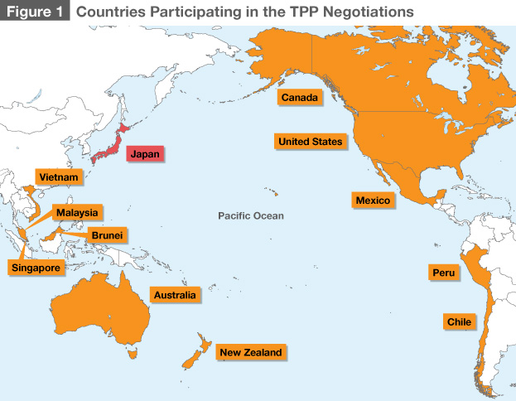


Slide 64

The Reciprocity Concept

Slide 65
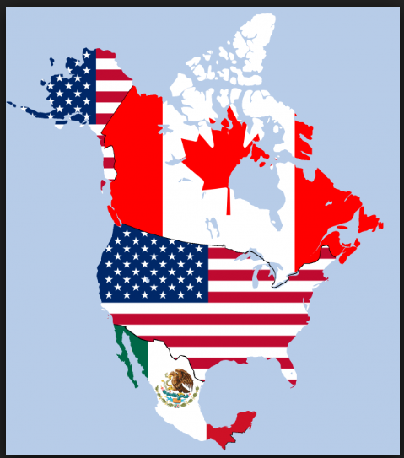
U.S. – Mexico – Canada Agreement (USMCA):
Procurement Chapter

Slide 66
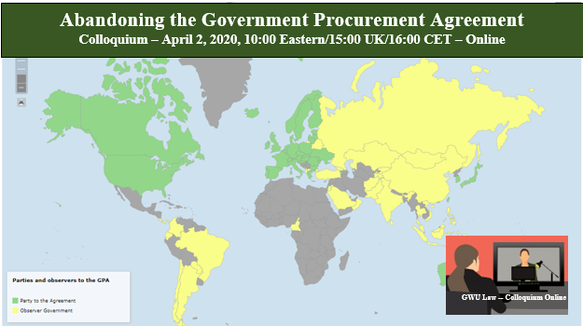

Slide 67
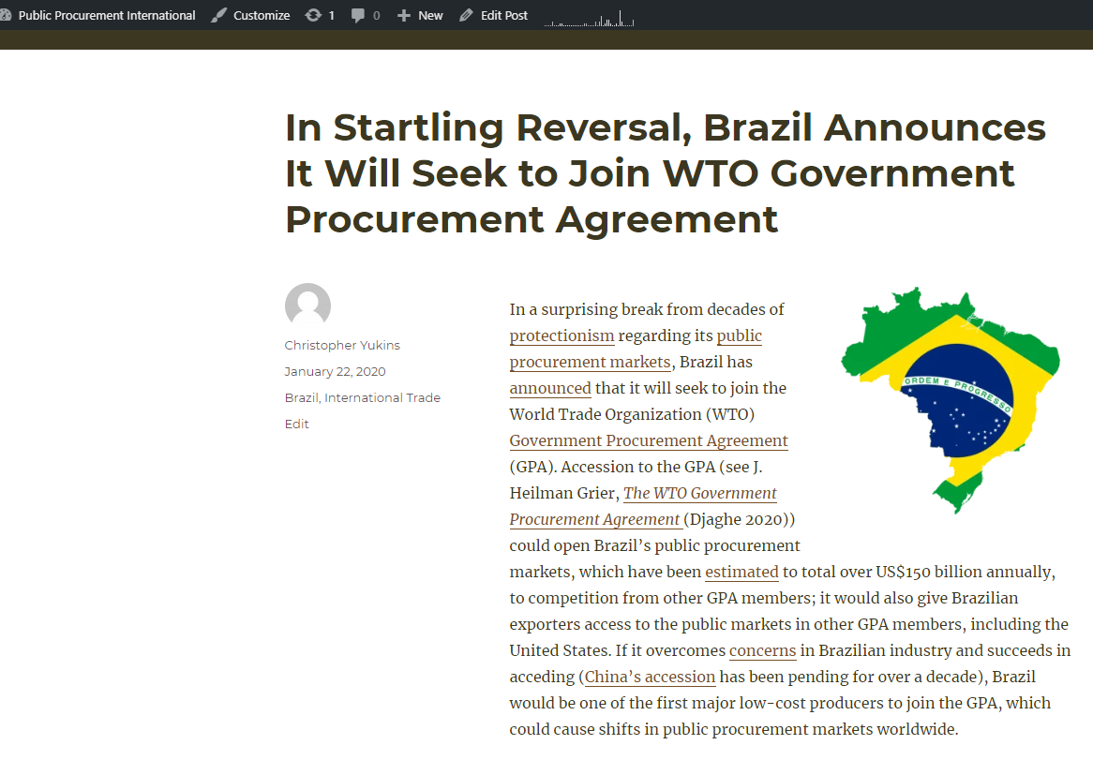

Slide 68
Europe and Trade

Slide 69
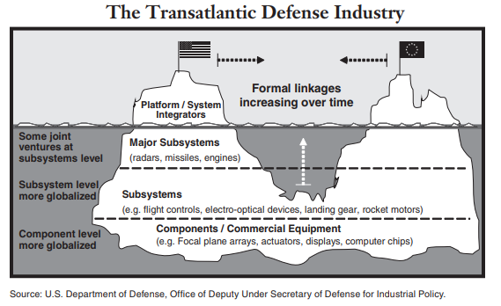

Slide 70
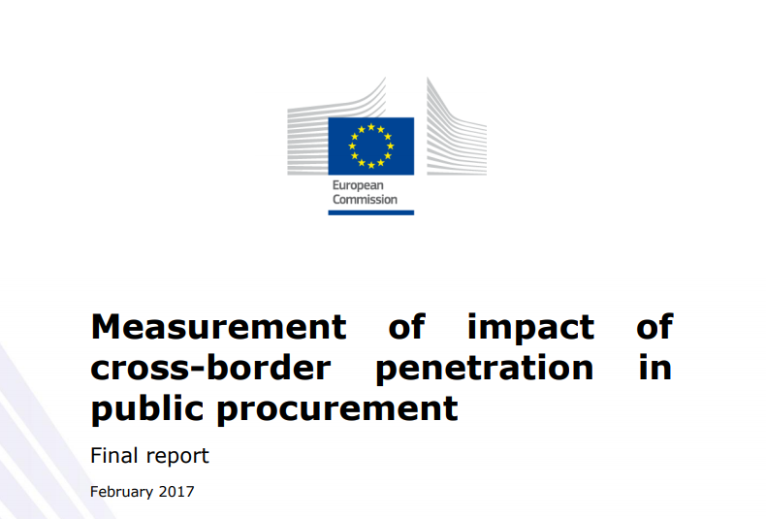
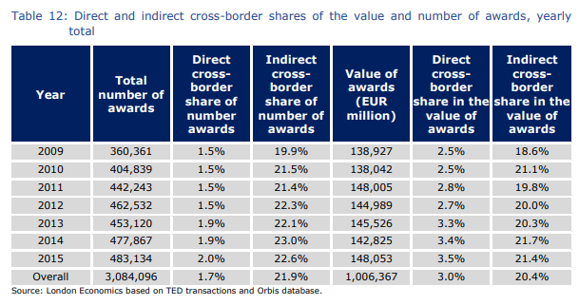
“At the EU level, it is estimated that import penetration in the private sector is about 10% higher than in the public sector. . . . There is no consistent indication of a domestic bias in public purchasing despite . . . the fact that overall import penetration in private purchasing is significantly higher than for the public sector. Higher import penetration in private sector purchasing appears to a large extent to be explained by the significant differences in the composition of purchases between the two groups.”
Notes:
https://publications.europa.eu/en/publication-detail/-/publication/5c148423-39e2-11e7-a08e-01aa75ed71a1/language-en

Slide 71
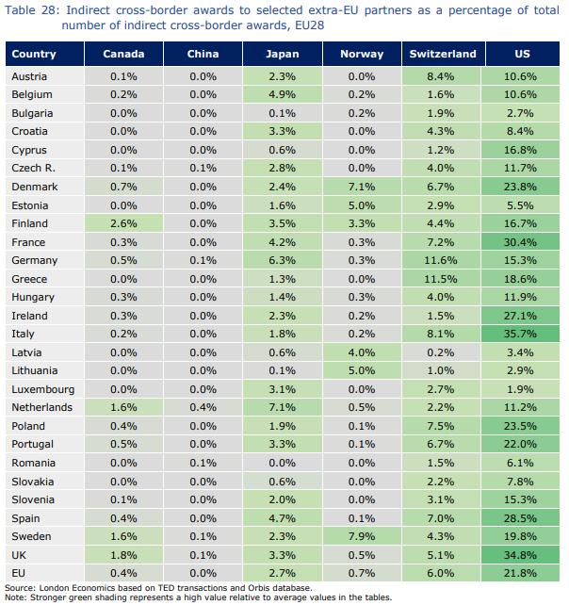
U.S. has largest shares of indirect cross-border awards in the European Union

Slide 72
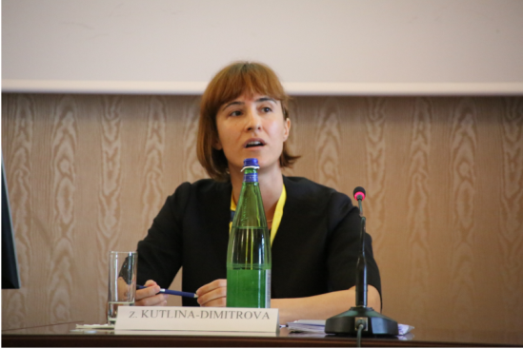
TTIP and International Public Procurement: The role of data-driven policy making*
Zornitsa Kutlina-Dimitrova, PhD
Chief Economist and Trade Analysis Unit
European Commission
4th Interdisciplinary Symposium on Public Procurement
26 October 2018
*The opinions expressed in this presentation are the author's own and do not necessarily reflect the
views and opinions of the European Commission.

Slide 73
International public procurement data collection and barriers assessment project (1)
Project objective:
The project's main objective is improving the availability, coverage and quality of government procurement data in an international context.
Time frame:
2016-2018 – extension of this project for another 3 years is possible.
Budget:
4 million euros + possible extension of another 4.5 million euros.
Country coverage:
China, India, Brazil, Indonesia, Australia, New Zealand and Thailand. In addition, the US and Canada will be covered in respect to modality 1 and 2 procurement.

Slide 74
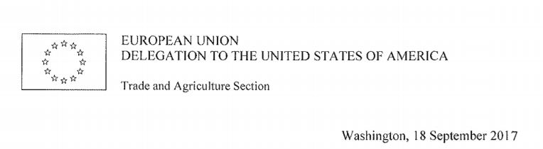
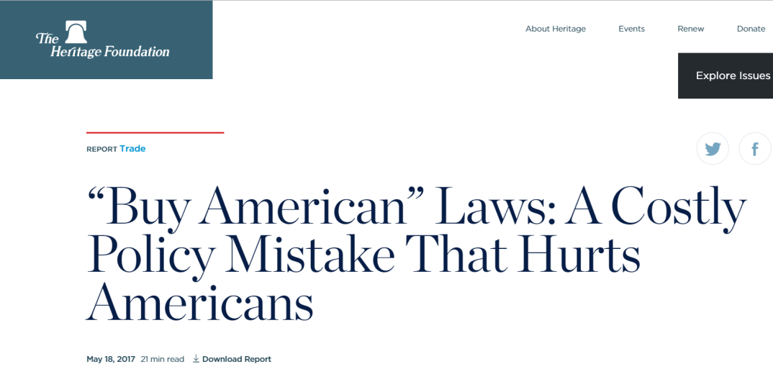
Notes:
http://www.copsmodels.com/ftp/workpapr/g-271.pdf

Slide 75
Exclusion/Debarment

Slide 76
Four Paradigms
Exclusion at Qualification
On a case-by-case basis
Adjudicative Debarment for “Bad Acts”
By senior official
Discretionary Debarment Official – U.S. Federal
In U.S. – done by contracting officer
Debarment is a cross-government “meta-qualification” determination
Based on “present responsibility”: focus on present status
Court-Ordered Debarment, After Judicial Proceedings
EU Directive Art. 57
E.g., World Bank
Performance Risk
Fiduciary Risk
Reputation Risk

Slide 77
EU 2014/24/EU
Art. 57: Exclusion
Recital 102
(102) | . . . it should be left to Member States to determine the exact procedural and substantive conditions applicable in such cases. They should, in particular, be free to decide whether to allow the individual contracting authorities to carry out the relevant assessments or to entrust other authorities on a central or decentralised level with that task.
6. Any economic operator that is in one of the situations referred to in paragraphs 1 and 4 may provide evidence to the effect that measures taken by the economic operator are sufficient to demonstrate its reliability despite the existence of a relevant ground for exclusion. If such evidence is considered as sufficient, the economic operator concerned shall not be excluded from the procurement procedure.
Recital 102

Slide 78
Sharing information between procuring entities: Exclusion is the tip of the iceberg
Exclusion
Termination
Performance
Fraud

Slide 79
Sharing Exclusion Information:
EU Directive 2014/24/EU – Recital 85
 | It is important that the decisions of contracting authorities should be based on recent information, in particular as regards exclusion grounds . . . . It is therefore preferable that, whenever possible, contracting authorities should verify such information by accessing relevant databases, which should be national in the sense of being administered by public authorities. At the current stage of development, there might still be cases where doing so is not yet possible because of technical reasons. The Commission should therefore envisage promoting measures that could facilitate easy recourse to up-to-date information electronically, such as strengthening tools offering access to virtual company dossiers, or means of facilitating interoperability between databases or other such flanking measures.

Slide 80
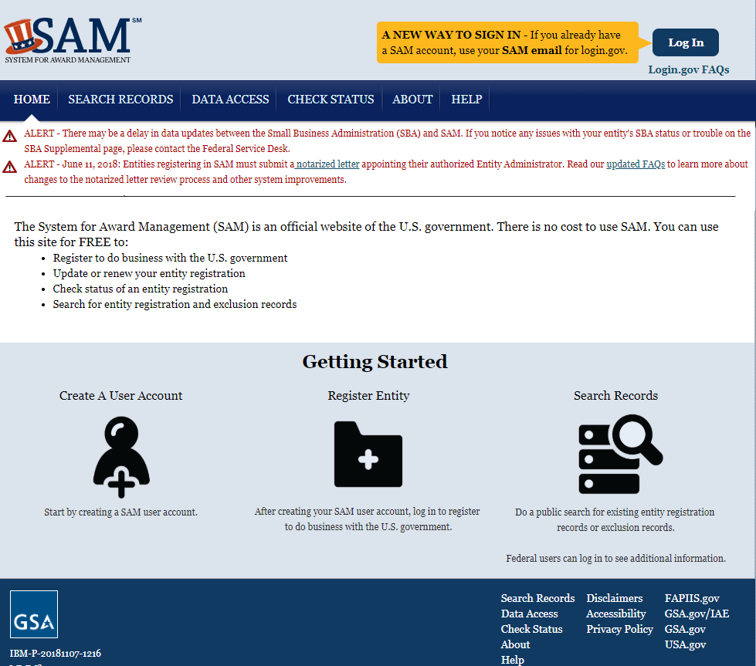
Sharing Exclusion Information:
U.S. System for Award Management (SAM.gov)

Slide 81
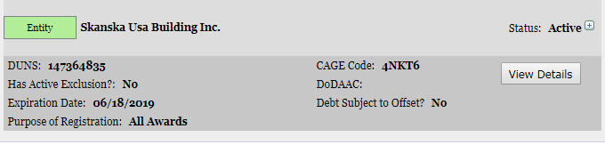
Sharing Exclusion Information:
U.S. System for Award Management (SAM.gov)

Slide 82
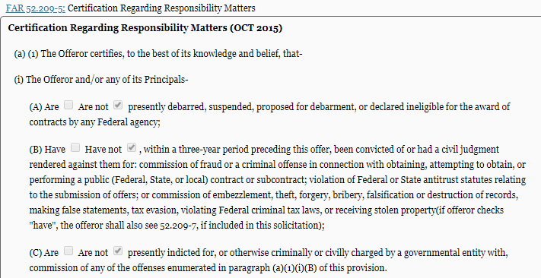
Sharing Exclusion Information:
U.S. System for Award Management (SAM.gov)

Slide 83
Conclusion
Caroline Nicholas:
  Caroline.Nicholas@uncitral.org
Christopher Yukins:
  cyukins@law.gwu.edu

