Slide 1
An international discussion of public contracting in a time of global pandemic, with procurement experts from Europe and the United States
. Public Contracts and . . .
Free Online Colloquium
Tuesday, March 24, 2020
12-13:30 pm Eastern US
Registration info: www.publicprocurementinternational.com
Graphic: Rosario Gutierrez/US Air Force

Slide 2
Agenda
Introductions
Moderators:
Prof. Christopher Yukins (GWU Law)
Prof. Gabriella Racca (U. Turin)
Speakers
Presentations
Q&A
0-5

Slide 3
Speakers
Mario Comba (U. Turin/Piedmont Regional Purchasing Authority) – regional responses in Italy
Gian Luigi Albano (CONSIP – Rome – centralized purchasing agency) – European Member States’ responses
Michelle Coleman (Crowell & Moring – on preparations and workforce)
J. Ryan Frazee (Wiley – on work stoppages and delays)
Kristen Ittig (Arnold & Porter – on claims and supply chain impacts)
Ellen Bonner (Epstein Becker – on healthcare and grants)
0-5

Slide 4
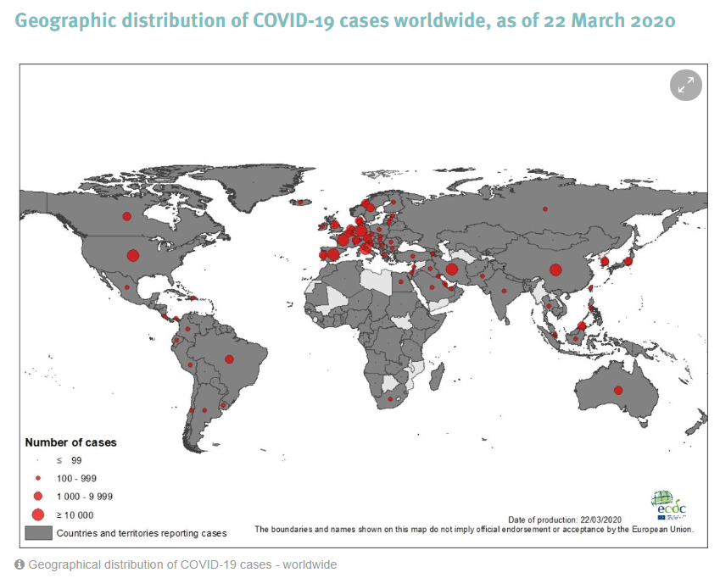

Slide 5
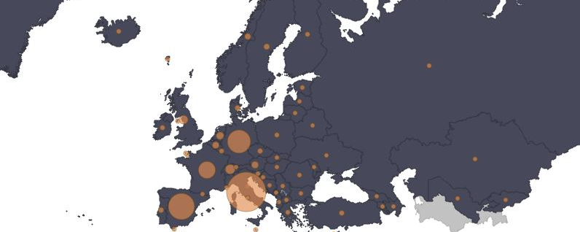
European perspective: Emergency Contracts -- Formation Issues
As of 22 March 2020
05-10

Slide 6
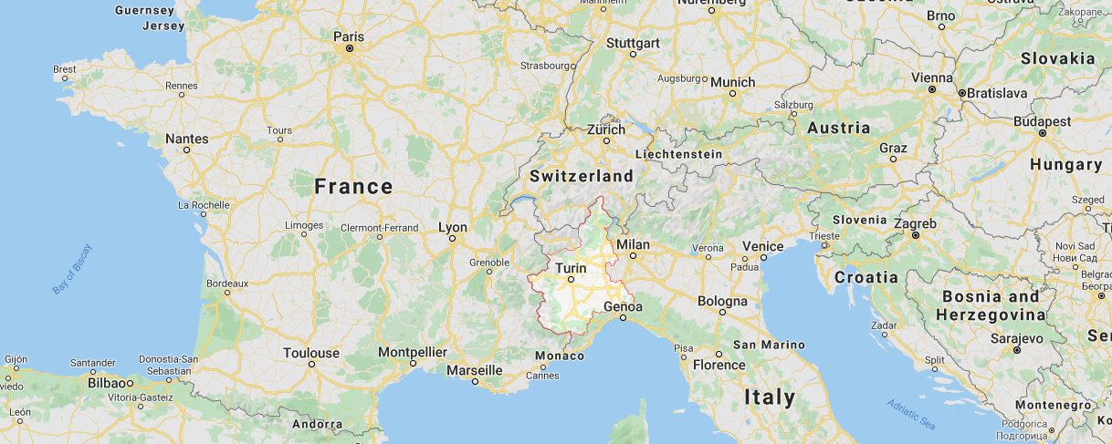
Piedmont, Italy
05-10

Slide 7
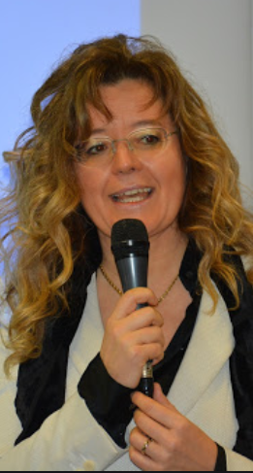
Gabriella Racca – University of Turin
Update on crisis in the EU and in Italy
Emergency measures
Centralized or decentralized procurement
Joint cross-border procurement issues
EU- Member States
Effects on cohesion of the European Union
Cooperation v. Competition and international speculation
National and Regional perspectives
05-10 – 1 of 2

Slide 8
Mario Comba – University of Turin – Comparative law
Centralized vs decentralized procurements
Machines (ventilators) centralized - CONSIP
Devices (masks, gloves ..) partially decentralized (Civil protection)
Drugs – decentralized (regional agencies)
Procurement strategies
Extreme urgency
Reliability of suppliers
Advance payment
Coordination at EU level
Exchange of information through EHPPA
05-10 – 2 of 2

Slide 9
Italy – Emergency contracting Gian Luigi Albano
Political and social environment in Italy
Agency in charge
Emergency procurement authorization
Fraud & price “gouging” (overpricing)
Market research
Cross-border procurement
Export controls
Centralized or decentralized procurement
Effect on cohesion of the European Union
10-30

Slide 10
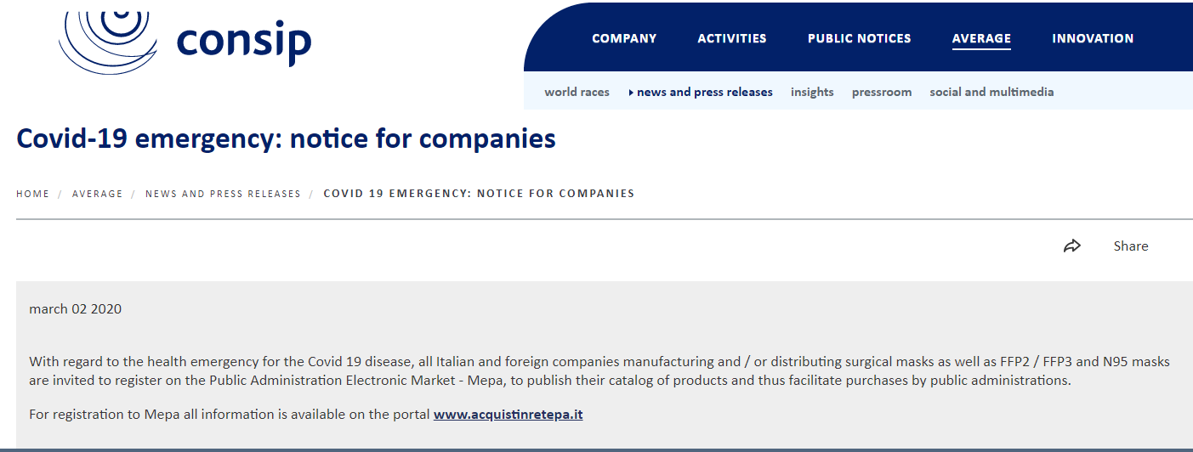
CONSIP – COVID-19 Emergency Contracting
05-10

Slide 11
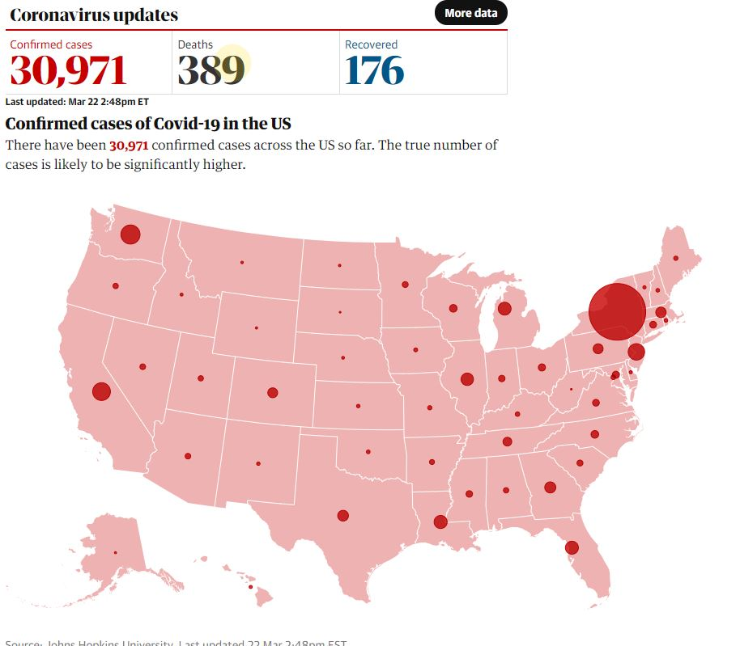
U.S. Perspective: Contract Administration Issues in an emergency
30

Slide 12
Michelle Coleman – Crowell & Moring
Preparations:
Create a Disaster Preparedness Plan
Prepare for Performance Interruptions
Labor and Employment Impacts:
Clear communications
Telework Capabilities
Sanitized workplaces
Biography: https://www.crowell.com/professionals/Michelle-Coleman
COVID-19 Preparedness Toolkit: https://www.crowell.com/NewsEvents/AlertsNewsletters/all/The-Government-Contractor-Coronavirus-COVID-19-Preparedness-Toolkit
Crowell & Moring’s Coronavirus Resource Center: https://www.crowell.com/Practices/Coronavirus-COVID-19-Resource-Center
30-37

Slide 13
J. Ryan Frazee – Wiley
Work stoppages and delays
Communication with customer
Check contract for applicable clauses
Excusable delays
Cost recovery clauses
Changes
Cost documenting procedures
More info: https://www.wiley.law/alert-The-Impact-of-the-Coronavirus-on-Government-Contractors
38-44

Slide 14
Kristen Ittig – Arnold & Porter
Government Contract Supply Chain
COVID-19 “Butterfly” Effect
FAR Part 18 (Emergency Acquisitions)
Defense Production Act (50 USC § 4501)
Defense Priorities and Allocations System (DPAS)
Health Resources Priorities and Allocations System (HRPAS)
Stafford Act (FAR Subpart 26.2)
Sovereign Acts Defense
More info: Arnold & Porter – Coronavirus Advisory for Government Contractors
45-51

Slide 15
Ellen C. bonner
Billions for Coronavirus (COVID-19): New Government Contracts and Grants on the Horizon
Supplemental funding for contracts and grants
Small Business loans
Letter contracts – FAR 16.603
More info:
https://www.healthlawadvisor.com/2020/03/09/coronavirus-supplemental-appropriations-act-construction-grants-for-non-federally-owned-facilities/
https://www.healthlawadvisor.com/2020/03/09/coronavirus-supplemental-appropriations-act-construction-grants-for-non-federally-owned-facilities/
https://www.ebglaw.com/coronavirus-resource-center/
Ellen C. Bonner
Member of the Firm
ebonner@ebglaw.com
Tel: 629-802-9252
52-58

Slide 16
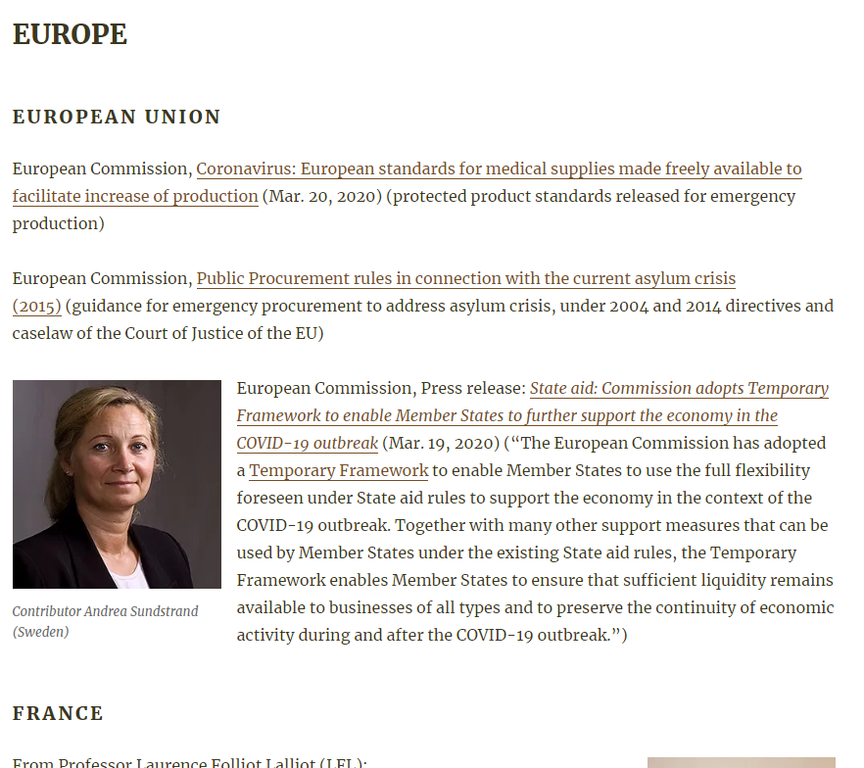
https://publicprocurementinternational.com/resources-on-covid-19-and-public-procurement/
RESOURCES ON COVID-19 AND PUBLIC PROCUREMENT
59-60

Slide 17
Questions & Answers

Slide 18
Initial Questions
Comment: Ben Koberna’s company is rapidly deploying electronic marketplaces for COVID-19 for purchasing nations. They are seeing unique price, payment and fulfillment challenges.
Ben Koberna, Electronic Auction Services (USA), https://www.eauctionservices.com/
Question: “How do we make sure that governments and business do not take advantage of the derogations to national public procurement laws? And what have we learned from similar past situations (natural disasters and pandemics) on the needed measures in [public procurement] and oversight bodies to cope with the current conditions?”
Ivan Zupan, Transparency International
Further questions from participants

Slide 19
Conclusion
A recorded version of this online colloquium will be available on demand, by registering:
https://zoom.us/webinar/register/WN_UedJv98KRmm3m2PssqrXkA

