Slide 1
Straight Talk: Emergency Procurement in the COVID-19 Pandemic Experts from Government - Business - Economics - Trade – Law Americas - Europe - Africa - Asia
Thursday, April 2, 9:00 ET/15:00 CET/21:00 CST
Info: www.publicprocurementinternational.com

Slide 2
Agenda
Introductions/Presentations (30 minutes)
Audience Q&A (30 minutes)
“Chat” open for questions throughout

Slide 3
Introductions
Moderators
Christopher Yukins, GW Law School
Laurence Folliot Lalliot, University of Paris Nanterre (based in Dakar, Senegal)
David Drabkin, Chair, Procurement Round Table (US)
Panelists
Gian Luigi Albano, CONSIP (Italy)
William Kovacic – GW Law School (former chair, U.S. Federal Trade Commission)
Ben Koberna, EASiBuy (USA)
CAO Fuguo, Law School of the Central University of Finance and Economics (Director, China Procurement Research Center) (China)
Simon Evenett, University of St Gallen (Switzerland)
Special guest – Q&A
Benedetta Audia (UNOPS)

Slide 4
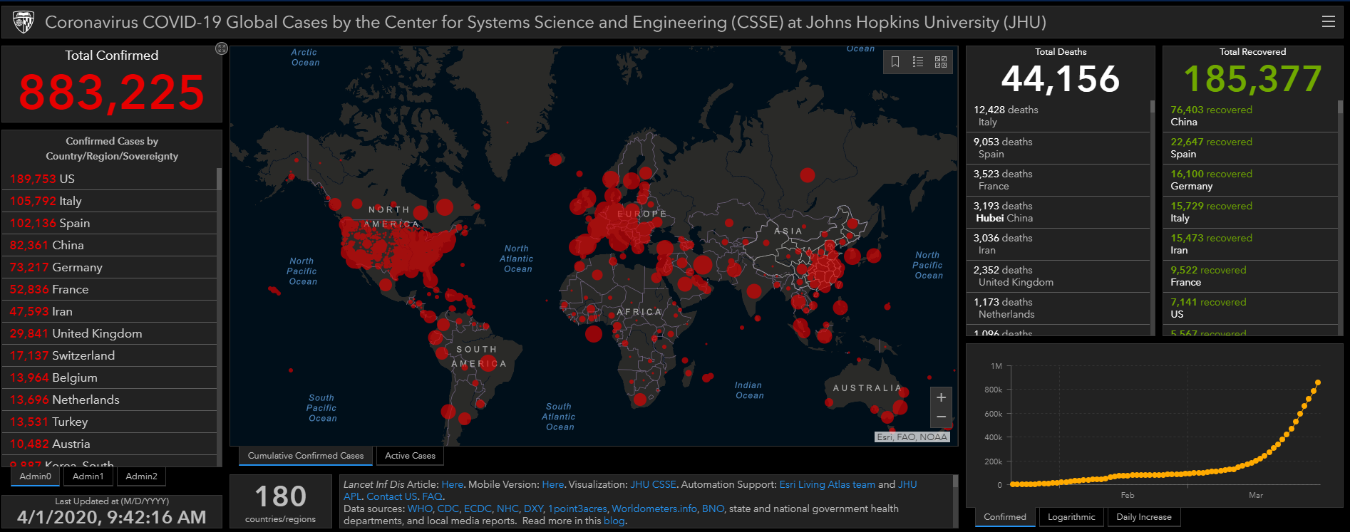
Washington Post, 1 April 2020

Slide 5
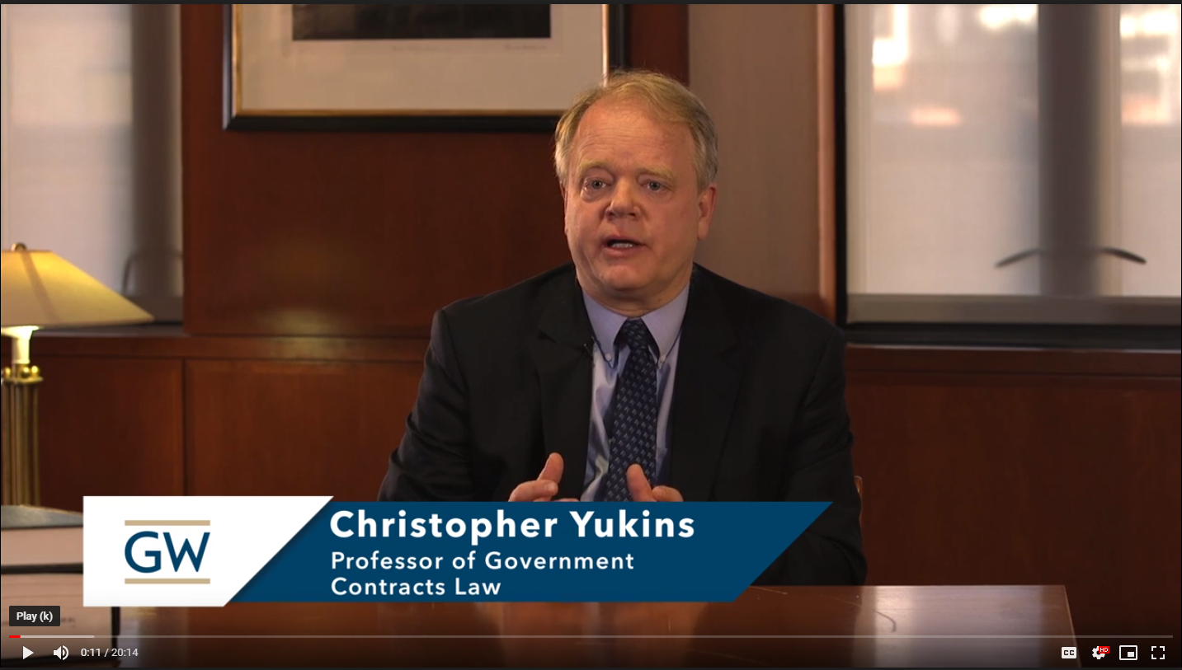
Christopher Yukins: Program today
Traditional public procurement rules depend on a buyer’s market. This is not.
Laurence Folliot Lalliot: Emergency laws – competition among governments
Gian Luigi Albano will speak to emergency contracting in Italy
William Kovacic: Competition law
Ben Koberna: Americas -- trends
CAO Fuguo: China’s supply strategy
Simon Evenett: Trade barriers
Benedetta Audia: Payment and delivery
Fiscal stimulus/health mitigation
David Drabkin: Section 3610 of U.S. CARES Act; see www.publicprocurementinternational.com – COVID-19 Resources

Slide 6
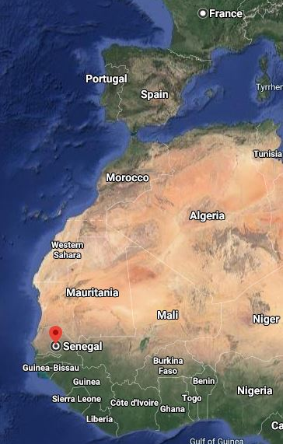
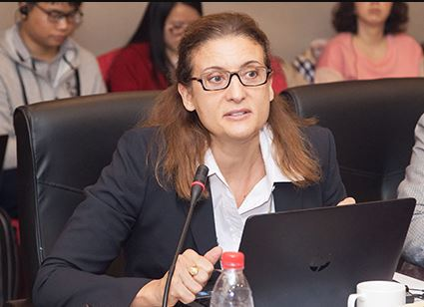
LAURENCE FOLLIOT-LALLIOT UNIVERSITY OF PARIS NANTERRE / IN DAKAR
Two international topics:
Competition among States and procuring entities
- Reversed market driven by vendors and intermediaries
- Auction and Diversion of supply
- EU COVID-19 procurement guidance
At risk: transparency and integrity of “COVID contracts”?
Emergency contracts often understood as non-transparent contracts
No prior or post-award publication
Only direct contracting
No definition of “emergency" concept
No limitation on contracting entities allowed to use exception
Example: Senegal -- New regulation excludes "COVID-19 contracts" from Public Procurement Code

Slide 7
Gian Luigi Albano – CONSIP (Italy)
Current market conditions in emergency supplies – Europe
Need for “Buyer Cooperation”

Slide 8
William Kovacic – GW Law
Competition law in the pandemic
Advice available
Hazards of cooperation
Potential enforcement for “price-gouging”

Slide 9
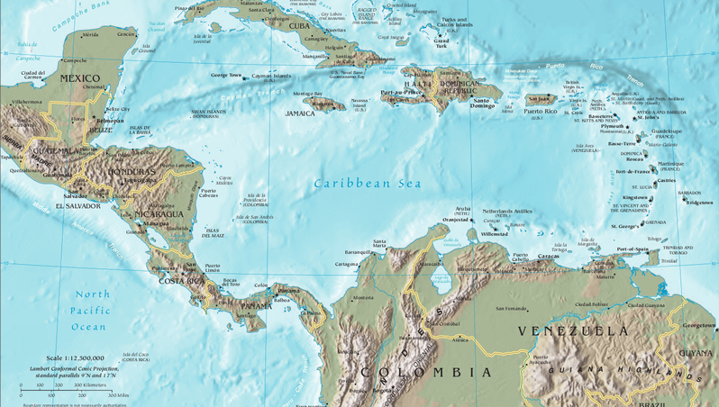
Ben Koberna - EASiBuy
Market trends – the Americas
Streamlining decision-making based on the COVID-19 market realities – assessing vendors / storing data
Counterfeit goods – strategies (short- and long-term)

Slide 10
Protection of People’s Life and Health in COVID 19 Pandemic: The Role of Government Procurement Law and Beyond
CAO Fuguo
Law School & China Institute for Public Procurement
Central University of Finance and Economics(Beijing)

Slide 11
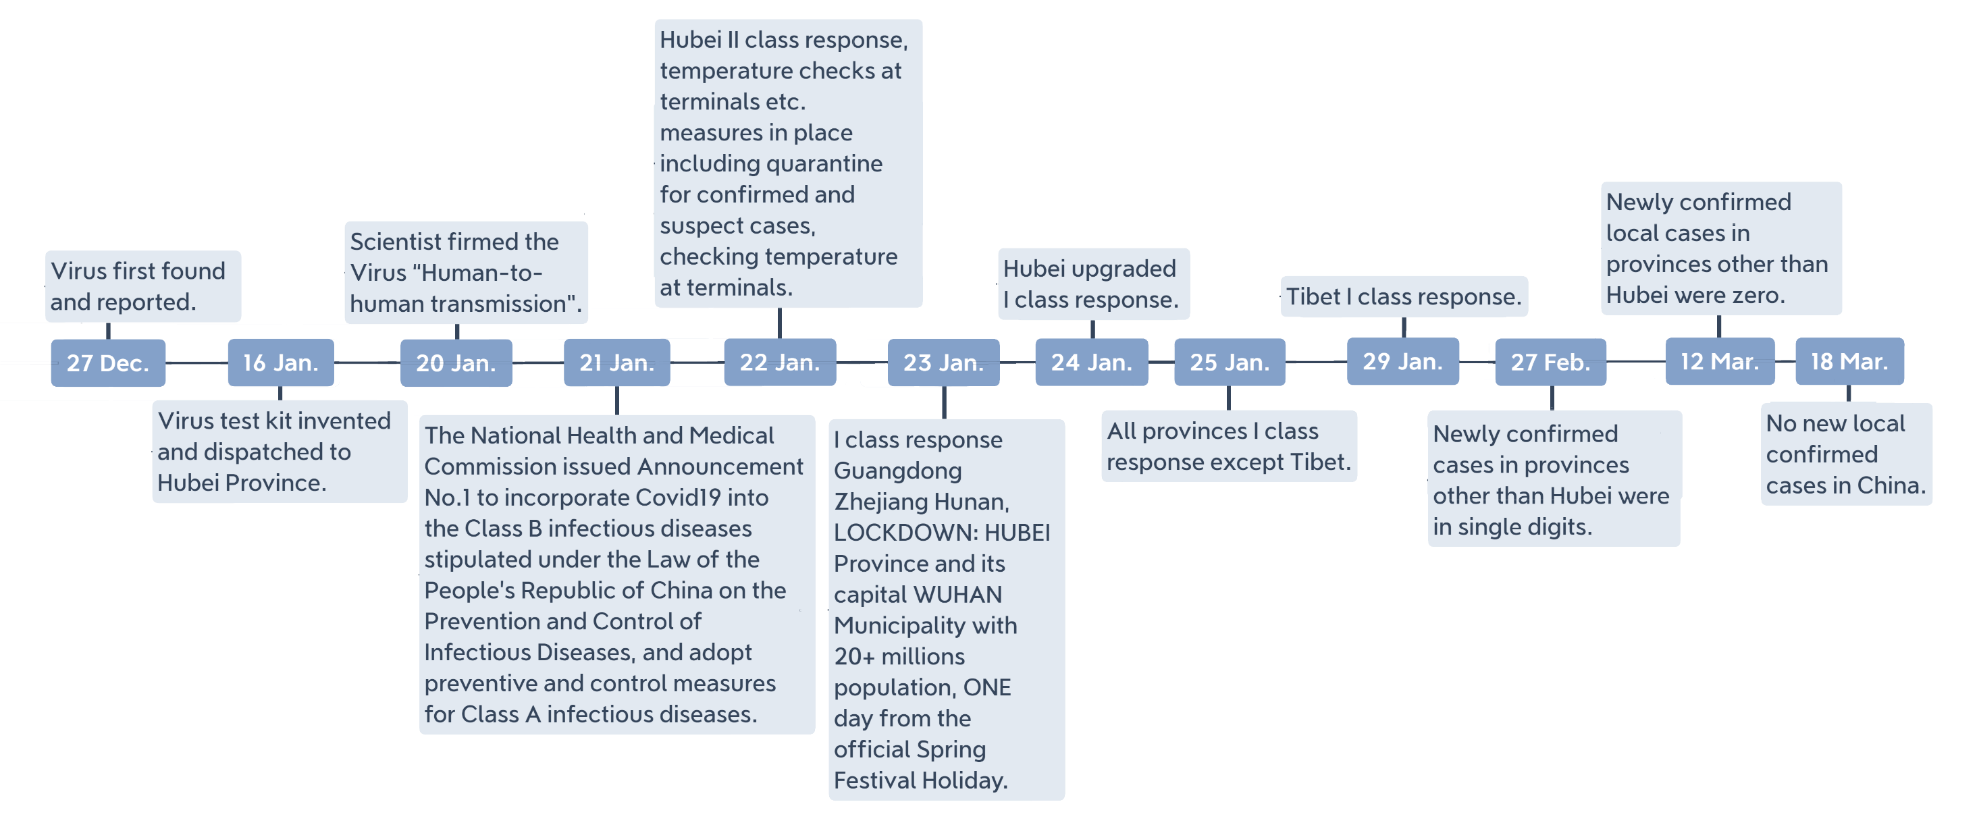
Critical timeline for containment and impact on procurement and supply chain
Social distancing, test and contact-tracing, 17days self-isolation, mask wearing, community response, research, security of critical medical supplies etc.
Scientist confirmed people to people transmission
The National Authority issued Announcement No. 1 to incorporate Covid19 into the Level B infectious diseases and adopt containment measures for Level A infectious diseases.

Slide 12
Impact of the timeline on Emergency domestic and international procurement/supply
Designated Exclusive Procurement and Supply System-DEPS System-Public private joint effort to stimulate production and supply for government exclusive purchase, with fiscal financial support, guaranteed purchase of any surplus
GPL escape timely
On 26 Jan., Notice by MOF on procurement Facilitating Containment of Covid 19
GPL also provides (Art.85):The Law shall not be applicable to the emergency procurements due to severe natural disasters and other force majeure events
GPL envisaged convergency situation: Competitive negotiation procedure and Sole source procurement
Next steps

Slide 13
Simon Evenett – University of St Gallen
Trade Restraints Threaten Public Health
Inherited Import Tariffs and Spreading Export Curbs

Slide 14
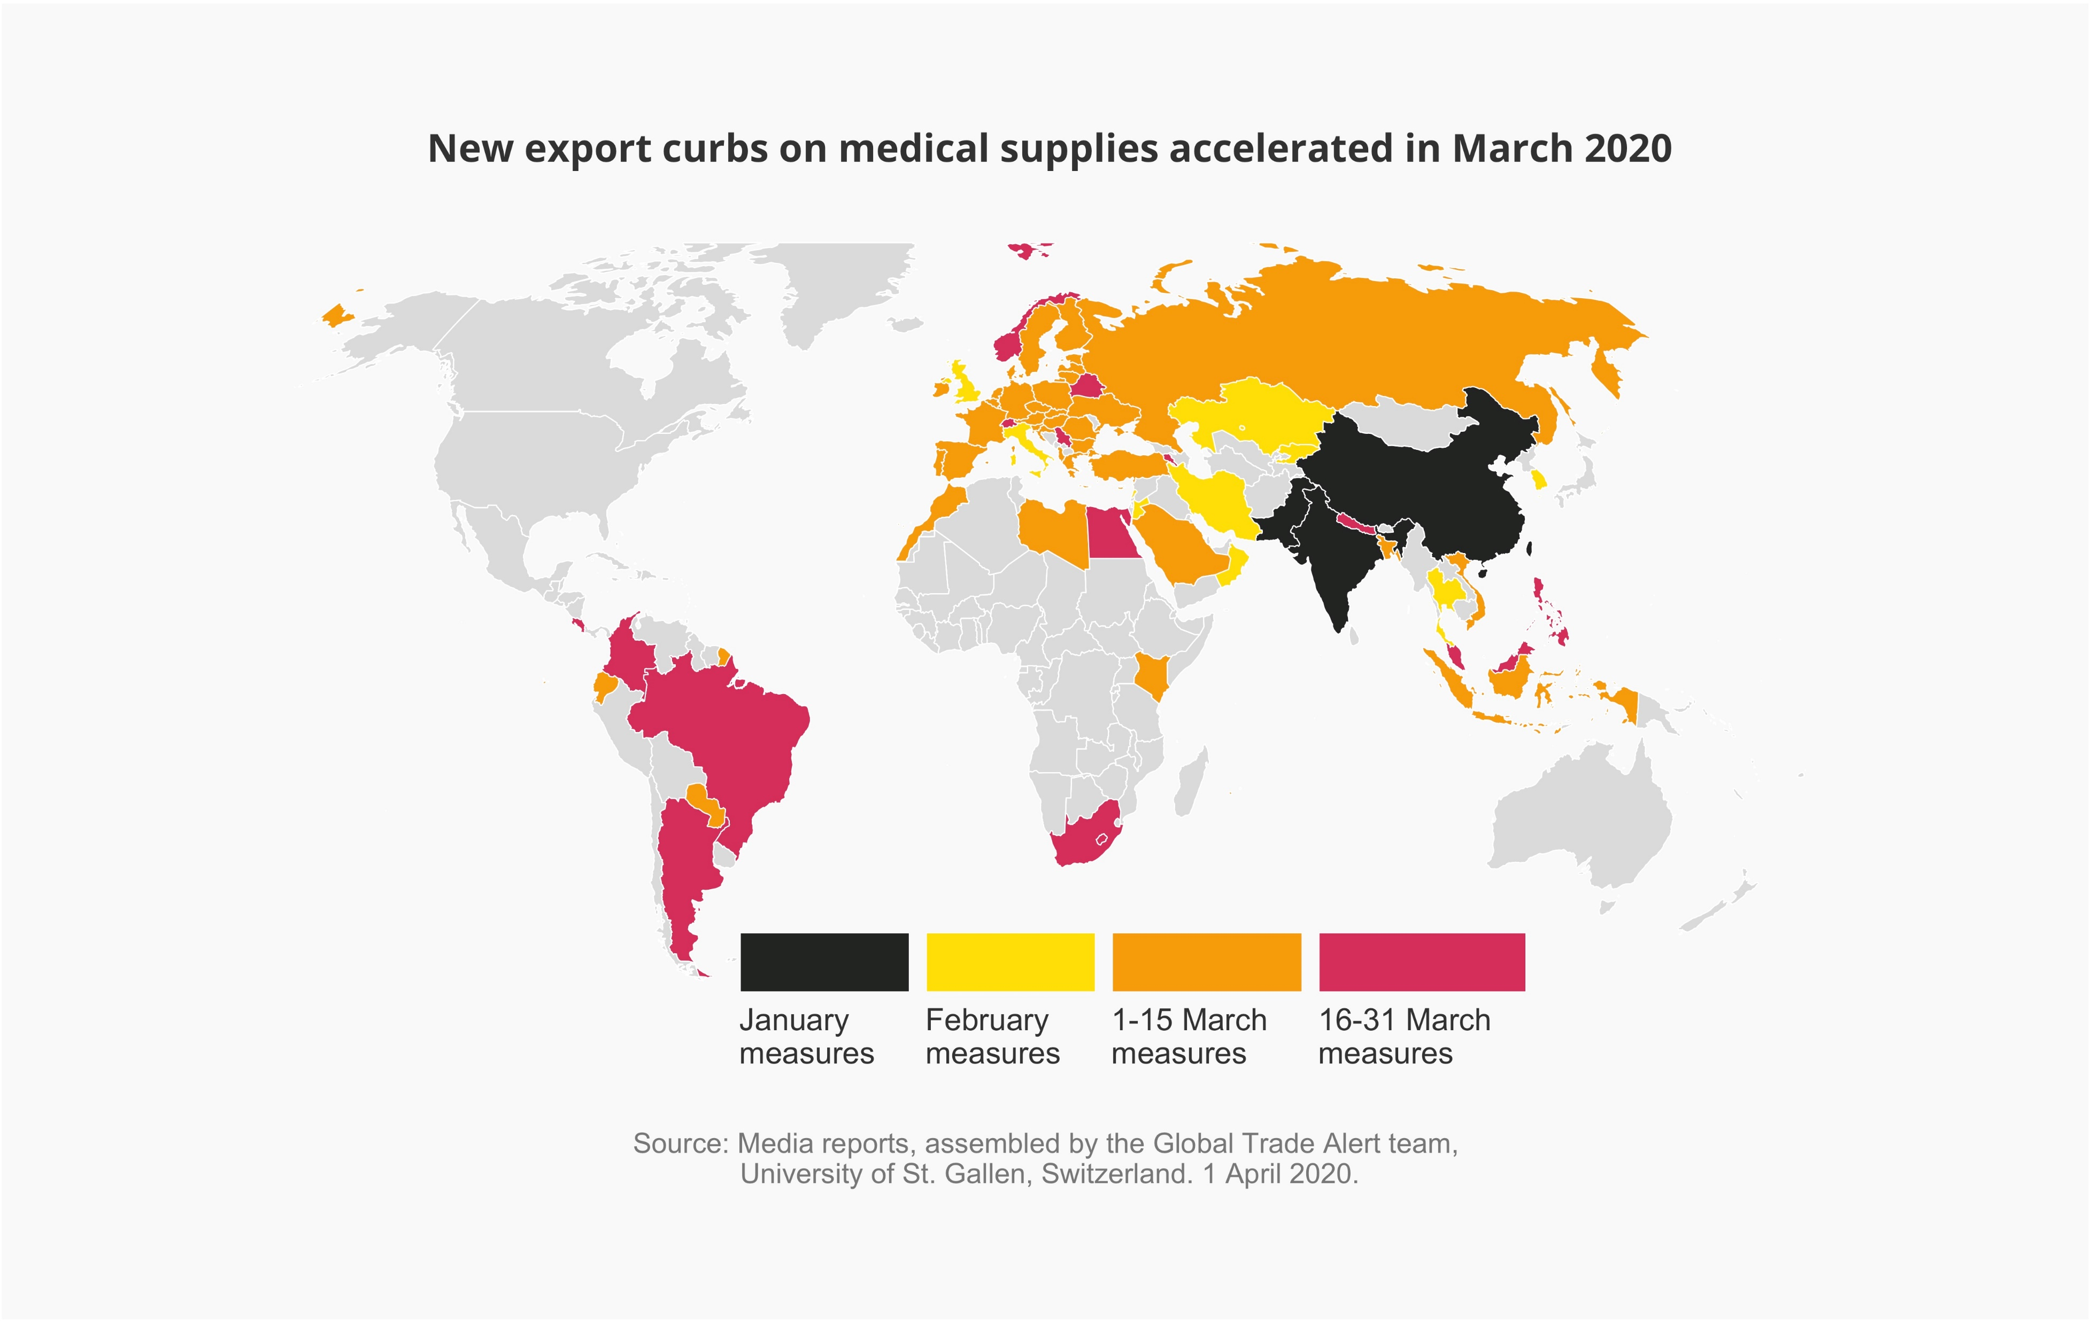
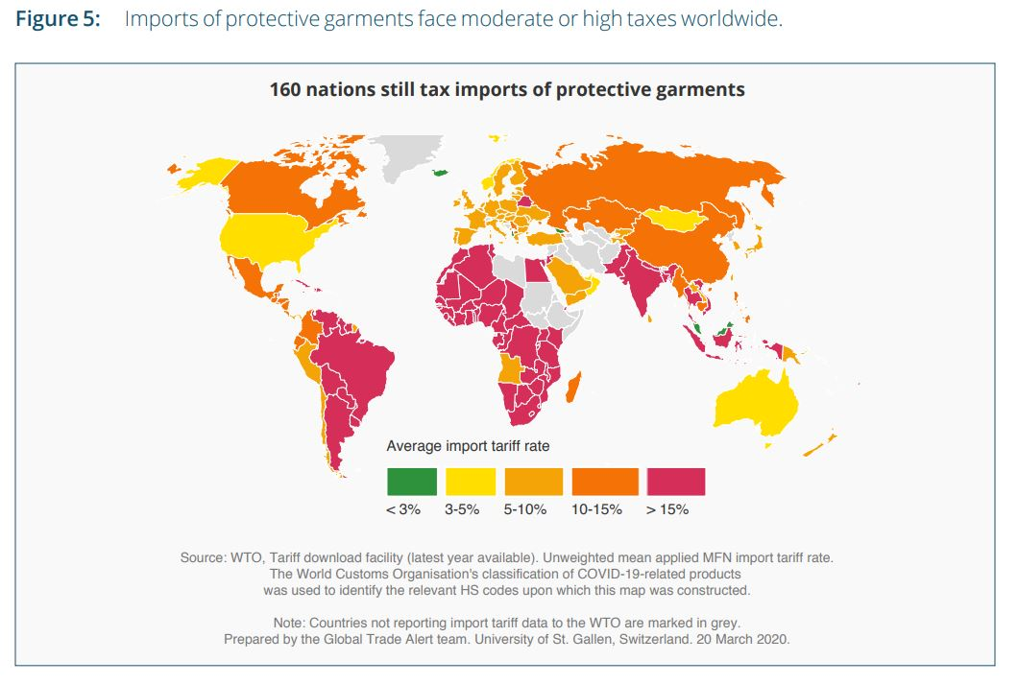
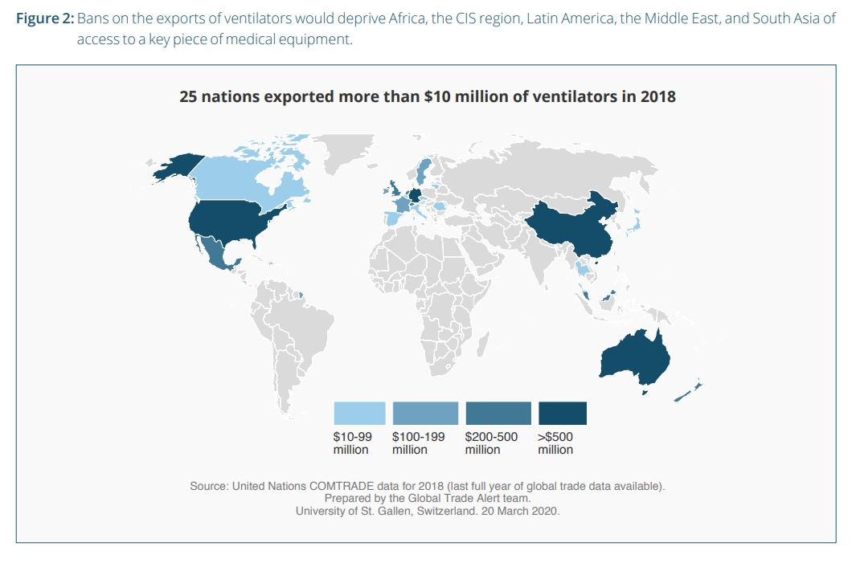
From Tackling COVID-19 Together

Slide 15
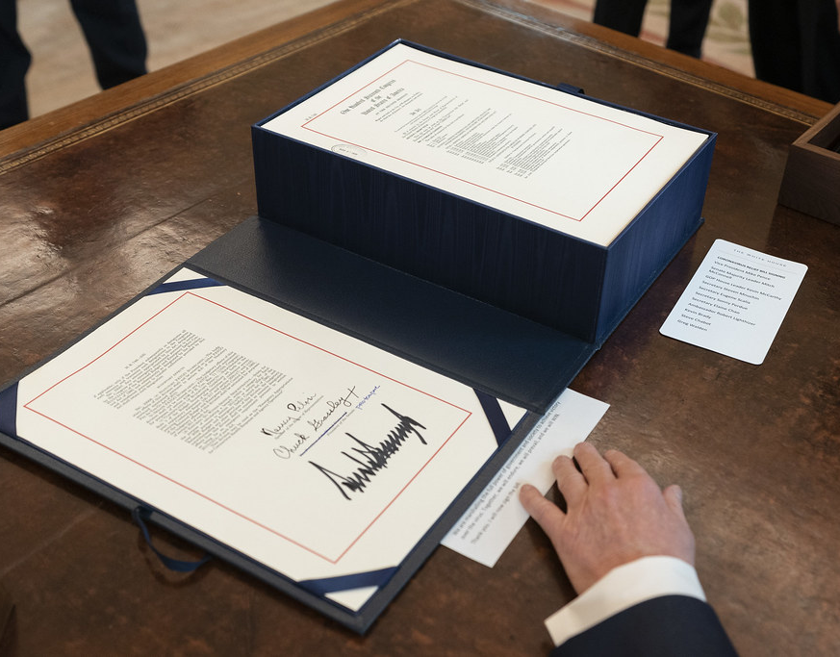
David Drabkin – United States
CARES Act, Section 3610 (Mar. 27, 2020)
Health measure / Fiscal stimulus / Maintaining contractor base -- contractors may be reimbursed for employees kept at home
Reimbursement by modifications to contracts
Implementation being developed by agencies

Slide 16
Question & Answers
Benedetta Audia (UNOPS)
Market conditions in UN procurement
Prices fluctuating – no fixed contract prices
Fulfillment uncertain – established relationships important
Vincent Moola (African Union (AU) – New Partnership for Africa’s Development (NEPAD)):
1. What immediate risks can we foresee along the supply chain systems globally that can hinder emergency supply and smooth flow of essential and critical COVID-19 Safety and Hygiene materials on-demand to most public and private hospitals worldwide, and what public procurement methodologies/approaches are likely to assist in a speed process towards COVID-19 mitigations?
2. What Trade Policy interventions can assist the smooth flow of supply chains from Tariff to Non-tariff barriers, etc., if supply chains will not be interrupted for the common fight and eradication of this pandemic?
Other questions from audience

Slide 17
Conclusion
A recording of this session will be posted at the program information page at publicprocurementinternational.com

