Slide 1
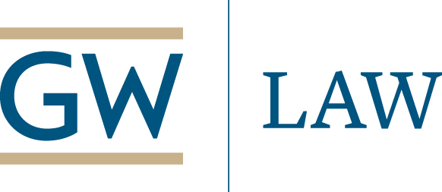
Fighting Fraud in COVID-19 Sourcing: What are the Tools? Will they work? Experts on Procurement – Fraud – Compliance – Data Analysis
Thursday, April 9, 9:00 ET/15:00 CET/21:00 CST
www.publicprocurementinternational.com

Slide 2
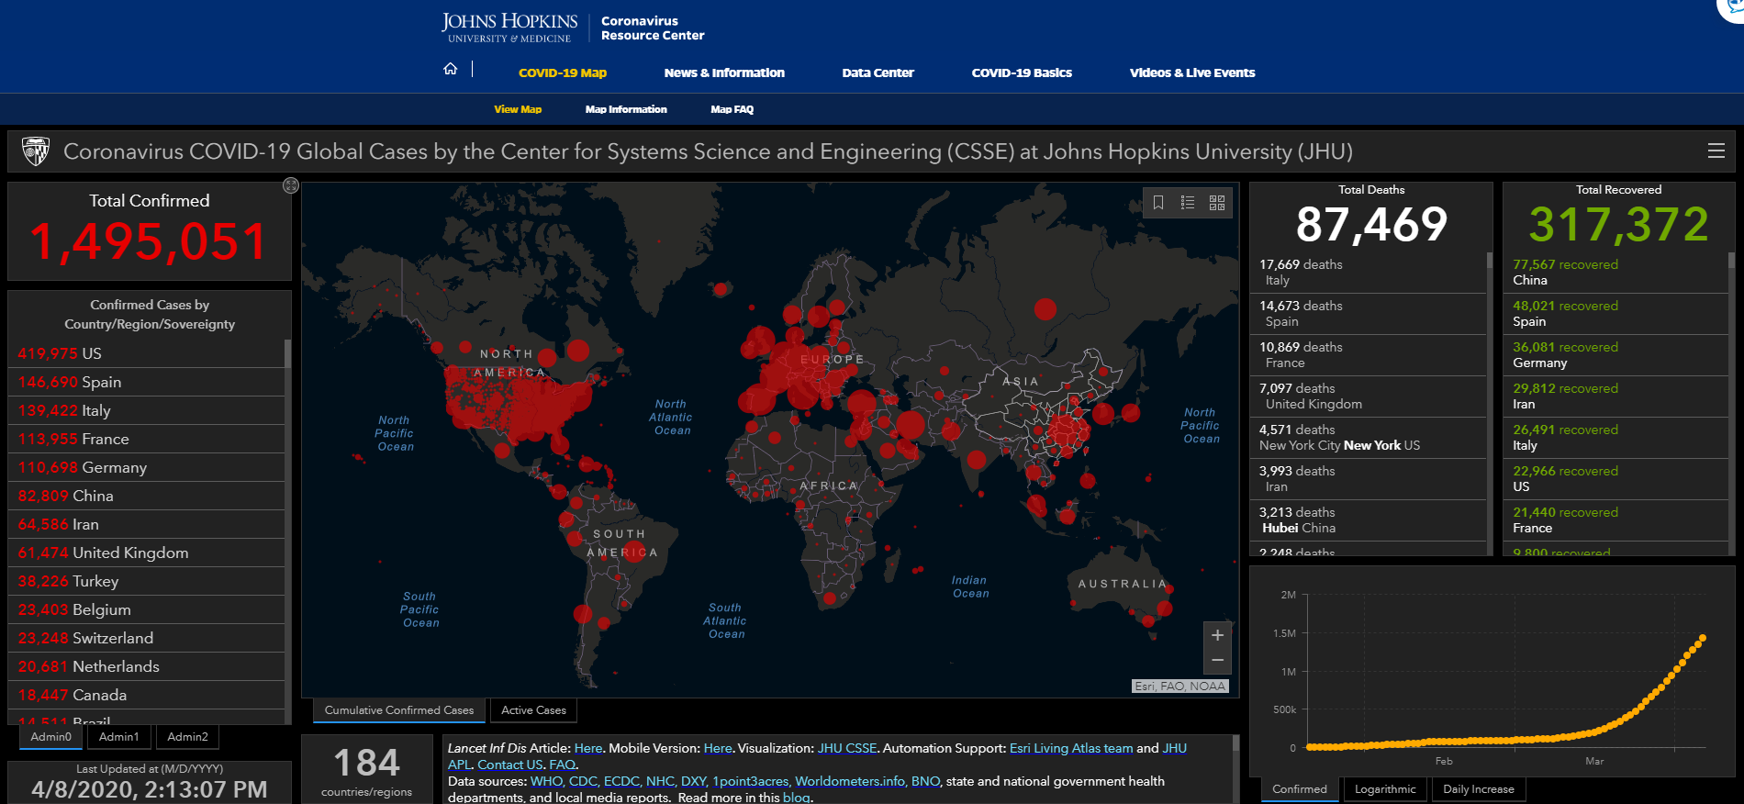

Slide 3
Agenda
Introductions
Panelists
Questions & Answers

Slide 4
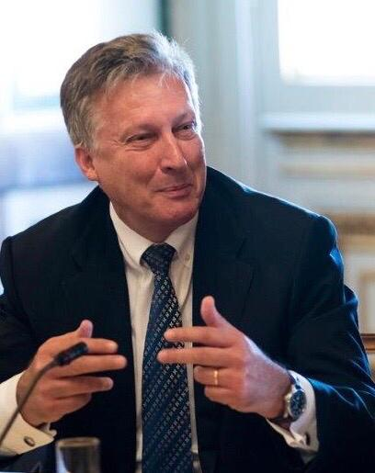
Thomas Stelzer Dean International Anti-Corruption Academy (IACA)

Slide 5
Introductions
Panelists
Michael Bowsher QC – Monckton Chambers / King’s College, London (London)
Thomas Hendrix – GW Law / Decisive Point (New York)
Aris Georgopoulos — University of Nottingham (United Kingdom)
Rocco Burdo, Head, Analysis and Research Section, Intelligence Office, Anti-Fraud and Controls Department, Customs and Monopolies Agency (Italy)
Jessica Tillipman — GW Law (Washington)
Mihály Fazekas – Central European University (Budapest) DIGIWIST Report
Paul Whittaker – OECD (Paris) OECD – Corruption in Procurement
Moderators: Christopher Yukins, GW Law School (Washington); Jean-Bernard Auby (Professor emeritus, Sciences Po Law School (Paris)); Gabriella Racca (University of Turin); Laurence Folliot Lalliot (University of Paris Nanterre (joining from Dakar))
:05
CHAT WILL BE OPEN – PLEASE DO NOT USE “Q&A” FUNCTION

Slide 6
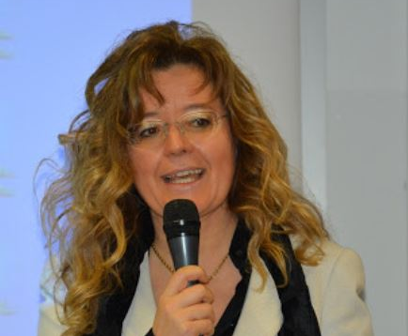
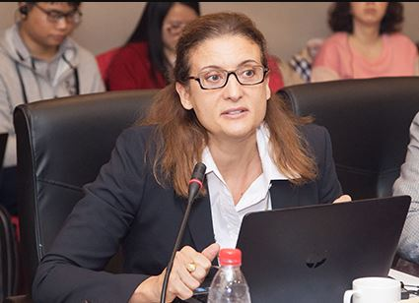
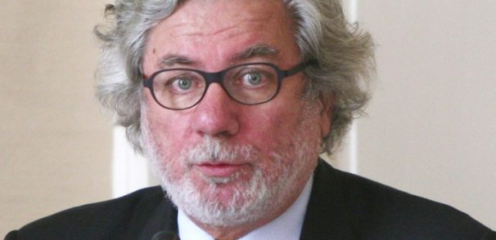
Co-Moderators
Jean-Bernard Auby (Professor emeritus, Sciences Po Law School (Paris))
Founder -- Network: Public Contracts in Legal Globalization (see Appendix)
Gabriella Racca (University of Turin)
Fraud and corruption as a violation of fundamental rights (right to life, to health)
Market intelligence and data analysis
Cooperation Strategies
Laurence Folliot Lalliot (University of Paris Nanterre (joining from Dakar))
:10

Slide 7
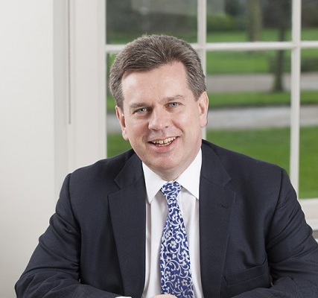
Michael Bowsher – Monckton Chambers / King’s College, London
Immediate Procurement Law Issues in Crisis
Quality and Transparency
What Sort of Market is this? Do our Current Laws Match the Realities of the Market?
Financial Issues Going Forward
Fraud, Subsidy and State Aid
Long Term Impact of the Crisis on Procurement Law
How will Events and Conduct in the Crisis affect Tendering in the Future?
:15

Slide 8
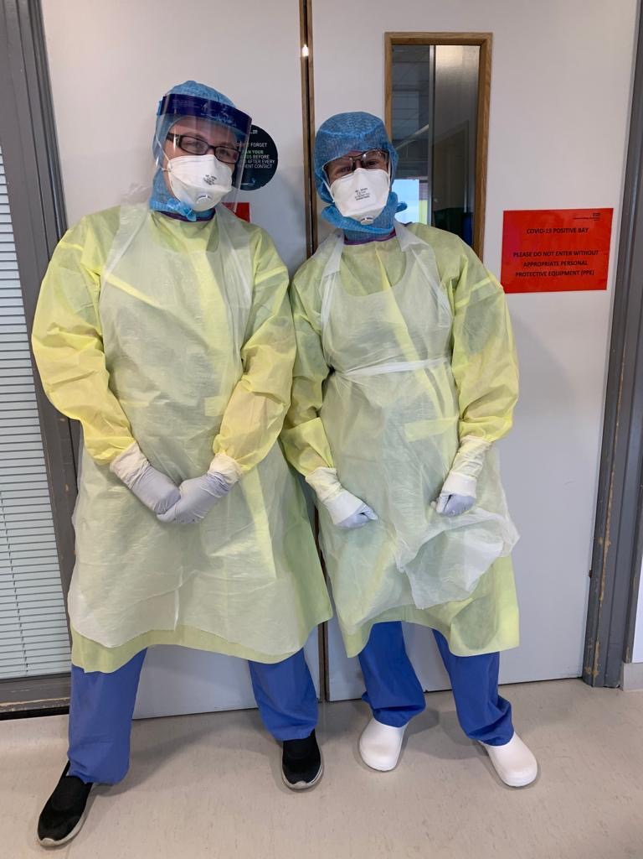
Grace and Courage

Slide 9
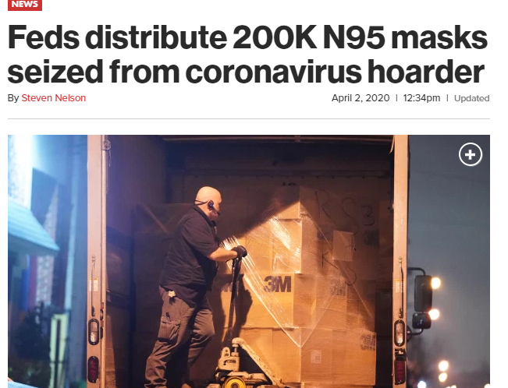
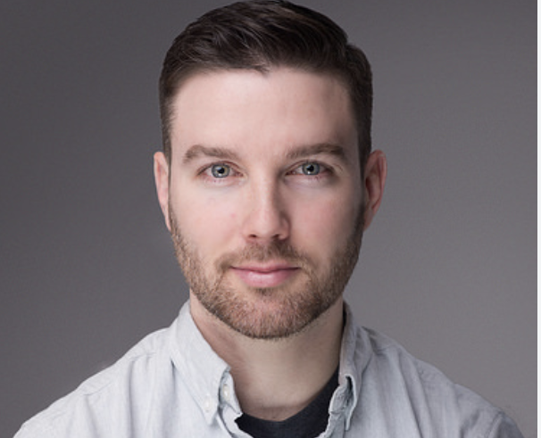
Thomas Hendrix – GW Law School – Decisive Point
Work on behalf of New York City in COVID-19 crisis
Fraud and Price Gouging in Market
See next slide
Assessing possible responses
Price constraints/enforcement?
Quality failures – fraud claims?
:20

Slide 10
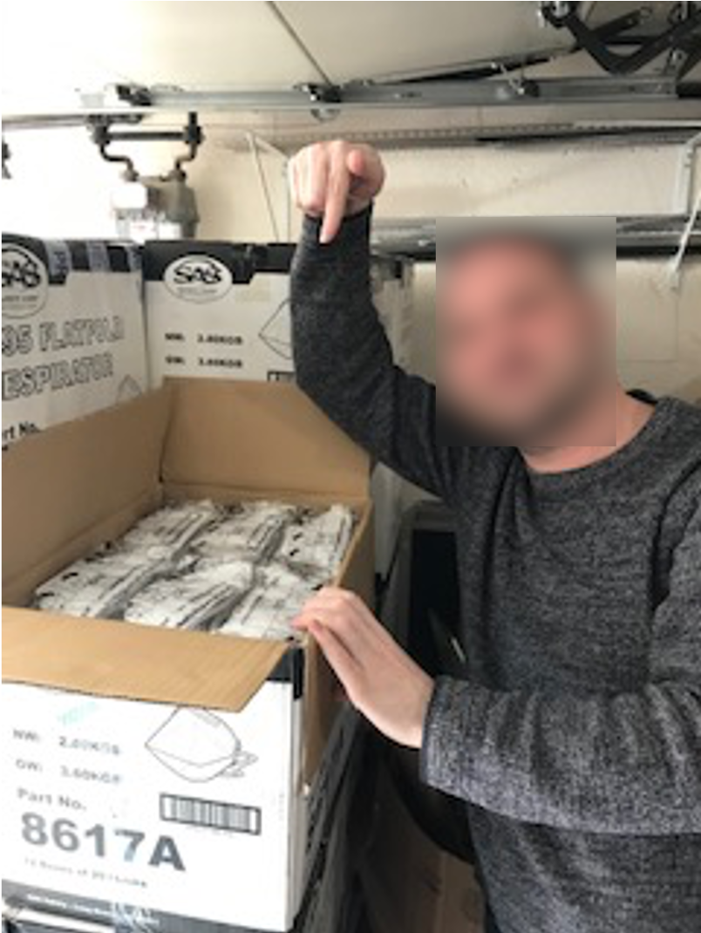
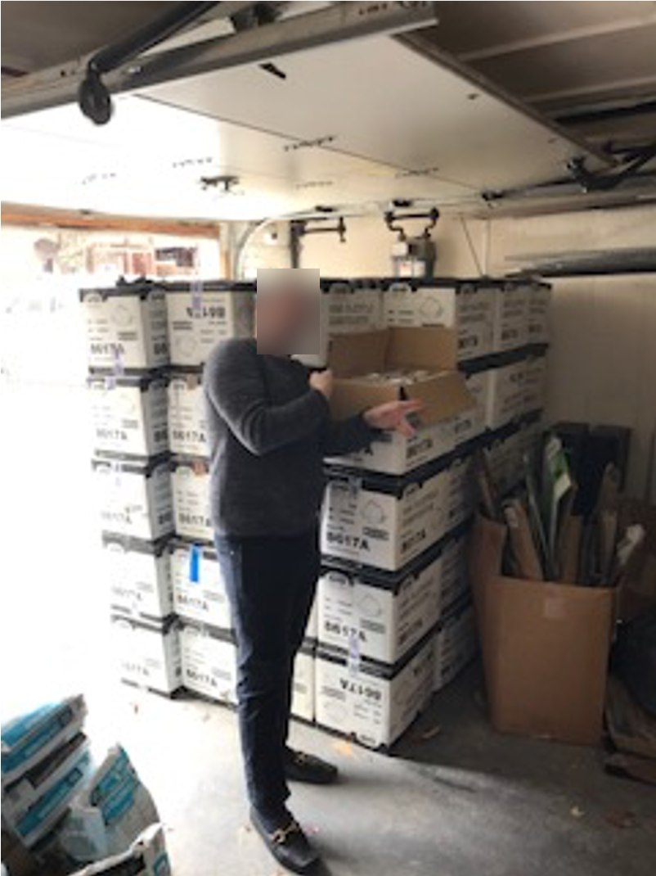
The Mask Guy

Slide 11
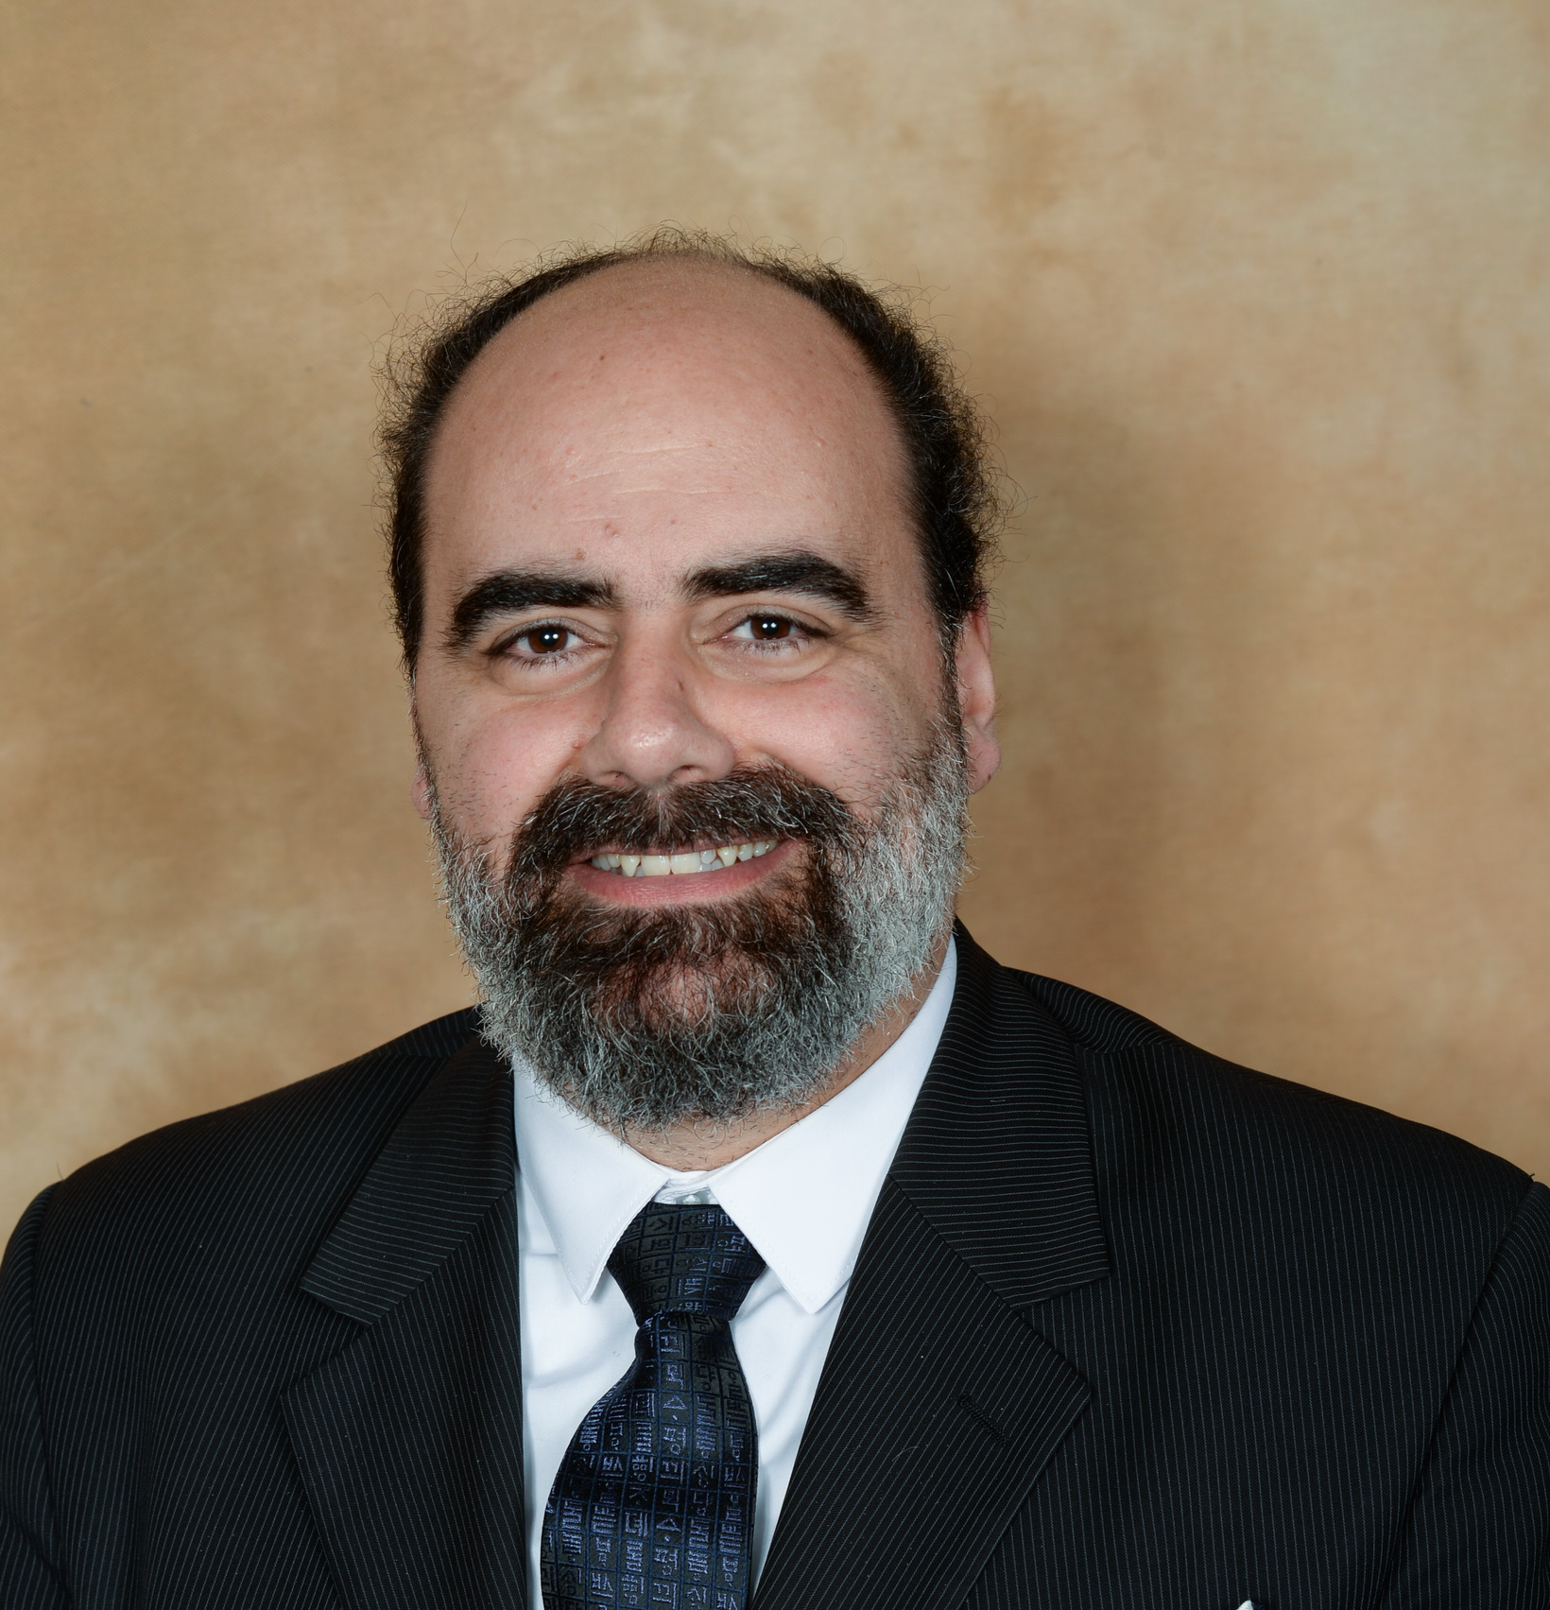
Aris Georgopoulos, University of Nottingham
Fraud and Corruption in Public Procurement – EU
Critical failures in COVID-19 procurement
Impact on government response
Potential impact on future EU rules
https://www.linkedin.com/in/aris-georgopoulos-25600a2/
aris.georgopoulos@nottingham.ac.uk
:25

Slide 12
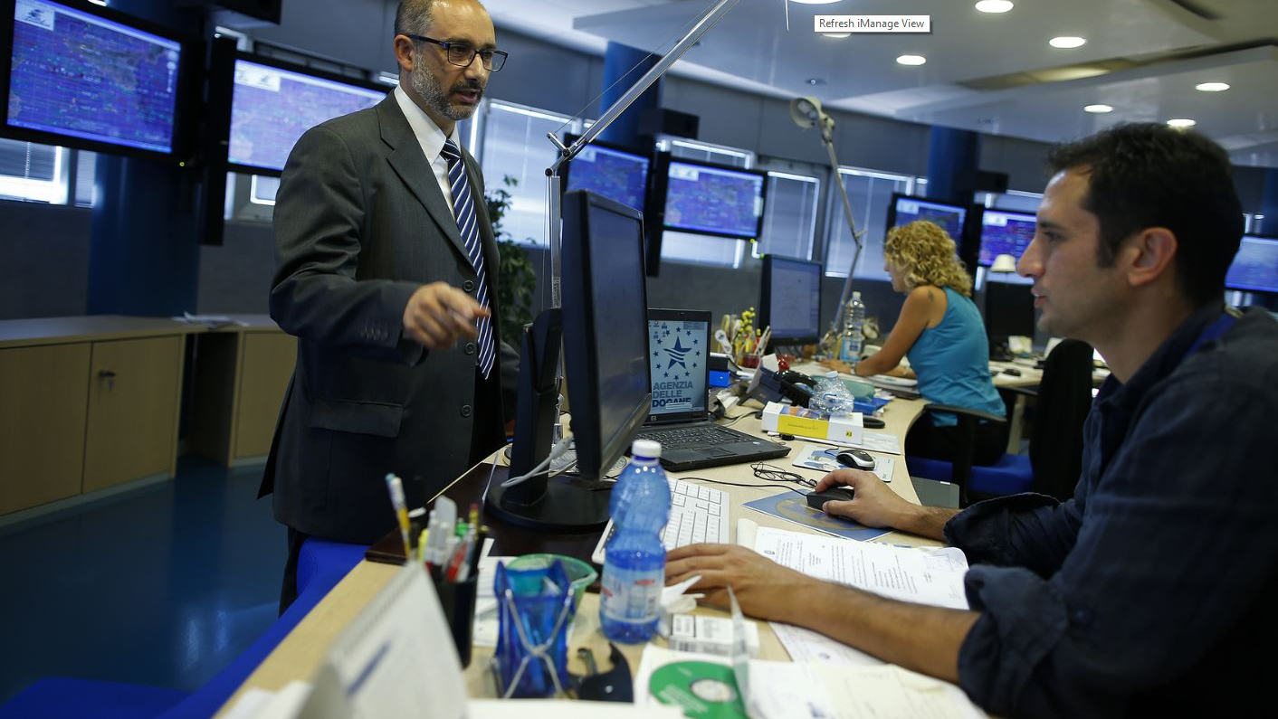
Dott. Rocco Antonio Burdo Customs and Monopolies Agency (Italy)
Comments by Gian Luigi Albano (CONSIP) (Rome)
:30

Slide 13
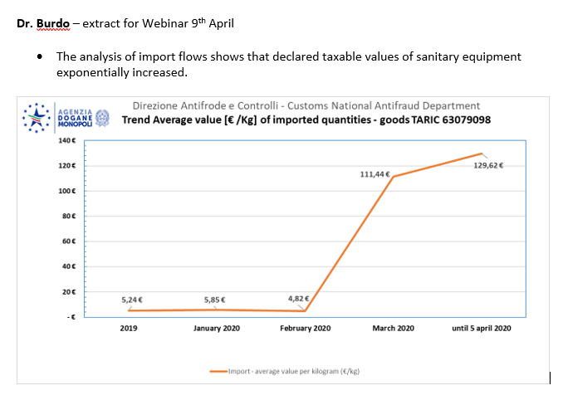
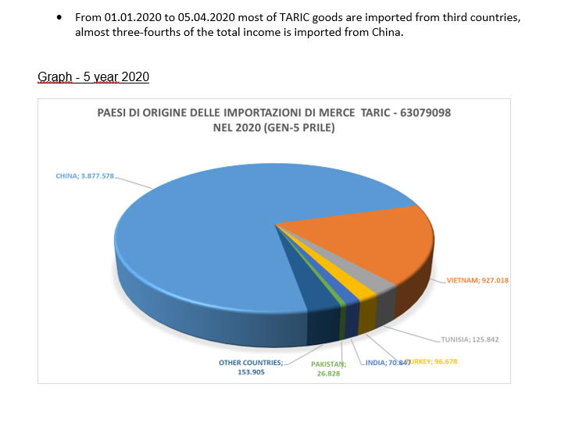
Data from Dr. Burdo

Slide 14
Analysis by Dr. Burdo
This shows the need to:
reconsider national and international security protection systems by means of more extensive risk criteria to detect threats;
define limits to the relocation of production and identify the economic sectors and products to be considered strategic stocks,
strengthened accountability of the main stakeholders and enterprises, especially in strategic sectors, by increasing the company's credibility / reputation and providing financial guarantees and precautionary disqualification measures ;
enhance transparency also at international level.
:30

Slide 15
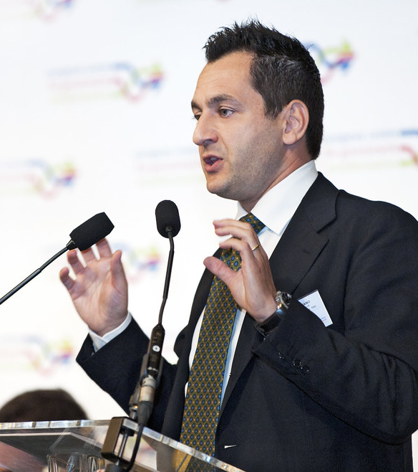
Additional Comments – Gian Luigi Albano
While the concept of “price gouging” remains a slippery one, simple logic would lead us to conclude that, under emergency circumstances, reducing the number of purchasing organizations might limit price spikes
Proper emergency procurement procedures, while taking a few hours more than sole-source award, still may limit the risk of frauds:
News #1 - Apr 9: Ongoing collaboration among Consip, the Customs Agency and the Police Force for financial Crimes (Guardia di Finanza) has led to the arrest of an Italian citizen who had created “puppet companies” which participated in two of Consip emergency procedures;
News #2 – Apr 9: An Italian Public Local Entity (of great relevance) had decided to purchase millions of protective masks directly from a broker. After receiving a 30% advance payment, namely Euro 11 million, the broker is reported to have disappeard. The masks will never be dispateched.
The only reasonable alternative or a complementary tool to proper emergency procurement or is home production, that is, autarky
:30

Slide 16
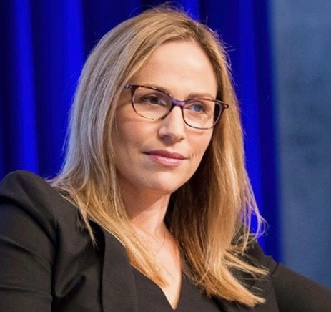
COVID-19 Fraud & Corruption: A U.S. Perspective
Investigations
Department of Justice
Congressional
Inspectors General
Criminal/Civil Statutes
False Claims Act
Anti-Corruption
Antitrust
Compliance Obligations
Mandatory Disclosure
Jessica Tillipman – GW Law School
:35

Slide 17
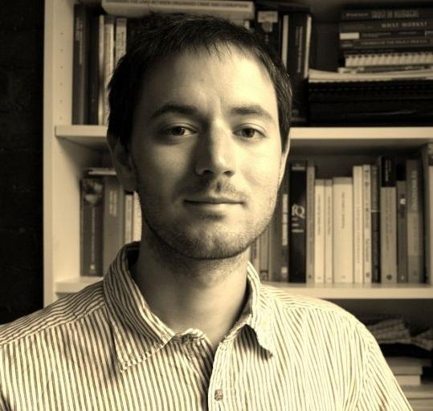
Mihály Fazekas – Central European University (Budapest)
How data analysis can be used to discern price and quality fraud/corruption in the chaos of COVID-19 procurement
What data should agencies be accumulating
:40

Slide 18
Indicators of corruption risk in the time of pandemic
Some of the widely used corruption proxies are of limited use in the COVID-19 chaos
Single bidding
Non-open procedures (e.g. direct awards)
Short advertisement periods
Instead, we should be looking at other indicators
Supplier history: do we see odd companies showing up, e.g. Dyson producing ventilators in the UK
Lax application of emergency rules: buying luxury ministry cars using COVID-19 emergency rules
Getting better data on production costs and retail prices (e.g. the Greek competition authority is doing just that using a company survey)
Getting better data on quality (e.g. through user surveys)
Ascertaining quantity of demand: are needs overstated to extract corrupt rents?
:40

Slide 19
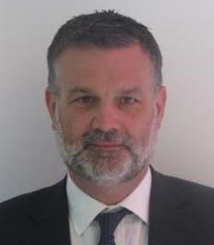
Paul Whittaker – Organization for Economic Cooperation & Development (OECD) (Paris)
OECD's role in fighting corruption worldwide
Types of corruption emerging in COVID-19
Potential long-term implications for the international community
http://www.oecd.org/corruption-integrity/
:45

Slide 20
Questions and Answers Program recording on www.publicprocurementinternational.com

Slide 21
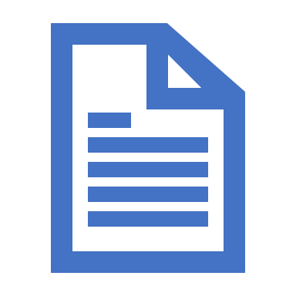
Appendix
Network: Public Contracts in Legal Globalization
COVID-19 Resources

Slide 22
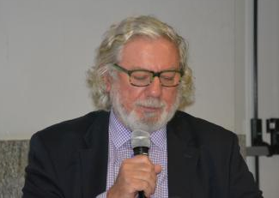
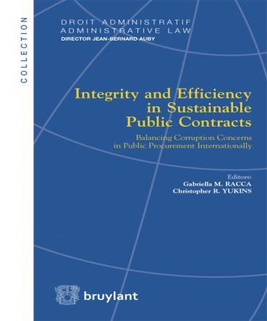
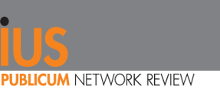
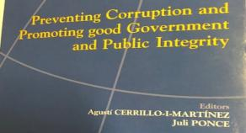
JEAN-BERNARD AUBY– EMERITUS PROFESSOR SCIENCES PO – PARIS
Building networks…
www.ius-publicum.com
www.gwu.edu/
www.public-contracts.net/inhalte/home.asp
https://publicprocurementinternational.com

Slide 23
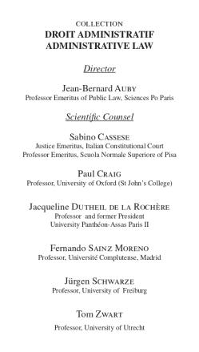
The Administrative Law series is composed 0f …
27 volumes
G.M. Racca, C.R. Yukins (eds. By), Joint Public Procurement and Innovation: Lessons Across Borders, Bruylant, 2019
Joint Public Procurement
and Innovation:
Lessons Across Borders
G.M. Racca, C.R. Yukins (eds. By), Integrity and Efficiency in Sustainable Public Contracts. Balancing Corruption Concerns in Public Procurement Internationally, Bruylant, 2014

Slide 24
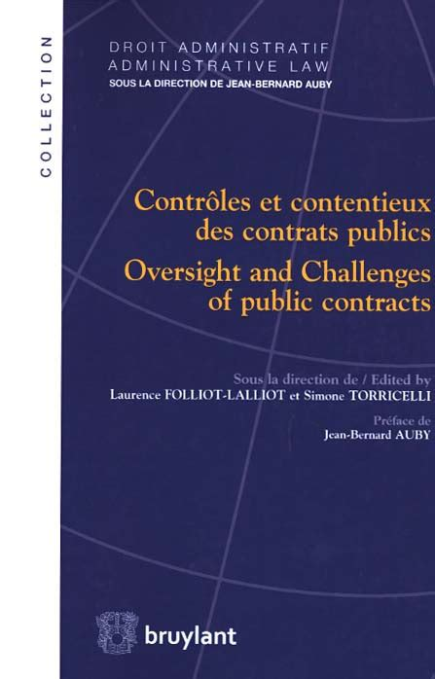

Slide 25
