Slide 1
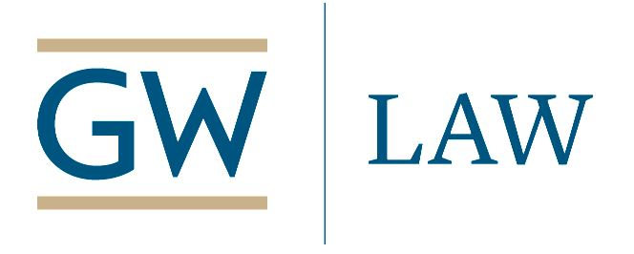
Government Contracting and COVID-19: Emerging Issues
Webinar – Thursday, April 23, 2020 – 9 am Pacific – 12 noon Eastern
Register: https://zoom.us/webinar/register/WN_hXhVVfHKSq2VykyQkkSqww
Info: https://publicprocurementinternational.com/2020/04/12/government-contracting-and-covid-19-nba-april-23-2020/

Slide 2
Disclaimer
The information presented may constitute lawyer advertising and should not be the basis of the selection of legal counsel.
Information provided on this webinar is believed to be accurate and correct as of today. The presentations by participating lawyers do not constitute legal advice. The facts of any particular circumstance determine the basis for appropriate legal advice, and no reliance should be made on the applicability of the information provided to any particular factual circumstance. No attorney-client relationship is established or recognized through your participation in this event. The presenters disclaim all liability for any errors or omissions and note that the information shared is being provided “as-is” without warranties of any kind either express or implied.

Slide 3
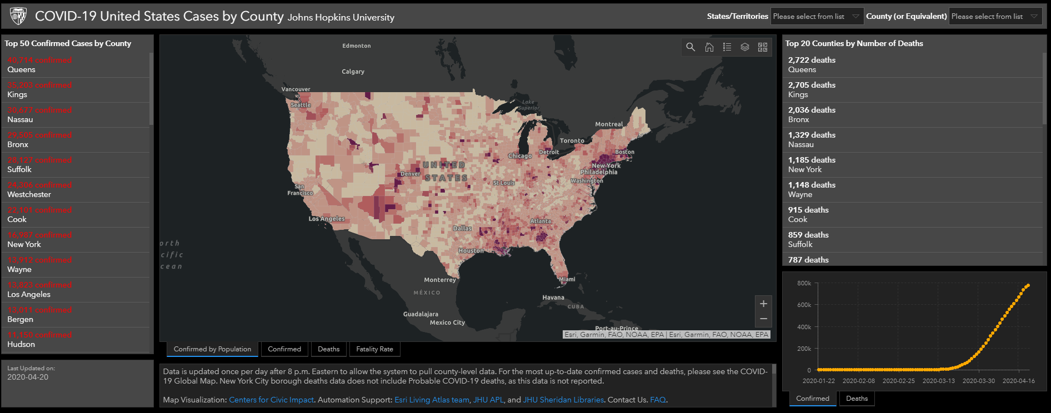

Slide 4
Agenda
Introductions
Presentations
Questions & Answers
Please use “Chat” (not “Q&A”) for questions and discussion
:02

Slide 5
Welcome National Bar Association President / Associate Dean, GW Law School Alfreda Robinson
:03

Slide 6
Panelists
Michelle Coleman, Counsel, Crowell & Moring
Liza Craig, Counsel, Reed Smith
Dominique Casimir, Partner, Blank Rome LLP
Judge Jeri Somers, Chair, US Civilian Board of Contract Appeals
Michael Bennett, Evans & Chambers Technology, LLC; Chair, DC Board of Elections
Danielle Conway, Dean, Penn State Dickinson Law
Moderators: Alfreda Robinson & Chris Yukins (GW Law)
:05

Slide 7
Michelle Coleman, Counsel, Crowell & Moring
Contractors Addressing COVID-19
Disaster Preparedness Plan
Performance Interruptions
Adjust and Innovate
CARES Act Section 3610 Contractor Support
Statute
DoD Guidance
OMB Memorandum
Biography: https://www.crowell.com/professionals/Michelle-Coleman
COVID-19 Preparedness Toolkit: https://www.crowell.com/NewsEvents/AlertsNewsletters/all/The-Government-Contractor-Coronavirus-COVID-19-Preparedness-Toolkit
Crowell & Moring’s Coronavirus Resource Center: https://www.crowell.com/Practices/Coronavirus-COVID-19-Resource-Center
::15

Slide 8
Liza Craig, Counsel, Reed Smith
CARES Act – relief beyond Section 3610
“Paycheck Protection” – eligibility - funding
Defense Production Act
History / Purpose
“Rated” Orders
Impact on COVID-19 Supply Chain
Further info:
Liza Craig’s Bio
Reed Smith’s Coronavirus (COVID-19) Resource Center
Reed Smith’s CARES Act Resource Center
:25

Slide 9
Dominique Casimir, Partner, Blank Rome LLP
Attorney General’s Memorandum – Prioritizing COVID-19 Enforcement (March 16, 2020)
Contractors should:
Assume costs will be questioned and proceed accordingly
Designate a Primary Point of Contact
Consider the Impact of Future IT Migrations and Personnel Departures
Create a File of Potentially Helpful Documents
Reinforce the Imperative of Compliance to Your Workforce
Further info: Dominique’s biography, “Tips to Mitigate Future COVID-Funding Enforcement Risks” (Law 360), Government Contracts Navigator Blog: COVID-19 and CARES Act, Blank Rome COVID-19 Task Force.
:35

Slide 10
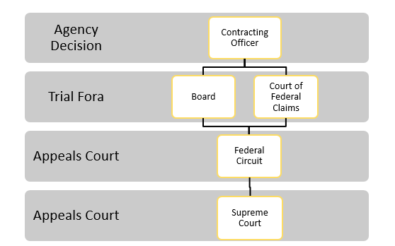
Judge Jeri Somers – Chair, Civilian Board of Contract Appeals
U.S. Federal Contracts
Disputes Structure
COVID-19 Claims
:45

Slide 11
Dean Danielle Conway, Penn State Dickinson Law
Michael Bennett, Evans & Chambers Technology, LLC; Chair, DC Board of Elections

Slide 12
Questions & Discussion
How is COVID-19 impacting American business?
Where is further funding needed?
How can we better prepare for the future?
Audience question: This relates to the Public Readiness and Emergency Preparedness (PREP) Act, which the U.S. Department of Health and Human Services (HHS) invoked last month in response to COVID-19. The Declaration HHS issued to invoke the Act provides immunity from certain federal and state law claims to “covered” government contractors that provide certain “covered countermeasures” to combat COVID-19 (such as antivirals and other drugs or devices used to mitigate the virus). Last week, however, HHS issued an advisory opinion indicating that even if a product is not a “covered countermeasure” it is enough (in HHS’s opinion) that the covered contractor providing the product “reasonably could have believed” the product was “covered” in order to take advantage of the immunity provided under the PREP Act. Question: Does the advisory opinion’s broad interpretation of what constitutes a “covered countermeasure” have any implications under the False Claims Act or in the civil litigation context that government contractors should be mindful of?
Kendra Perkins Norwood, Wiley

Slide 13
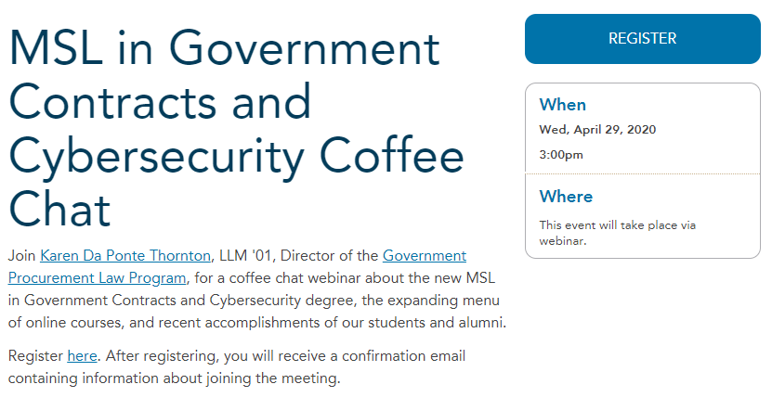
Next National Bar Association/GW Law Program on Government Contracts and COVID-19: May 6, 2020, Noon ET
https://www.law.gwu.edu/msl-government-contracts-and-cybersecurity-coffee-chat

Slide 14
Conclusion
Materials and a recording of this program will be posted on www.publicprocurementinternational.com

