Slide 1
Protectionism in the Pandemic
Tuesday, April 21, 9:00 ET/15:00 CET/21:00 CST
www.publicprocurementinternational.com

Slide 2
Agenda
Status of the Pandemic
Introductions
Presentations
Questions & Answers
:02

Slide 3
Introductions
Simon Evenett, University of St Gallen (Switzerland)
Robert Anderson, Hon. Professor, U. Nottingham (WTO-retired)
Jean Heilman Grier, Djaghe Consulting (Washington DC)
Tom McSorley, Arnold & Porter (Washington DC)
Zornitsa Kutlina-Dimitrova, European Union – DG for Trade
:03

Slide 4
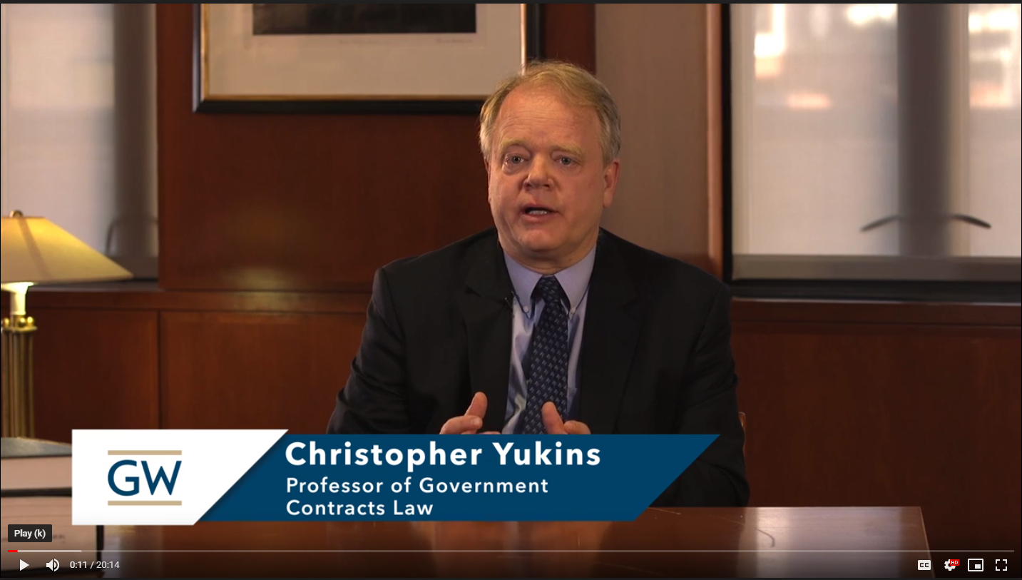
Moderators
Laurence Folliot Lalliot (University of Paris Nanterre (joining from Dakar))
Vanessa Sciarra, National Foreign Trade Council
Christopher Yukins, GW Law School
:04

Slide 5
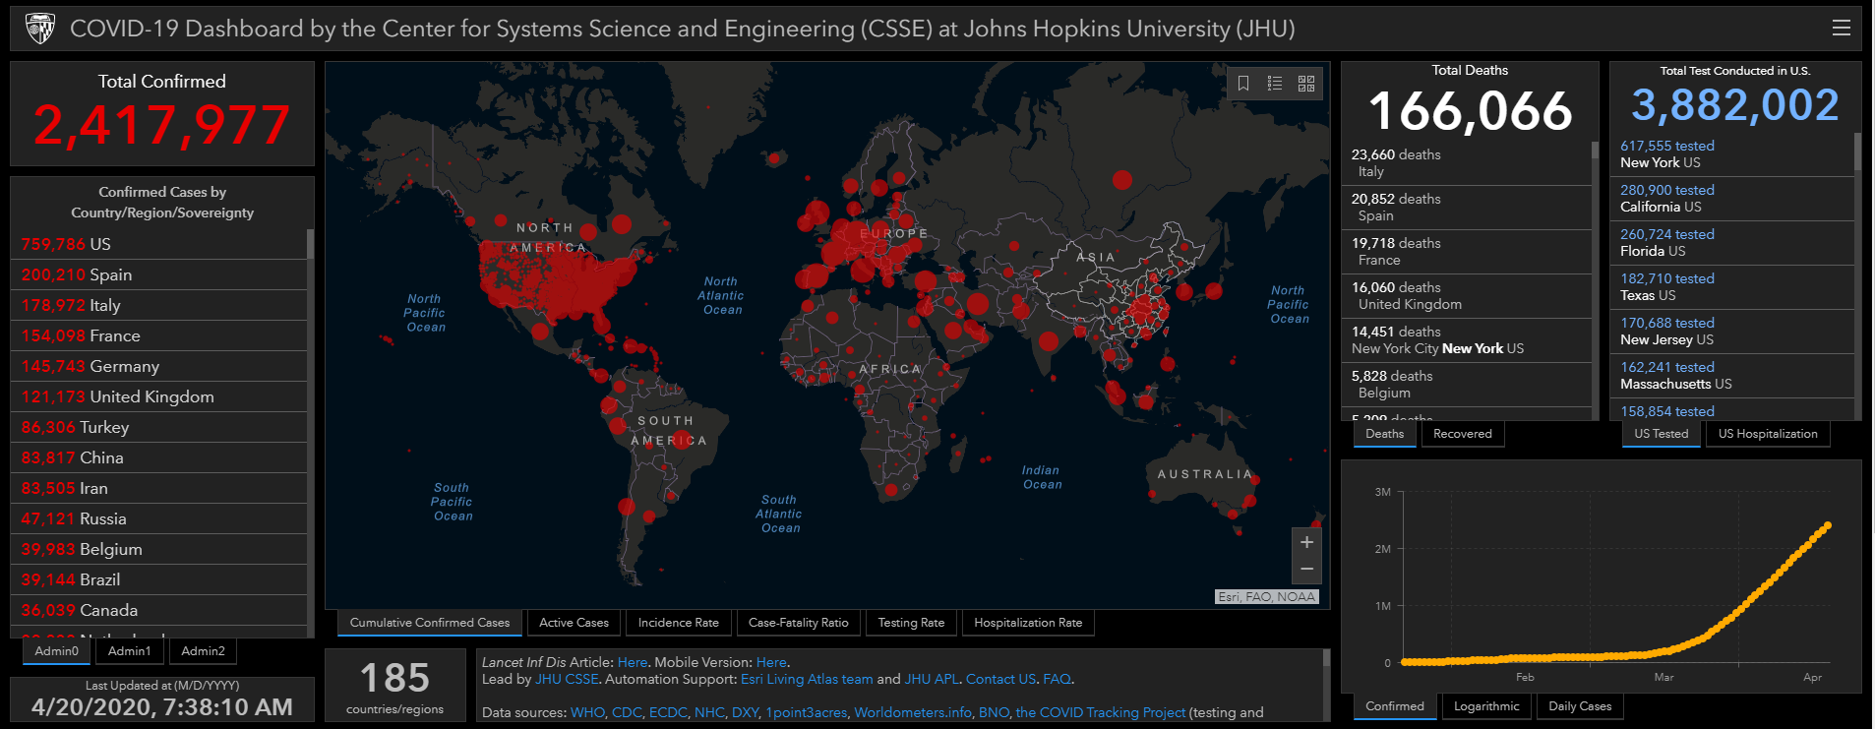

Slide 6
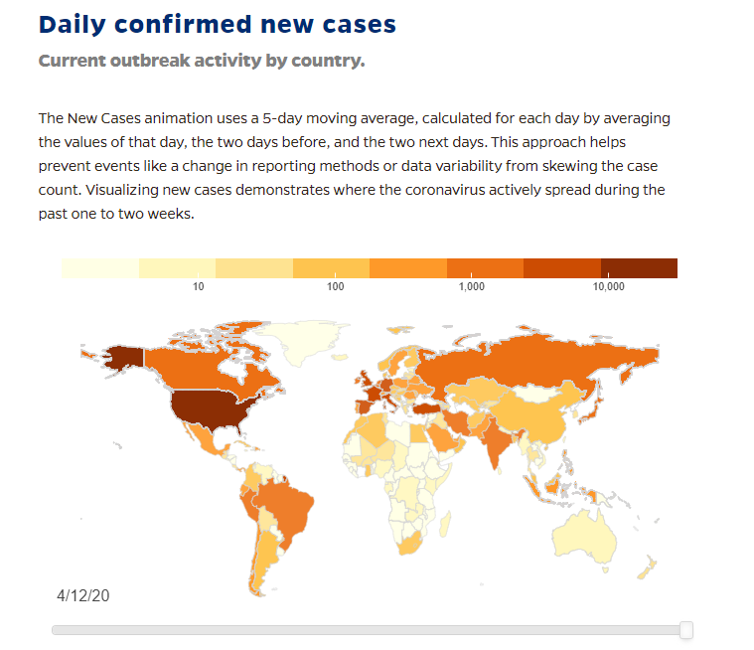

Slide 7
Laurence Folliot Lalliot: Impact of trade restrictions in Africa
A multi-layered crisis:
Health Crisis: Dr. Mukhisa Kituyi, Secretary-General of UNCTAD, called for a health “Marshall Plan” for Africa
African countries are under-equipped, heavily dependent on imported medicines (94%), and overtaken by the biggest buyers in the international competition for medical supplies
This is amplified by the tariff policies in place in many African countries
Food Crisis: price surges, export bans or revenue loss can all have grave consequences on food distribution
Security Crisis? Spread of the COVID-19 disease, extreme poverty of populations without social safety nets, facing complete shutdowns, are likely to lead quickly to violent turmoil in fragile political situations
:08

Slide 8
Simon Evenett University of St Gallen (Switzerland)
115 export curbs on medical supplies and medicines have been introduced this year by 75 governments.
79 governments have liberalized their import regimes with respect to medical supplies and medicines.
Approximately 25 governments have imposed export curbs on food.
Worldwide the number of tariff increases this year is sharply down on last year (which was a dreadful year in this respect.)
Additional information: https://www.globaltradealert.org/reports
:16

Slide 9
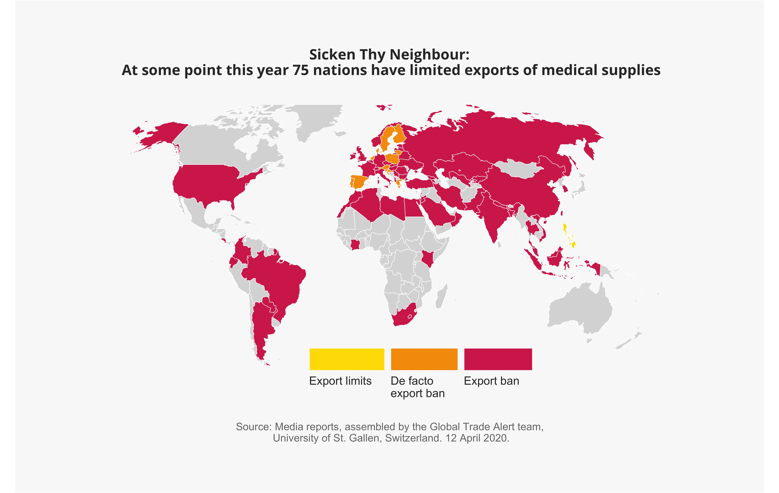
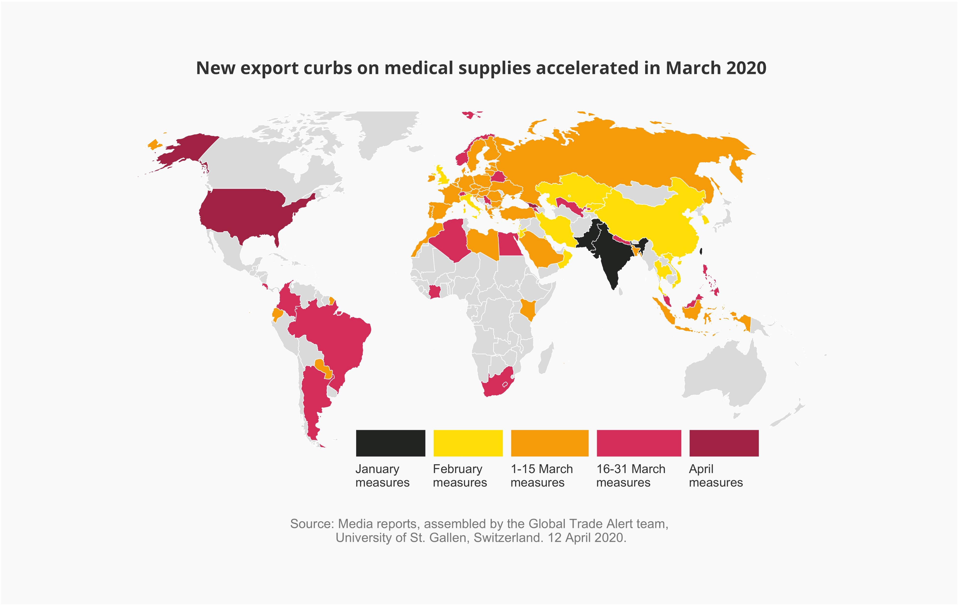

Slide 10
Robert Anderson – Hon. Professor, University of Nottingham (WTO-ret.)
The GPA’s application to and coverage of COVID-related goods and services and why this is important;
The “flexibilities” available to the GPA Parties in responding to the pandemic, including the general exception for the protection of human life and health; and
The general importance of existing trade liberalization arrangements and the futility and counter-productivity of trade restrictions in the time of COVID-19.
:24

Slide 11
Jean Heilman Grier, Djaghe Consulting (Washington DC)
U.S. restrictions on foreign sourcing under Trade Agreements Act and Buy American Act.
Temporary waiver of restrictions on purchases of N95 masks, hand sanitizers and several other products.
Pressure to expand Buy American restrictions to medical and pharmaceutical products with proposed executive order.
Potential withdrawal of U.S. from WTO procurement agreement.
Additional information: https://trade.djaghe.com
:32

Slide 12
Tom McSorley, Arnold & Porter (Washington DC)
U.S. export control regime
Special export controls for sanctioned nations, e.g., Iran and Syria
Humanitarian exceptions
Defense Production Act (DPA) – “rated” and “allocation” orders
Use of authority to curb U.S. exports of Personal Protective Equipment (PPE)
Implementation and exceptions
Impact of U.S. export controls on global medical supply chains
Further information: https://www.arnoldporter.com/en/people/m/mcsorley-tom
:25
:40

Slide 13
Zornitsa Kutlina-Dimitrova European Commission, DG TRADE
Protectionism in government procurement has been on the rise and the situation has worsened in the times of the COVID-19 crisis.
Recent economic research shows that there are sizeable economic benefits to be reaped from extending the scope and coverage of the GPA and/or removing buy-local restrictions in domestic markets.
Evidence-based assessment of protectionist measures requires government procurement data that covers all procurement modes of foreign suppliers participation in international procurement markets.
Building a global public procurement database:
First attempt to create a database combining both public procurement flows data covering government procurement barriers and the three procurement modalities:
Direct cross-border sales
Sales through local subsidiaries, and
Value-added along the supply chain of procurement
Challenging undertaking as there is a severe lack of data on both the flows and barriers side, let alone a combination of those.
Joint effort at national and international levels is required to fill-in this crucial gap.
:48

Slide 14
Questions & Discussion
Do existing import and export restraints take into account impacts on public health, both domestically and globally?
How might international agreements or institutions help?
Other audience questions

Slide 15
Conclusion
Program materials (including the program recording) will be posted at www.publicprocurementinternational.com

