Slide 1
Accelerating Innovation by Prioritizing Procurement
April 2020
Thomas Hendrix

Slide 2
Intro
Accelerating innovation by prioritizing procurement from the start.
It is not easy for new technologies to scale in sectors that are deeply entrenched in government bureaucracy. Unfamiliar laws and regulations, inefficient processes, and byzantine organizational structures can make working with the government difficult; however, success in the federal market unlocks massive opportunity and defendable lines of revenue.
While there are a number of ongoing efforts to modernize the Department of Defense and its various components, increased speed to contract award has not effectively translated into transition from R&D to procurement and adoption as part of larger programs of record. Often times, these larger programs are difficult for emerging technology companies to access because their technology has not fully matured to a level where it can be successfully integrated.
In order to effectively achieve adoption and scale within the government, innovation opportunities like Small Business Innovation and Research (SBIR) contracts should be aligned with programs of record earlier in the acquisition lifecycle.

Slide 3
Overview
Accelerating innovation through procurement reform.
To keep pace with a rapidly changing world, the United States must seek out the most innovative technology solutions to solve our biggest national challenges and seek diversified supply chains to keep up and defend against the threat of near peer adversaries. For early stage companies, successfully navigating the federal acquisitions process can provide non-dilutive R&D funding, early sales channels, and defendable markets.
The Department of Defense captures over 44% of the US Government’s R&D budget. With much of those funds going to a handful of large prime contractors. However, the traditional defense industrial bases alone cannot keep pace with the R&D investment of the commercial market. The US Government must look to emerging technology companies for the next generation of capabilities.

Slide 4
Private Sector R&D Spending
The USG cannot keep pace with technology by relying on the traditional defense industrial base alone.
Source: Statista.com

Slide 5
The Need for Innovation
Finding a way to reach non-traditional defense contractors.
To meet the need for greater exposure to the many innovative commercial technology companies springing up across the country, the Department of Defense has sought to find ways to reach this non-traditional market, resorting to procurement through non-traditional means like Other Transactions, a contract type that is commercial in nature and is not governed by Federal Acquisition Regulations. These tools did not solve the broader, institutional frictions that inherently cause the government to move slowly and resist change.
The Department of Defense began to establish organizations specifically designed to work with non-traditional contractors and startups. But, in doing so, it may have conflated the need to modernize with the need for more innovation, unleashing a dizzying array of innovation outfits throughout the various services. However, the landscape is fractured, and few companies or technologies are able to successfully gain the required traction to transition from R&D efforts to meaningful procurement.

Slide 6
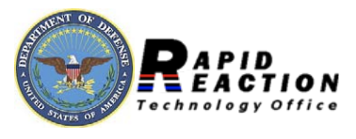
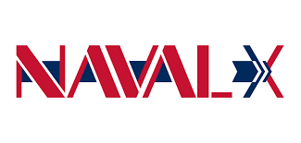
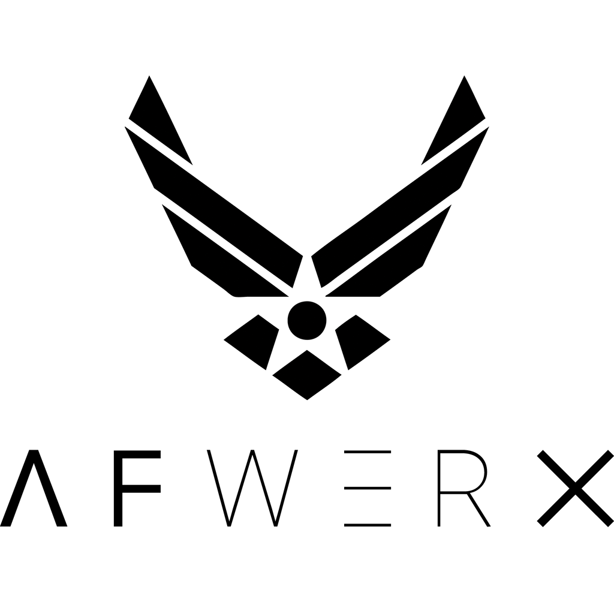
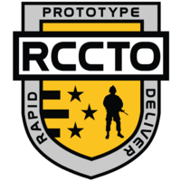
Defense Innovation Ecosystem
In recent years, numerous modernization initiatives have launched within the DoD.

Slide 7
The Case for “GovTech”
Now, more than ever, government is a safe bet for new technology.
The challenges associated with working with the government often create barriers to entry for non-traditional contractors. However, innovation for defense and government makes good sense for many technology companies.
Benefits of working with the government:
Government contracts are “sticky” -- or predicable lines of revenue
Federal spending is largely uncorrelated from market volatility
Government business provides strong brand value
In the past 18-months, the DoD – led by the Air Force – has overhauled the SBIR program, creating opportunities for hundreds of startups to introduce their technology to the government.

Slide 8
Defense Spending Trends
Defense spending is largely uncorrelated to economic conditions and market trends.
$693B
Total US Defense Spending (2019)
44%
US Share of Global Defense Market
5% CAGR
US defense market is estimates to grow at a CAGR of over 5% from 2019-2024
Source: Statista.com
The United States spends more on defense than the total defense budgets of
China, Saudi Arabia, Russia, United Kingdom, India, France, Japan, Germany, and South Korea combined.

Slide 9
The Challenge
The status quo creates an uphill battle for new technology adoption.
Early stage companies require capital to grow. For those that wish to enter the federal marketplace, there are inherent challenges which make near term viability difficult. The sales timeline is slow, meaning they require a longer runway before seeing predictable revenue.
In many cases companies can secure research funding from the government at a very early stage through opportunities like SBIR awards; however, the transition from R&D to commercialization can be long and difficult to navigate.
Often, R&D funding opportunities are not directly aligned with programs of record or difficult to connect to larger government modernization initiatives.
R&D
O&M Funding
Procurement
Resource Gap
Science & Tech
Operational Use
R&D Funding

Slide 10
Innovation By Design
Building a strategy for aligning R&D with Procurement.
One of the most difficult challenges, even among companies and technologies which have been met with early success in the federal market, is transitioning from R&D to procurement of a technology solution. The so-called “valley of death” between R&D funds aimed at maturing a technology for government applications, and the integration of a technology into a new or existing program of record is where many companies either abandon efforts to work with the government or fail.
This challenge may be solved, in part, by making future procurement pathways a meaningful part of the innovation ecosystem earlier in the process. This would mean collaboration on programs between prime contractors and companies with less mature, cutting edge technologies. While there are no doubt frictions that will emerge, alignment between R&D and operational employment must become aligned to effectively modernize DoD capabilities.

Slide 11
A Coordinated Approach
Reimaging the way in which startups work with the government.
By introducing opportunities to integrate R&D projects into existing programs of record earlier in the contracting lifecycle, the “valley of death” can be closed, allowing technologies to mature and scale with a practical use case already defined.
Large programs have a variety of tools at their disposal to better integrate with early stage companies, from Cooperative Research and Development Agreements (CRADA) to providing additional funding and milestones on SBIR contracts, the goal in each case should be to get new technology being developed fully aligned with future applications from the start.
R&D
Procurement
O&M Funding
Science & Tech
Operational Use
R&D Funding

Slide 12
Value Creation for All
Closing the gap between R&D and procurement drives value.
The delta between the current innovation road map and one that prioritizes early engagement with programs and end-users represents value that is unlocked for the government and for the contractor. This incentivizes non-traditional contractors to remain engaged on DoD projects.
Overall, while there is risk in introducing emerging technologies into larger programs at an early stage, the result would likely be a higher percentage of successful transitions from R&D to procurement and more efficient integration between new capabilities and existing programs.
R&D
Value
O&M Funding
Procurement
Science & Tech
Operational Use
R&D Funding

