Slide 1

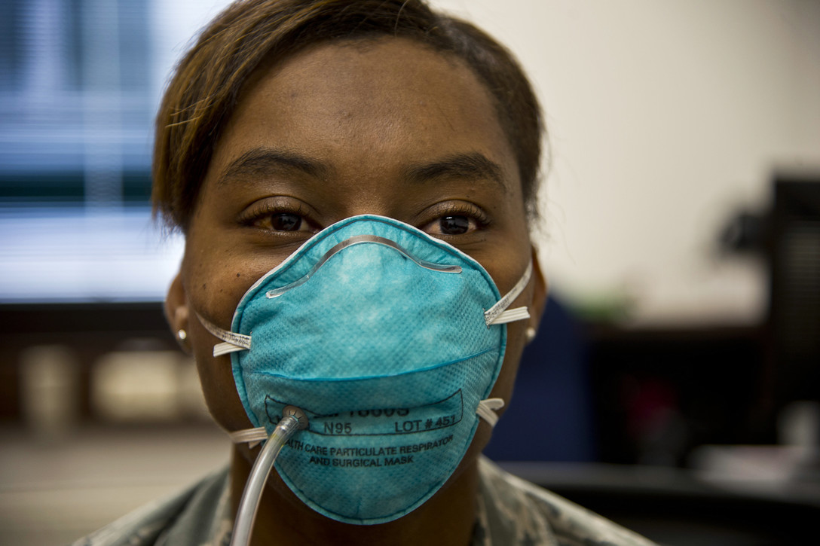
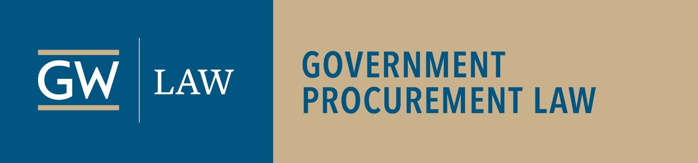
COVID-19: Contractors’ Road to Recovery
Webinar – Wednesday, May 6, 2020 – 12 noon Eastern – Info: publicprocurementinternational.com

Slide 2
Agenda
Introductions
Economic Impact
Contractor Strategies
Roundtable Discussion – including audience questions

Slide 3

Introductions –
Alfreda Robinson
Michael Bennett, Evans & Chambers Technology, LLC; Chair, DC Board of Elections
Dominique Casimir, Partner, Blank Rome
Michelle Coleman, Counsel, Crowell & Moring
Danielle Conway, Dean, Penn State Dickinson Law
Liza Craig, Counsel, Reed Smith
Kendra Perkins Norwood, Wiley
Judge Jeri Somers, Chair, US Civilian Board of Contract Appeals
Moderators: National Bar Association President Alfreda Robinson (Assoc. Dean, GW Law School) & Christopher Yukins (Professor, GW Law School)
:02

Slide 4
Welcome – Christopher Yukins
Please use “Chat” – not Q&A
Disclaimers:
  The information presented may constitute lawyer advertising and should not be the basis of the selection of legal counsel.
  Information provided on this webinar is believed to be accurate and correct as of today. The presentations by participating lawyers do not constitute legal advice. The facts of any particular circumstance determine the basis for appropriate legal advice, and no reliance should be made on the applicability of the information provided to any particular factual circumstance. No attorney-client relationship is established or recognized through your participation in this event. The presenters disclaim all liability for any errors or omissions and note that the information shared is being provided “as-is” without warranties of any kind either express or implied.
Next webinar: European Responses to COVID-19 – American Perspectives – May 14, 2020, 9 am Eastern
:04

Slide 5


Economic Outlook and Impact of the Pandemic –
Dean Danielle Conway and Michael Bennett

Slide 6
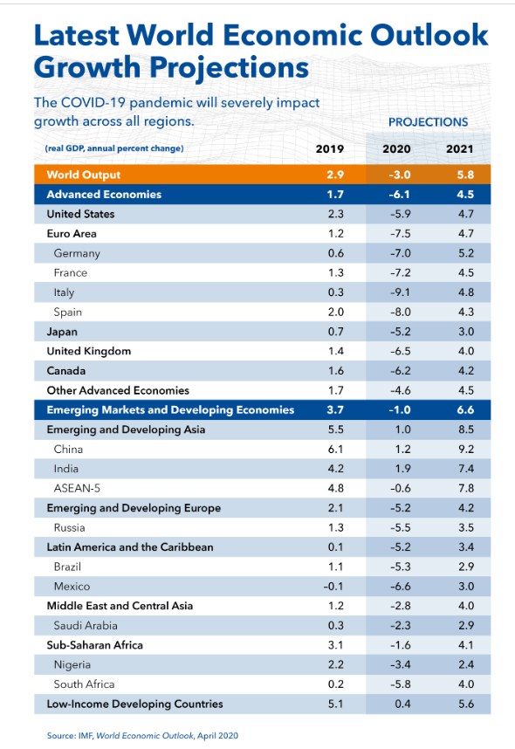
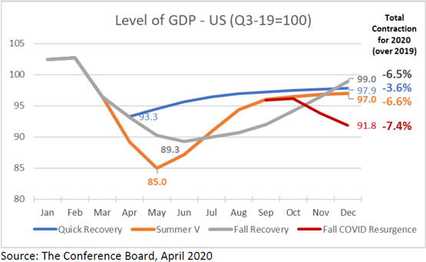
Notes:
Updated: April 9, 2020
The US economy will contract between 3.6 and 7.4 percent in 2020
Given the highly volatile nature of the ongoing COVID-19 pandemic, The Conference Board continues to rely upon a scenario based approach to its US economic forecasting. To help businesses navigate and consider how to respond to a variety of environments that may emerge over the coming months, The Conference Board has developed four scenarios for the course of the US economy for the remainder of 2020:
May Reboot (quick recovery): Assumes a peak in new COVID-19 cases for the US as a whole by mid-April. Economic activity may gradually resume in May beginning with the most impacted sectors, such as restaurants, travel, etc. Even in this optimistic scenario, annual GDP growth contracts by 3.6 percent.
Summertime V-Shape (deep contraction, V-shaped recovery): Assumes that the peak in new COVID-19 cases will take place in early May, creating a deep economic contraction in Q2, especially for consumption. While we may see a strong recovery in Q3, annual GDP growth will still contract by as much as 6.6 percent.
Fall COVID-19 Resurgence (2nd contraction in Q4, W-shaped recovery): Attempts to keep new COVID-19 cases under control in the Fall fail, requiring the implementation of stringent measures starting in October. The economy would begin to contract again in Q4, following a recovery in Q3. Annual GDP growth contracts to 7.4 percent – substantially more than under the previous scenarios.
Fall Recovery (extended contraction, U-shape recovery): Government policies such as social distancing help to ‘flatten the curve’ but extend economic weakness to Q3. The recovery will be slower but more controlled than in the V- and W-shaped scenarios, giving businesses more time to prepare for the recovery.
While we refrain from attaching probabilities to the scenarios, creating any false sense of certainty, at present we treat the Fall Recovery scenarios as our base case. Under this scenario, we assume that social distancing measures are executed in a balanced fashion that prioritize protecting people’s health and wellbeing while simultaneously gradually rebooting the economy. On the basis of this scenario we forecast a 33 percent contraction in GDP in Q2 (on an annualized basis) and no growth in Q3. While Q4 will see a sizable rebound, the economy will contract by 6.5 percent for the entire year (compared to 2019). A significant reduction in consumer spending is the primary driver of this weakness, but weak residential and non-residential investment, exports, and a reduction in inventories exacerbate the pain. Unemployment would rise to 15 percent by May, and average 12% in both Q2 and Q3, and then gradually drop off to 8 percent by Q4. Fiscal stimulus from the government would be insufficient to offset weakness in the private sector of the economy.

Slide 7
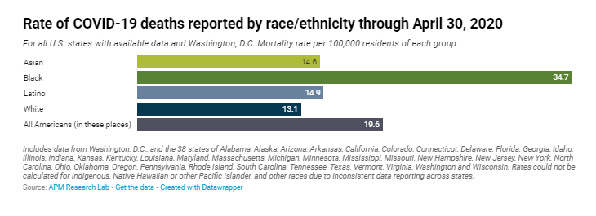
Notes:
https://www.apmresearchlab.org/covid/deaths-by-race

Slide 8
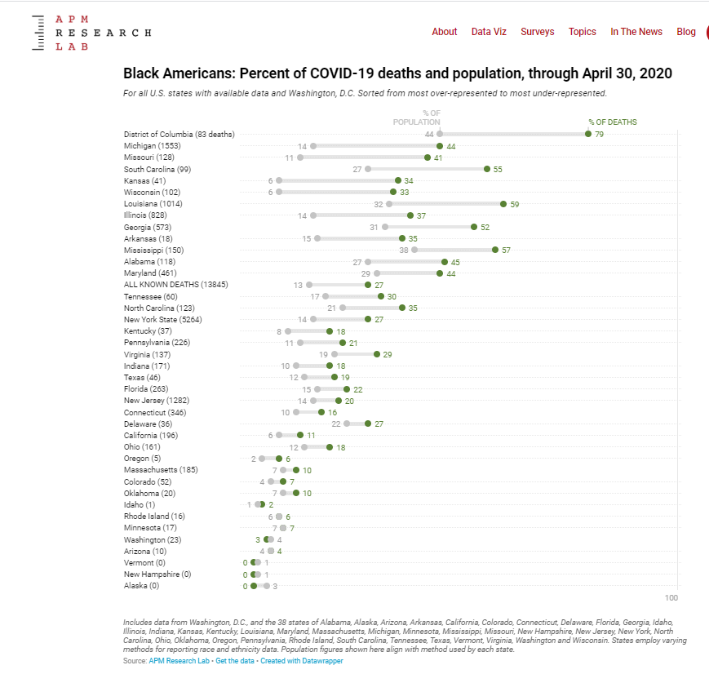
Notes:
https://www.apmresearchlab.org/covid/deaths-by-race
CDC analysis of reasons for racial and ethnic disparity in disease:
https://www.cdc.gov/coronavirus/2019-ncov/need-extra-precautions/racial-ethnic-minorities.html

Slide 9
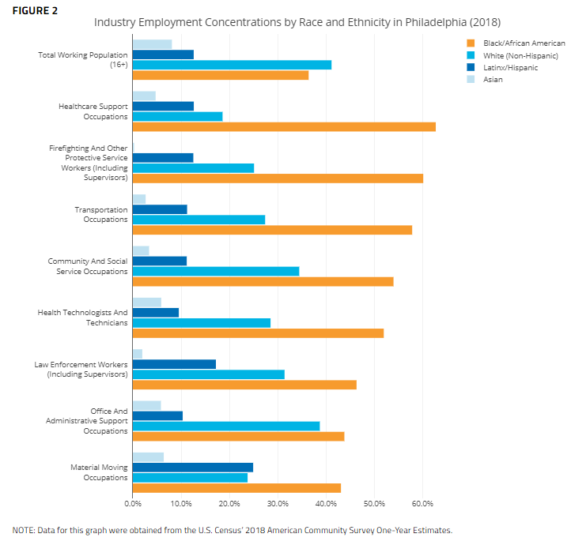
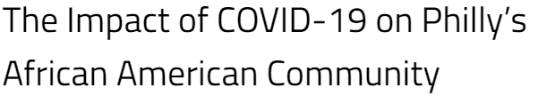
Notes:
http://economyleague.org/providing-insight/leadingindicators/2020/04/15/covid19blackcommunities

Slide 10
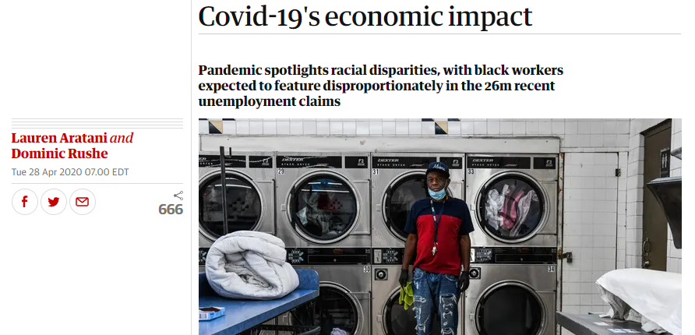

Notes:
https://www.theguardian.com/us-news/2020/apr/28/african-americans-unemployment-covid-19-economic-impact

Slide 11
Economic Outlook and Impact of the Pandemic –
Dean Danielle Conway and Michael Bennett
Global recession likely
U.S. recession – unemployment and risks
Strategies for surviving recession of 2020
Access to federal market
Should contractors use a new line of access: online “electronic marketplaces”?
:14

Slide 12
Contractor strategies for recovery

Slide 13

CARES Act – Section 3610 –
Michelle D. Coleman, Crowell & Moring
Section 3610 reimbursement
  Any funds made available to an agency
  May be used to reimburse contractors’ paid leave
  No “double-dipping”
Agency guidance issued
  OMB government-wide guidance endorsed
Agencies and OMB have suggested relief “permissive”
  May result in litigation
  Impact on fiscal stimulus and public health goals
Biography: https://www.crowell.com/professionals/Michelle-Coleman
COVID-19 Preparedness Toolkit: https://www.crowell.com/NewsEvents/AlertsNewsletters/all/The-Government-Contractor-Coronavirus-COVID-19-Preparedness-Toolkit
Section 3610 Guidance: https://www.crowell.com/NewsEvents/AlertsNewsletters/all/Updated-Section-3610-Guidance
Crowell & Moring’s Coronavirus Resource Center: https://www.crowell.com/Practices/Coronavirus-COVID-19-Resource-Center
:22

Slide 14

COVID-19 Relief – Hidden Strings
Dominique Casimir, Blank Rome
Audits and enforcement likely after pandemic
Section 3610 specifically bans “double-dipping”
New inspector general for COVID-19 relief
DoD has issued guidance for carefully tracing COVID-19 spending
Contractors should prepare
:30

Slide 15

Defense Production Act –
Liza Craig, Reed Smith
Expanding use of Defense Production Act
  “Rated” orders – affect state and local governments as well
  Export controls
  “Price-gouging” prosecutions
Issues for future
:38

Slide 16


Public Readiness and Preparedness (PREP) Act and Other Immunities –
Kendra Perkins Norwood, Wiley
PREP Act
  Immunity for “covered” COVID-19 contractors and countermeasures
  Expanded immunity through HHS Advisory Opinion
Pub. Law 85-804 indemnification
  Immunity for DOE and Veterans Affairs contractors
Defense Production Act
  Immunity under rated orders
  Antitrust immunity
:46

Slide 17

Question from Audience
Craig Barrett, U.S. Government Publishing Office -- How should agencies justify contractor reimbursements under the CARES Act Section 3610?

Slide 18

Roundtable Discussion –
Judge Jeri Somers
Audience questions
Next steps
  CARES Act Section 3610 Recovery
  Other COVID-19 Relief
  Anti-Fraud and Audits
  Defense Production Act
  Immunities

Slide 19
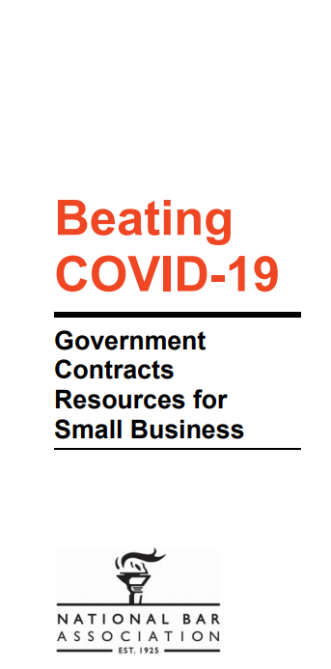

COVID-19 Resources for Small Businesses
https://publicprocurementinternational.com/resources-on-covid-19-and-public-procurement/small-business/

Slide 20
Conclusion
Materials and a recording of this program will be posted on www.publicprocurementinternational.com

