Slide 1
Innovation procurement The private perspective
Stephan Corvers (s.corvers@corvers.com)
May 14th 2020

Slide 2
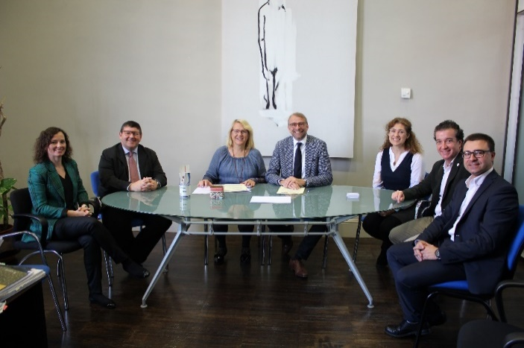
Corvers Chair on Public Procurement of Innovation

Slide 3
Eafip 2015-now
European Assistance for Innovation Procurement (eafip)
Initiative European Commission DG CONNECT
Corvers Commercial & Legal Affairs
Knowledge transfer about how to conduct innovation procurement to contracting authorities throughout Europe
Workshops & conferences
Toolkit
Local assistance (18 PCPs and PPIs)
Network-approach
Demand driven policy – no support to companies
www.eafip.eu

Slide 4
Overview COVID-19 Innovation Procurement Background Information
Webinar, April 3rd, 2020 Eafip-initiative | Opportunities to tackle the COVID-19 Crisis through Innovation Procurement – a legal and economic perspective - | www.eafip.eu & www.corvers.com/eafip/webinar
Webinar, April 22nd, 2020 Corvers Chair on Innovation procurement | Consultas al Mercado y Compra Pública de Innovación en crisis COVID-19 | www.corvers.com/chair-on-innovation-procurement/webinar
Position paper, April 24th, 2020 Corvers Chair on Innovation procurement | Opportunities to tackle COVID-19 and similar crises through Innovation Procurement – a legal and economic perspective - | www.corvers.com/chair-on-innovation-procurement/position-paper
Paid Webinar, May 13th, 2020 Corvers Commercial & Legal Affairs & Vtrek | The Business (Value) Case in the face of COVID-19 | https://www.corvers.com/news-events/webinars

Slide 5
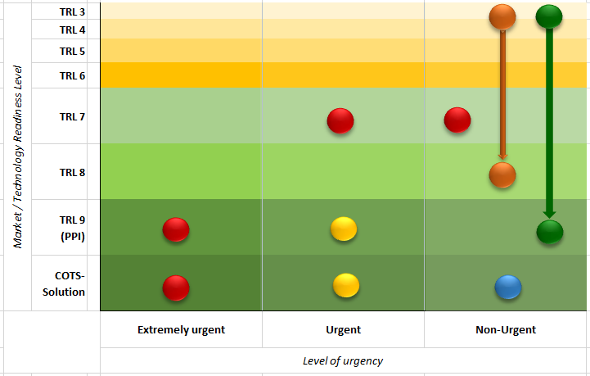
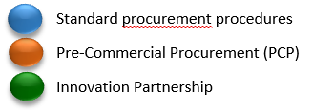
TRL – Urgency Matrix

Slide 6
Examples
Eafip-initiative (2015-now) (www.eafip.eu) :
direct guidance and support on innovation procurement to contracting authorities in the EU
Horizon scanning initiative (HSI) (2020) (www.beneluxa.org/horizonscanning)
Member States initiative (Belgium, Denmark, Ireland, Luxemburg, Netherlands, Norway, Portugal, Sweden, Switzerland)
Cooperation through a newly set up organization under Belgian law (2020)
To identify & analyse the R&D pipeline for medicins/drugs
Running PPI
Crucial to understand the (beyond) –state-of-the-art
Crucial to understand the technology vendors / broaden the scope of so-called usual suspects
Contactperson: Mr Aldo Golda (aa.golja@minvws.nl)

Slide 7
Recommendations
Horizon scanning initiative (HSI)
To understand the beyond-state-of-the-art and to broaden the outreach to technology vendors / usual suspects
Team up with HSI (countries)
Speed up & broaden the HSI scope to medical devices and PPE
Organizational perspective
Set up a Rapid Deployment Procurement Force (RDPF), with the mandate, the financial means and the facilities to procure on behalf of the participating member states/countries (on European level / NATO level / global level) during medical crisis situations

Slide 8
Thank you for your attention
Corvers Procurement Services
The Netherlands
Tel: +31 73-612 6566
info@corvers.com
www.corvers.com
www.eafip.eu

