Slide 1
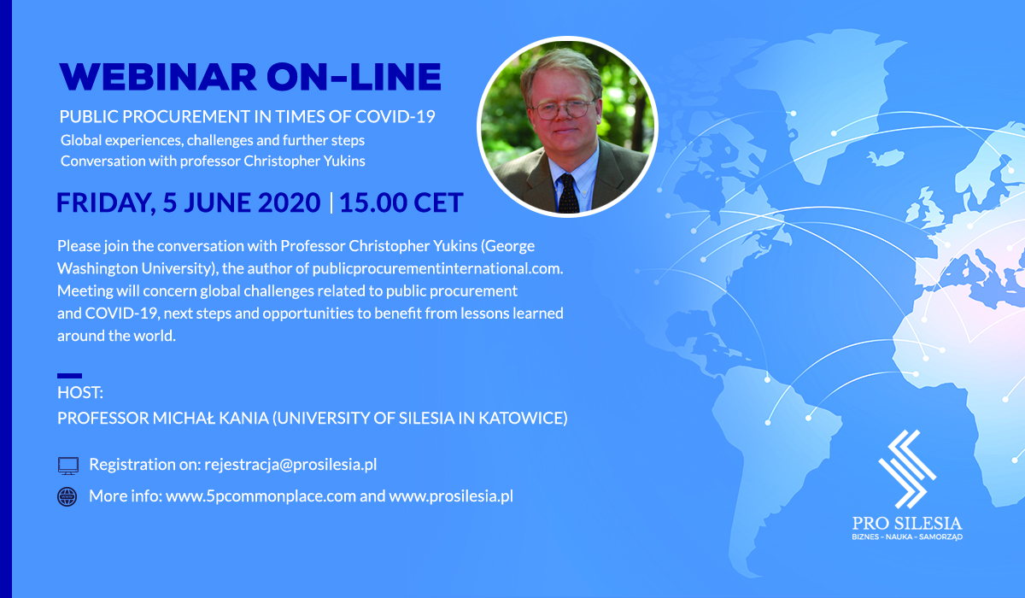

Slide 2
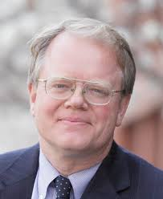
Professor Christopher Yukins
a thought-leader in global public procurement
serves as co-director of the government procurement law program at George Washington University Law School
teaches contract formations and performance issues in public procurement, bid protests and claims litigation, state and local procurement, anti-corruption issues, foreign contracting, procurement reform, and comparative and international law
is currently counsel to the firm of Arnold & Porter
is building bridges between scholars and practitioners dealing with public procurement around the globe
has a blog at publicprocurementinternational.com

Slide 3
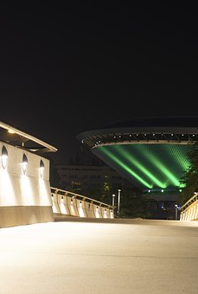
Silesia, University of Silesia, Association ,,Pro Silesia’’
The region in southern Poland
4,5 million citizens
71 cities
Centre of Industrial Poland
University of Silesia in Katowice
Pro Silesia Association

Slide 4

Public Procurement in the Time of COVID-19
lessons for procurement from COVID-19 pandemic
potential reforms
(for academics) research topics

Slide 5

Questions
How has the public procurement market changed in the time of the COVID-19 pandemic?
What general challenges have there been to public procurement during the pandemic?
What has the reaction to these challenges been on the public buyers’ side?

Slide 6
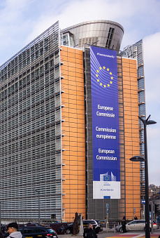
Questions
Are the current regulations related to public procurement also sufficient during an emergency situation such as combating the COVID-19? pandemic
Should we treat public procurement regulations only as a barrier and a red tape monster, or are there maybe some benefits to using public procurement regimes even during this complicated time? (reputational risk)

Slide 7
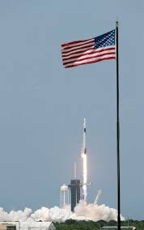
Questions
Is there any special role for public procurement in the near future?
How can public procurement contribute to the road to recovery after COVID-19?

Slide 8
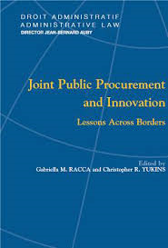
Questions
Is there a special role for innovative public procurement in combating the COVID-19 pandemic?
What does the term “innovative procurement” mean for the practice of public contractors?

Slide 9

Q/A Session

Slide 10


Slide 11
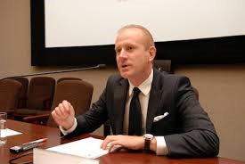
Thank you!

