Slide 1
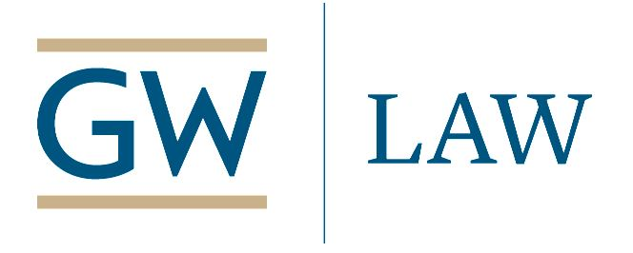
Webinar – Trump’s Attacks on the Inspectors General:
Presidential Prerogative or Punishing Critics?
Intelligence
Defense
Transportation
Health & Human Services
State
Trump
(photo: Gage Skidmore)
Wednesday, June 3, 2020, 12 noon Eastern
Info: www.publicprocurementinternational.com

Slide 2
Agenda
Disclaimer: All opinions offered are the personal opinions of the participants, and should not be attributed to their organizations.
Introductions
Panelists
Questions & Answers
Note: please submit all questions in Chat only – not Q&A

Slide 3
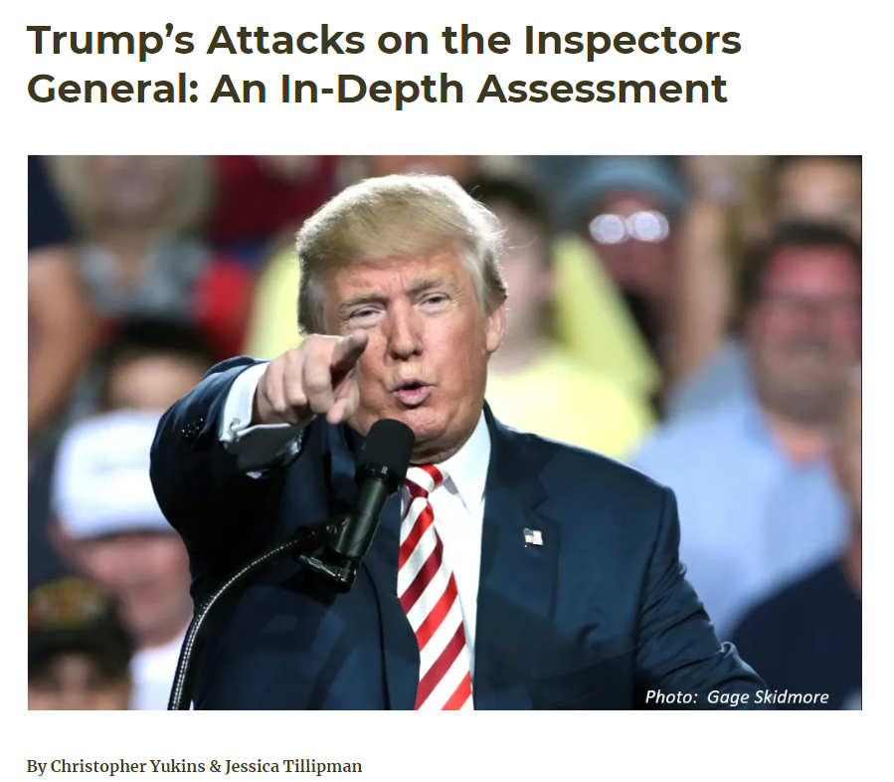
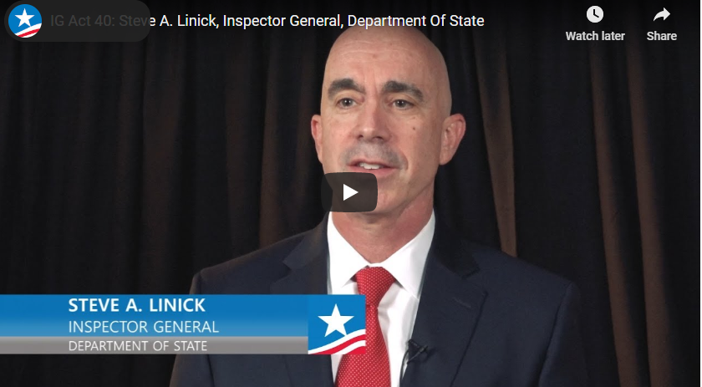
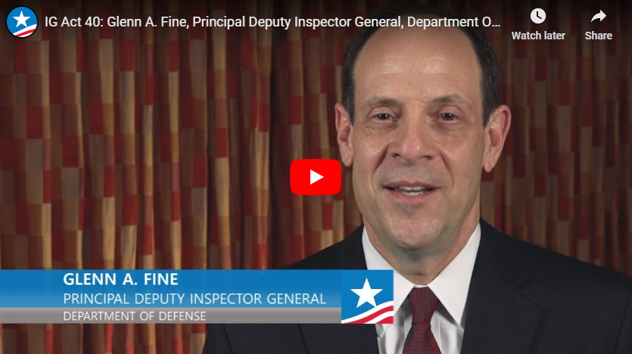
Resource - https://publicprocurementinternational.com/trump-igs-in-depth-assessment/

Slide 4
Introductions
Jessica Tillipman – Assistant Dean & Professorial Lecturer of Law, George Washington University Law School
Clark Ervin, Partner, Squire Patton Boggs
Lisa Rein, Washington Post
Christopher Yukins, George Washington University Law School
Noah Bookbinder, Exec. Director, Citizens for Responsibility & Ethics in Washington (CREW)

Slide 5
Christopher Yukins - Moderator
Trump Administration Removals of Inspectors General – April/May 2020
Name/Title | Agency | Political Risk | Open Issues
Inspector General Michael Atkinson | Intelligence Community | Atkinson gave Congress whistleblower complaint regarding Ukraine | White House response to congressional inquiry after 30-day period expires adequate? Was Trump’s “loss of confidence” rationale enough ground for removal?
Acting Inspector General Glenn Fine | Defense | Obama appointee
Acting Inspector Christi Grimm | Health & Human Services | Embarrassing report regarding COVID-19 preparations.
Inspector General Steve Linick | State | Linick was not part of State Department “team”; IG investigation of Secretary Pompeo and wife reportedly pending. | Was Linick removed to block investigation? Was Trump’s “loss of confidence” enough ground for removal? “Dual-hatted” replacement IG?
Acting Inspector General Mitch Behm | Transportation | Congressionally requested investigation of Secretary Chao. | Was Behm removed to block investigation? “Dual-hatted” replacement IG?
:08
Intelligence
Defense
Transportation
HHS
State
Trump
(photo: Gage Skidmore)

Slide 6
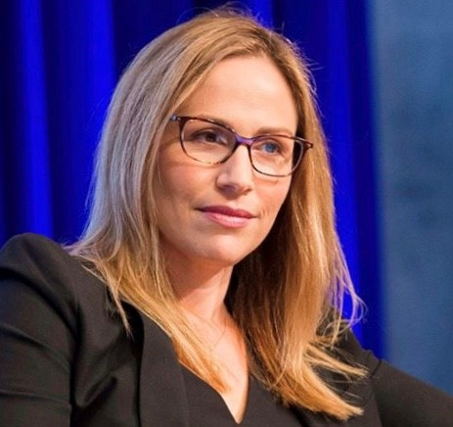
Jessica Tillipman – GWU Law
:16
Role of Inspectors General
Inspector General Act of 1978
  Independent – appointment by President
  No interference in investigations
  Transparent to Congress and public
  No “dual-hatting” by agency program personnel
  Removal by President
    30 days’ notice and statement of reasons
    2008 Amendments

Slide 7
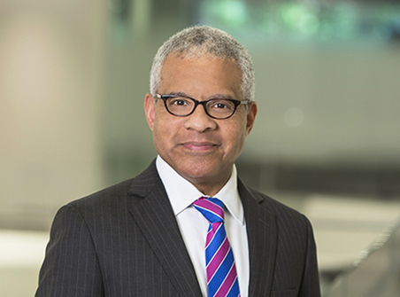
Clark Ervin – former Inspector General at State Department & Department of Homeland Security, Administration of George W. Bush
:24
Evolution of inspectors general
  Removals by Reagan and Obama
  Disputes in Obama years: access to agency records
Practical challenges
  Focus on investigations
  Balance transparency to Congress and public
  Handling relationship with agency head and President

Slide 8

Lisa Rein – Washington Post
Michael Atkinson – Intelligence Community – Provided “whistleblower” complaint regarding Ukraine to Congress
Glenn Fine – Defense – Obama appointee, was pushed aside after appointment as chairman of the IG panel overseeing $2.1 trillion in pandemic spending.
Christi Grimm – HHS –Was effectively acting IG as second-in-command. Reported on shortage of hospital PPE supplies.
Steve Linick – State – Was said to be investigating Secretary Pompeo on multiple fronts.
Mitch Behm – Transportation – In acting role, said to be investigating Secretary Chao.
:32

Slide 9
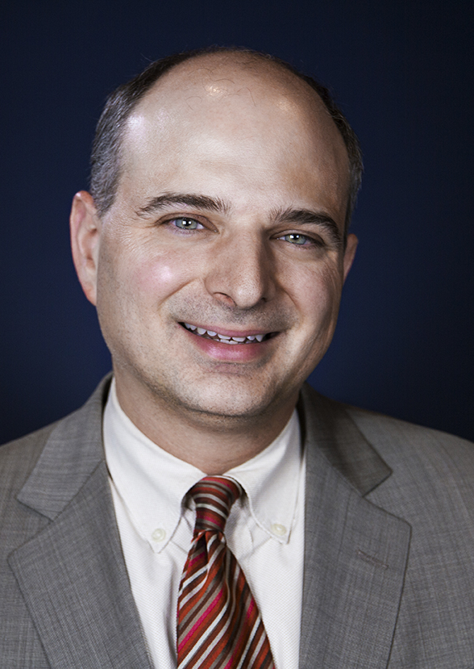
Noah Bookbinder - CREW
:40
Context of other administration attacks on oversight and accountability
Potential reforms
  “For cause” removal – but CFPB case pending at Supreme Court
  CORE Act: vacancies filled by career official, legal cause of action, outside review of firing
  Congressional override of firing
Key Members of Congress
Timing of potential reforms

Slide 10
Questions
Is the statutory ban against interfering with investigations enforceable?
Will the Trump removals of IG’s continue – and if so, who’s next?
Why hasn’t the Senate pressed harder?
Why have Rep. Jim Cooper (D-TN) and the House been so quiet?
The HEROES Act would roll up the major pending reforms (“for-cause” removal only, term limits, etc.). Will it pass?
Is the Supreme Court CFPB case on “for-cause” removals the linchpin to reform?
Questions from audience

Slide 11
Conclusion
Materials and a recording of this program will be posted on www.publicprocurementinternational.com

