Slide 1
Joint Public Procurement and Innovation: Lessons Across Borders
Book Discussion:
Prof. Gabriella M. Racca
Full Professor of Administrative Law
University of Turin - Italy
gabriella.racca@unito.it
Prof. Christopher R. Yukins
Professor of Government Procurement Law
George Washington University
cyukins@law.gwu.edu

Slide 2
Agenda
Introduction
Gabriella Racca/Christopher Yukins: 15:00-15:15
Discussants
Caroline Nicholas: 15:15-15:30
Rozen Noguellou: 15:30-15:45
Paulo Magina: 15:45-16:00
Stephane De La Rosa:16:00-16:15
Observations
Gabriella Racca/Christopher Yukins: 16:15-16:25
Laurence Folliot Lalliot: 16:25-16:35
Jean-Bernard Auby: 16:35-16:50
Questions and Conclusion

Slide 3
Introduction
Gabriella Racca, University of Turin
Christopher Yukins, George Washington University

Slide 4
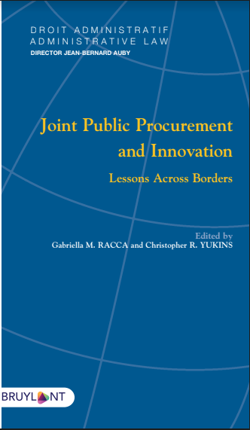
https://www.larcier.com/fr/joint-public-procurement-and-innovation-2019-9782802763802.html
Selected chapters available in draft at:
https://publicprocurementinternational.com/joint-public-procurement-lessons-across-borders/

Slide 6
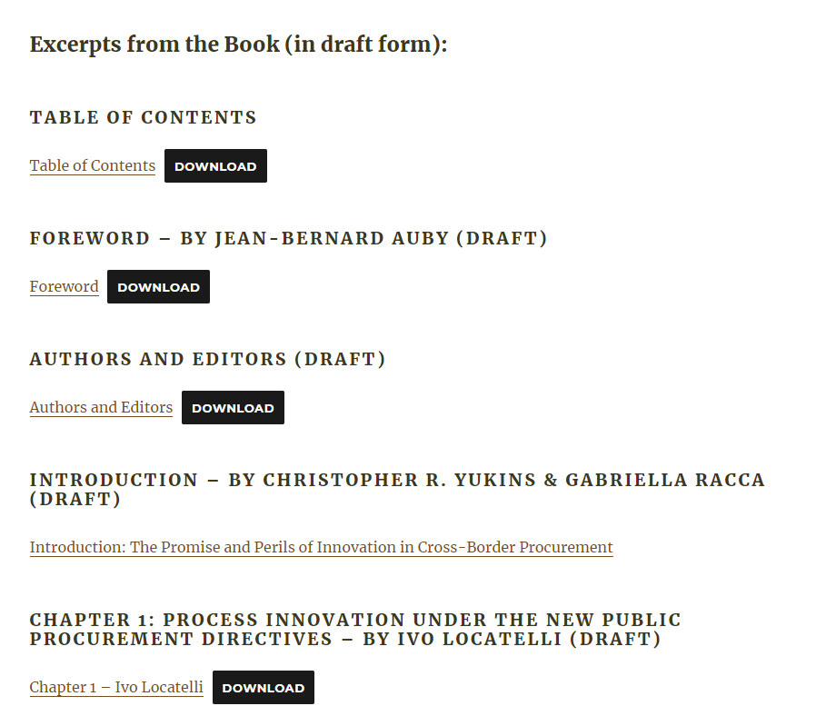

Slide 7
Joint Public Procurement and Innovation: Lessons Across Borders (Eds. By G.M. Racca – C.R. Yukins)
Table of contents:
PART I. Crossborder Procurement and Innovation
PART II. Smart Cities and Procurement
PART III. Encouraging Innovation
PART IV. Innovation in the Procurement Process
Joint Public Procurement
and Innovation:
Lessons Across Borders

Slide 8
Innovation in Procurement:
Buying cutting-edge technology in public procurement markets.
Encouraging innovative suppliers in the procurement process.
Developing methods and approaches for the procurement process.
JOINT - CROSSBORDER
PURCHASE OF INNOVATION
INNOVATION IN PROCUREMENT
INNOVATION IN THE PROCUREMENT PROCESS ITSELF

Slide 9
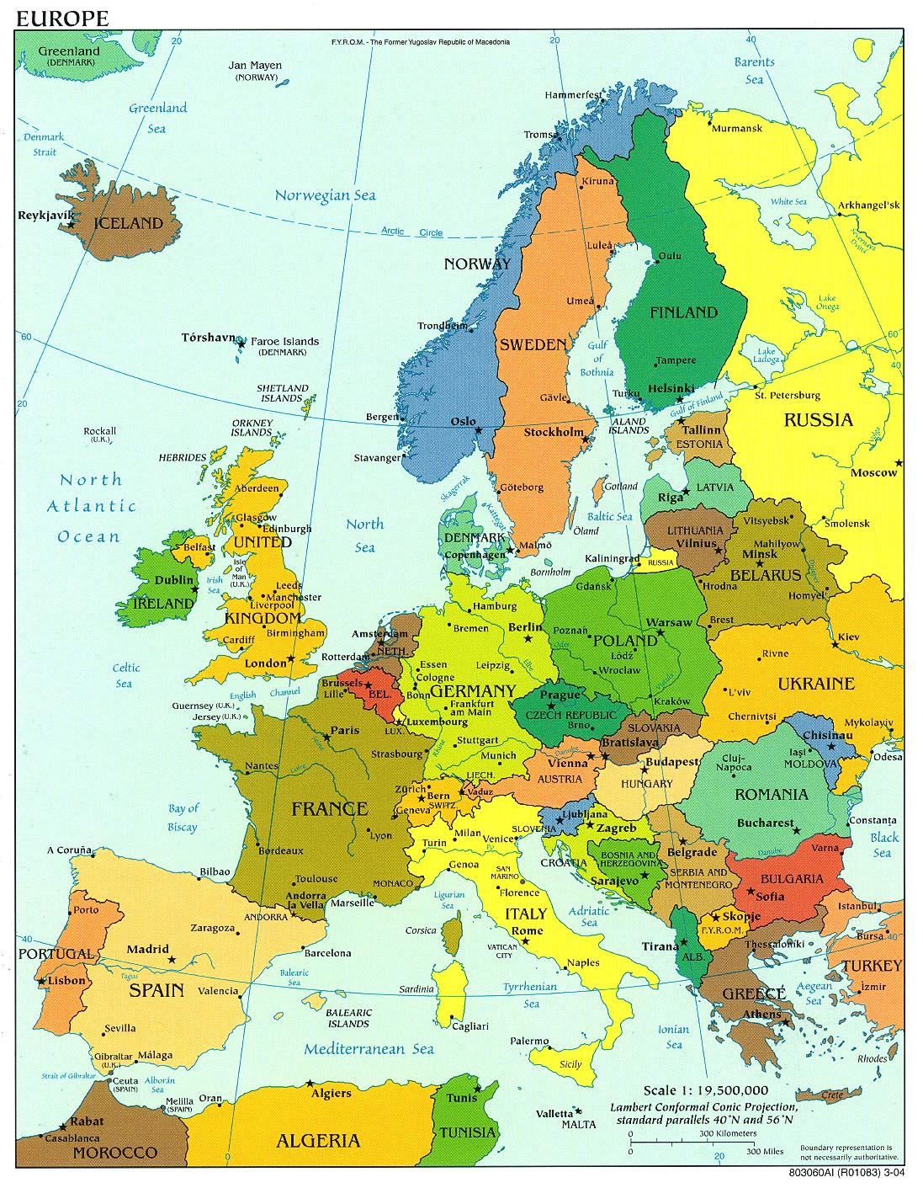
Directive 2014/24/EU, Art. 39
Cleared the Way for Joint Procurement in the European Union
“A Member State shall not prohibit its contracting authorities from using centralised purchasing activities offered by central purchasing bodies located in another Member State.”
C. A.
C. A.
C. A.
CPB
C. A.

Slide 10
Choice of Law
EU Procurement Directive, Art. 39, para. 4:
The provision of centralised purchasing activities by a central purchasing body located in another Member State shall be conducted in accordance with the national provisions of the Member State where the central purchasing body is located . . .
Whose law applies?

Slide 11
NATIONAL ASSOCIATION OF
STATE PROCUREMENT OFFICIALS
Master Agreement
(Minnesota)
Alabama
Wisconsin
“Cooperative Purchasing” (Joint Procurement) in the United States
Demand
Supply
Legal Control

Slide 12
U.S. Government Seized Supplies Using the Authority of the Defense Production Act

Slide 13
“Un-cooperative Purchasing” in the Pandemic
Federal Government:
Legal Control
Contractors
State Governments:
Demand
Supply

Slide 14
Supply Chain Risk
Private
Public
Operations: Counterfeit
Physical:
Pandemic
Strategic: Limited Supplies
Financial:
Payment
Operations: Counterfeit
Physical:
Pandemic
Strategic: Limited Supplies
Financial:
Payment
Political - Legal

Slide 15
Discussants
Caroline Nicholas
Rozen Noguellou
Paulo Magina
Stephane De La Rosa

Slide 16
Discussion points
Caroline Nicholas
Key themes: Innovation and its potential benefits; turning potential into reality
Innovation as “new ways of doing things”
Engaging/empowering citizens/suppliers
Improving business processes
Working collaboratively
Diversifying supply chains
Flexible notion of innovation in PP: beyond industrial policy through PP
Cultural shift: supply side as innovators (existing concept in PPPs/Competitive Dialogue)
“Problem-based procurement methods and practices”
Small business support in US, EU “launch customer/early adopter”
Preferences/guaranteed sales once innovative product available
Flexibility and possibilities to scale up (pandemic recovery)
Examples: general and Covid-19 related

Slide 17
Discussion points
Caroline Nicholas
Turning potential into reality: Trust and risk
Collaboration
Voluntary for both parties
Benefits (commercial, experience-sharing – CPAs; key role of data) against time and costs (familiarity, legal, regulatory, etc)
Challenge 1: Legal relationships (fitness checks needed)
Horizontal: between partners eg CPAs (especially across borders)
Vertical: CPAs/procuring entities/suppliers
“Public procurement remains highly regulated”
Examples: creation of a joint purchasing entity under an international agreement; creation of a group with lead procuring entity based one State – can bodies in another State join? whose law for the procurement procedure (two stages under framework agreements – they may differ); whose law for the contracts/disputes?
Indications of some national legal restrictions on use of joint purchasing arrangements (eg maximum contract values, ability to procure directly from a CPA in another State)
“Joint responsibility” and “lead agency responsibility” – theory and practice

Slide 18
Discussion points
Caroline Nicholas
Turning potential into reality: Trust and risk
Challenge 2 – policy areas
Trade offs – short-term focus on value for money, administrative efficiency (key benefits of digitisation) and costs of innovation
“Just in time” vs “Just in case” – has Covid-19 led to acceptance of more qualitative approach and longer-term view?
Less formal collaboration among suppliers: risks to competition?
Demarcation between market interaction for research and procurement processes
Risk aversion (SMEs research shows procurement is inherently conservative)
Risk-sharing eg contractual mechanisms so that suppliers remain responsible for operation/management of infrastructure
Challenge 3: Practical considerations …
Languages, cross-border recognition of certificates
Trust: reliance on others’ conduct of steps in the procedure (examples of cross-border suppliers’ lists in some regions)?
Time to conclude collaborative arrangements (timely supply)

Slide 19
Discussion points
Caroline Nicholas
Conclusions (from an UNCITRAL perspective)
Many of the issues in joint and innovative procurement involve new aspects of traditional procurement problems
Harmonisation and modernisation offer key benefits
One size does not fit all => toolbox approach
Ensuring transferability of solutions – national, regional, international
Some issues are not procurement issues: legal issues in e-commerce; political relations, closed borders …
Keep up the exchange of ideas and dialogue!

Slide 20
Joint Public Procurement and Innovation: Lessons Across Borders
Book Discussion:
Discussion by S. de La Rosa,
Full Professor of Public Law,
Jean Monnet Chair
Université Paris Est Créteil
stephane.delarosa@u-pec.fr

Slide 21
The implementation of cross-borders procurement in Europe. Ambitious objectives but poor implementation?
The book rightly stresses on the diversity of meaning of cross-borders
Relevant distinctions and typology between cross-border (a single entity joining two Member States), joint procurement (2 MS acting as contracting authorities) and using ressources of another MS (ressources of central purshasing body)
A question which appears in several contributions of the book: introduction, ch. 3, ch. 4.
The topic became central with the Covid-19 crisis
The “Guidance from the European Commission on using the public procurement framework in the emergency situation related to the COVID-19 crisis” refers to joint procurement for medical supplies => common needs but weakness of common answers.

Slide 22
Lack of appropriation of cross border procurements : 2 topical examples
EGTC (European Grouping of Territorial Cooperation - reg. 1302/2013)
A legal instrument and a legal entity designed to facilitate and promote cross-border, transnational and interregional cooperation.
Success of the tool: 77 GECT at the current stage (see https://portal.cor.europa.eu/egtc/CoRActivities/Pages/egtc-list.aspx)
Virtually, a proper ground to foster cross procurement: art. 39 d. 2014/24.
The provision sets up a real leeway for MS and recognizes a form of “law shopping” (possibility to choice or to mix the law which apply to the contract).
Existence of a “friendly environment” (p. 15 of the book)

Slide 23
Lack of appropriation of cross border procurements : 2 topical examples
EGTC (European Grouping of Territorial Cooperation - reg. 1302/2013): The mountain labored and brought forth a mouse ?
In practice: very few examples of public procurements concluded by EGTC acting as contracting authority.
Using keyword “EGTC” on TED database :
On the last 7 years, only 25 contracts notices for EGCT/CGET
Always the same entities: Eurorégion Aquitaine Euskadi, Eurorégion Luxembourg, Hopital Cerdanya (FR/ESP)
For similar needs: e.g. Miscellaneous engineering services, interpretation services, marketing or communication (no notices for public work contracts or concessions or object related to innovation).
Therefore, most of the contracts of these entities are below the thresold ? Or inexistent ? Or a lack of relevant legal competences confered to such entities for concluding contracts ? .

Slide 24
Lack of appropriation of cross border procurements : 2 topical examples
2) Joint procurement for medical supplies
Strong insistence in the Covid-19 communication of the Commission on public procurement: “the Commission together with the Member States has already stepped up efforts by launching joint procurement actions for various medical supplies”
Legal base in the directive 2014/14, art. 39 (often quoted by several contributors), allowing “contracting authorities from different Member States may act jointly in the award of public contracts by using one of the means provided for in this Article”: central purchasing body in a Member State, framework agreement, EGCT.

Slide 25
Lack of appropriation of cross border procurements : 2 topical examples
2) Joint procurement for medical supplies
In practice: uselessness of. art. 39 for the Joint Procurement of medical countermeasures in the context of the Covid-19
Activation of the joint procurement mechanism : a "lex specialis" legal base: décision n° 1082/2013 on serious cross-border threats to health, art. 5 "joint procurement procedure"
and Council Regulation (EU) 2020/521 of 14 April 2020 activating the emergency support under Regulation (EU) 2016/369 on the ground of art. 122 TFUE (emergency measures).

Slide 26
Lack of appropriation of cross border procurements : 2 topical examples
Regulation (EU) 2020/521, art. 5. Emergency support under this Regulation may be granted in any of the following forms:
(a) joint procurement with Member States as referred to in Article 165(2) of Regulation (EU, Euratom) 2018/1046 whereby Member States may acquire, rent or lease fully the capacities jointly procured;
➔ Legal base from financial regulation of EU (rules applying to public contracts of EU institutions) and not from directive. Need to use to budget of EU and specific requirements.
(b) procurement by the Commission on behalf of Member States based on an agreement between the Commission and Member States; (but no references to art. 39 dir. 2014/24).
(c) procurement by the Commission, as wholesaler, by buying, stocking and reselling or donating supplies and services, including rentals, to Member States or partner organisations selected by the Commission.
➔ Commission acting as a purchasing entity

Slide 27
Concluding remarks
Difficulty to find and to establish a common normative framework for cross border procurement, at least in Europe : more a cobweb of rules rather than a clear book of rules.
Discrepancy between the legal bases, the flexibility of the rules and new tools (e.g. EGCT) and the practical implementation. A “friendly environment” is a pre requisite but is not sufficient : a common administrative culture and convergences in the practices of purchasing are needed
Covid-19: (excessive?) temptation to tighten at the national level issues of public purchase

Slide 28
Observations
Laurence Folliot Lalliot
Jean-Bernard Auby

Slide 29
REFERENCES

Slide 30
Directive 2014/24/EU
Whereas no. 73
Joint awarding of public contracts by contracting authorities from different Member States currently encounters specific legal difficulties concerning conflicts of national laws. Despite the fact that Directive 2004/18/EC implicitly allowed for cross-border joint public procurement, contracting authorities are still facing considerable legal and practical difficulties in purchasing from central purchasing bodies in other Member States or jointly awarding public contracts. In order to allow contracting authorities to derive maximum benefit from the potential of the internal market in terms of economies of scale and risk-benefit sharing, not least for innovative projects involving a greater amount of risk than reasonably bearable by a single contracting authority, those difficulties should be remedied. Therefore new rules on cross-border joint procurement should be established in order to facilitate cooperation between contracting authorities and enhancing the benefits of the internal market by creating cross-border business opportunities for suppliers and service providers.

Slide 31
Directive 2014/24/EU
Whereas no. 73
…Those rules should determine the conditions for cross-border utilisation of central purchasing bodies and designate the applicable public procurement legislation, including the applicable legislation on remedies, in cases of cross-border joint procedures, complementing the conflict of law rules of Regulation (EC) No 593/2008 of the European Parliament and the Council (13). In addition, contracting authorities from different Member States should be able to set up joint entities established under national or Union law. Specific rules should be established for such forms of joint procurement.
However, contracting authorities should not make use of the possibilities for cross-border joint procurement for the purpose of circumventing mandatory public law rules, in conformity with Union law, which are applicable to them in the Member State where they are located. Such rules might include, for example, provisions on transparency and access to documents or specific requirements for the traceability of sensitive supplies.

Slide 32
Directive 2014/24/EU
Article 39
Procurement involving contracting authorities from different Member States
1. Without prejudice to Article 12, contracting authorities from different Member States may act jointly in the award of public contracts by using one of the means provided for in this Article.
Contracting authorities shall not use the means provided in this Article for the purpose of avoiding the application of mandatory public law provisions in conformity with Union law to which they are subject in their Member State.
2. A Member State shall not prohibit its contracting authorities from using centralised purchasing activities offered by central purchasing bodies located in another Member State.
In respect of centralised purchasing activities offered by a central purchasing body located in another Member State than the contracting authority, Member States may, however, choose to specify that their contracting authorities may only use the centralised purchasing activities as defined in either point (a) or in point (b) of point (14) of Article 2(1).

Slide 33
Directive 2014/24/EU
Article 39
3. The provision of centralised purchasing activities by a central purchasing body located in another Member State shall be conducted in accordance with the national provisions of the Member State where the central purchasing body is located.
The national provisions of the Member State where the central purchasing body is located shall also apply to the following:
(a) the award of a contract under a dynamic purchasing system;
(b) the conduct of a reopening of competition under a framework agreement;
(c) the determination pursuant to points (a) or (b) of Article 33(4) of which of the economic operators, party to the framework agreement, shall perform a given task.

Slide 34
Directive 2014/24/EU
Article 39
4. Several contracting authorities from different Member States may jointly award a public contract, conclude a framework agreement or operate a dynamic purchasing system. They may also, to the extent set out in the second subparagraph of Article 33(2), award contracts based on the framework agreement or on the dynamic purchasing system. Unless the necessary elements have been regulated by an international agreement concluded between the Member States concerned, the participating contracting authorities shall conclude an agreement that determines:
(a) the responsibilities of the parties and the relevant applicable national provisions;
(b) the internal organisation of the procurement procedure, including the management of the procedure, the distribution of the works, supplies or services to be procured, and the conclusion of contracts.

Slide 35
Directive 2014/24/EU
Article 39
4. …
A participating contracting authority fulfils its obligations pursuant to this Directive when it purchases works, supplies or services from a contracting authority which is responsible for the procurement procedure. When determining responsibilities and the applicable national law as referred to in point (a), the participating contracting authorities may allocate specific responsibilities among them and determine the applicable provisions of the national laws of any of their respective Member States. The allocation of responsibilities and the applicable national law shall be referred to in the procurement documents for jointly awarded public contracts.

Slide 36
Directive 2014/24/EU
Article 39
5. Where several contracting authorities from different Member States have set up a joint entity, including European Groupings of territorial cooperation under Regulation (EC) No 1082/2006 of the European Parliament and of the Council (30) or other entities established under Union law, the participating contracting authorities shall, by a decision of the competent body of the joint entity, agree on the applicable national procurement rules of one of the following Member States:
(a) the national provisions of the Member State where the joint entity has its registered office;
(b) the national provisions of the Member State where the joint entity is carrying out its activities.
The agreement referred to in the first subparagraph may either apply for an undetermined period, when fixed in the constitutive act of the joint entity, or may be limited to a certain period of time, certain types of contracts or to one or more individual contract awards.

Slide 37
Conclusion
Thank you for your attention!
Prof. Gabriella M. Racca
Full Professor of Administrative Law
University of Turin
gabriella.racca@unito.it
SSRN page:
https://papers.ssrn.com/sol3/cf_dev/AbsByAuth.cfm?per_id=1571949

