Slide 1
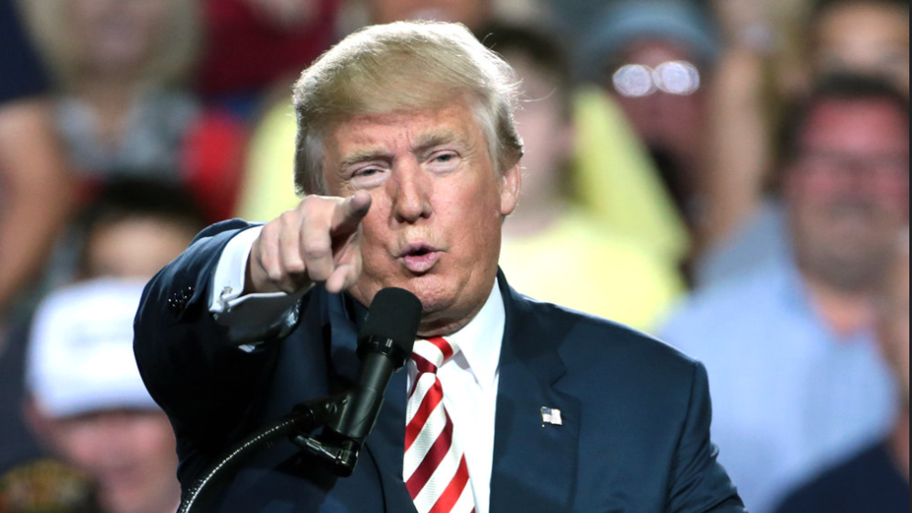
GW Law Webinar – A Tumultuous Year for Trade in Procurement
Thursday, 3 September 2020
9:00 ET / 15:00 CET
Info: www.publicprocurementinternational.com
Photo: Gage Skidmore

Slide 2
Agenda
Disclaimer: All opinions offered are the personal opinions of the participants and should not be attributed to their organizations.
:02
Introductions
Presentations
Questions & Answers (note: please use chat function for questions during the session)
5-minute break
Special Follow-Up Discussion Session: Section 889

Slide 3
Introductions
:::05
Christopher Yukins
George Washington University Law School
Laurence Folliot Lalliot
University of Paris - Nanterre
Scott Sheffler
Feldesman Tucker
Tom McSorley
Arnold & Porter
Jean Heilman Grier
Djaghe, LLC
Robert Anderson
WTO (retired)
Roland Stein
BLOMSTEIN, Berlin
Michal Kania
University of Silesia

Slide 4
Key disruptive forces at play with the COVID crisis may have durably modified the public procurement trade market (L. Folliot Lalliot & C. Yukins, Concurrences (Sept. 1, 2020))
:10
Temporal
Geographical
Security/Safety
New Competition
Professor Laurence Folliot Lalliot (University of Paris – Nanterre)

Slide 5
Scott Sheffler – Feldesman Tucker
Section 889 – “Huawei ban”

Slide 6
Section 889 The “Huawei Ban”
:17
889 Portions | Basic Rules (Paraphrased – Apply to all contracts and orders) | Regulatory Implementation
(a)(1)(A) | Federal Agencies may not “procure or obtain[,] or extend or renew a contract to procure or obtain[,] any equipment, system, or service that uses covered telecommunications equipment or services as a substantial or essential component of any system. . .” | FAR Subpart 4.21; 52.204-24; 52.204-25 Rep that will not provide Contract clause requiring prompt reporting if discovered Flow-down required
(a)(1)(B) | Federal Agencies may not “enter into a contract (or extend or renew a contract) with an entity that uses any equipment, system, or service that uses covered telecommunications equipment or services as a substantial or essential component of any system. . .” | Same Provisions/Clauses No “use” org-wide (reasonable inquiry) Does not flow-down to subs, but “use” seems to be a broad concept
(b) | Federal Agencies may not “obligate or expend loan or grant funds to procure or obtain [or] extend or renew a contract to procure or obtain . . . the equipment, services, or systems described in subsection (a).” Implemented a sub-federal level. | 2 C.F.R. §§ 200.216, 200.471 / App. II Federally funded entities essentially “mini” federal agencies implementing (a)(1)(A)-type rule. (89 FR 49506)
What is “covered telecommunications technology” – legal and (substantial) practical issues.
As implemented, (a)(1)(A) and (b) impact what a contractor furnishes to a federal agency or federal grant recipient (e.g., state government) purchasing with federal dollars.
As implemented, (a)(1)(B) is particularly impactful. Government contract holder cannot “use” system or equipment that contains “covered technology” as a “substantial component.” Will this operate to advantage U.S. entities in U.S. procurements as the U.S. market adapts to the pervasive limits on Huawei tech?
Compensable unilateral contract mod or sovereign act?

Slide 7
Tom McSorley – Arnold & Porter Cybersecurity Maturity Model Certification (CMMC)
:24
DoD moves from a self-certification to third party verification model
Since 2013, DoD has refined and expanded cybersecurity requirements imposed on DoD contractors (and many of their contractors’ suppliers)
“Controlled” information provided by DoD under the contract…or “used” in support of the contract … must be protected under, at a minimum, a published U.S. government standard
DoD’s approach has been to rely on contractor self-certification to these requirements, but there is continued concern from both the U.S. government, and contractors, about uncertainty in self-certification
This is not all government driven; contractors that “falsely” self-certify are at risk of significant liability.
CMMC is an evolution of these requirements: 5 progressively more onerous levels of requirements to meet, and verification of compliance by “CMMC Third Party Assessment Organizations (C3PAOs)”
“Certainty” replaces flexibility; but DoD contractors will become a cybersecurity “in group”

Slide 8
Jean Heilman Grier – Djaghe, LLC
:31
Context for Buy American pressures in fighting pandemic
President’s “Executive Order on Ensuring Essential Medicines, Medical Countermeasures, and Critical Inputs Are Made in the United States (Aug. 6, 2020)
Requires federal agencies to purchase US-produced essential medicines, countermeasures such as PPEs and critical inputs, using limiting tendering procedures and dividing a procurement between 2 or more U.S. manufacturers. Typical exceptions apply, including where cost of domestic products would be more than 25% of foreign products.
Extends buy domestic requirements to the Department of Defense’s (DoD) procurement of essential medicines under Defense Reciprocal Procurement Agreements; requires DoD to “reject otherwise acceptable offers of such products from sources in Qualifying Countries in instances where considered necessary for national defense reasons.”
General Service Administration’s non-availability determination (Apr. 2020)
PPEs, N95 masks, hand sanitizers and other products needed to fight covid-19 manufactured in U.S. or trade agreement countries were not available in sufficient quantities.
Temporarily lifted procurement ban on purchases of products from China and other countries that have not opened their procurement to U.S.
Buy American legislative proposals would require federal agencies to purchase U.S.-made PPEs
Democratic presidential nominee Joe Biden’s Buy American plan
Tighten domestic content requirements and waivers of those requirements.
Extend Buy American requirements to other forms of governmental assistance.
Work with trading partners to modernize international rules “to make sure that the U.S. and allies can use their own taxpayer dollars to spur investment in their own countries.”
WTO Government Procurement Agreement (GPA) and Free Trade Agreements (FTAs)
Obligation to not discriminate against goods from other parties.
New Buy American requirements would inconsistent with U.S. obligations unless remove products from agreements or invoke exception for protection of human life or health.
President directed U.S. Trade Representative to remove essential medicines from GPA and FTAs. Requires notification of parties and allows them to withdraw substantially equivalent coverage from U.S.
Erosion of procurement covered under trade agreements

Slide 9
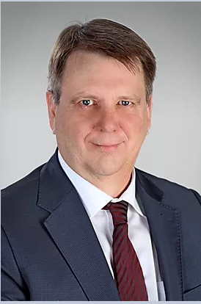
Robert Anderson – World Trade Organization (retired)
:38
Need for international cooperation to address pandemic
Costs of medical and procurement nationalism
Ongoing weakening of the international trading system
Government Procurement Agreement (GPA) on pandemic-related procurements:
Notice periods
Limited tendering
Exception for human life or health
What more could help
Possible new agreement(s) covering vaccines/export restraints.

Slide 10
Michael Kania – University of Silesia White Paper on leveling the playing field as regards foreign subsidies
:45
Background on the European Commission’s White Paper
EU Single Market Approach and State Aid restrictions
Procedure
Initiation
Investigation
Redressive measures
Next steps and conclusions

Slide 11
Roland Stein – BLOMSTEIN, Berlin International Procurement Instrument Exclusion of Chinese bidder

Slide 12
International Procurement Instrument (IPI)
:52
Proposal
Amended Proposal
Position Paper
Approval by the European Parliament and Council expected by 2021
2012
2016
2020
2016
2019
No deal breakers
Topics under discussion:
Leverage effect towards third-countries
Possibility to completely exclude bidders
Avoiding additional burden
Discussion of the proposal and request for amendments
Discussions intensified

Slide 13
Exclusion of Chinese Bidder
:52
Public Contracting Authority
Highlights
Requirements „clearly and undoubtedly“ met
Provision clearly in line with EU law
No time bar

Slide 14
Questions and Discussion

Slide 15
Questions
What is the goal of the Section 889 “Huawei Ban” – to counter Chinese government espionage against the U.S. government, to check Chinese theft of industrial secrets, or to undercut Chinese economic dominance?
Does the answer to that question affect the question of what Section 889 violations may be “material,” for purposes of potential fraud liability under the False Claims Act?
What is the future trajectory of the Cybersecurity Maturity Model Certification (CMMC)?
Why did President Trump announce that the United States would be revising its coverage under the Government Procurement Agreement – why not simply exercise the “health” or “security” exceptions under Article III of the GPA in “on-shoring” production of medicines for the U.S. government market?
When is the next round of European procurement directives likely – and is there a significant risk that they will include new protectionist measures?
Audience questions

Slide 16
After 5-minute break:
Special session on Section 889 (the “Huawei Ban”)

Slide 17
Conclusion
Materials and a recording of this program will be posted on www.publicprocurementinternational.com

