Slide 2
Program Begins: 9 am Eastern US / 13:00 UK / 14:00 CET / 15:00 South Africa

Slide 3
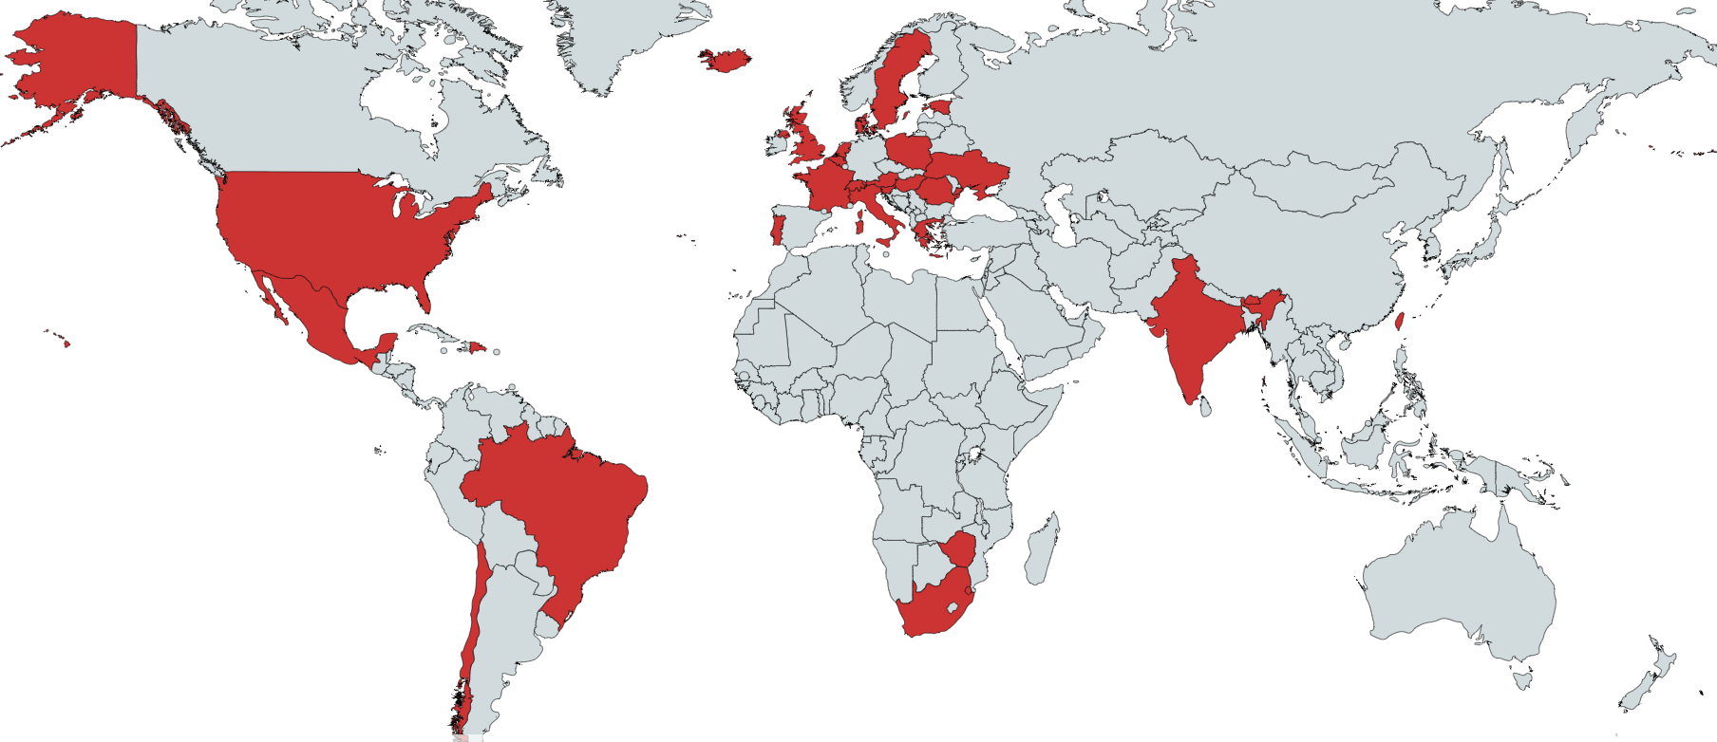
Welcome to over 350 government officials, managers, researchers, attorneys, students and academics registered from over 30 countries

Slide 4
Agenda
Disclaimer: All opinions offered are the personal opinions of the participants and should not be attributed to their organizations.
Introductions
Presentations
Questions & Answers (note: please use chat function for questions during the session)

Slide 5
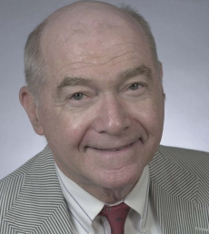
In Memoriam Professor Frederick J. Lees, 1930-2020

Slide 6
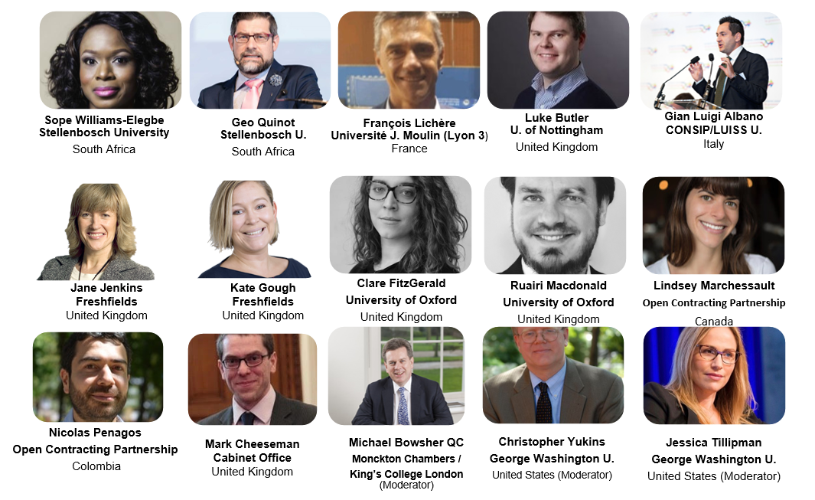
Panelists
Emergency Contracting &
Anti-Corruption
Contract Administration
Supply Chain Resilience
Social Contracting
Contractual
Risk
Allocation
Open Data
Cross-
Border
Studies
:00-:05
Anti-Fraud

Slide 7
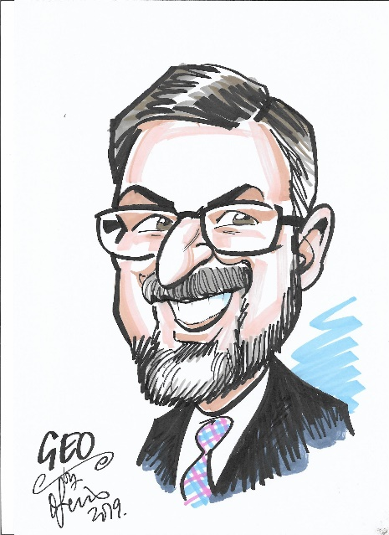
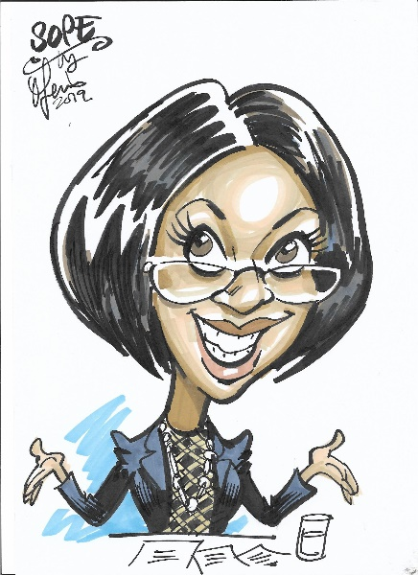
South Africa
Prof Geo Quinot & Prof Sope Williams-Elegbe
Stellenbosch University & African Procurement Law Unit
Approach to COVID-19 procurement
Centralisation (Transversal contracting)
Emergency procurement – direct contracting
Price controls
Consequences
Investigations and prosecutions
Future initiatives
:05-:15

Slide 8
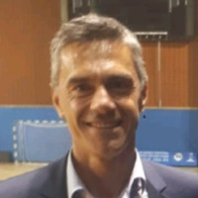
CONTRACT ADMINISTRATION: RECOVERY OF ADDITIONAL COSTS
François Lichère Université J. Moulin (Lyon 3) France
FACTORS AFFECTING…One major one = risk profile
E.g. contract type: fixed/firm, target, cost-plus (some argue use cost-plus more in response!)
STANDARD CLAUSES … No “EU Contract Administration Directive”. So… model/individual clauses…
US: FAR - force majeure style permitting excusable/compensable delay
UK: no standard clauses per se – policy steer away from suspension/termination to continuity e.g. (model) interim payments etc
RECOVERY - “Allowable costs” – from existing costs affected by COVID-19 to remobilisation
How do you decide?
UK change of law clause may permit recovery; if not, Government procurement policy?
“Appropriate”, “attributable”, “reasonable” (US FAR, UK Open Book Contract Management, UK SSCR)
How do you verify?
UK “open book” e.g. records for reconciliation: how if poor oversight/audit?
Luke Butler U. of Nottingham
United Kingdom
:15-:25

Slide 9
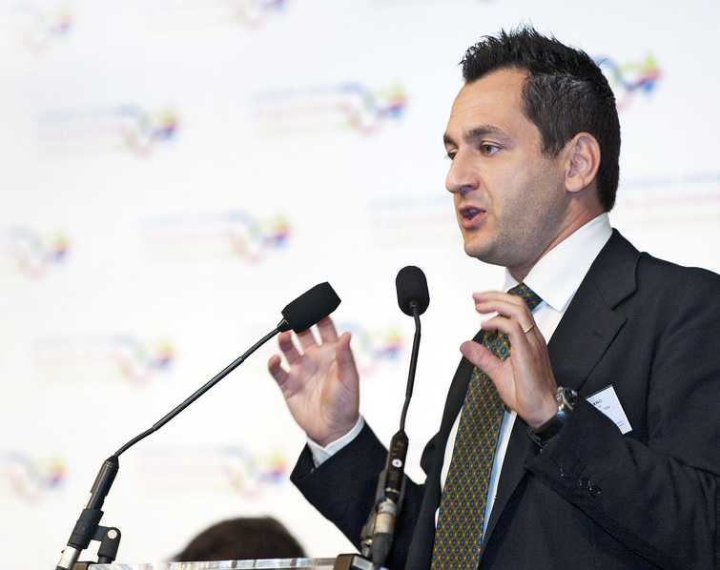
Buyers’ Coordination Gian Luigi Albano (CONSIP – Rome / University LUISS “G. Carli”)
Chaotic marketplace:
Buyers competing against each other
PPE’s becoming almost financial assets
Sensible -under normal circumstances- purchasing tools (e.g. FAs) standing on a fragile global supply chain
Challenges:
Dealing with vendors born overnight
Checking quality when you need to buy quickly
Getting rid of the “direct award” option
:25-:35

Slide 10
Protecting the supply chain
The UK government’s efforts to maintain a resilient supply chain during the pandemic
Overview of UK Government guidance and measures
Reality of the contractual position
Practical work arounds for suppliers/the UK government
What next?
Jane Jenkins
Kate Gough
:35-:45

Slide 11
Cross Sector Partnerships for Better Social Outcomes Clare FitzGerald and Ruairi Macdonald
In UK outcomes-based contracts (e.g. impact bonds):
A focus on outcomes (vs. activities) should allow more flex in delivery, but…
Changes to services, measurement of outcomes, payment terms
Contract terms proving unhelpful meaning…
Contract & relationship mgmt. capabilities important even in ‘clever’ contracts
GO Lab website: https://golab.bsg.ox.ac.uk/
Database on Impact Bonds worldwide
Peer learning groups: Procurement of Government Outcomes Club
POGO Club Meeting re Social Value on Nov 24
Email golab@bsg.ox.ac.uk to signup.
:45-:55

Slide 12
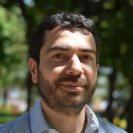
The Promise of Open Contracting Lindsey Marchessault, Director for Data and Engagement Nicolas Penagos, Head, Latin America Open Contracting Partnership
Background on Open Contracting Partnership
12-country study -- how open data and open contracting strategies can facilitate governments’ responses to emergencies.
:55-1:05

Slide 13
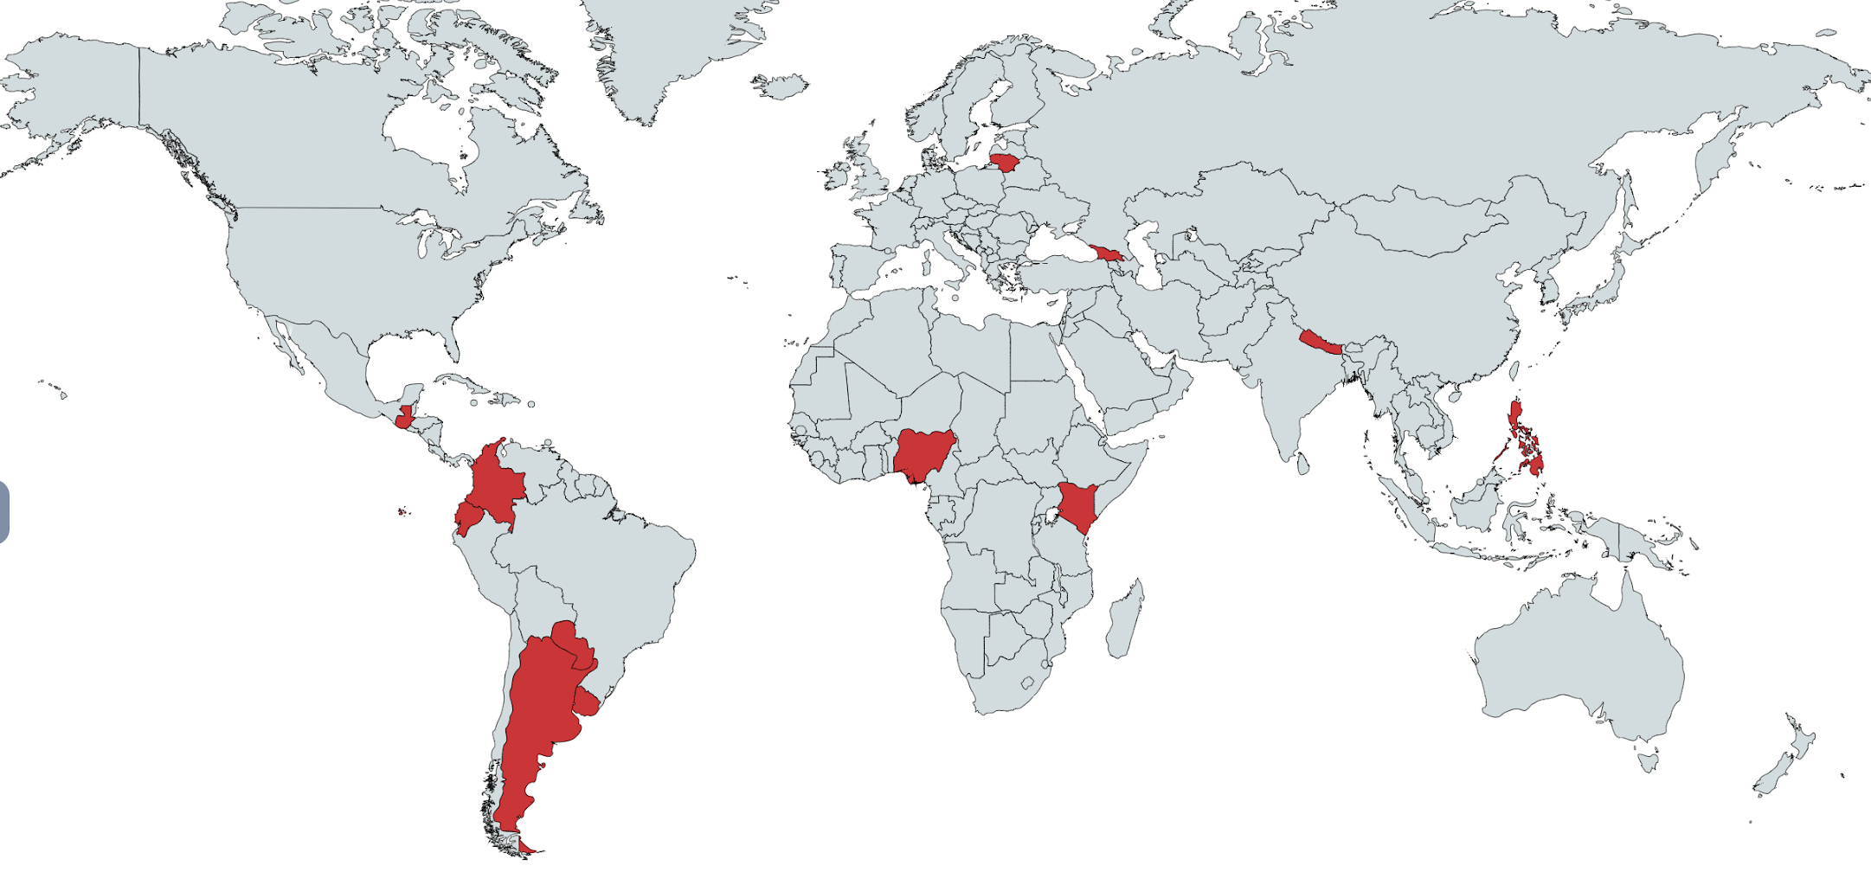
OCP’s Covid-19 Action Research Program: 1,350,000+ contracts analyzed
Summary Findings
Higher prices & disparity in unit prices paid by different buyers
High usage of ‘multipurpose firms’ & firms with no prior experience selling the purchased items
Use of firms less than 6 months old
Serious quality and completeness issues in the published data
Places where published data was standardized, timely and
of good quality enabled the best analysis
:55-1:05

Slide 14
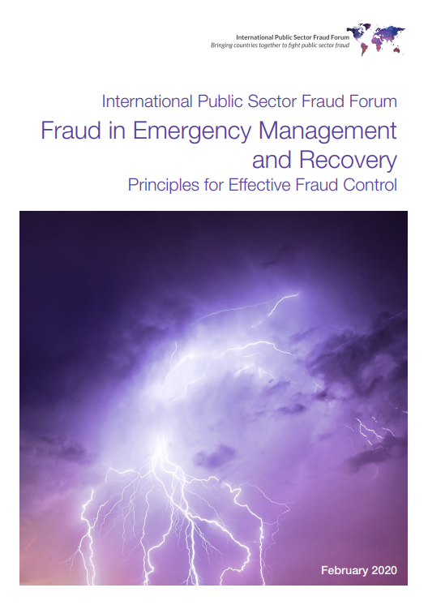
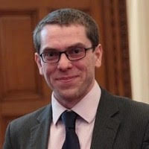
Fraud in the Emergency Mark Cheeseman Director of Government Counter Fraud Function and COO Cabinet Office United Kingdom
Fraud in emergency management and recovery
Recent study published by the UK Cabinet Office
1:05-:15

Slide 15
Questions & Discussion
Different nations have taken different approaches to force majeure – to the question of which party should bear the risk of a natural disaster, the government or the contractor. Does it make sense to leave that risk with contractors?
In the same vein – if contractors fail, who bears that risk?
Are these questions a first step to understanding how a government might use its procurement function to effect a fiscal stimulus – or accomplish other socioeconomic goals in a disaster?
Our discussion of “buyer cooperation” amongst governments and public agencies in a disaster raises this question: is this an argument against outsourcing the public procurement function?
1:15-:30

Slide 16
Conclusion
Program recording and materials will be available on www.publicprocurementinternational.com

Slide 17
Resources

Slide 18
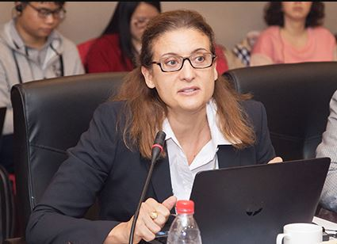
COVID-19: Lessons learned in public procurement -- Time for a new normal?
Laurence Folliot Lalliot & Christopher Yukins, Concurrences, Sept. 2020, https://papers.ssrn.com/sol3/papers.cfm?abstract_id=3685860

Slide 19
https://www.open-contracting.org/action-research-lessons-COVID19 Complete collection of Covid-19 research & guidance can be found at www.open-contracting.org/covid19

Slide 20
Available at: https://assets.publishing.service.gov.uk/government/uploads/system/uploads/attachment_data/file/864310/Fraud_in_Emergency_Management_and_Recovery_10Feb.pdf

Slide 21
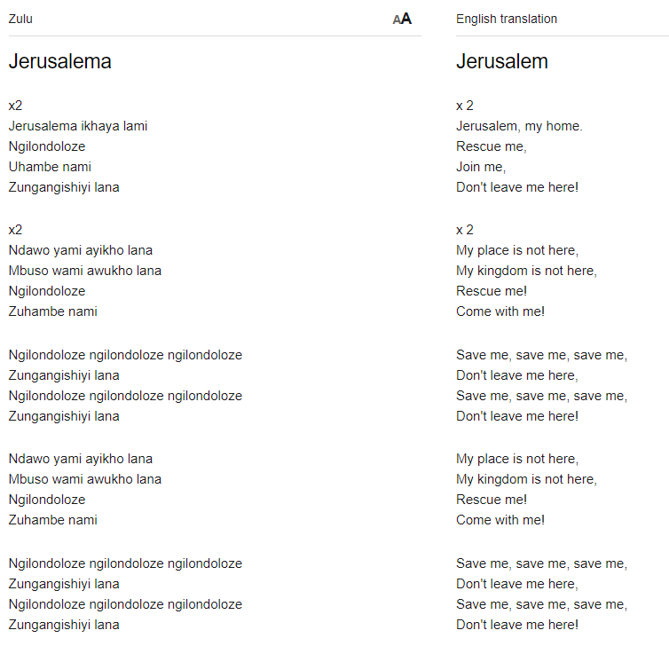
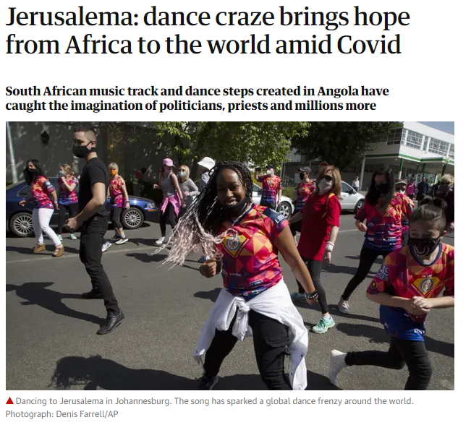
Lyrics to Jerusalema, by Master KG and Nomcebo Zikode https://lyricstranslate.com/en/jerusalema-jerusalem.html-0 Kids take dance challenge: https://www.youtube.com/watch?v=2GJxT5ZbEME&list=PL5j1BMtOAsi2Pl9LfMPGqlYB-KKxcxAug

