Slide 1
Planning for the Vaccine Robert Handfield Bank of America Distinguished Professor of Supply Chain Management Poole College of Management Email: robert_handfield@ncsu.edu https://scm.ncsu.edu/scm-articles/article/category/directors-blog

Slide 2
Supply Chain Resource Cooperative
The Cooperative serves as a thought leader in the increasingly complex and competitive supply chain industry; documenting and disseminating new supply chain management knowledge to help companies, practitioners, and students.
Members include Altria, Biogen, Siemens, VF Corp, UPS, Gilead Duke Energy, Thermo Fisher, Merck, American Red Cross, Advanced Auto Parts, Global Trade Professionals Alliance, Caterpillar, John Deere, and others.
Extensive articles, blogs, etc.
www.scm.ncsu.edu

Slide 3
Agenda
The Global Supply Chain
The Plan for the Vaccine
How Robust is the Vaccine Supply Chain?
Plan
Source
Make
Deliver
Sell / Return
Looking forward

Slide 4
The changing face of global supply chains
Global Value Chain Development Report 2019
World Bank, World Trade Organization

Slide 5
Exponential Complexity and Single Point of Failure
A large OEM may have as many as 5,000 direct suppliers
Each of these may have up to 250 suppliers of their own
This results in a supply network of 1.25 million suppliers
It takes one incident to disrupt operations
Most organizations have no idea who is in their tier 2 supplies and have not paid attention
Example: N95 masks, PPE, and other key API’s are all produced in China!
Notes:
Exponential Complexity and Single Point of Failure" - b/c we have deep and wide SC complexity that is overwhelmingly reliant on China as a source. This, in effect, creates a single point of failure when they take national policy action to prohibit/limit exports

Slide 6
** Assumes no major side effects over time, Phase 1A &1B health workers first. Don’t forget to vaccinate the value chain!
Notes:
Phases assume no major side effects over time...may need to add an *** for that -- Phase 1A and 1B assume healthcare workers first. There is a discussion about vaccinating vulnerable groups first (in terms of health risk vs. infection risk) -- Great time to mention vaccinating the value chain for the vaccine as well

Slide 7
PLAN
ISSUES
Allocation Issues
How waves of distribution will be allocated
Inventory positioning
State level communications with federal
Tracking the second dose of vaccine
RISKS
Shortages
Hacking
IP Loss
Lack of coordination resulting in inequities
Terrorism or Nation State Sabotage

Slide 8
SOURCE
ISSUES
Supply bottlenecks
Lack of critical materials
Rubber and glass are critical
Health of key supply chain personnel
RISKS
Unable to scale up production due to shortages
Inability to get FDA permissions for alternative suppliers
Vaccine worker infections slow or stop production
Natural rubber runs out or slows down

Slide 9
MAKE
ISSUES
Fill finish capacity
Lack of freezer capacity for storage
Lack of skilled personnel
RISKS
Bottlenecks
Quality issues
Regulatory requirements
FDA Shutdowns

Slide 10
DELIVER
ISSUES
Cold Chain store
Life capacity (air)
Distribution security
Last mile delivery
CDL trucker shortages
RISKS
Lack of cold chain transportation capacity
Damage to product
Diversion
Counterfeit
Notes:
As of Aug. 1, the number of drivers who tested positive for drug use and placed in a prohibited “do not hire” status was 26,433. Of this group, 21,053 have not yet started the return-to-duty process. Another contributing factor to the present shortage is that fewer drivers have been going through training schools due to limited seating capacity from social distancing. Driver schools are graduating 30% to 40% fewer drivers, and Costello expects this will result in “tens of thousands of drivers” not entering the labor pool this year.
“The driver shortage is going to remain for a while,” Costello said. “It’s like 2018 all over again.”

Slide 11
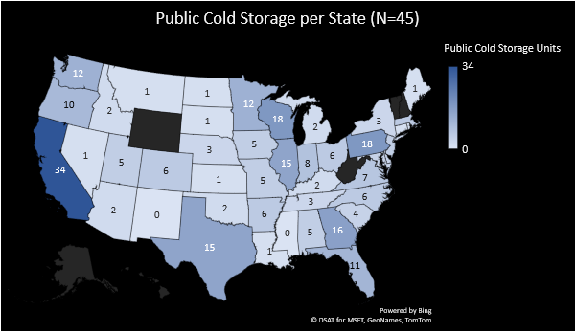
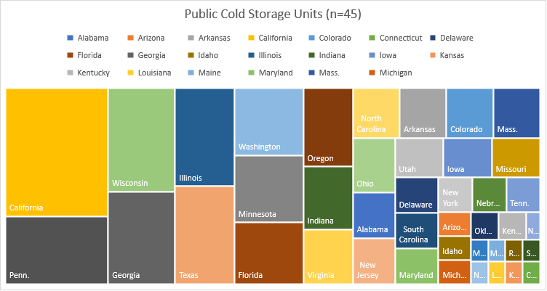

Slide 12
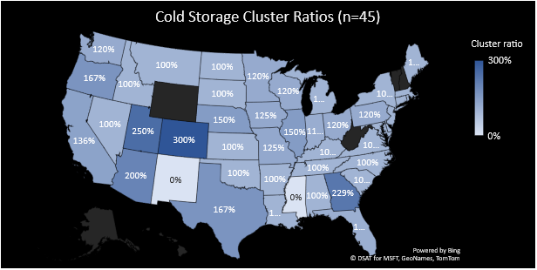
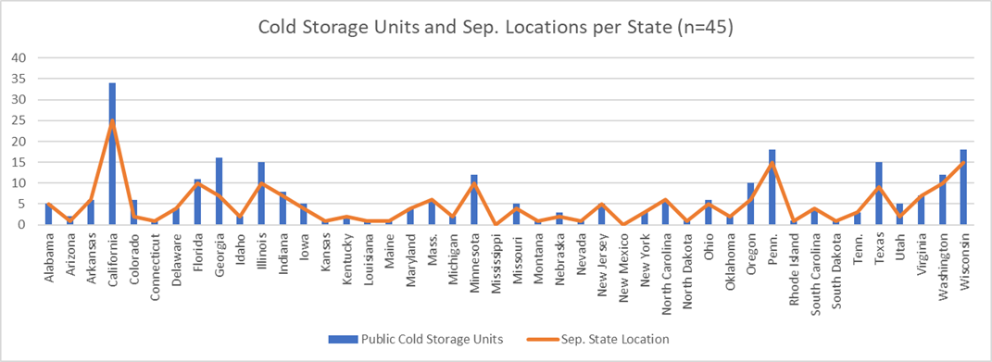

Slide 13
SELL / RETURN
ISSUES
Injection staff and PPE
Return of healthcare waste
Safe disposition of used needles
Marketing the vaccine
Lack of value chain mapping for critical steps, personnel, and channels
RISKS
Lack of staff
Convincing consumers to get vaccinated
Lack of PPE and safe locations
Lack of planning to minimize vaccine time out of controlled cold storage
Notes:
personnel and channeling issues. Value chains become Vital Chains in this instance

Slide 14
Looking forward
Vaccine deployment will not be smooth
There has not been effective communication of the plan
Suggest having your DHS group connect with federal planning agencies
Begin thinking about your deployment plan at a state and local level
Need to map the entire cold storage facility capacity in the US to ensure that states and Fed gov’t can prioritize purchase of support items
Explore options like MECOTEC one-stop transport solutions to reduce handling outside of temp controlled environments (esp. rural geo-separate states)
Notes:
Lack of full value chain mapping to ID critical steps, personnel and channeling issues. Value chains become Vital Chains in this instance." "Lack of planning to minimize vaccine time out of controlled cold storage. Need to consider options like MECOTEC one-stop transport solutions to reduce handling outside of temp controlled environments." "Need to map the entire cold storage facility capacity in the US to ensure that states and Fed govt can prioritize purchases of support items like MECOTEC one-stop units to more rural/geo-separated states vs. just large population states."

Slide 16
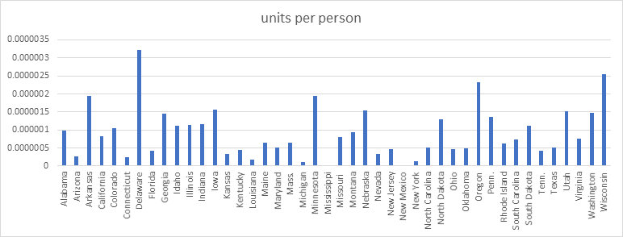

Slide 17
