Slide 1
Webinar – Delivering the Vaccine: Procurement’s Challenge
10 December 2020
9 am Eastern / 14:00 GMT / 15:00 CET
Information and Registration:
https://publicprocurementinternational.com/webinar-delivering-the-vaccine/
Notes:
Chris

Slide 2
Welcome to Today’s Program
Disclaimer: All opinions offered are the personal opinions of the participants and should not be attributed to their organizations.
Introductions
Presentations
Questions & Discussion (note: please use chat function for questions during the session)
9:02
Notes:
Chris

Slide 3
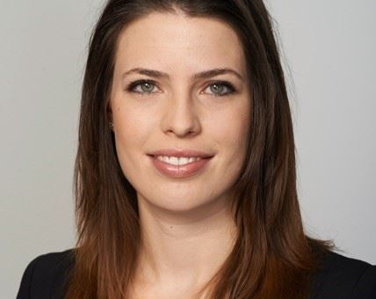
Désirée Klingler – PhD Candidate, University of St. Gallen – Introductions and agenda
9:04
Notes:
Chris: PhD Candidate in data-driven Public Procurement Law at the University of St. Gallen, lecturer in law and economics at the University of Hamburg and former strategy consultant in the public sector.

Slide 4
Panelists
Désirée Klingler – PhD Candidate, University of St. Gallen
Prof. Robert Handfield – NC State
Steve Guppy – Crown Agents
Prof. Simon Evenett – University of St. Gallen
Prashant Yadav – Center for Global Development
Christopher Yukins – GW Law School
Amanda Willett – Crown Agents
Maribel Ramos – National Governors Association
Notes:
Desiree to note panelists

Slide 5
Agenda
9:04
9:00 – 9:02
Christopher Yukins – Open and instructions
9:06-9:07
Maribel Ramos – U.S. distribution – issues for the states
9:17 – 9:25
Robert Handfield – Observations on U.S. distribution of vaccine
9:25 – 9:33
Simon Evenett – Emerging trade barriers to distribution
9:33 – 9:43
Prashant Yadav – Supply chain issues in int’l distribution
9:43 – 9:50
Steve Guppy – Some observations from the field
9:50 – 10:00
Questions and discussion
9:04-9:05
Amanda Willett – Crown Agents - Welcome
9:02-9:04
Desiree Klingler – Introductions and agenda
Chris Yukins – Vaccine status
9:07 – 9:17
Notes:
Desiree – quick review of names and topics

Slide 6
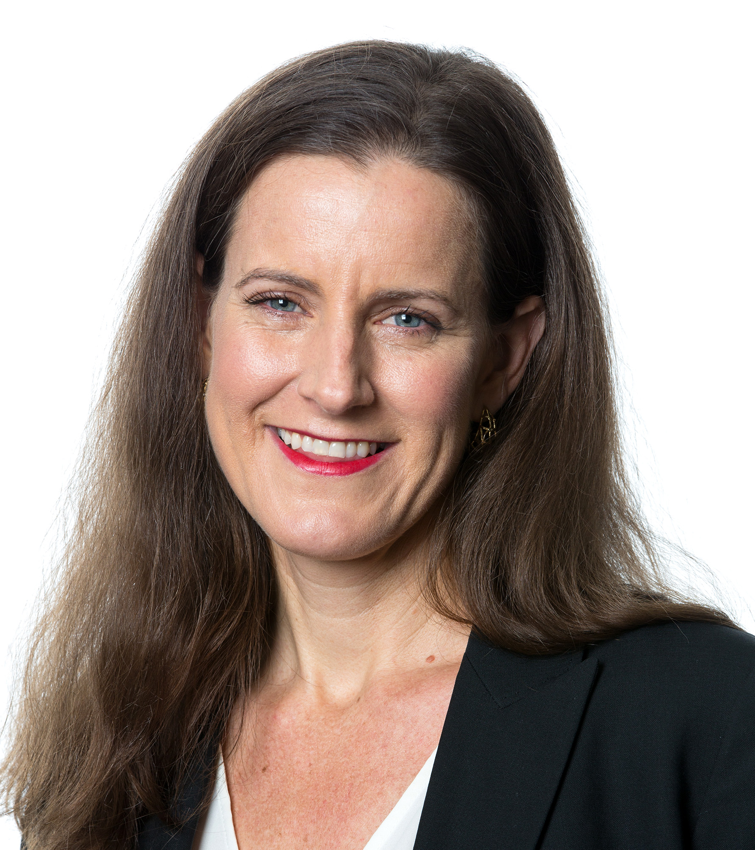
Amanda Willett – Crown Agents USA
9:05
Welcome
Notes:
Désirée: President and CEO of Crown Agents USA, international development company that helps governments to reduce poverty and improve health, by providing consultancy, financial services and training. Amanda has worked in international development for nearly 20 years across many countries.
*****
Amanda: Good morning, afternoon, evening to each of you. I have the distinct pleasure of welcoming everyone. We are thrilled with the amazing turnout and huge interest in today’s webinar! As Désirée mentioned, I am President & CEO of Crown Agents USA. Crown Agents is a global group of companies headquartered in London. We have over 187 years of procurement experience and expertise delivering supply chain services, tracking and tracing supplies through the last mile in some of the world’s most challenging operating environments from South Sudan to Myanmar.
We’ve got an absolutely packed agenda bringing together both domestic U.S. and international perspectives! The news and information has really accelerated over the past week since the U.K. led the world granting the first approval of the “rigorously tested” Pfizer vaccine and got immunizations underway.
Procurement, distribution, access, and equity issues will abound as more vaccines are expected to secure approval and distribution begins to scale globally through both bilateral agreements and COVAX, co-led by the World Health Organization, GAVI, the vaccine alliance, and the Coalition for Epidemic Preparedness Innovations. The challenges ahead for the world will be enormous and our panelists are here to walk us through what we can expect in the weeks, months, and even years ahead. We hope you enjoy the presentations, and very much look forward to your questions. Without further ado I will hand over to my co-panelist, Professor Chris Yukins of George Washington University Law School, to kick us off.

Slide 7
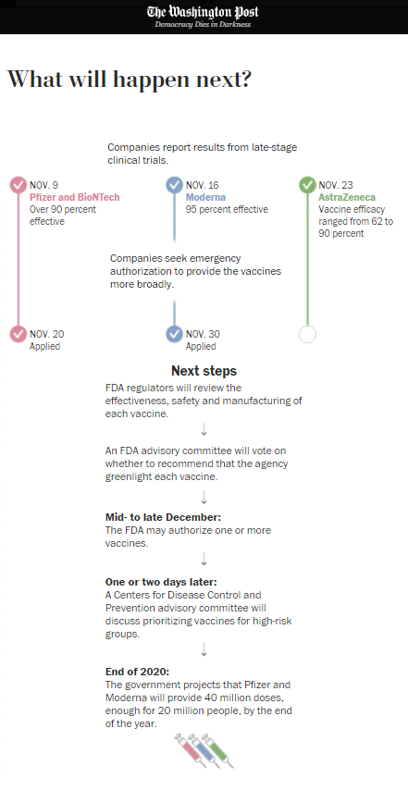
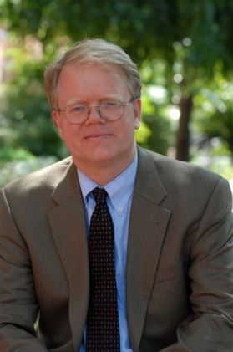
Update on Vaccine – Christopher Yukins GW Law School
9:07
Vaccine distributions underway in China, Russia and UK (Pfizer)
Two shots of vaccine needed
In U.S., first priority likely to (1) healthcare providers, and (2) residents of long-term care facilities
General U.S. population: April - June
Notes:
Amanda: Christopher Yukins, Professor for government procurement at Georgetown University Law School. Many years of experience as trial attorney at the US Department of Justice. He was an advisor to the US delegation on the working group of the UN Commission on International Trade Law UNCITRAL model procurement law.
******
U.S. Centers for Disease Control & Prevention (CDC) – Information on vaccine distribution - https://www.cdc.gov/coronavirus/2019-ncov/vaccines/recommendations-process.html
Washington Post, What Happens Next? https://www.washingtonpost.com/health/2020/11/17/covid-vaccines-what-you-need-to-know/?arc404=true
https://slate.com/news-and-politics/2020/12/russia-britain-covid-19-vaccine-rollout.html

Slide 8
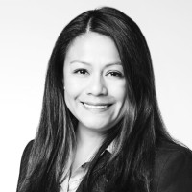
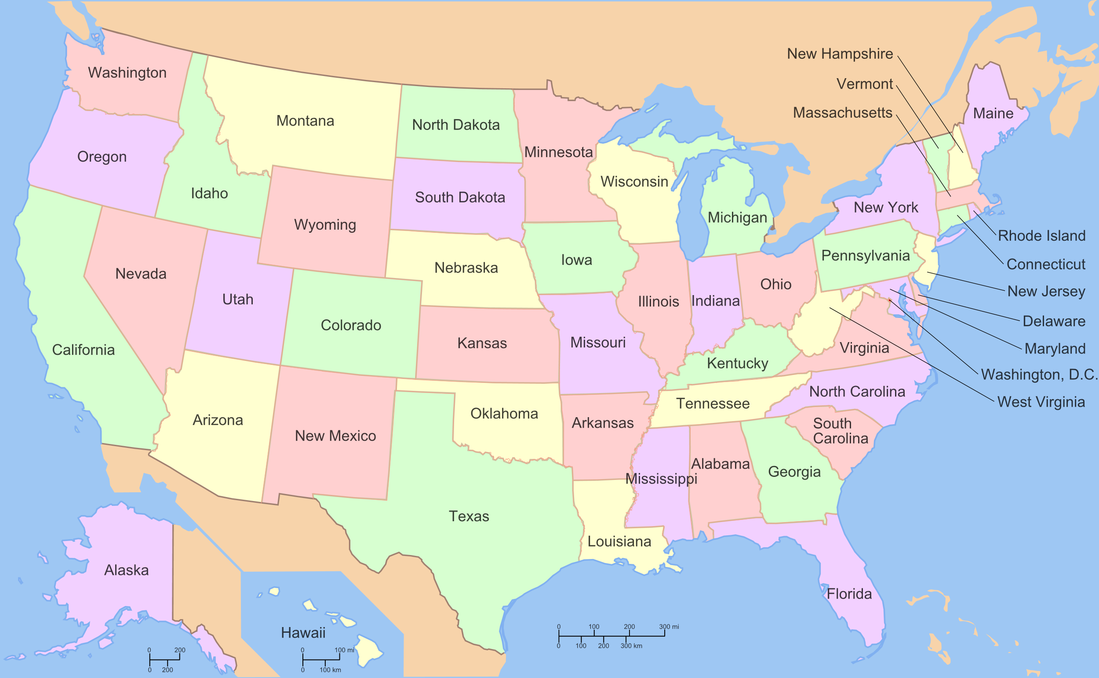
Maribel Ramos – National Governors Association
9:17
Governors of states and territories, working in close collaboration with local partners, will have responsibility for the “last mile” of COVID-19 vaccine distribution.
Phased roll-out
Distributing and monitoring
Provider enrollment and on-boarding
Cold storage
Multiple vaccines and doses
Mass vaccination sites
Notes:
Désirée: Maribel Ramos, legislative director for health at the National Governors Association. NGA is a very influential non-partisan organization that consists of the 50 state governors of the United States. The NGA is an important public policy instrument between state governments and the federal government. They represent state policies at the White house.
********************
https://www.nga.org/wp-content/uploads/2020/11/Vaccine-Distribution-and-Administration-Systems-and-Data-Flow.pdf

Slide 9
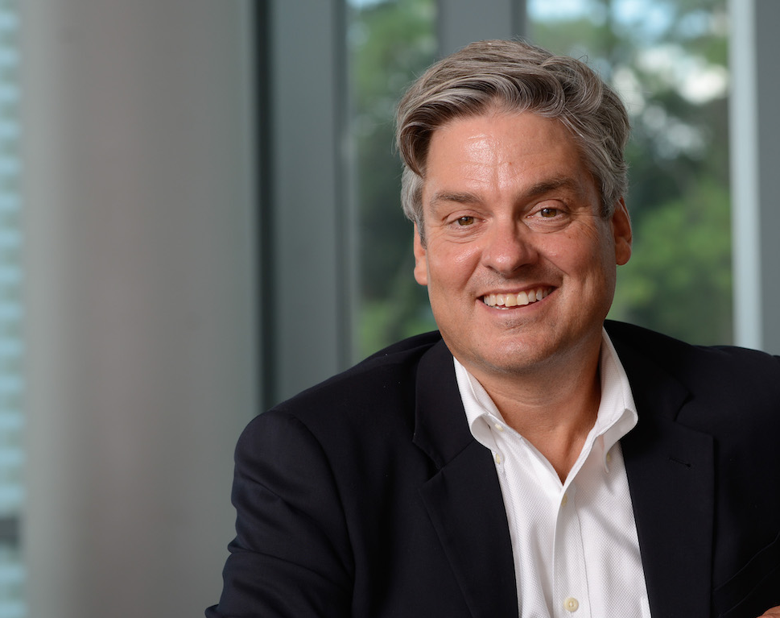
Professor Robert Handfield – North Carolina State University
Observations on U.S. vaccine distribution
Bottlenecks that are likely to emerge
Challenges with return logistics
Other threats to be aware of (hacking, counterfeiting)
9:25
Notes:
Désirée: Rob Handfield, Professor of Supply Chain Management at the North Carolina State University. He has co-authored many books on supply chain management, and consulted many Forbes 500 companies. He is consulting editor of the Journal of Operations Management.

Slide 10
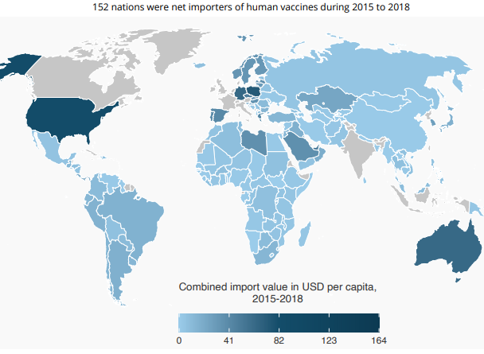
Simon Evenett – University of St. Gallen Emerging Trade Barriers
9:33
Notes:
Désirée: Simon Evenett is professor for international trade and economic development and MBA director at the University of St. Gallen, Switzerland. He created the leading independent monitor of protectionism. He has served as World Bank official twice.
*********************
https://www.globaltradealert.org/reports/60

Slide 11
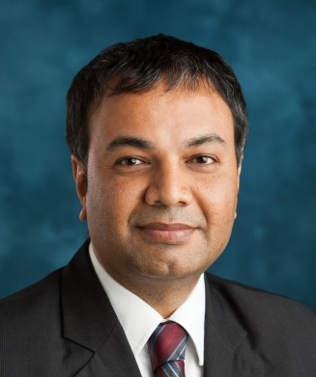
Prashant Yadav – Center for Global Development Challenges in International Distribution
Manufacturing capacity and auxiliary supplies, e.g., vials, syringes
COVID-19 vaccine supply chain in-country, and no-regrets investments in system and infrastructure development
Leveraging data and similar tools for better COVID-19 Vx supply chains
9:43
Notes:
Désirée: Prashant Yadav, senior fellow at the Center for Global Development, a think tank based in Washington DC and London. He is also an affiliate professor at INSEAD. He focuses on improving health care supply chains and supply chains for products with social benefits. He has recently published an article on equitable distribution of the Covid vaccine in the Harvard Business Review (April 2020) and given an interview on how the distribution infrastructure will deploy the coronavirus vaccine (CNBC, November 2020).
https://hbr.org/2020/04/a-covid-19-vaccine-will-need-equitable-global-distribution

Slide 12
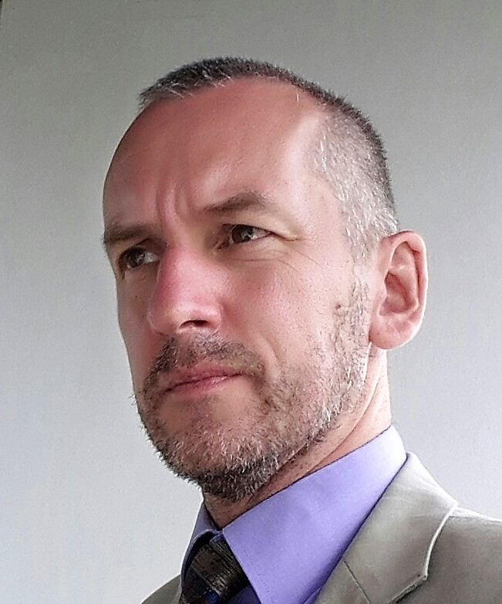
Steve Guppy – Crown Agents
Observations from the field
The COVAX alliance
Readiness and planning
Temperature control
Supply chain security
9:50
Notes:
Désirée: Steve Guppy, Director of procurement at Crown Agents, an international development company specializing in international procurement and supply chain. He is working for Crown agents for 30 years in many countries in Africa and Asia. A supporter and proponent of integrity and transparency within the supply chain.
He will provide some insights from the field, talking briefly about the COVAX model for equal access to vaccines, and then discuss the process of readiness assessments, temperature logging and will touch on issues of supply chain security.

Slide 13
Questions
Where are supply chains most likely to fail in vaccine distributions?
Will there be a role for public procurement to close gaps in the distribution of vaccines?
What broader lessons does vaccine distribution teach for public procurement?
How will having multiple vaccines help or complicate the race to get the world vaccinated?
What changes should we expect under the incoming Biden administration?
The U.S. Defense Department has been engaged in the U.S. Operation Warp Speed and generally the U.S. response to the pandemic. Do you expect militaries to play a role in the global distribution efforts?
Are there lessons we can draw from the distribution and administration of the Ebola vaccine and anti-HIV efforts?
How can tracking and tracing be effectively managed in countries where cellphone networks and electricity may not be readily or consistently available?
Are there lessons from the quite distinct U.S. and U.K. distribution and administration models that both low- and middle-income countries? How might public private partnerships work in global distribution and country-level vaccine distribution and administration?

Slide 14
Conclusion
Program recording and materials posted at www.publicprocurementinternational.com

