Slide 1
Public Procurement in International Trade Professor Christopher Yukins
January 2021

Slide 2
Christopher Yukins Professor of Government Procurement Law
George Washington University Law School

Slide 3
Sources
PubKLaw.com Annual Review Conference – 26 January 2021 - presentation
Christopher Yukins, “Assessing the Trade Agenda for Government Procurement in the Biden Administration” – to be presented February 2021, Thomson Reuters Government Contracts Year in Review
Publicprocurementinternational.com - on European Commission “White Paper,” European Defense Fund and “commercial platforms” initiative
President Biden’s Executive Order (Jan. 25, 2021) – https://www.whitehouse.gov/briefing-room/presidential-actions/2021/01/25/executive-order-on-ensuring-the-future-is-made-in-all-of-america-by-all-of-americas-workers/
President Biden’s remarks (Jan. 25, 2021) - https://www.whitehouse.gov/briefing-room/speeches-remarks/2021/01/25/remarks-by-president-biden-at-signing-of-executive-order-on-strengthening-american-manufacturing/

Slide 4
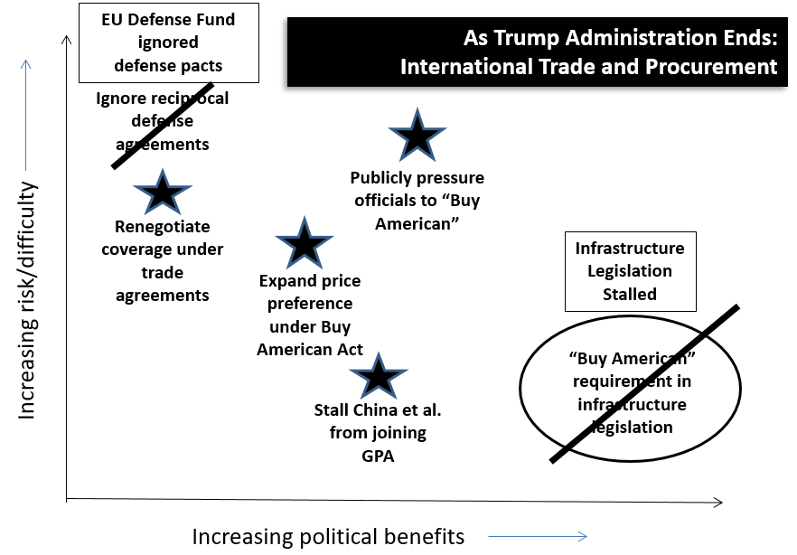
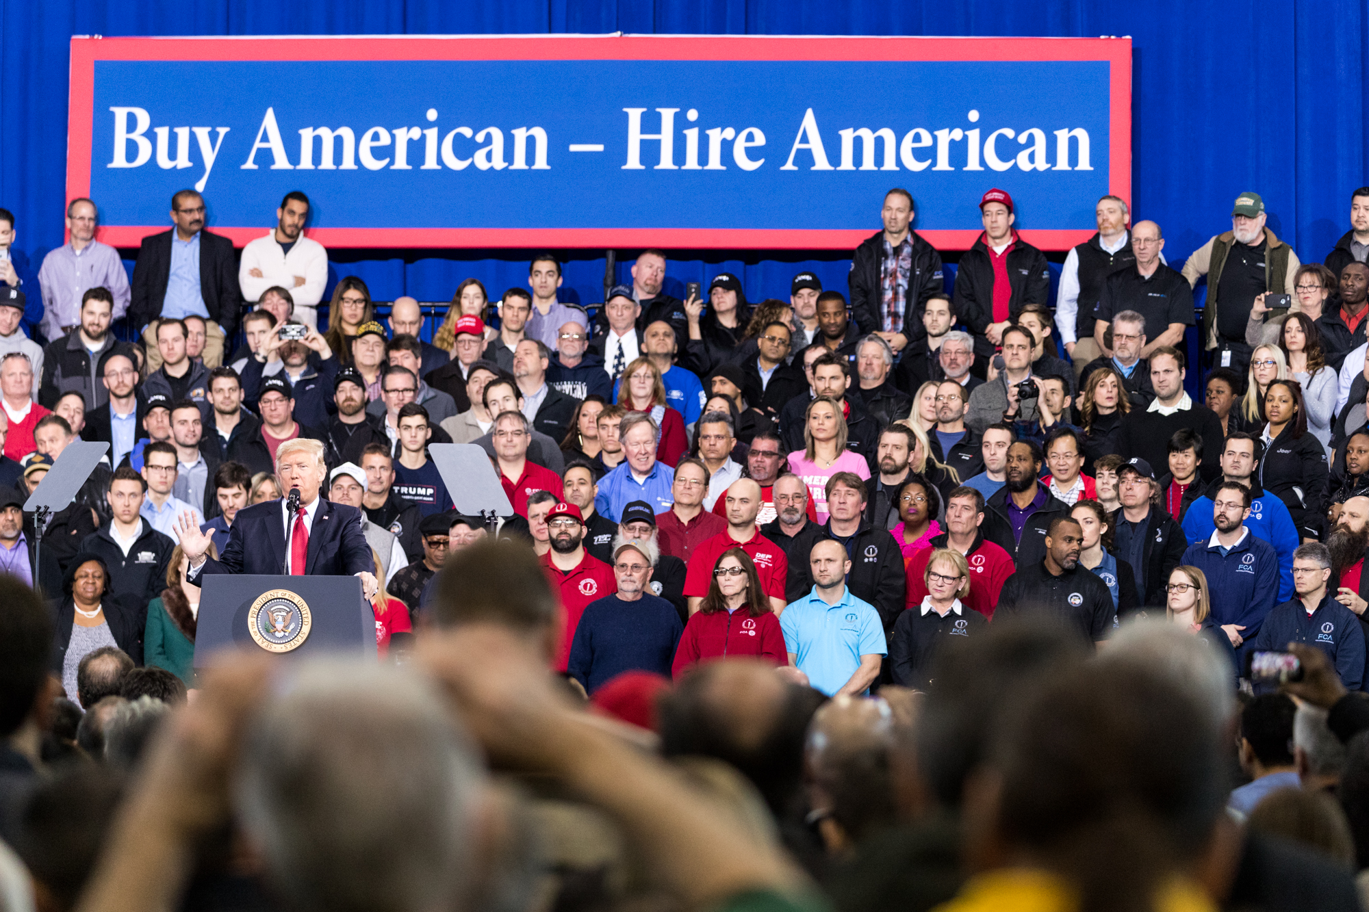
Trump on Trade in Procurement

Slide 5
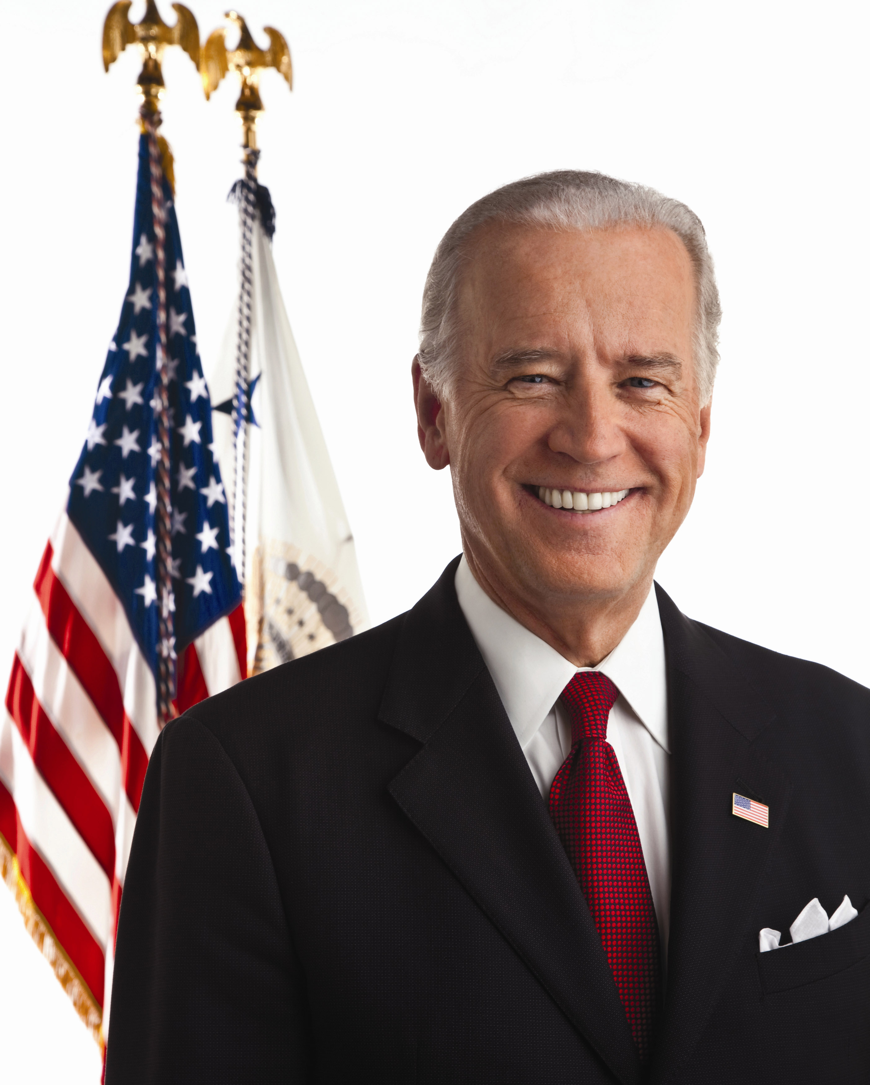
Biden Administration
President Joe Biden
Nominating USTR Katherine Tai: “Trade as a Force of Good”
“Made in America” policy
Challenges
“Huawei Ban” – Section 889 Interim Rule
Cybersecurity Maturity Model Certification (CMMC)
European Commission “White Paper” -- Foreign Government Subsidies
Addressing global warming -- FAR 23.103, GSA 2010 report
Regulatory Cooperation – what process and standards?

Slide 6
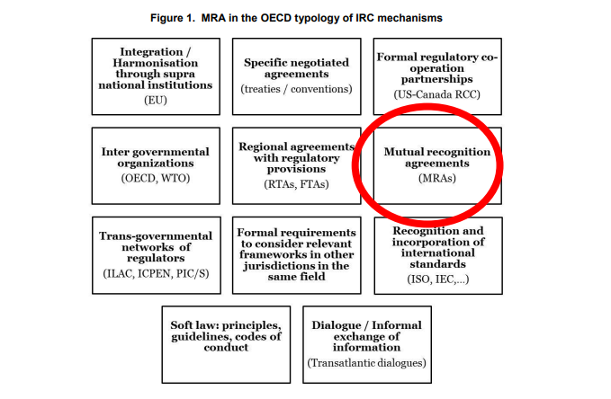
Regulatory Cooperation Strategies
From: Correia de Brito, A., C. Kauffmann & J. Pelkmans, The Contribution of Mutual Recognition to International Regulatory Co-operation (OECD 2016), http://dx.doi.org/10.1787/5jm56fqsfxmx-en (citing OECD, International Regulatory Co-operation – Addressing Global Challenges (2013), http://dx.doi.org/10.1787/97892642004663-en).

Slide 7
President Biden’s “Buy American” Executive Order January 25, 2021 – Questions are in red
Sec. 1: “The United States Government should, whenever possible, procure goods, products, materials, and services from sources that will help American businesses compete in strategic industries and help America’s workers thrive.” How should contracting personnel implement?
Sec. 3: “Review of Agency Action Inconsistent with Administration Policy. (a) The head of each agency shall, as soon as practicable and as appropriate and consistent with applicable law, including the Administrative Procedure Act, consider suspending, revising, or rescinding those agency actions that are inconsistent with the policy set forth in section 1 of this order.” What does this mean for trade agreements – including reciprocal defense procurement agreements entered into by the Defense Department?

Slide 8
President Biden’s “Buy American” Executive Order January 25, 2021
Sec. 4: “Updating and Centralizing the Made in America Waiver Process. (a) The Director of the Office of Management and Budget (OMB) shall establish within OMB the Made in America Office. The Made in America Office shall be headed by a Director of the Made in America Office (Made in America Director), who shall be appointed by the Director of OMB. . . . Before an agency grants a waiver, and unless the OMB Director provides otherwise, the agency (granting agency) shall provide the Made in America Director with a description of its proposed waiver and a detailed justification for the use of goods, products, or materials that have not been mined, produced, or manufactured in the United States.” For supplies, Buy American Act (BAA) procurement-specific waivers apply only to purchases between the micro-purchase threshold (generally $10,000) and the Trade Agreements Act (TAA) threshold (generally $182,000). Do waivers matter?
Sec. 5: “Accounting for Sources of Cost Advantage. To the extent permitted by law, before granting a waiver in the public interest, the relevant granting agency shall assess whether a significant portion of the cost advantage of a foreign-sourced product is the result of the use of dumped steel, iron, or manufactured goods or the use of injuriously subsidized steel, iron, or manufactured goods.” Echo the European Commission’s “White Paper” calling for sanctions against subsidized contractors?

Slide 9
President Biden’s “Buy American” Executive Order - January 25, 2021
Sec. 8: “Promoting Enforcement of the Buy American Act of 1933. (a) Within 180 days of the date of this order, the Federal Acquisition Regulatory Council (FAR Council) shall consider . . .: (i) replac[ing] the “component test” in Part 25 of the FAR that is used to identify domestic end products and domestic construction materials with a test under which domestic content is measured by the value that is added to the product through U.S.-based production or U.S. job-supporting economic activity; (ii) increase the numerical threshold for domestic content requirements for end products and construction materials; and (iii) increase the price preferences for domestic end products and domestic construction materials. How would “value” in the supply chain be measured? And does this duplicate ongoing rulemaking under Trump EO 13881, see 85 FR 56558 (Sept. 14, 2020) – President Biden EO supersedes EO 13881 “to the extent that they are inconsistent with this order”?
Sec. 10: “Report on Information Technology That Is a Commercial Item. The FAR Council shall promptly review existing constraints on the extension of the requirements in Made in America Laws to information technology that is a commercial item and shall develop recommendations for lifting these constraints to further promote the policy set forth in section 1 of this order, as appropriate and consistent with applicable law. Would commercial item IT no longer be exempt from the Buy American Act? Impact? Are the General Services Administration’s “commercial platforms” another pathway (for micro-purchases)?

Slide 10
President Biden’s “Buy American” Executive Order January 25, 2021
Sec. 11. “Report on Use of Made in America Laws. Within 180 days of the date of this order, the head of each agency shall submit to the Made in America Director a report on . . . (a) the agency’s implementation of, and compliance with, Made in America Laws; (b) the agency’s ongoing use of any longstanding or nationwide waivers of any Made in America Laws, with a written description of the consistency of such waivers with the policy set forth in section 1 of this order; and (c) recommendations for how to further effectuate the policy set forth in section 1 of this order. Different from TAA waivers (see below)?
Sec. 12. Bi-Annual Report on Made in America Laws. Bi‑annually following the initial submission described in section 11 of this order, the head of each agency shall submit to the Made in America Director a report on: (a) the agency’s ongoing implementation of, and compliance with, Made in America Laws; (b) the agency’s analysis of goods, products, materials, and services not subject to Made in America Laws or where requirements of the Made in America Laws have been waived; (c) the agency’s analysis of spending as a result of waivers issued pursuant to the Trade Agreements Act of 1979, as amended, 19 U.S.C. 2511, separated by country of origin; and (d) recommendations for how to further effectuate the policy set forth in section 1 of this order. Leave Trade Agreements structure (including BAA waiver (per President Jimmy Carter) in place? How to determine countries of origin?

Slide 11
President Biden’s “Buy American” Executive Order - January 25, 2021
President’s remarks:
“It also means replenishing our stockpiles to enhance our national security. As this pandemic has made clear, we can never again be in a position where we have to rely on a foreign country that doesn’t share our interest in order to protect our people during a national emergency. We need to make our own protective equipment, essential products and supplies. And we’ll work with our allies to make sure they have resilient supply chains as well. We’ll also make historic investments in research and development — hundreds of billions of dollars — to sharpen America’s innovative edge in markets where global leadership is up for grabs — markets like battery technology, artificial intelligence, biotechnology, clean energy. ” Change to stockpile strategy? Continue Trump EO on essential medical supplies? How coordinate research and development with allies?
“At the same time, we’ll be committed to working with our trading partners to modernize international trade rules, including those relating to government procurement, to make sure we can use — we can all use our taxpayer dollars to spur investment that promotes growth and resilient supply chains.” Use European Defense Fund – subsidized R&D by European nations (and like-minded third nations) leading to preferenced production – as a model?

Slide 12
Conclusion
cyukins@law.gwu.edu
+1 703-304-4773 (m)

