Slide 1
Bid Protest reform: Making a Better Use of Bid Protests
Ryan Taft – Procurement Reform
Distortions to Public Procurement from Bid Protest
CO Shapes Actions to Avoid Bid ProtesIt follow on years of congressional concern over bid protests[RESEARCH PAST NDAA’s AND BID PROTEST PROVISIONS]
Pre-award Solicitation, Oral Presentation & Discovery & Post-award Debriefings & Evaluation of an offerors Proposal
Bid protests are considered a pain point not a learning opportunity
Making bid protests a better means of addressing errors
GAO should address protests by industry sector
Protests should be more efficient – increased reliance on agency-level protests
Agencies should develop internal systems to capture lessons learned from protests
Researching internal Air Force tracker.
Conclusion – the study called for by section 886 may not identify critical reforms
Notes:
Making better use of the bid protest system started with the preconceived on-the-job training that the administration suffered from extensive protests that regularly delay the procurement system. Further research proved this could not be further from the truth. It is my impression that a better bid system would improve transparency by providing the interested parties with all their documentation upfront to avoid supplemental protests. This improved system would offset frivolous protests by removing legal fee reimbursements to protestors. As research continued, Daniel Gordon swayed my understanding in his writing “Bid Protests: The costs are real, but the benefits outweigh them.” He diligently breaks down that for 2010 that out of 2299 cases, only 282 were core cases, the remaining being supplemental protests to the original core dispute. Out of this 282, only 45 were sustained. That breakdown leads me to believe that the modified procurement system instead should be simplified. First, GAO should be separated into procurement categories such as services, construction, commodities, large dollar, and micro-purchases. These categories would bring significant expertise for the protestor. By simplifying the protest system to match current commercial standards, shorter litigation periods would be achieved. This would incentivize increased protests allowing agencies to capture greater feedback while encouraging a correction of preconceived notions that contractors and the government are opposing forces on the grounds of dispute resolution, but instead actively engaged as partners to ensure continued transparency

Slide 2
Transparency: greater encouragement to expand Affars 5133.104(a)(3)(ii)
What info we Do/Don’t Share due to Supplemental Protest
CO & Lawyer Answer Matrix for Protest
Inequal release of information to lawyers & non-lawyers
Reducing Average Supplemental Protests

Slide 3
Air Force Protest, Disputes, and Appeals
AFICC PGI 5333.102-90(a)(2)(i) Each Specialized/Operational Contracting Unit (ESS, SCONS, CONS, CONF, etc.) should ensure their respective AFICC OL and/or ESS/KD designated protest focal points are apprised of the status of protests and protest resolutions to include such information as the disposition (denied or sustained), protest withdrawn, corrective action(s) taken, decisions, etc.
AFICC PGI 5333.103 & AFMC PGI 5333.103 Both instruct the contracting officer to obtain legal review and that the COCO should review and make the final decision
PGI Paragraph | MAJCOM | Paragraph Title
PGI 5333.102-90 | AFICC | General
PGI 5333.102-90 | AFMC | General
PGI 5333.103 | AFICC | Protests to the Agency
PGI 5333.103 | AFMC | Protests to the Agency
PGI 5333.9000 | AFICC | Congressional Inquiries Process
Notes:
AFICC & AFMC 5333.103 contains the FAR terms “Should,” and “May” instead of “shall.” My work experience with these terms indicates that as the CO you better have a significant reason for not following these suggested guidelines and that reasoning better be documented into the file (this typically requires some form of review). I want to emphasize this because the Air Force takes agency-level protests very seriously and genuinely questions their internal actions that the contractor protested. It is quite common that corrective action is taken.
AFFARS 5333.103 additionally states that the offeror may request an independent review by the SCO.

Slide 4
What information is collected
AFMC PGI 5333.102-90
(1) Date protest received
(2) Protest type (agency or GAO - before award or after award)
(3) Protestor name and address
(4) Solicitation number and number of offerors or potential offerors
(5) Contract number (if applicable)
(6) Contractor name (if applicable)
(7) Contracting method and type
(8) Amount or estimated amount of acquisition
(9) Buyer/contracting officer name, phone and office
(10) Description of item (including NSN), service, or program name
(11) Summary of protest/issues
(12) Legal liaison assigned to protest
Notes:
I was informed that the reason this tracker information isn’t more transparent is because lines 10 & 11 contain sensitive information on active cases engaged in current litigation/review. That some of these cases at GAO or COFC have gag orders and any agency-level protest could still be escalated to these fora as a “second bite” protest.

Slide 5
Primary reasons for protst
Of the protests resolved on the merits during fiscal year 2020, our Office sustained 15 percent of those protests. Our review shows that the most prevalent reasons for sustaining protests during the 2020 fiscal year were:
unreasonable technical evaluation;1
(2) flawed solicitation;2
(3) unreasonable cost or price evaluation;3 and
(4) unreasonable past performance evaluation.4

Slide 6
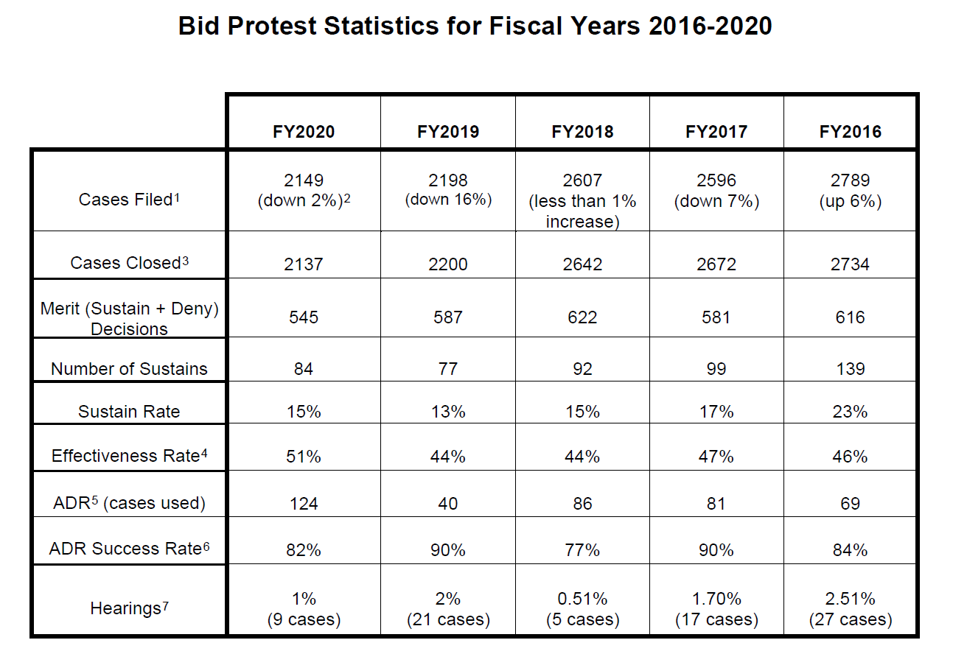
Success Rate of Agency-Level Bid Protests
GAO 21-281SP
Notes:
It is important to note that a significant number of protests filed with our Office (GAO) do not reach a decision on the merits because agencies voluntarily take corrective action in response to the protest rather than defend the protest on the merits. Agencies need not, and do not, report any of the myriad reasons they decide to take voluntary corrective action.

Slide 7
886 Evaluation Shall
This study shall address:
(1) The rate at which protestors are awarded the contract that was the subject of the bid protest;
(2) A description of the time it takes the Department to implement corrective actions after a ruling or decision, the percentage of those corrective actions that are subsequently protested, and the outcomes of those protests;
(3) Analysis of the time spent at each phase of the procurement process attempting to prevent a protest, addressing a protest, or taking corrective action in response to a protest, including the efficacy of any actions attempted to prevent the occurrence of a protest; and
(4) Analysis of the number and disposition of protests filed within the Department.

Slide 8
886 Evaluation Should
the study should evaluate the following factors for agency-level bid protests: prevalence, timeliness, outcomes, availability, and reliability of data on protest activities; consistency of protest processes among the military Services; and any other challenges that affect the expediency of such protest processes.

Slide 9
Airforce system meets the needs of 886
The Data that is collected within the Air Force can answer most but not all the requirements of the section 886 evaluation. The current tracker is capable of answering
Shall
1) the rate at which protestors are awarded the contract.
2) Time it takes to implement corrective action, number of actions that were subsequently protested after corrective action, and the outcomes of subsequent protests.
Should
prevalence, timeliness, outcomes, availability, and reliability of data on protest activities; consistency of protest processes
Notes:
AFMC PGI 5333.102-90 demonstrates most of the data that is collected in the current AF tracker system. The tracker system monitors protests that occur at GAO & COFC and would adequately respond to all of Q2

Slide 10
FAR 33.102 General
(a) contracting officers shall consider all protests and seek legal advice
(b) If, in connection with a protest, the head of an agency determines that a solicitation, proposed award, or award does not comply with the requirements of law or regulation, the head of the agency may-
(1) Take any action that could have been recommended by the Comptroller General had the protest been filed with the Government Accountability Office;
(2) Pay appropriate costs
FAR 33.103 Agency Level
(d)(4) interested parties may request an independent review of their protest at a level above the contracting officer… it will not extend GAO’s timeliness requirements.
(f)(3) Upon receipt of a protest within 10 days after contract award or within 5 days after a debriefing date… the contracting officer shall immediately suspend performance, pending resolution of the protest within the agency, including any review by an independent higher level official
(f)(4) Pursuing an agency protest does not extend the time for obtaining a stay at GAO.
ARMY AFAR 5133.103
(d)(3) must inform the protester, identifying the contracting office that will handle the protest and giving the point of contact within that office.
NAVY NMCARS 5233.103
(d)(3) HCAs are responsible for establishing procedures
(f) “level above the contracting officer” means the CCO or, if the CCO is less than two levels higher than the contracting officer, the Chief of the next higher contracting office. An individual so designated who has been personally and substantially involved with the procurement shall recuse himself or herself
Air Force AFFARS 5333.103
(d)(4) When an agency protest is denied, an offeror may request an independent review by the SCO.
(f) The decision to deny a protest must be made at a level no lower than that at which the protest was filed. Protests may be sustained at any level in the review process, with the concurrence of the cognizant legal office.

Slide 11
When isn’t an agency-level protest applicable
(IDIQ & GSA contracts at ordering level)
FAR 16.505(a)(10)(i) No protest under subpart 33.1 is authorized in connection with the issuance or proposed issuance of an order under a task-order contract or delivery-order contract, except—
(A) A protest on the grounds that the order increases the scope, period, or maximum value of the contract; or
(B) (1) For agencies other than DoD, NASA, and the Coast Guard, a protest of an order valued in excess of $10 million (41 U.S.C. 4106(f)); or
(2) For DoD, NASA, or the Coast Guard, a protest of an order valued in excess of $25 million (10 U.S.C. 2304c(e)).
(ii) Protests of orders in excess of the thresholds stated in 16.505(a)(10)(i)(B) may only be filed with the Government Accountability Office, in accordance with the procedures at 33.104.
(iii) For protests of small business size status for set-aside orders, see 19.302.

Slide 12
Bid protest system needs defined
Legislature has never truly defined the purpose of the protest system and without answering to what end the protest system serves it is that much harder to position protest reform. “A consistent theme of the arguments in favor of a robust protest process is the need for the government to have a means of checking its own performance to ensure compliance with law and regulation and to protect public funds. A vocal minority were also concerned about protecting the rights of disappointed offerors.” ²⁰ Businesses don’t build success by guessing at their strategy they build success by taking calculated risks on outcomes with high probability and without a defined direction it is nearly impossible to determine your course of dealing.

Slide 13
What is needed to attract users
Resolving why contractors protest by incorporating their concerns into the data.
Consistency *FAR is too vague
“(1) a firm deadline for a timely decision; (2) a deemed denial if no timely decision is issued; and, (3) a requirement that any adverse agency action be conveyed clearly to the vendor in writing.” ¹⁷
“six primary purposes of an effective bid protest system that stem from this oversight function: deterrence and corrective action, compliance monitoring, accountability, integrity, speed, and efficiency.” ¹³
Need for Greater Uniformity/predictability across agencies
Firm Timeline for CO/ADR Final Decision
Stay of Procurement should carry over to GAO while agency makes final decision
“If the express procedures were used in a GAO protest which followed an agency-level bid protest that was resolved (as FAR 33.103 suggests) within 35 days, the additional 65 days for the “express” GAO protest would total 100 days of protest procedures — the normal duration of a GAO protest. Thus if GAO used the “express” procedures, a follow-on protest after an agency-level protest would not need to delay the underlying procurement more than a traditional GAO bid protest would.” ¹⁷

Slide 14
Protests are rare
Bid Protests: The Costs are Real, But the Benefits Outweigh Them
Daniel I. Gordon
This article demonstrated that the GAO overinflates the number of protests received and that in actuality .51% (2008) to .74% (2011) of procurements are protested.
The article also demonstrates that the Sustainment Rate is over exaggerated. For example, in FY 2010, the GAO reported 441
decisions on the merits, of which 82 were reported as sustained
protests.76 But a count of actual decisions (counting each
decision as one, even if it resolves two or more B numbers)
reveals that there were actually 282 decisions on the merits,
rather than 441, and that of these only 45 decisions sustained
the 82 protests that the GAO reported as having been sustained.

