Slide 1



Webinar –
Post-Brexit UK Procurement:
The Pending Wave of Reform
Tuesday, April 20, 2021 – 9:00 ET – 14:00 UK – 15:00 CET
Info: https://publicprocurementinternational.com/webinar-post-brexit-uk-procurement/

Slide 2
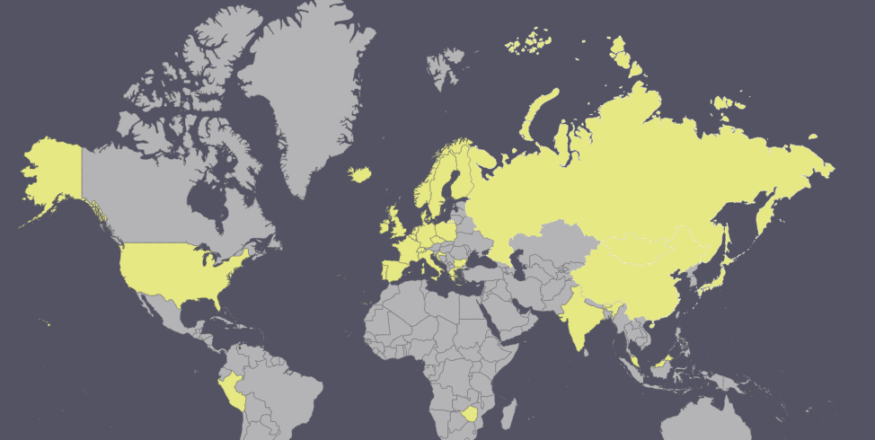
Over 450 registrants from 30+ countries

Slide 3
Welcome to Today’s Program
CY:02
Disclaimer: All opinions offered are the personal opinions of the participants and should not be attributed to their organizations.
Introductions
Presentations
Questions & Discussion
Please Use “Chat” for Questions
Notes:
Chris

Slide 4
Christopher Vajda QC
Michael Bowsher QC
Jane Jenkins
Albert Sanchez-Graells
Kate Gough
Luke Butler
Anne Davies
Christopher Yukins
Ruairi Macdonald
MB:06

Slide 5
Panelists
MB:06
Christopher Vajda QC (Monckton Chambers / King’s College, London / former judge, Court of Justice of the European Union) – Moderator – Key differences between EU and UK approaches
Michael Bowsher QC (Monckton Chambers / King’s College, London) – On history of the reforms, and what’s missing
Professor Anne Davies (Professor of Law and Public Policy, Faculty of Law, University of Oxford) and Ruairi Macdonald (Research Associate, Blavatnik School of Government, University of Oxford) – Impacts on social contracting (see Oxford POGO Club comments)
Professor Luke Butler (University of Nottingham – Public Procurement Research Group) – Where’s defence? An assessment of UK defence procurement under the proposed changes
Jane Jenkins / Kate Gough (Freshfields) – On bid challenges, debarment and contract administration
Professor Albert Sanchez-Graells (Professor of Economic Law and Director of the Centre for Global Law and Innovation, University of Bristol Law School) – The Green Paper: Not what it says on the tin (see London School of Economics comments)
Professor Christopher Yukins (George Washington University Law School) – U.S. perspectives and cooperation (see comments submitted to UK government)

Slide 6

Monckton Chambers – King’s College London
:20
Former Judge, Court of Justice for the EU
Key differences in the EU and UK approaches to public procurement

Slide 7
Post-Brexit UK Procurement
Christopher Vajda QC
Monckton Chambers, London
Visiting Professor, King’s College, London
20 April 2021

Slide 8
The problem with the EU regime « complex and inflexible »

Slide 9
What is the purpose of new UK regulatory framework?
“I want now to create a regulatory framework that delivers the best possible commercial outcomes with the least burden on our businesses and the public sector”
Ministerial Foreword to the Green Paper (my emphasis).

Slide 10
Procurement that better meets the UK’s needs
The 6 principles of public procurement including « the public good » and « value for money »

Slide 11
What does the public good mean?
« Public procurement should also be leveraged to support strategic national priorities. »
What does value for money mean?
Selection of supplier that « offers best social value for money »

Slide 12
The National Procurement Policy Statement
All CAs to have regard to this
Key outcomes
  Creating new businesses, new jobs, new skills in the UK
  Improving supplier diversity
  Tackling climate change and reducing waste
CAs also able to take account of their own strategic priorities.

Slide 13
Is this likely to produce complexity or simplicity?
:20
See further www.monckton.com/event/the-uk-legal-regime-after-brexit-what-every-lawyer-needs-to-know-procurement-law/

Slide 14


Post-Brexit UK Procurement:
The Pending Wave of Reform
King’s College London/
George Washington University
:28
Michael Bowsher QC
  Visiting Professor, King’s College London
  Barrister practising in London, Belfast & Dublin

Slide 15
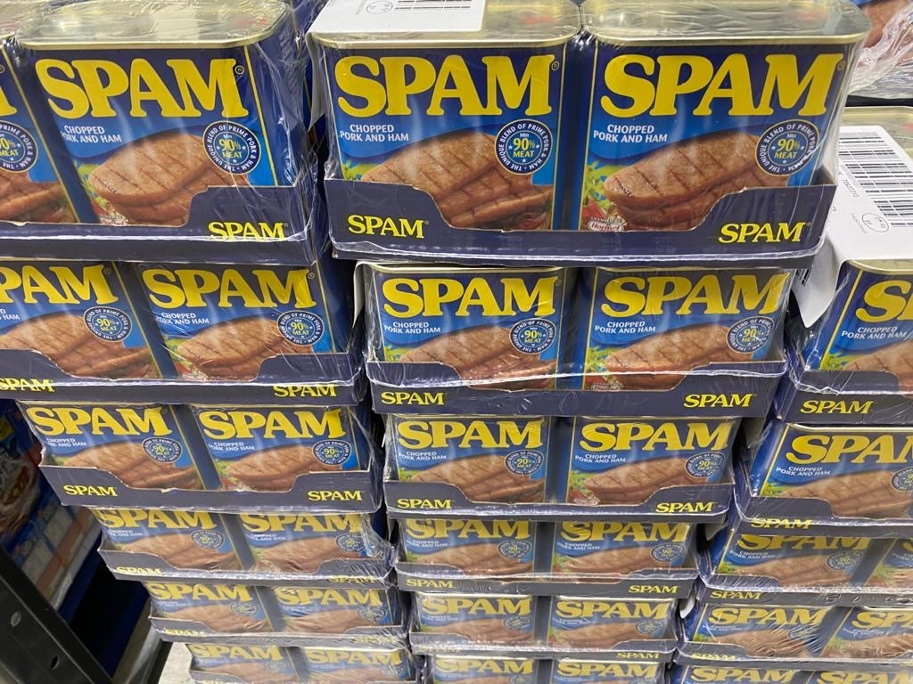
UK Procurement Law: How we got here and what we’ve produced
“When we leave Europe to be able to fashion our own rules, we've got a once in a generation opportunity to make sure that we have the best procurement system in the world.” Cabinet Office Minister 2019
GPA Accession & Roll Over of existing EU-derived legislation with minimal change
Trade and Cooperation Agreement (“TCA”), Title V, Public Procurement – including express reference to GPA and supplementary obligations – see https://mostlyprocurement.typepad.com/my-blog/2020/12/public-procurement-provisions-in-the-eu-uk-trade-and-cooperation-agreement.html
European Union (Future Relationship) Act 2020, section 29 – if domestic law, including retained EU law, does not already reflect the substance of the TCA then domestic law takes effect in the terms of the TCA. So, for instance, for the first time GPA has an immediate effect in UK domestic law.
See this developed in PPN02/21 – narrow examples given, but the section 29 effect may be much broader and more significant post Lipton v BA City Flyer
Common Procurement Framework – contemplates yet greater divergence between the regimes in the 3/4 jurisdictions of the United Kingdom
Result - A blend of material from many sources that is now too hard to separate out into its separate elements – but 90% meat? (although we’re trying to get rid of that)
:28

Slide 16


Impacts on social contracting (1)
Anne Davies, Faculty of Law, University of Oxford
:36
Oxford POGO Club response available here
  Commercial/transactional v social/relational
  Law reform v ‘transformation’
  Flexible procedures v flexibility in practice
  Oversight v learning

Slide 17




:44
Ruairi Macdonald LLM, Research Associate
GO Lab, University of Oxford
Culture, Outcomes, Learning
Social outcomes frameworks?
Transparency (open contracting) and learning
Next Oxford POGO Club session
Tuesday 27 April, 2021
Social Outcomes Conference #SOC21
9 and 10 September 2021
Call for papers: 30 April 2021
@ukgolab
golab.ox.ac.uk
golab@bsg.ox.ac.uk

Slide 18

WHERE’S DEFENCE?
:52
Starting point…Defence and Security Industrial Strategy CP 410 March 2021
1. UK will conduct procurements consistent with relevant international obligations
Buy British? Mind the Exports! GPA, TCA, and CPTPP – defence/security coverage?
US-UK Reciprocal Defence Procurement MOUs etc
2. No longer assumption that global competition is always best way to meet UK needs
Much MOD expenditure is “single source”: 35%/£8bn a year
Replace with “a much more sophisticated and nuanced approach”!? In regulatory terms…
  Green Paper: single uniform set of rules (MOD OK with CO leading?) + open procedure
  Other? “supplemented with defence and security sector-specific rules where these are required to protect our national security interest or our industrial base”
    A346 TFEU space/confidentiality rules: more for security than defence?
    Int’l agreements/cooperation flexibility: FMS, F-35, EDA/OCCAR etc
3. Reform of Single Source Contract Regulations
Not a Brexit “dividend” but part of new “single source is usually best”(?) approach
Too much focus on 10% profit mark-up and not remaining 90%?. How are reports best used?
Command Paper on proposals to come “later this year”
For info on the Executive Programme in Public Procurement Law and Policy:
ll-execpp@exmail.nottingham.ac.uk
18

Slide 19


The pending wave of reform
The Green Paper: bid challenges, debarment and contract administration
  Bid challenge
      Chapter 7: ‘Fair and fast challenges to procurement decisions’
      Current regime: too slow, too expensive, does not provide bidders with effective remedies
      Key changes:
        New tailored expedited procedure
        Potential tribunal system for low value claims and claims while procurement on foot
        Shift of focus to pre-contractual remedies
        Caps to damages
        Removing the automatic suspension for contracts let in crisis or extreme urgency
        Removing mandated requirement to provide an individual debrief letter
      Proposals for a fast track procedure. ? But significant questions around capacity of TCC and effectiveness of a specialist tribunal
      Shift to pre-contractual remedies. ? Question how will be effected including approach to lifting automatic suspension
      Caps to damage. Where damages clear exception capping to 1.5x bid costs does not provide an effective remedy
      Unclear how removing the automatic suspension in extreme urgency will allow for effective protection of bidders
      Transparency concerns re removing debrief letter – despite wider transparency reforms
Jane Jenkins
Kate Gough

Slide 20
The pending wave of reform
1:08
The Green Paper: bid challenges, debarment and contract administration
  Debarment
      Chapter 4 ‘awarding the right contract to the right supplier’
      Key changes:
        New grounds for exclusion: including fraud, non-disclosure of beneficial ownership
        New debarment list
        Expansion of past poor performance exclusion beyond termination/damages to include persistent failures and substantive obligations e.g. KPIs
      DPAs included as discretionary exclusion ground: see SFO v G4S Care and Justice Services
      For mandatory exclusion grounds debarment lists could be a useful tool to achieve consistency
        ? Who will manage the debarment list?
        ? Machinery for appeal and removal following self-cleaning
        ? Collection of information for non UK suppliers?
  Contract administration
      Chapter 8 ‘effective contract management’
      Historically – EU procurement not tool for effective contract management
      UK has historically gone further than the directives and issued detailed guidance/policy e.g. outsourcing playbook, construction playbook, PPNs on approach to payment/social value
      Key changes:
        Further measures to tackle payment delays:
          Any tier of supply chain can raise payment delays with CA
          CA to have right to investigate payment performance at any tier – para 227
          Note also: proposal for payment performance as exceptional evaluation criteria – para 104
          Increased flexibility to amend contracts in times of crisis
          New requirement to publish contract amendment notices
        Capping profit on extensions where incumbent raises legal challenge
      In principle use of procurement to effect good contract performance is positive

Slide 21
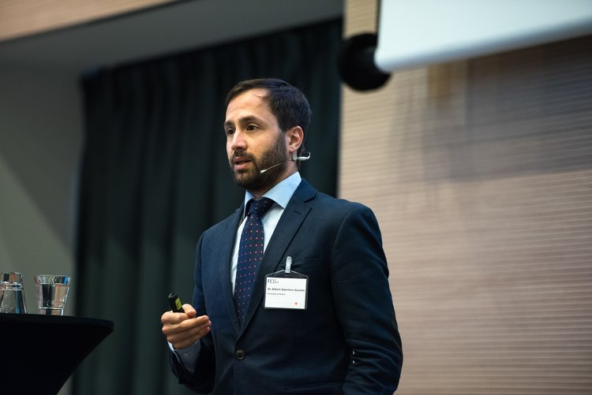

The Green Paper: Not what it says on the tin
21
1:16
Albert Sanchez-Graells
No Brexit dividend – EU law allowed for most GP aims, except for procedural de-regulation
No bonfire of red tape – but rather a hyper-inflation of (mandatory) guidance
No transformation – riddled with exceptions
Simplification ≠ flexibility (transaction costs …)
Incompatibility of incentives – chilling effects
Training first!

Slide 22

The Rebirth of British Procurement – Comments – Chris Yukins, GW Law
1:24
Comments on publicprocurementinternational.com
Post-Brexit rewrite opens door to U.S. discussions
  Consolidation of UK law = unitary open market -- should United States do the same, at the state level?
  Debarment should balance government agencies’ performance and reputational risks
  International norm: three bid challenge channels:
    Courts – Independent Agency – Purchasing Agency
  Corporate compliance: Selbstreinigung or follow UK Bribery Act?
  U.S. use of competitive negotiations (60%) versus open tendering (2%): a cautionary tale for a critical ally
  Needed: ready means of regulatory cooperation – including on information-sharing

Slide 23

Questions & Discussion
1:30

Slide 24
Conclusion
Program recording and materials posted at www.publicprocurementinternational.com

