Slide 1

Bid Challenges:
International Perspectives
Poland
Michał Kania
University of Silesia in Katowice

Slide 2
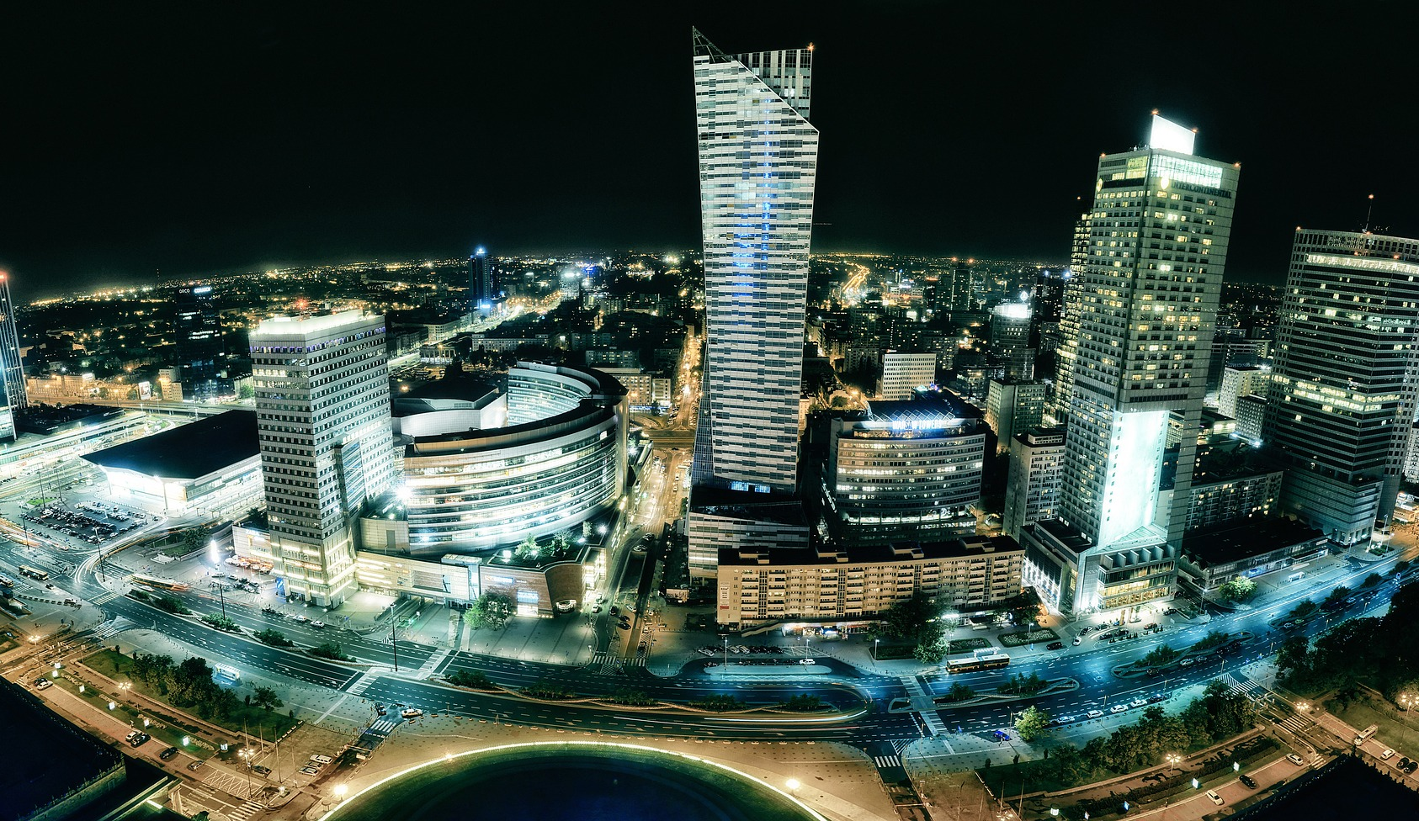
Polish public procurement market
General information
Value of the Polish public procurement market: ca. 45 bln Euro annualy
Number of contracting authorities: ca. 32.000
Number of public procurement contracts: 141 023
Average number of bids in a single procedure: 2.6
Foreign bidders on the market: 2.91%

Slide 3
Polish public procurement market:
The legal framework and the new law
The Public Procurement Law of 29 January 2004 (Journal of Laws of 2017, item 1579)
The Public Procurement Law of 11 September 2019 (Journal of Laws item 2019 as amended)
Regulation of the Prime Minister of 30 December 2020 on the procedure for examining appeals by the National Appeal Chamber (Journal of Laws, item 2453)
Regulation of the Prime Minister of 30 December 2020 on the detailed types of appeal proceedings costs, their settlement and the amount and manner of collecting an appeal fee (Journal of Laws, item 2437)
New regulation:
Expanded the scope of subjects subject to appeal
Expanded the scope of the subject matter of the appeal
Reinforced the status and professionalization of the Public procurement court (Warsaw) - second instance body

Slide 4
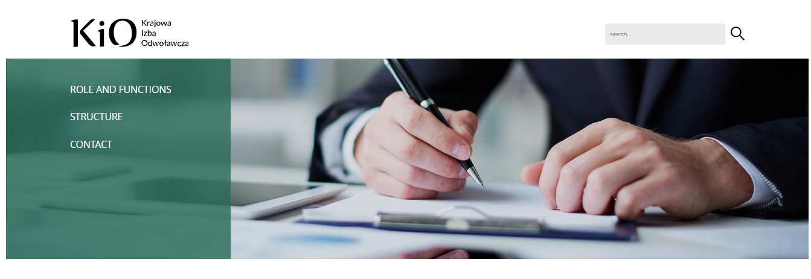
The structure of the Polish reviewing bodies in public procurement procedure
National Appeals Chamber (NAC) is the first instance body in the review proceedings against decisions of contracting authorities
According to the Public Procurement Law (PPL), the NAC is to consist of no more than 100 members appointed and dismissed by the minister responsible for the economy, from among persons satisfying the requirements, referred to below, who have attained the best results in a competitive procedure
Currently, there are 46 members of the NAC
The Public procurement court is the second instance body.
The parties and participants in the appeals procedure may complain to the court regarding the Chamber’s ruling.

Slide 5
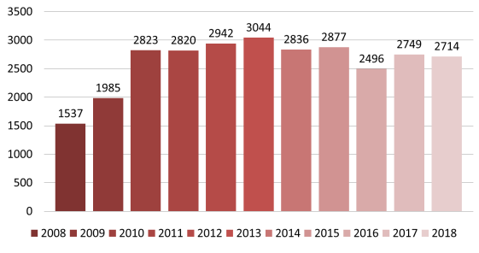
Statistics regarding legal remedies in the Polish public procurement market
Appeals in 2019: 2694
  Services: 41%
  Supplies: 39%
  Works: 20%
Sectors:
  Healthcare: 15,73%
  IT: 15,10%
  Construction: 12,24%
Rate of successful appeals: 40%
The average time for a decision on an appeal filed was 14 days
Complaints: 126
Rate of successful complaints: 16%

Slide 6
Aim: redress to the bidders?
Legally protective measures are extended to economic operators and participants in the design contest, as well as to other persons if they:
have or had an interest in being awarded the contract, and
suffered or may suffer damage as a result of the violation of the provisions of the Act by the contracting authority
In the case of an appeal, the contracting authority cannot conclude the contract agreement until the Board of Appeals announces a judgment or a decision ending the appeals proceedings
Possible accession to the proceedings by other contractors

Slide 7

Aim: transparency and accountability?
Organizations entered on the list of organizations authorized to file legal protection measures, kept by the President of the Public Procurement Office, published on the website of the Public Procurement Office – currently 151 organizations, including economic chambers etc.
  Krajowa Izba Odwoławcza - Lista organizacji uprawnionych do wnoszenia odwołań (uzp.gov.pl)
Ombudsman for Small and Medium-sized Enterprises

Slide 8

Are both goals achievabl?
An appeal may be filed in when:
In a public procurement procedure, a framework agreement, a dynamic purchasing system, a system for qualifying economic operators, or a competition, the awarding entity undertakes an action that is incompatible with the regulations (inc. non-use of legal regulation)
The contracting authority fails to conduct a procurement procedure or organize a competition in accordance with the provisions of the Act, while it was obliged to do so.
New regulation has extended aims of public procurement in Poland (effectiveness rule article 17(1)(2)) –towards Strategic Procurement
Public procurement’s role in the support of the Polish National Recovery Plan (ca. 58 bln. Euro)

Slide 9

Thank you!
Professor Michał Kania
University of Silesia -- Katowice
Michal.kania@us.edu.pl
www.5pcommonplace.com

