Slide 1
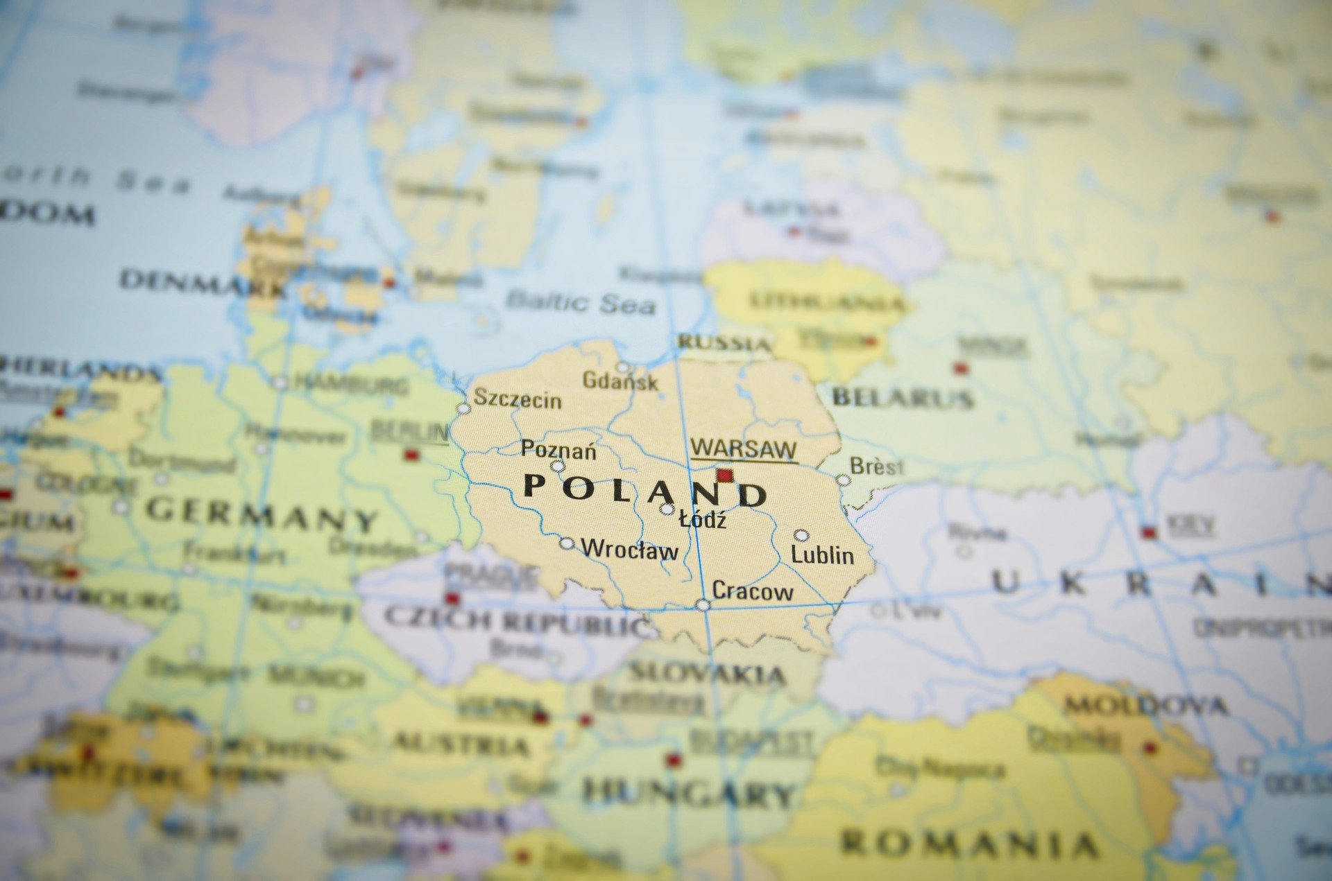
How often do bid challenges arise? Are they disruptive? Expensive? Michał Kania University of Silesia in Katowice

Slide 2
How often do bid challenges arise? Are they disruptive? Expensive? General information of the Polish public procurement market
Statistics from 2019 (representative for the Polish PP market)
Value of the Polish public procurement market: ca. 45 bln. Euro annually
Number of contracting authorities: ca. 32.000
Number of public procurement contracts: 141 023
Number of contracts awarded to foreign bidders: 2.91%

Slide 3
How often do bid challenges arise? Are they disruptive? General information of the Polish public procurement market
The structure of the review authorities in the Polish public procurement legal remedies system
National Appeal Chamber
Public procurement court in Warsaw – new regulation
Supreme Court – new regulation
Courts of general jurisdiction (in civil remedies cases, Supreme Court resolution No. III CZP 16/20 February 25, 2021)
Seeking damages from a contractor whose tender was not selected as a result of infringement of the provisions of the Act of 29 January 2004 by the contracting authority. Public Procurement Law (consolidated text: Journal of Laws of 2019, item 1843) does not require a prior finding of a violation of the provisions of this Act by a final ruling of the National Appeal Chamber or a final court ruling issued after a complaint against a ruling of the National Appeal Chamber was examined.

Slide 4
How often do bid challenges arise? Are they disruptive? Expensive? The statistics of the legal remedies in the Polish public procurement market
Appeals number in 2019: 2694
Services: 41%
Supplies: 39%
Works: 20%
Sectors:
Healthcare: 15,73%
IT: 15,10%
Construction: 12,24%
Rate of succesfull appeals: 40% (inc. corrective actions and sustain)
The average time for a decision on an appeal filed: 14 days
Complaints number: 126
Rate of succesful complaints: 16%

Slide 5
Thank you!
Professor Michał Kania
Univeristy of Silesia in Katowice
Michal.kania@us.edu.pl
www.5pcommonplace.com

