Slide 1
ABA Public Contract Law Section: State Suspension & Debarment
September 23, 2021
11 am Eastern

Slide 2
Speakers
Francis Kiley – State Debarment Survey
Christopher Yukins – Potential reforms pivoting on the ABA Model Procurement Code (MPC)
Collin Swan – World Bank: Gathering national debarment data and info on how debarment is done

Slide 3
Francis Kiley Cross-Debarments in the United States

Slide 4
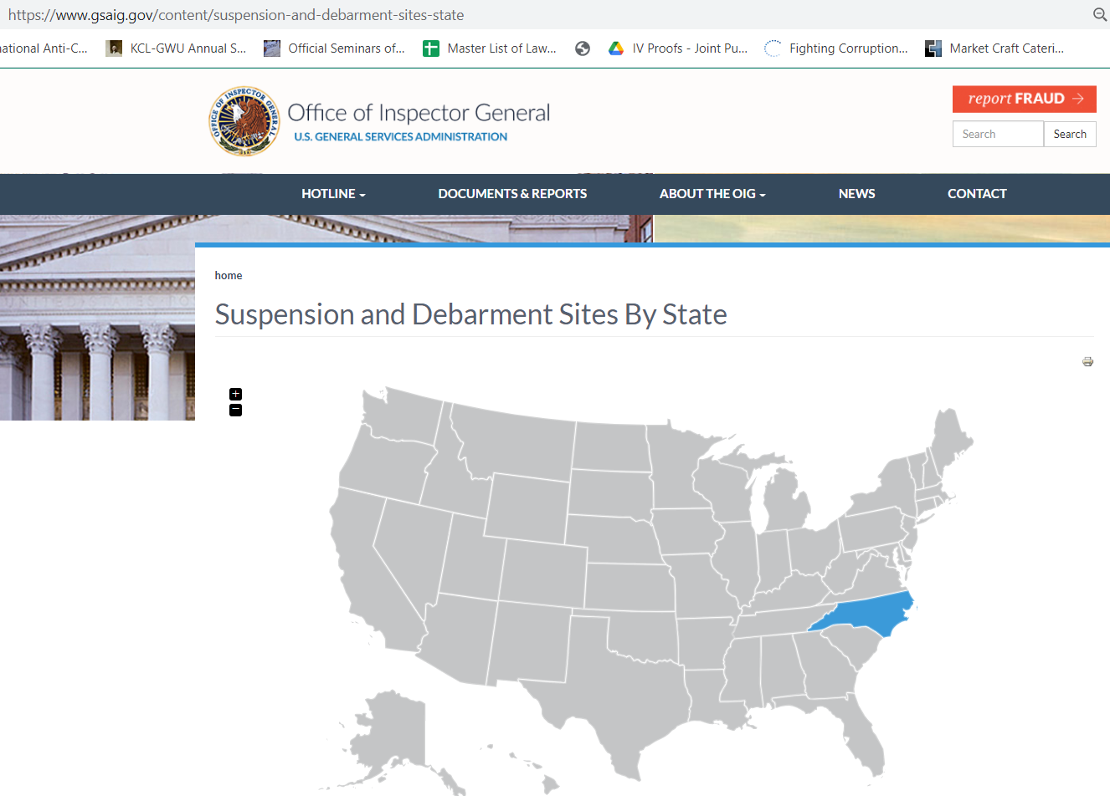

Slide 5
Christopher Yukins
Debarment and the Model Procurement Code

Slide 6
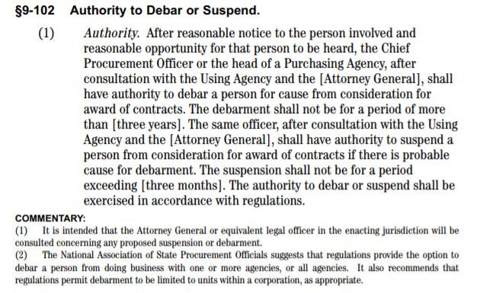
Model Procurement Code Section 9-102(1) -- Authority and Process
Model MPC regulations allow affected person to request informal hearing, with due process protections including potentially document production, and a written report on which the affected person may comment. CPO or head of agency may call for oral argument by parties before issuing decision. List of debarred persons available to public on request.
Notice and Opportunity to Be Heard
Authority: CPO or Head of Agency
Consult with AG & Using Agency
Up to 3 Years
Suspension (up to 3 months) If Probable Cause to Debar
Regulations
NASPO Recommendation

Slide 7
Model Procurement Code Section 9-102(2) Causes for Debarment or Suspension
Cause | Comment
(a) Criminal conviction related to contract | Parallels FAR 9.406-2(a)(1)
(b) State or federal conviction for embezzlement, theft, forgery, bribery, etc., “or any other offense indicating a lack of business integrity . . . which currently, seriously, and directly affects responsibility as a contractor | Parallels FAR 9.406-2(a)(3)
(c) State or federal conviction for antitrust violation arising out of bid or proposal | Parallels FAR 9.406-2(a)(2)
(d) Contract violation which is considered by Chief Procurement Officer or head of agency “to be so serious” as to justify debarment: (i) deliberate failure to perform per specifications or schedule; (ii) recent record of failure to perform. | Parallels FAR 9.406-2(b)
(e) any other cause CPO or head of agency “determines to be so serious and compelling as to affect responsibility as a . . . contractor, including debarment by another governmental entity for any cause listed in regulations” | Parallels FAR 9.406-2(c), which includes subcontractors
(f) violation of the ethical standards set forth in Article 12 (Ethics in Public Contracting). | No direct FAR parallel
Additional federal grounds for debarment include “Made in America” fraud, arms export violations, failing to pay taxes, unfair trade practices under the Defense Production Act, Drug Free Workplace violations, immigration violations, and failure to make mandatory disclosures of wrongdoing.

Slide 8
Model Procurement Code Section 9-102(2) Debarment Decision
CPO or head of agency issues written decision which:
States Reasons for Action
Copy of Decision to Affected Person and any Intervening Party
Decision Is Final Unless Fraudulent or Challenged in Court, or Appealed Administratively
Informs Affected Person of Rights to Judicial or Administrative Review
Notes:
Decision. The Chief Procurement Officer or the head of a Purchasing Agency shall issue a written decision to debar or suspend. The decision shall: (a) state the reasons for the action taken; and (b) inform the debarred or suspended person involved of its rights to judicial * or administrative * review as provided in this Article. (4) Notice of Decision. A copy of the decision under Subsection (3) of this Section shall be mailed or otherwise furnished immediately to the debarred or suspended person and any other party intervening. (5) Finality of Decision. A decision under Subsection (3) of this Section shall be final and conclusive, unless fraudulent, or (a) the debarred or suspended person commences an action in court in accordance with Section 9-403(2) (Waiver of Sovereign Immunity in Connection with Contracts, Debarment or Suspension); or (b) * the debarred or suspended person appeals administratively to the Procurement Appeals Board in accordance with Section 9- 507 (Suspension or Debarment Proceedings). * * Language between asterisks to be enacted if Article 9, Part E (Procurement Appeals Board) is enacted.

Slide 9
Observations on MPC Debarment Provisions
MPC contemplates relatively formal adjudicative process
Federal debarment procedures often pivot informally to forward-looking discussions regarding contractor remedial and compliance efforts
No reference in 2000 Model Procurement Code or 2002 model regulations to remedial (compliance) measures which are central part of current federal approach
Contrast with risk-based compliance approach advanced by federal 2008 contractor compliance and mandatory disclosure rule
Only suspension/debarment list will be published by state or local government, and only on public request – no public statement of reasons
Difficult for other states/governments to assess qualification issues raised by suspension or debarment
Within foreseeable future, probably most qualification information will be public

Slide 10
Using Debarment Information Across Borders
Other Governments
Who was debarred (list)
Why was that person debarred = Qualification information
How was the debarment done – is the process reliable?

Slide 11
Collin Swan

