Slide 1


Brazil’s public procurement market: new opportunities, new challenges
October 7, 2021
Presented by:
The George Washington University Law School
Grupos Negocios Públicos

Slide 2
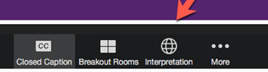
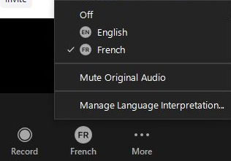
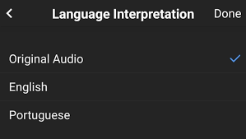
Translation services
This program will be in English. To hear the program in Portuguese, please select the “interpretation” button.
Then, please select the “Portuguese” channel.
Then, press “mute original audio”.

Slide 3

Welcome
Professor Chris Yukins
GW Law School
This webinar discusses Brazilian procurement law and Brazil's possible accession to the WTO GPA
Recording and materials at www.publicprocurementinternational.com
English-Portuguese interpretation is kindly being provided by Negocios Públicos
Program structure – we will use chat (not Q&A) in Portuguese and English
All panelists' statements are in their personal capacities

Slide 4

Bem-vindos
Professora Ana Victoria Christoff
GW Law School
Bem-vindos a nosso webinar: O mercado de compras públicas do Brasil: novos desafios, novas oportunidades
Há muito interesse nos avanços do mercado de compras públicas no Brasil, especialmente:
  A nova Lei 14.133/2021
  A solicitação de adesão do Brasil ao Acordo sobre Compras Governamentais da OMC
Aqui nos Estados Unidos, estamos monitorando os avanços no Brasil. Mas, mais importante, em toda a América Latina.

Slide 5
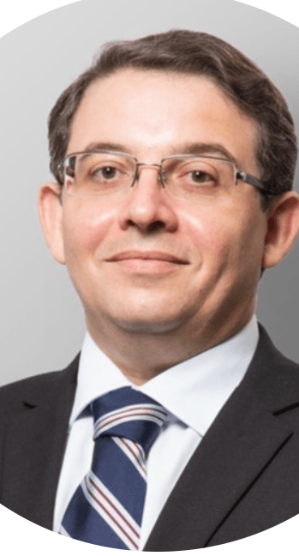
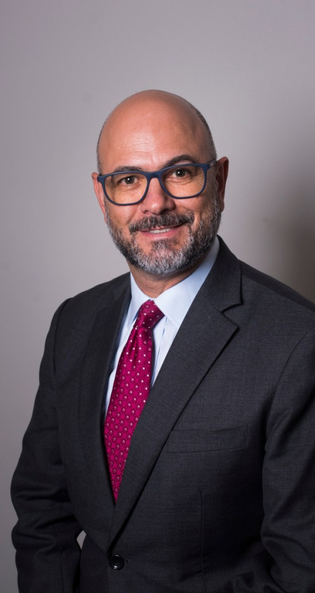


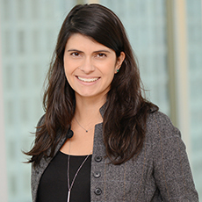
Panelists
Cristiana
Fortini
Marina Maciel
Jonas Lima
Ricardo Campello
Cesar Pereira

Slide 6



U.S./Brazil Comparative Overview
Jonas Lima, Jonas Lima Advocacia
Legal framework – Titles of the United States Code (USC) and of the Code of Federal Regulations (CFR), this last including the Federal Acquisition Regulation (FAR) + Statutes of specific sectors such as national defense + Administrative regulations + States and local legislation (with autonomy in relation to the federal procurement law) GPA-WTO – Member Opportunities information - Different portals for federal (www.sam.gov), state and local agencies Bidder registration – Federal SAM (DUNS + CAGE NATO domestic | NCAGE NATO foreign) and state and local registration systems National preferences – The Buy American Act + Articles of the FAR + Executive Orders + “Buy America” statutes Socio-economic programs – Small business (preferences, quotas and subcontracting), service-disabled veteran-owned and others Lifecycle and quality of the product – Yes Past performance required - Yes Contracting on demand - GSA Schedules – 5/20 years (e-marketplace) Duration of contract – Up to 5 years or more, if applicable Fiscal Year – From Oct. 1 to Sept. 30 of the next year Bid Challenges – Agency-level protest, bid protest before the General Accountability Office (GAO) and lawsuit before the U.S. Court of Federal Claims (CFC) | generally similar relief in the states | Legal framework – Law 8,666 (General Law of Biddings and Contracts) + Law 10,520 (Reverse auction) + Law 14,133/2021 (New Law of Biddings and Contracts) + Statutes of specific sectors such as national defense + Administrative regulations + States and local legislation (but all apply the federal law in the general provisions) GPA-WTO – In accession process Opportunities information - With the Law 14,133/2021, same portal (national) for federal, state and local agencies Bidder registration – Federal SICAF (Domestic qualification docs. | DUNS or TIN-WCO foreign) and state and local registration systems National preferences – Law 8,666 + Law 14,133/2021 + Executive Decrees Socio-economic programs – Small business (preferences, quotas and subcontracting), ex-prisoners and others Lifecycle and quality of the product – Yes Past performance required - Yes Contracting on demand – Price Registration System – 1 year before and up to 2 years now (marketplace in planning) Duration of contract – Up to 5 years or more, if applicable Fiscal Year – From Jan. 1 to Dec. 31 Bid challenges – Administrative appeal before the agency, representation before the Federal Court Of Accounts (TCU) and lawsuit before the Federal Courts | generally similar relief in the states

Slide 7
Brazil – International Bidding
Jonas Lima, Jonas Lima Advocacia
Bidding carried out in national territory with the participation allowed to foreign bidders and possibility of proposal in foreign currency or bidding in which the contractual object can or must be performed in whole or in part abroad.
Most opportunities to foreign companies by reverse auction are in items such as medical devices and supplies, tactical equipment, weapons, special vehicles and other items for public security and national defense and information technology.
The bidder registration before the SICAF is quick and easy, but it is very important strategic preparation in regulatory compliance of products to be offered.
Additionally, by auction or sealed competitive bidding, Brazil has billions of reais in investment budgets for structural projects, such as concessions for airports, ports, highways, railways, energy, sanitation and other areas.
Foreign companies can take part individually or in a consortium.
The legal, technical, fiscal, social and labor and economic-financial qualification are met with foreign documents equivalent to the Brazilian ones.
Embassies, consulates and other offices abroad follow only the principles of the law.

Slide 8
Brazil’s new public procurement law: 14.133/2021
Governance and Law’s main goals
Governance and the role of the highest level of administrators of public institutions and entities
Professionalization: another important topic
Planning: another structural axis of the new legal framework
Transparency
Cristiana Fortini

Slide 9

Law 14.133/2021: Sanctions,
Accountability and Criminal Aspects
Why mix public procurement and fight against corruption or misconduct?
Evolution in the definition of infractions and allocation of penalties
Disqualification: scope and main cases (contractual breaches)
Debarment: scope and main cases (falsehood, fraud, anticorruption violations)
Due process requirements and statute of limitations
Joint prosecution of procurement and anticorruption infractions
Disregard of corporate entities: parent companies and shareholders
Published lists of punished suppliers (naming and shaming)
Rehabilitation
  Requirements: (a) compensation of damages, (b) payment of penalties, (c) minimum time (1 year for disqualification and 3 years for debarment), (d) other requirements set out in the sanction, (e) legal opinion ascertaining fulfillment, (f) compliance and integrity program (sanction for false documents or anticorruption violation)
  A system of self-cleaning? Not quite
  Harsh punishment and complex rehabilitation v. LINB 2018 philosophy toward cure of wrongdoings
Cesar Pereira

Slide 10
Law 14.133/2021: Sanctions,
Accountability and Criminal Aspects
Oversight (auditing and accountability)
Borrowed idea from corporate governance: the 3 “lines of defense”
  (a) procurement officers, (b) state attorneys, (c) accountability officers and courts of audit
Criminal offenses
  Conceptual change: addition to the Criminal Code
  Specific offenses
    Unlawful direct awards
    Bid-rigging
    Unlawful advocacy for public tenders or contracts found to be illegal
    Disturbance of public tenders
    Breach of confidentiality
    Fraud in public tenders or contracts through specific actions
    Contracting of disqualified or debarred suppliers
    Omission of information by designers or engineers
  Penalties: longer prison terms and fines (minimum of 2% of contract price)
  Criticism
Cesar Pereira

Slide 11
Brazil’s new public procurement law, environmental aspects
Environmental aspects included in every step.
Aspects when choosing a proposal:
  Environmental impact indirect costs;
  Recycled, recyclable and biodegradable goods are preferred;
  Tie-breaking criterion: GHG mitigation.
Compliance with sustainability may affect concessionaries’ bottom line
The bid ad may establish who is responsible for the environmental permit procedure.
Priority to construction works and services
In case of delay – economic rebalancing
Marina Maciel
Mandatory in PPPs and large works
Risk Matrix
More legal safety to parties

Slide 12

Brazil on its ways to becoming a GPA member
Current Status:
  Oct. 2017, Brazil joins the GPA as an observer
  May 2020, Brazil formally requests to engage in the accession process
  Oct. 2020, Brazil submits to the WTO the “Checklist of Issues or Provision of Information” (restricted access document)
  Feb. 2021, Brazil presented its initial proposal in terms of procurement access
  Expected negotiations for the next three years
The country’s expectations in terms of benefit:
  Corruption reductions: ↑more competition ↓less cartels (e.g.: Petrobrás’s Carwash Operation and cartels regarding drugs and medical devices).
  Lower prices specially for commodities (e.g.: drug acquisitions through OPAs for Covid-19 treatment)
  Access to goods and services not available in the country
  Participating in an international debate regarding best procurements practices
Ricardo Campello

Slide 13
Brazil on its ways to becoming a GPA member
Some trade-related concerns regarding the accession:
  Potential exclusions of health and defense-related procurement from coverage
  Potential exclusions of state and local governments procurements from coverage
Some procurement-related concerns regarding the accession:
  Both old and new Public Procurement Acts (Statute #8,666/1993 and Statute #14,133/2021) allow preferential treatment for Brazilian companies such as: (i) price preference for locally manufactured products or “national” services; and (ii) being a Brazilian company as a tie-breaking criteria.
  Other potential price preference programs for recycled, recyclable and biodegradable goods without any time limitation à potential violations of article V, paragraph 4(b)
  Use of offsets like local investments and technology transfer without any time limitation à violation of article IV, paragraph 6
  Difference of opinions between federal, state and local public bodies regarding the interpretation of the New Public Procurement Act and its compliance with GPA requirements
Ricardo Campello

Slide 14
Questions
Perguntas

Slide 15
Thank You
Muito obrigado

Slide 16
Resources
Jonas Lima: LinkedIn: www.linkedin.com/in/jonas-lima-law; E-mail: jonaslima@jonaslima.com; Phone: +55 (61) 3223-0015
Cristiana Fortini: LinkedIn: www.linkedin.com/in/cristiana-fortini-2522a612b/; E-mail: cristiana@carvalhopereirafortini.adv.br
Cesar Pereira: LinkedIn: https://www.linkedin.com/in/cesar-pereira-fciarb-35196b3/; E-mail: cesar@justen.com.br
Marina Maciel: LinkedIn: https://www.linkedin.com/in/marina-pinto-maciel-6b94525b/ E-mail: msi@bmalaw.com.br
Ricardo Campello: LinkedIn: https://www.linkedin.com/in/ricardo-campello-83558243/ E-mail: ricardo.campello@lickslegal.com
Professor Christopher Yukins: LinkedIn: https://www.linkedin.com/in/christopher-yukins-73b9037/; Email: cyukins@law.gwu.edu
Professora Ana Victoria Christoff: LinkedIn: www.linkedin.com/in/ana-victoria-christoff/; Email: avchristoff@law.gwu.edu

