Slide 2
Welcome Professor Christopher Yukins GW Law School
Recording and materials at www.publicprocurementinternational.com
Questions – please use chat (not Q&A)
All panelists' statements are in their personal capacities

Slide 3
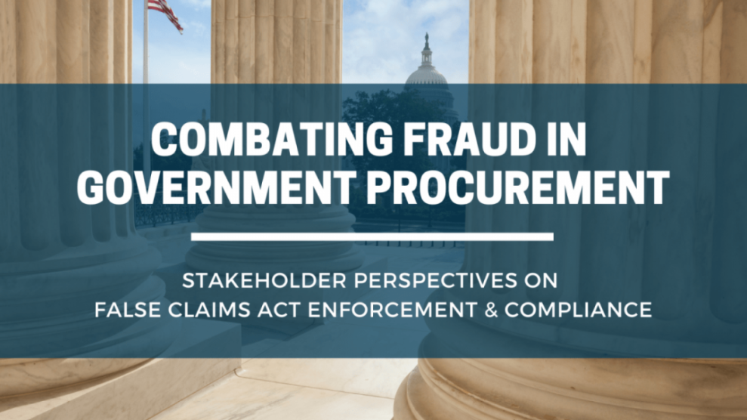
https://www.law.gwu.edu/combating-fraud-government-procurement

Slide 4
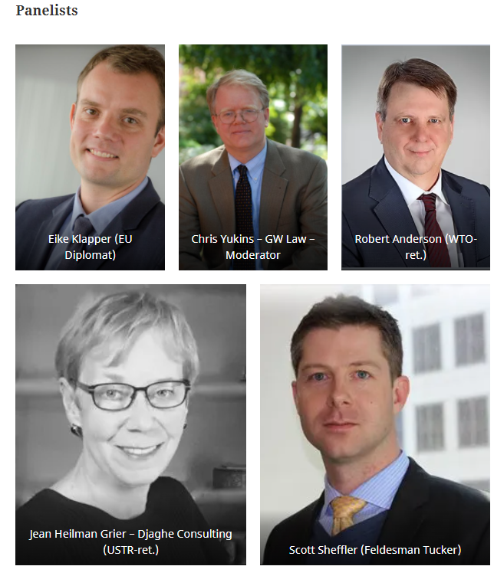
Introductions
:05

Slide 5
Agenda Christopher Yukins
:05
Scope of Legislation - Grants vs. Procurement
Grants
Procurement (Buy American Act)
Trade Agreements Review
Conclusion – Questions & Answers

Slide 6
Impact of Legislation: Procurement vs. Grants
:07
Notes:
GAO report: https://www.gao.gov/products/gao-19-17
Infrastructure figures: usafacts.org

Slide 7
FEDERAL FINANCIAL ASSISTANCE Scott Sheffler
Background (Pre-2021)
Numerous independent statutes, largely in programs involving traditional infrastructure (roads, railways, etc.) See CRS Rpt. R44266 (Jul 2, 2019), Effects of Buy America on Transportation Infrastructure and U.S. Manufacturing 2 C.F.R. § 200.322 Added effective Nov 12, 2020 Soft preference (“should, to max extent practical”) Goods/products/materials Scope beyond infrastructure unclear, but appears to technically exist Extends to State Gov’ts
E.O. 14005 (Jan 25, 2021)
Sets policy standard for agencies: “Should, consistent with applicable law, use T/C of Fed Fin. Asst. to maximize” Goods/products/materials Creates OMB-level Made in America Office (“MIAO”) Calls for information gathering re “longstanding or nationwide waivers” via reports from agency heads “Made in America Laws” Waivers Intent to centralize waivers through OMB review process (15-day review) Reporting of all proposed waivers and whether granted via single website
OMB Memo M-21-26 (Jun 21)
Commences Implementation of E.O. 14005 By Jul 24, Agency Heads to report on: Use of Made in America Laws List of waivers granted in 2020 Description of any ongoing longstanding or national waivers and the consistency of such with E.O. policy statement Reports do not appear to be public Anecdotally, grant-making agency policies do not seem to have changed as of fall 2021

Slide 8
FEDERAL FINANCIAL ASSISTANCE Scott sheffler
:14
Infrastructure Investment and Jobs Act, Pub. L. 117-58 (Nov. 15, 2021)
Sec. 70914 sets government-wide baseline standard for fed-funded infrastructure: “Not later than 180 days after the date of enactment of this Act, the head of each Federal agency shall ensure that none of the funds made available for a Federal financial assistance program for infrastructure, including each deficient program, may be obligated for a project unless all of the iron, steel, manufactured products, and construction materials used in the project are produced in the United States.” Waiver authority for (i) public interest, (ii) nonavailability, and (iii) cost increase of overall project by 25 percent Very similar to 23 U.S.C. § 313 standard for U.S. sourcing in surface transportation projects (both standard and waiver authority) but adds “construction materials.” Calls for OMB to update 2 C.F.R. Part 200 (Sec. 70915) Likely to see a regulatory update to 2 C.F.R. § 200.322 providing additional guidance Prediction: (i) specific to infrastructure, (ii) hard preference per law, (iii) definition of “construction materials” Made in America Office at OMB Calls for new reports on use of Made in America Laws (due Jan 14, 2022, and to be published in the Federal Register) (Sec. 70913); Calls for summary of E.O. 14005 agency reports be provided to Congress (Sec. 70923(e)) Single website (GSA run “BuyAmerican.gov”) to include info on all waivers (Sec. 70936) 15-day GSA-website notice and comment for waivers (may “re-de-centralize” for Fin. Asst. Agency Heads) (Id.) OMB Memo M-22-08 (Dec 20, 2021) Guidance on reports Provides “infrastructure” definition and instructs to further construe broadly (includes “buildings and real prop”) Calculates date of hard preference implementation as May 14, 2022

Slide 9
“Construction Material” – Federal Acquisition Regulation (FAR) Clause
:16
"Construction material" means an article, material, or supply brought to the construction site by the Contractor or a subcontractor for incorporation into the building or work. The term also includes an item brought to the site preassembled from articles, materials, or supplies. However, emergency life safety systems, such as emergency lighting, fire alarm, and audio evacuation systems, that are discrete systems incorporated into a public building or work and that are produced as complete systems, are evaluated as a single and distinct construction material regardless of when or how the individual parts or components of those systems are delivered to the construction site. Materials purchased directly by the Government are supplies, not construction material.
COTS Exception for Components?
Notes:
FAR 52.225-9: https://www.acquisition.gov/far/52.225-9

Slide 10
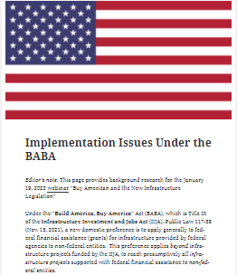
For more information on BABA implementation issues, go to publicprocurementinternational.com

Slide 11
“Buy America(n)” Requirements in Infrastructure Investment and Jobs Act and Trade Agreements Jean Heilman Grier
:23
Application of Trade Agreements to Procurement
o WTO Government Procurement Agreement (GPA) and FTAs
o U.S. waives Buy American Act for procurement covered by agreements
o “Buy America” requirements in grants
Prior “Buy America” Restrictions
o DOT & EPA funding restrictions: excluded from trade agreements
o ARRA: broadened application of “Buy America”; limited to ARRA-funded projects; did not apply to procurement covered under trade agreements
Infrastructure Investment and Jobs Act (IIJA): “Buy America” Requirement
o Applies to all federally funded projects; not restricted to IIJA funding
o Like ARRA, excludes procurement covered under trade agreements
o Will limit US ability to expand future procurement commitments
Buy American Act Provisions in IIJA
o Adds exceptions for trade agreements and defense MOUs
o Recommends increases in domestic content requirements (like Biden administration’s proposed changes in FAR)
o Statutorily establishes Made in America Office; seeks to reduce waivers
o Requires assessment of whether cost advantage of a foreign product results from unfair trade practices
o Directs establishment of the BuyAmerican.gov website

Slide 12
The mandated review of US trade agreements in section 70934 of the Infrastructure Legislation Robert Anderson
:30
Apparent relation to review mandated by previous US Administration (Trump Executive Order -- mandated report never released)
Of potentially greater concern, this time around?
The need for a broad (positive) approach to assessing the Agreements:
Five decades of US leadership (at least) re: open and transparent public procurement markets!
WTO GPA is the centerpiece (FTA chapters/CPTPP build on it)
Many practical advantages and benefits for US suppliers (market access but also transparency and fair procedures backed up by independent review)
A necessary tool for achieving real structural change in China/other advanced developing economies (note Brazil’s pending accession; also Russia's)
And benefits transcend market access per se (Kutlina-Dimitrova; Hoekman; others)
Instead of ever greater caution/retrenchment, why not renewed US leadership for open and transparent markets?
Seize the opportunity of mandated GPA renegotiation!
Consider rejoining CPTPP, to pre-empt possible dilution of standards
Also tweak the GPA/other agreements to support Biden Admin. goals re: sustainability/climate change!

Slide 13
Transatlantic procurement one year into the Biden administration: “Made in America” vs. “America is back”? Eike Klapper – EU Diplomat
:37
Made in America
Executive Order on Ensuring the Future Is Made in All of America by All of America’s Workers
Infrastructure Investment and Jobs Act
Other developments: Electric Vehicles Tax Credits, Supply Chain reviews, Jones Act, etc.
America is back
GPA/WTO engagement
Trade and Technology Council
Where do we go from here?

Slide 14
Questions & Discussion

Slide 15
Questions for Discussion
:59
1. Do you think that the U.S. has fair access to foreign procurement markets under the current trade agreements?
2. Are there trade developments in the European Union of which our U.S. audience should be aware?
3. What are the most difficult compliance issues presented by the new law?
4. What are other important developments you see regarding Buy American requirements, on (for example) on-shoring of critical supplies?

Slide 16
Video recording will be available on PublicProcurementInternational.com and the GW Law Government Procurement Law Program YouTube Page

