Slide 1
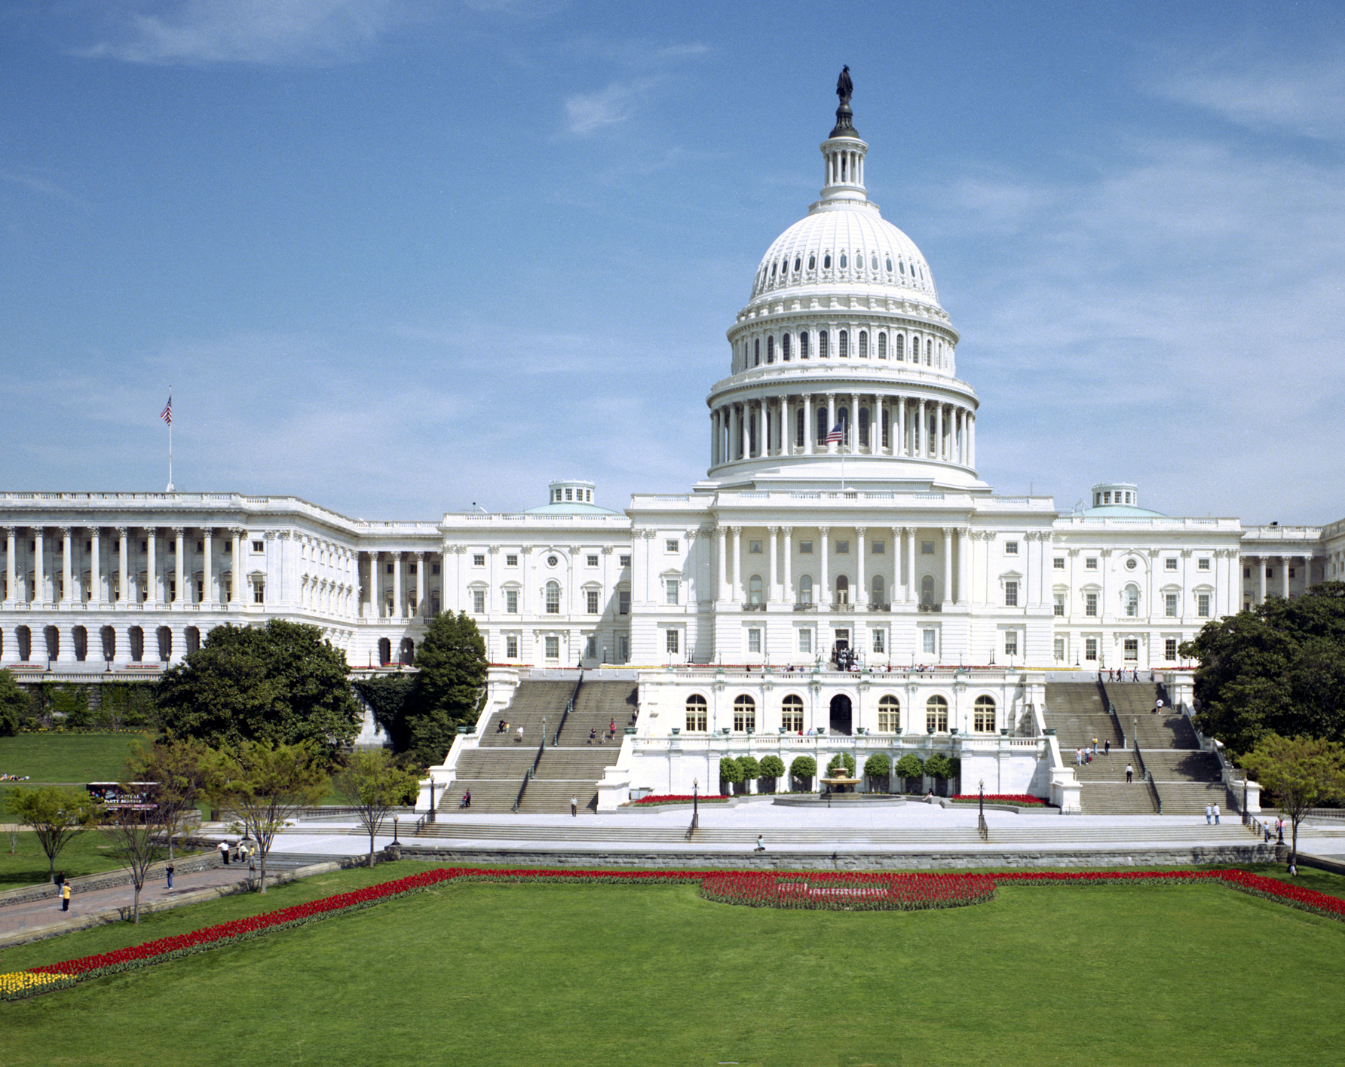
Congressionally Mandated Study of Bid Protests at the U.S. Department of Defense
Meeting with Principal Investigators
April 19, 2022, 12:00-1:30 pm Eastern
Online

Slide 2
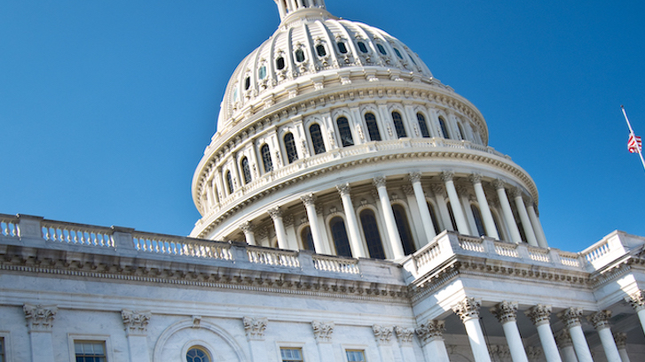
Meeting Description
In the conference report which accompanied section 886 of the National Defense Authorization Act (NDAA) for Fiscal Year (FY) 2021, Congress called for the Defense Department to launch a new study of bid protests.
The conferees said that the study “should review existing law, the Federal Acquisition Regulation, and agency policies and procedures,” and should “solicit input from across the DOD and industry stakeholders.”
A meeting with the principal investigators will be held on the study on Tuesday, April 19, 2022 at 12:00 - 1:30 Eastern. Principal investigators David Drabkin and Christopher Yukins will discuss initial steps from the study, and will seek input on the questions posed by Congress, above. The meeting will be virtual and will not be recorded, and attendance is limited to 50 persons.

Slide 3
Agenda
Bid Protest Study Description
Questions from Congress
Project Status
Questions and Discussion
Project Resources
Project Team
Will Dawson -- Data Analysis

Slide 4
Bid Protest Study Description
In the conference report which accompanied the National Defense Authorization Act for FY2021, Congress called for a study of bid protests at the U.S. Department of Defense by the Acquisition Innovation Research Center
DoD provided an interim report to Congress in 2021 – available on study page, https://publicprocurementinternational.com/congressionally-commissioned-bid-protest-study/
Final report is expected in second half 2022

Slide 5
Project Team
David Drabkin (PI) – Chairman of congressionally mandated comprehensive study of acquisition reforms under Section 809 of the National Defense Authorization Act for FY2016, which included bid protest reform recommendations; former Senior Procurement Executive, U.S. General Services Administration; extensive DoD procurement and legal experience; Chairman, Procurement Roundtable (senior members of acquisition community).
Christopher Yukins (PI) – Professor, George Washington University Law School; attorney with extensive bid protest experience in government and private sector; works regularly with government and private sector on government acquisition reform efforts; led Administrative Conference of the United States (ACUS) study of agency-level bid protests.
Roxanne Reinhardt – Research Scientist and coordinator. GW Law -- Third Year. BA in History and Anthropology from Eastern Michigan University. Legal area of interest: the intersection of government contracts and national security. Member and the prior Projects and Symposium Editor of the Public Contract Law Journal. Has interned with the Maritime Administration's Government Procurement Division and two government contracts law firms.
Dinesh Verma – Founding Dean of the School of Systems and Enterprises at Stevens Institute of Technology (2007-2016); serves as the Executive Director of the Systems Engineering Research Center (SERC), a U.S. Department of Defense- sponsored University Affiliated Research Center (UARC) focused on systems engineering research, which includes the Acquisition Innovation Research Center.
Philip Anton – Chief Scientist of the Acquisition Innovation and Research Center (AIRC) at the Stevens Institute of Technology; former Senior Information Scientist, RAND Corporation; founder, U.S. Department of Defense Acquisition Policy Analysis Center; former Technology Area Manager and Principal Scientist, MITRE.

Slide 6
Questions from Congress
The rate at which protestors are awarded the contract that was the subject of the bid protest;
The time it takes the Defense Department to implement corrective actions after a ruling or decision, the percentage of those corrective actions that are subsequently protested, and the outcomes of those protests;
Analysis of the time spent at each phase of the procurement process attempting to prevent a protest, addressing a protest, or taking corrective action in response to a protest, including the efficacy of any actions attempted to prevent the occurrence of a protest; and
Analysis of the number and disposition of protests filed within the Defense Department.

Slide 7
Additional Direction from Congressional Conferees
“[P]otential benefits of a robust agency-level bid protest process”
Study to evaluate the following for agency-level bid protests: “prevalence, timeliness, outcomes, availability, and reliability of data on protest activities; consistency of protest processes among the military Services; and any other challenges that affect the expediency of such [agency-level bid] protest processes.”
Cited with approval: study by Administrative Conference of the United States (ACUS)
Overall, study “should review existing law, the Federal Acquisition Regulation, and agency policies and procedures,” and should “solicit input from across the DOD and industry stakeholders.”

Slide 8
Steps
Task 1: Background and Literature Review – see next slide for detail
Agency-level protests at DoD Components
Government Accountability Office (GAO) protests
Courts – U.S. Court of Federal Claims, U.S. District Courts, U.S. Court of Appeals for the Federal Circuit
Congressional reform initiatives
Literature on bid protest trends and impacts
Task 2: Data Gathering
Interviews and public outreach: congressional staff, agency counsel, procurement officials, program managers, industry and bar, GAO/U.S. Court of Federal Claims
Per congressional research questions, survey on how each DoD Component tracks protests – follow up if questions
Task 3: Analysis
Analyze trends in and prevalence of protest activity: rates protestors get awards; how often incumbents protest; time it takes contracting officials to take corrective actions, and percentage of corrections subsequently protested; number and disposition of protests filed directly with the DoD components.
Task 4: Conclusions and Recommendations: Report findings and recommendations, including potential reforms, workforce training and gaps in data structures and cost-effective ways to improve structured data collection.

Slide 9
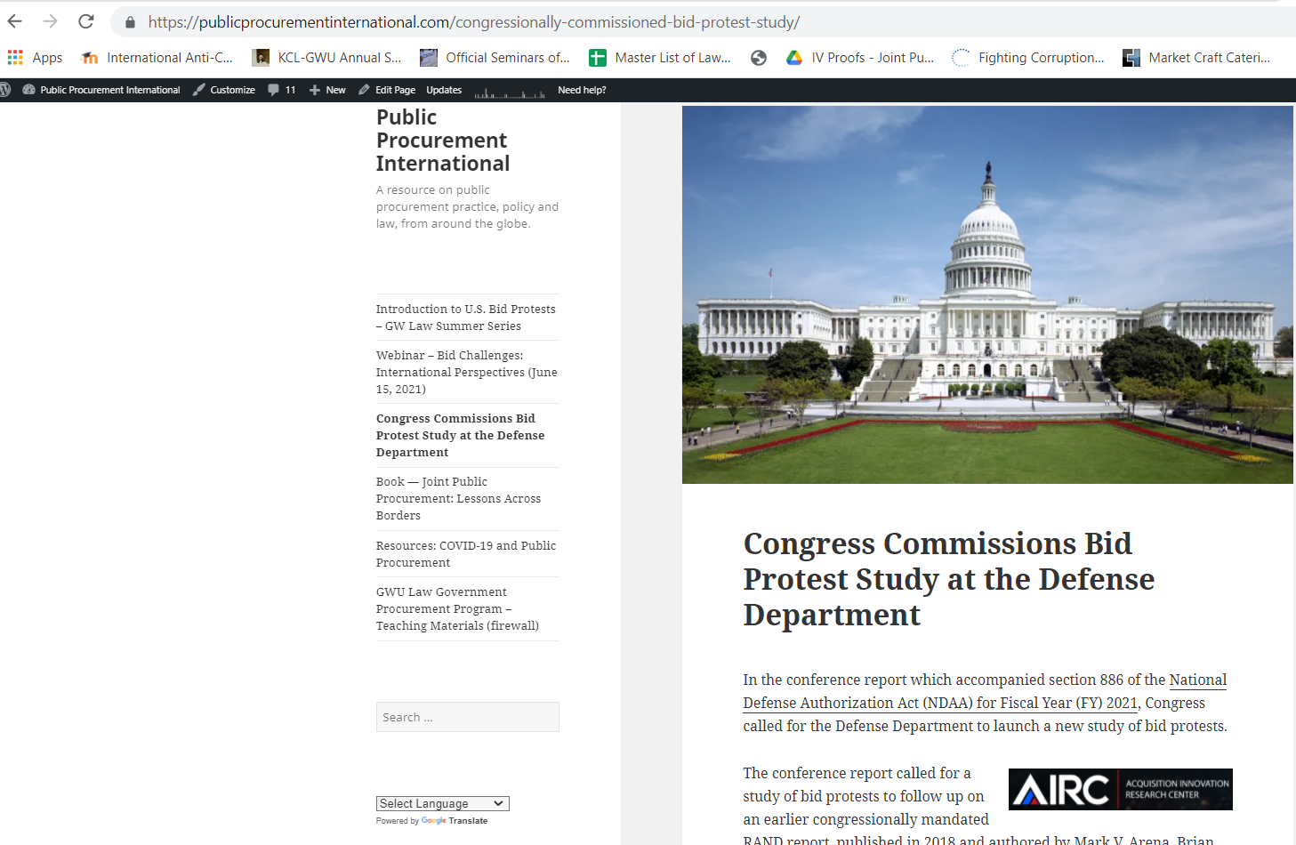
Project Resources: Public Posting & Data Repository

Slide 10
Questions for Discussion
Comments on Will Dawson’s proposed approach; comments on suggested approaches to:
The rate at which protestors are awarded the contract that was the subject of the bid protest;
The time it takes the Defense Department to implement corrective actions after a ruling or decision, the percentage of those corrective actions that are subsequently protested, and the outcomes of those protests;
Analysis of the time spent at each phase of the procurement process attempting to prevent a protest, addressing a protest, or taking corrective action in response to a protest, including the efficacy of any actions attempted to prevent the occurrence of a protest;
Analysis of the number and disposition of protests filed within the Defense Department.
Agency-level bid protests: “prevalence, timeliness, outcomes, availability, and reliability of data on protest activities; consistency of protest processes among the military Services; and any other challenges that affect the expediency of [agency-level bid] protest processes”

Slide 11
Conclusion ddrabkin@stevens.edu cyukins@stevens.edu

